Slide 1
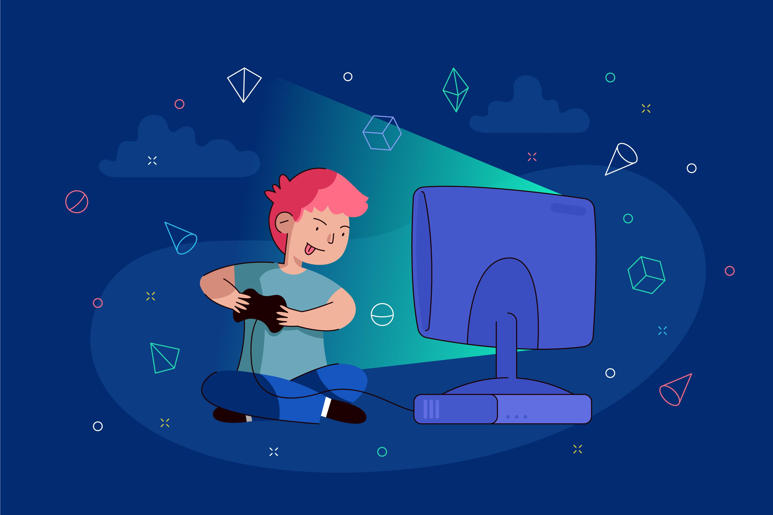
Positive effects of playing video games

