Slide 1

Genomics and Science Dojo 2.0
3-Minute Presentation
Lasso-Logistic Regression and Artificial Neural
Network for Prostate Adenocarcinoma Metastasis
Prediction and Biomarker Discovery Based on Gene
Expression Profile
DZAKWANIL HAKIM
ELIZABETH LOHO
27/02/2025
Supported by:

Slide 2
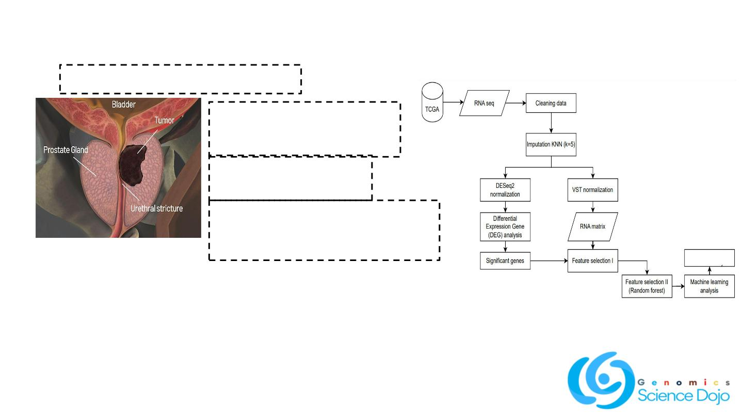
Introduction
Methods
Prostate adenocarcinoma / prostate cancer
4th most prevalent cancer
among men in Indonesia
Frequently advances to
metastasis
Metastasis detection relies on
histopathology and CT scans, which
are takes time and costly.
Biomarker
analysis
Research objective:
1. To develop a machine learning model for
predicting prostate cancer metastasis using gene
expression data.
2. To identify key biomarkers linked to prostate
cancer metastasis for improved diagnosis and
treatment.
Figure 1.
RNA-seq analysis pipeline, from preprocessing and normalization to
feature selection, classification, and biomarker identification.

Slide 3
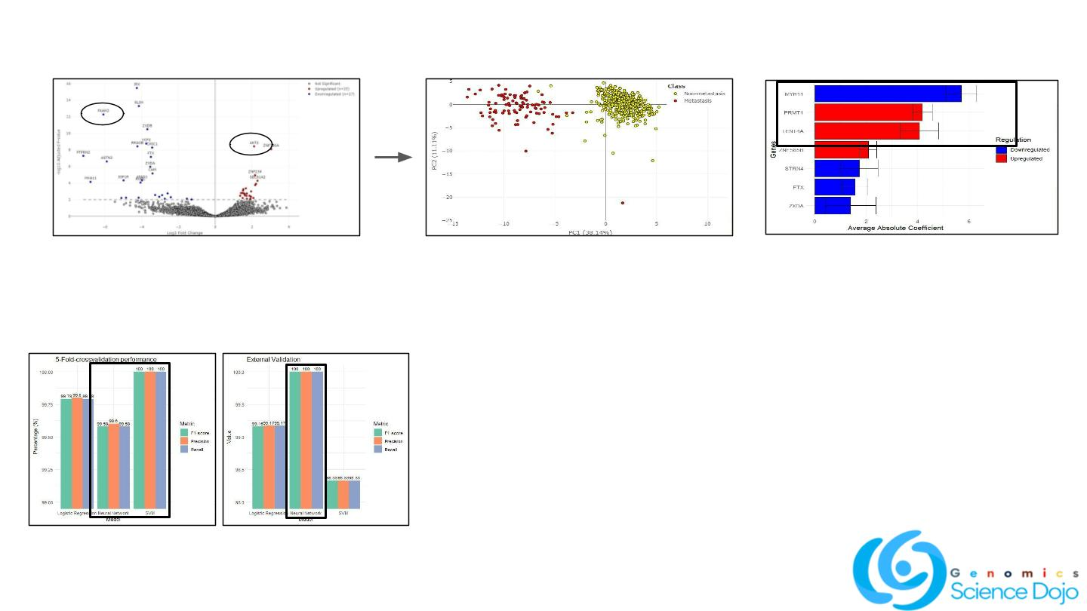
Results
1.Feature selection I : Differential Expression Genes
2.Data distribution (PCA)
3.Feature selection II : Feature importance
(
●
Several genes are significantly (q<0.01)
down-regulated (27 genes; such as FAAH)
and up-regulated (25 genes; such as AKT)
in metastatic prostate cancer
●
●
The PCA plot shows distinct gene
expression patterns between metastatic
●
●
Trained Lasso-logistic regression and
random forest to assess feature
importance, with logistic regression
showing the best performance (100%)
Identified seven key genes, selecting three
as biomarkers for the next classifier model
(MYH11, PRMT1, TENT4A)
(red)
and
non-metastatic
(yellow)
prostate cancer samples.
The clear separation of data points
indicates significant differences in their
gene expression profiles.
4.Cross validation & external validation
5.Biomarker pathway analysis
●
●
●
MYH11 (Myosin Heavy Chain 11) = downregulated in metastasis, leading to
cytoskeleton disorganization and easier cancer cell detachment from the
primary tumor
PRMT1 (protein arginine methyltransferase 1) = upregulated in metastasis,
EMT induction by regulating E-cadherin and ZEB1, promotes motility and
invasion by β-catenin downregulation
TENT4A (Terminal Nucleotidyltransferase 4A) = upregulated in metastasis,
regulates mRNA stability and degradation, potentially influencing cancer
progression by modulating oncogene expression and RNA quality control.
●
●
SVM performs well in cross-validation but suffers from
overfitting.
External validation is more important, and the neural
network is the best at generalizing patterns, making it the
preferred choice.

Slide 4

Conclusion
● Lasso-Logistic Regression outperformed Random Forest in feature selection, and Artificial
Neural Network achieved high classification performance during external validation using only
three biomarkers.
● The three identified biomarkers (MYH11, PRMT1, and TENT4A) are associated with metastasis
induction through cytoskeleton disorganization, EMT promotion, and mRNA stabilization.
Limitation
● This study relies on RNA-seq data from non-Indonesian patients due to limited available patient
data in Indonesia.
● Requires more external validation, which can be achieved by increasing the dataset size.

