Slide 1
CRT Essentials
or The Dave Zampino Power Hour
David Zampino

Slide 2

dzampino.github.io/crt-essentials-2026
Notes:
https://dzampino.github.io/crt-essentials-2026/

Slide 3
Agenda
Passwords
PKI
Email security
PowerShell
Building a Windows DFIR box
Notes:
Timing: introduction 5 minutes, passwords 20, PKI 25, email security 30, PowerShell 20, DFIR box 15, questions and wrap-up 5.

Slide 4
Passwords

Slide 5
Authentication
Something you know, something you are, something you have
Passwords are something you know; we refer to them as secrets
  Other types of secrets: passphrases, PINs, secret questions
Goal in all authentication methods is good enough uniqueness
We can add behavior to assist in making risk assessments
Notes:
NIST SP 800-63B-4 covers passwords alongside the other authenticator types: https://pages.nist.gov/800-63-4/sp800-63b.html

Slide 6
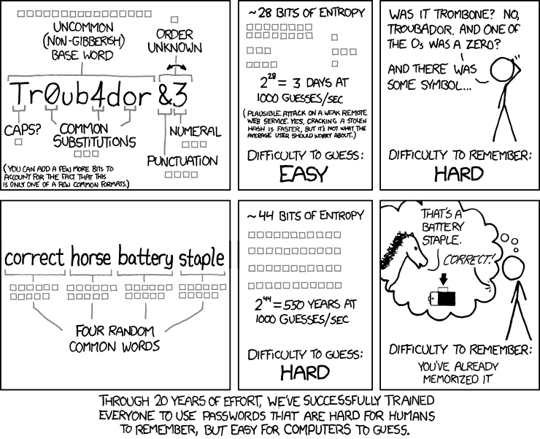
correct horse battery staple
xkcd 936, “Password Strength”
https://xkcd.com/936/
Notes:
xkcd 936, “Password Strength,” by Randall Munroe: https://xkcd.com/936/ (CC BY-NC 2.5).
The explanation holds when the words are randomly selected rather than chosen by a person. The comic’s guess rates are historical, not a present-day benchmark.

Slide 7
Entropy
“My greatest concern was what to call it. I thought of calling it ‘information,’ but the word was overly used, so I decided to call it ‘uncertainty.’ When I discussed it with John von Neumann, he had a better idea. Von Neumann told me, ‘You should call it entropy, for two reasons. In the first place your uncertainty function has been used in statistical mechanics under that name, so it already has a name. In the second place, and more important, no one really knows what entropy really is, so in a debate you will always have the advantage.’”
— Claude Shannon
Notes:
Claude Shannon, as recounted in M. Tribus and E. C. McIrvine, “Energy and Information,” Scientific American 225(3), 1971.

Slide 8
Entropy (cont.)
Bits of entropy (aka shannons) = log₂(search space)
Search space = alphabet^{length}
Secret | Alphabet | Length | Bits
6-digit PIN | 10 | 6 | 19.9
Lowercase | 26 | 8 | 37.6
xkcd words | 2,048 | 4 | 44.0
EFF wordlist | 7,776 | 4 | 51.7
Printable ASCII | 95 | 8 | 52.6
Lowercase | 26 | 15 | 70.5
Notes:
The alphabet/length formula assumes each character, or word, is chosen uniformly at random from the alphabet. Human-chosen passwords do not meet that assumption.
Bits = log₂(alphabet^{length}) = length × log₂(alphabet). xkcd 936 uses 11 bits per word (2,048 words). The EFF large wordlist has 7,776 words (five dice): https://www.eff.org/dice
Get-PasswordEntropy and Get-PasswordLength on the companion site calculate these.

Slide 9
Entropy calculator
Multiplicative vs exponential
Entire search space
Average time to crack
Notes:
Switch to the companion site for the entropy calculation: dzampino.github.io/crt-essentials-2026/passwords.html
Adding a character multiplies the search space by the alphabet size (adds log₂(alphabet) bits); doubling the alphabet adds only one bit per character. On average an attacker finds the secret after searching half the space, which is one bit less.

Slide 10
Cracking = time x money
Who is the threat
How is it protected
Hash (one RTX 5090) | Guesses/second | 8 printable chars, average
NTLM (NT hash) | 340.1 G | 2.7 hours
SHA2-256 | 28.4 G | 32.5 hours
bcrypt (32 iterations) | 304.8 k | 345 years
Notes:
Rates: hashcat v6.2.6 benchmark, RTX 5090 Founders Edition, Chick3nman, February 2025: https://gist.github.com/Chick3nman/09bac0775e6393468c2925c1e1363d5c Average time = (95⁸ / 2) / rate, a full brute force with no wordlist. Real attacks start with wordlists and rules, so human-chosen passwords fall much faster.
Each RTX 5090 draws up to 575 W, all of which becomes heat: about 1,960 BTU/h, or 0.16 tons of cooling per card. The companion site works out power and cooling for each threat level.
A stored Windows NT hash and an NTLM protocol exchange (NetNTLMv2, 16.0 G/s on the same card) are different things.
OWASP Password Storage Cheat Sheet: https://cheatsheetseries.owasp.org/cheatsheets/Password_Storage_Cheat_Sheet.html Microsoft, Passwords technical overview: https://learn.microsoft.com/en-us/windows-server/security/kerberos/passwords-technical-overview

Slide 11
Protecting users
Do what we can to protect users
Attack modeling should be based on online attacks
We have duties to protect hashes from getting stolen
Notes:
NIST SP 800-63B-4 section 3.2.2: rate limiting SHALL limit consecutive failed attempts on an account to no more than 100. Section 3.1.1.2: passwords SHALL be salted (at least 32 bits) and hashed with a suitable password hashing scheme; the cost factor SHOULD be as high as practical. https://pages.nist.gov/800-63-4/sp800-63b.html

Slide 12
Takeaways
Uniqueness means password managers
Check for compromised passwords; no complexity, no rotation
Use standards otherwise: NIST is 8 with MFA and 15 without MFA
Use MFA
Notes:
NIST SP 800-63B-4 section 3.1.1.2: minimum 15 characters when a password is used as a single-factor authenticator, 8 when used only as part of MFA; support at least 64 characters; compare against a blocklist; SHALL NOT impose other composition rules; SHALL NOT require periodic changes, but force a change on evidence of compromise. https://pages.nist.gov/800-63-4/sp800-63b.html Have I Been Pwned, Pwned Passwords: https://haveibeenpwned.com/Passwords

Slide 13
Questions?

Slide 14
PKI

Slide 15
Public key infrastructure
Public keys and private keys
  What one key does, only the other can undo
  The private key never leaves its owner
What a certificate does and does not prove
  A CA bound this public key to this name, for this use, for this time
  Not that the site is safe, or that the operator is who you think
Certificate authorities and trust
  You trust a CA because your certificate store says so
Notes:
RFC 5280, Internet X.509 PKI Certificate and CRL Profile: https://www.rfc-editor.org/rfc/rfc5280.html

Slide 16
What’s in a certificate?
Fields (X.509 v3)
Subject, issuer, serial number
Validity: not before, not after
Public key and signature algorithm
Distinguished names and the common name (CN)
Extensions
Subject alternative name (SAN)
Key usage, extended key usage
Basic constraints: CA or end entity
CRL distribution points, authority information access
Notes:
RFC 5280 section 4.1 (fields) and 4.2 (extensions).
RFC 9525 section 2: “The Common Name RDN MUST NOT be used to identify a service.” Names are matched against the SAN. https://www.rfc-editor.org/rfc/rfc9525.html

Slide 17
Our training certificate
Serial Number: 3e:23:6d:a6:5a:1d:83:f6:...:8e:0c
Issuer: O=Fictional Cheese Curd Authority, CN=Squeaky Curd Root CA
Not Before: Oct 1 00:00:00 2026 GMT
Not After : Oct 1 00:00:00 2027 GMT
Subject: L=Curdsville, O=Squeaky Curds Co-op, CN=squeakycurds.example
Basic Constraints: critical, CA:FALSE
Subject Alternative Name: DNS:squeakycurds.example
Extended Key Usage: TLS Web Server Authentication
Notes:
Inspect it with openssl x509, certutil -dump or XCA.
Output trimmed and condensed from: openssl x509 -in training-leaf.pem -noout -text (OpenSSL 3.5). The full subject also has ST=Wisconsin, C=US.
Fictional training certificates for the fictional Squeaky Curds Co-op; .example is reserved (RFC 2606), so the names do not exist. No private keys are included. Do not install the training root.
XCA, a graphical certificate and key manager: https://hohnstaedt.de/xca/

Slide 18
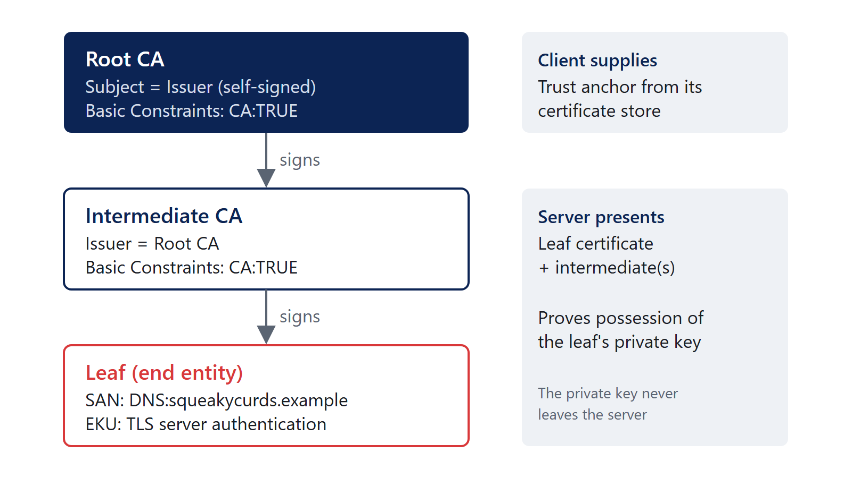
Certificate chains
Leaf, intermediate, root
Trust anchors and the certificate store
A valid signature is not the same as a trusted certificate
Notes:
The training sample is a two-level chain: the root signs the leaf directly. Public CAs issue from intermediates.
RFC 5280 section 6 (certification path validation).

Slide 19
Certificate formats
ASN.1 describes the structure; DER encodes it as bytes
PEM is Base64 DER between -----BEGIN and -----END lines
A file extension does not necessarily tell you what’s inside
Extension | Usually holds
.cer / .crt | One certificate, DER or PEM
.pem | Anything PEM: certificates, keys, CSRs
.p7b | PKCS #7 bundle of certificates, no key
.pfx / .p12 | PKCS #12: certificate plus private key
.csr | PKCS #10 certificate request
Notes:
RFC 7468 (PEM textual encodings), RFC 7292 (PKCS #12), RFC 5652 (CMS, the basis of .p7b), RFC 2986 (PKCS #10).
training-leaf.pem and training-leaf.der are the same certificate: both have SHA-256 fingerprint D1:B7:D4:59:…:C0:E5. certutil -dump reads both.
OpenSSL on Windows: it comes with Git for Windows, or winget install ShiningLight.OpenSSL.Light (other builds: https://github.com/openssl/openssl/wiki/Binaries).

Slide 20
Certificate requests and issuance
Certificate signing request (CSR / PKCS #10)
  Create a key pair; the CSR carries the public key and requested names
  Signed with the private key to prove possession
Internal CAs / AD CS and certificate templates
  certreq -new, certreq -submit, certreq -accept
ACME and automated issuance
  The CA checks control of the name, then issues
Notes:
RFC 2986 (PKCS #10): https://www.rfc-editor.org/rfc/rfc2986.html certreq: https://learn.microsoft.com/en-us/windows-server/administration/windows-commands/certreq_1 RFC 8555 (ACME): https://www.rfc-editor.org/rfc/rfc8555.html
The training CSR’s public key matches the training leaf: openssl req -in training-request.csr -noout -verify reports “Certificate request self-signature verify OK”.

Slide 21
Putting a certificate to use
A service needs three things
  The certificate
  The private key
  The intermediate certificates
The certificate presented by a service versus the trust configured on a client
  The server sends its chain; the client supplies the root
Notes:
A common incident-response finding: a missing intermediate works in one browser (which cached or fetched it) and fails in another client.

Slide 22
Certificate validation
Name matching, validity dates, chain, trust, and permitted usage
CRLs and OCSP; client behavior varies
What happens when a check fails?
Check | OpenSSL says
Untrusted root | unable to get local issuer certificate
Incorrect name | hostname mismatch
Expired | certificate has expired
Wrong usage | unsuitable certificate purpose
Notes:
Each row was produced against the training files with openssl verify (OpenSSL 3.5); the commands are on the companion site.
Revocation: Let’s Encrypt ended its OCSP service on August 6, 2025 and publishes revocation through CRLs only: https://letsencrypt.org/2025/08/06/ocsp-service-has-reached-end-of-life Chrome uses CRLSets rather than online checks for most certificates: https://www.chromium.org/Home/chromium-security/crlsets/

Slide 23
Renewal and maintenance
Expiration, replacing certificates, and deployment
Public TLS certificate lifetimes are shrinking
Automation is no longer optional for public certificates
Issued on or after | Maximum validity
March 15, 2026 | 200 days
March 15, 2027 | 100 days
March 15, 2029 | 47 days
Notes:
CA/Browser Forum Baseline Requirements section 1.2.2, from ballot SC-081v3 (passed April 2025): https://cabforum.org/working-groups/server/baseline-requirements/requirements/
These limits apply to publicly trusted TLS certificates. Internal CAs set their own policy; the training root is not a statement of public Web PKI issuance policy.

Slide 24
Questions?

Slide 25
Email security

Slide 26
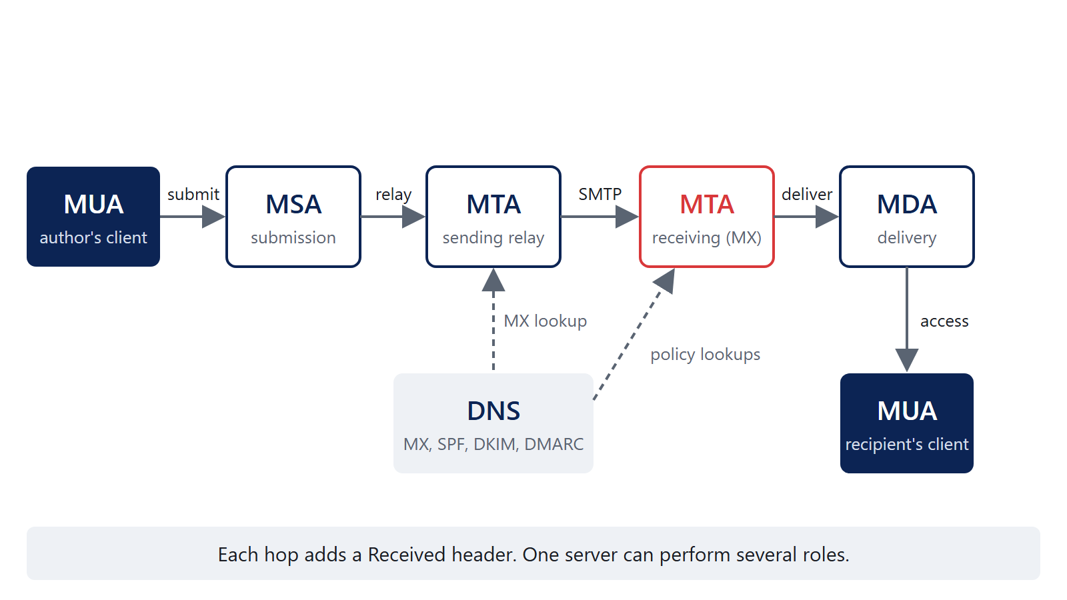
How email works
MUA, MSA, MTA, MDA
SMTP, submission, relay, delivery, and DNS/MX records
Submission is usually authenticated on 587 or 465, but can be unauthenticated on 25
Notes:
RFC 5598, Internet Mail Architecture: https://www.rfc-editor.org/rfc/rfc5598.html RFC 5321, SMTP: https://www.rfc-editor.org/rfc/rfc5321.html
RFC 6409 section 4.3: the MSA must reject unauthenticated mail by default “unless it has already independently established authentication or authorization (such as being within a protected subnetwork)”. Section 3.1: “A site MAY choose to use port 25 for message submission.” Printers, scanners and applications relaying through an IP-restricted connector are the everyday example. https://www.rfc-editor.org/rfc/rfc6409.html

Slide 27
The envelope versus the message
Envelope (RFC 5321)
MAIL FROM and RCPT TO
SMTP commands, not message headers
The receiver records MAIL FROM as Return-Path
Message (RFC 5322)
From: the author, what the user sees
Sender: who actually sent it, if different
  Outlook: “Sender on behalf of From”
The visible sender and the envelope sender can differ
Notes:
RFC 5321 section 4.4: the delivering SMTP server inserts Return-Path from the MAIL FROM reverse-path. RFC 5322 section 3.6.2: From, Sender, Reply-To.

Slide 28
Reading email headers
Received headers and the path a message took
  Each hop adds one at the top; read from the bottom up
Authentication-Results and which system added them
  Trust the one your own boundary added
Which headers can be trusted?
  Only those added by systems you control; everything below can be forged
Microsoft’s Message Header Analyzer lays it all out
Notes:
RFC 8601, Authentication-Results: https://datatracker.ietf.org/doc/html/rfc8601
Message Header Analyzer: paste headers at https://mha.azurewebsites.net/pages/mha.html, or install the Outlook add-in. Source: https://github.com/microsoft/MHA

Slide 29
SPF
What SPF checks: is this IP allowed to send for the envelope domain?
DNS records, sending IPs, and envelope domains
SPF pass does not necessarily mean DMARC pass
red.secondary.com. TXT "v=spf1 ip4:182.107.92.190 -all"
Notes:
RFC 7208: SPF checks the MAIL FROM domain (or the HELO domain when MAIL FROM is empty), not the From header. https://www.rfc-editor.org/rfc/rfc7208.html
Record from learndmarc.com example 1.

Slide 30
DKIM
What DKIM signs and verifies: selected headers and the body
Signing domain (d=), selector (s=), and DNS public key
The relevant fields in a DKIM signature
DKIM-Signature: v=1; a=rsa-sha256; d=primary.com; s=selector;
h=from:to:subject:date; bh=...; b=...
selector._domainkey.primary.com TXT "v=DKIM1; k=rsa; p=..."
Notes:
RFC 6376: https://www.rfc-editor.org/rfc/rfc6376.html The d= domain does not have to match the From domain; DMARC is what requires alignment.

Slide 31
DMARC
Start with the domain in the message From header
Alignment with SPF and/or DKIM: a pass and a matching domain
Strict versus relaxed alignment
  Strict: identical domains
  Relaxed: same organizational domain
DMARC policy and reporting: p=none | quarantine | reject, rua=
Notes:
RFC 9989 (May 2026, Standards Track) obsoletes RFC 7489 and RFC 9091. Section 3.2.10 defines strict and relaxed alignment; adkim and aspf default to r (relaxed). Changes: pct, rf and ri removed; t (test mode), np and psd added; organizational domain found by a DNS tree walk instead of a public suffix list. https://www.rfc-editor.org/rfc/rfc9989.html Aggregate reports: RFC 9990. Failure reports: RFC 9991.

Slide 32
Work through it: example 1
> HELO red.secondary.com
. 250 smtp.learndmarc.com Hello red.secondary.com <153.112.107.49>
> MAIL FROM: <gina@red.secondary.com>
> From: "Gina" <gina@blue.secondary.com>
> DKIM-Signature: v=1; a=rsa-sha256; d=primary.com; s=selector;
(DKIM Auth Result: PASS)
_dmarc.blue.secondary.com: "v=DMARC1; p=quarantine; t=y;"
red.secondary.com: "v=spf1 ip4:182.107.92.190 -all"
blue.secondary.com: "v=spf1 ip4:24.121.50.128 ~all"
Notes:
Transcript from learndmarc.com, abridged. Lines starting > are the client; lines starting . are the server. Ask: what are the sender identities, what did SPF and DKIM return, and does it pass DMARC?

Slide 33
Example 1: answer
DMARC fails, but the message will not be treated as suspicious
SPF uses red.secondary.com (MAIL FROM); DMARC uses blue.secondary.com (From)
SPF fails: 153.112.107.49 is not allowed for red.secondary.com
DKIM passes, but primary.com does not align with secondary.com
Relaxed alignment applies (no adkim/aspf)
t=y is test mode: receivers are asked not to apply the policy

Slide 34
Work through it: example 2
> HELO red.primary.com
. 250 smtp.learndmarc.com Hello red.primary.com <97.196.174.88>
> MAIL FROM: <terry@red.primary.com>
> From: "Terry" <terry@blue.primary.com>
> DKIM-Signature: v=1; a=rsa-sha256; d=secondary.com; s=selector;
(DKIM Auth Result: FAIL)
_dmarc.blue.primary.com: "v=DMARC1; p=quarantine; adkim=s; aspf=s;"
red.primary.com: "v=spf1 ip4:95.129.128.101 ~all"
blue.primary.com: "v=spf1 ip4:44.62.173.139 ~all"
Notes:
Transcript from learndmarc.com, abridged.

Slide 35
Example 2: answer
DMARC fails, and the message will be quarantined
SPF uses red.primary.com; DMARC uses blue.primary.com
SPF fails: 97.196.174.88 is not allowed for red.primary.com
DKIM fails validation: the message has been altered
Strict alignment: domains must match exactly
Neither SPF nor DKIM passed with alignment; p=quarantine

Slide 36
Work through it: example 3
> HELO blue.secondary.com
. 250 smtp.learndmarc.com Hello blue.secondary.com <156.157.23.197>
> MAIL FROM: <ray@blue.secondary.com>
> From: "Ray" <ray@red.primary.com>
> DKIM-Signature: v=1; a=rsa-sha256; d=blue.primary.com; s=selector;
(DKIM Auth Result: PASS)
_dmarc.red.primary.com: "v=DMARC1; p=none; adkim=s; aspf=s;"
blue.secondary.com: "v=spf1 ip4:62.165.120.61 ~all"
red.primary.com: "v=spf1 ip4:156.157.23.197 -all"
Notes:
Transcript from learndmarc.com, abridged. Note the trap: the sending IP is listed in red.primary.com’s SPF record, but SPF is evaluated against the MAIL FROM domain.

Slide 37
Example 3: answer
DMARC fails, but no action is taken
SPF uses blue.secondary.com; DMARC uses red.primary.com
SPF fails: 156.157.23.197 is not allowed for blue.secondary.com
DKIM passes, but strict alignment: blue.primary.com ≠ red.primary.com
  Under relaxed alignment, DKIM would have aligned
p=none: monitoring only
Notes:
Both domains share the organizational domain primary.com, which is why relaxed alignment would have passed.

Slide 38
Other email security mechanisms
MTA-STS and TLS reporting (TLS-RPT)
  MTA-STS: publish that your MX requires TLS with a valid certificate
  TLS-RPT: receive reports when senders cannot negotiate TLS
Sender ID (briefly, for historical context)
  Checked a “purported responsible address” taken from the headers; the experiment was concluded in favor of SPF (RFC 6686, 2012)
Notes:
RFC 8461 (MTA-STS): https://www.rfc-editor.org/rfc/rfc8461.html RFC 8460 (TLS-RPT): https://www.rfc-editor.org/rfc/rfc8460.html RFC 6686 (Sender ID and SPF experiment resolution): https://www.rfc-editor.org/rfc/rfc6686.html

Slide 39
Questions?

Slide 40
PowerShell

Slide 41
Why PowerShell?
Administration, automation, and analysis
Turning a repetitive task into something repeatable
Objects, not text: no parsing columns with regex
Notes:
Get-Member shows the properties and methods of whatever a command returns.

Slide 42
Finding commands
Get-Command, Get-Help
Find the parameters and figure out what a command returns
Get-Command -Noun WinEvent
Get-Help Get-WinEvent -Parameter FilterHashtable
Get-Command Get-FileHash -Syntax
(Get-Command Get-FileHash).OutputType
Notes:
Get-Help shows local help; run Update-Help once (as administrator in Windows PowerShell 5.1) or use Get-Help -Online.

Slide 43
Objects and the pipeline
Objects versus plain text
Get-Member, Select-Object
Pass objects between commands
Get-Item C:\Windows\notepad.exe | Get-Member -MemberType Property
Get-Item C:\Windows\notepad.exe |
Select-Object Name, Length, LastWriteTime, VersionInfo
Notes:
about_Pipelines: https://learn.microsoft.com/en-us/powershell/module/microsoft.powershell.core/about/about_pipelines

Slide 44
Working with data
Where-Object, Sort-Object, Group-Object
Selecting information and exporting results
Get-ChildItem -Path .\Case -Recurse -File |
Where-Object Length -gt 10MB |
Sort-Object Length -Descending |
Select-Object FullName, Length, LastWriteTimeUtc |
Export-Csv .\LargeFiles.csv -NoTypeInformation
Notes:
Export-Csv: https://learn.microsoft.com/en-us/powershell/module/microsoft.powershell.utility/export-csv -NoTypeInformation is the default in PowerShell 7 and needed in Windows PowerShell 5.1.

Slide 45
Example: file metadata and hashing
Get-ChildItem -Path .\Case -Recurse -File |
Get-FileHash -Algorithm SHA256 |
Select-Object Hash, Path |
Export-Csv .\Hashes.csv -NoTypeInformation
Get-ChildItem -Path .\Case -Recurse -File |
Group-Object Extension |
Sort-Object Count -Descending |
Select-Object Count, Name
Notes:
Working with an existing collection of files. Get-FileInventory, on the companion site, combines these into one function.

Slide 46
Example: collected event logs
Get-WinEvent -FilterHashtable @{
Path = '.\Case\Security.evtx'
Id = 4624, 4625
} |
Group-Object Id |
Select-Object Count, Name
Query a copied .evtx, not the live log
-FilterHashtable filters before objects reach the pipeline
Notes:
Get-WinEvent: https://learn.microsoft.com/en-us/powershell/module/microsoft.powershell.diagnostics/get-winevent 4624 is a successful logon, 4625 a failed logon. Get-EvtxSummary and Get-LogonEvent on the companion site extend this.

Slide 47
Making a script reusable
Parameters instead of hard-coded values
Functions, -Verbose, -WhatIf where applicable
An example of automating part of the DFIR box build
function New-CaseFolder {
[CmdletBinding(SupportsShouldProcess)]
param(
[Parameter(Mandatory)]
[string]$Path
)
if ($PSCmdlet.ShouldProcess($Path, 'Create case folder')) {
New-Item -Path $Path -ItemType Directory | Out-Null
}
}
Notes:
about_Functions_CmdletBindingAttribute and ShouldProcess: https://learn.microsoft.com/en-us/powershell/module/microsoft.powershell.core/about/about_functions_cmdletbindingattribute New-CaseFolder -Path E:\2026-0142 -WhatIf shows what would happen without doing it. The full version on the companion site creates Collected, Output and Notes.

Slide 48
Your own module
A .psm1 file of functions, in a folder of the same name
In your Documents\PowerShell\Modules folder, PowerShell loads it for you
$Docs = [Environment]::GetFolderPath('MyDocuments')
$Folder = "$Docs\PowerShell\Modules\MyTools"
New-Item -Path $Folder -ItemType Directory -Force
notepad "$Folder\MyTools.psm1" # paste functions, save
Get-Command -Module MyTools
Notes:
about_Modules: https://learn.microsoft.com/en-us/powershell/module/microsoft.powershell.core/about/about_modules Windows PowerShell 5.1 uses Documentsinstead. Every function on the companion site is in its own copyable block.

Slide 49
Questions?

Slide 50
Building a Windows DFIR box

Slide 51
What we’re building
A Windows analysis machine, not an evidence acquisition machine
Evidence is already collected
Memory acquisition is handled separately (Magnet in our workflow)
Notes:
Evidence arrives through the read-only Evidence shared folder; output goes to Cases. The VM stays off the internet during cases.

Slide 52
Disposable/nonpersistent virtual machine
Return the machine to a known state
VMware Workstation Pro
System disk: independent, non-persistent
Power off, and every change is gone
Keep case data and analysis output separate from what gets reset
Shared Folders on the host
Evidence: read-only
Cases (output, logs, notes): read-write
Notes:
Independent non-persistent disks discard changes at power-off: https://docs.vmware.com/en/VMware-Workstation-Pro/17/com.vmware.ws.using.doc/GUID-A6792F54-2734-4AF4-9473-C8B9AD8321AF.html Workstation Pro is free for commercial, educational and personal use since November 2024: https://knowledge.broadcom.com/external/article/368667/download-and-license-vmware-desktop-hypervisor.html In the guest, shared folders are at \vmware-hostFolders.

Slide 53
Automating the build
Decide on the Windows image and tool list
  Windows Server 2025: stable, Defender is a removable feature, no TPM needed
Make setup repeatable rather than configuring it by hand each time
  An unattend file: schneegans.de/windows/unattend-generator
Notes:
Windows Server hardware requirements list a TPM as required only for certain features: https://learn.microsoft.com/en-us/windows-server/get-started/hardware-requirements Defender on Windows Server is the Windows-Defender feature: https://learn.microsoft.com/en-us/defender-endpoint/microsoft-defender-antivirus-windows-server-configure The 180-day evaluation must be activated online within its first 10 days. The unattend generator is written for Windows 10 and 11. For Server 2025, enter the product key (generic or real) and select the image by name or index.

Slide 54
Configuring Windows for analysis
Tools that need to run as administrator
UAC: normally I don’t disable security features, but this is a disposable VM and reducing friction matters
Other Windows security settings as decisions specific to this machine, not general recommendations
  Defender removed, long paths on
  File extensions and hidden files shown
Notes:
UAC off: EnableLUA = 0. Defender: Uninstall-WindowsFeature -Name Windows-Defender. Long paths: LongPathsEnabled = 1. All of these are options in the unattend generator. Commands are on the companion site.

Slide 55
Tools for analysis
Select the tools and versions
  Eric Zimmerman’s tools, KAPE, FTK Imager, Volatility 3, plaso
  Chainsaw, Hayabusa, Autopsy, Office if licensed
Chocolatey installs most of them in one line
KAPE modules for processing already-collected artifacts
  Targets collect; modules process what was collected
choco install -y ericzimmermantools volatility3 autopsy
Notes:
The full line on the companion site also installs 7-Zip, Sysinternals and PowerShell 7. KAPE, FTK Imager, Chainsaw and Hayabusa are direct downloads; Chocolatey’s “chainsaw” package is a different program. Plaso runs on Windows through Docker. KAPE and the community KapeFiles repository: https://github.com/EricZimmerman/KapeFiles KAPE is free for CRT members; commercial use needs a Kroll enterprise license: https://www.kroll.com/en/kape-license-agreement

Slide 56
Using and resetting the box
Run tools against existing artifacts
Retain the results and relevant logs
Verify the environment and reset it for the next case
Notes:
Read from the read-only Evidence share, write to Cases. Before power-off, confirm the output is on the Cases share; after power-on, confirm the system disk is clean.

Slide 57
Questions?

Slide 58
Wrap-Up

Slide 59
Key takeaways
Passwords: unique, long, checked against breaches, with MFA
PKI: a certificate binds a key to a name; validation checks name, dates, chain, trust and usage
Email: DMARC starts with the From domain and needs an aligned pass
PowerShell: objects in a pipeline turn a task into something repeatable
DFIR box: a disposable analysis VM with case data kept elsewhere

Slide 60
References
NIST SP 800-63B-4: pages.nist.gov/800-63-4/sp800-63b.html
RFC 5280, RFC 9525, RFC 2986, RFC 8555 (PKI)
RFC 5321, RFC 6409, RFC 5322, RFC 7208, RFC 6376, RFC 9989, RFC 9990, RFC 9991 (email)
Microsoft Learn: about_Pipelines, about_Modules, Get-WinEvent, Export-Csv
Full list with links on the companion site
dzampino.github.io/crt-essentials-2026

Slide 61
Questions

