Slide 1
Dockerizing a Web App in the AWS Cloud
Dominic Zarro (ADNET Systems, Inc.)
SESDA Web CIG
October 2018
Notes:
Click to add notes

Slide 2
Five Steps
Set up an AWS Elastic Compute Cloud (EC2) instance:
https://aws.amazon.com/ec2
Install Docker client:
https://docs.docker.com/install/
Install application files
Build a Docker image
Run a Docker container

Slide 3
Docker
What is Docker?
Docker is a platform to develop, deploy, and run applications within containers:
https://docs.docker.com/get-started
What is a Docker Image?
An image is an executable package that includes everything needed to run an application--the code, a runtime, libraries, environment variables, and configuration files.
What is a Docker Container?
A container is a runtime instance of a Docker image.

Slide 4
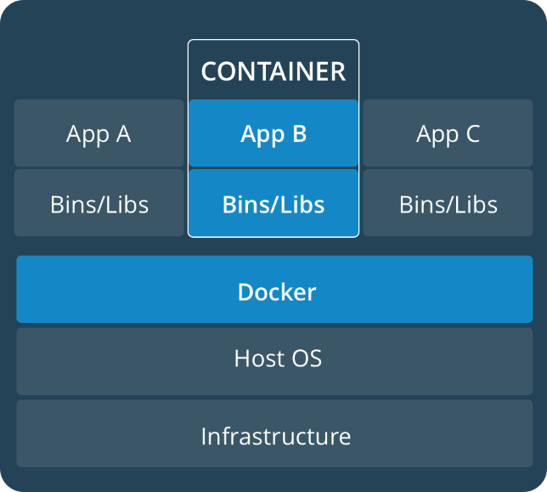
Docker Background
Why use Docker?
Flexible: Complex applications can be containerized.
Lightweight: Containers leverage and share the host kernel.
Portable: Build images locally, deploy to the cloud, and run anywhere.
Distributed: Access Docker Hub registry for pre-built and tested images: https://hub.docker.com
Export App
Local Host
Remote Host

Slide 5
Install & Build Application
PHP app to install: http://www.heliodocs.com
Install application files from Git Hub https://github.com/dzarro/xdoc
git clone https://github.com/dzarro/xdoc.git
Create a Docker (instruction) file
FROM php:7.2-apache # load PHP/Apache image from Docker Hub
COPY xdoc/ /var/www/html/ # copy app files into image
EXPOSE 8080 # expose application port
Build a Docker image
docker build -t dzarro/xdoc . # image name dzarro/xdoc

Slide 6
Run & Deploy Application
Run image in a container
docker run –d –p 8080:8080 –-name dzarro/xdoc xdoc
-d # run in detached/background mode
-p # forward internal Docker port to external server port
Test application
http://52.61.137.34:8080
Deploy to Docker Hub
docker login
docker push dzarro/xdoc

