Slide 1
Heap

Slide 2
Heap
1 | 1
1

Slide 3
Heap
1 | 1 | 2 | 2
2
1

Slide 4
Heap
1 | 1 | 2 | 2 | 3 | 3 | 3 | 4 | 4 | 4 | 4 | 5 | 5 | 5 | 5 | 5 | 5
3
2
5
1
4

Slide 5
Heap
1 | 1 | 2 | 2 | 3 | 3 | 3 | 4 | 4 | 4 | 4 | 5 | 5 | 5 | 5 | 5 | 5 | 6 | 6 | 7 | 8 | 8 | 8 | 8
3
6
2
7
5
1
4
8

Slide 6
Heap
1 | 1 | 2 | 2 | 3 | 3 | 3 | 4 | 4 | 4 | 4 | 5 | 5 | 5 | 5 | 5 | 5 | 6 | 6 | 7 | 8 | 8 | 8 | 8
3
6
2
7
5
1
4
9
8

Slide 7
System.OutOfMemoryException

Slide 8
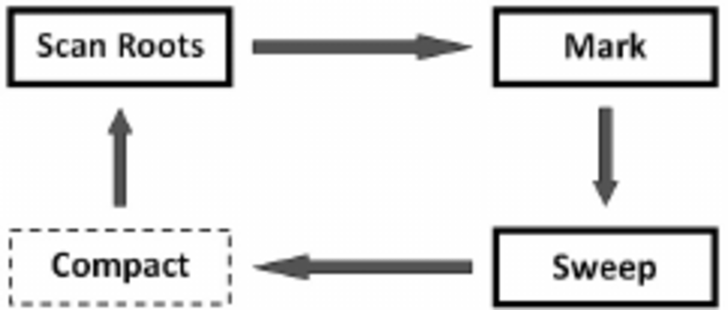
Garbage Collection Cycle

Slide 9
Roots
Local variable in a method that is currently running
Static variables

Slide 10
Garbage Collection – Scan Roots and Mark
1 | 1 | 2 | 2 | 3 | 3 | 3 | 4 | 4 | 4 | 4 | 5 | 5 | 5 | 5 | 5 | 5 | 6 | 6 | 7 | 8 | 8 | 8 | 8
3
6
2
7
5
1
4
9
8

Slide 11
Garbage Collection – Scan Roots and Mark
1 | 1 | 2 | 2 | 3 | 3 | 3 | 4 | 4 | 4 | 4 | 5 | 5 | 5 | 5 | 5 | 5 | 6 | 6 | 7 | 8 | 8 | 8 | 8
3
6
2
7
5
1
4
9
8

Slide 12
Garbage Collection – Sweep
1 | 1 |  |  | 3 | 3 | 3 | 4 | 4 | 4 | 4 |  |  |  |  |  |  | 6 | 6 | 7 | 8 | 8 | 8 | 8
3
6
7
1
4
9
8

Slide 13
Garbage Collection – Compact
1 | 1 | 3 | 3 | 3 | 4 | 4 | 4 | 4 | 6 | 6 | 7 | 8 | 8 | 8 | 8
3
6
7
1
4
9
8

Slide 14
Continue
1 | 1 | 3 | 3 | 3 | 4 | 4 | 4 | 4 | 6 | 6 | 7 | 8 | 8 | 8 | 8 | 9 | 9 | 9
3
6
7
1
4
9
8

Slide 15
GC Optimization - Generations

Slide 16
No generations
1 | 1 | 2 | 2 | 3 | 3 | 3 | 4 | 4 | 4 | 4 | 5 | 5 | 5 | 5 | 5 | 5 | 6 | 6 | 7 | 8 | 8 | 8 | 8

Slide 17
No generations
1 | 1 | 3 | 3 | 3 | 4 | 4 | 4 | 4 | 6 | 6 | 7 | 8 | 8 | 8 | 8

Slide 18
No generations
1 | 1 | 3 | 3 | 3 | 4 | 4 | 4 | 4 | 6 | 6 | 7 | 8 | 8 | 8 | 8 | 9 | 9 | 9 | 10 | 10 | 11 | 12 | 12

Slide 19
No generations
1 | 1 | 3 | 3 | 3 | 4 | 4 | 4 | 4 | 6 | 6 | 7 | 8 | 8 | 8 | 8 | 9 | 9 | 9 | 10 | 10 | 11 | 12 | 12

Slide 20
3 generations
1 | 1 | 2 | 2 | 3 | 3 | 3 | 4 | 4 | 4 | 4

Slide 21
3 generations
1 | 1 | 3 | 3 | 3 | 4 | 4 | 4 | 4

Slide 22
3 generations
1 | 1 | 3 | 3 | 3 | 4 | 4 | 4 | 4 | 5 | 5 | 5 | 5 | 5 | 5 | 6 | 6 | 7 | 8 | 8 | 8 | 8

Slide 23
3 generations
1 | 1 | 3 | 3 | 3 | 4 | 4 | 4 | 4 | 6 | 6 | 7 | 8 | 8 | 8 | 8

Slide 24
3 generations
1 | 1 | 3 | 3 | 3 | 4 | 4 | 4 | 4 | 6 | 6 | 7 | 8 | 8 | 8 | 8 | 9 | 9 | 9 | 10 | 10 | 11 | 12 | 12

Slide 25
3 generations
1 | 1 | 3 | 3 | 3 | 4 | 4 | 4 | 4 | 6 | 6 | 7 | 8 | 8 | 8 | 8 | 9 | 9 | 9 | 10 | 10 | 11 | 12 | 12

Slide 26
3 generations
1 | 1 | 3 | 3 | 3 | 7 | 8 | 8 | 8 | 8 | 9 | 9 | 9 | 12 | 12

Slide 27
3 generations
1 | 1 | 3 | 3 | 3 | 7 | 8 | 8 | 8 | 8 | 9 | 9 | 9 | 12 | 12 | 13 | 13 | 13 | 13 | 13 | 13

