Slide 1


AN INTRODUCTION TO MULE ESB FOR BEGINNERS
Davide Zaza

Slide 2
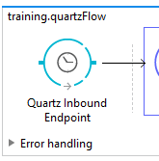
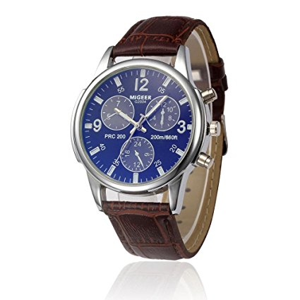
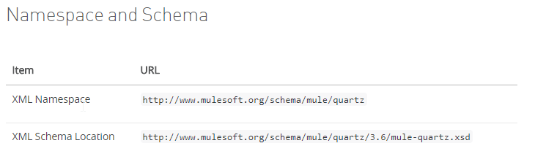
CONNECTORS
Quartz
You need to import the right namespace

Slide 3
CONNECTORS
Quartz – you have to import the right NAMESPACE AND IT’S SCHEMA LOCATION
Correct
Not Correct
If you don’t import the right namespaces you will get an exception

Slide 4

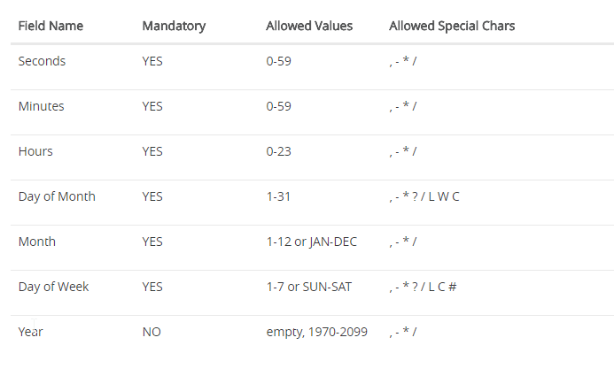
CONNECTORS
Quartz – cron expression

Slide 5
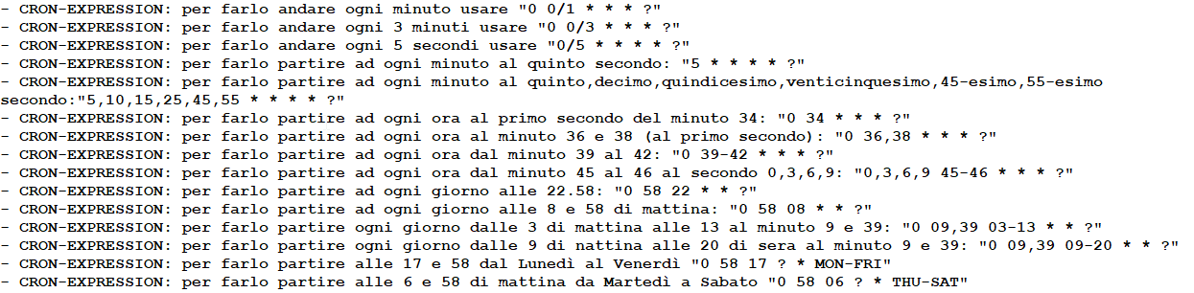
CONNECTORS
Quartz – examples of cron expressions

Slide 6
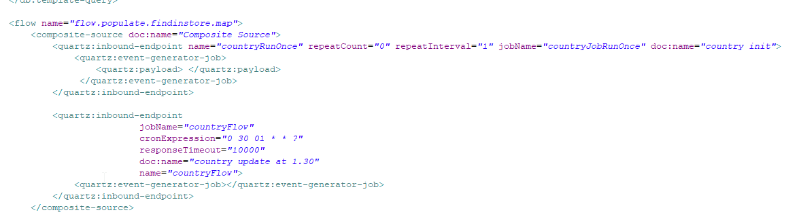
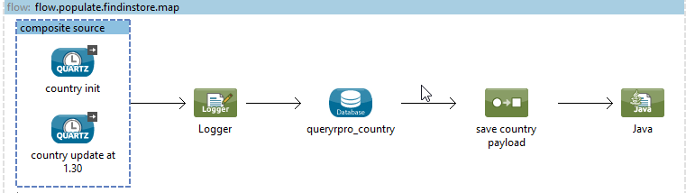
CONNECTORS
Quartz – how to start while the app is deploying

Slide 7
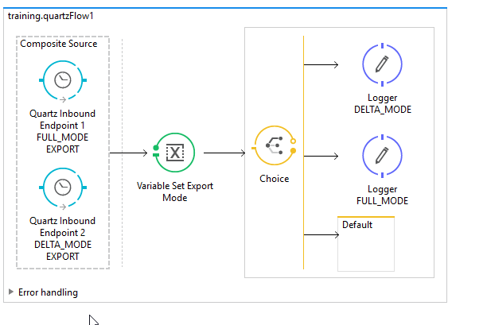
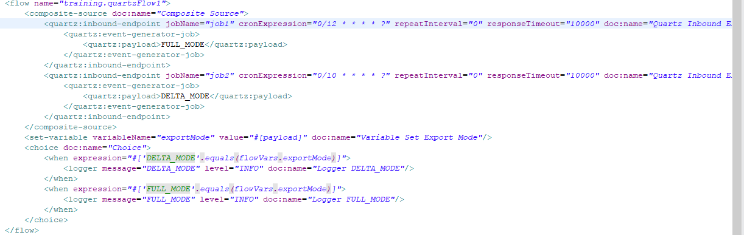
CONNECTORS
Quartz – how to recognize the job from composite inbound

Slide 8
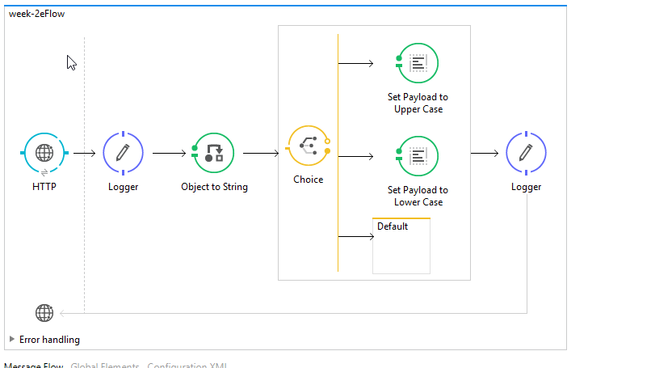
CONNECTORS
HTTP – Listener in Inbound and …

Slide 9
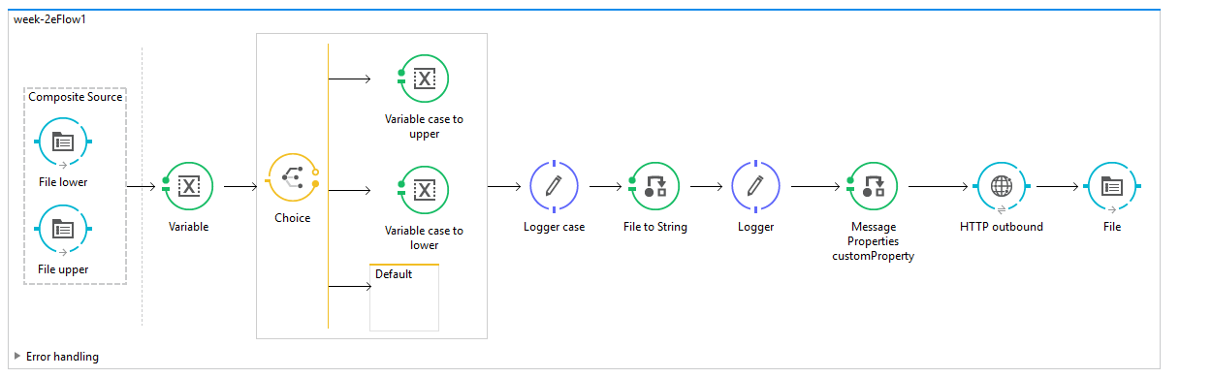
CONNECTORS
HTTP – … and Request in Outbound

Slide 10
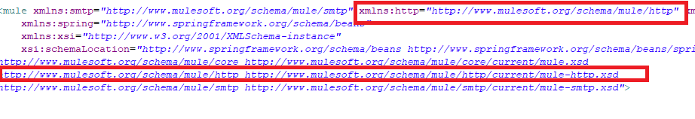
CONNECTORS
HTTP – namespace and schema localtion

Slide 11
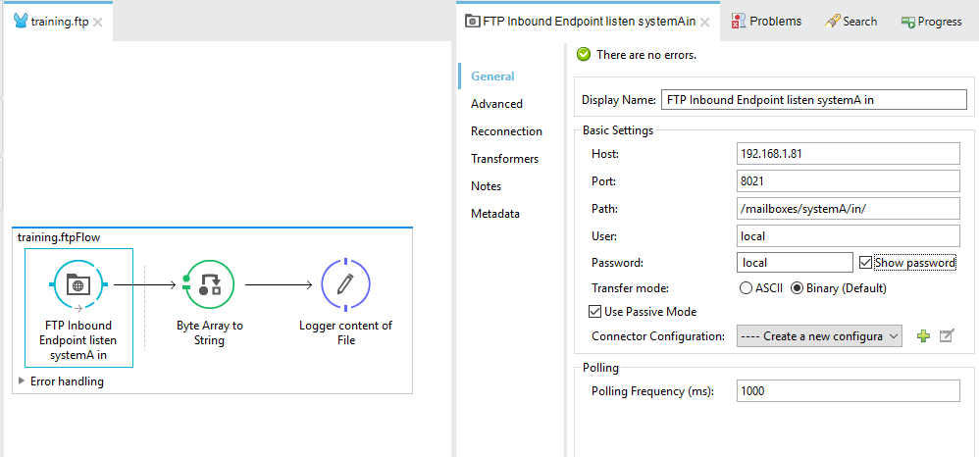
CONNECTORS
FTP - inbound

Slide 12
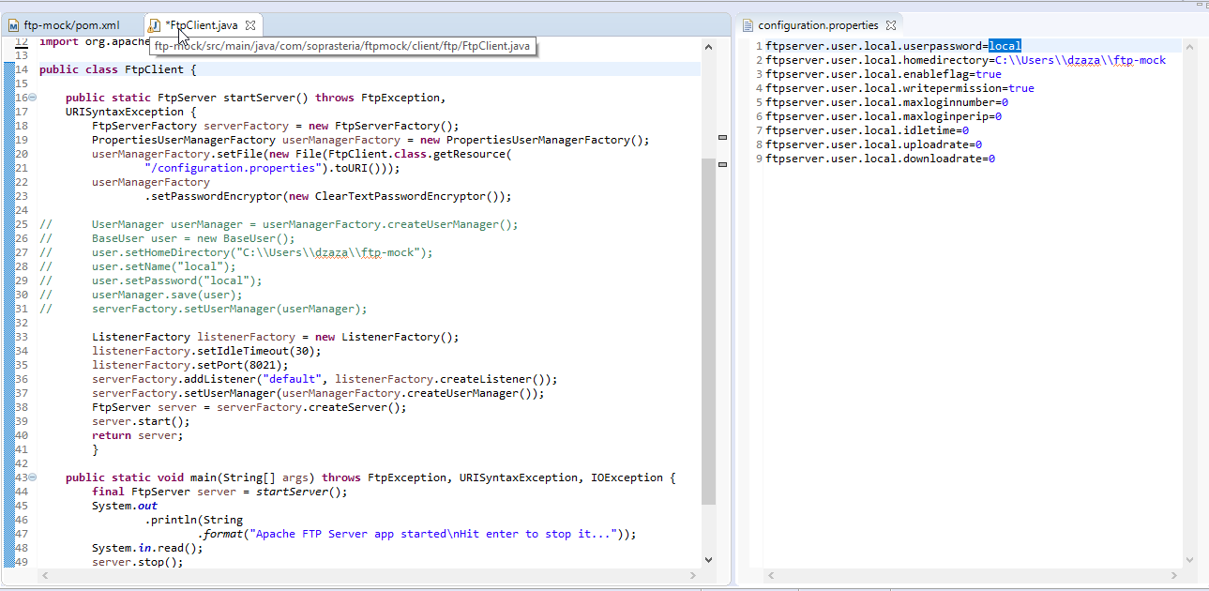
CONNECTORS
FTP – Apache FtpServer ( local client )

Slide 13
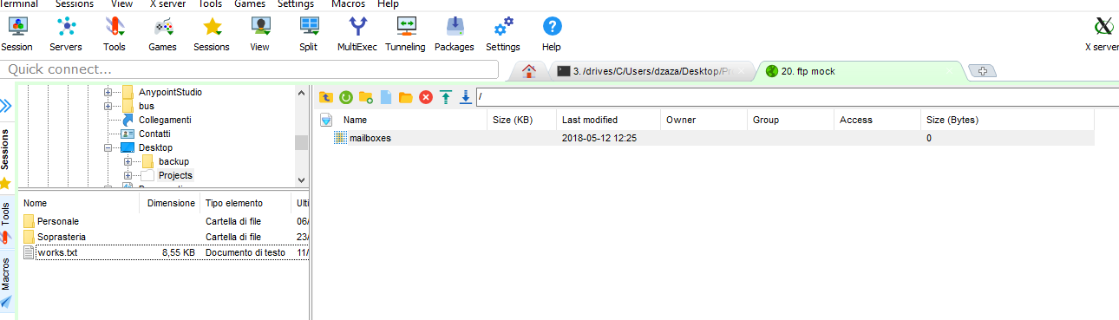
CONNECTORS
FTP - MobaXTerm

Slide 14
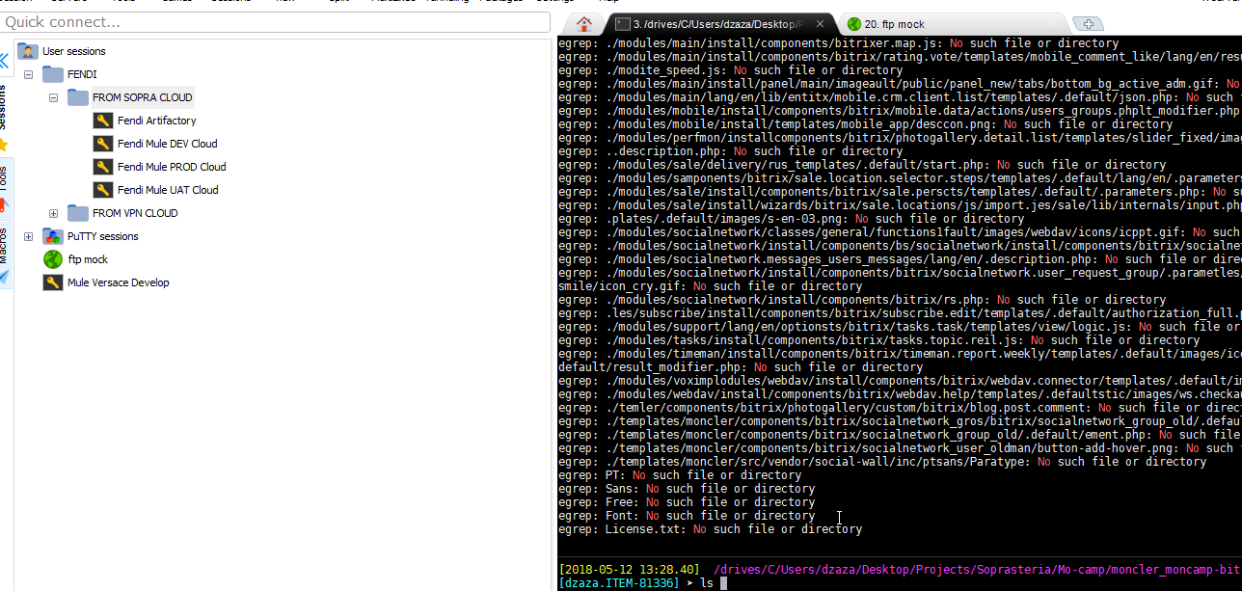
CONNECTORS
FTP – is much more than ftp client … ssh client!

Slide 15
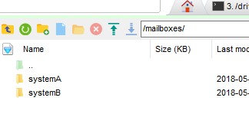

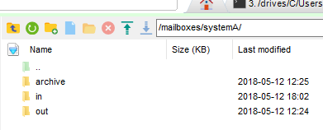
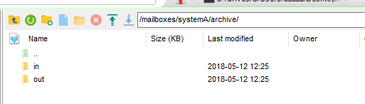
CONNECTORS
FTP – The right trees

Slide 16
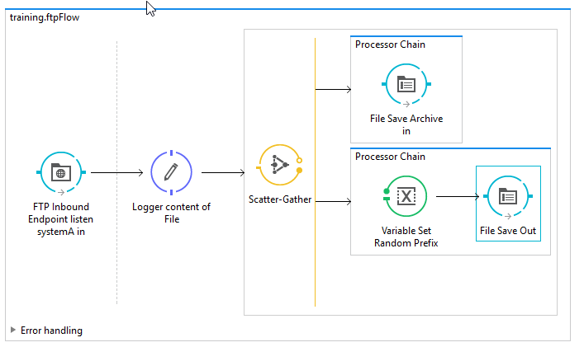
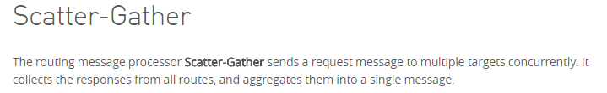
CONNECTORS
FTP – Please mind to save your files

Slide 17
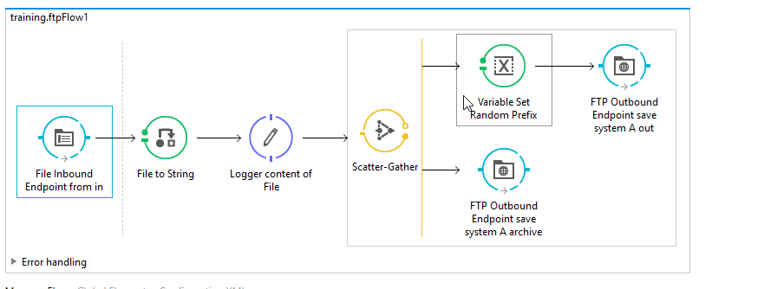
CONNECTORS
FTP - outbound

Slide 18
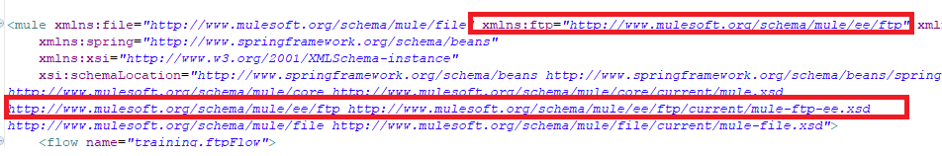
CONNECTORS
FTP – namespace and schema localtion

Slide 19
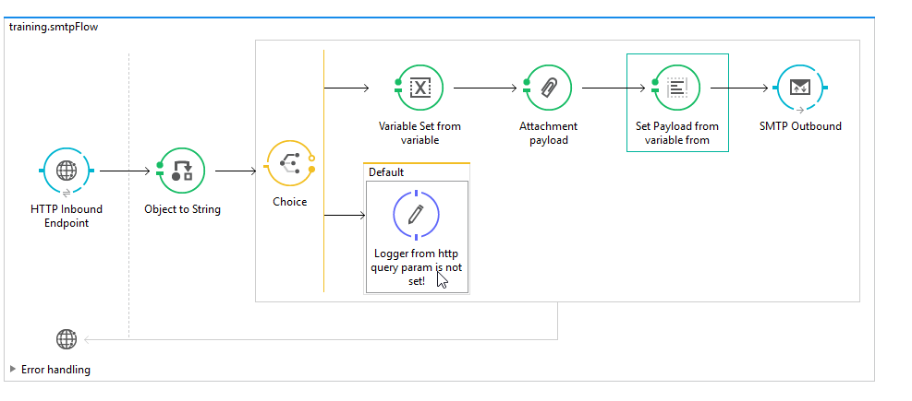
CONNECTORS
SMTP

Slide 20
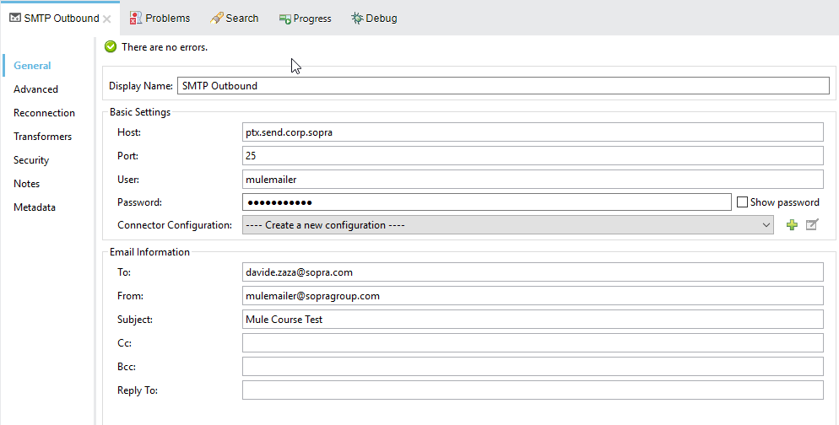
CONNECTORS
SMTP

Slide 21
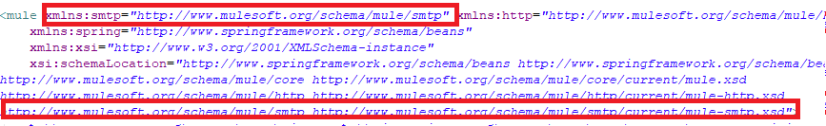
CONNECTORS
SMTP – namespace and schema localtion

Slide 22
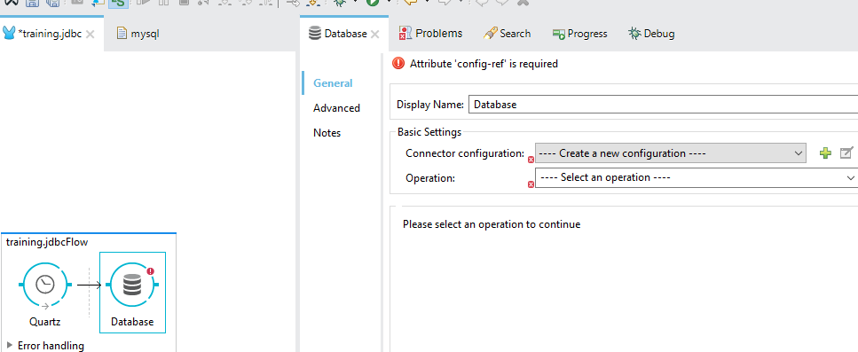
CONNECTORS
JDBC – Query with mule

Slide 23
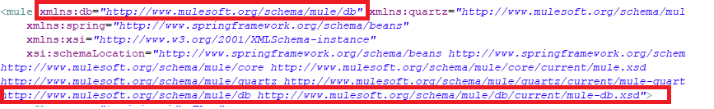
CONNECTORS
JDBC – namespace and schema localtion

Slide 24
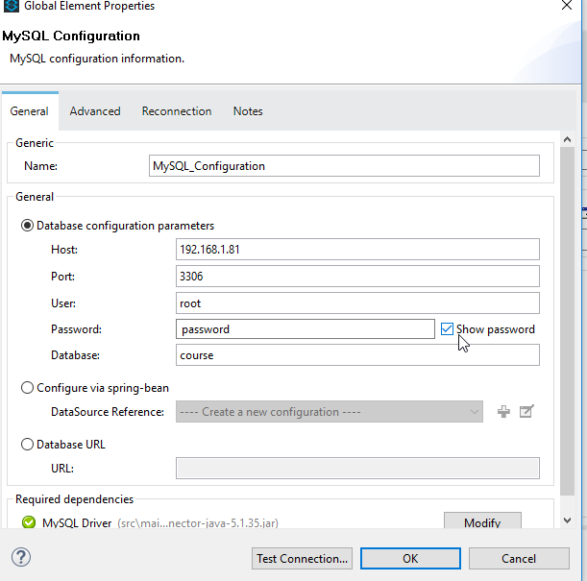
CONNECTORS
JDBC – global configuration

Slide 25
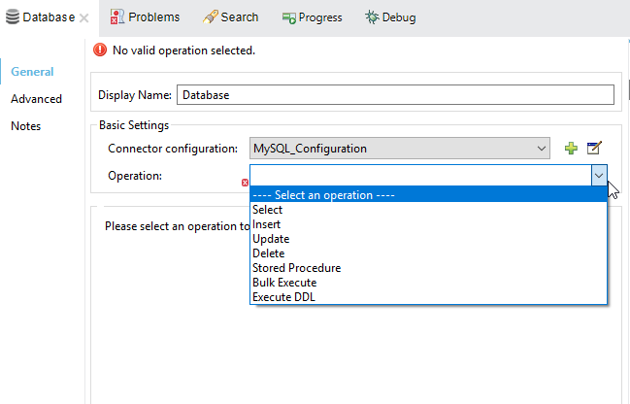
CONNECTORS
JDBC – chose your operation

Slide 26
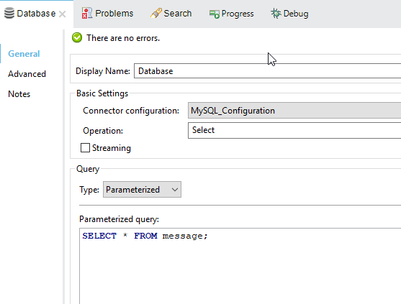
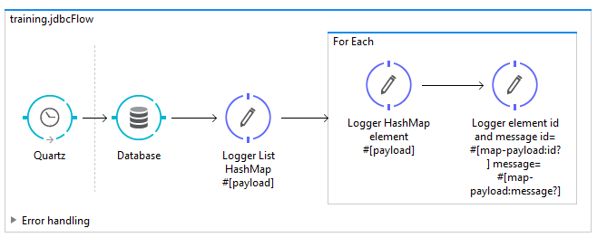
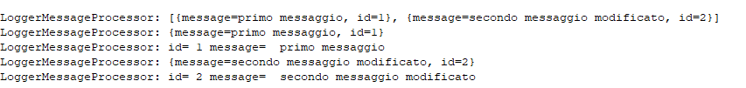
CONNECTORS
JDBC – select

Slide 27
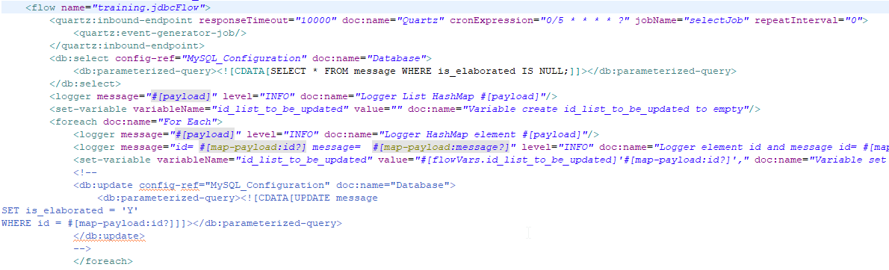
CONNECTORS
JDBC – update
If it’s possible don’t do the update in the for-each

Slide 28
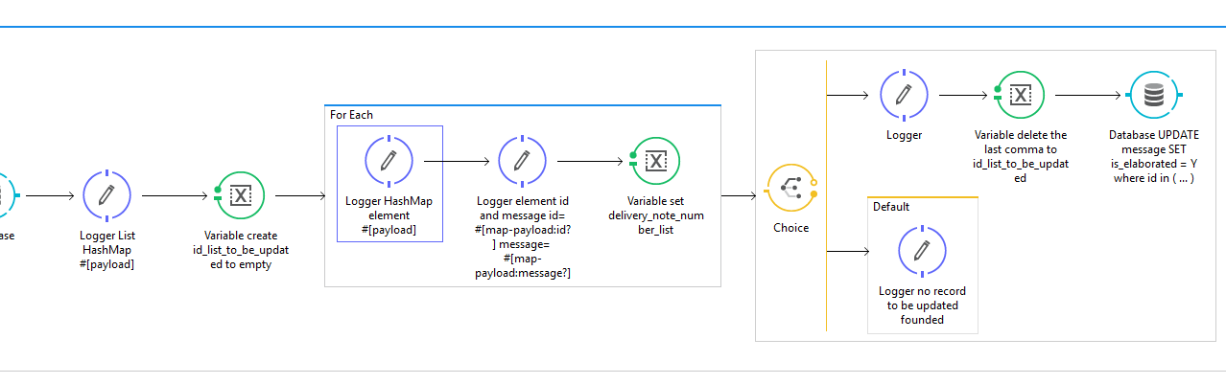
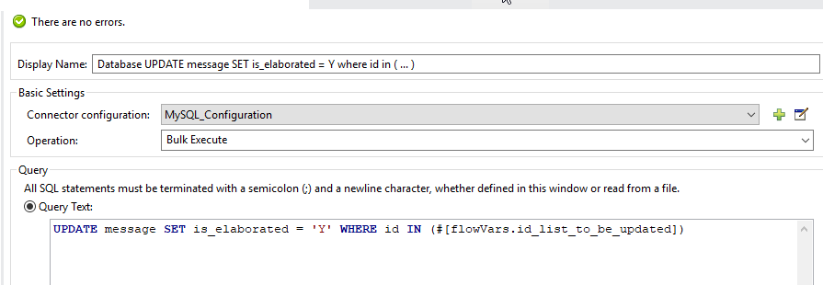
CONNECTORS
JDBC – bulk update

Slide 29
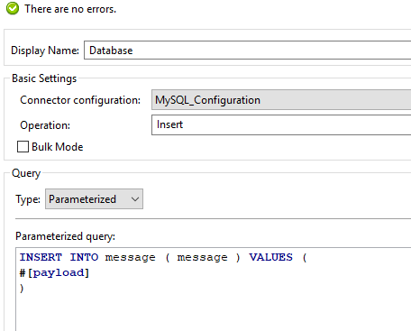
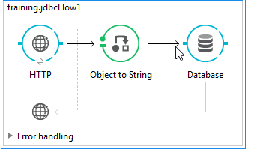
CONNECTORS
JDBC – Insert

