Slide 1


AN INTRODUCTION TO MULE ESB FOR BEGINNERS
Davide Zaza

Slide 2
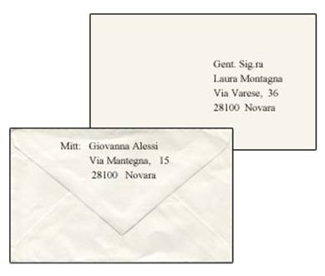
MULE MESSAGE
What is a Mule message?
NOT THIS!
Not an envelope that contains
Sender and reciever information
And a letter inside it
Don’t forget we are in java world

Slide 3
MULE MESSAGE
What is a Mule message?
A Set that contains …
PAYLOAD
METADATA

Slide 4
MULE MESSAGE
What is the payload? What are the metadata?
A Mule message contains payload and metadata:
Mule Message is the envelope and contains :
The letter inside the envelope (PAYLOAD)
The sender and reciever addresses (METADATA)
The payload is the information!
It contains the business-specific data
Metadata are the header properties of the message

Slide 5
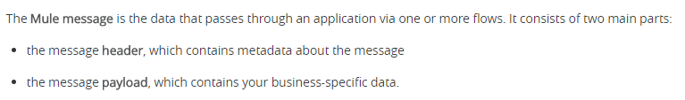
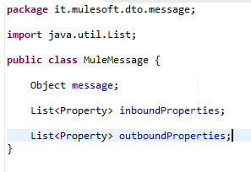
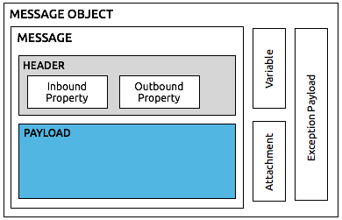
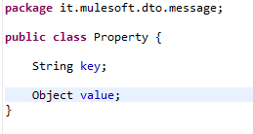
MULE MESSAGE
The message is a java class!
Properties and Variables share a common format
Both have a name (key) and values

Slide 6

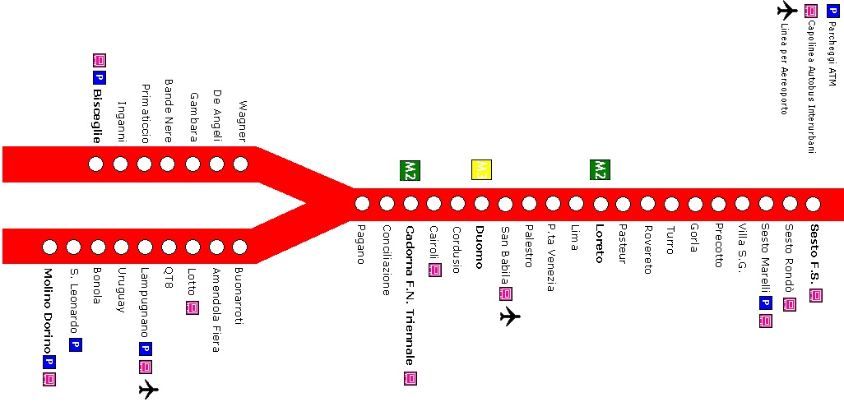
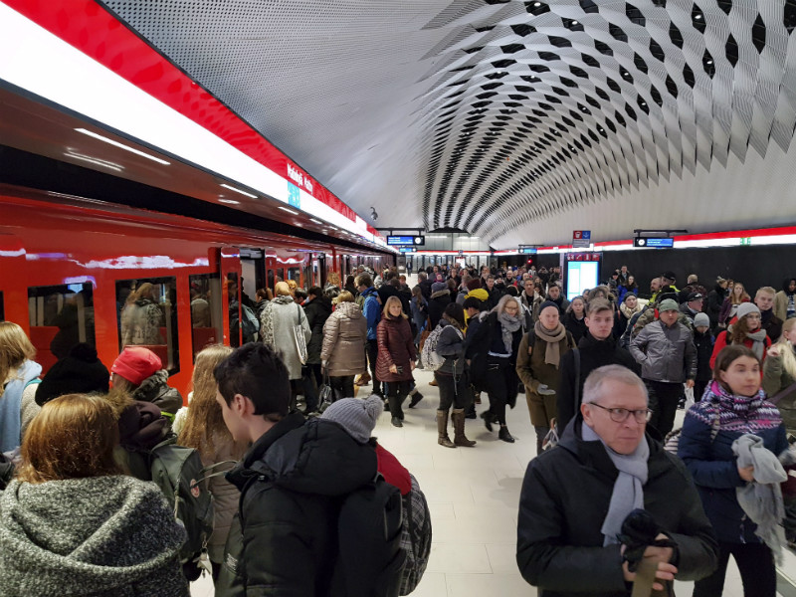
MULE MESSAGE
What is the Payload?
People travel
People in
People out

Slide 7




MULE MESSAGE
What is the Payload and what means that it can canghe nature?
Mule is the train
that brings the People to the stops
Mule is the train
That brings the message to the stops=message processors
Message start from an inbound endpoint and travel through the flows, message processors … until it end in an outbound endpoint

Slide 8

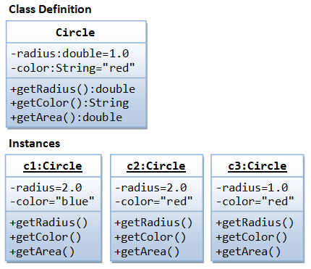
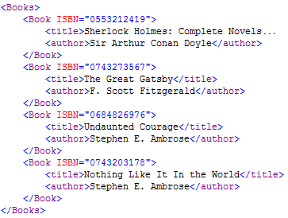
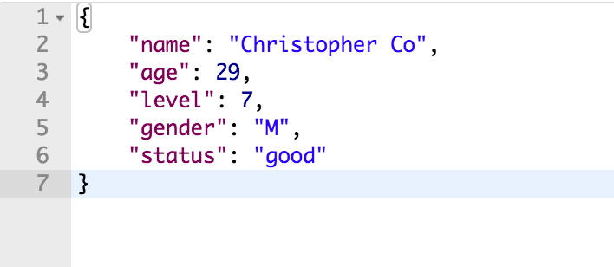
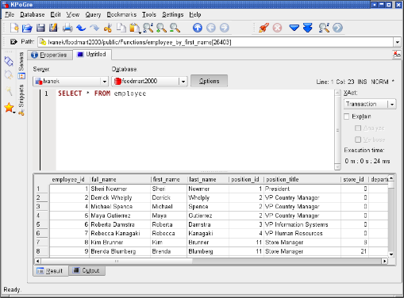
MULE MESSAGE
WHAT IS THE PAYLOAD?
The payload is the information
the real content of the message
and can canghe during the travel
But what kind of information?
It’s a File?
It’s a String?
It’s a XML?
It’s a JSON?
It’s a result of a query?

Slide 9
MULE MESSAGE
WHAT IS THE PAYLOAD?
For sure it’s a java object but what object?
It depends!
Essentially the payload contains the 'result' of the previous step
The payload contains whatever you put in it last
Payload contains output previous processor/endpoints
The Message source and processor provide the details to payload
And the same is valid for the metadata

Slide 10
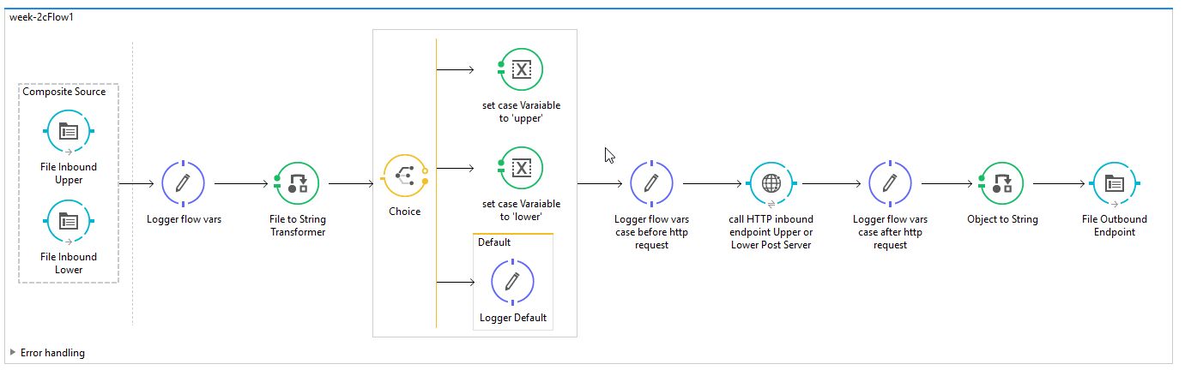
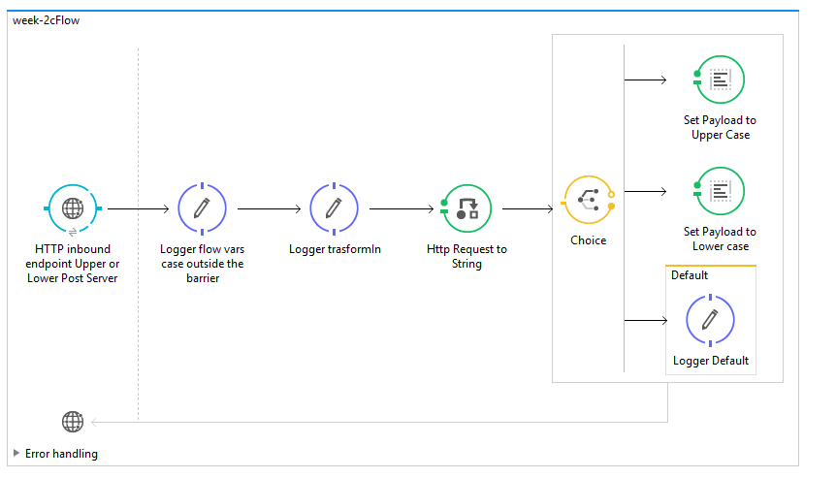
MULE MESSAGE
Try to follow the trasformation about the payload throught the integrations flow

Slide 11
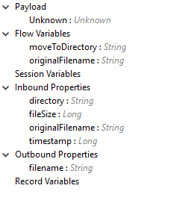
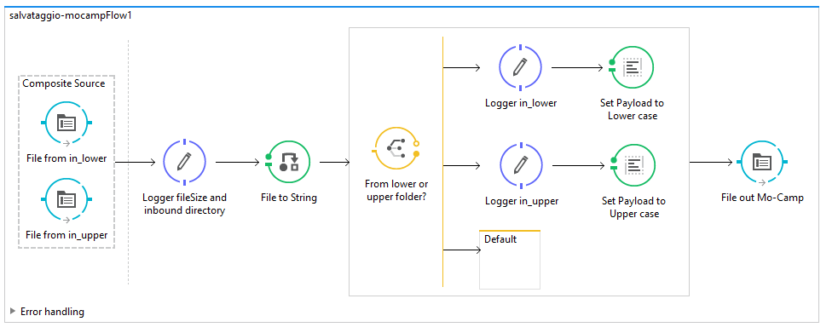
MULE MESSAGE
The message is a java class and change from inbound connector and message processor

Slide 12
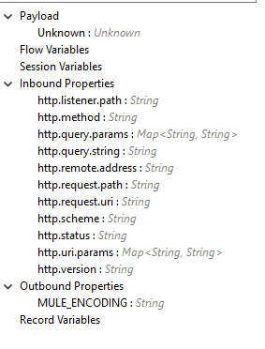
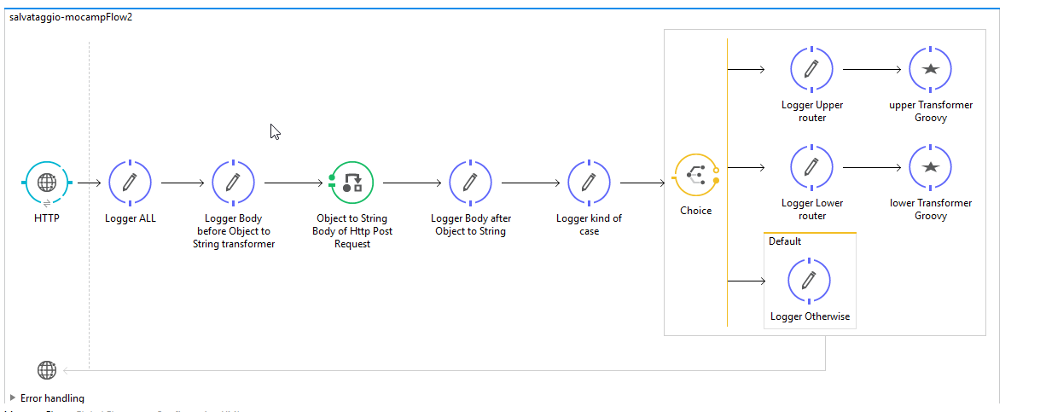
MULE MESSAGE
The message is a java class and change from inbound connector and message processor

Slide 13

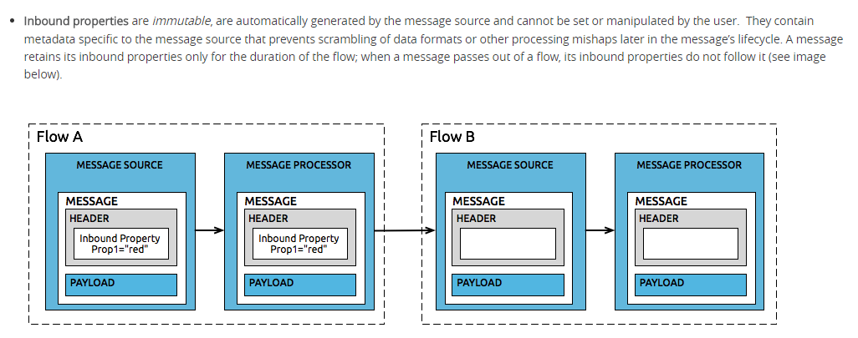
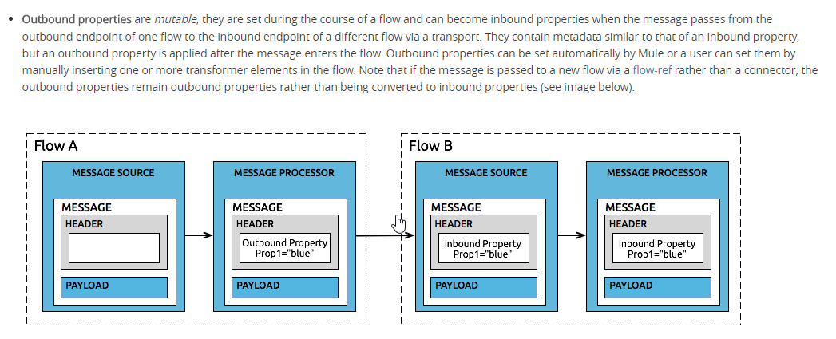
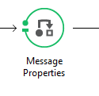

MULE MESSAGE
We have inbound and outbound properties
Properties:
Inbound
Outbound
Transport Barrier
When you use an
Outbound Connector
to send a message To an
Inbound Connector

Slide 14
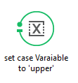
MULE MESSAGE
And flow and session variables
Flow Variables : they live only in the flow were they are created
Session Variables : they live until the message ends it’s travel ( also across the barrier )
But
the Session Variable persist for the entire message lifecycle, regardless of transport barriers,
except for the HTTP Connector which doesn’t propagate them
Variables are temporary pieces of information about a message that are meant to be used by the application that is processing it, rather than passed along with the message to its destination

Slide 15
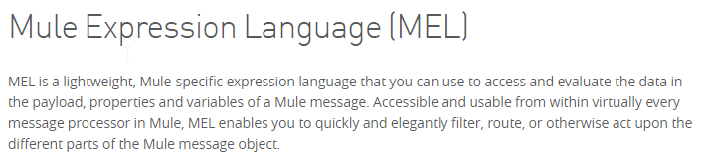
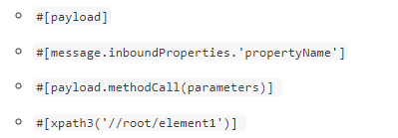
MULE MESSAGE
MEL Mule Expression Language
In which way we can write a code in the mule configuration files?
We need a language to log and navigate the information,
to create iterative and conditional constructs and
that let it us to set the various information like we want

Slide 16
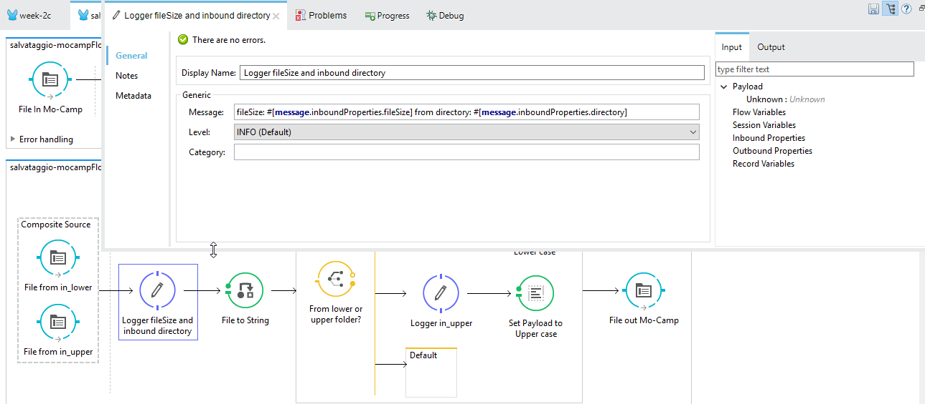
MULE MESSAGE
MEL Mule Expression Language – for example …

Slide 17
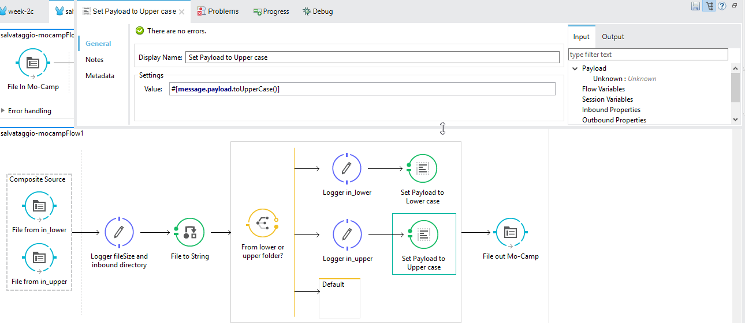
MULE MESSAGE
MEL Mule Expression Language – for example …

Slide 18
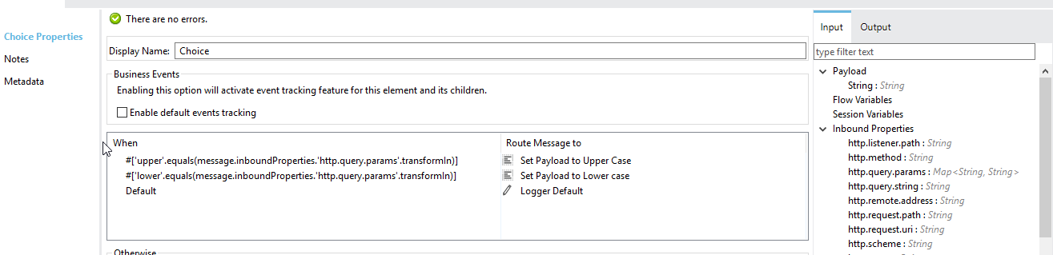
MULE MESSAGE
MEL Mule Expression Language – for example …
THE COICHE!

Slide 19
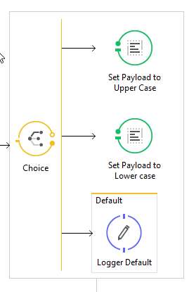
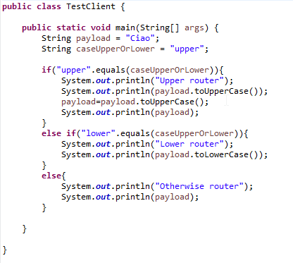
MULE MESSAGE
MEL Mule Expression Language – for example …
Coiche is the conditional construct for Mule

Slide 20
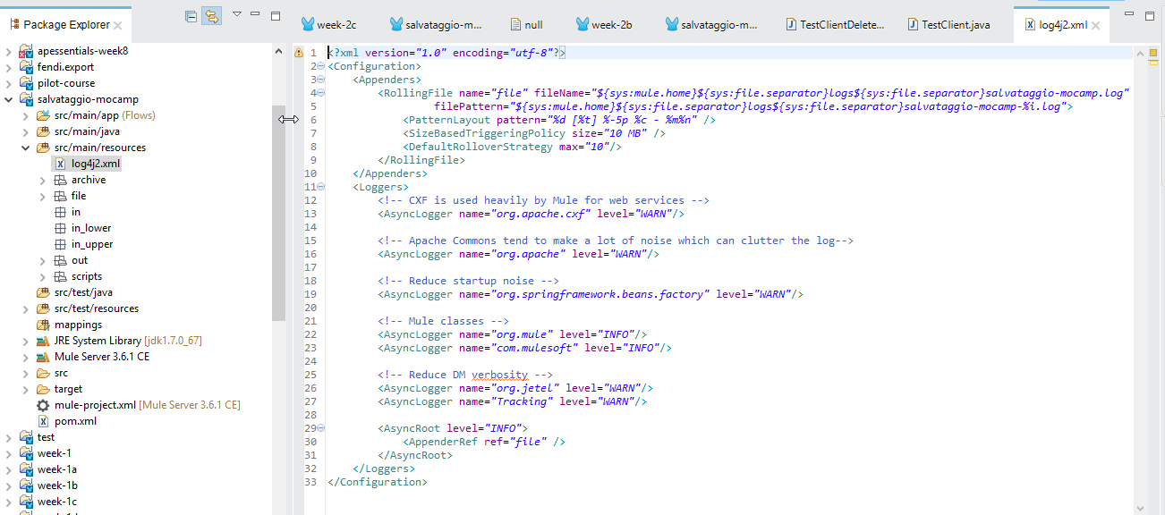
MULE MESSAGE
LOG4j
IT’S A LOGGING FRAMEWORK
We can log in the console, in any file were we like to write the informations

Slide 21
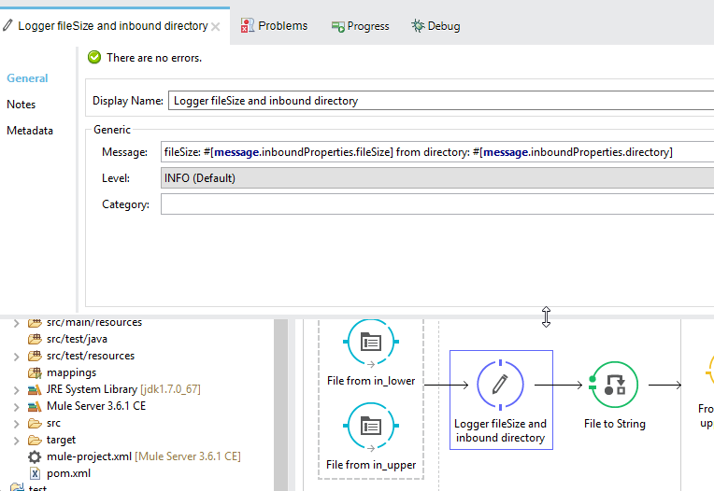
MULE MESSAGE
LOG4j – We already use!

Slide 22
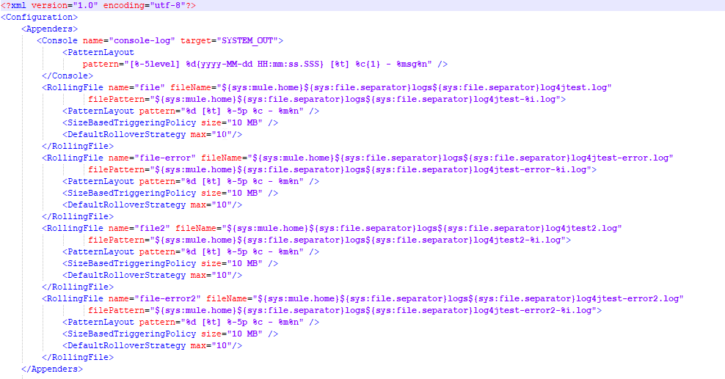
MULE MESSAGE
LOG4j – The Appenders Rolling File

Slide 23
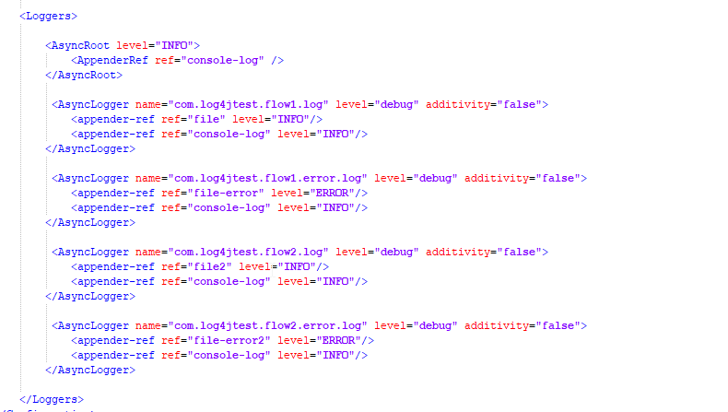
MULE MESSAGE
LOG4j – The Logger that bind the appenders with the level of logging desired

Slide 24
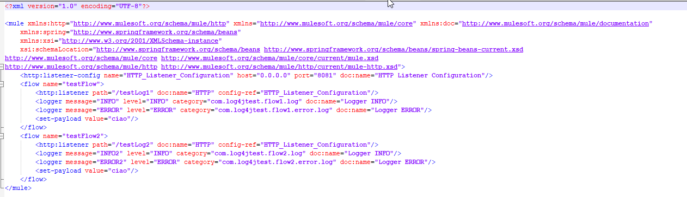
MULE MESSAGE
LOG4j – The Flow

