Slide 1
Problem Statement
Predicting Olympic medal winners using weight and height

Slide 2
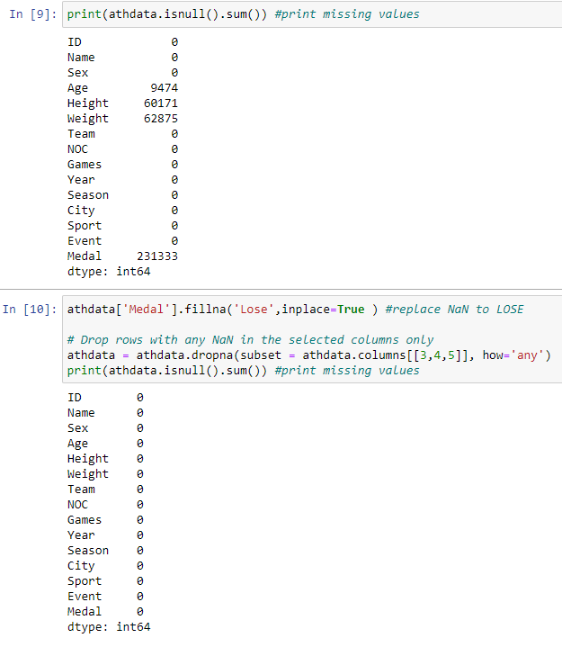
Data Cleaning
Dropping NaN values in height, weight, age since the selected parameters need to be available
Filling out Nan values for no medal winners

Slide 3
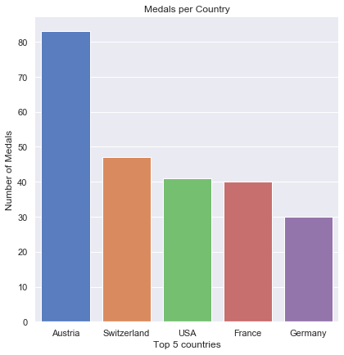
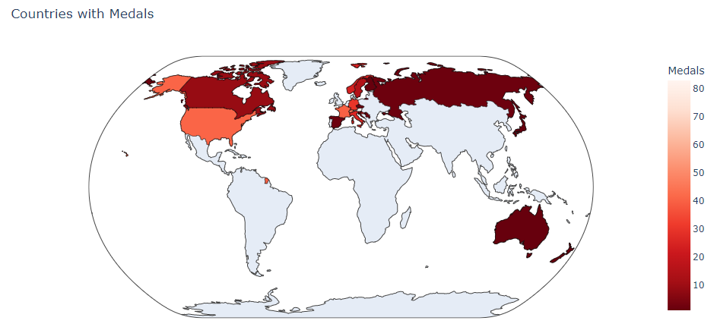
Medal Winners
By country, over the last 120 years from Y1896 to Y2016

Slide 4
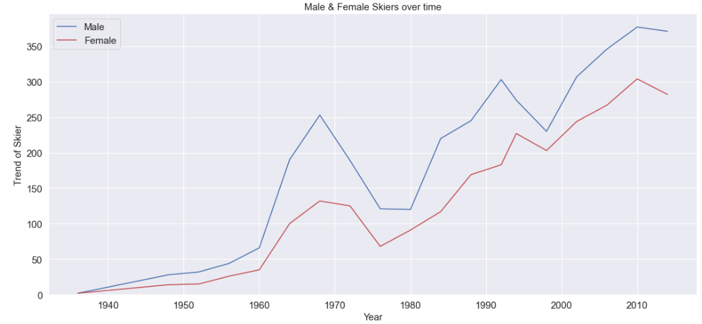
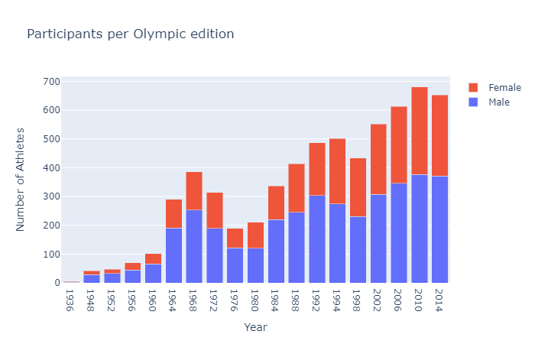
Participation by Sex
Increasing trend over the years will give a much higher or better accuracy for finding the medal winners with chosen parameters

Slide 5
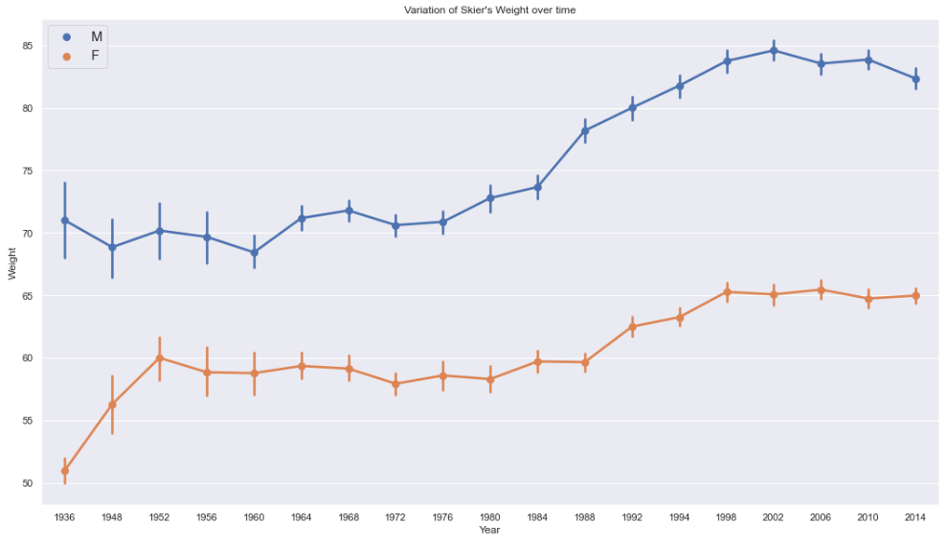
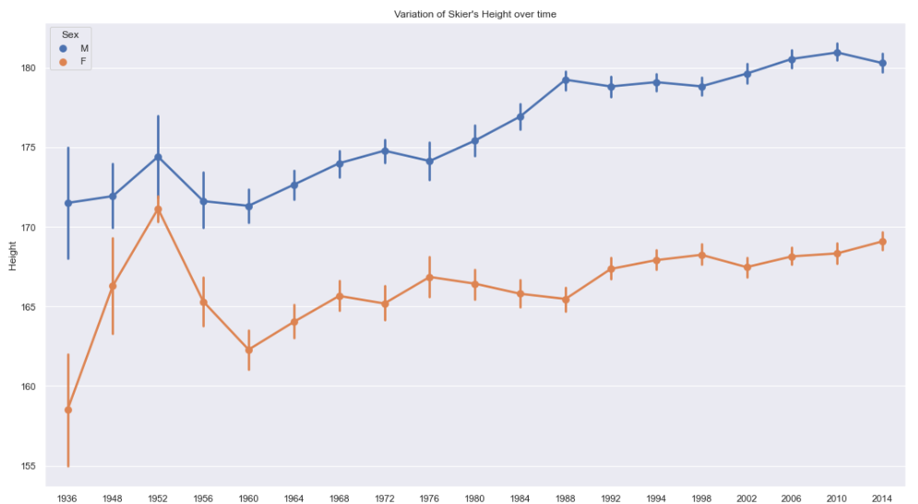
Weight and Height Variation
There are many kinds of sports that the bigger they are, the higher chances of winning. Therefore, the sport is narrowed to alpine skiing, a sport that requires agility and speed.
Increasing weight trend has been shown up till 21st century but from year 1952 to 1960 there seems to be a notion that any heavier is not good. But that was not the case due to athletes being heavier up to year 2014. In earlier years up till year 1956, weight and height of athletes were shown to be quite varied but has reduced over the years.

Slide 6
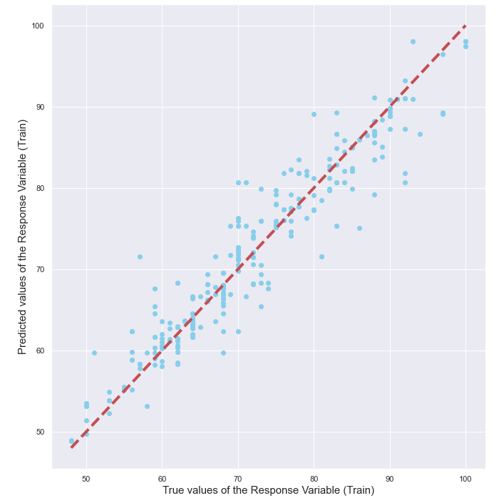

Regression of the Parameters
The trained data resulted in a positive skew of 0.916 showing that bigger athletes in a speedy sport do make bigger impact

