Slide 1
Problem Statement
Variables that contributes to the profitability of insurance premium

Slide 2
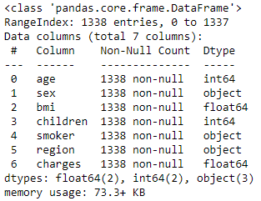
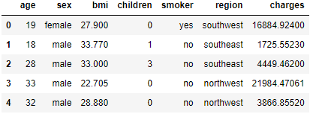
Data Cleaning
No missing values from any columns while age, BMI, children and charges are in either int or float. Data can be used straight away.

Slide 3

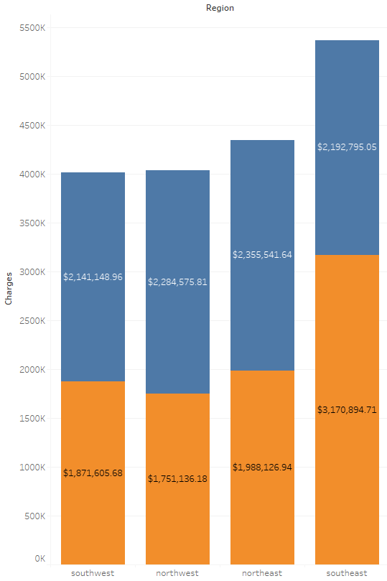
Insights - Region
Southeast region pays the most and rest of the regions are comparable and well-balanced
The available variables that could impact on how much the premium is paid for southeast against the other regions are BMI or children to find the profitability

Slide 4
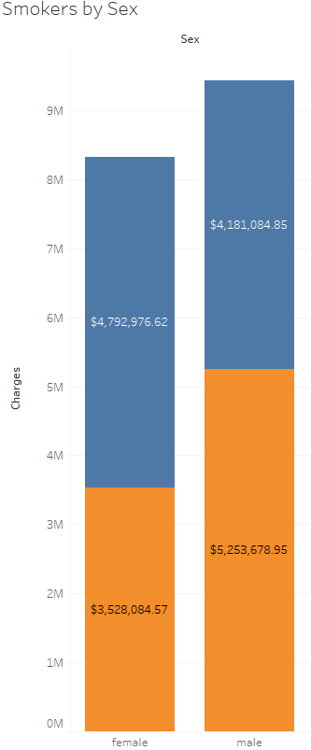
Insights – Sex factor
Sexuality does not matter whether there is money to be made, although male smokers do pay substantially more

Slide 5
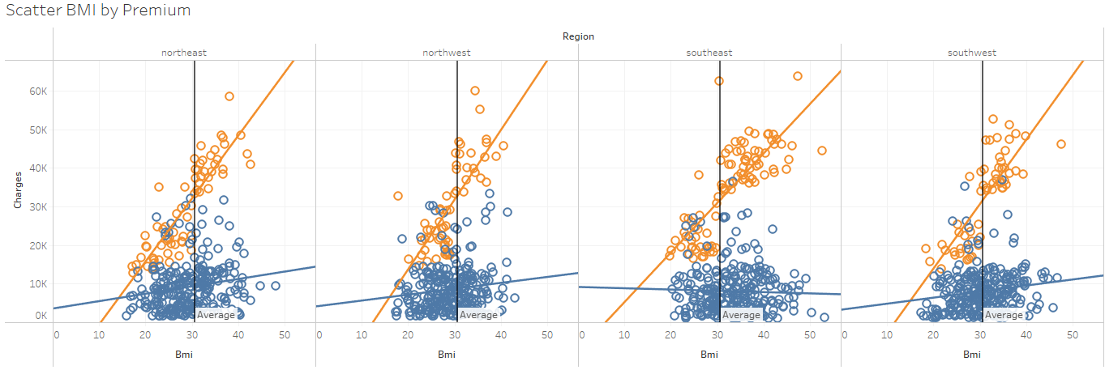
Insights – Region by BMI
Mean line by BMI is shown, no correlation between the relations of premium paid against BMI
However, a positive correlation of smokers with higher BMI seems to suggest that they do pay at higher premium

Slide 6
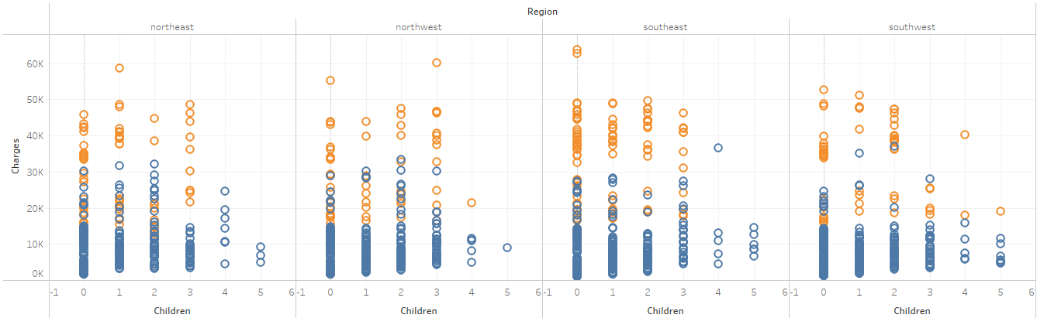
Insights – Region by Children
Overall, parents with less than 4 children are willing to buy insurance but smokers will pay much more
Possibly due to financial means of a family, but cannot be confirmed due to lack of data.

Slide 7
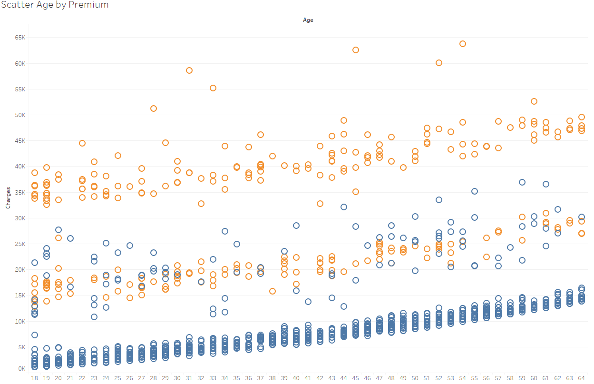
Insights – Age factor
Positive correlation showing an uptrend irrespective of regions, the skew of older age pays significantly more compared to youngsters especially if they are smokers
Obvious outliers spotted that could be impacted from different variables that were not provided, more information is needed to ascertain the problem

Slide 8
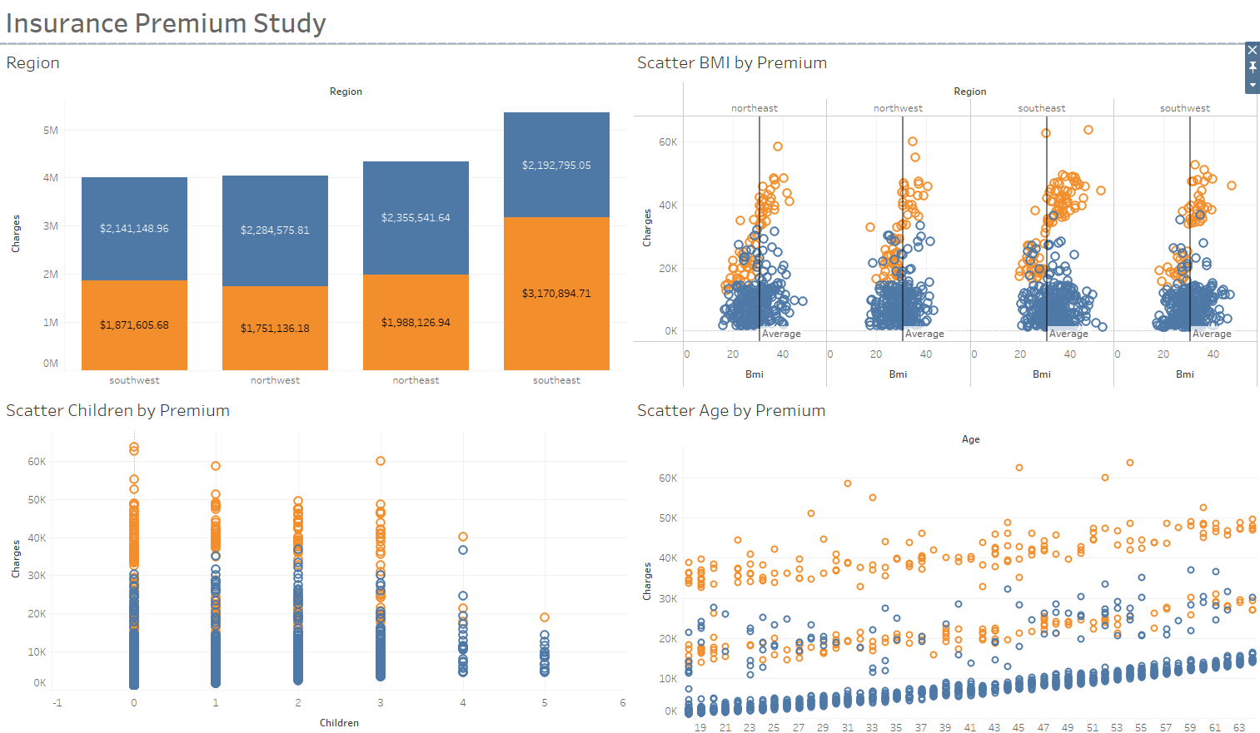
Dashboard
https://public.tableau.com/app/profile/chua.ding.zhang/viz/InsurancePremiumPaid/Dashboard1?publish=yes

Slide 9
Conclusion
There is a positive correlation between smokers with higher BMI, or older age and it will yield higher premium paid
Customers with fewer children, preferentially, less than 4 would pay for insurance. And more than 3 suggest that they are less likely to smoke
Therefore, smokers generally pay at much higher premium due to direct or indirect complications, such as health or child

