Slide 1


Intensive Care Window
A multi-modal monitoring tool for Intensive Care
Research and Practise
Harald Gjermundrod, Marios Papas,
Demetrios Zeinalipour-Yazti, Marios D. Dikaiakos
Department of Computer Science - University of Cyprus
Nicosia Cyprus
George Panayi, Theodoros Kyprianou
Intensive Care Unit - Nicosia General Hospital, Cyprus

Slide 2
Motivation
More than 4000000 people are admitted to Intensive Care Units (ICU) in the U.S. – 500000 of them do not survive. (The Leapfrog group, 2000)
Effective and reliable monitoring of the patients is required to assist the intensivists in their work.
Collection, storage and processing of patients´ vital parameters can bring tremendous benefits to the Intensive Care Medicine.

Slide 3
Multi-modal monitoring
May help the physicians to identify biopatterns reflecting the prognoses of a patient
Implementation challenges in modern ICUs
  A plethora of proprietary medical devices are used in the ICU to monitor the patients
  Large volumes of produced data that hospitals storage systems cannot handle
  The storage of patient data off-site and potential sharing of them raise issues of personal data security

Slide 4
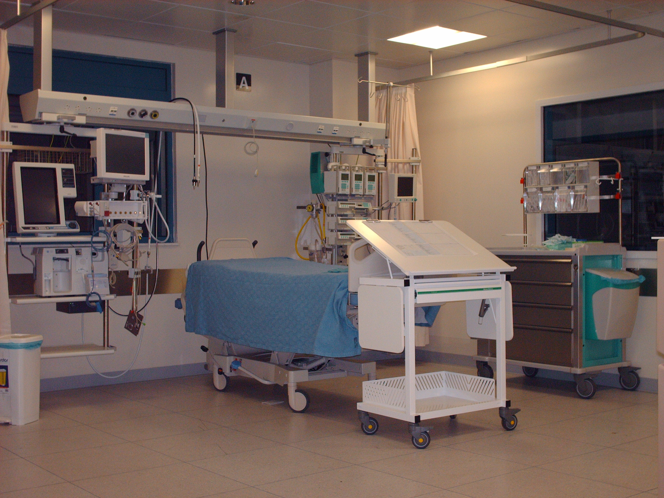
Medical Devices in the ICU
Monitoring and life supporting devices
  Bedside patient monitor
  Ventilator
  Drug administration pumps
  Standalone devices
    Brain pressure monitor
    Renal failure support device
    etc.

Slide 5
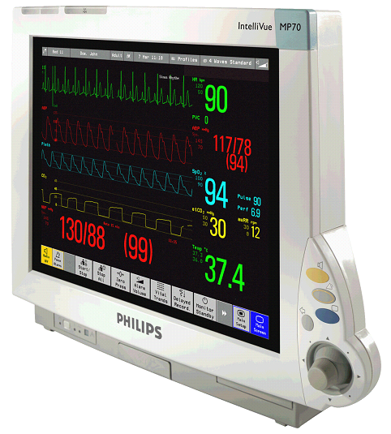
Hardware
The Philips Intellivue MP70 bedside patient monitor
Advanced monitoring capabilities
  ECG, Blood Pressure, EEG, SvO2, Cardiac output etc.
Two interfaces for communication
  UDP/IP
  MIB/ RS232

Slide 6
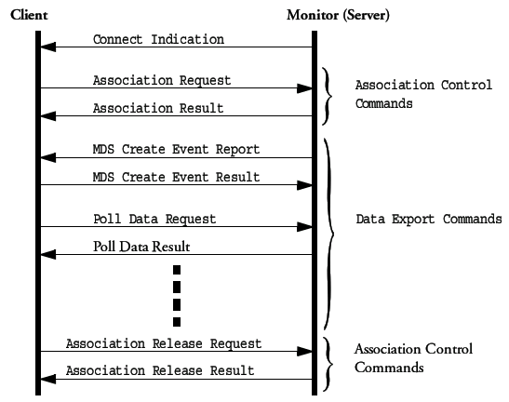
The Intellivue Data Export interface
The Intellivue uses a connection oriented protocol
Connection with external pc is achieved with association messages
Data are extracted using Poll Requests
Same protocol for both interfaces

Slide 7
The IC Window overview
Developed for use by intensivists in the ICU
Connects to the Philips MP70 bedside patient monitor and extracts user selected vital parameters of the patient
Tab graphical user interface - friendly and easy to use by inexperienced computer users
Operates in the Windows XP environment

Slide 8
The IC Window architecture
Consists of two modules and a GUI
PhMon Module: Base module for the implementation of the interface protocol over UDP/IP
PhMon Listener Module: For discovering other monitors in the network
GUI: Used for extracting and displaying the information from the patient monitor

Slide 9
The GUI in more detail
Single parameter or multiparameter extraction
Single poll or continuous poll of data
Real time or post time graphs of the acquired parameters
Selection of storage place/media
Capability to select a monitor in the network

Slide 10
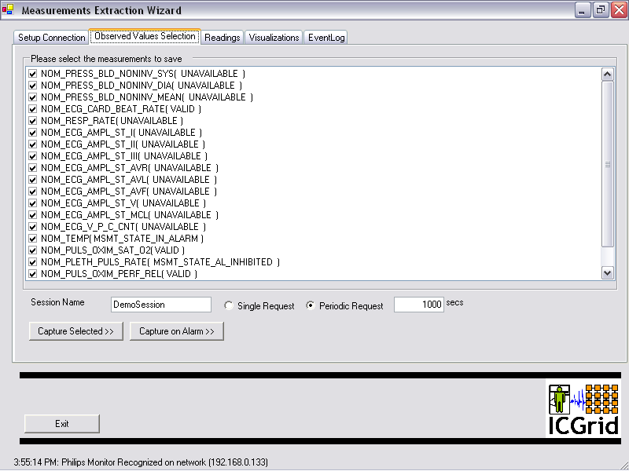
GUI - Parameters screen

Slide 11
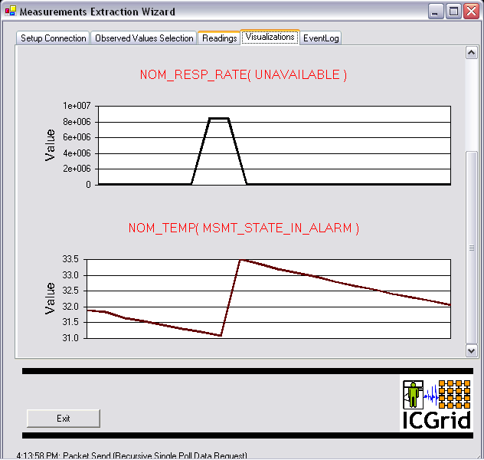
GUI – Graphs screen

Slide 12
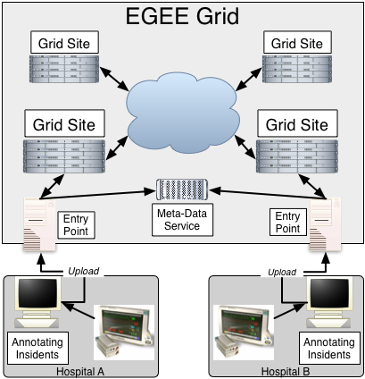
The ICGrid
The IC Window will produce large volumes of data
Hospital infrastructure do not have the resources to meet the demand
The Grid infrastructure is a very promising solution
  EGEE Grid is the largest Grid infrastructure
    More than 200 sites worldwide
    More than 30000 CPUs employed
    About 5 PByte of storage
    Grid node at UCY

Slide 13
Current work
Measurements in real life cases have been conducted
A new version of the IC Window using the MIB/RS232 interface is currently evaluated
  Allows the IC Window to connect to patient monitors that use the UDP/IP interface for networking with other monitors with central monitoring station
  More parameters have been added
  More graph options – time scale capability
  Export capabilities in CSV files
  Communication interface with ventilators added

Slide 14
Future work
Development of the communication interfaces for other medical devices used in the ICU
Data transfer to the EGEE Grid node at the University of Cyprus
Development of tools in the Grid environment for analyzing the data

Slide 15
Thank you for your attention

