Slide 1
Distributed Spatio-Temporal
Similarity Search
Demetrios Zeinalipour-Yazti dzeina@cs.ucy.ac.cy
University of Cyprus
Song Lin slin@cs.ucr.edu
University of California - Riverside
Dimitrios Gunopulos dg@cs.ucr.edu
University of California - Riverside
http://www.cs.ucr.edu/~slin
ICDE 2006
Song Lin University of California, Riverside

Slide 2
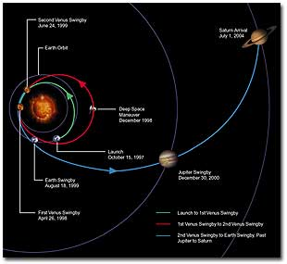
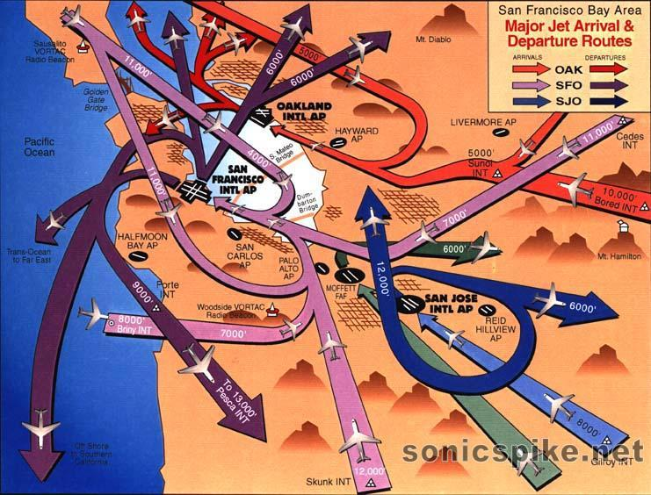
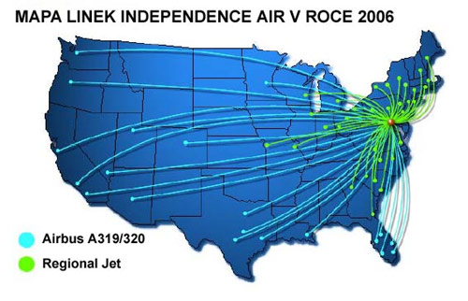

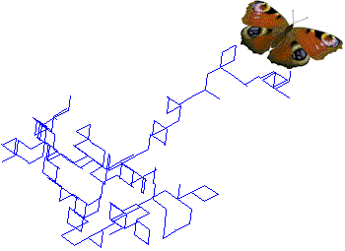
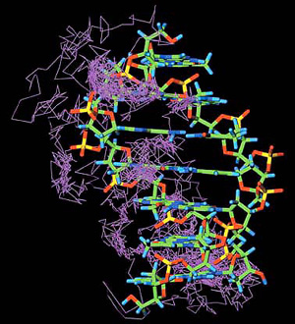
Trajectories are everywhere
Song Lin University of California, Riverside

Slide 3
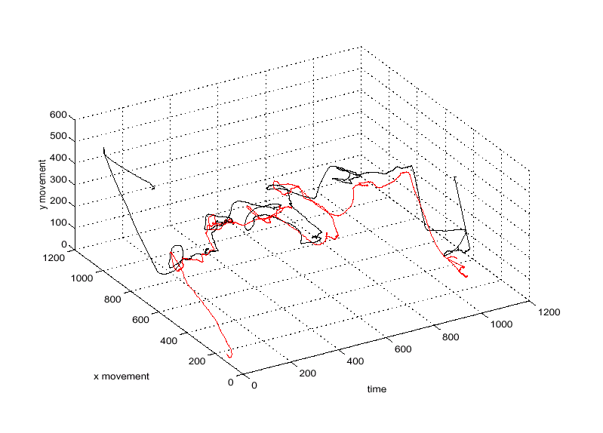
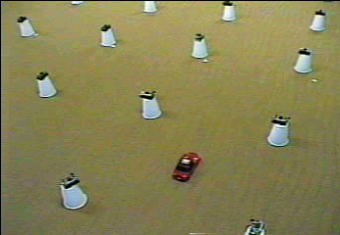
Trajectory Similarity Search
Habitat monitoring
  Animal migration patterns
Sign language detection
  Movement of fingers
Store surveillance video
  Customer movement patterns
Camera sensor network
  Each sensor can monitor
  the movement of objects
  within a small area
Song Lin University of California, Riverside

Slide 4
Distributed Similarity Search
The setting
  Monitoring area G with m objects moving inside
  G is segmented into n non-overlapping cells each having a camera sensor
  Each record of the trajectory is stored locally at the closest sensor
Problem
  Given a query trajectory Q, retrieve the top K trajectories which are most similar to Q.
Song Lin University of California, Riverside

Slide 5
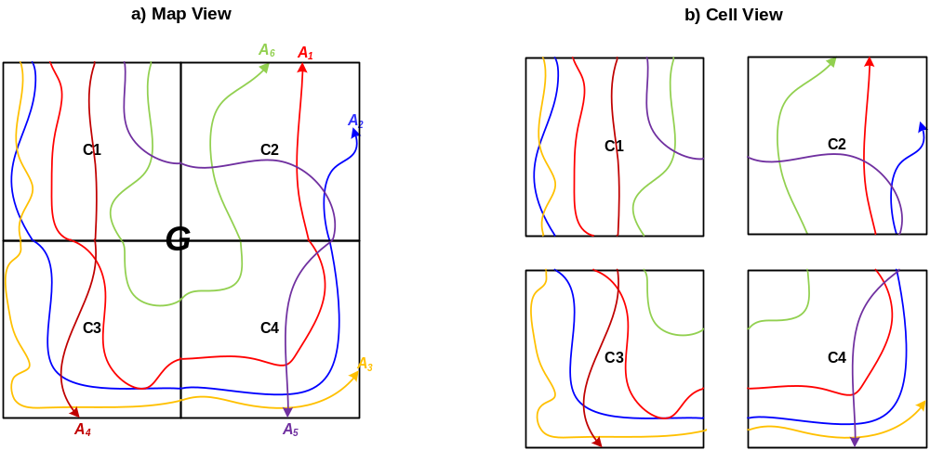
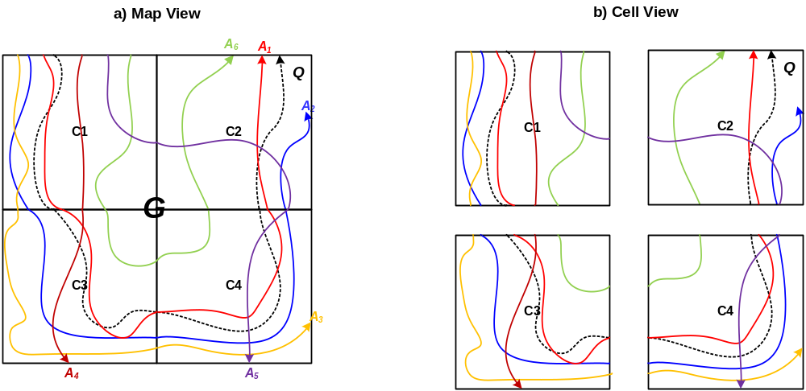
An example
Distributed top-K problem
  The trajectories of objects are distributed at different cells
  It is expensive to collect all the trajectories centrally.
Song Lin University of California, Riverside

Slide 6
Finding K most similar trajectories
We have to define what is similar
  We use well known similarity measures for trajectories
    Euclidean
    Dynamic Time Wrapping (DTW)
    Berndt D., Clifford J., “Using Dynamic Time Warping to Find Patterns in Time Series”, In KDD’94, Menlo Park, CA, pp. 229-248, 1994.
    Longest Common SubSequence (LCSS)
    Das G., Gunopulos D., Mannila H., “Finding Similar Time Series”, In PKDD’97, Trondheim, Norway, pp. 88-100, LNCS 1263, 1997.
We have to find the most similar trajectories
  We focus on LCSS, but the techniques work for DTW as well.
Song Lin University of California, Riverside

Slide 7
Similarity Measures
Euclidean Matching
A)
Dynamic Time Warping Matching
B)
Longest Common SubSequence Matching
C)
Courtesy of Dr. Eamonn Keogh
Song Lin University of California, Riverside
Song Lin University of California, Riverside

Slide 8
Longest Common Sub_Sequence
(LCSS)
Used in string matching problems
Captures out-of-phase matches, Captures outliers (ignore matching with outliers)
n
1
Out-of-phase Match
LCSS Figure: courtesy of Dr. Eamonn Keogh
Song Lin University of California, Riverside

Slide 9
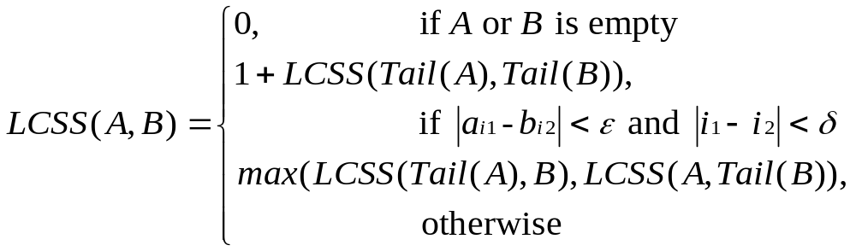
Longest Common Sub_Sequence
(LCSS)
LCSS can be computed in O(δ(l₁+l₂) ) by dynamic programming algorithm.
In general, it is expensive to compute this similarity exactly, so we can also compute the bounds of it.
Song Lin University of California, Riverside

Slide 10
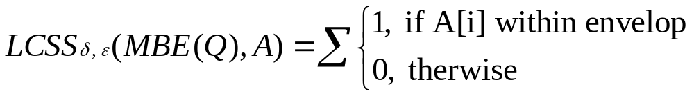
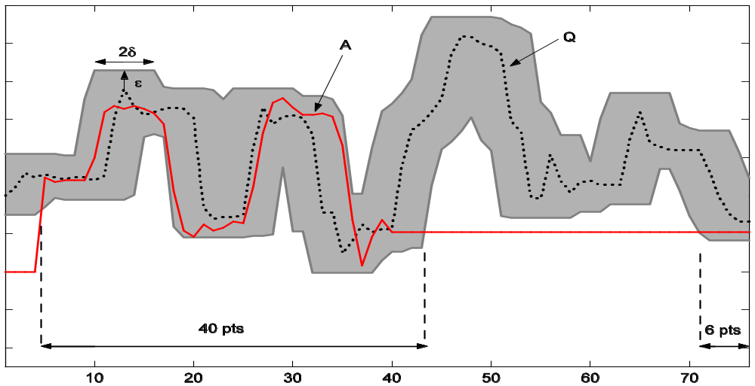
Centralized LCSS UpperBound
Song Lin University of California, Riverside

Slide 11
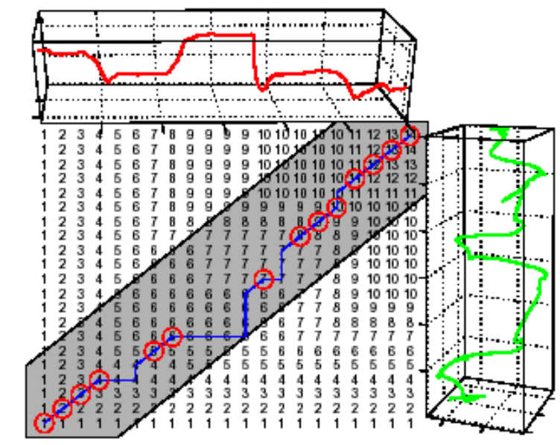
Problem with distributed computation of LCSS
In distributed setting, computing lCSS is difficult, because
  Sequential matching problem
  Matching may occur across cells
Cell 1
Cell 2
Cell 3
Cell 4
Song Lin University of California, Riverside

Slide 12
Our Solution
We compute lower bound and upper bound of the LCSS similarity distributively.
We develop new distributed top-K algorithms (UB-K, UBLB-K) that use these bounds to find the most similar trajectories.
Song Lin University of California, Riverside

Slide 13
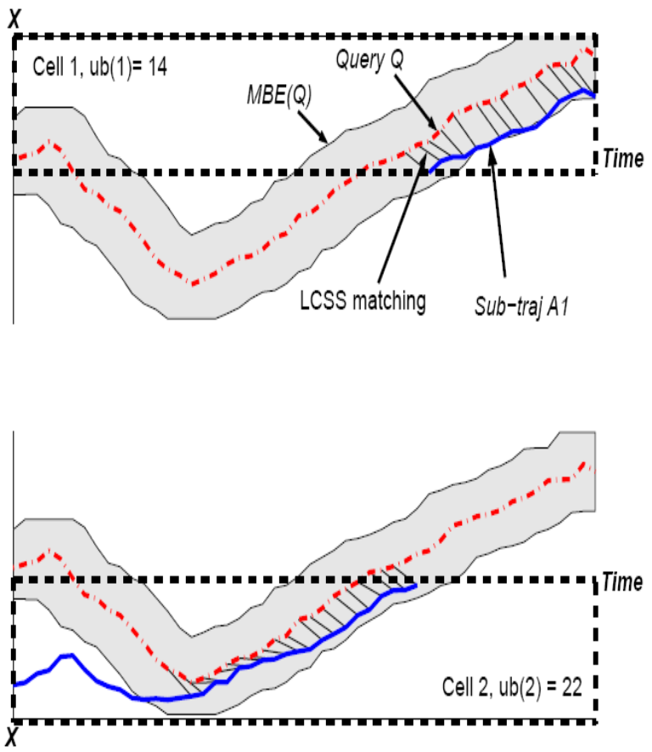
Distributed LCSS UpperBound
Each cell uses LCSS_{δ,ε}(MBE(Q), A_{ij})
to calculate the similarity of each
local sub_trajectory A_{ij} to MBE(Q)
Upper bound DUB_LCSS(Q,A_{i}) is
computed by adding the n local
results
Theorem 1
Song Lin University of California, Riverside

Slide 14
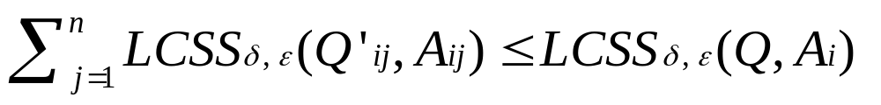
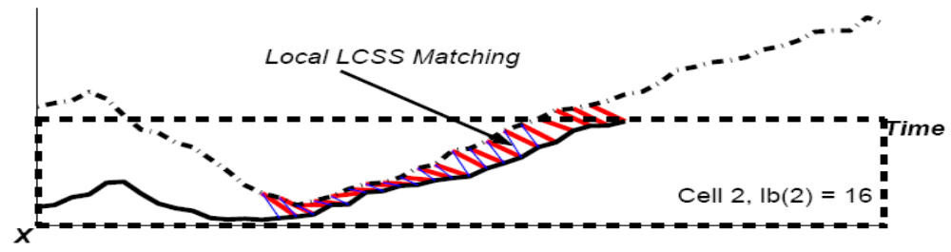
Distributed LCSS LowerBound
For each trajectory A_{i}, cell c_{j} finds the time region T_{ij} = {ts(p)|p in A_{ij}} when A_{i} stays in cell c_{j}. Filter Q into Q′_{ij} such that Q′_{ij} is in the same time intervals as A_{ij} , Q′_{ij} = {p|p in Q and ts(p) in T_{ij}}.
Each cell performs a local computation of LCSS_{δ,ε}(Q’_{ij}, A_{ij})
The lower bound DLB_LCSS(Q,A_{i}) is computed by adding the n local results
Theorem 2
Song Lin University of California, Riverside

Slide 15
Distribute top K algorithms
Threshold Algorithm (TA)
Fagin R., Lotem A. and Naor M., “Optimal Aggregation Algorithms For Middleware”, In PODS’01, Santa Barbara, CA, pp. 102-113, 2001.
Three-Phase Uniform Threshold (TPUT)
P. Cao and Z. Wang. Efficient Top-K Query Calculation in Distributed Networks. In PODC, Newfoundland, Canada, 2004.
Threshold Join Algorithm (TJA)
D. Zeinalipour-Yazti, Z. Vagena, D. Gunopulos, V. Kalogeraki, V. Tsotras, M. Vlachos, N. Koudas, D. Srivastava. The Threshold Join Algorithm for Top-k Queries in Distributed Sensor Networks. In DMSN,Trondheim, Norway, 2005.
Song Lin University of California, Riverside

Slide 16
Problem with existing approaches
Assume the exact partial scores are available
The exact scores at each cell can not be computed efficiently (recall that the matching may occur at the crossing cells)
We use upper (lower) bounds to perform distributed top-k computation (based on Theorem 1 and Theorem 2)
Song Lin University of California, Riverside

Slide 17
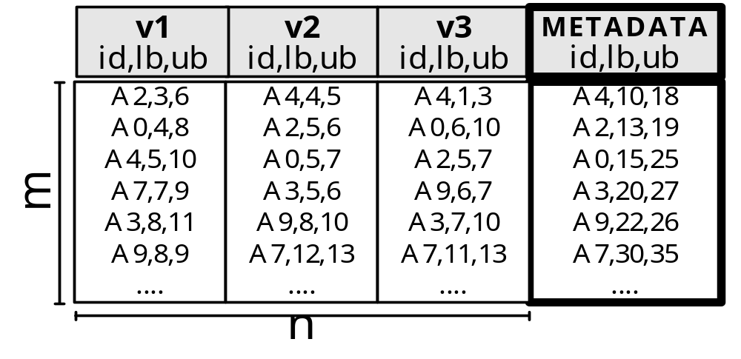
Distributed top-K computation with bounds
Now we have the Lower and Upper Bounds rather than Exact scores.
e.g. instead of sim(A0,Q)=20 it gives us [A0,15,25]
We propose UB-K and UBLB-K algorithms to compute the top-K results.
Song Lin University of California, Riverside

Slide 18
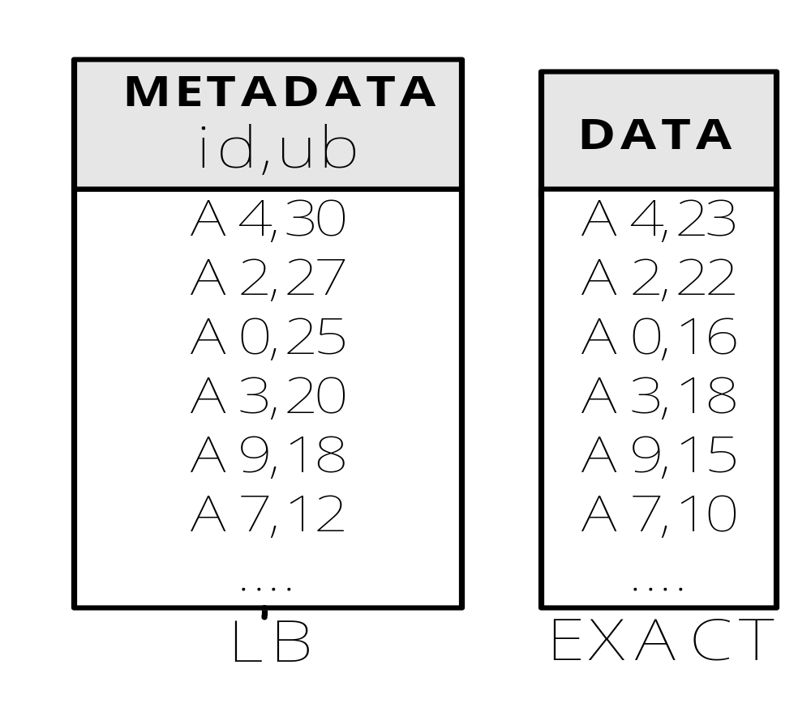
UB-K Algorithm
Query: Find the K=2 highest ranked answers
TJA
λ
λ+1
≥?
TJA
2λ
2λ+1
Why not stop at 25?
Because we might have another object X [UB:24, Real:23]
Song Lin University of California, Riverside

Slide 19
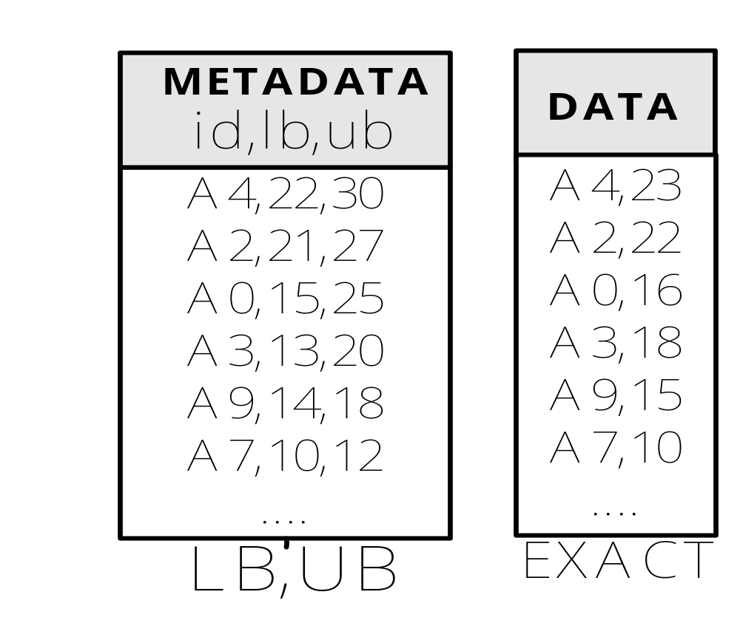
UBLB-K Algorithm
TJA
λ+1
≥?
TJA
2λ+1
Note: Kth highest LB is: 21
Therefore A3 (UB:20) and below are not necessary
Song Lin University of California, Riverside

Slide 20
UB-K vs. UBLB-K
Both fetch METADATA objects incrementally (αλ+1).
UB-K uses upper bounds, while UBLB-K uses both upper bounds and lower bounds
UB-K always fetches αλ+1 (α: step increment) DATA objects, while UBLB-K may fetch less DATA objects.
UB-K fetches DATA incrementally, while UBLB-K uses a final bulk DATA transfer.
Song Lin University of California, Riverside

Slide 21
Experimental Evaluation
Comparison system
  Centralized
  UB-K
  UBLB-K
Dataset
  25,000 trajectories generated over the Oldenburg street map, using the Network Based Generator of Moving Objects*.
* Brinkhoff T., “A Framework for Generating Network-Based Moving Objects”. In GeoInformatica,6(2), 2002.
Song Lin University of California, Riverside

Slide 22
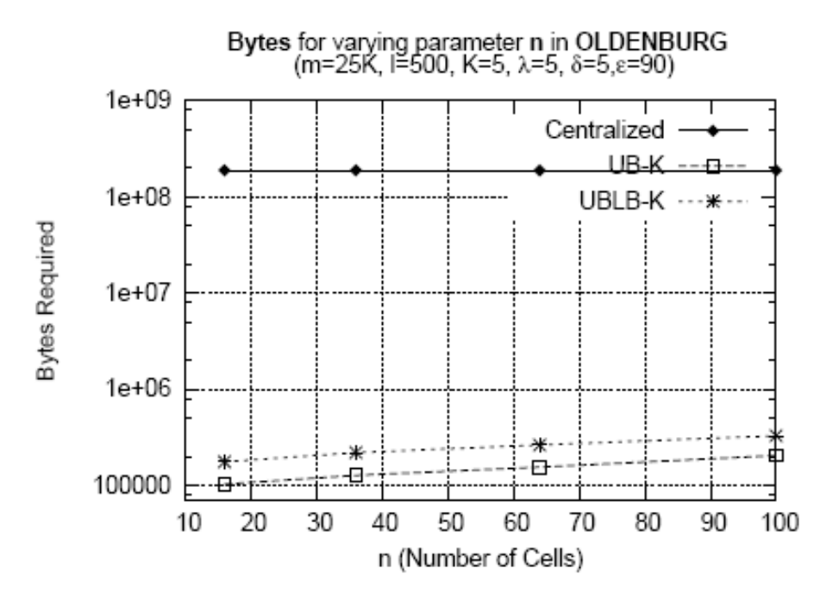
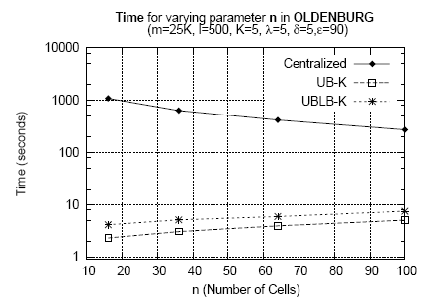
Performance Evaluation
Song Lin University of California, Riverside

Slide 23
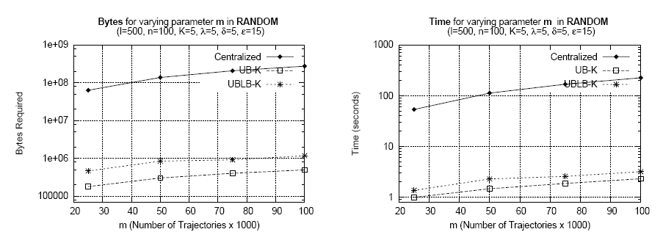
Scalability Evaluation
Song Lin University of California, Riverside

Slide 24
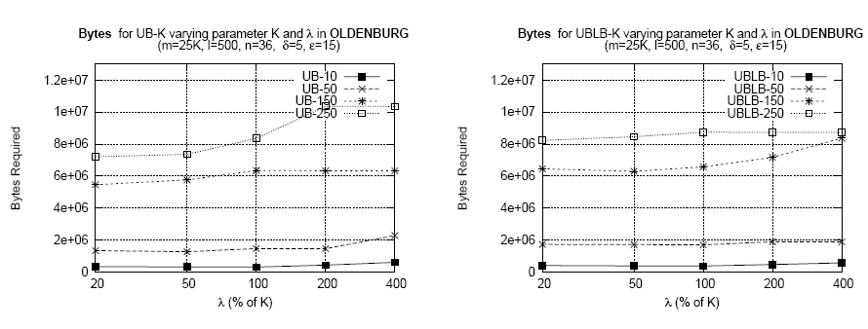
Varying K and λ
Song Lin University of California, Riverside

Slide 25
Summary
We described and analyzed well known similarity measures for trajectories
DUB_LCSS and DLB_LCSS for bounding similarity of two trajectories distributively
UB-K and UBLB-K to find K most similar trajectories
Easily extended for DTW and other similarity measures
Song Lin University of California, Riverside

Slide 26
Distributed Spatio-Temporal
Similarity Search
Demetrios Zeinalipour-Yazti dzeina@cs.ucy.ac.cy
University of Cyprus
Song Lin slin@cs.ucr.edu
University of California - Riverside
Dimitrios Gunopulos dg@cs.ucr.edu
University of California - Riverside
http://www.cs.ucr.edu/~slin
ICDE 2006
Song Lin University of California, Riverside

