Slide 1
“The Threshold Join Algorithm for Top-K Queries in Distributed Sensor Networks”
D. Zeinalipour-Yazti, Z. Vagena, D. Gunopulos, V. Kalogeraki, V. Tsotras
(University of California – Riverside)
M. Vlachos
IBM T.J. Watson
N. Koudas
University of Toronto
D. Srivastava
AT&T Research
DMSN 2005
2nd International VLDB Workshop on Data Management for Sensor Networks August 29, 2005, Trondheim, Norway

Slide 2
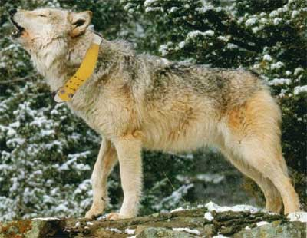
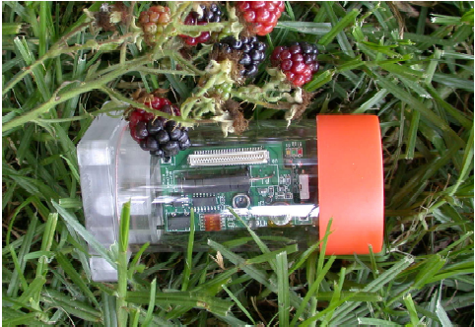

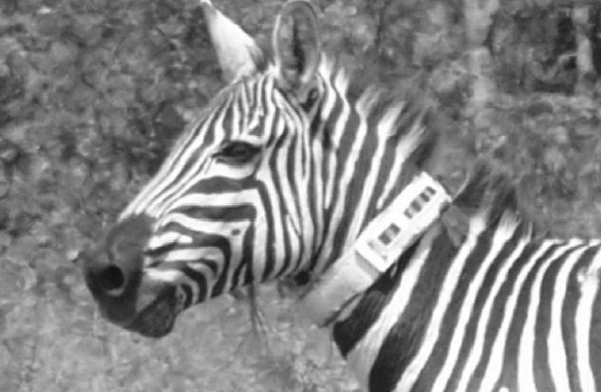
The Ubiquitous Silicon Era
Applications:
  Environmental and habitant monitoring
  Seismic and Structural monitoring, ….
Effect:
  Sense the environment at very high resolutions.
Is this just the beginning?
Wildlife Tracking: GPS Collars
Environmental Monitoring
Structural Monitoring
Notes:
Advancements in networks and multimedia

Slide 3
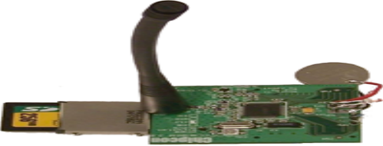
New Challenges
Frameworks such as TinyDB and Cougar:
  - Provide a declarative SQL-like approach for accessing data.
  - Are suitable for continuous queries.
  - Push aggregation in the network but keep much of the processing at the sink.
New Challenges: Efficient Query Processing Algorithms that exploit the Hierarchical Structure of Sensor Networks
Also…
  - Many applications do not require the query to be evaluated continuously (e.g. Average temperature in the last 6 months?).
  - Local Storage in the future might increase e.g. the Riverside Sensor (RISE) features an external SDMedia card (up to 4GB!)
Notes:
Advancements in networks and multimedia

Slide 4
Presentation Outline
Introduction: Distributed Top-K Query Processing in Sensor Networks (D-TOPK)
Current Solutions for D-TOPK.
    The Centralized Join Algorithm (CJA).
    The Staged Join Algorithm (SJA).
The Threshold Join Algorithm (TJA)
Experimental Evaluation.
Related Work.
    Threshold Algorithm / Fagin Algorithm
    The TPUT Algorithm
Conclusions & Future Work.

Slide 5
Distributed Top-K Query Processing
TOP-k Query Objectives:
To find the k highest ranked answers to a user defined similarity (scoring) function.
Minimize some cost metric associated with the retrieval of the correct answers (e.g. I/Os, network traffic).
Cost Metric in a Sensor Environment?
➔ The Utilization of the Communication Medium.
(The energy consumption of sending 1 byte ≈ 1120 CPU instructions) Source: The RISE (Riverside Sensor) (NetDB’05, IPSN’05 Demo, SECON’05)
For the remainder of the presentation: Assume that the query is disseminated using some query dissemination mechanism, e.g. flooding, directed antennas, etc.
Notes:
Advancements in networks and multimedia

Slide 6

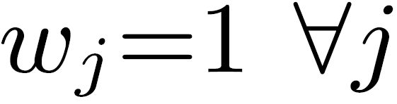
Distributed Top-K Query Processing
Problem Formulation
Consider n sensors S={s₁,s₂,…,s_{n}} each of which maintains a sliding window of m {o₁,o₂,…,o_{m}} readings. Note: o_{ij} denotes the ith reading of the jth sensor.
Also consider Q = {q₁,q₂,…,q_{n}} , an n-dimensional top-k query (the jth attribute in Q refers to jth sensor in S).
Objective: Find the K objects with the maximum value in:
  w_{j} : Sensor Weight. The readings of some sensors might be more important than other sensors (for this presentation )
  Sim(q_{j} , o_{jj}) : A monotone Similarity Function.
Notes:
Advancements in networks and multimedia

Slide 7
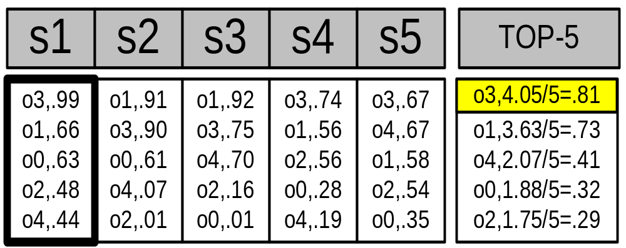
Distributed Top-K Query Processing
Problem Example
Assume that we have n=5 sensor each of maintains locally a sliding window of m=5 readings. (See table)
TOP-1 Query: “On which timestamp did we have the highest temperature across all sensors?”
Note: Score(o_{i}) can only be calculated if we combine the readings from all 5 sensor.
Local score
Complete
Timestamp
{
Score
m
list_{s1}
n
Notes:
Advancements in networks and multimedia

Slide 8
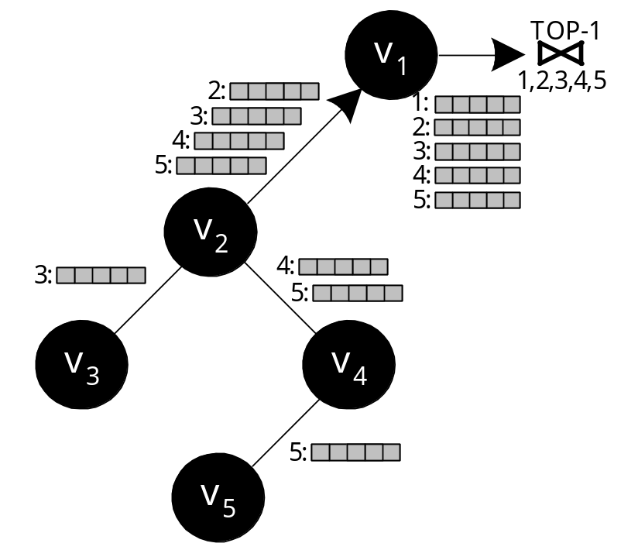
Naïve Solution: Centralized Join (CJA)
Each Node sends all its local scores (list)
Each intermediate node forwards all received lists
Similar to the Technique deployed in File-sharing systems (Gnutella)
Drawbacks
  Overwhelming amount of messages.
  Huge Query Response Time
Notes:
I.R: Bulit a system that retrieves documents that users are likely to find relevant

Slide 9
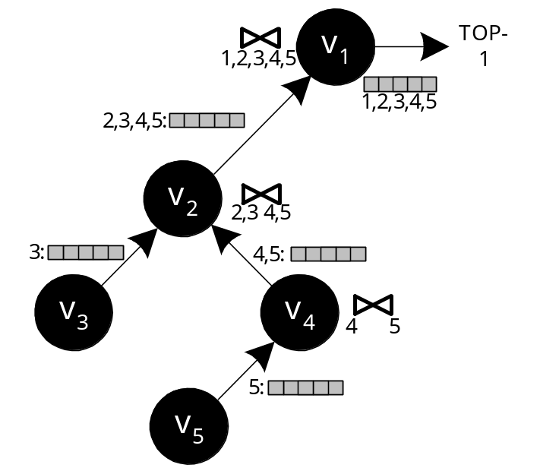
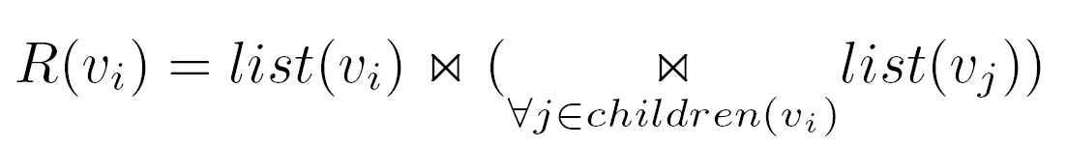

Improved Solution: Staged Join (SJA)
Aggregate results before these are forwarded to the parent using:
This is essentially the TAG approach (Madden et al. OSDI '02)
Advantage: Only (n-1) messages instead of:
Drawback: Still sending everything!
δ(u_{ι}) = depth of uι from sink
m = number of objects
Notes:
I.R: Bulit a system that retrieves documents that users are likely to find relevant

Slide 10
Threshold Join Algorithm (TJA)
Why send all objects from all lists ?
TJA is our 3-phase algorithm that minimizes the number of transmitted objects and hence the utilization of the communication channel.
How does it work:
  LB Phase: We probe the sensors in the network and create a set of objects that identify a threshold τ .
  HJ Phase: The sink retrieves from each sensor the objects that are above the threshold τ. The rest objects are eliminated at this point and are not transmitted to the sink.
  CL Phase: If at the end we have not identified the complete score of the K highest rank objects, we perform a cleanup phase to identify the complete score of all incompletely calculated scores.
Notes:
I.R: Bulit a system that retrieves documents that users are likely to find relevant

Slide 11
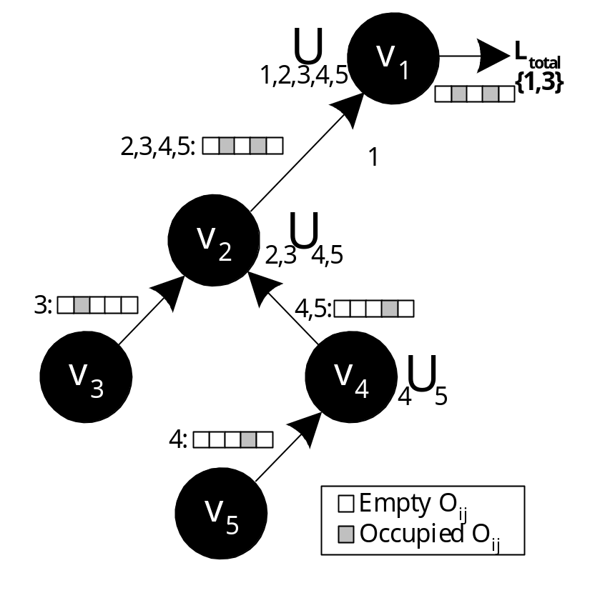




Step 1 - LB (Lower Bound) Phase
Each leaf node sends its top-k results to its parent.
Each intermediate node performs a union of all received lists (denoted
as L(root)):
Notes:
I.R: Bulit a system that retrieves documents that users are likely to find relevant

Slide 12

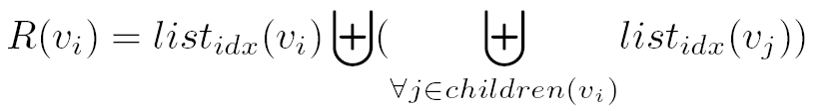
Step 2 – HJ (Hierarchical Join) Phase
Disseminate L(root) to all nodes
Each node uses L(root) to define the local threshold (idx) as: All objects with score above the minimum score in L(root).
Before sending the objects, each node performs a fullouterjoin of children results.
All non-joining objects are marked as incomplete and their score is set using an upper bound estimation
Notes:
I.R: Bulit a system that retrieves documents that users are likely to find relevant

Slide 13
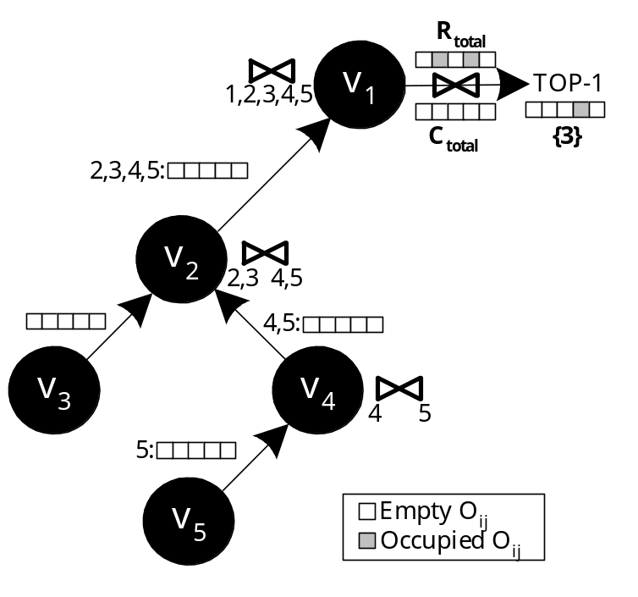
Step 3 – CL (Cleanup) Phase
The querying node now has a list of objects with complete and incomplete scores (upper bound estimations)
Find the complete score for each incomplete object (all in a single batch phase)
CL ensures correctness
In a real setting it is rarely required.
Notes:
I.R: Bulit a system that retrieves documents that users are likely to find relevant

Slide 14
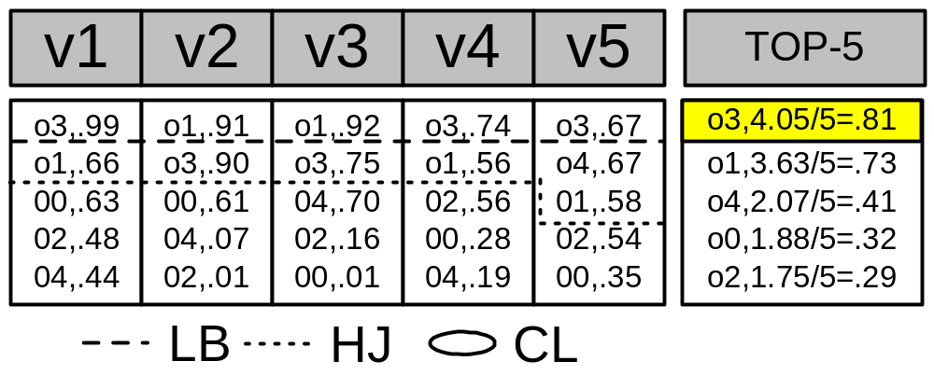
TJA: Example
Notes:
I.R: Bulit a system that retrieves documents that users are likely to find relevant

Slide 15
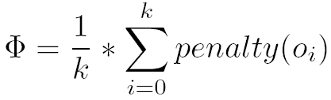
Experimental Evaluation
Dataset: 32 atmospheric monitoring stations in Washington
- Measurements between June 2003-June 2004
http://www-k12.atmos.washington.edu/k12/grayskies/.
Query: “K timestamp on which average temperature across all sensors was maximum”
Network: - Random Graph with degree=4 and degree=10.
- We construct a Query Spanning Tree using Flooding
Messages: - 23 byte header (includes TTL, messageID, etc)
- Object = 8 bytes (4B timestamp, 4B value)
Evaluation Criteria:
i) Bytes Transferred, ii) Time Required, iii) Messages
iv) Result Quality under failures (Average Error Φ)
[ penalty(o_{i}) = realrank(o_{i}) – rank(o_{i}) ]
Notes:
I.R: Bulit a system that retrieves documents that users are likely to find relevant

Slide 16
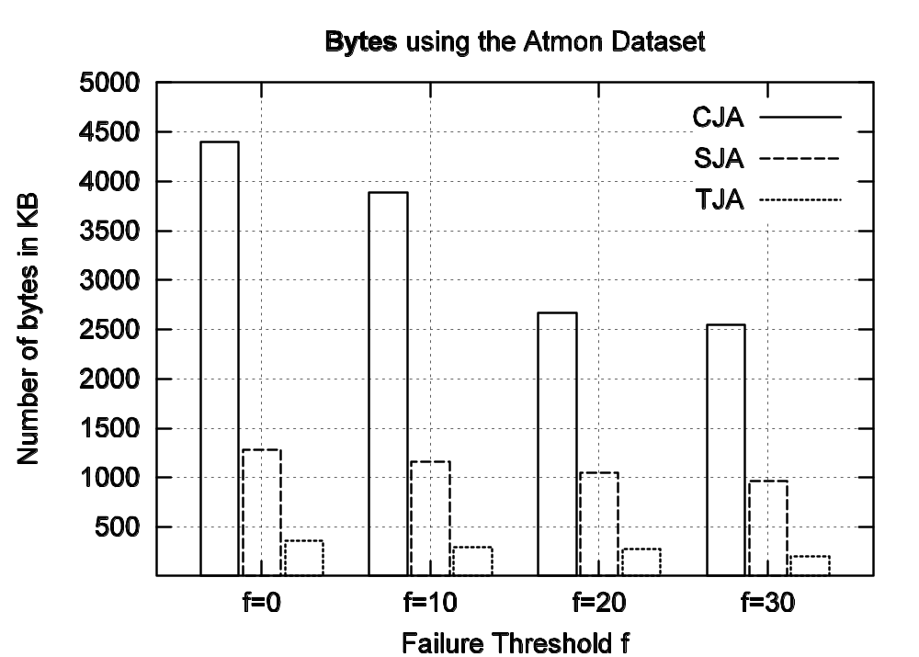
Experimental Results
Notes:
I.R: Bulit a system that retrieves documents that users are likely to find relevant

Slide 17
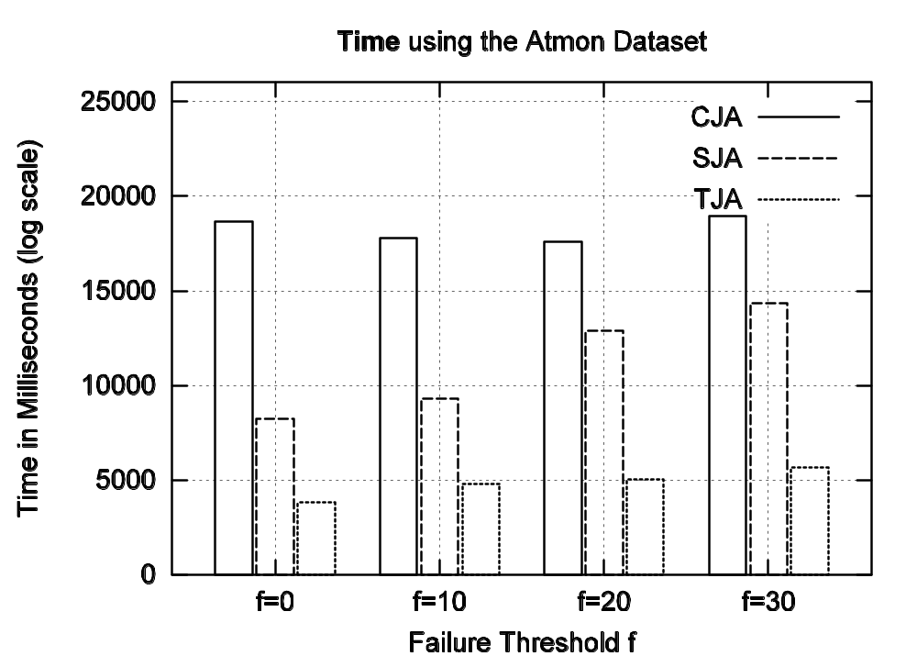
Experimental Results
Notes:
I.R: Bulit a system that retrieves documents that users are likely to find relevant

Slide 18
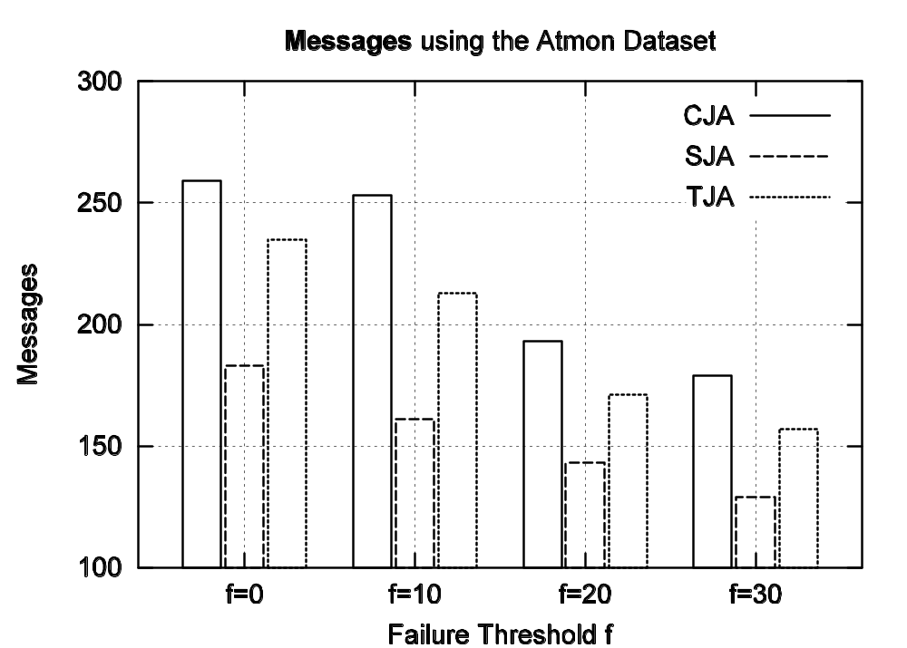
Experimental Results
Notes:
I.R: Bulit a system that retrieves documents that users are likely to find relevant

Slide 19
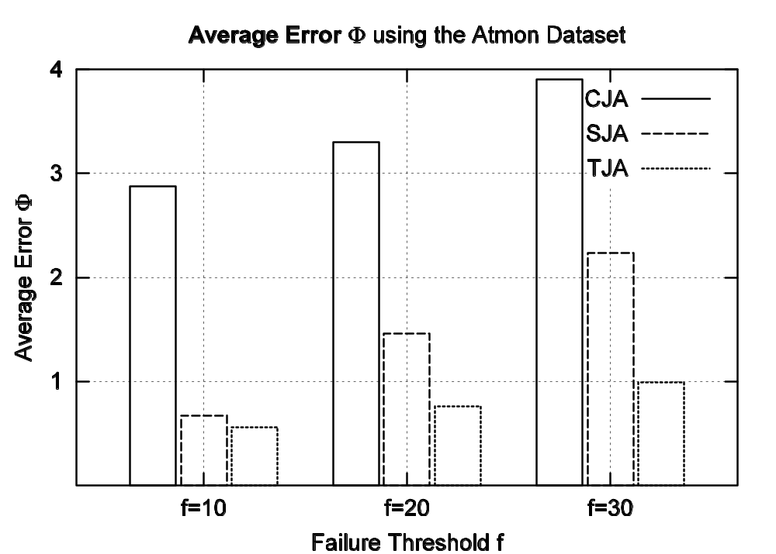
Experimental Results
Notes:
I.R: Bulit a system that retrieves documents that users are likely to find relevant

Slide 20

Related Work
Fagin’s/Threshold Algorithm (FA,TA):
Long studied and well understood.
ΤΑ Algorithm
1) Access the n lists in parallel.
2) While some object o_{i} is seen, perform a random access to the other lists to find the complete score for o_{i}
3) After finding the complete score for each object in the current row compute the threshold τ as the sum of all complete scores in the current row.
4)The algorithm stops after K objects have been found with a score above τ.
Why not TA/FA in a Distributed Environment?
They require an undefined number of round-trips (phases) => too expensive
TJA Advantages
- TJA uses only three phases => Also more in-network aggregation
- TJA organizes the individual random accesses in one final Clean-up phase.
Notes:
I.R: Bulit a system that retrieves documents that users are likely to find relevant

Slide 21
Related Work
The TPUT Algorithm (Cao et al, PODC’05)
(developed concurrently with TJA for a client/server
environment – was also published earlier ☹)
TPUT (Three Phase Uniform Threshold) Algorithm
Fetch K first entries from all n lists (same with TJA). Define threshold τ as
τ = (Kth lowest partial score / n).
τ (the uniform threshold) is then disseminated to all nodes.
2) Each node sends any pair which has a score above τ.
3) If we could find the complete score for less than K objects then we perform a random access for all incomplete objects (in a single batch phase - same with TJA)
Drawback?
- The threshold is uniform for all lists – too coarse.
- Example follows…
Notes:
I.R: Bulit a system that retrieves documents that users are likely to find relevant

Slide 22
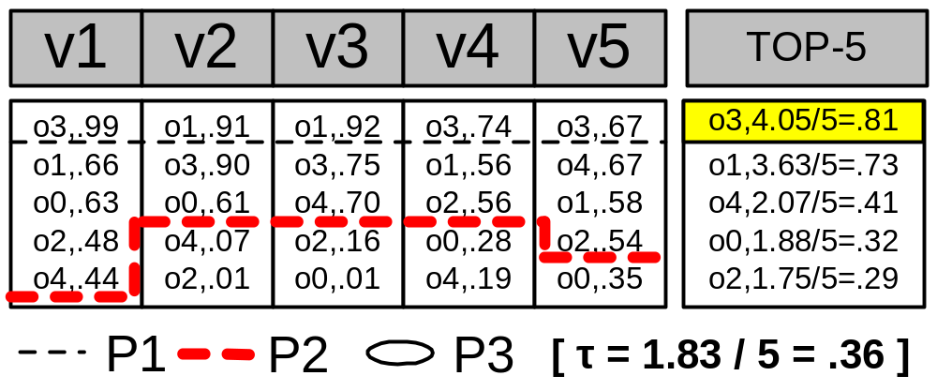
Related Work
TPUT Example
Notes:
I.R: Bulit a system that retrieves documents that users are likely to find relevant

Slide 23
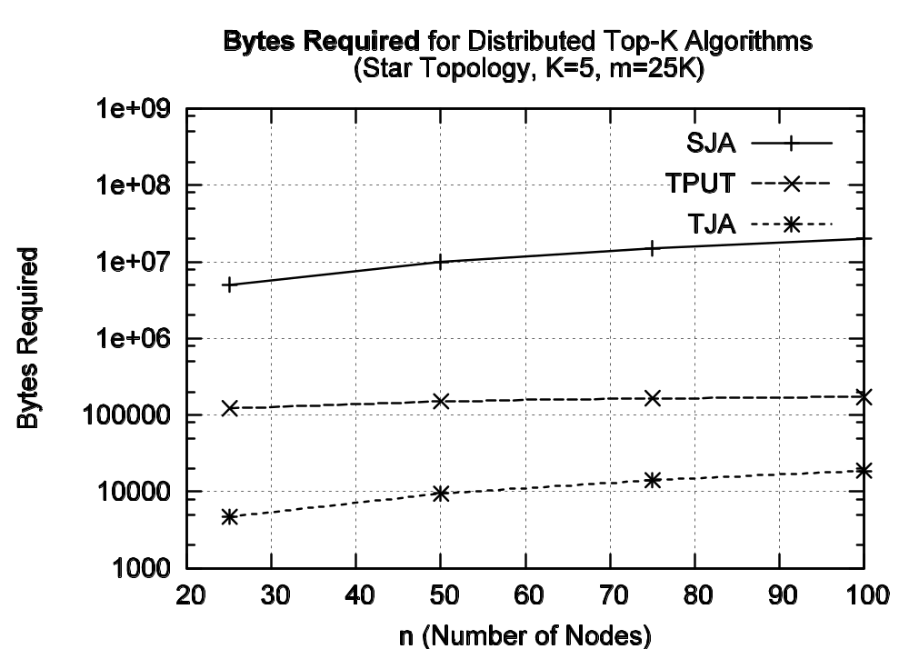
TJA vs. TPUT
Notes:
I.R: Bulit a system that retrieves documents that users are likely to find relevant

Slide 24
Conclusions & Future Work
TJA resolves top-k queries with an order of magnitude less network bytes, time and than its competitors.
We expect that TJA Algorithm will be a useful component for query processing engines of sensor data management systems.
In the future we will deploy our under development prototype in nesC over the RISE Sensor.
Notes:
I.R: Bulit a system that retrieves documents that users are likely to find relevant

Slide 25
“The Threshold Join Algorithm for Top-K Queries in Distributed Sensor Networks”
Thank You!
D. Zeinalipour-Yazti, Z. Vagena, D. Gunopulos, V. Kalogeraki, V. Tsotras
(University of California – Riverside)
M. Vlachos
IBM T.J. Watson
N. Koudas
University of Toronto
D. Srivastava
AT&T Research
DMSN 2005
2nd International VLDB Workshop on Data Management for Sensor Networks August 29, 2005, Trondheim, Norway

