Slide 1


Towards a Network-aware Middleware for Wireless Sensor Networks
The 8th International Workshop on Data Management for Sensor Networks, in conjunction with VLDB 2011, August 29, 2011, The Westin Hotel, Seattle, WA, USA
Panayiotis G. Andreou, Demetrios Zeinalipour-Yazti, George Samaras and Panos K. Chrysanthis
Presenter: Panickos Neophytou
University of Cyprus
Department of
Computer Science
University of Pittsburgh
Department of
Computer Science
Notes:
I’ll talk about a wireless sensor network middleware framework that reduces energy consumption, provides support for complex queries, and reduces the amount of communication

Slide 2
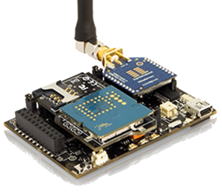
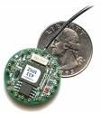
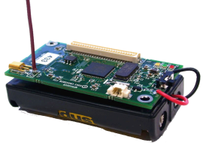
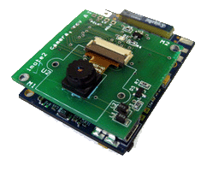
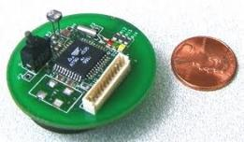
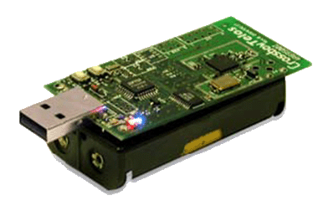
Wireless Sensor Networks (WSNs)
Wireless Sensor Device (WSD) evolution
WEC
MICADOT
MICA2
TELOS
IMOTE2
WASPmote
1998
2000
2002
2004
2008
2010
Characteristics of WSDs
+ Low cost
+ Low power
+ On-the-fly programming
- Limited energy
- Limited CPU
- Limited memory
- Prone to failures
We need energy-efficient algorithms for sensor operations (e.g., data acquisition)
Notes:
WSNS are composed of resource constraint devices, called sensors, and are utilized by numerous applications for monitoring and understanding the physical world.
Typically, these devices are not expensive, ranging from 10$-150$, they use low-power components and support on the fly programming which enables application designers to update their applications after the WSN has been deployed.
However, they also feature a number of disadvantages with the most important being their limited energy as they are typically powered by 2 AA batteries, they have limited possessing speed and memory and are very prone to failures.
As a result there is a need for developing energy efficient algorithms for any sensor operation and especially for data acquisition which is one of the most important ones.

Slide 3
KSpot+ Goals
Addresses 3 problems in an integrated fashion:
Data Transmission Inefficiencies
Bottlenecks inside the routing tree.
Energy-driven Tree Construction.
Data Reception Inefficiencies
When should a node be listening for data?
Workload-aware routing.
Lack of support for complex Top-K queries.
Design Goals: Distributed and Autonomous Behavior, Modularity, Scalability, Resilience in the presence of failures

Slide 4
Related Work
Middleware Approach | Key Features | Energy-aware | Workload Optimization | Topology Optimization | Complex Queries
Data-centric
TinyDB [SIGMOD’03] | SQL syntax, lifetime/event-based queries, In-network aggregation | Y | Y | N | N
Cougar [SIGMOD’02] | SQL-syntax, Virtual relational db, centralized optimizer | Y | Y | N | N
SNEE [ICDE’08] | rich, expressive language, scheduling of different workloads | Y | Y | N | N
DSWare [DSO’03] | SQL-syntax, real-time semantics, event detection | Y | N | N | N
SINA [Percom’01] | Virtual spreadsheet database, Attributed -based naming, Hierarchical Clustering | Y | N | N | N
Application-driven
Milan [Network’04] | Topology adaptation | Y | N | Y | N
MidFusion [FUSION’08] | Information fusion, sensor agents | Y | N | N | N
Virtual Machine-based
Mate [SIGOPS’02] | Byte code interpreter, OTAP, code capsules | Y | N | N | N
MagnetOS [SIGOPS’02] | Java VM, OTAP, Single System Image | Y | Y | N | N
Publish-Subscribe
Mires [PUC’05] | Aggregation service, high-level interfaces | Y | N | N | N
Aware [SSRR’07] | WSN and UAV coordination | Y | Y | N | N
Agent-based
Impala [SIGPLAN’03] | Adaptivity,reparability,OTAP, single executing application | Y | Y | N | N
Agilla [TAAS’09] | Self-adaptation, tuple-space abstraction, location addressing | Y | Y | N | N
KSpot⁺ | SQL-syntax, top-k, materialized views, topology/workload-aware, logical groups | Y | Y | Y | Y

Slide 5
Presentation Outline
Introduction
Motivation
The KSpot+ Framework
KSpot+ Architecture
Workload Balancing Module
Tree Balancing Module
Query Processing Module
Experimental Evaluation
Conclusions
Future Work
Notes:
Now, we present our KSpot+ framework, its main components and their algorithmic foundations.

Slide 6
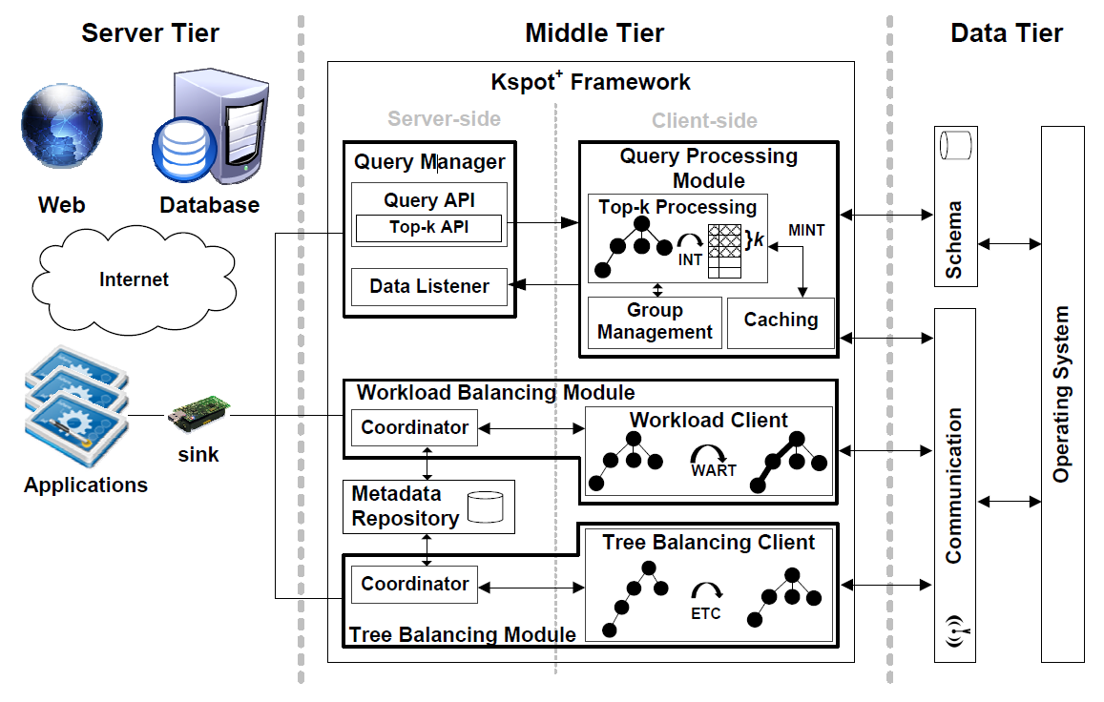
KSpot⁺ Framework Architecture Design
W
T
Q
Notes:
The KSpot⁺ Framework Architecture Design is depicted on this slide.
It resides on the middle tier between the server and the data tier and consists of server and client side components.
Applications can send queries or balancing requests through the sink station to the appropriate components.
The Query manager translates SQL-like queries through the query API (or in the case of Top-k queries) through the Top-k Query API and sends them to the Query Processing Module.
Depending on the query the Query Processing module may utilize the group management or caching components.
Balancing requests are send to the Workload or the Tree Balancing Modules.
Both utilize coordinator components that store global information about the sensor network, like the optimal branching factor or the critical path value that I will explain later.
The requests are then forwarded to the respective modules for client-side processing.
We utilize the following TAGs in the remaining presentation to easily pinpoint on which module we are referring to.

Slide 7
System Technical Characteristics
Testbed Characteristics
Language (OS):
Client-side: nesC (TinyOS)
Server-side: JAVA
Sensor Device: Crossbow’s TelosB
Queries: Continuous, Single-tuple (ST), Multi-tuple Fixed Size (MTF), Multi-tuple Arbitrary Size (MTA), Group-By
Energy Modeling: PowerTOSSIM
Network Link Modeling: TinyOS LossyBuilder
Notes:
Our testbed has the following characteristics.
As we mentioned earlier, the client side components are implemented in nesC and the server-side in JAVA
We utilize the energy model of the TelosB Sensor Device
We perform experiments using Real and Realistic Datasets of various sizes
Our Queries are Continuous and we include three types: the Single-tuple (ST), which return a single result, the Multi-tuple Fixed Size (MTF), which return multiple tuples of fixed size and the Multi-tuple Arbitrary Size (MTA), which return multiple tuples of arbitrary size
Our energy modeling is performed using PowerTOSSIM which is a popular power modelling tool for TOSSIM the TinyOS simulator.
Finally, in order to build multihop topologies and introduce lossy scenarios we use the TinyOS LossyBuilder

Slide 8
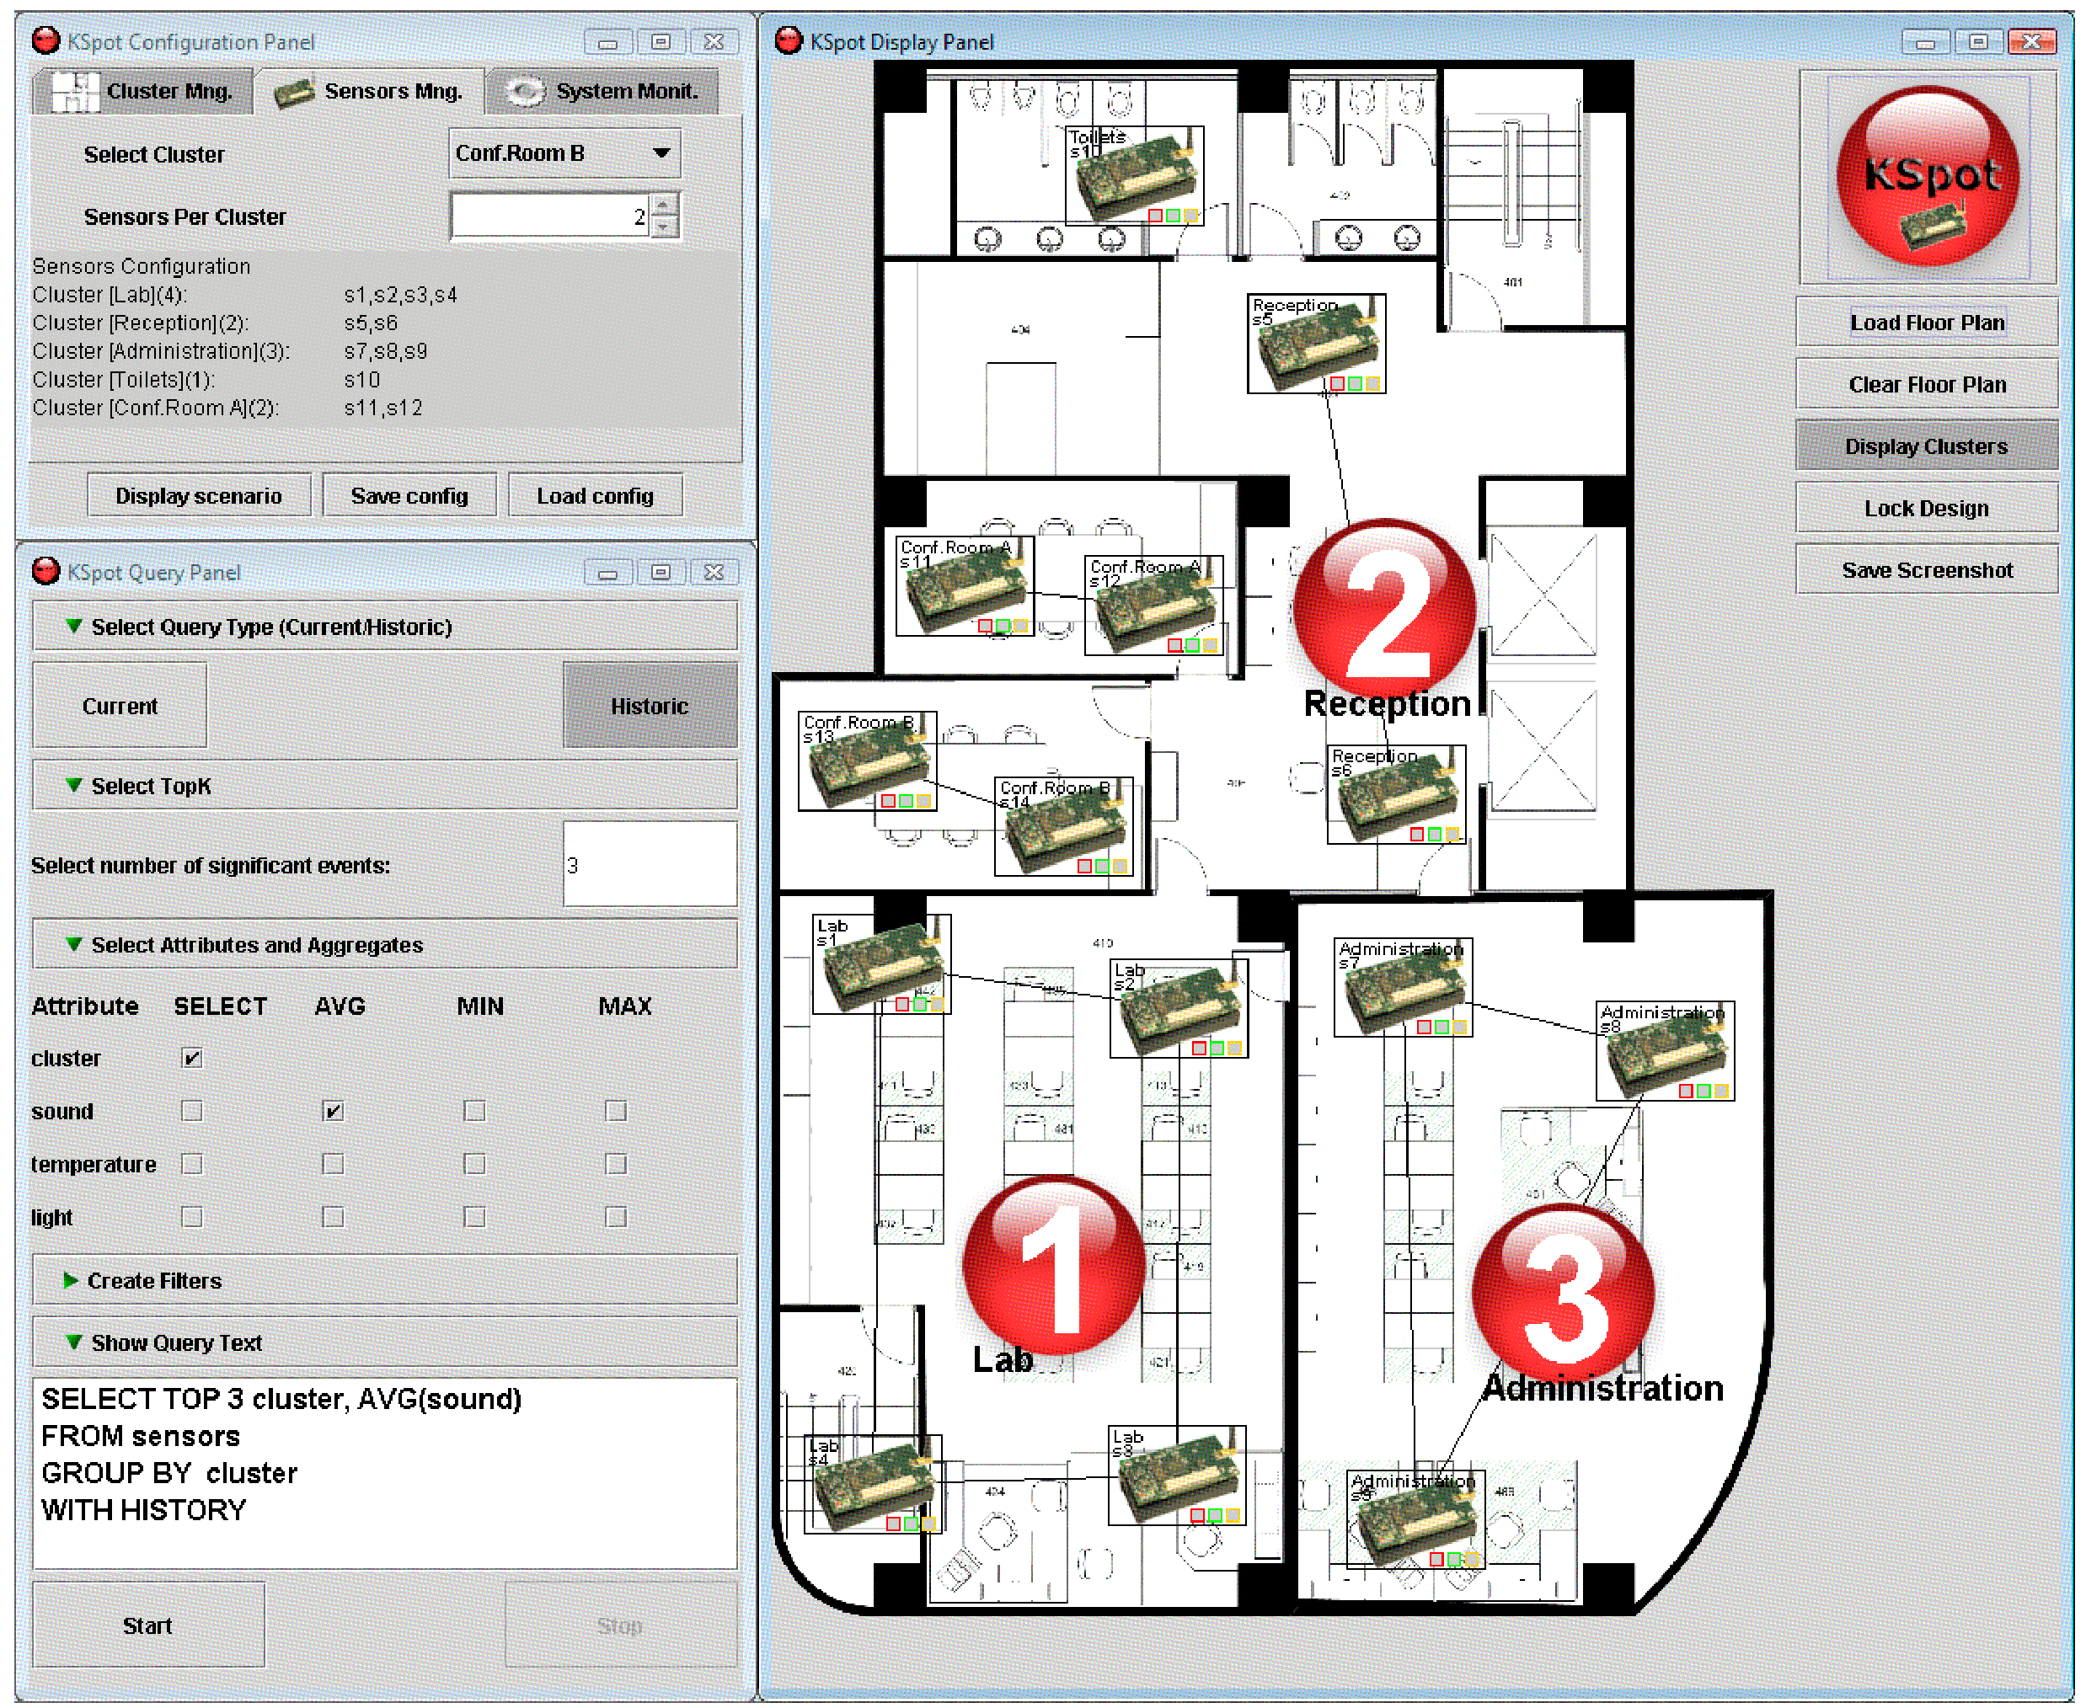
KSpot⁺ Proof of Concept Application
Configuration Panel
Display Panel
Continuous ranking of top-k results
Query Panel
Publicly available at http://www.cs.ucy.ac.cy/~panic/kspot/
Notes:
In order to experimentally validate our framework, we have created a prototype implementation of KSpot+ in JAVA for the
server-side components and nesC for the client-side components.
The interface we’ve created allows us to visually display the sensors in rooms and send queries to the network using the Query Panel.
Finally, we visualize continuous ranking of the top-k results using these bullets.
The framework is publicly available for other researchers to download and experiment on.

Slide 9
KSpot⁺ - Workload Balancing Module
(DMSN’07-
MDM’08)
W
Objective: Dynamically adapt sensor waking windows τ to minimize the time the transceiver is turned on.
Utilizes the Workload-Aware Routing Tree (WART) algorithm, which:
Profiles recent data acquisition
Schedules τ using an in-network execution of the Critical Path Method (CPM)
WART phases:
Recursively compute the critical path value of the network Ψ
Disseminate Ψ to the network and adjust τ locally
Adjust τ according to workload changes
Notes:
Now we present the three major components of KSpot in details.
Firstly, the Workload Balancing module, whose objective is to Dynamically adapt sensor waking windows τ to minimize the time the transceiver is turned on.
It utilizes the WART algorithm, which:
Profiles recent data acquisition
Schedules τ using an in-network execution of the Critical Path Method (CPM)
WART has three phases:
To Recursively compute the critical path value of the network Ψ
To Disseminate Ψ to the network and adjust τ locally
To Adjust τ according to workload changes
I will explain WART’s phases in more detail in the next slides.

Slide 10
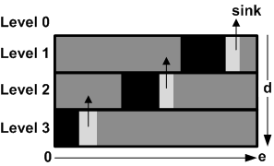
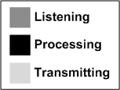
Query Tree Construction
W
Query Routing Trees (Ƭ) are typically constructed in an ad hoc manner (First-Heard-From).
This presents two major sources of inefficiencies:
Data Reception Inefficiencies
Ƭ structures do not define the data reception/transmission
window (τ) of a sensing device. In many cases τ is an
over-estimate that leads to significant energy waste.
Naïve approach: Leave the transceiver ON
sink
Level 0
Level 1
Level 2
Level 3
Naive
Problem 1: Unsynchronized Ƭ structures increase energy consumption and hamper network longevity
Notes:
Since Query Routing trees are constructed in the ad hoc they usually present two major sources of inefficiencies.
The first one is data reception inefficiencies, which occurs because sensor nodes are not assigned a specific time interval in which they power on their transceiver, receive results and then transmit the results to their parents.
In many cases this is an overestimate that leads to significant energy waste.
Let’s take for example this query routing tree. It has 3 levels of 7 sensors. A naïve approach to route data back to the sink will be to continuously leave the transceiver on. However, as we can see in the highlighted sections, the sensors could have powered down the transceiver during these time periods without affecting the operation of the tree.
So, the first problem we have identified is that Unsynchronized Query Routing Trees increase energy consumption and hamper network longevity

Slide 11
WART: Construction Phase
W
Find the Critical Path value Ψ of the network
s₂
Ψ=Max(13+11, 15, 22+20)=42
11 is the workload
e.g., number of
tuples
s₁
s₅
22
13
15
Max=11
s₂
s₃
s₄
Max=20
11
7
20
s₅
s₆
s₇
Notes:
The construction phase aims to find the critical path value of the network.
In simple terms, the critical path value is the branch of the tree who has the maximum cumulative workload of all sensors.
Let us assume that each sensor has some workload value (for example s5 has a workload value of 11)
11 can be the number of tuples that s5 transmits at each epoch or the number of packets.
Leaf nodes start by sending their results to the parents.
Each parent calculates the maximum workload value of their child nodes and transmits it to its parent.
This procedures is executed recursively until the sink node calculates the critical path value.

Slide 12
WART: Dissemination Phase
W
Disseminate the Critical Path value Ψ=42 to all nodes
s₁
42
42
42
Local waking
window adjustment
42
13
22
15
[29..42)
s₂
s₃
s₄
[27..42)
[20..42)
29
29
20
11
7
20
s₅
s₆
s₇
[18..29)
[22..29)
[0..20)
Notes:
In the dissemination phase, the sink node transmits the critical path value to its child sensor nodes until they all tune their waking windows accordingly.
Sensors receiving the critical path value, subtract their workload value and then forward the new critical path value to their child nodes.
For example, s2 received the critical path value, 42 and subtracted its own workload value, 13.
Therefore its waking window is from time 29 to time 42.
It then transmitted the new critical path value 29 to its child sensors s5 and s6 who in turn perform their own local arrangements.

Slide 13
KSpot⁺ - Tree Balancing Module (SeNTIE’09)
T
Objective: identify structural inefficiencies and attempt to remove them by reconstructing the query routing tree.
Utilizes the Energy-driven Tree Construction (ETC) algorithm, which:
Identifies bottlenecks in the query routing tree
Rearrange query routing tree in a distributed manner
ETC phases:
Discover optimal branching factor β
Disseminate β to the network and reassign parents recursively
Notes:
We now move on to the Tree Balancing module, whose objective is to identify structural inefficiencies and attempt to remove them by reconstructing the query routing tree.

Slide 14
ETC: Tree reConstruction Example
T
Discovery: Find the Optimal Branching Factor β
Depth=2, Nodes=10 ➔ β = ^{d}√n = ⌊ ²√10 ⌋ = ⌊ 3,16 ⌋ = 3
2. Balancing: Disseminate β and reassign parents
Reconstruction changes
the workload. ETC precedes
WART
s₁
Children(s₁)=3 ≤ β
➔ΟΚ
13
41
30
21
12
Children(s₂)=5 > β
➔FIX
d=2
s₂
s₃
s₄
11
4
7
2
29
3
s₅
s₆
s₇
s₈
s₉
s₁₀
Notes:
Let’s see an example of how ETC reconstructs the initial query routing tree.
In the first phase, the sink node discovers the optimal branching factor b by disseminating a query to the network.
The values represent the workload values which are not taken into consideration at this point.
In the second phase, the sink node disseminates β to the network and each parent reassigns the parents of its child nodes.
s1 checks if it has a larger number of child nodes than the optimal branching factor. There isn’t any problem so it proceeds by sending the β value to its child nodes.
s2 has a problem as it has 5 child nodes which is larger than 3.
As a result it reassigns the parent of s8 and s9 to s3.
To process is repeated recursively until all parent nodes make their local arrangements.
Of course, since the number of child sensor nodes change so is the workload occurred on affected nodes.
Since a change of workload occurs then we need to first run ETC and then WART.

Slide 15
KSpot⁺ - Query Processing Module
(MDM’07)
Q
Objective: introduce Top-k queries in conjunction with In-network Views to further minimize the energy cost of query execution
Utilizes the INT/MINT algorithm, which:
Minimize the packet size by pruning tuples not in Top-k
Minimize the packet number by using materialized Views.
INT/MINT phases:
Construct local View
Prune tuples not in Top-k result
Differentially update View at each epoch

Slide 16
Top-k Continuous Queries in WSNs
Q
Simple Queries
SELECT TOP 2 light
FROM sensors
EVERY 100ms
*easy case: sensors prune locally
Complex/Aggregate Queries
SELECT TOP 1 roomid, AVG(temp)
FROM sensors
GROUP BY roomid
EVERY 100ms
*not so trivial
Notes:
Let’s first see some examples of Top-k queries.
The first query retrieves the two maximum light values from the network every 1000 milliseconds and is considered an easy case as sensor can prune locally and transmit only the two tuples with the maximum light value.
On the other hand, this query which retrieves the room with the maximum average temperature, is not so trivial and I will show why.

Slide 17
Distributed Top-k pruning in WSNs
Q
Naïve Solution: Each node eliminates any tuple with a score lower than its Top-1 result.
A
D:76.5
Drawback: We received an incorrect answer (D:76.5) instead of (C:75). Why?
This happens because we eliminated (D:39) that would have changed the result to (D:64).
C:75
C:75
s₁
A:42
A:42
C:75
D:76.5
A:42
B:74
B:74
B:75
D:39
B:75
D:39
s₂
s₃
s₄
B
s₅
s₆
s₇
s₈
s₉
C:75
C:75
D:78
D:75
D:39
C
D
Notes:
Let’s see what happens if we adopt the naïve solution we mentioned for simple queries on a group by query.
Assume that sensors are located in various rooms as seen here and that the query is to retrieve the top-1 room with the maximum average temperature.
The leaf nodes start by recording their local temperature values from the room they are assigned to.
In the second step, they transmit their results to their parents.
Let’s take s2 for example.
It received two measurements of C-75 from its child nodes (the average is again 75) and recorded its own temperature value B-74.
The maximum temperature value is C-75 so it prunes the other value and transmits only this one.
This happens at each sensor node and finally s1 calculates the final value D76.5 that will be transmitted to the sink node.
Is this correct?
The answer is no as the room with the maximum average temperature is C-75 and not D-76.5.
The question is why this happened.
The answer is because we eliminated (D,39) that would have changed the result to (D,64).

Slide 18
Top-k pruning in KSpot⁺
Q
The MINT Views algorithm
Main Idea: Bound Above tuples with their max possible value
e.g., Assume that max temp=120F and #sensors/room=5
k-covered boundset : Includes all the objects that have an upper bound (v^{ub}) greater or equal to the k^{th} highest lower bound (τ), i.e., v^{ub} > τ
Intermediate Result
k=1
room
2
k-covered bound set
5
6
11
12
15
τ
v^{lb}
v^{ub}
100
200
400
600
800
Notes:
In order to alleviate this problem we developed the MINT Views algorithm.
Its main idea is to bound tuples with their maximum possible value.
In order to accomplish this we first need to have a priori knowledge of the minimum and maximum values for each attribute and the number of sensors in each room.
In our example, let us assume that the maximum temperature values is 120F and the number of sensors in each room is 5.
At some point a sensor may have the following intermediate results from its child sensors.
If we display this graphically then we have this.
Now let’s take room 2 for example. It has recorded so far a total temperature of 200F from 4 sensors.
Since we know that the maximum number of sensors in each room is 5 then we are missing only one value.
We assumed that the maximum value for temperature is 120F so we can safely assume that the maximum total temperature value that room 2 can get is 200+120=320F.
We apply this to all rooms and we get the upper bounds for all.
Now we define the k-covered bound-set as a set which includes all the objects that have an upper bound greater or equal to the k^{th} highest lower bound
Let’s see an example of what we mean.
In our previous example we considered a top-1 query therefore k=1.
What is the kth = the first highest lower.
Now what rooms can have a larger value than this threshold. Only rooms 11 and 12.
That is the k-covered boundset and we can now safely eliminate all other tuples.

Slide 19
Presentation Outline
Introduction
Motivation
The KSpot+ Framework
Experimental Evaluation
Conclusions and Next Steps
Notes:
We have performed a preliminary experimental evaluation (not included in the paper), which shows that the KSpot+ framework offers significant energy savings.

Slide 20
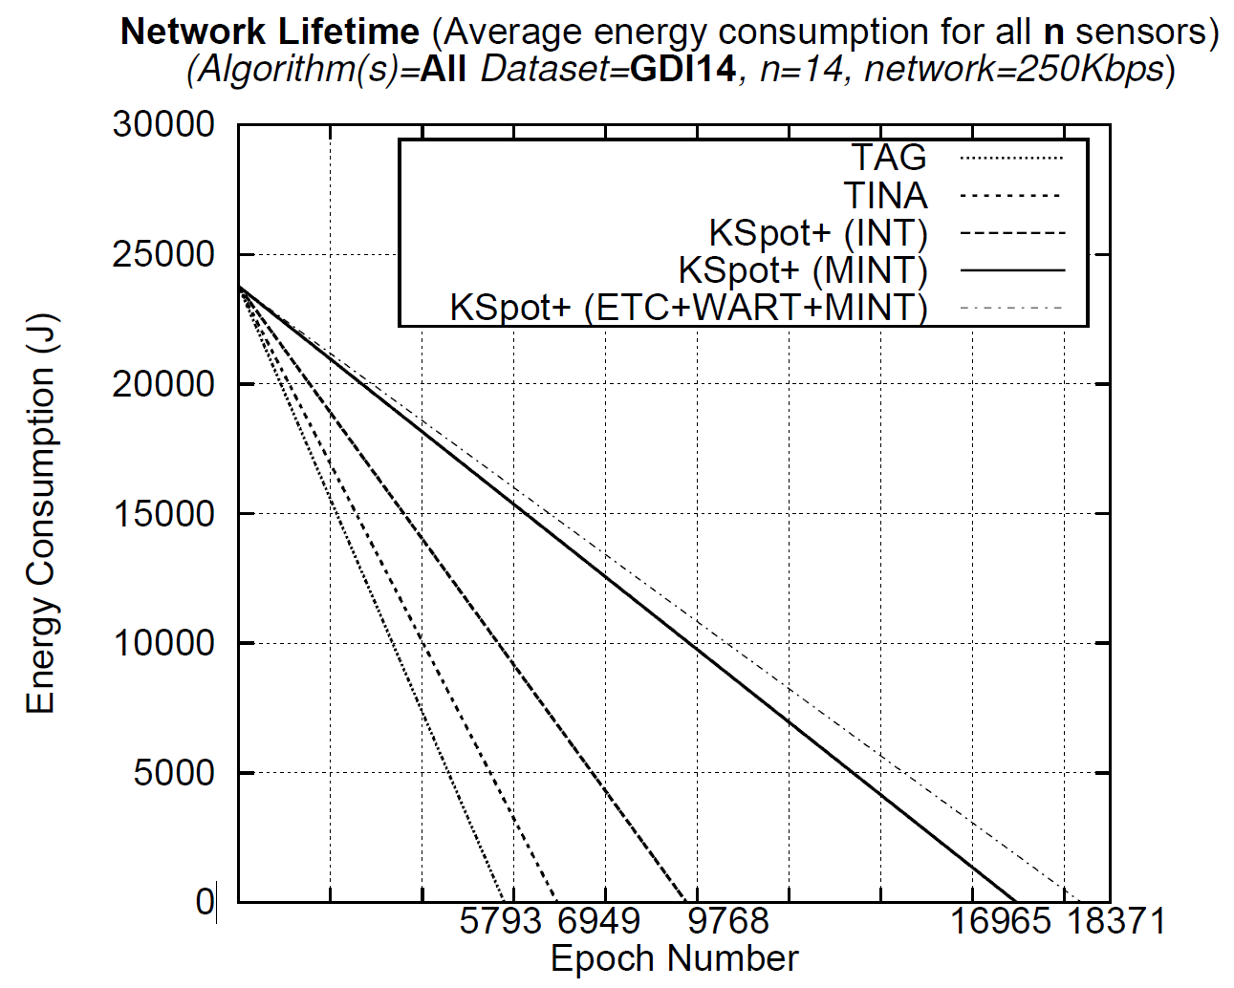
Network Lifetime
Study the effect of all modules on the network longevity
Initial Energy Budget: 23760J
Average energy of all sensors at each epoch
Stop when Energy(t’)=0
TAG 193min
TINA 231min
INT 325min
MINT 565min
KSpot+ 612min
Significant increase of network longevity
20
Notes:
In our experiments we studied the effects of each module on the network longevity.

Slide 21
Kspot+
Kspot+
WART
Workload Balancing
TiNA
MINT
Top-K
TAG
T
ETC
Notes:
Here we summarize how Kspot+’s compenents relate to the existing technologies we have compared it with. TAG augmented with the Tree module makes the Energy driven Tree construction.
Tina with MINT enables Top-K complex queries
And Tina with TAG and Wart compose the Workload balancing module.

Slide 22
Presentation Outline
Introduction
Motivation
The KSpot+ Framework
Experimental Evaluation
Conclusions and Future Work
Notes:
We now present our conclusions

Slide 23
Conclusions
We showed that KSpot⁺ makes a strong case for an alternative framework design tailored specifically for energy-efficient wireless sensor networks:
provides significant energy savings compared to predominant data-centric frameworks
minimizes data reception and transmission inefficiencies
minimizes both the size and number of packets transmitted over the network
prolongs the longevity of a WSN
enables complex queries
Notes:
We showed that KSpot⁺ makes a strong case for an alternative framework design tailored specifically for energy-efficient wireless sensor networks:
provides significant energy savings (up to 317%) compared to predominant data-centric middleware
minimizes data reception and transmission inefficiencies
minimizes both the size and number of packets transmitted over the network
prolongs the longevity of a WSN
Additionally, the algorithms presented in this work can be adapted to support a number of future applications (e.g., people-centric sensing, mobile sensor networks, etc.)

Slide 24
Future Work
In the future we plan to study:
Minimize the critical path reconstruction frequency by dynamically configuring parameters
Investigate network optimizations based on query and not network semantics
Applicability of the KSpot+ framework in other types of networks (e.g., Mobile Sensor Networks (MSNs) and Smartphone Networks)

Slide 25
Towards a Network-aware Middleware for Wireless Sensor Networks
The 8th International Workshop on Data Management for Sensor Networks, in conjunction with VLDB 2011, August 29, 2011, The Westin Hotel, Seattle, WA, USA
Thank you!
Questions?
Panayiotis G. Andreou, Demetrios Zeinalipour-Yazti, George Samaras and Panos K. Chrysanthis
Presenter: Panickos Neophytou
Publicly available at http://www.cs.ucy.ac.cy/~panic/kspot/
University of Cyprus
Department of
Computer Science
University of Pittsburgh
Department of
Computer Science

Slide 26
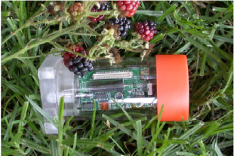

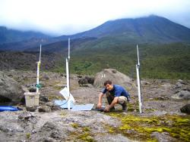

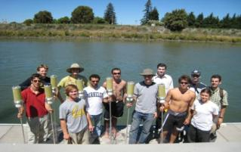
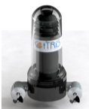
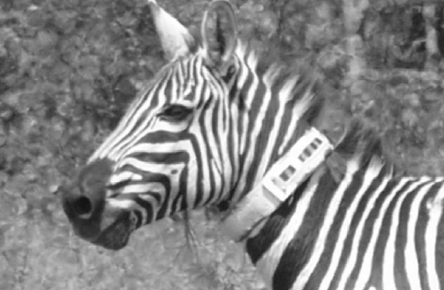
Introduction
Wireless Sensor Networks (WSNs) are resource constrained devices utilized for monitoring and understanding the physical world at a high fidelity.
Numerous Application Domains
Environmental monitoring
Industrial Automation
Home monitoring
Health Monitoring
Traffic management
and many more…
Great Duck Island – Maine (Temperature, Humidity)
Golden Gate – SF (Vibration, Displacement)
Tungurahua Volcano – Ecuador (infrasound)
Vital Signs Monitoring
(pressure, ECG, glucose)
Floating Sensor Drifters -CA
(GPS, temperature, and salinity)
Zebranet – Kenya
(GPS)
Notes:
WSNS are composed of resource constraint devices, called sensors,
and are utilized by numerous applications for monitoring and understanding the physical world.

Slide 27


Data Routing
How is data routed back to the sink?
Sensors have limited communication range
Sink broadcasts continuous query to sensors within range (e.g., “Find temperature every 30s”)
Each sensor forwards the query to nearby sensors
When a sensor receives a query it sets the sender as its parent (i.e., all data will be forwarded to the parent)
A Query Routing Tree is formed
Need for disseminating queries and acquiring data in an energy-efficient manner
Notes:
Since the majority of applications require data, it is important to understand first how are data routed back to a central location (most commonly known as sink).
First of all, sensors have limited communication range up to 300feet and they use broadcast.
The sink nodes start by broadcasting a continuous query (e.g., Find temperature every 30 seconds) to all sensors within communication range.
Then each sensor forwards the query to its nearby sensors. Additionally, each sensor sets the sender of the query as its parent, which means that all results will be forwarded to it.
This results in a Query Routing Tree
A very important research challenge is how to disseminate queries and acquire data in an energy efficient manner.

Slide 28
KSpot+ History
W
Q
WART “The MicroPulse Framework for Adaptive Waking Windows in Sensor Networks”, D. Zeinalipour-Yazti, P. Andreou, P. Chrysanthis, G. Samaras, A. Pitsillides, IEEE First International Workshop on Data Intensive Sensor Networks (DISN’07), Mannheim, Germany, May 11, 2007.
MINT
“MINT Views: Materialized In-Network Top-k Views in Sensor Networks” , D. Zeinalipour-Yazti, P. Andreou, P. Chrysanthis and G. Samaras, In IEEE 8th International Conference on Mobile Data Management (MDM’07), Mannheim, Germany, May 7 – 11, 2007.
W
T
Q
Workload Balancing Module
"Workload-aware Query Routing Trees in Wireless Sensor Networks", P. Andreou, D. Zeinalipour-Yazti, P. Chrysanthis, G. Samaras, The 9th International Conference on Mobile Data Management (MDM’08), Beijing, China, April 27-30, 2008.
ETC
“ETC: Energy-driven Tree Construction in Wireless Sensor Networks”', P. Andreou, A. Pamboris, D. Zeinalipour-Yazti, P. K. Chrysanthis, G. Samaras, 2nd International Workshop on Sensor Network Technologies for Information Explosion Era (SeNTIE'09), in conjunction with (MDM'09), IEEE Press, May 18th - May 20th, Tapei, Taiwan, 2009.
KSpot
“KSpot: Effectively Monitoring the K Most Important Events in a Wireless Sensor Network”, P. Andreou, D. Zeinalipour-Yazti, M. Vassiliadou, P.K. Chrysanthis, G. Samaras, 25th International Conference on Data Engineering March (ICDE'09), Shanghai, China, May 29 - April 4, 2009
W
T
Q
Tree/Workload Balancing Modules
“Optimized Query Routing Trees for Wireless Sensor Networks”, P. Andreou, D. Zeinalipour-Yazti,A. Pamboris, P.K. Chrysanthis, G. Samaras, Information Systems Journal (InfoSys’11), Volume 36, Issue 2, pp.267-291, April 2011.
Query Processing Module
“Power Efficiency through Tuple Ranking in Wireless Sensor Network Monitoring”, P. Andreou, D. Zeinalipour-Yazti, P.K. Chrysanthis, G. Samaras, Distributed and Parallel Databases Journal (DAPD’11), Vol.29, No.1-2, pp.113-150, 2011.
W
T
Q
KSpot⁺
“Towards a Network-aware Middleware for Wireless Sensor Networks”, P. Andreou, D. Zeinalipour-Yazti, G. Samaras, P.K. Chrysanthis, In Data Management for Sensor Networks (DMSN’11), 2011
Notes:
Our work started in 2007 were we introduced the algorithmic foundations for the Workload Balancing and Query Processing Modules.
We then proceeded in 2008 and 2009 with producing the first versions of these two modules as well as introduced the algorithmic foundations for the Tree Balancing Module.
Next in 2010 we created the final versions of the modules as well as experimented with the combination of the Tree and Workload Balancing Modules.
Finally in 2011 we created the KSpot+ framework.

Slide 29
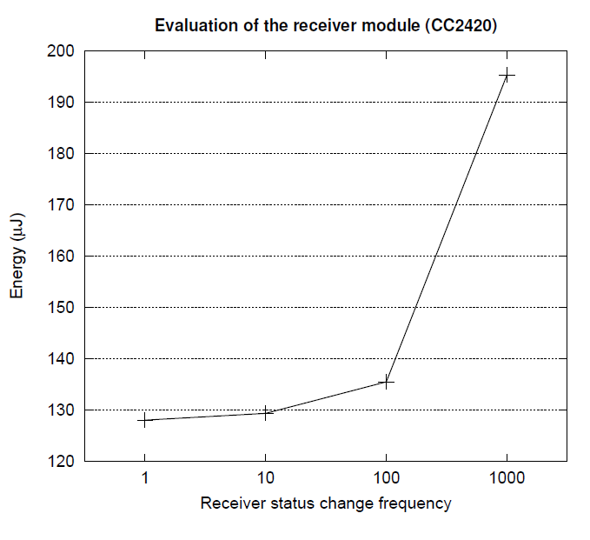
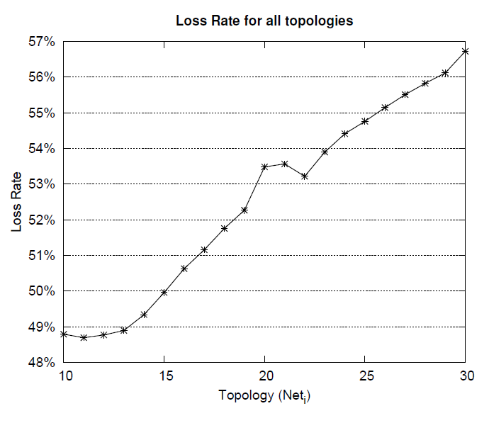
Motivation: Micro-benchmarks
Two experiments on CC2420 radio chip (TelosB) that justify why data reception/transmission inefficiencies have to be optimized
Data Reception Inefficiencies
Data Transmission Inefficiencies
195μJ
128μJ
Continuously changing the transceiver state consumes ~65% more energy
The Workload Balancing Module assigns specific time intervals → transceiver is enabled only once
As the number of children nodes increases, so does the data loss rate
The Tree Balancing Module balances the network →data transmission collisions are decreased
Notes:
In order to experimentally justify why data reception and transmission inefficiencies have to be optimized we have performed two micro-benchmarks on the CC2420 radio chip that is utilized in various sensor motes including the TelosB one utilized in our experiments.
In the first experiment we study data reception inefficiencies
More specifically, we transmit 1000 16-byte packets between two TelosB devices in 1, 10, 100, 1000 rounds and measure the energy in milliJoules.
For example in the 1-round experiment we turn ON the transceiver once, transmit the 1000 tuples and then turn it OFF.
In the 10 round experiment we turn ON and OFF the transceiver, 10 times, transmitting 100 packets each time.
We found out that continuously changing the transceiver consumes approximately 65% more energy.
In the Kspot+ framework, the Workload Balancing Module assigns specific time intervals thus the transceiver is enabled only once at each epoch.
In the second experiment we study data transmission inefficiencies.
For this purpose, we construct 20 star topologies ranging from 10 to 30 nodes where all nodes try to transmit the same packet to the sink node.
We observe that as the number of children nodes rise, so does the data loss rate.
To alleviate this problem in the Kspot+ framework, the Tree Balancing module creates balanced query routing trees that decrease the number of data transmission collisions.
[---INFO---
To accomplish this we have utilized the TOSSIM environment along with its LossyBuilder module that created “lossy” radio models for each topology. The lossy model we have created places the sensors at various distances from the sink node and generates a Gaussian packet loss probability distribution for each distance.
We measure: i) the Total Packets Sent from all sensors to the sink, and ii) the Total Packets Received from s0
It should be noted these findings are highly correlated with the lossy model generated by the TOSSIM’s LossyBuilder component. More pessimistic lossy models would have generated even higher loss rates. However, investigating the results of our experiments indicates that nodes closer to the sink node manage to transmit more messages successfully and that is why the loss rates may appear somewhat optimistic.
]

Slide 30
Related Work
Traditional middleware frameworks (e.g., CORBA, JINI, EJB) are considered heavyweight for WSNs.
Many research works have proposed lightweight and energy efficient middleware frameworks tailored specifically for WSNs.
Data-centric Middleware Frameworks related to KSpot+:
Cougar: SQL-syntax, Virtual relational DB, centralized optimizer
+ coordinates sensor nodes in an energy-efficient manner
- massive amount of messages are transmitted to the sink
- node and comm. failures severely hamper the efficiency
- No support for workload optimization, complex queries

Slide 31
Related Work
TinyDB: SQL syntax, lifetime/event-based queries
+ Fully implemented
+ In-network aggregation through TAG
+ adapting sampling rates to minimize power consumption
- uniform waking window
- No support for topology optimization, complex queries
SINA: Virtual spread-sheet database, Attributed -based naming, Hierarchical Clustering
+ scalable and energy-efficient organization
- sacrifice the results of some sensors to avoid data collisions
- node and comm. failures severely hamper the efficiency
- No support for workload optimization, complex queries

Slide 32
Related Work
DsWare: real-time semantics, event detection
+ filtering mechanism decrease messages transmitted
- filtering mechanism provides approximate values
- No support for workload/topology optimization, complex queries
SNEE: extensive JOIN support, complete query optimizer
+ Workload Optimization
- SNEE assumes that an efficient protocol for self-organization
of the topology exists, does not investigate the effects of
an unbalanced topology.
- No support for topology optimization, complex queries*

Slide 33
Related Work
Other middleware approaches for WSNs:
Application-driven (Milan, MidFusion)
Allow application designers to specify their QoS requirements inside the sensor network application code.
+ Specification of QoS requirements inside the sensor network application code. Support for workload and topology optimization
- Sacrificing accuracy for energy efficiency may lead to inaccurate results. No support for Top-k
Virtual Machine-based (Mate, MagnetOS)
Allow application designers to specify their QoS requirements inside the sensor network application code.
+ Complex programs can be written with minimal code. Reduction of energy for transmitting these programs to the sensor network
- Rely on a built-in ad hoc routing algorithms that may produce unbalanced and workload inefficient topologies

Slide 34
Related Work
Other middleware approaches for WSNs:
Publish/Subscribe (Mires, Aware)
Publish/Subscribe layer that allows each device to publish its capabilities (i.e., data channels) and attributes, to a centralized registry where other devices can subscribe to and receive feeds.
+ A number of packet-level optimizations can be performed that can greatly decrease the number of communication packets
- Topology optimization is not taken into account.
Agent-based (Impala, Agilla)
Employ agent-based components that enable dynamic adaptation of running applications in order to improve performance, energy-efficiency and robustness.
+ High degree of energy-efficiency without user intervention
- The coordination of mobile agents on a large-scale network may seriously hamper the overall performance of the network

Slide 35
KSpot⁺ Framework Architecture Design
A novel network-aware data-centric framework for WSNs that enables energy efficient data acquisition.
It consists of 3 basic components:
The Workload Balancing Module: discovers data reception inefficiencies and dynamically adapts the waking window of each sensor → Addresses Problem 1
The Tree Balancing Module: identifies structural inefficiencies in the initial Ƭ and reconstructs Ƭ in a balanced manner. → Addresses Problem 2
The Query Processing Module: that facilitates execution of complex queries (e.g., Top-k, Group-By) in conjunction with Materialized In-network Views. → Addresses Problem 3
Design Goals: Distributed and Autonomous Behavior, Modularity, Scalability, Accuracy in Failures
Notes:
Kspot+ is a novel network-aware data-centric framework for WSNs that enables energy efficient data acquisition.
It consists of 3 basic components:
- The Workload Balancing Module, which addresses the first problem mentioned in the motivation by discovering data reception inefficiencies and dynamically adapting the waking window of each sensor
- The Tree Balancing Module, which addresses the second problem mentioned in the motivation by identifying structural inefficiencies in the initial Query Routing Tree and reconstructing it in a more balanced manner
- The Query Processing Module, which addresses the third problem mentioned in the motivation by that facilitating the execution of complex queries (e.g., Top-k, Group-By) in conjunction with Materialized In-network Views
Design Goals: Modularity, Distributed and Autonomous Behavior, Scalability, Accuracy in Failures

Slide 36
Motivation
Current frameworks focus on the complete result for a Query. However, users are usually interested in the most important events (Top-k) in the network.
Supporting Top-k queries can:
Minimize the size of packets
Top-k queries prune away tuples that will not appear
in final result. For example, in a Top-1 query,
each sensor node will transmit exactly one tuple
Minimize the number of packets
Materializing a Top-k result can seed the result of
the next epoch thus save redundant communication
sink
35◦
34◦
32◦
32◦
35◦
33◦
33◦
34◦
33◦
32◦
33◦
34◦
33◦
35◦
32◦
33◦
Problem 3: Not supporting Top-k queries can increase the energy cost of query execution
Notes:
Finally, from our study, we observed that the majority of proposed frameworks focus on the complete result for a Query. However, users are usually interested in the most important events of the network. For example, in a forest fire detection system, the fire officers are not interested in all values but only the ones that are over a specific threshold.
This can be avoided by supporting Top-k queries, which can
Minimize the size of packets by pruning tuples that will not appear in the final results.
Let’s see an example with a Top-1 query.
In this tree each sensor records its local temperature value and transmits it to its parent.
A parent records its local reading and receives the results of its child nodes.
Now, instead of transmitting a packet with three tuples, it calculates which is the highest one (or lower depending on the query) and sends only that to its parent. And this is repeated recursively until the final result reaches the sink node.
Furthermore, top-k queries can minimize the number of packets as first of all minimizing the size of packets means less segmentation of large packets and additionally, if we materialize the result of a specific time instance we may not have to transmit it in the next epoch if it is the same.
As a result, if a framework does not support Top-k queries this can lead to an increase in energy cost for query execution.

Slide 37
Experimental Methodology
Testbed Characteristics
Trace-driven evaluation using the KSpot⁺ prototype
Language (OS):
Client-side: nesC (TinyOS)
Server-side: JAVA
Sensor Device: Crossbow’s TelosB
Datasets
Real Datasets: traces of sensor deployments, Great-Duck-Island (GDI14), AtmoMon32, Intel-Labs-54 (Intel54)
Realistic Datasets: derived from GDI14 and Intel54 datasets for large-scale experiments, GDI140, Intel540
Queries: Continuous, Single-tuple (ST), Multi-tuple Fixed Size (MTF), Multi-tuple Arbitrary Size (MTA), Group-By
Energy Modeling: PowerTOSSIM
Network Link Modeling: TinyOS LossyBuilder
Notes:
Our testbed has the following characteristics.
We utilize a trace-driven evaluation using the KSpot⁺ prototype.
As we mentioned earlier, the client side components are implemented in nesC and the server-side in JAVA
We utilize the energy model of the TelosB Sensor Device
We perform experiments using Real and Realistic Datasets of various sizes
Our Queries are Continuous and we include three types: the Single-tuple (ST), which return a single result, the Multi-tuple Fixed Size (MTF), which return multiple tuples of fixed size and the Multi-tuple Arbitrary Size (MTA), which return multiple tuples of arbitrary size
Our energy modeling is performed using PowerTOSSIM which is a popular power modelling tool for TOSSIM the TinyOS simulator.
Finally, in order to build multihop topologies and introduce lossy scenarios we use the TinyOS LossyBuilder

