Slide 1
An Overview of Distributed Top-K Ranking Algorithms
30-min presentation by
Demetris Zeinalipour
Lecturer
School of Pure and Applied Sciences
Open University of Cyprus
Friday, December 12th, 2008, 16:00-16:30
Communication Systems Group (CSG), ETH Zurich, Switzerland
http://www.cs.ucy.ac.cy/~dzeina/

Slide 2
Top-k Queries: Introduction
Top-K Queries are a long studied topic in the database and information retrieval communities
The main objective has been to return the K highest-ranked answers quickly and efficiently.
A Top-K query returns the subset of most relevant answers, in place of ALL answers, for two reasons:
  i) to minimize the cost metric that is associated with the retrieval of all answers (e.g., disk, network, etc.)
  ii) to maximize the quality of the answer set, such that the user is not overwhelmed with irrelevant results

Slide 3




Top-k Queries: Then
SELECT TOP-2 pictures
FROM PICTURES
WHERE SIMILAR(picture, )
Query Processing
{ }
Assumptions
The data is available locally on disks or over a “high-speed”, “always-on” network
Trade-off
Clients want to get the right answers quickly
Service Providers want to consume the least possible resources
Notes:
Query By Example: Applies to database and middleware scenarios

Slide 4

Top-k Queries: Now
In-Network Top-k Query Processing
Base Station
A few motivating queries:
Snapshot Query: Find the K nodes with the highest temperature values
Continuous Query: For the next one hour continuously report the K rooms with the highest average temperature
Historic Query (nodes store all data locally): Find the K nodes with the highest average temperature during the last 6 months

Slide 5
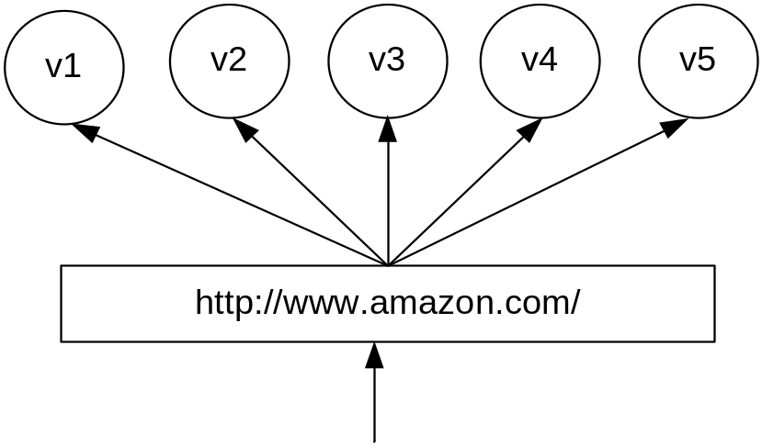
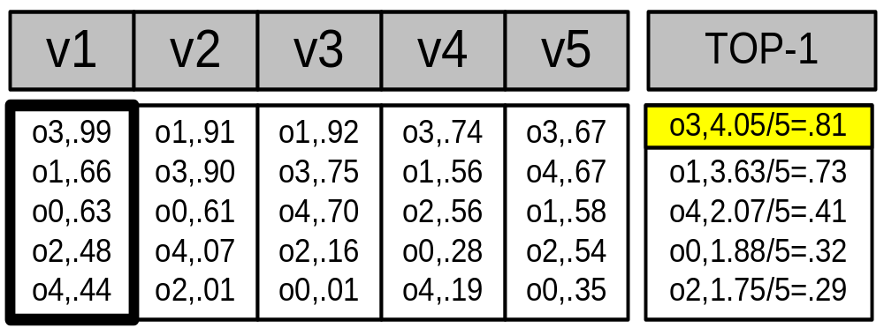
Top-k Queries: Now
Assume a cluster of n=5 Web-servers
Each server maintains locally a replica of the same m=5 static Web-pages
When a web page is accessed by a client, the respective server increases a local hit counter by one
Scoring Table
Hits++
Hits
PageID
{
(M) Timestamps
client
TOP-1 Query: “Find the webpage with the highest number of hits across all servers”
(N) Web-servers
Notes:
CDN example!, reorganize the layout of the website at real time in such a way that the most accessed URLs become availble with the fewest number of user clicks.

Slide 6
Presentation Outline
A. Introduction
B. Centralized Top-K Query Processing
  The Threshold Algorithm (TA)
C. Distributed Top-K Query Processing
  The Threshold Join Algorithm (TJA)
  Experimentation using 75 workstations
Other Applications of Top-K Queries
  Distributed Spatio-temporal Trajectory Retrieval
  In-Network Top-K Views (MINT Views)

Slide 7

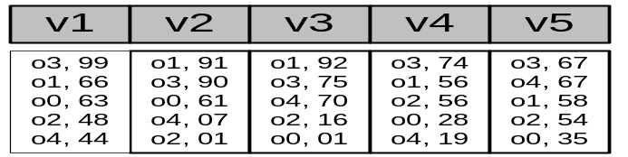
Centralized Top-K Query Processing
Fagin’s* Threshold Algorithm (TA):
(In ACM PODS’02) * Concurrently developed by 3 groups
The most widely recognized algorithm for Top-K Query
Processing in database systems
ΤΑ Algorithm
1) Access the n lists in parallel.
2) While some object o_{i} is seen, perform a random access to the other lists to find the complete score for o_{i}.
3) Do the same for all objects in the current row.
4) Now compute the threshold τ as the sum of scores in the current row.
5)The algorithm stops after K objects have been found with a score above τ.

Slide 8
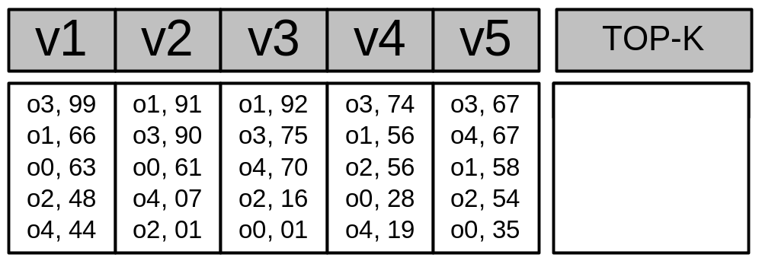
Centralized Top-K: The TA Algorithm (Example)
O3, 405
O1, 363
O4, 207
Iteration 1 Threshold
τ = 99 + 91 + 92 + 74 + 67 => τ = 423
Have we found K=1 objects with a score above τ? => ΝΟ
Iteration 2 Threshold
τ (2nd row)= 66 + 90 + 75 + 56 + 67 => τ = 354
Have we found K=1 objects with a score above τ? => YES!
Why is the threshold correct?
It gives us the maximum score for the objects we have not seen yet (<= τ)
Notes:
After the first row is resolved, there might be an object X in the second row that has a maximum value equal to the threshold.

Slide 9
Presentation Outline
A. Top-K Algorithms: Definitions
B. Centralized Top-K Query Processing
  The Threshold Algorithm (TA)
C. Distributed Top-K Query Processing
  The Threshold Join Algorithm (TJA)
  Experimentation using 75 workstations
Other Applications of Top-K Queries
  Distributed Spatio-temporal Trajectory Retrieval
  In-Network Top-K Views (MINT Views

Slide 10
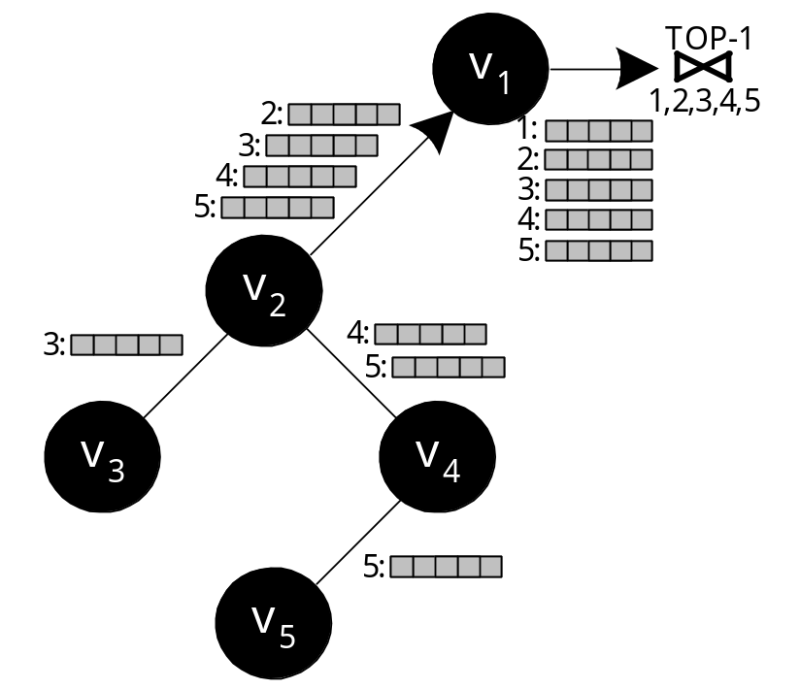
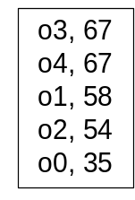
The Centralized Join Algorithm (CJA)
Problem: To overcome the arbitrary phases of the Threshold Algorithm?
Naive solution:
  Perform the computation in one phase: each node sends its complete list of scores
  Each intermediate node forwards all received lists
Disadvantage
  Overwhelming amount of messages.
  Huge Query Response Time

Slide 11
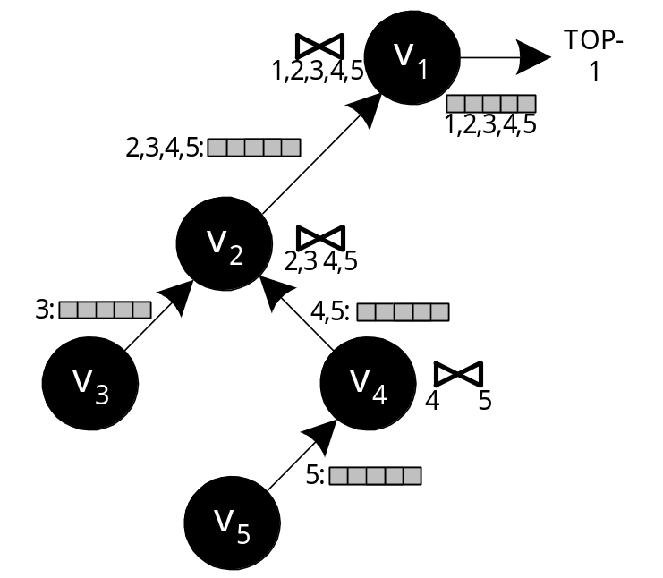
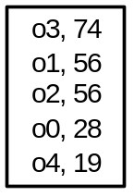
The Staged Join Algorithm (SJA)
Improved Solution: Aggregate the lists before these are forwarded to the parent:
This is the In-network aggregation approach
Advantage: Only O(n) messages
Disadvantage: The size of each message is still very large in size (i.e., the complete list)

Slide 12
Threshold Join Algorithm (TJA)
TJA is our 3-phase algorithm that optimizes top-k query execution in distributed (hierarchical) environments.
Advantage:
  It usually completes in 2 phases.
  It never completes in more than 3 phases (LB Phase, HJ Phase and CL Phase)
  It is therefore highly appropriate for distributed environments
“The Threshold Join Algorithm for Top-k Queries in Distributed Sensor Networks", D. Zeinalipour-Yazti et. al, In VLDB’s DMSN’05.
“Finding the K Highest-Ranked Answers in a Distributed Network”, D. Zeinalipour-Yazti et. al, Computer Networks, Elsevier, 2008.

Slide 13
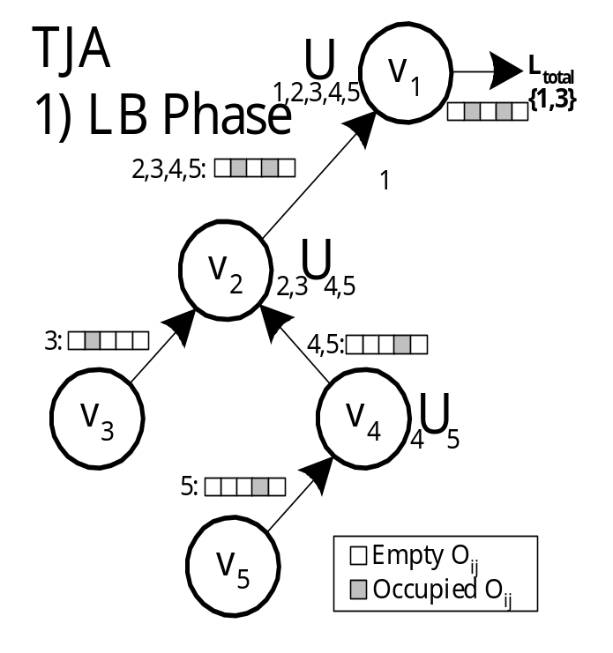
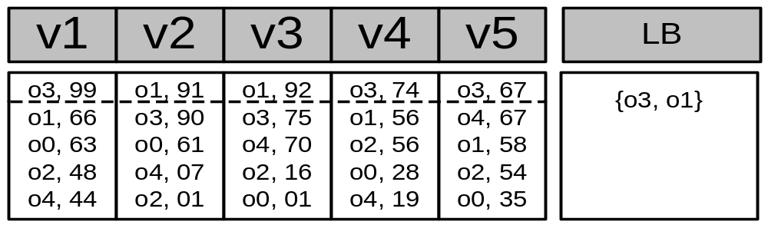
Step 1 - LB (Lower Bound) Phase
Recursively send the K highest objectIDs of each node to the sink.
Each intermediate node performs a union of the received results (defined as τ)
Τ=
Query: TOP-1

Slide 14
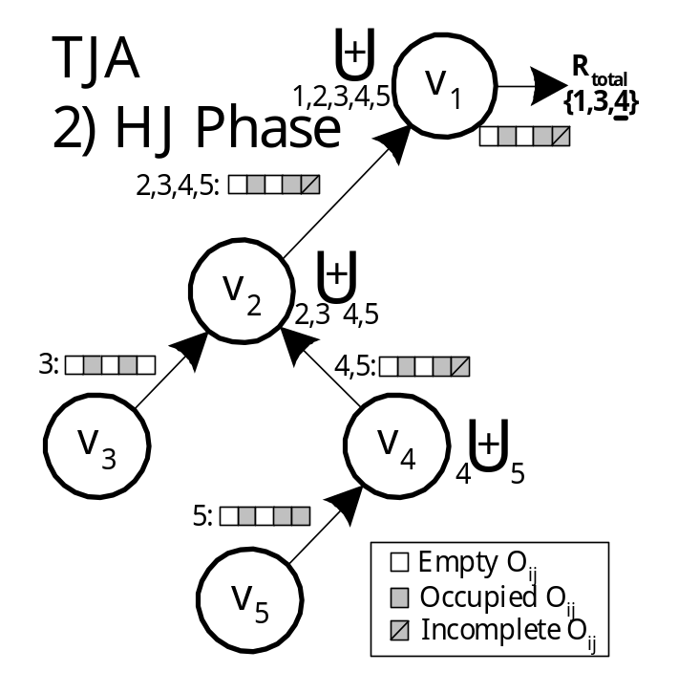
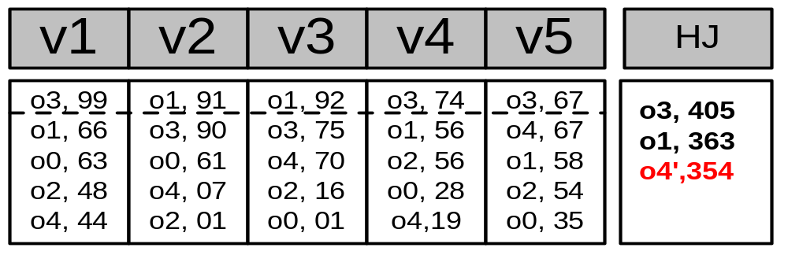
Step 2 – HJ (Hierarchical Join) Phase
Disseminate τ to all nodes
Each node sends back all objects with score above the objectIDs in τ
Before sending the objects, each node tags as incomplete, scores that could not be computed exactly
}
Complete
Incomplete

Slide 15
Step 3 – CL (Cleanup) Phase
Have we found K objects with a complete score that is above all incomplete scores?
  Yes: The answer has been found!
  No: Find the complete score for each incomplete object (all in a single batch phase)
CL ensures correctness
This phase is rarely required in practice!

Slide 16
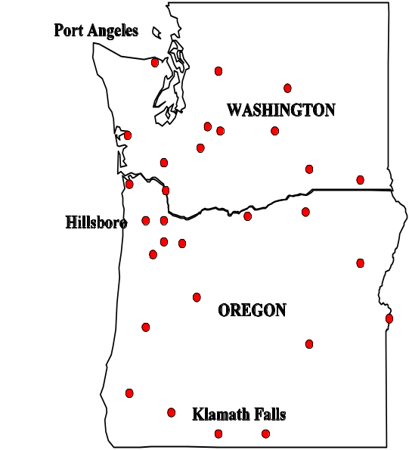
Experimental Evaluation
We have implemented a P2P middleware in JAVA (sockets + binary transfer protocol).
We tested our implementation with a network of 1000 real nodes using 75 Linux workstations.
We use a trace driven experimentation methodology with data from an Environmental Monitoring Facility in Washington / Oregon
Summary of Findings
Bytes: CJA = 10xTJA; SJA = 3xTJA
Time: TJA:3.7s [LB:1.0s,HJ:2.7s,CL:0.08s]; SJA: 8.2s; CJA:18.6s
Messages:TJA:259, SJA:183, CJA:246

Slide 17
Presentation Outline
A. Top-K Algorithms: Definitions
B. Centralized Top-K Query Processing
  The Threshold Algorithm (TA)
C. Distributed Top-K Query Processing
  The Threshold Join Algorithm (TJA)
  Experimentation using 75 workstations
Other Applications of Top-K Queries
  Distributed Spatio-temporal Trajectory Retrieval (UB-K and UBLB-K Algorithms)
  In-Network Top-K Views (MINT Views)

Slide 18
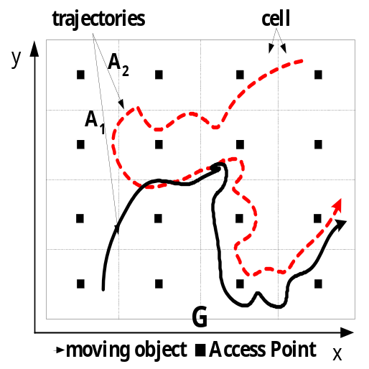
Application 2: SpatioTemporal Similarity Search
Similarity Search: Given a query Q, find the degree of similarity (Euclidean distance, DTW, LCSS) between Q and a set of m target trajectories {A1,A2,…,Am}.
Each Αi (i<=m) is segmented into a number of non-overlapping cells {C1,C2,…,Cn} that maintain the local subsequences.
Challenge: How can we find the K most similar trajectories to Q without pulling together all subsequences
"Distributed Spatio-Temporal Similarity Search”,
D. Zeinalipour-Yazti, S. Lin, D. Gunopulos, ACM 15th Conference on Information and Knowledge Management, (ACM CIKM 2006), November 6-11, Arlington, VA, USA, pp.14-23, August 2006.
Q

Slide 19
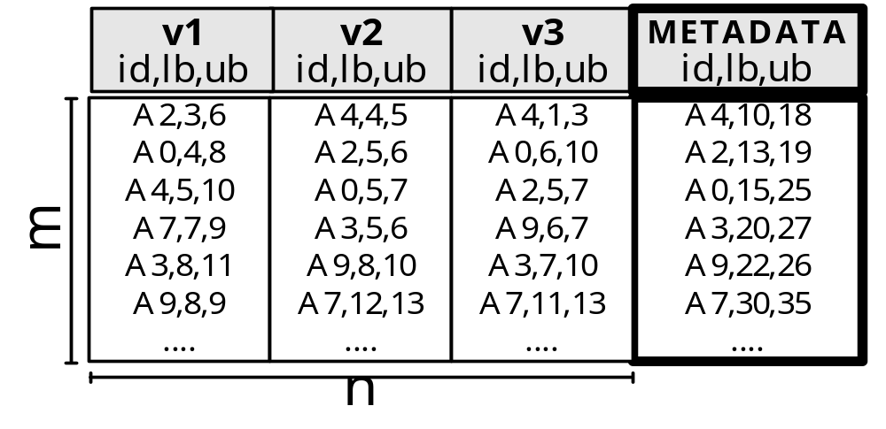
Application 2: Spatiotemporal Query Processing
Solution Outline
Each cell computes a lower bound and an upper bound on the matching of Q to its local subsequences.
The distributed scoring table now contains score bounds (lower,upper) rather than exact scores.
Q
We have proposed two iterative algorithms: UB-K and UBLB-K, which combine these score bounds.
UB-K and UBLB-K find the K most similar trajectories to Q without pulling together the distributed subsequences.

Slide 20
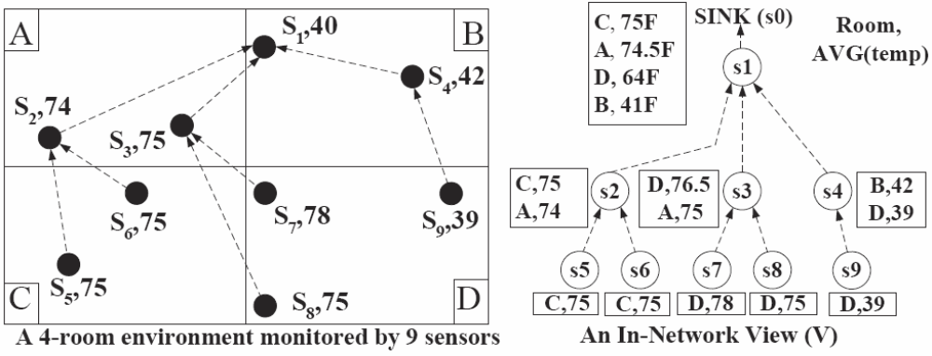
Application 3: ΜΙΝT
ΜΙΝΤ : a framework for optimizing the execution of continuous monitoring queries in sensor networks.
"MINT Views: Materialized In-Network Top-k Views in Sensor Networks"
D. Zeinalipour-Yazti, P. Andreou, P. Chrysanthis and G. Samaras, In IEEE 8th International Conference on Mobile Data Management, Mannheim, Germany, May 7 – 11, 2007
Query: Find the K=1 rooms with the highest average temperature

Slide 21
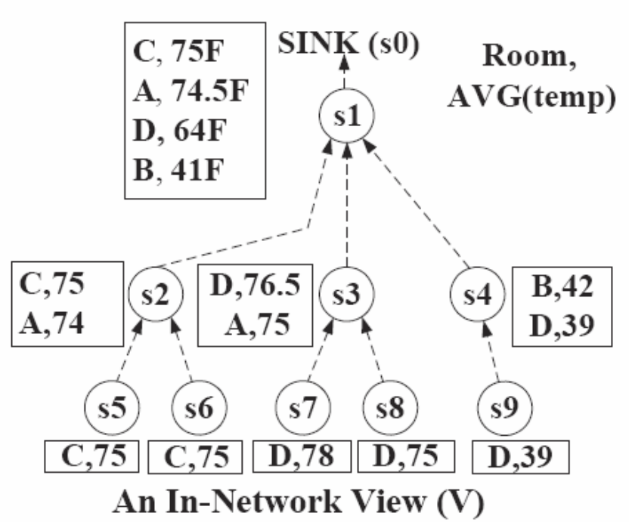
ΜΙΝΤ Views: Problem
Objective: To prune away tuples locally at each sensor such that messaging is minimized.
Naïve Solution: Each node eliminates any tuple with a score lower than its top-1 result.
D,76.5
C,75
B,41
Problem:
We received a incorrect answer i.e., (D,76.5) instead of (C,75).
(B,40)

Slide 22
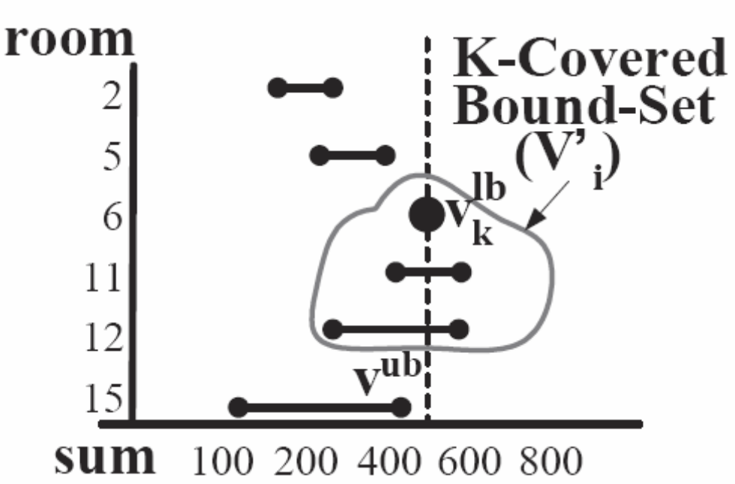
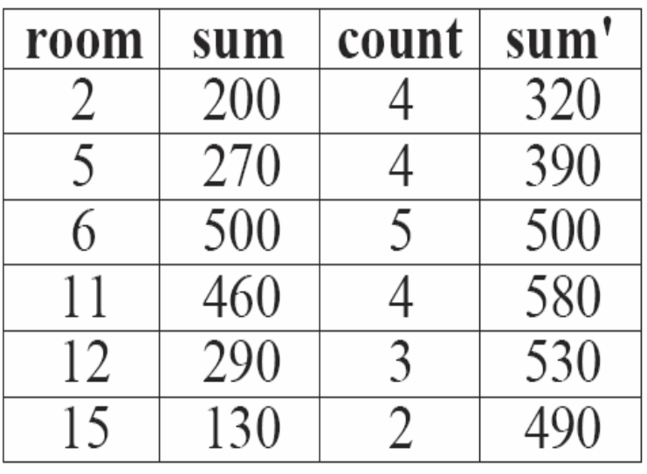
ΜΙΝΤ Views: Main Idea
Bound above each tuple with its maximum possible value.
K-covered Bound-set : Includes all the objects which have an upper bound (v^{ub}) greater or equal to the kth highest lower bound (τ), i.e., v^{ub} > τ
τ
sum
v^{lb}
v^{ub}

Slide 23
ΜΙΝΤ Views: Main Idea
Bound above each tuple with its maximum possible value.
K-covered Bound-set : Includes all the objects which have an upper bound (v^{ub}) greater or equal to the kth highest lower bound (τ), i.e., v^{ub} > τ
τ
sum
v^{lb}
v^{ub}

Slide 24
An Overview of Distributed Top-K Ranking Algorithms
Thank you!
Demetris Zeinalipour
This presentation is available at:
http://www2.cs.ucy.ac.cy/~dzeina/talks.html
Related Publications available at:
http://www2.cs.ucy.ac.cy/~dzeina/publications.htm

Slide 25
Backup Slides
Main Findings:
Dataset: Environmental Measurements from atmospheric monitoring stations in Washington & Oregon. (2003-2004)
Query: Find the K timestamps on which the average temperature across all stations was maximum.
Network: Random Graph (degree=4, diameter 10)
Evaluation Criterions: i) Bytes, ii) Time, iii) Messages

Slide 26
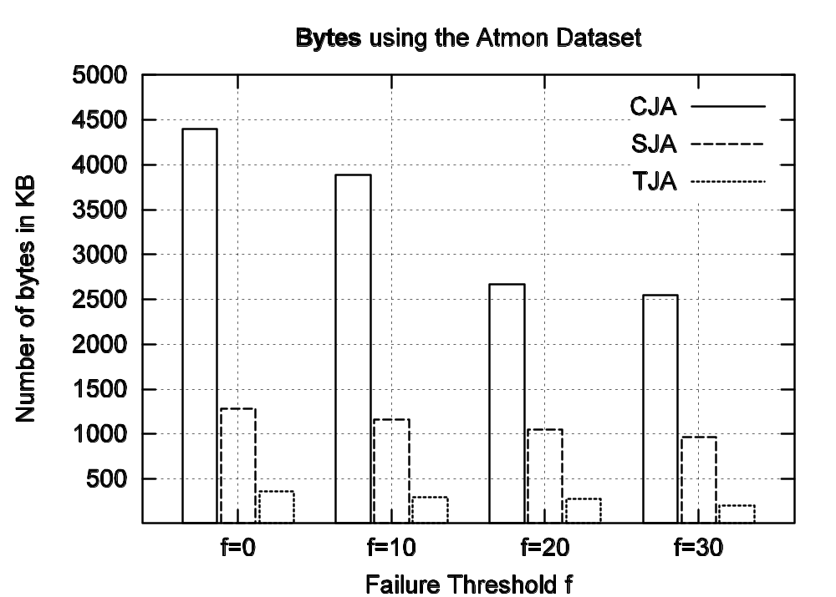
Experimental Results
TJA requires one order of magnitude less
bytes than CJAs!

Slide 27
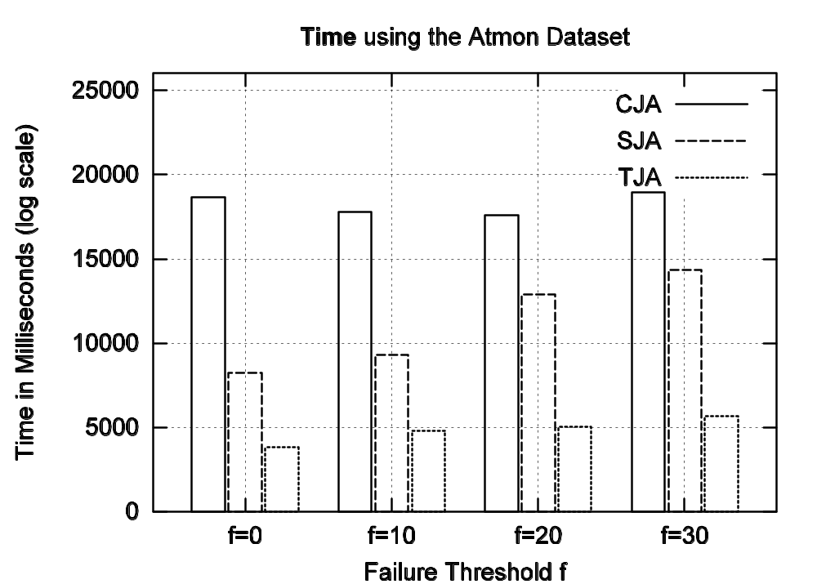
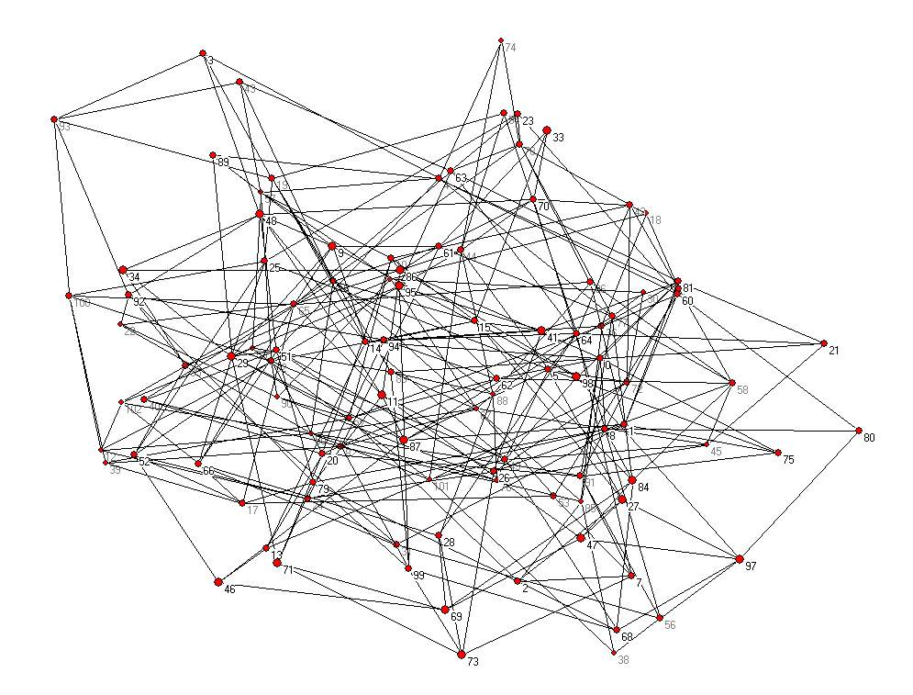
Experimental Results
TJA: 3.7sec [ LB:1.0sec, HJ:2.7sec, CL:0.08sec ] SJA: 8.2sec CJA:18.6sec

Slide 28
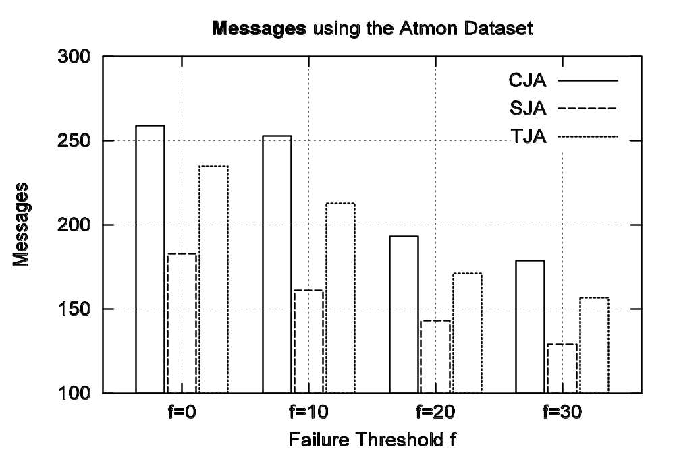
Experimental Results
259
246
183
Although TJA consumes more messages than SJA these are small-size messages

Slide 29

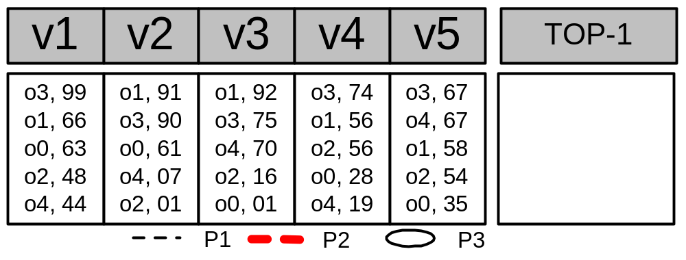
The TPUT Algorithm
o1=183, o3=240
o3=405
o1=363
o2’=158
o4’=137
o0’=124
Q: TOP-1
Phase 1 : o1 = 91+92 = 183, o3 = 99+67+74 = 240
τ = (Kth highest score (partial) / n) => 240 / 5 => τ = 48
Phase 2 : Have we computed K exact scores ?
Computed Exactly: [o3, o1] Incompletely Computed: [o4,o2,o0]
Drawback: The threshold is uniform (too coarse)

Slide 30
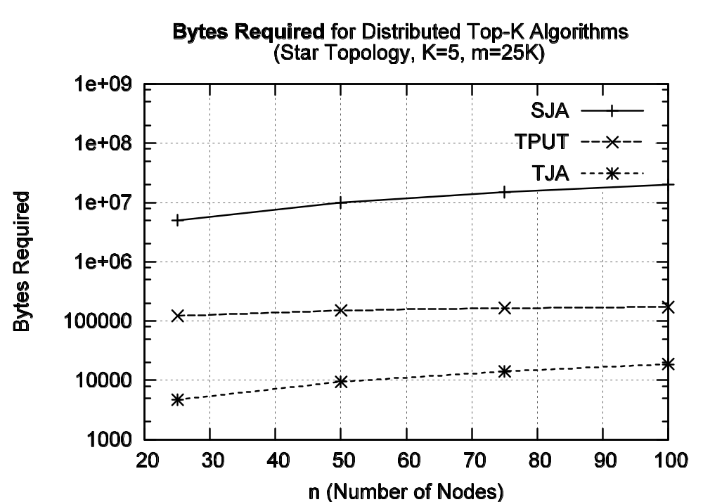
TJA vs. TPUT

Slide 31
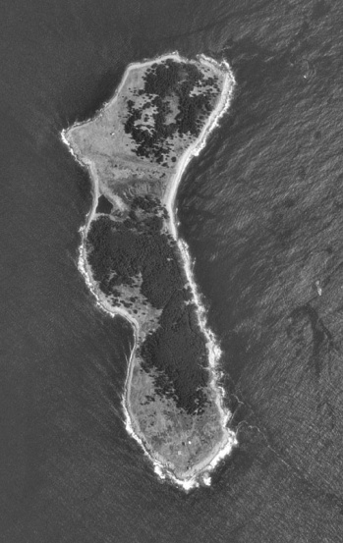
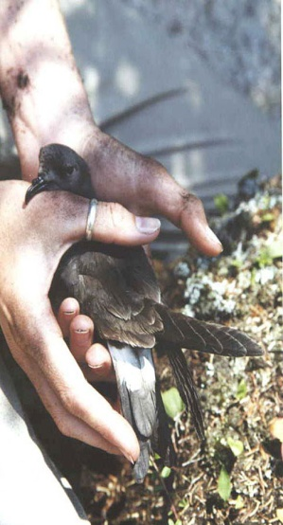
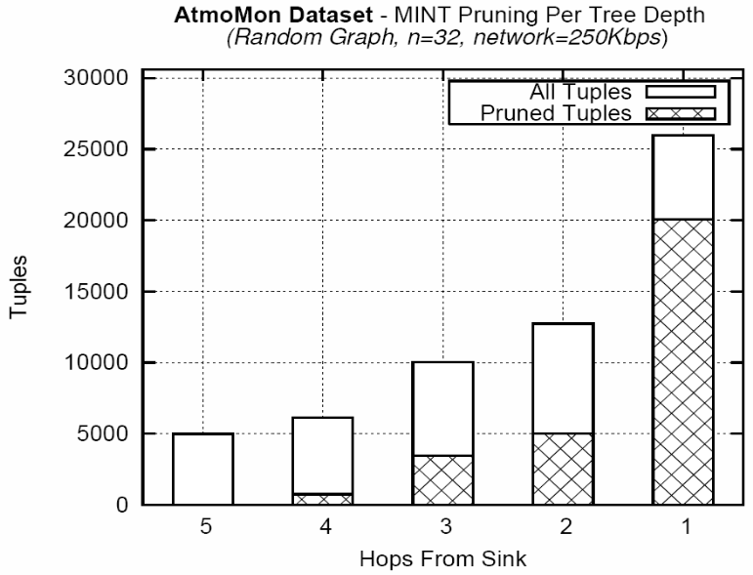
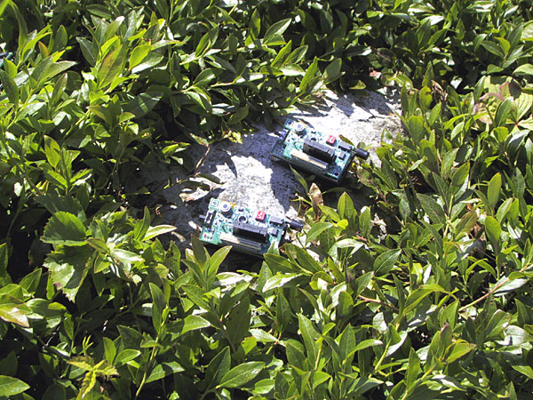
ΜΙΝΤ Views: Experimentation
We obtained a real trace of atmospheric data collected by UC-Berkeley on the Great Duck Island (Maine) in 2002.
We then performed a trace-driven experimentation using XBows TELOSB sensor.
Our query was as follows:
  SELECT TOP-K area, Avg(temp)
  FROM sensors
  GROUP BY area
77%
39%
34%
0%
12%

