Slide 1
Ranking Query Results in a Networked World
Demetris Zeinalipour
Lecturer
Department of Computer Science
University of Cyprus
Thursday, May 27th, 2010
Messaging and Event Systems Department,
IBM T. J. Watson Research Center, Hawthorne, NY 10532, USA
http://www.cs.ucy.ac.cy/~dzeina/

Slide 2
Presentation Goals
To present the concepts behind Top-K algorithms for centralized and distributed settings.
To present the intuition behind the family of Top-K query processing algorithms we developed and evaluated in a variety of environments:
  P2P Networks
  Sensor Networks
  Smartphone Networks

Slide 3
References
The ideas presented herein are analyzed in the below papers:
  “Power Efficiency through Tuple Ranking in Wireless Sensor Networks”, P. Andreou, P. Andreou, D. Zeinalipour-Yazti, P.K. Chrysanthis, G. Samaras, Distributed and Parallel Databases, Springer (under review), 2010.
  ``KSpot: Effectively Monitoring the K Most Important Events in a Wireless Sensor Network", P. Andreou, D. Zeinalipour-Yazti, M. Vassiliadou, P.K. Chrysanthis, G. Samaras, 25th International Conference on Data Engineering March (ICDE'09), Shanghai, China, May 29 - April 4, 2009,
  "MINT Views: Materialized In-Network Top-k Views in Sensor Networks" , D. Zeinalipour-Yazti, P. Andreou, P. Chrysanthis and G. Samaras, In IEEE 8th International Conference on Mobile Data Management, Mannheim, Germany, May 7 – 11, 2007
  ``Finding the K Highest-Ranked Answers in a Distributed Network”, D. Zeinalipour-Yazti et. al, Computer Networks 53(9): 1431-1449, Elsevier (2009).
    ``The threshold join algorithm for top-k queries in distributed sensor networks’’, D. Zeinalipour-Yazti et. al.:. DMSN 2005 (with VLDB 2005) , 61-66 , Trondheim, Norway, 2005.
  ``Seminar: Distributed Top-K Query Processing in Wireless Sensor Networks’’, D. Zeinalipour-Yazti, Z. Vagena, Tutorial at the 9th Intl. Conference on Mobile Data Management (MDM'08), IEEE Press, April 27-30, 2008
  ``Distributed Spatio-Temporal Similarity Search'', D. Zeinalipour-Yazti, S. Lin, D. Gunopulos, The 15th ACM Conference on Information and Knowledge Management (CIKM'06), Arlington, VA, USA, November 6-11, 2006.

Slide 4
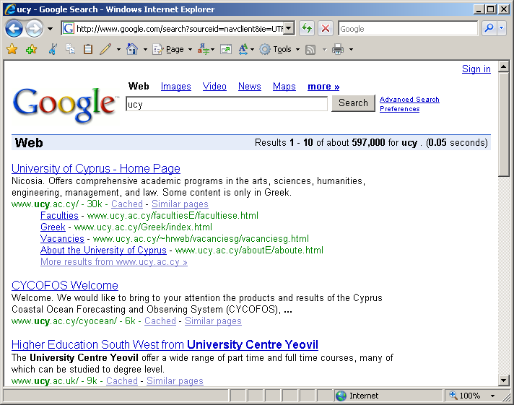
Motivation: Why Top-K?
Clients want to get the right answers quickly.
Clients are not willing to browse through the complete answer-set.
Service Providers want to consume the least possible resources (disks, network, etc).
Even on the web, it makes sense to focus on the K highest ranked answers (or Top-K) answers if that can speedup the retrieval time.

Slide 5
Top-k Queries: Introduction
Top-K Queries are a long studied topic in the database and information retrieval communities
The main objective of these queries is to return the K highest-ranked answers quickly and efficiently.
A Top-K query returns the subset of most relevant answers, instead of ALL answers, for two reasons:
  i) to minimize the cost metric that is associated with the retrieval of all answers (e.g., disk, network, etc.)
  ii) to maximize the quality of the answer set, such that the user is not overwhelmed with irrelevant results

Slide 6
Top-k Queries: Definitions
Top-K Query (Q)
Given a database D of m objects (each of which characterized by n attributes) a scoring function f, according to which we rank the objects in D, and the number of expected answers K, a Top-K query Q returns the K objects with the highest score (rank) in f.
Scoring Table
An m-by-n matrix of scores expressing the similarity of Q to all objects in D (for all attributes).

Slide 7
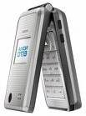



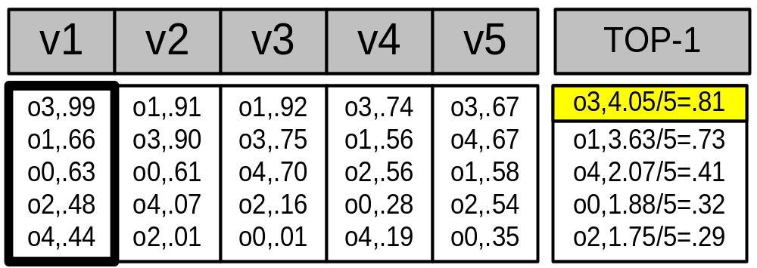
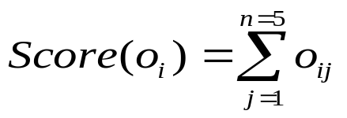
Top-k Queries: Then
SELECT TOP-2 pictures
FROM PICTURES
WHERE SIMILAR(picture, )
Query Processing
{ }
Assumptions
The data is available locally on disks or over a “high-speed”, “always-on” network
Trade-off
Clients want to get the right answers quickly
Service Providers want to consume the least possible resources
Scoring Table
Similarity
Image
{
(M) Images
(N) Features
A monotone scoring function:
Notes:
Query By Example: Applies to database and middleware scenarios

Slide 8
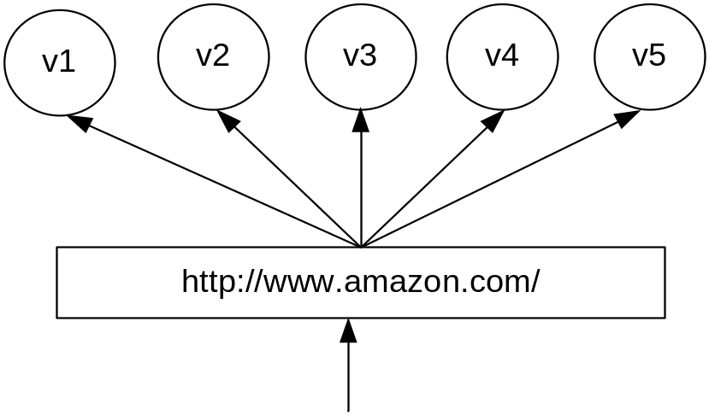
Top-k Queries Now: Another Example
Assume a cluster of n=5 WebServers (features)
Each server maintains locally a replica of the same m=5 static WebPages (objects)
When a web page is accessed by a client, the respective server increases a local hit counter by one
Scoring Table
Hits++
Hits
PageID
{
(M) WebPages
client
TOP-1 Query: “Find the webpage with the highest number of hits across all servers”
(N) WebServers
Notes:
CDN example!, reorganize the layout of the website at real time in such a way that the most accessed URLs become availble with the fewest number of user clicks.

Slide 9

Top-k Queries: Now
In-Network Top-k Query Processing
Base Station
New System Model: Wireless Sensor Networks, Smartphone Networks, Vehicular Networks, etc. feature a graph communication structure & expensive wireless link.
New Queries (Examples from Sensor Networks):
  Snapshot Query: Find the K areas with the highest average temperature during the last 6 months (data remains in-situ)
  Continuous Query: Continuously report the K rooms with the highest average temperature

Slide 10
Presentation Outline
Introduction
Centralized Top-K and TA
C. Distributed Snapshot Top-K Queries
  The Threshold Join Algorithm (TJA)
  Evaluation: P2P Network (Java & Linux)
Distributed Continuous Top-K Queries
  The MINT Algorithm
  Evaluation: Sensor Network (nesC & TinyOS)
Distributed Spatio-Temporal Top-K Queries
  The UB-K, UBLB-K, HUB-K Family of Algorithms
  Evaluation: Smartphone Network (Java & Android)

Slide 11

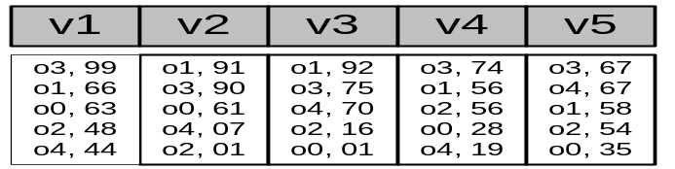
Centralized Top-K Query Processing
Fagin’s* Threshold Algorithm (TA):
(In ACM PODS’02) * Concurrently developed by 3 groups
The most widely recognized algorithm for Top-K Query
Processing in database & middleware systems
ΤΑ Algorithm
1) Access the n lists in parallel.
2) While some object o_{i} is seen, perform a random access to the other lists to find the complete score for o_{i}.
3) Do the same for all objects in the current row.
4) Now compute the threshold τ as the sum of scores in the current row.
5)The algorithm stops after K objects have been found with a score above τ.

Slide 12
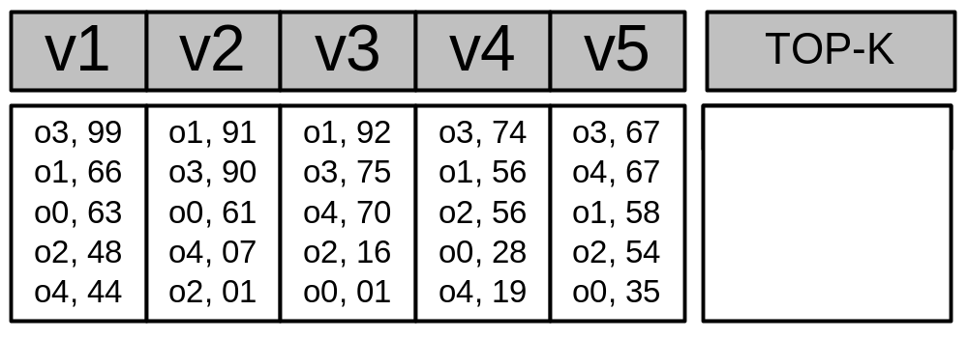
Centralized Top-K: The TA Algorithm (Example)
O3, 405
O1, 363
O4, 207
Iteration 1 Threshold
τ = 99 + 91 + 92 + 74 + 67 => τ = 423
Have we found K=1 objects with a score above τ? => ΝΟ
Iteration 2 Threshold
τ (2nd row)= 66 + 90 + 75 + 56 + 67 => τ = 354
Have we found K=1 objects with a score above τ? => YES!
Why is the threshold correct?
It gives us the maximum score for the objects we have not seen yet (<= τ)
Notes:
After the first row is resolved, there might be an object X in the second row that has a maximum value equal to the threshold.

Slide 13
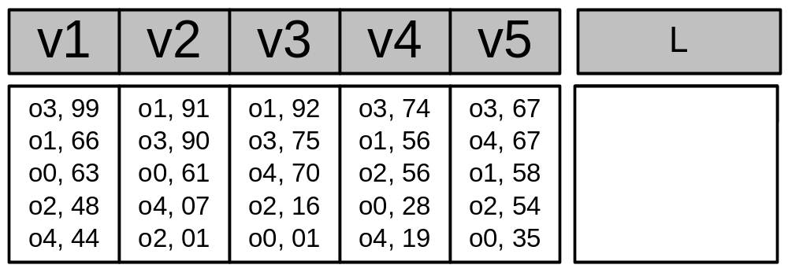
FA Algorithm Example
Top-1 Query: Find the object with the highest aggregate score
{O3’, O1’}
{O3, O1’, O4’}
OID’: Incompletely Calculated; OID: Completely Calculated
Sorted Access 1 (Fetch first row)
Have we found K=1 completely calculated objects? => ΝΟ
Sorted Access 2 (Fetch second row)
Have we found K=1 completely calculated objects? => YES! (i.e., O3)
Random Access 1 (Fetch tuples of all incomp. objects i.e., O1’, O4’)
Score(O3) = 99 + 90 + 75 + 74 + 67 = 405
Score(O1) = 66 + 91 + 92 + 56 + 58 = 363
Score(O4) = 44 + 07 + 70 + 19 + 67 = 207
TOP-1 Result

Slide 14
Presentation Outline
Introduction
Centralized Top-K and TA
C. Distributed Top-K Queries
  The Threshold Join Algorithm (TJA)
  Evaluation: P2P Network (Java & Linux)
Distributed Continuous Top-K Queries
  The MINT Algorithm
  Evaluation: Sensor Network (nesC & TinyOS)
Distributed Spatio-Temporal Top-K Queries
  The UB-K, UBLB-K, HUB-K Family of Algorithms
  Evaluation: Smartphone Network (Java & Android)

Slide 15
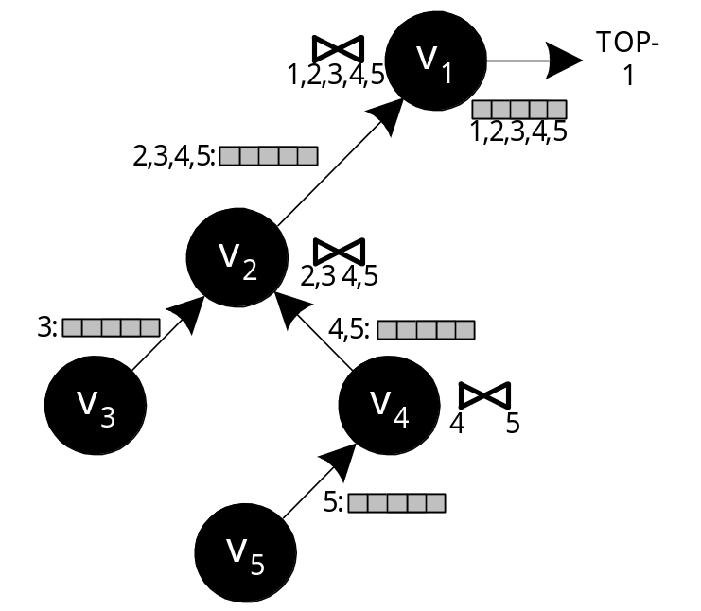
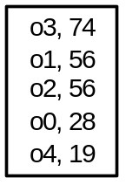
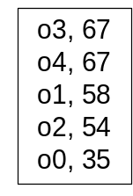
The Staged Join Algorithm (SJA)
Improved Solution: Aggregate the lists before these are forwarded to the parent:
This is referred to as the In-network aggregation approach
Advantage: Only O(n) messages
Disadvantage: The size of each message is still very large in size (i.e., the complete list)

Slide 16
Threshold Join Algorithm (TJA)
TJA is our 3-phase algorithm that optimizes top-k query execution in distributed (hierarchical) environments.
Advantage:
  It usually completes in 2 phases.
  It never completes in more than 3 phases (LB Phase, HJ Phase and CL Phase)
  It is therefore highly appropriate for distributed environments
“The Threshold Join Algorithm for Top-k Queries in Distributed Sensor Networks", D. Zeinalipour-Yazti et. al, In VLDB’s DMSN’05.
“Finding the K Highest-Ranked Answers in a Distributed Network”, D. Zeinalipour-Yazti et. al, Computer Networks, Elsevier, 2009

Slide 17
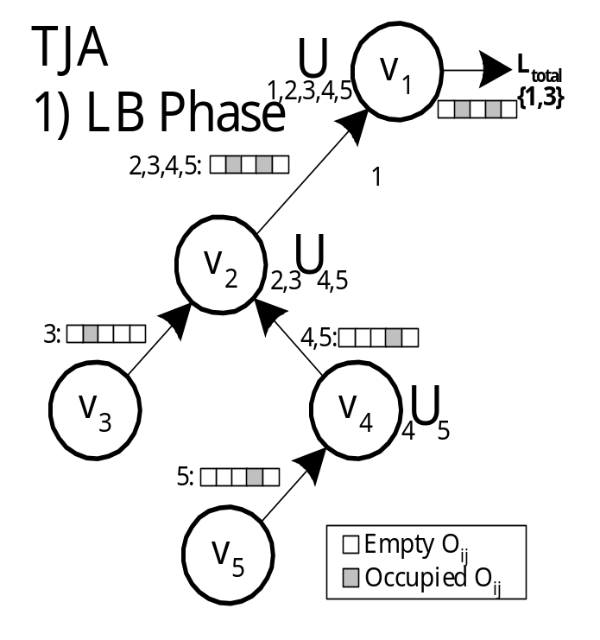
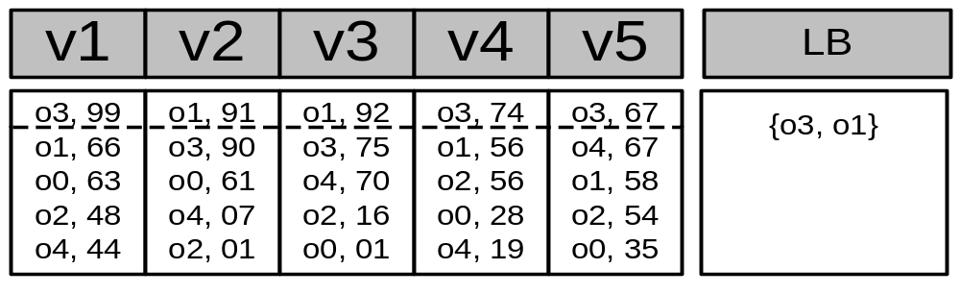
Step 1 - LB (Lower Bound) Phase
Recursively send the K highest objectIDs of each node to the sink.
Each intermediate node performs a union of the received results (defined as τ)
Τ=
Query: TOP-1

Slide 18
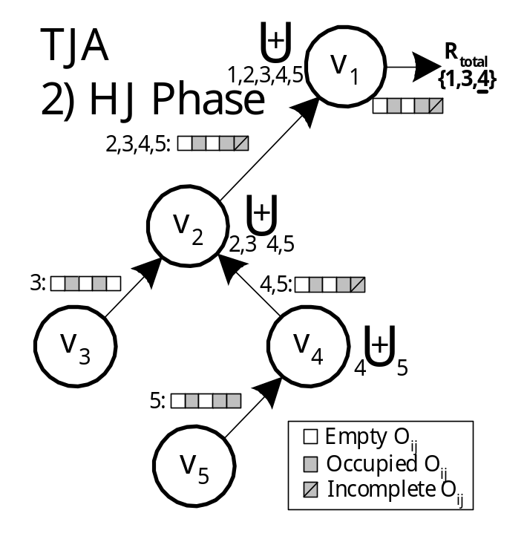
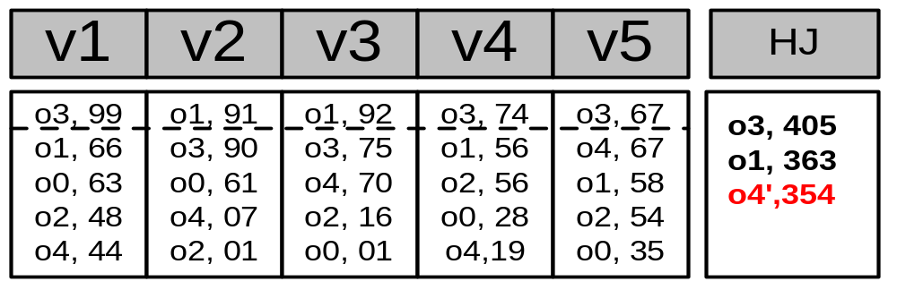
Step 2 – HJ (Hierarchical Join) Phase
Disseminate τ to all nodes
Each node sends back all objects with score above the objectIDs in τ
Before sending the objects, each node tags as incomplete, scores that could not be computed exactly
}
Complete
Incomplete

Slide 19
Step 3 – CL (Cleanup) Phase
Have we found K objects with a complete score that is above all incomplete scores?
  Yes: The answer has been found!
  No: Find the complete score for each incomplete object (all in a single batch phase)
CL ensures correctness
This phase is rarely required in practice!

Slide 20
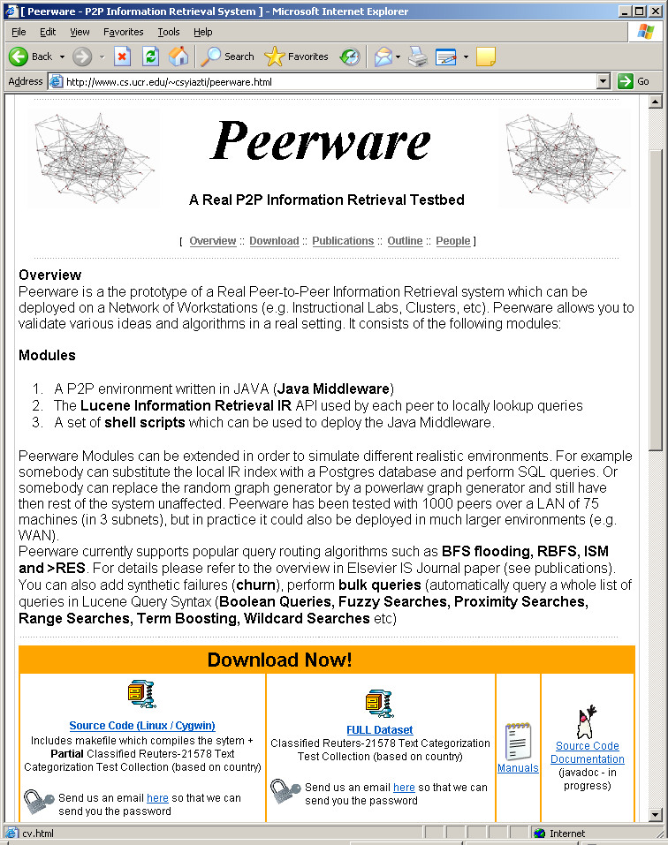
Experimental Evaluation
We have implemented a P2P middleware in JAVA (sockets + binary transfer protocol).
Real P2P Middleware tested on 1000 peers over 75 Linux workstations.
We use a trace-driven experimental methodology with traces from real
world applications.
Summary of Findings
Bytes: CJA = 10xTJA; SJA = 3xTJA
Time:
TJA:3.7s [L1.0s,HJ:2.7s,CL:0.08s];
SJA: 8.2s;
CJA:18.6s
Messages:
TJA:259
SJA:183
CJA:246
http://www.cs.ucr.edu/~csyiazti/peerware.html
(An open-source Distributed Content-Retrieval System)

Slide 21
Presentation Outline
Introduction
Centralized Top-K and TA
C. Distributed Snapshot Top-K Queries
  The Threshold Join Algorithm (TJA)
  Evaluation: P2P Network (Java & Linux)
Distributed Continuous Top-K Queries
  The MINT Algorithm
  Evaluation: Sensor Network (nesC & TinyOS)
Distributed Spatio-Temporal Top-K Queries
  The UB-K, UBLB-K, HUB-K Family of Algorithms
  Evaluation: Smartphone Network (Java & Android)

Slide 22
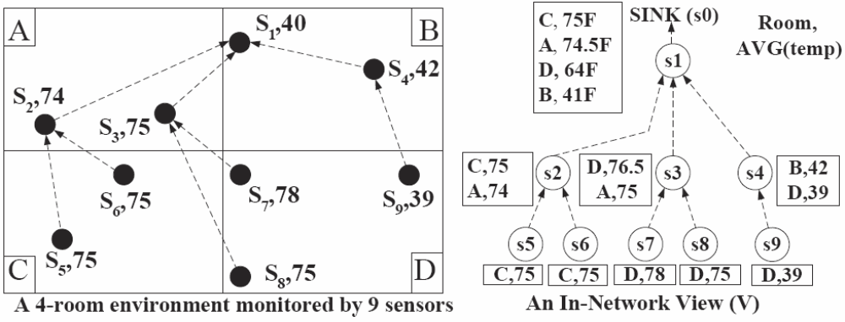
ΜΙΝT-View Framework
ΜΙΝΤ : a framework for optimizing the execution of continuous monitoring queries in sensor networks.
  “Power Efficiency through Tuple Ranking in Wireless Sensor Networks”, P. Andreou, P. Andreou, D. Zeinalipour-Yazti, P.K. Chrysanthis, G. Samaras, Distributed and Parallel Databases, Springer (under review), 2010.
  "MINT Views: Materialized In-Network Top-k Views in Sensor Networks" , D. Zeinalipour-Yazti, P. Andreou, P. Chrysanthis and G. Samaras, In IEEE 8th International Conference on Mobile Data Management, Mannheim, Germany, May 7 – 11, 2007
Query: Find the K=1 rooms with the highest avg. temp. per room

Slide 23
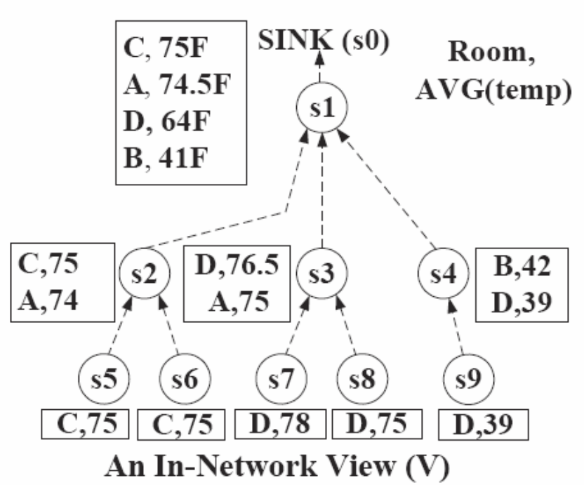
ΜΙΝΤ Views: Problem
MINT Objective: To prune away tuples locally at each sensor such that messaging is minimized.
Naïve Solution: Each node eliminates any tuple with a score lower than its top-1 result.
D,76.5
C,75
B,41
Problem:
We received a incorrect answer i.e., (D,76.5) instead of (C,75).
(B,40)

Slide 24
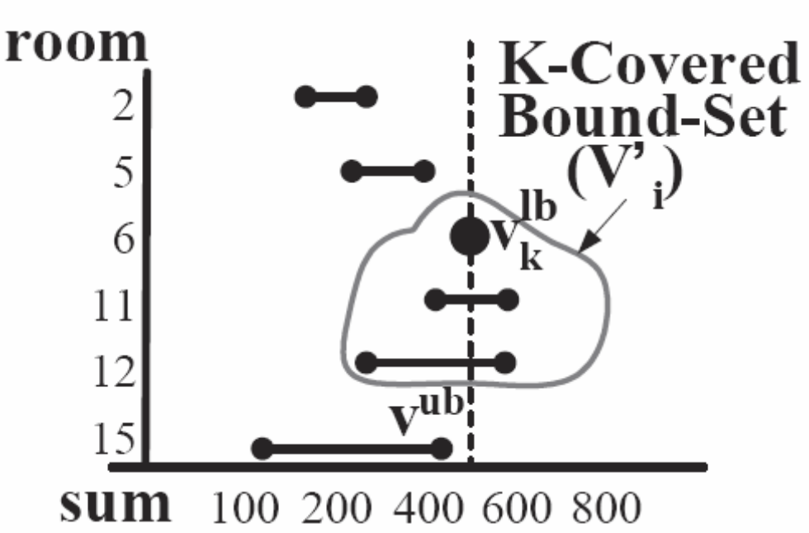
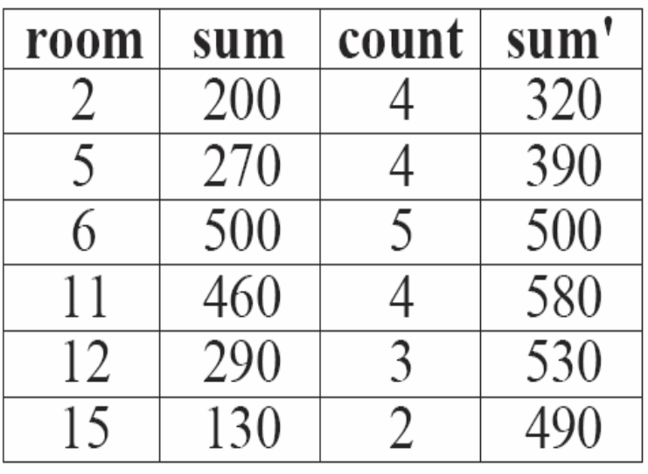
ΜΙΝΤ Views: Main Idea
Main Idea: Bound Above tuples with their max. possible value
  e.g., Assume that maxtemp=120F and #sensors/room=5
K-covered Bound-set : Includes all the objects that have an upper bound (v^{ub}) greater or equal to the kth highest lower bound (τ), i.e., v^{ub} > τ
Intermediate Q Result
τ
sum
v^{lb}
v^{ub}

Slide 25
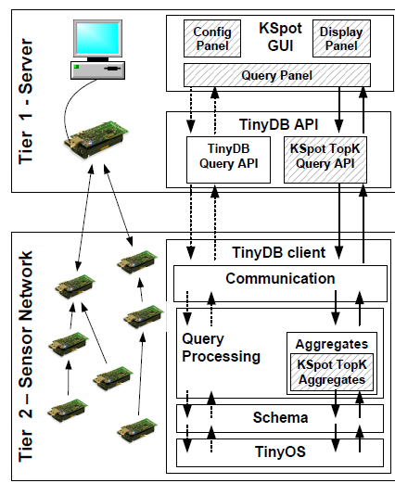
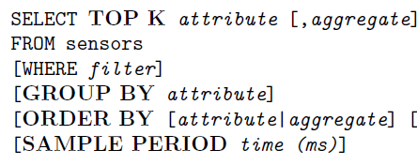
KSpot System Architecture
``KSpot: Effectively Monitoring the K Most Important Events in a Wireless Sensor Network", P. Andreou, D. Zeinalipour-Yazti, M. Vassiliadou, P.K. Chrysanthis, G. Samaras, 25th International Conference on Data Engineering March (ICDE'09), Shanghai, China, May 29 - April 4, 2009.

Slide 26
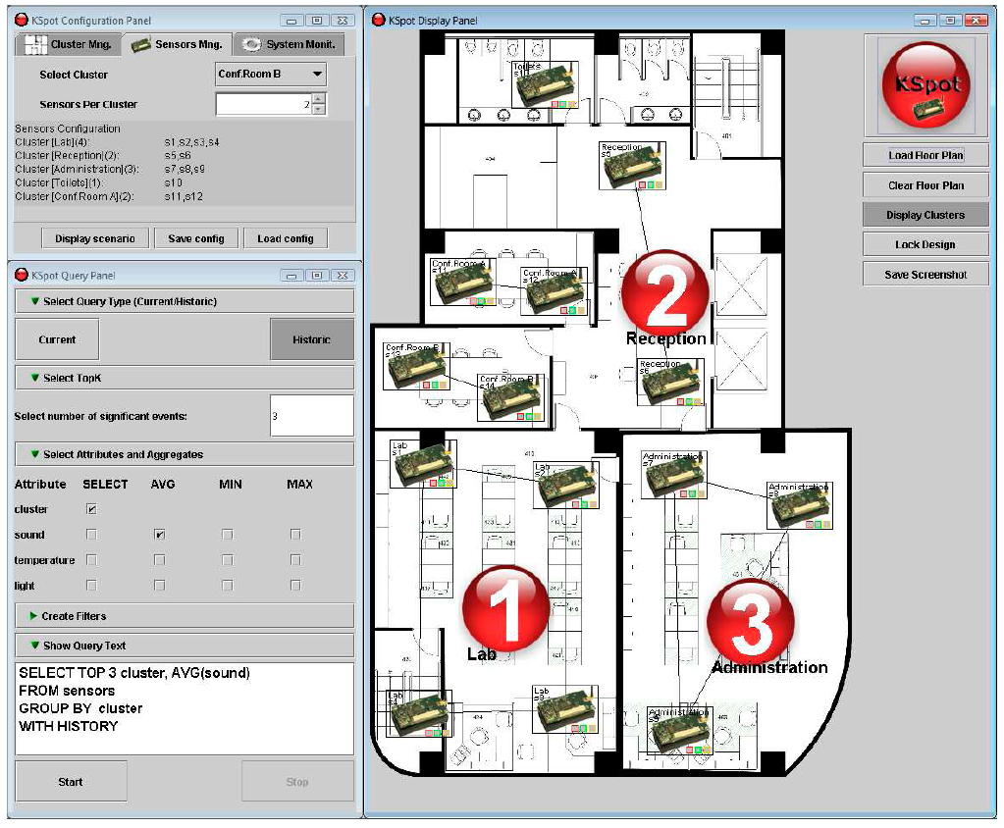
KSpot System GUI
Configuration Panel
Online Ranking
Query Box
Download: http://www.cs.ucy.ac.cy/~panic/kspot
Notes:
ICDE: highest noise level, indicator for crowded areas of the conference

Slide 27
ΜΙΝΤ Views: Experimentation
  We have conducted a real study of MINT using KSpot and validated that it is easy to implement and does not make any unreasonable assumptions.
    “Power Efficiency through Tuple Ranking in Wireless Sensor Networks”, P. Andreou, P. Andreou, D. Zeinalipour-Yazti, P.K. Chrysanthis, G. Samaras, Distributed and Parallel Databases, Springer (under review), 2010.
  Testbed Characteristics
  Trace-driven evaluation using the real system
  Language (OS): nesC (TinyOS)
  Sensor Device: Crossbow’s TelosB
  Datasets: Great-Duck-Island-14, Atmomon-32, Intel-Labs-49 (real traces of sensor deployments)
  Energy Modeling: TinyOS’s PowerTOSSIM
  Network Link Modeling: TinyOS’s LossyBuilder

Slide 28
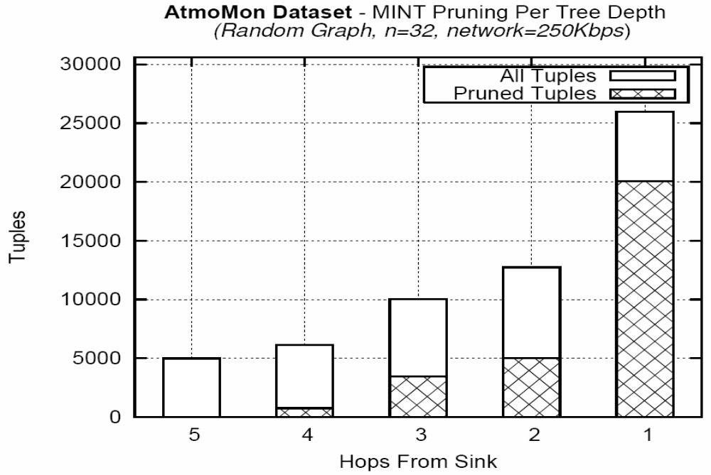
ΜΙΝΤ Views: Experimentation
Pruning Magnitude per Network Level
77%
39%
34%
12%
0%

Slide 29
Presentation Outline
Introduction
Centralized Top-K and TA
C. Distributed Snapshot Top-K Queries
  The Threshold Join Algorithm (TJA)
  Testbed: P2P Network (Java & Linux)
Distributed Continuous Top-K Queries
  The MINT Algorithm
  Testbed: Sensor Network (nesC & TinyOS)
Distributed Spatio-Temporal Top-K Queries
  The UB-K, UBLB-K, HUB-K Family of Algorithms
  Testbed: Smartphone Network (Java & Android)

Slide 30

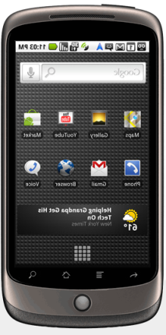
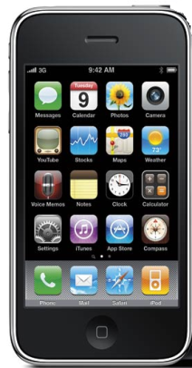


What is a Smartphone Network?
Smartphone Network: A collection of smartphones that communicate over a network to realize a collaborative task (Sensing activity, Social activity, ...)
    Bluetooth: Infrastructure-less P2P applications
    WiFi 802.11, WCDMA/UMTS(3G) / HSPA(3.5G): Infrastructure-Oriented.
Smartphone: offers more advanced computing and connectivity than a basic 'feature phone'.
  OS: Android, Nokia’s Maemo, Apple X
  CPU: >1 GHz ARM-based processors
  Memory: 512MB Flash, 512MB RAM, 4GB Card;
  Sensing: Proximity, Ambient Light, Accelerometer, Camera, Microphone, Geo-location based on GPS, WIFI, Cellular Towers,…

Slide 31
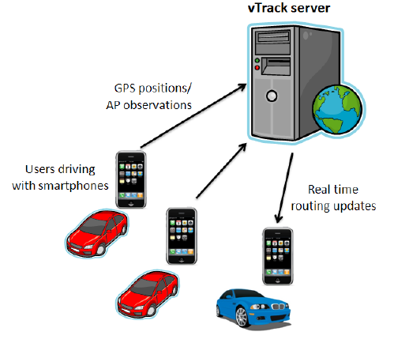
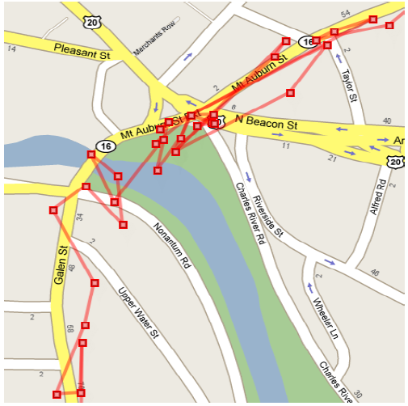
Smartphone Network: Applications
Intelligent Transportation Systems with VTrack
Better manage traffic by estimating roads taken by users using WiFi beams (instead of GPS) .
Graphics courtesy of: A .Thiagarajan et. al. “Vtrack: Accurate, Energy-Aware Road Traffic Delay Estimation using Mobile Phones, In Sensys’09, pages 85-98. ACM, (Best Paper) MIT’s CarTel Group
Notes:
Smartphones participate in a collaborative sensing activity to enable a new service: i.e., high-fidelity traffic estimation.

Slide 32
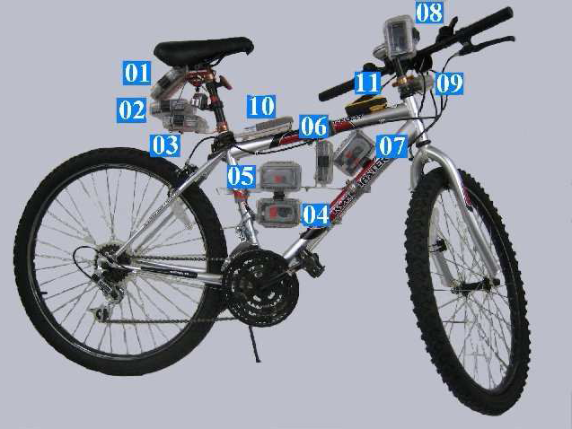
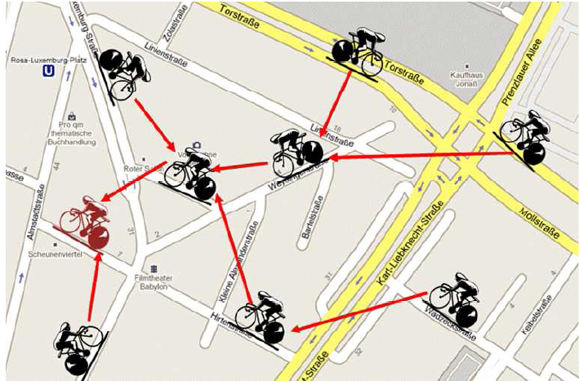
Smartphone Network: Applications
BikeNet: Mobile Sensing for Cyclists.
Real-time Social Networking of the cycling community (e.g., find routes with low CO2 levels)
Left Graphic courtesy of: S. B. Eisenman et. al., "The BikeNet Mobile Sensing System for Cyclist Experience Mapping", In Sensys'07 (Dartmouth’s MetroSense Group)

Slide 33
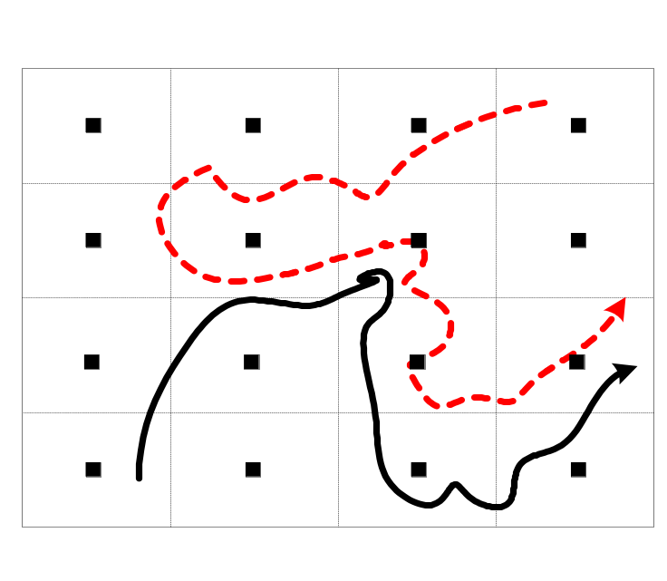

Spatio-Temporal Query Processing
Effectively querying spatio-temporal data, calls for specialized query processing operators.
Distributed Spatio-Temporal Similarity Search: How to find the K most similar trajectories to Q without pulling together all data
``Distributed Spatio-Temporal Similarity Search’’, D. Zeinalipour-Yazti, et. al, In ACM CIKM’06.
"Finding the K Highest-Ranked Answers in a Distributed Network", D. Zeinalipour-Yazti et. al., Computer Networks, Elsevier, 2009.
In-Situ DATA
Q

Slide 34
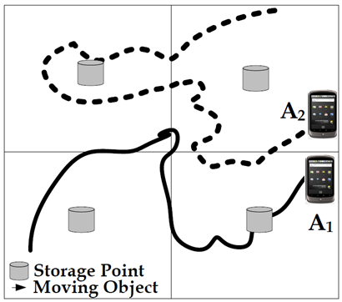
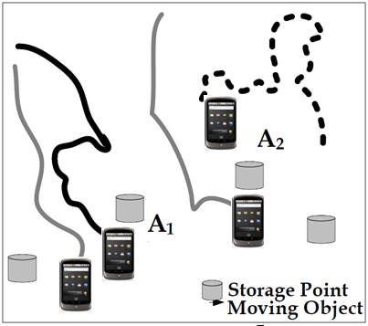
Spatio-Temporal Query Processing
Vertical Fragmentation
(of trajectories)
Horizontal Fragmentation
(of trajectories)
UB-K & UBLB-K
Algorithms
HUB-K Algorithm

Slide 35
The Longest Common Subsequence
ST Similarity Search Challenges?
  Flexible matching in time
  Flexible matching in space (ignores outliers)
LCSS is proven to be good at both, but is computationally expensive.
ignore majority of noise
match
match

Slide 36
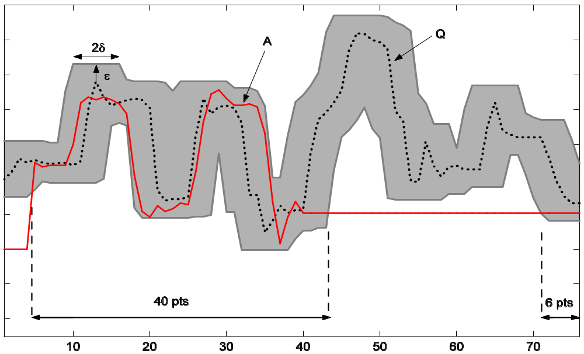
The Longest Common Subsequence
Bounding Above the LCSS Metric
ΜΒΕ: Minimum Bounding Envelope
Q
ε
A
2δ
40 pts
6 pts
* Indexing multi-dimensional time-series with support for multiple distance measures,
M. Vlachos, M. Hadjieleftheriou, D. Gunopulos, E. Keogh, In KDD 2003.

Slide 37
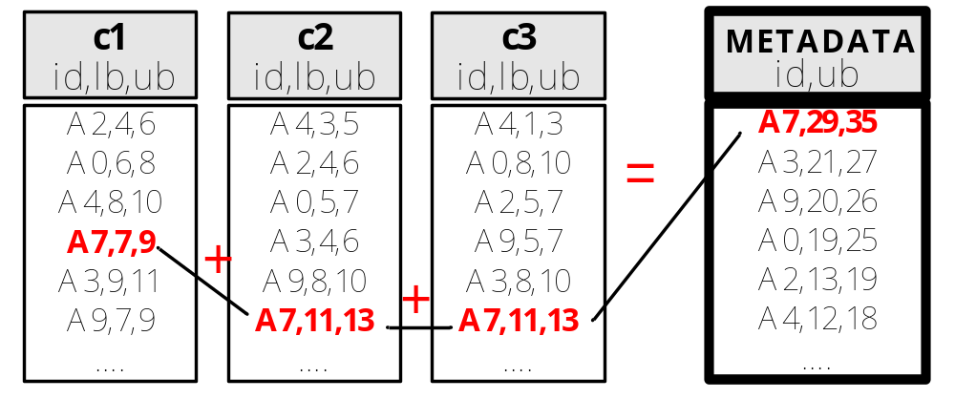
Score Bounds: Problem Overview
In the Distributed Top-K Processing with Score Bounds (rather than Exact Scores).
Task of Identifying Top-K Results becomes trickier.
We have devised a family of new algorithms for combining these bound scores effectively
  UB-K and UBLB-k Algorithms => Vertically-fragmented data
  HUB-K Algorithm => Horizontally-fragmented data.

Slide 38
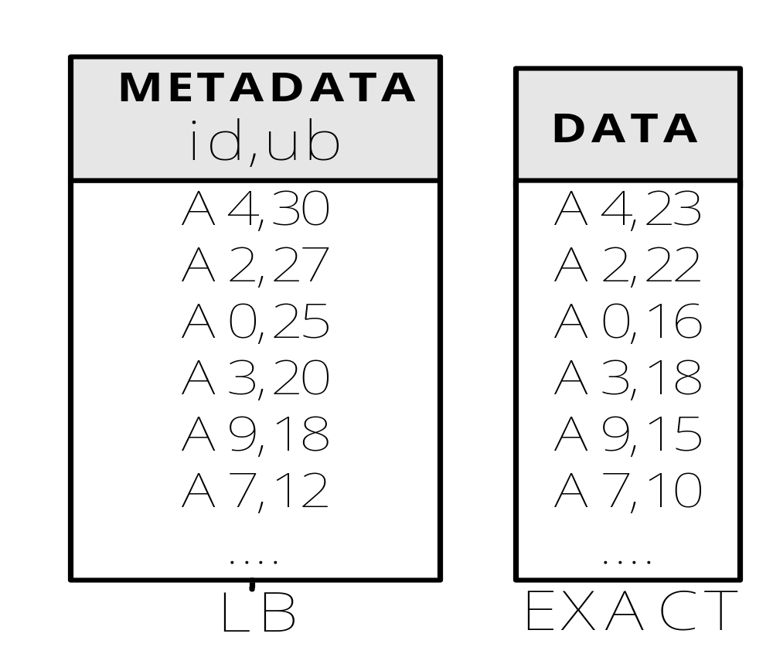
UB-K Execution
Query: Find the K=2 most similar trajectories to Q
Q
Retrieve the sequences A4, A2
A4
TJA
LCSS(Q,A4)=23
Stop if
Kth LCSS
>=
Λth UB
=>Kth LCSS
Λ=3
≥?
TJA
Λ=5
K=2
22
23

Slide 39
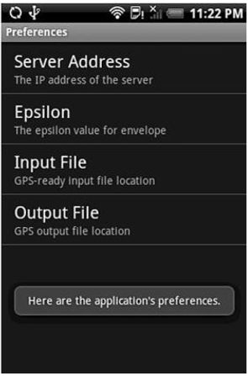
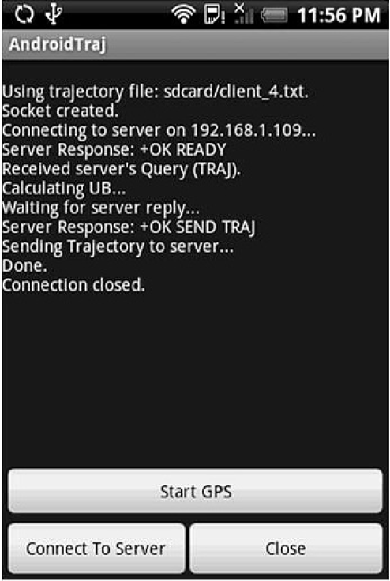
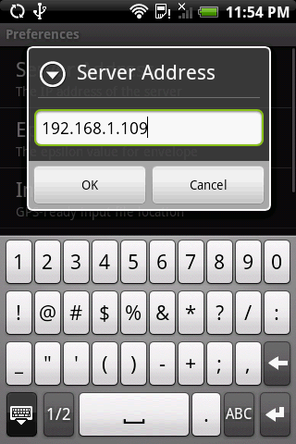
Evaluation Testbeds
Query Processor
Running HUB-K
Querying large traces within seconds rather than minutes

Slide 40
Evaluation Testbeds for Smartphone Network Applications
Currently, there are no testbeds for realistically emulating and prototyping Smartphone Network applications and protocols at a large scale.
  MobNet project (at UCY 2010-2011), will develop an innovative cloud testbed of mobile sensor devices using Android
    Application-driven spatial emulation.
    Develop MSN apps as a whole not individually.

Slide 41
Ranking Query Results in a Networked World
Thanks!
Demetris Zeinalipour
University of Cyprus
http://www2.cs.ucy.ac.cy/~dzeina/talks.html
Thursday, May 27th, 2010
Messaging and Event Systems Department,
IBM T. J. Watson Research Center, Hawthorne, NY 10532, USA
http://www.cs.ucy.ac.cy/~dzeina/

