Slide 1
Distributed Top-K Ranking Algorithms
Demetris Zeinalipour
Lecturer
School of Pure and Applied Sciences
Open University of Cyprus
Monday, December 15th, 2008, 15:30-16:30
DAMA Group, Polytechnic University of Catalonia (UPC), Barcelona
http://www.cs.ucy.ac.cy/~dzeina/

Slide 2
Acknowledgements
The results shown in this presentation are based on the following papers:
  ``KSpot: Effectively Monitoring the K Most Important Events in a Wireless Sensor Network", P. Andreou, D. Zeinalipour-Yazti, M. Vassiliadou, P.K. Chrysanthis, G. Samaras, 25th International Conference on Data Engineering March (ICDE'09) (demo), Shanghai, China, May 29 - April 4, 2009,
  ``Finding the K Highest-Ranked Answers in a Distributed Network”, D. Zeinalipour-Yazti et. al, Computer Networks journal, Elsevier, 2009.
  ``Seminar: Distributed Top-K Query Processing in Wireless Sensor Networks’’, D. Zeinalipour-Yazti, Z. Vagena, Tutorial at the 9th Intl. Conference on Mobile Data Management (MDM'08), April 27-30, 2008
  ``Distributed Spatio-Temporal Similarity Search'', D. Zeinalipour-Yazti, S. Lin, D. Gunopulos, The 15th ACM Conference on Information and Knowledge Management (CIKM'06), Arlington, VA, USA, November 6-11, to appear, 2006.

Slide 3
Top-k Queries: Introduction
Top-K Queries are a long studied topic in the database and information retrieval communities
The main objective of these queries is to return the K highest-ranked answers quickly and efficiently.
A Top-K query returns the subset of most relevant answers, in place of ALL answers, for two reasons:
  i) to minimize the cost metric that is associated with the retrieval of all answers (e.g., disk, network, etc.)
  ii) to maximize the quality of the answer set, such that the user is not overwhelmed with irrelevant results

Slide 4
Top-k Queries: Definitions
Top-K Query (Q)
Given a database D of m objects (each of which characterized by n attributes) a scoring function f, according to which we rank the objects in D, and the number of expected answers K, a Top-K query Q returns the K objects with the highest score (rank) in f.
Scoring Table
An m-by-n matrix of scores expressing the similarity of Q to all objects in D (for all attributes).

Slide 5




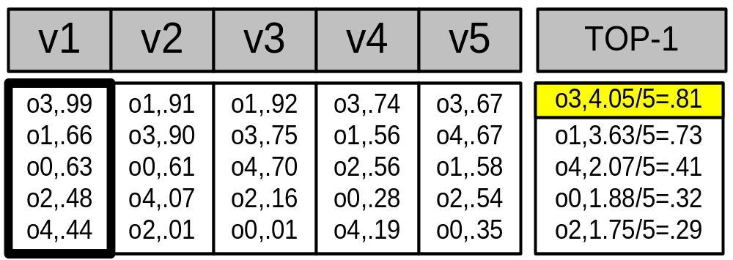
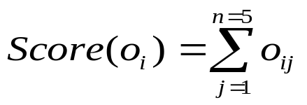
Top-k Queries: Then
SELECT TOP-2 pictures
FROM PICTURES
WHERE SIMILAR(picture, )
Query Processing
{ }
Assumptions
The data is available locally on disks or over a “high-speed”, “always-on” network
Trade-off
Clients want to get the right answers quickly
Service Providers want to consume the least possible resources
Scoring Table
Similarity
Image
{
(M) Images
(N) Features
A monotone scoring function:
Notes:
Query By Example: Applies to database and middleware scenarios

Slide 6

Top-k Queries: Now
In-Network Top-k Query Processing
Base Station
New System Model: Wireless Sensor Networks, Peer-to-Peer Networks, Vehicular Networks, etc. feature a graph communication structure.
New Queries (Examples from Sensor Networks):
  Snapshot Query: Find the K nodes with the highest temperature values.
  Continuous Query: For the next one hour continuously report the K rooms with the highest average temperature
  Historic Query (nodes store all data locally): Find the K nodes with the highest average temperature during the last 6 months

Slide 7
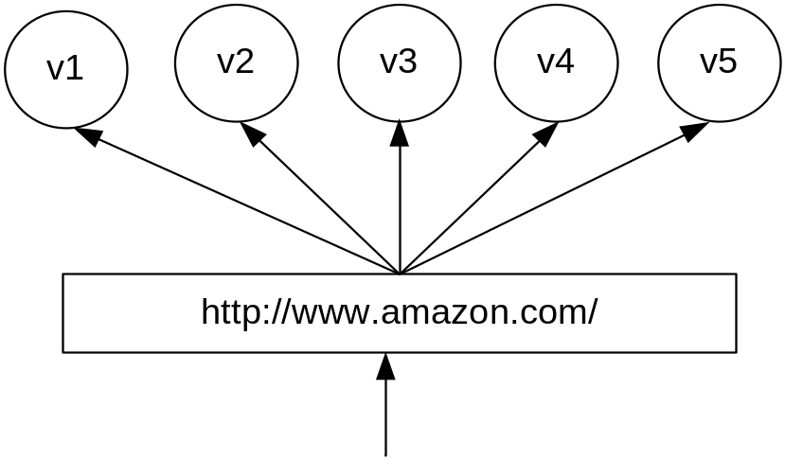
Top-k Queries Now: Another Example
Assume a cluster of n=5 WebServers (features)
Each server maintains locally a replica of the same m=5 static WebPages (objects)
When a web page is accessed by a client, the respective server increases a local hit counter by one
Scoring Table
Hits++
Hits
PageID
{
(M) WebPages
client
TOP-1 Query: “Find the webpage with the highest number of hits across all servers”
(N) WebServers
Notes:
CDN example!, reorganize the layout of the website at real time in such a way that the most accessed URLs become availble with the fewest number of user clicks.

Slide 8
Presentation Outline
A. Introduction
B. Centralized Top-K Query Processing
  The Threshold Algorithm (TA)
C. Distributed Top-K Query Processing with Exact Scores
  The Threshold Join Algorithm (TJA)
  Experimentation using 75 workstations
Distributed Top-K Query Processing with Score Bounds
  The UB-K and UBLB-K Algorithms

Slide 9

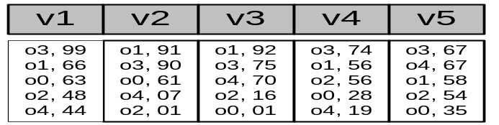
Centralized Top-K Query Processing
Fagin’s* Threshold Algorithm (TA):
(In ACM PODS’02) * Concurrently developed by 3 groups
The most widely recognized algorithm for Top-K Query
Processing in database systems
ΤΑ Algorithm
1) Access the n lists in parallel.
2) While some object o_{i} is seen, perform a random access to the other lists to find the complete score for o_{i}.
3) Do the same for all objects in the current row.
4) Now compute the threshold τ as the sum of scores in the current row.
5)The algorithm stops after K objects have been found with a score above τ.

Slide 10
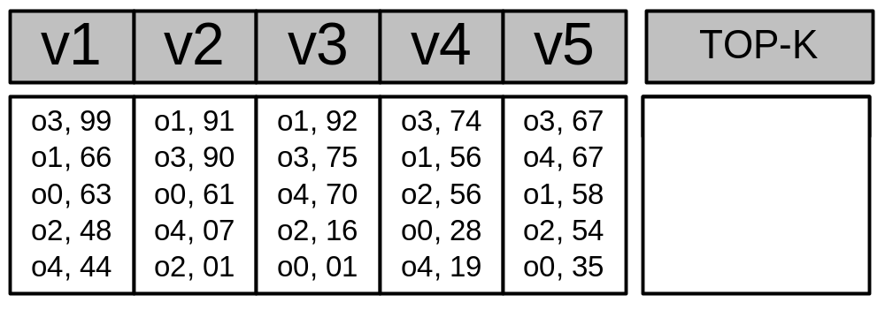
Centralized Top-K: The TA Algorithm (Example)
O3, 405
O1, 363
O4, 207
Iteration 1 Threshold
τ = 99 + 91 + 92 + 74 + 67 => τ = 423
Have we found K=1 objects with a score above τ? => ΝΟ
Iteration 2 Threshold
τ (2nd row)= 66 + 90 + 75 + 56 + 67 => τ = 354
Have we found K=1 objects with a score above τ? => YES!
Why is the threshold correct?
It gives us the maximum score for the objects we have not seen yet (<= τ)
Notes:
After the first row is resolved, there might be an object X in the second row that has a maximum value equal to the threshold.

Slide 11
Presentation Outline
A. Introduction
B. Centralized Top-K Query Processing
  The Threshold Algorithm (TA)
C. Distributed Top-K Query Processing with Exact Scores
  The Threshold Join Algorithm (TJA)
  Experimentation using 75 workstations
Distributed Top-K Query Processing with Score Bounds
  The UB-K and UBLB-K Algorithms

Slide 12
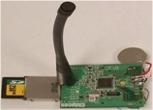
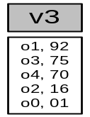
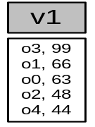
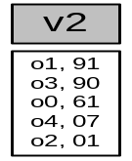
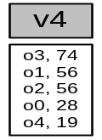
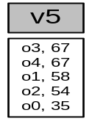
Distributed Top-K Query Processing
Distributed Setting:
Query Processor
The base relation is vertically fragmented across the network.
Centralized algorithms require several iterations to complete (recall TA) and each iteration introduces additional latency and messaging.

Slide 13
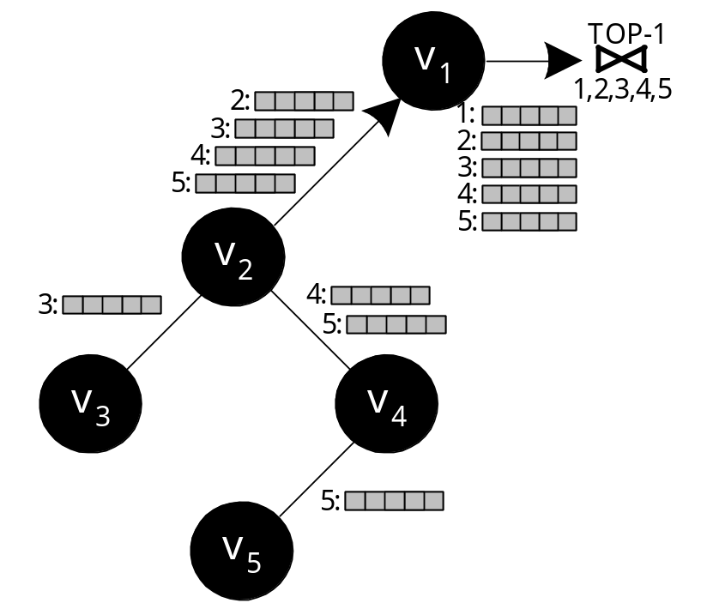
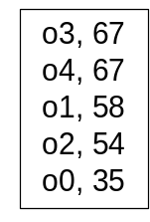
Centralized Join Algorithm (CJA)
Main Idea
Collect all possible tuples at the sink and then discard the tuples in excess (to the parameter k).
Advantages
Can complete in only one acquisition round.
Disadvantages
Overwhelming amount of messages!
Huge Query Response Time.

Slide 14
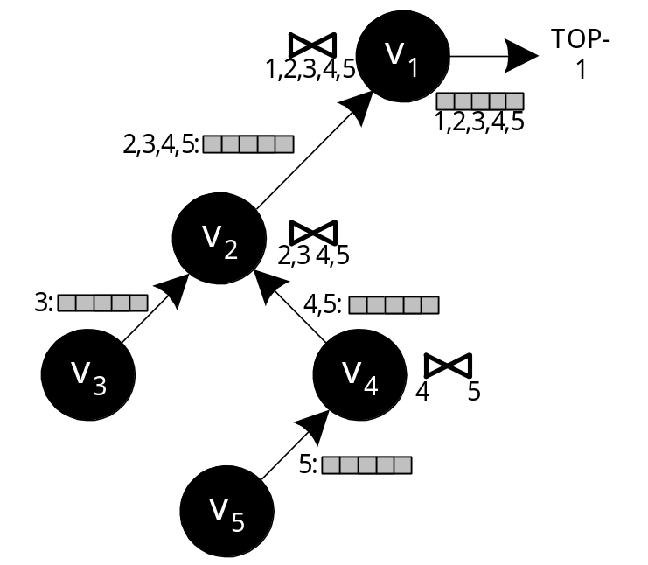
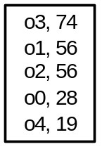
The Staged Join Algorithm (SJA)
Improved Solution: Aggregate the lists before these are forwarded to the parent:
This is referred to as the In-network aggregation approach
Advantage: Only O(n) messages
Disadvantage: The size of each message is still very large in size (i.e., the complete list)

Slide 15
Threshold Join Algorithm (TJA)
TJA is our 3-phase algorithm that optimizes top-k query execution in distributed (hierarchical) environments.
Advantage:
  It usually completes in 2 phases.
  It never completes in more than 3 phases (LB Phase, HJ Phase and CL Phase)
  It is therefore highly appropriate for distributed environments
“The Threshold Join Algorithm for Top-k Queries in Distributed Sensor Networks", D. Zeinalipour-Yazti et. al, In VLDB’s DMSN’05.
“Finding the K Highest-Ranked Answers in a Distributed Network”, D. Zeinalipour-Yazti et. al, Computer Networks, Elsevier, 2008.

Slide 16
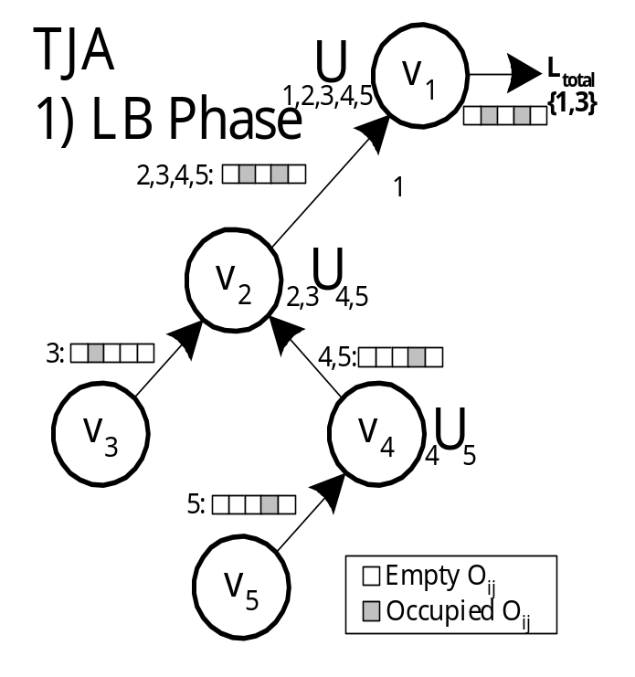
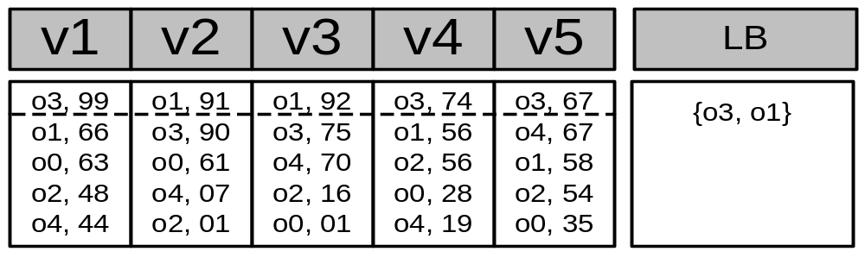
Step 1 - LB (Lower Bound) Phase
Recursively send the K highest objectIDs of each node to the sink.
Each intermediate node performs a union of the received results (defined as τ)
Τ=
Query: TOP-1

Slide 17
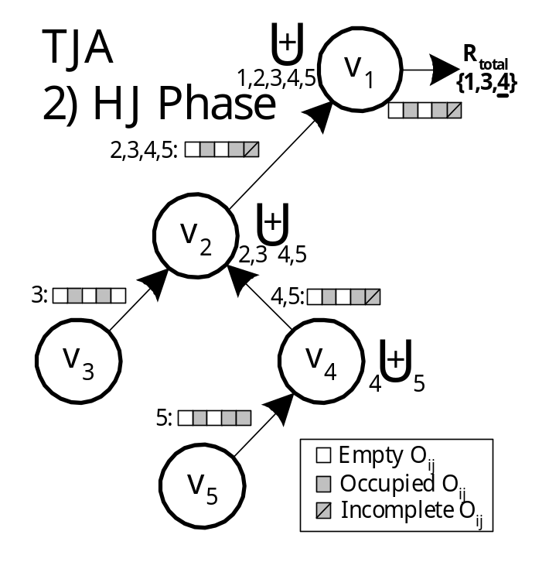
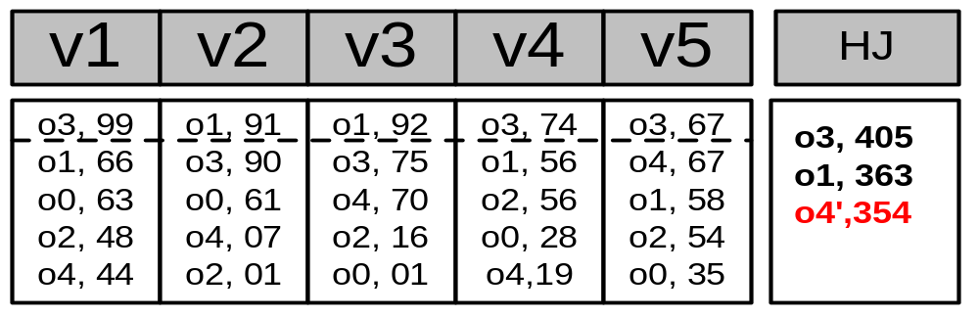
Step 2 – HJ (Hierarchical Join) Phase
Disseminate τ to all nodes
Each node sends back all objects with score above the objectIDs in τ
Before sending the objects, each node tags as incomplete, scores that could not be computed exactly
}
Complete
Incomplete

Slide 18
Step 3 – CL (Cleanup) Phase
Have we found K objects with a complete score that is above all incomplete scores?
  Yes: The answer has been found!
  No: Find the complete score for each incomplete object (all in a single batch phase)
CL ensures correctness
This phase is rarely required in practice!

Slide 19
Experimental Evaluation
Setup: Trace-Driven Experimentation
Testbed: Java Middleware deployed over 1000 nodes on 75 Linux workstations.
Dataset: Environmental Measurements from 32 atmospheric monitoring stations in Washington & Oregon. (2003-2004)
Query: Find the K timestamps on which the average temperature across all stations was maximum.
Evaluation Criteria: i) Bytes, ii) Time, iii) Messages
Various Failure Rates: 0%, 10%, 20% and 30%, Net Diameter=10, Node Degree=4.

Slide 20
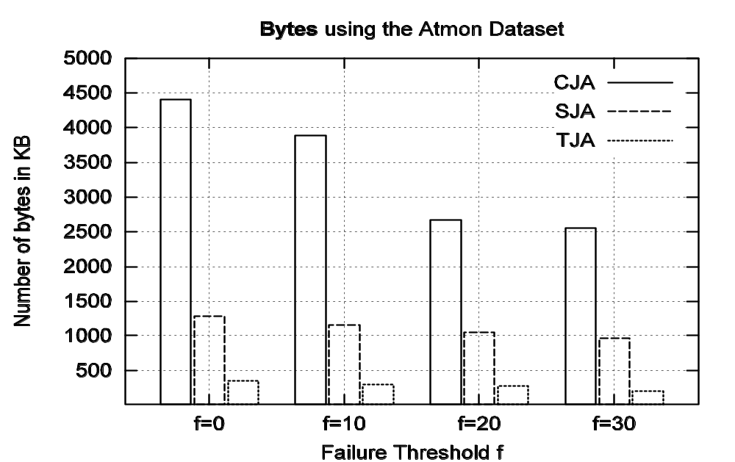
Experimental Evaluation
TJA requires one order of magnitude less
bytes than CJA and SJA!

Slide 21
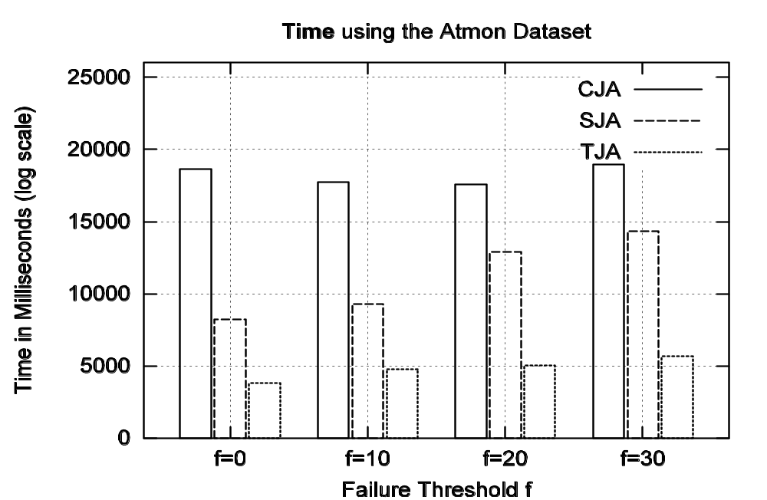
Experimental Evaluation
TJA: 3.7sec [ LB:1.0sec, HJ:2.7sec, CL:0.08sec ] SJA: 8.2sec CJA: 18.6sec

Slide 22
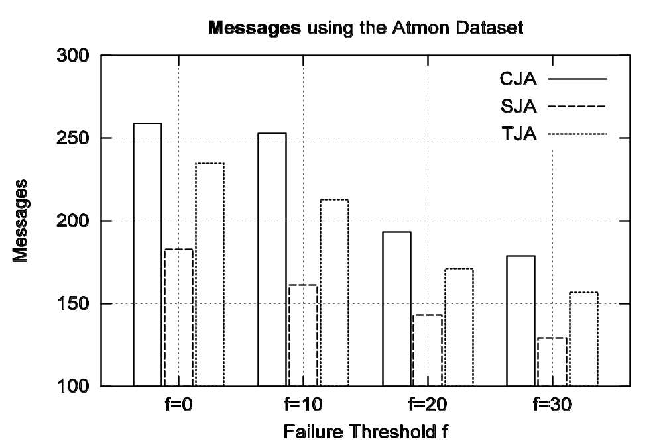
Experimental Evaluation
259
246
183
Although TJA consumes more messages than SJA and CJA, these are small-size messages

Slide 23
Presentation Outline
A. Introduction
B. Centralized Top-K Query Processing
  The Threshold Algorithm (TA)
C. Distributed Top-K Query Processing with Exact Scores
  The Threshold Join Algorithm (TJA)
  Experimentation using 75 workstations
Distributed Top-K Query Processing with Score Bounds
  The UB-K and UBLB-K Algorithms

Slide 24
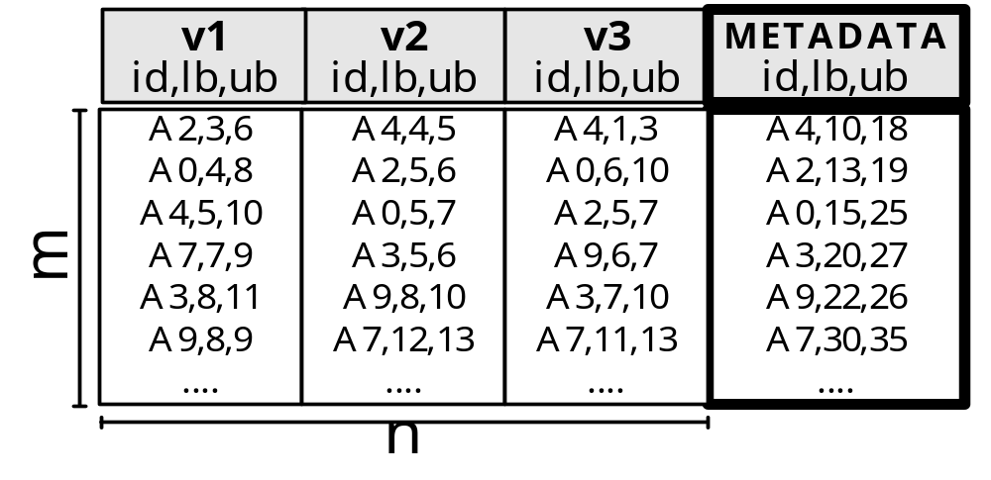
Score Bounds: Problem Overview
Now suppose that each node can only return Lower/Upper Bounds rather than Exact scores.
e.g., instead of 16 it returns [11..19]
Score Bound Table
Let us now study an application of a Score Bound Table in the context of Distributed Spatio-Temporal Similarity Search….

Slide 25
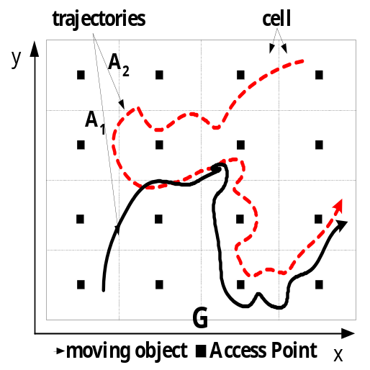
Score Bounds: Problem Overview
Distributed Spatio-Temporal Similarity Search: Given a query Q, find the degree of similarity between Q and a set of m target trajectories {A₁,A₂,…,A_{m}}.
Each Α_{i} (i<=m) is segmented into a number of non-overlapping cells {C₁,C₂,…,C_{n}} that maintain the local subsequences.
Challenge: How can we find the K most similar trajectories to Q without pulling together all subsequences
"Distributed Spatio-Temporal Similarity Search”,
D. Zeinalipour-Yazti, S. Lin, D. Gunopulos, ACM 15th Conference on Information and Knowledge Management, (ACM CIKM 2006), November 6-11, Arlington, VA, USA, pp.14-23, August 2006.
Q

Slide 26
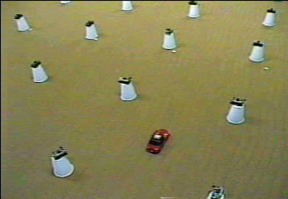
Score Bounds: Problem Overview

Slide 27
Score Bounds: Problem Overview
A. Euclidean Matching
The trajectories are matched 1:1
Out-of-phase matching
A
B
outlier
Longest Common SubSequence (LCSS) Matching
Copes with out-of-phase matches and outliers (it ignores them)
Cell 1
Cell 2
Cell 3
Cell 4
  Problem with Vertical Fragmentation: The matching might happen at the boundary of neighboring cells.
Notes:
Euclidean:
Cons: does not capture out-of-phase matches and noisy data because points are only matched at identical time instances.
Pros : fast to compute in a distributed fashion

Slide 28
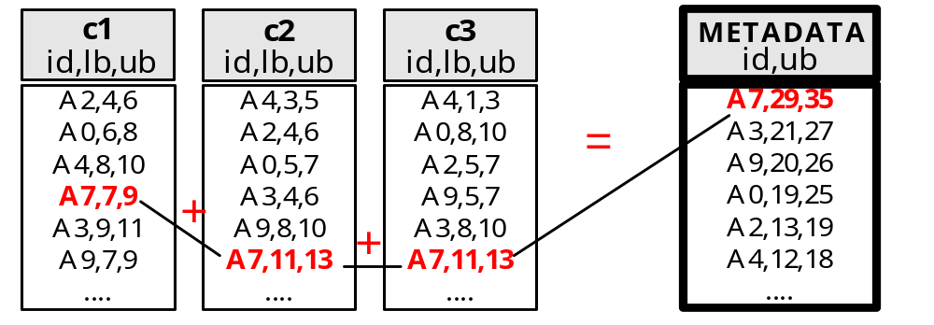
Score Bounds: Problem Overview
Each cell computes a lower bound and an upper bound on the matching of Q to its local subsequences.
The distributed scoring table now contains score bounds (lower,upper) rather than exact scores.
We have proposed two iterative algorithms: UB-K and UBLB-K, which combine these score bounds to derive the K most similar trajectories to Q without pulling together ALL distributed subsequences.

Slide 29
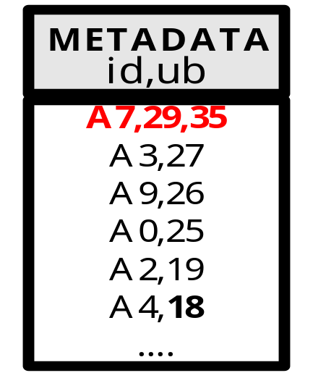
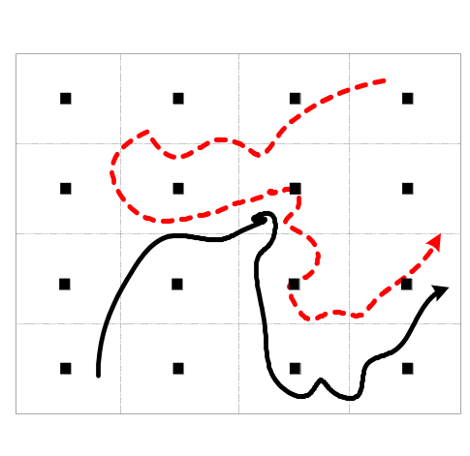

The UB-K Algorithm
An iterative algorithm to find the K most similar trajectories to Q.
Characteristics
  Phases: Iterative
  Scores: Approximate
  Result: Exact
  Query: Snapshot
Main Idea: Utilize the upper bounds in the METADATA table to minimize the transfer of DATA.
DATA
Q

Slide 30
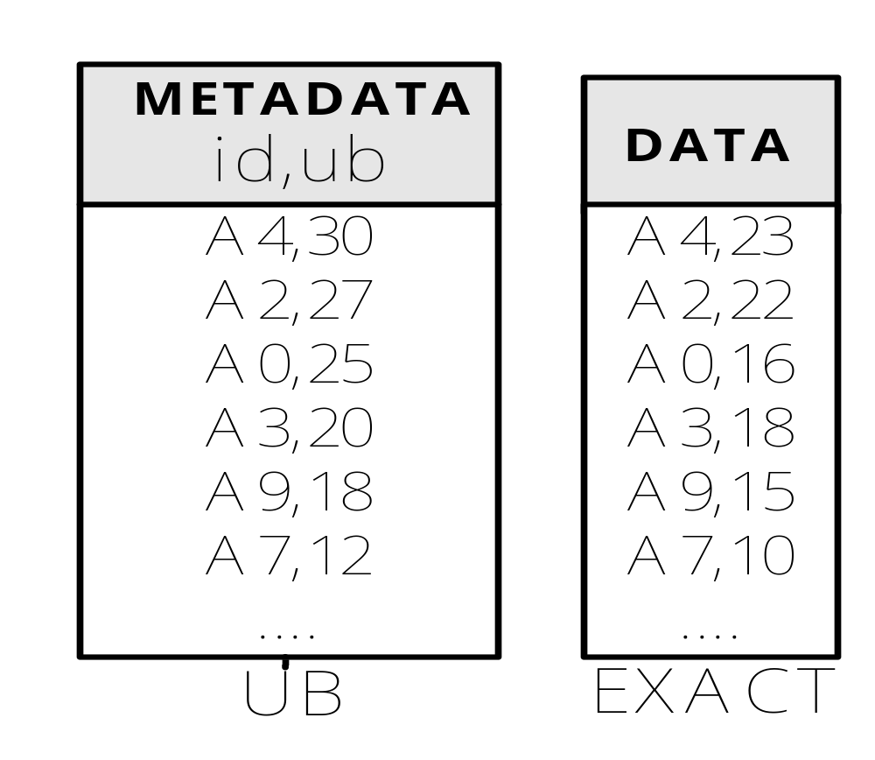
UB-K Execution
Query: Find the K=2 most similar trajectories to Q
Q
Retrieve the sequences A4, A2
A4
LCSS(Q,A4)=23
Stop if
Kth Exact
>=
Smallest UB
>Kth Exact Score
K+1
≥?
2K+1
K=2
22
23

Slide 31
The UBLB-K Algorithm
Also an iterative algorithm with the same objectives as UB-K
Characteristics
Phases: Iterative
Scores: Approximate
Result: Exact
Query: Snapshot
Differences:
Utilizes both an upper-bound and a lower bound on the LCSS matching to derive the top-k result-set.
Transfers the DATA in a final bulk step rather than incrementally (by utilizing the LBs)

Slide 32
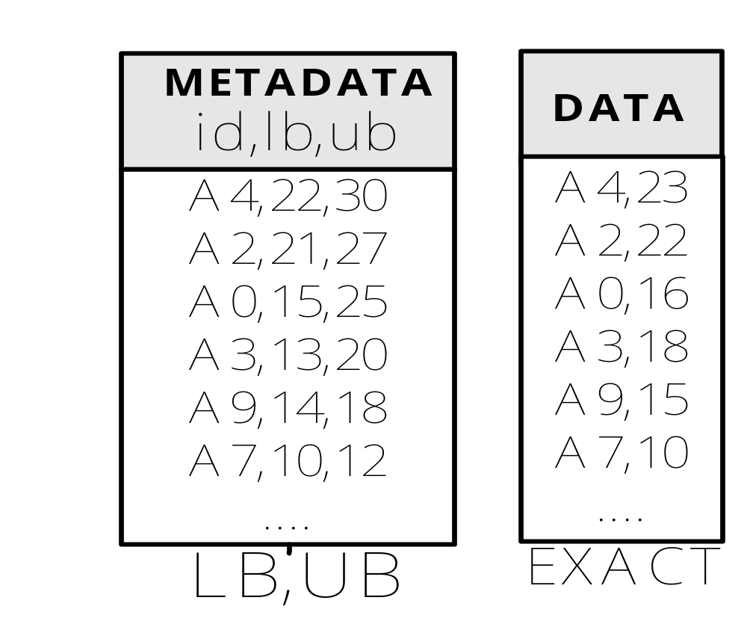

UBLB-K Execution
Query: Find the K=2 most similar trajectories to Q
Q
Stop if
Kth LB
>=
Smallest UB
A4
≥?
≥?
LCSS(Q,A4)=23
K+1
K=2
2K+1
Kth-LB
Note: Since the Kth LB 21 >= 20, anything below this UB is not retrieved in the final phase!

Slide 33
Final Remarks
I have presented the concepts behind popular Top-k query processing algorithms in centralized and distributed settings.
I have also presented a variety of algorithms that we have developed in order to support this new era of distributed databases.
Top-K Query Processing is a new area with many new challenges and opportunities!
We are working on applying this technology in new application areas, e.g.:
“FailRank: Towards a Unified Grid Failure Monitoring and Ranking System”, with UCY (Cyprus) and ICS/Forth (Crete, Greece), ZIB (Germany)

Slide 34
Distributed Top-K Ranking Algorithms
Thank you!
Demetris Zeinalipour
This presentation is available at:
http://www2.cs.ucy.ac.cy/~dzeina/talks.html
Related Publications available at:
http://www2.cs.ucy.ac.cy/~dzeina/publications.html

Slide 35
Backup Slides

Slide 36
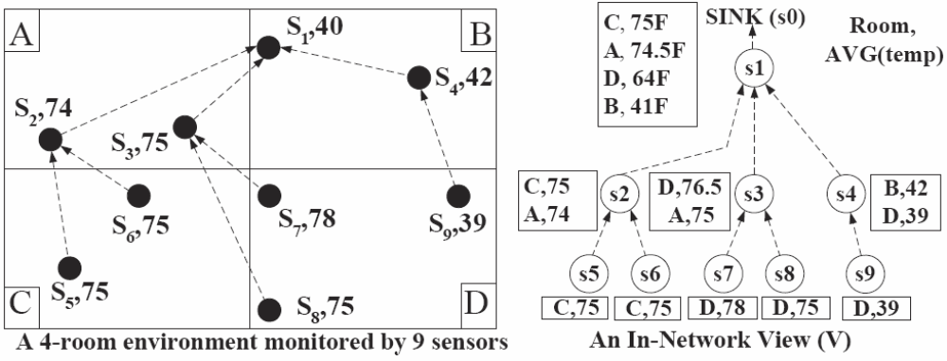
ΜΙΝT-View Framework
ΜΙΝΤ : a framework for optimizing the execution of continuous monitoring queries in sensor networks.
"MINT Views: Materialized In-Network Top-k Views in Sensor Networks"
D. Zeinalipour-Yazti, P. Andreou, P. Chrysanthis and G. Samaras, In IEEE 8th International Conference on Mobile Data Management, Mannheim, Germany, May 7 – 11, 2007
Query: Find the K=1 rooms with the highest average temperature

Slide 37
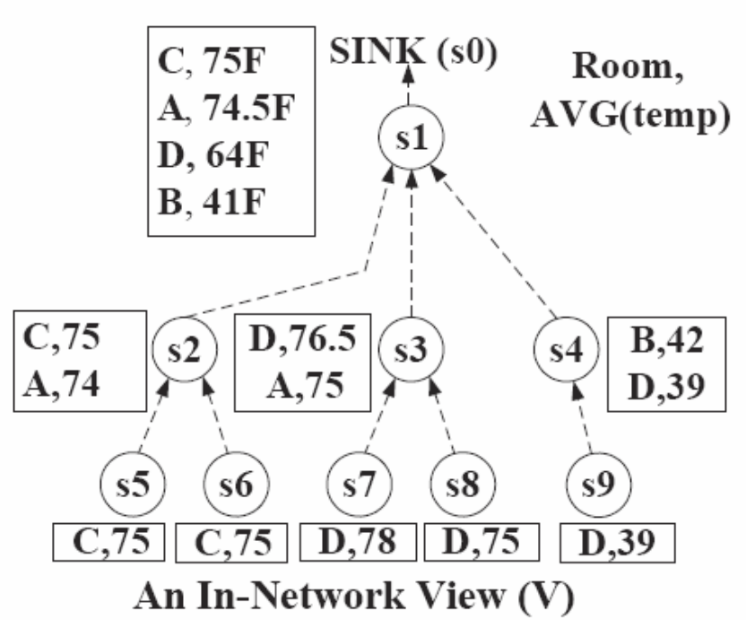
ΜΙΝΤ Views: Problem
Objective: To prune away tuples locally at each sensor such that messaging is minimized.
Naïve Solution: Each node eliminates any tuple with a score lower than its top-1 result.
D,76.5
C,75
B,41
Problem:
We received a incorrect answer i.e., (D,76.5) instead of (C,75).
(B,40)

Slide 38
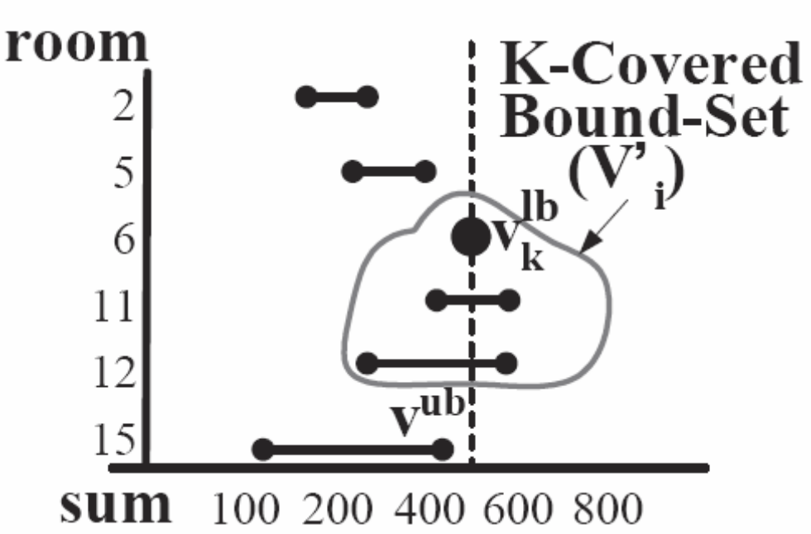
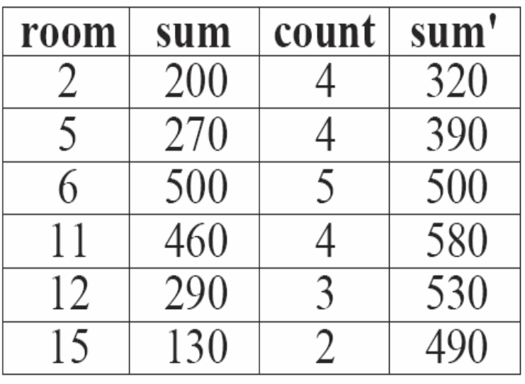
ΜΙΝΤ Views: Main Idea
Bound above each tuple with its maximum possible value.
K-covered Bound-set : Includes all the objects which have an upper bound (v^{ub}) greater or equal to the kth highest lower bound (τ), i.e., v^{ub} > τ
τ
sum
v^{lb}
v^{ub}

Slide 39
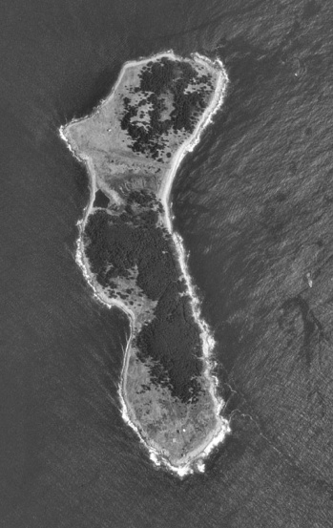
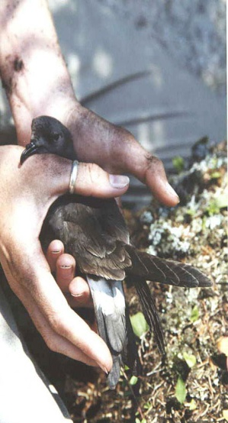
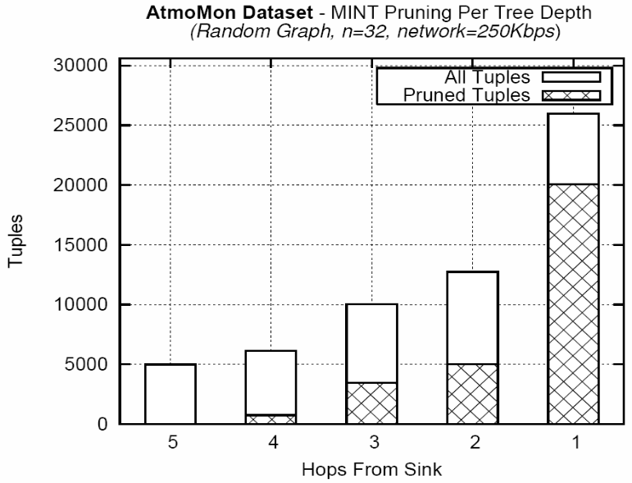
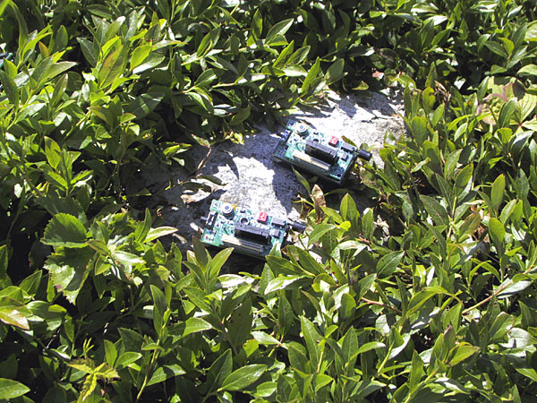
ΜΙΝΤ Views: Experimentation
We obtained a real trace of atmospheric data collected by UC-Berkeley on the Great Duck Island (Maine) in 2002.
We then performed a trace-driven experimentation using XBows TELOSB sensor.
Our query was as follows:
  SELECT TOP-K area, Avg(temp)
  FROM sensors
  GROUP BY area
77%
39%
34%
0%
12%

Slide 40
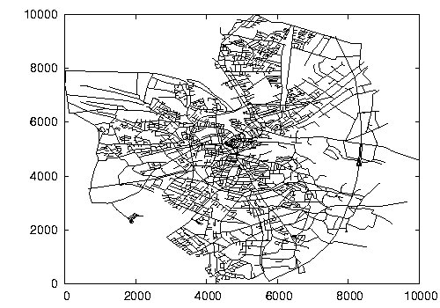
Experimental Evaluation
Comparison System
  Centralized
  UB-K
  UBLB-K
Evaluation Metrics
  Bytes
  Response Time
Data
  25,000 trajectories generated over the road network of the Oldenburg city using the Network Based Generator of Moving Objects*.
* Brinkhoff T., “A Framework for Generating Network-Based Moving Objects”. In GeoInformatica,6(2), 2002.

Slide 41
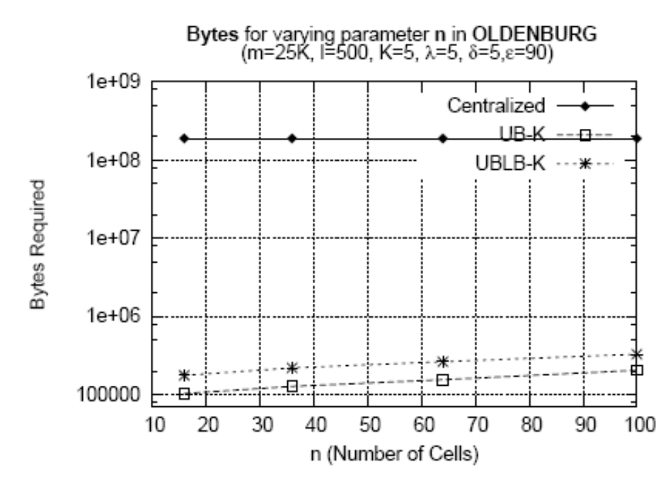
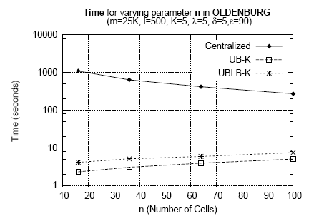
Performance Evaluation
100ΜΒ
16min
4 sec
100ΚΒ
Remarks
  Bytes: UBK/UBLBK transfers 2-3 orders of magnitudes fewer bytes than Centralized.
    Also, UBK completes in 1-3 iterations while UBLBK requires 2-6 iterations (this is due to the LBs, UBs).
  Time: UBK/UBLBK 2 orders of magnitude less time.
Notes:
Οι αλγοριθμοι μας θελουν περισσοτερα μηνυματα

Slide 42

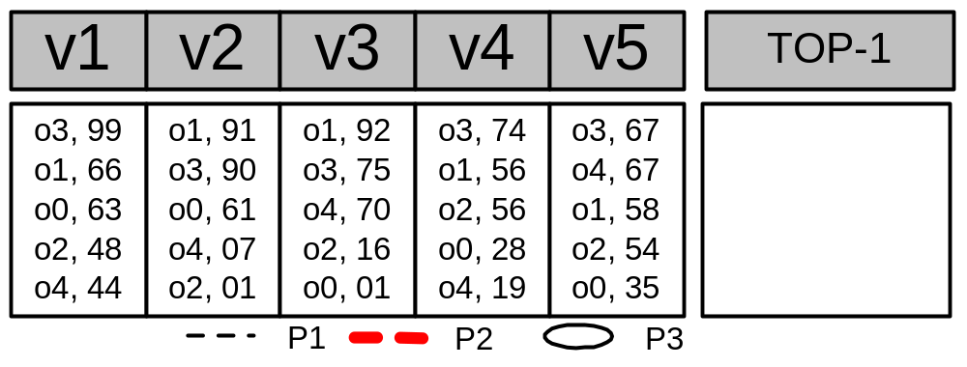
The TPUT Algorithm
o1=183, o3=240
o3=405
o1=363
o2’=158
o4’=137
o0’=124
Q: TOP-1
Phase 1 : o1 = 91+92 = 183, o3 = 99+67+74 = 240
τ = (Kth highest score (partial) / n) => 240 / 5 => τ = 48
Phase 2 : Have we computed K exact scores ?
Computed Exactly: [o3, o1] Incompletely Computed: [o4,o2,o0]
Drawback: The threshold is uniform (too coarse)

Slide 43
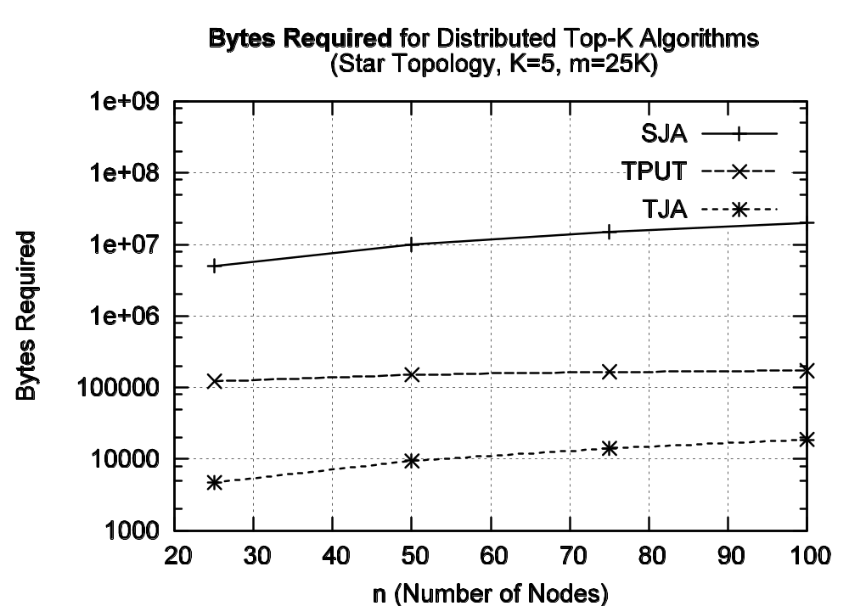
TJA vs. TPUT

