Slide 1


Top-K Query Processing Techniques for Distributed Environments
Department of Computer Science - University of Cyprus
by
Demetris Zeinalipour
Visiting Lecturer
Department of Computer Science
University of Cyprus
Wednesday, June 7th, 2006
"Mediteranean Studies" Seminar Room,
FORTH, Heraklion, Crete
http://www.cs.ucy.ac.cy/~dzeina/

Slide 2
Presentation Goals
To provide an overview of Top-K Query Processing algorithms for centralized and distributed settings.
To present the Threshold Join Algorithm (TJA) which is our distributed top-k query processing algorithm.
To present other research activities that are directly or indirectly related to this work.

Slide 3


















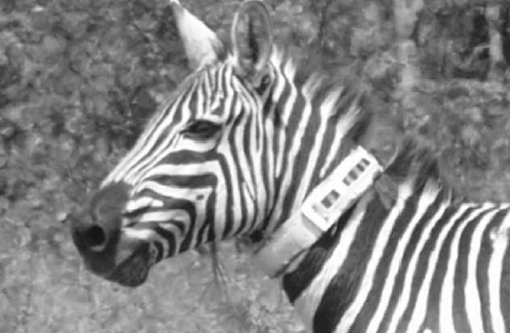
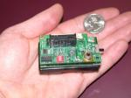



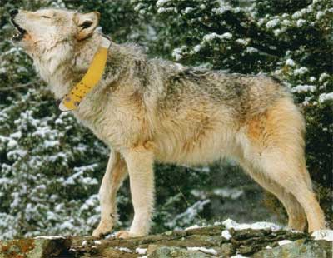

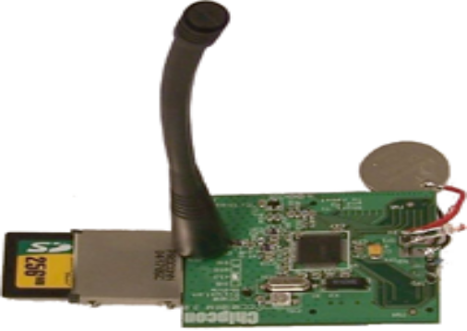


Data Management & Query Processing Today
We are living in a world where data is generated
All The Time & Everywhere
Notes:
- Data is generated anywhere, anytime
- That makes Traditional Query Processing Techniques not applicable, due to volume, rate

Slide 4


Characteristics of these Applications
“Data is generated in a distributed fashion” e.g. sensor data, file-sharing data, Geographically Distributed Clusters)
“Distributed Data is often outdated before it is ever utilized”
(e.g. CCTV video traces, Internet ping data, sensor readings, weblogs, RFID Tags,…)
“Transferring the Data to a centralized repository is usually more expensive than storing it locally”
Notes:
In GB there are 4 Million Cameras

Slide 5
Motivating Question
Why design algorithms and systems that a’ priori organize information in centralized repositories?
Our Approach: “In-situ Data Storage & Retrieval”
  Data remains in-situ (at the generating site).
  When Users want to search/retrieve some information they perform on-demand queries.
Challenges:
  Minimize the utilization of the communication medium
  Exploit the network and the inherent parallelism of a distributed environment. Focus on Hierarchical Networks are ubiquitous (e.g. P2P, and sensor-nets).
  Number of Answers might be very large ➔ Focus on Top-K
Notes:
You want to exploit the inherent parallelism of a distributed environment

Slide 6
Presentation Outline
Introduction to Top-K Query Processing
Related Work & Algorithms
The Threshold Join Algorithm (TJA)
4. Experimental Evaluation using our Middleware Testbed.
5. Related Activities & Future Work.

Slide 7
Distributed Top-K Query Processing
TOP-k Query Objectives:
  To find the k highest ranked answers to a user defined scoring function
  (e.g. Record1: 0.7 red, Record2: 0.4 red, etc)
  2. Minimize some cost metric associated with the retrieval of the complete answer set.

Slide 8
Distributed Top-K Query Processing
Cost Metric in a Distributed Environment
A) Bandwidth
  Transmitting less data conserves resources, energy and minimizes failures.
  e.g. in a Sensor Network sending 1 byte ≈ 1120 CPU instructions.
Source: The RISE (Riverside Sensor) (NetDB’05, IPSN’05 Demo, IEEE SECON’05)
B) Query Response Time
- The #bytes transmitted is not the only parameter.
- We want to minimize the time to execute a query.

Slide 9

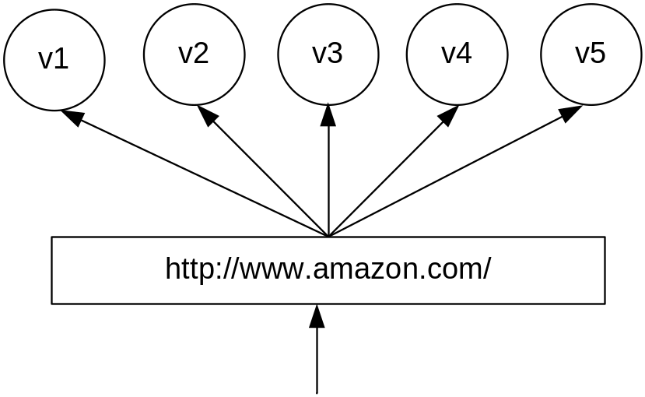
Distributed Top-K Query Processing
Motivating Example
Assume that we have a cluster of n=5 webservers.
Each server maintains locally the same m=5 webpages.
When a web page is accessed by a client, a server increases a local hit counter by one.
TOTAL SCORE
Notes:
CDN example!, reorganize the layout of the website at real time in such a way that the most accessed URLs become availble with the fewest number of user clicks.

Slide 10
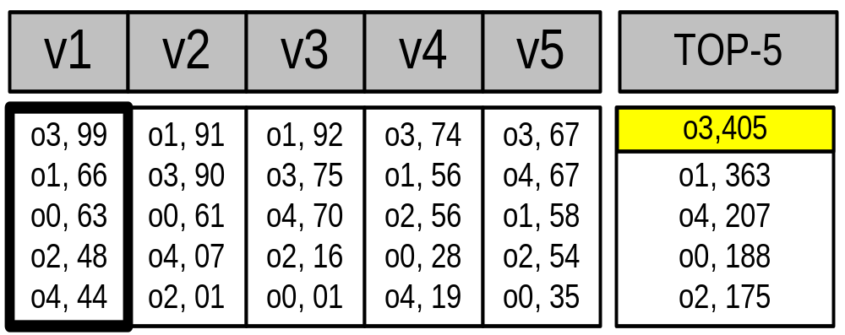
Distributed Top-K Query Processing
Motivating Example (cont’d)
TOP-1 Query: “Which Webpage has the highest number of hits across all servers (i.e. highest Score(o_{i}) )?”
Score(o_{i}) can only be calculated if we combine the hit count from all 5 servers.
Local score
URL
{
m
n
TOTAL SCORE
Notes:
CDN example!, reorganize the layout of the website at real time in such a way that the most accessed URLs become availble with the fewest number of user clicks.

Slide 11
Distributed Top-K Query Processing
Other Applications
Sensor Networks: Each sensor maintains locally a sliding window of the last m readings (i.e. m (ts, val) pairs).
Q: Find when did we have the K=3 highest average temperatures across all sensors.
Other Applications: Collaborative Spam Detection Networks, Content Distribution Networks, Information Retrieval, etc
Notes:
CDN example!

Slide 12
Presentation Outline
Introduction to Top-K Query Processing
Related Work & Algorithms
The Threshold Join Algorithm (TJA)
4. Experimental Evaluation using our Middleware Testbed.
5. Related Activities & Future Work.

Slide 13
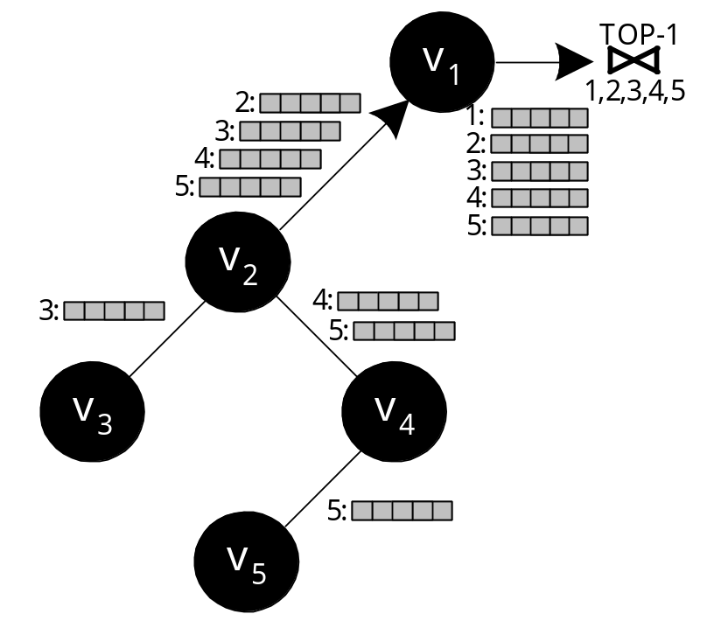
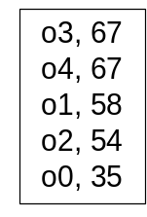
Naïve Solution: Centralized Join (CJA)
Each Node sends all its local scores (list)
Each intermediate node forwards all received lists
The Gnutella Approach
Drawbacks
  Overwhelming amount of messages.
  Huge Query Response Time

Slide 14
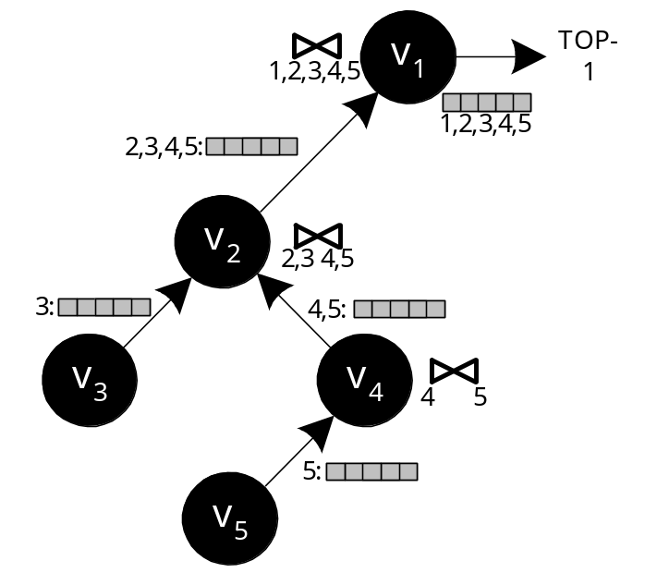
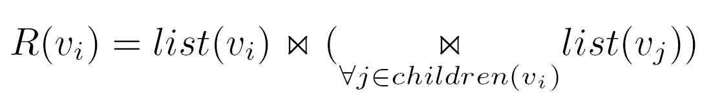
Improved Solution: Staged Join (SJA)
Aggregate the lists before these are forwarded to the parent using:
This is essentially the TAG approach (Madden et al. OSDI '02)
Advantage: Only (n-1) messages
Drawback: Still sending everything!

Slide 15

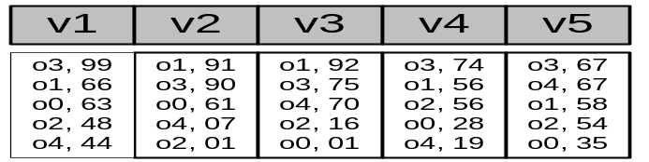
The Threshold Algorithm (Not Distributed)
Fagin’s* Threshold Algorithm (TA):
Long studied and well understood.
* Concurrently developed by 3 groups
ΤΑ Algorithm
1) Access the n lists in parallel.
2) While some object o_{i} is seen, perform a random access to the other lists to find the complete score for o_{i}.
3) Do the same for all objects in the current row.
4) Now compute the threshold τ as the sum of scores in the current row.
5)The algorithm stops after K objects have been found with a score above τ.

Slide 16
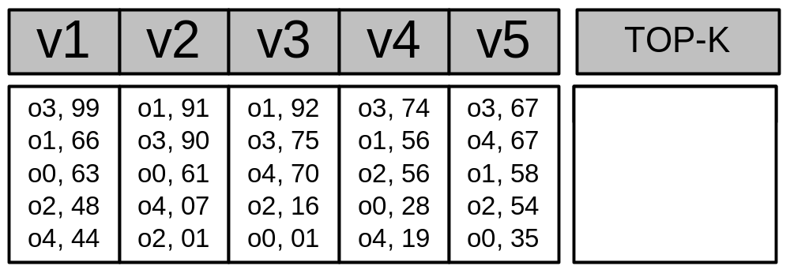
The Threshold Algorithm (Example)
O3, 405
O1, 363
O4, 207
Iteration 1 Threshold
τ = 99 + 91 + 92 + 74 + 67 => τ = 423
Have we found K=1 objects with a score above τ? => ΝΟ
Iteration 2 Threshold
τ (2nd row)= 66 + 90 + 75 + 56 + 67 => τ = 354
Have we found K=1 objects with a score above τ? => YES!
Notes:
If there is some object o4 then this will have a score of 423

Slide 17
The Threshold Algorithm (Not Distributed)
Why is the threshold correct?
Because the threshold essentially gives us the maximum Score for the objects not seen (<= τ)
Advantages:
  The number of object accessed is minimized!
Why Not TA in a distributed Environment?
Disadvantages:
Each object is accessed individually (random accesses)
  A huge number of round trips (phases)
  Unpredictable Latency (Phases are sequential)
  In-network Aggregation not possible

Slide 18
Presentation Outline
Introduction to Top-K Query Processing
Related Work & Algorithms
The Threshold Join Algorithm (TJA)
4. Experimental Evaluation using our Middleware Testbed.
5. Related Activities & Future Work.

Slide 19
Threshold Join Algorithm (TJA)
TJA is our 3-phase algorithm that minimizes the number of transmitted objects and hence the utilization of the communication channel.
How does it work:
  LB Phase: Ask each node to send the K (locally) highest ranked results.
  The union of these results defines a threshold τ .
  2. HJ Phase: Ask each node to transmit everything above this threshold τ .
  3. CL Phase: If at the end we have not identified the complete score of the K highest ranked objects, then we perform a cleanup phase to identify the complete score of all incompletely calculated scores.
Notes:
I.R: Bulit a system that retrieves documents that users are likely to find relevant

Slide 20
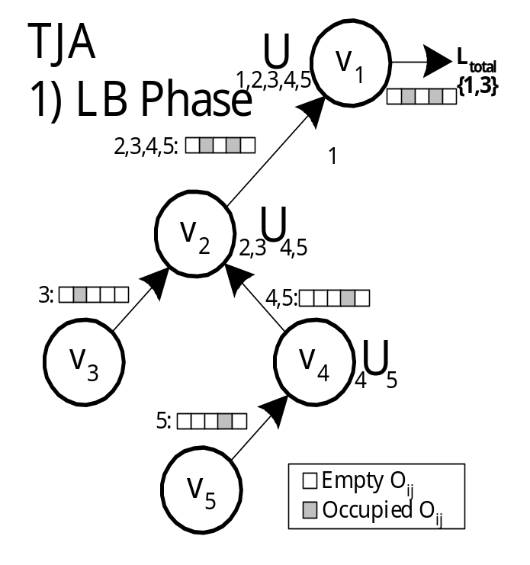
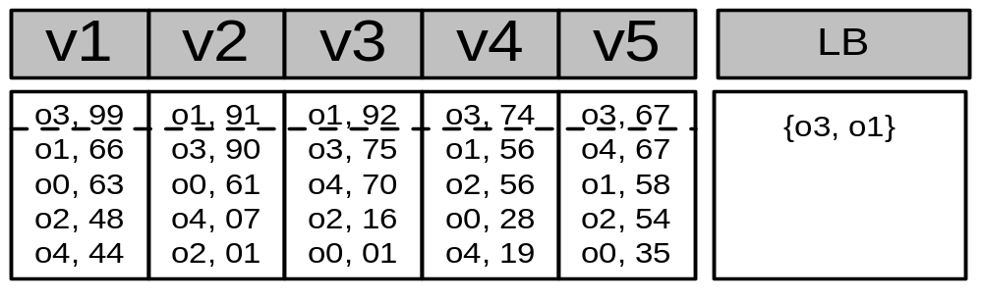
Step 1 - LB (Lower Bound) Phase
Each node sends its top-k results to its parent.
Each intermediate node performs a union of all received lists (denoted
as τ):
Query: TOP-1

Slide 21
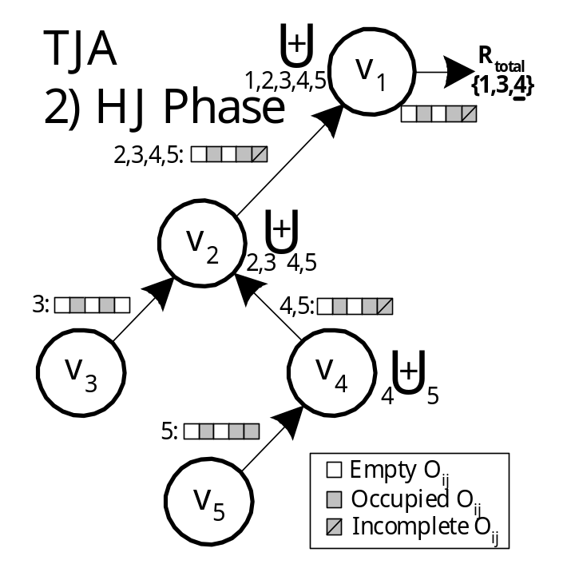
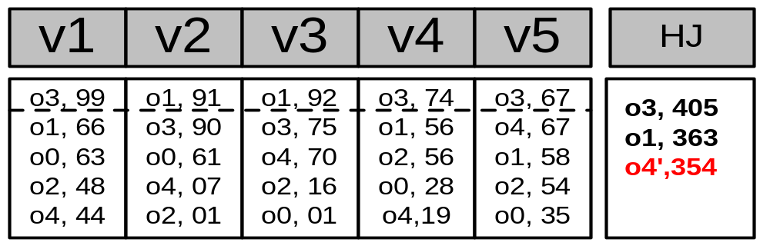
Step 2 – HJ (Hierarchical Join) Phase
Disseminate τ to all nodes
Each node sends back everything with score above all objectIDs in τ.
Before sending the objects, each node tags as incomplete, scores that could not be computed exactly (upper bound)
}
Complete
Incomplete

Slide 22
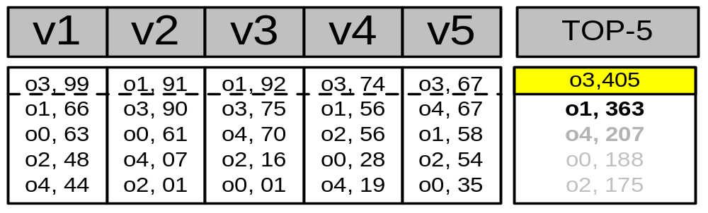
Step 3 – CL (Cleanup) Phase
Have we found K objects with a complete score?
Yes: The answer has been found!
No: Find the complete score for each incomplete object (all in a single batch phase)
CL ensures correctness!
This phase is rarely required in practice.

Slide 23
Presentation Outline
Introduction to Top-K Query Processing
Related Work & Algorithms
The Threshold Join Algorithm (TJA)
4. Experimental Evaluation using our Middleware Testbed.
5. Conclusions & Future Work.

Slide 24
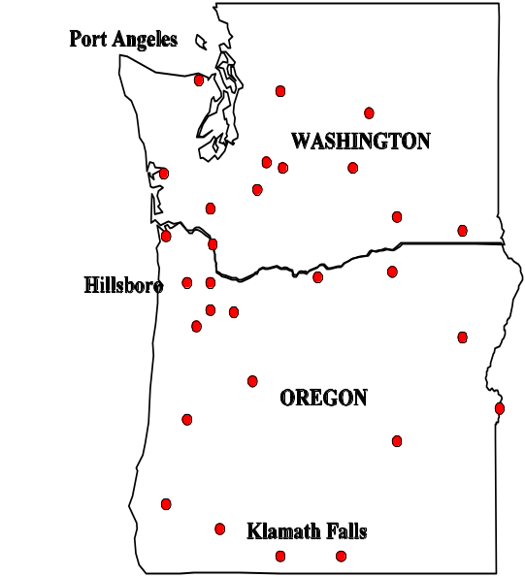
Experimental Evaluation
We implemented a real P2P middleware in JAVA (sockets + binary transfer protocol).
We tested our implementation with a network of 1000 real nodes using 75 Linux workstations.
We use a trace driven experimentation methodology.
For the results presented in this talk:
  Dataset: Environmental Measurements from 32 atmospheric monitoring stations in Washington & Oregon. (2003-2004)
  Query: K timestamps on which average temperature across all stations was maximum
  Network: Random Graph (degree=4, diameter 10)
  Evaluation Criteria: i) Bytes, ii) Time, iii) Messages

Slide 25
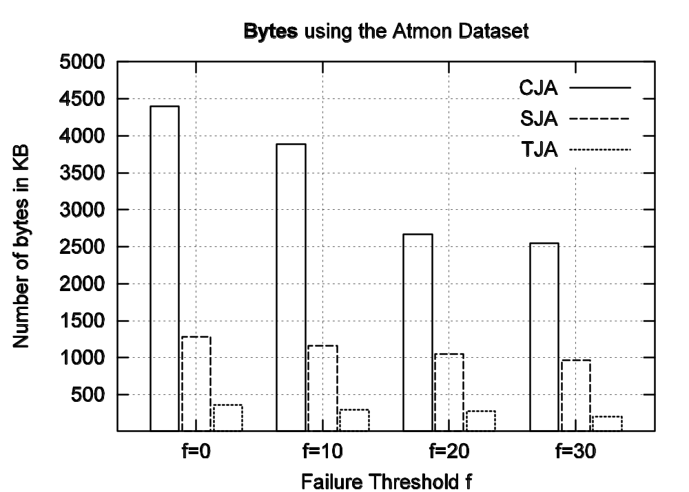
Experimental Results
TJA requires one order of magnitude less
bytes than the Centralized Algorithm!

Slide 26
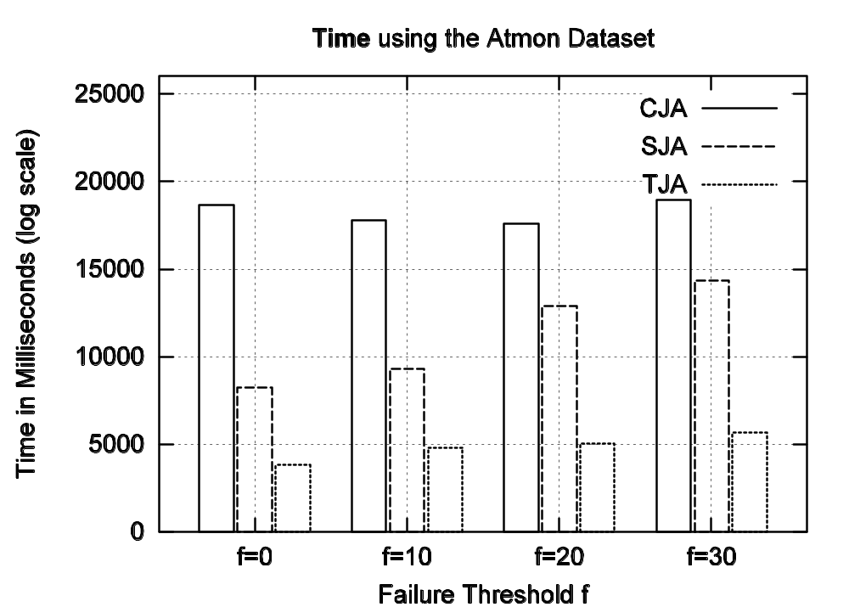
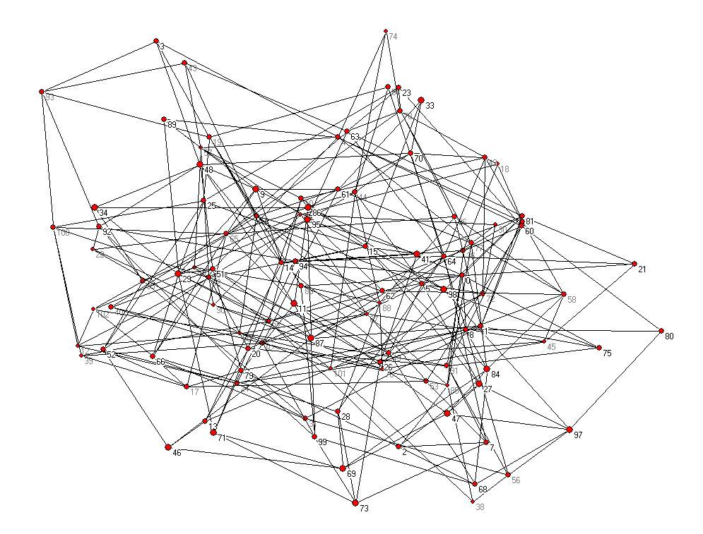
Experimental Results
TJA: 3,797ms [ LB:1059ms, HJ:2730ms, CL:8ms ] SJA: 8,224ms CJA:18,660ms

Slide 27
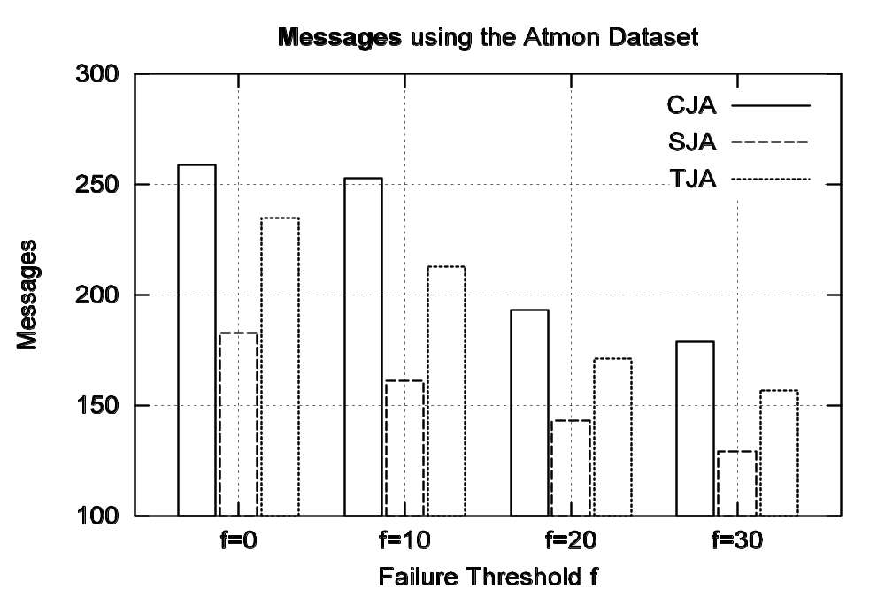
Experimental Results
259
246
183
Although TJA consumes more messages than SJA, these are small size messages

Slide 28

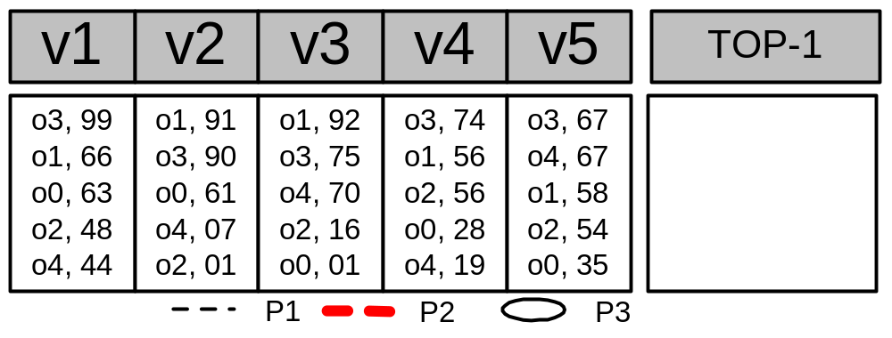
The TPUT Algorithm
o1=183, o3=240
o3=405
o1=363
o2’=158
o4’=137
o0’=124
Q: TOP-1
Phase 1 : o1 = 91+92 = 183, o3 = 99+67+74 = 240
τ = (Kth highest score (partial) / n) => 240 / 5 => τ = 48
Phase 2 : Have we computed K exact scores ?
Computed Exactly: [o3, o1] Incompletely Computed: [o4,o2,o0]
Drawback: The threshold is too coarse (uniform)

Slide 29
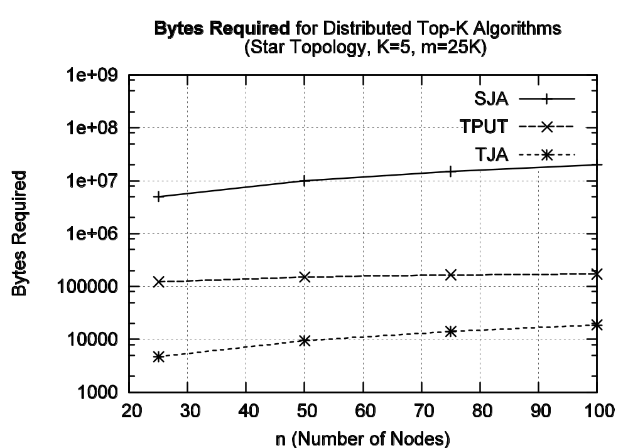
TJA vs. TPUT

Slide 30
Presentation Outline
Introduction to Top-K Query Processing
Related Work & Algorithms
The Threshold Join Algorithm (TJA)
4. Experimental Evaluation using our Middleware Testbed.
5. Conclusions & Future Work.

Slide 31
Conclusions
Distributed Top-K Query Processing is a new area with many new challenges and opportunities!
We showed that the TJA is an efficient algorithm for computing the K highest ranked answers in a distributed environment.
We believe that our algorithm will be a useful component in Query Optimization engines of future Database systems.

Slide 32
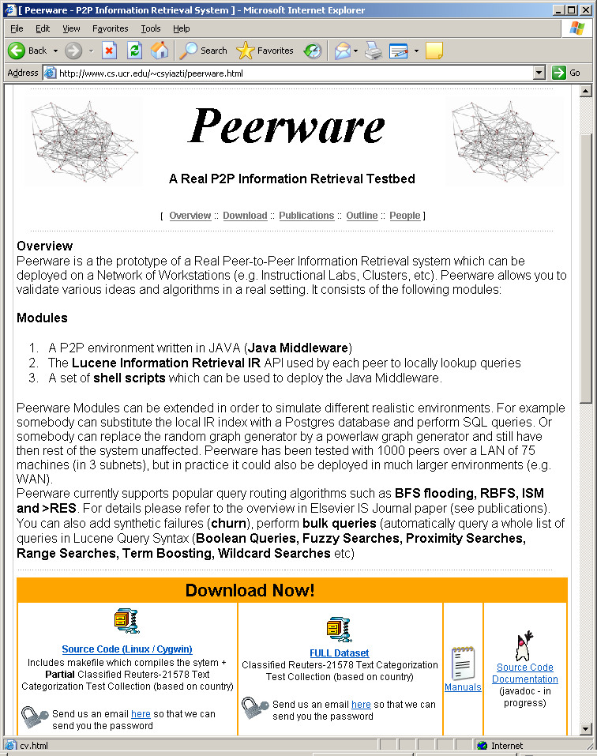
Future Work
Implementation of the TJA algorithm in nesC the programming language of TinyOS. Deployment using the Riverside Sensor
Provide the implementation of TJA as an extension of our Open Source P2P Information Retrieval Engine :
http://www.cs.ucr.edu/~csyiazti/peerware.html
Explore other domains in which the discussed ideas might be beneficial Grids, vehicular networks, etc.
Peerware

Slide 33
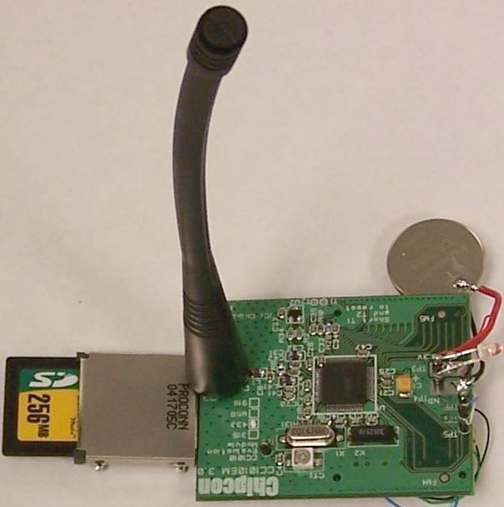
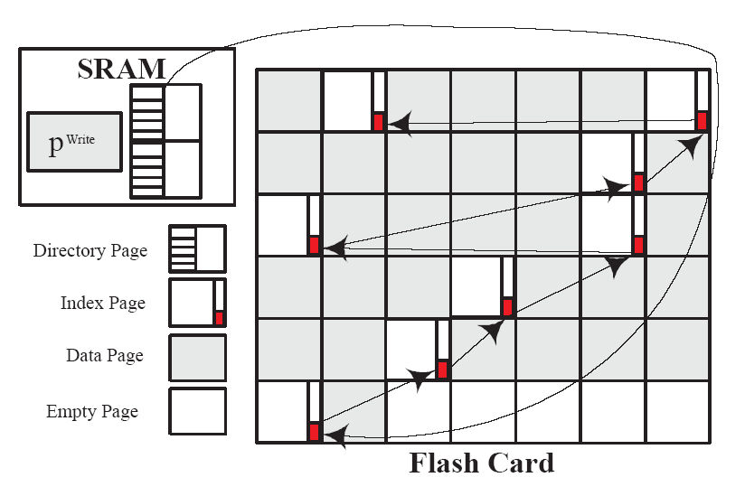
Related Activity 1: Sensor Local Access Methods
TJA assumes that random and sequential access methods to local data is available at each site.
Problem: What happens if the target
device is a battery-limited sensor device?
Distinct Characteristics
  New storage medium: FLASH memory
  Asymmetric Read/Write Characteristics
We propose "MicroHash: An Efficient Index Structure for Flash-Based Sensor Devices",
D. Zeinalipour-Yazti, S. Lin, V. Kalogeraki, D. Gunopulos and W. Najjar, The 4th USENIX Conference on File and Storage Technologies (FAST’05), 2005.
RISE Sensor

Slide 34
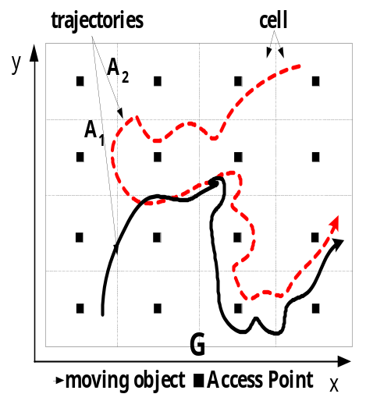
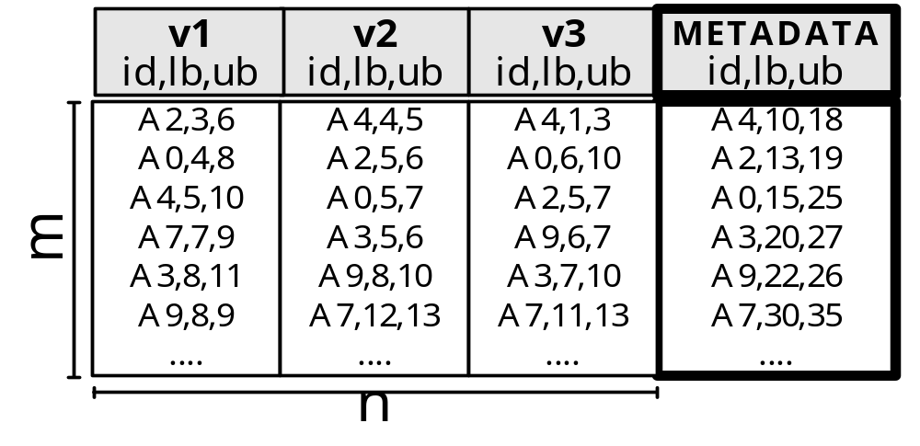
Related Activity 2: Retrieval using Score Bounds
Suppose that each Node can only return Lower and Upper Bounds rather than Exact scores.
e.g. instead of 16 it tells us that the similarity is in the range [11..19]
Q
We developed two new algorithms: UBK & UBLBK
Proposed in “Distributed Spatiotemporal Similarity Search", D. Zeinalipour-Yazti, S. Lin, D. Gunopulos, under review

Slide 35
References
  TOP-K Query Processing & In-Situ Data Storage
  D. Zeinalipour-Yazti, Z. Vagena, D. Gunopulos, V. Kalogeraki, V. Tsotras, M. Vlachos, N. Koudas, D. Srivastava "The Threshold Join Algorithm for Top-k Queries in Distributed Sensor Networks", Proceedings of the 2nd international workshop on Data management for sensor networks DMSN (VLDB'2005), Trondheim, Norway, 2005.
  D. Zeinalipour-Yazti, S. Neema, D. Gunopulos, V. Kalogeraki and W. Najjar, "Data Acquision in Sensor Networks with Large Memories", IEEE Intl. Workshop on Networking Meets Databases NetDB (ICDE'2005), Tokyo, Japan, 2005.
  D. Zeinalipour-Yazti, V. Kalogeraki, D. Gunopulos, A. Mitra, A. Banerjee and W. Najjar "Towards In-Situ Data Storage in Sensor Databases", 10th Panhellenic Conference on Informatics (PCI'2005) Volos, Greece, 2005.

Slide 36
Top-K Query Processing Techniques for Distributed Environments
Department of Computer Science - University of Cyprus
by
Demetrios Zeinalipour
Thanks!
Wednesday, June 7th, 2006
"Mediteranean Studies" Seminar Room,
FORTH, Heraklion, Crete

