Slide 1
Top-K Algorithms:
Concepts and Applications
Department of Computer Science - University of Cyprus
by
Demetris Zeinalipour
Visiting Lecturer
Department of Computer Science
University of Cyprus
Tuesday, March 20th, 2007, 15:00-16:00, Room #147 Building 12
EPL 671: Computer Science: Research and Technology
Department of Computer Science - University of Cyprus
http://www.cs.ucy.ac.cy/~dzeina/

Slide 2
Presentation Goals
To present the concepts behind Top-K algorithms for centralized and distributed settings.
To present applications in which Top-K query processing can yield significant savings in CPU, bandwidth, latency, etc.
To present the intuition behind the family of Top-K query processing algorithms we developed and evaluated.

Slide 3
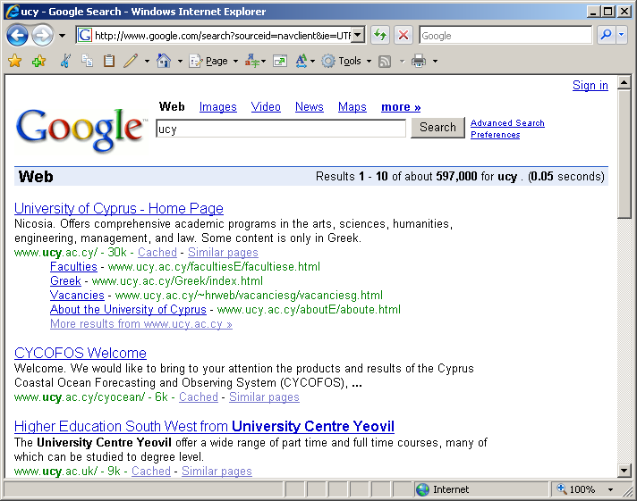
Motivation
Clients want to get the right answers quickly.
Clients are not willing to browse through the complete answer-set.
Service Providers want to consume the least possible resources (disks, network, etc).
In many scenarios it makes sense to focus on the K highest ranked answers (or Top-K) answers rather than finding all of them.

Slide 4
Presentation Outline
A. Top-K Algorithms: Definitions
B. Centralized Top-K Query Processing
  The Threshold Algorithm (TA)
C. Distributed Top-K Query Processing
  The Threshold Join Algorithm (TJA)
  Experimentation using 75 workstations
Other Applications of Top-K Queries
  Distributed Spatio-temporal Trajectory Retrieval
  In-Network Top-K Views (MINT Views)

Slide 5
Definitions
Top-K Query (Q)
Given a database D of n objects, a scoring function (according to which we rank the objects in D) and the number of expected answers K, a Top-K query Q returns the K objects with the highest score (rank) in D.
  Objective:
  Trade # of answers with the query execution cost, i.e.,
  Return less results (K<<n objects)
  …but minimize the cost that is associated with the retrieval of the answer set (i.e., disk I/Os, network I/Os, CPU etc)

Slide 6






Definitions
Assume the following Query-By-Example Scenario in Multimedia Content-Retrieval
O1
O2
O3
Find the K most similar pictures to image Q
O4
O5
Q=(q₁,q₂,…,q_{m})
O_{i}=(o_{i1}, o_{i2}, …, o_{im})
Q and Oi (i<=m) are expressed as vectors of features e.g. Q=(“color=#CCCCCC”, ”texture=110”, shape=“Λ”, …, )
Answers are inherently fuzzy, i.e., each answer is associated with a score (O3,0.95), (O1,0.80), (O2,0.60),….
Notes:
Color histogram is usually used for color comparison

Slide 7

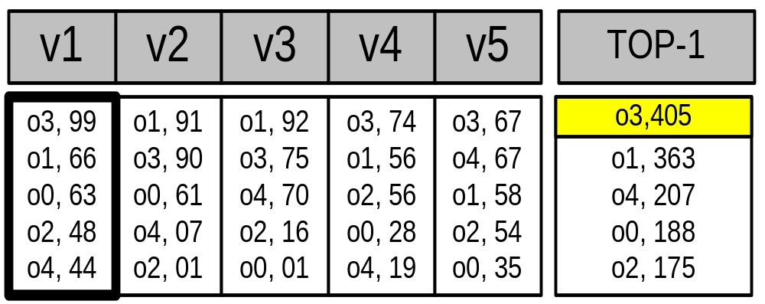
Definitions
The Scoring Table
An m-by-n matrix of scores expressing the similarity of Q to all objects in D (for all attributes).
In order to find the K highest-ranked answers we have to compute Score(o_{i}) for all objects (requires O(m*n) time).
Score
imageID
{
m objects
n image attributes
TOTAL SCORE

Slide 8
Presentation Outline
A. Top-K Algorithms: Definitions
B. Centralized Top-K Query Processing
  The Threshold Algorithm (TA)
C. Distributed Top-K Query Processing
  The Threshold Join Algorithm (TJA)
  Experimentation using 75 workstations
Other Applications of Top-K Queries
  Distributed Spatio-temporal Trajectory Retrieval
  In-Network Top-K Views (MINT Views)

Slide 9

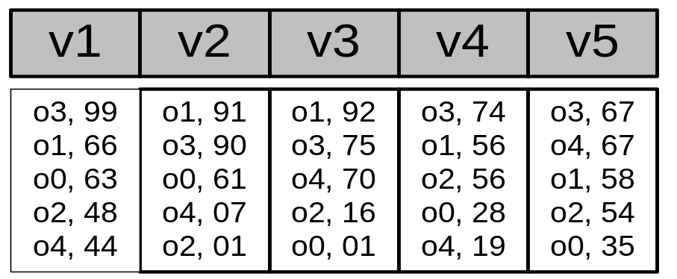
Centralized Top-K Query Processing
Fagin’s* Threshold Algorithm (TA):
(In ACM PODS’02) * Concurrently developed by 3 groups
The most widely recognized algorithm for Top-K Query
Processing in database systems
ΤΑ Algorithm
1) Access the n lists in parallel.
2) While some object o_{i} is seen, perform a random access to the other lists to find the complete score for o_{i}.
3) Do the same for all objects in the current row.
4) Now compute the threshold τ as the sum of scores in the current row.
5)The algorithm stops after K objects have been found with a score above τ.

Slide 10
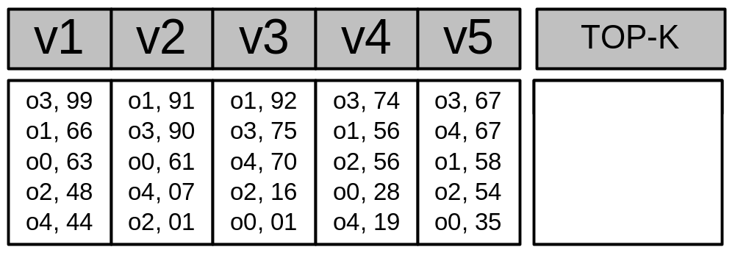
Centralized Top-K: The TA Algorithm (Example)
O3, 405
O1, 363
O4, 207
Iteration 1 Threshold
τ = 99 + 91 + 92 + 74 + 67 => τ = 423
Have we found K=1 objects with a score above τ? => ΝΟ
Iteration 2 Threshold
τ (2nd row)= 66 + 90 + 75 + 56 + 67 => τ = 354
Have we found K=1 objects with a score above τ? => YES!
Why is the threshold correct?
It gives us the maximum score for the objects we have not seen yet (<= τ)
Notes:
In the first row O1 might have a score above o3 99+91+92+74+67=
Advantages:
The number of object accessed is minimized!

Slide 11
Presentation Outline
A. Top-K Algorithms: Definitions
B. Centralized Top-K Query Processing
  The Threshold Algorithm (TA)
C. Distributed Top-K Query Processing
  The Threshold Join Algorithm (TJA)
  Experimentation using 75 workstations
Other Applications of Top-K Queries
  Distributed Spatio-temporal Trajectory Retrieval
  In-Network Top-K Views (MINT Views

Slide 12

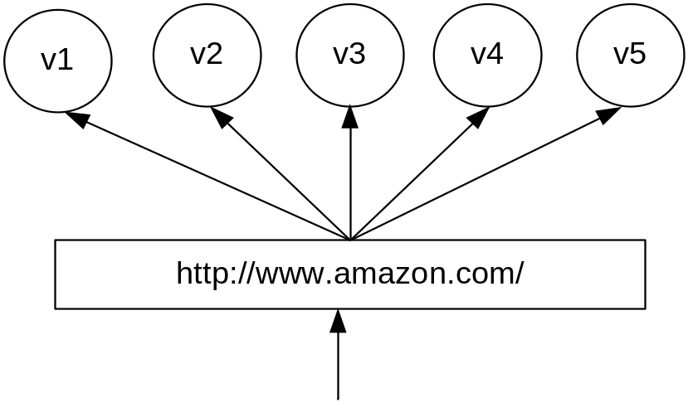
Distributed Top-K Query Processing
Motivating Example
We have a cluster of n=5 Web-servers.
Each server maintains locally a replica of the same m=5 static Web-pages.
When a web page is accessed by a client, the respetive server increases a local hit counter by one.
Hits++
client
TOP-1 Query: “Find the webpage with the highest number of hits across all servers”
Notes:
CDN example!, reorganize the layout of the website at real time in such a way that the most accessed URLs become availble with the fewest number of user clicks.

Slide 13
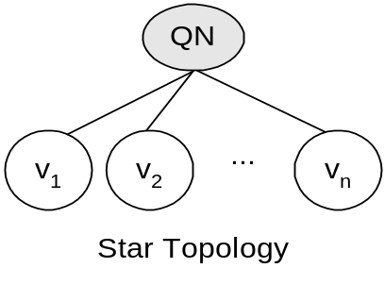
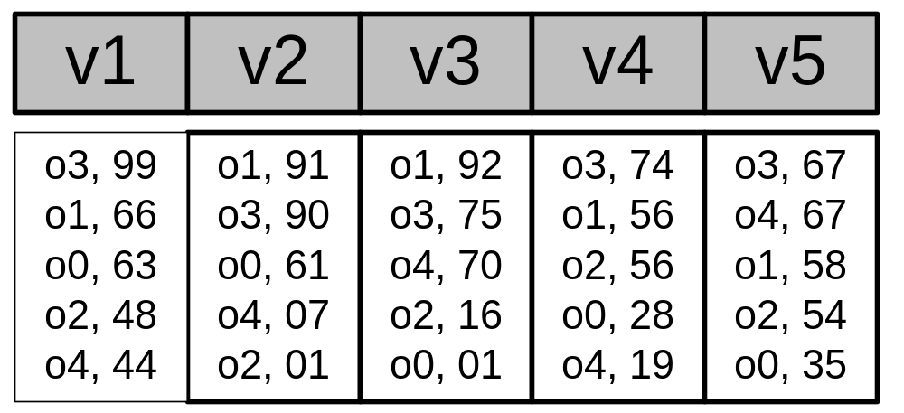
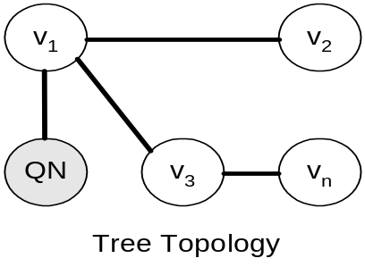
Distributed Top-K Query Processing
The scoring table is now vertically fragmented across N remote sites.
Each site is accessible over a fundamentally expensive network.
Each site is accessible directly (Our example) or indirectly (P2P and Sensor Nets)

Slide 14
Distributed Top-K Query Processing
Is the TA Algorithm efficient when the scoring table is vertically fragmented?
Answer: No, because in TA we have an arbitrary number of phases (iterations).
Each iteration introduces additional latency and messaging, making it expensive for a distributed environment.
Notes:
We have two round trips per iteration:
a) fetch the ID in row i for each node, i.e., O(n) messages.
b) request the VALUE for the IDs in the current row, i.e., O(n²) messages

Slide 15
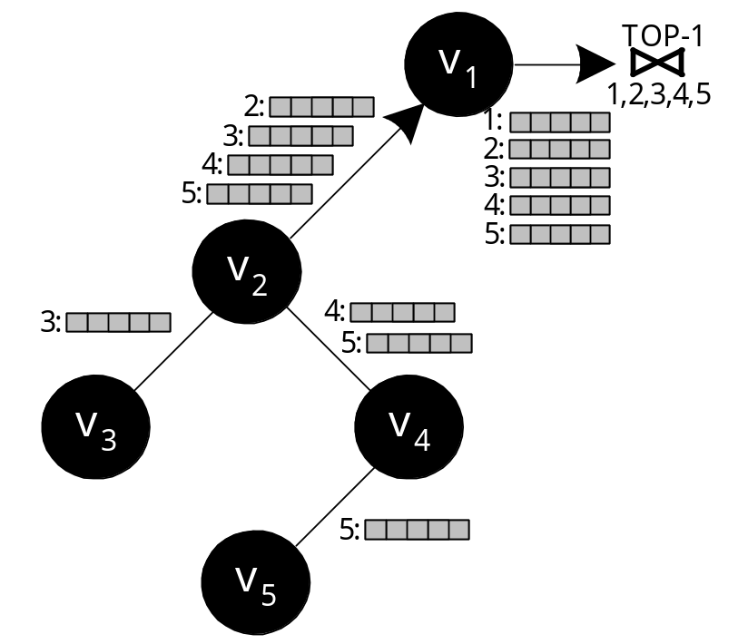
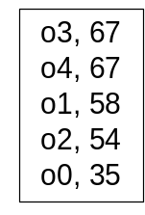
The Centralized Join Algorithm (CJA)
Problem: How to overcome the arbitrary phases of the Threshold Algorithm?
Naive solution:
  Perform the computation in one phase: each node sends its complete list of scores
  Each intermediate node forwards all received lists
Disadvantage
  Overwhelming amount of messages.
  Huge Query Response Time

Slide 16
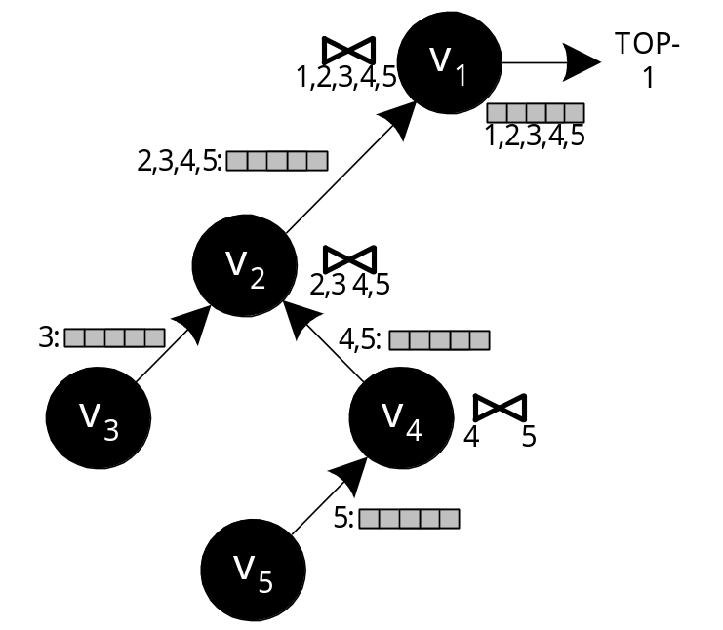
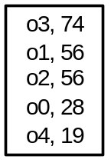
The Staged Join Algorithm (SJA)
Improved Solution: Aggregate the lists before these are forwarded to the parent:
This is the In-network aggregation approach
Advantage: Only O(n) messages
Disadvantage: The size of each message is still very large in size (i.e., the complete list)

Slide 17
Threshold Join Algorithm (TJA)
TJA is our 3-phase algorithm that optimizes top-k query execution in distributed (hierarchical) environments.
Advantage:
  It usually completes in 2 phases.
  It never completes in more than 3 phases (LB Phase, HJ Phase and CL Phase)
  It is therefore highly appropriate for distributed environments
“The Threshold Join Algorithm for Top-k Queries in Distributed Sensor Networks", D. Zeinalipour-Yazti et. al, Proceedings of the 2nd international workshop on Data management for sensor networks DMSN (VLDB'2005), Trondheim, Norway, ACM Press; Vol. 96, 2005.

Slide 18
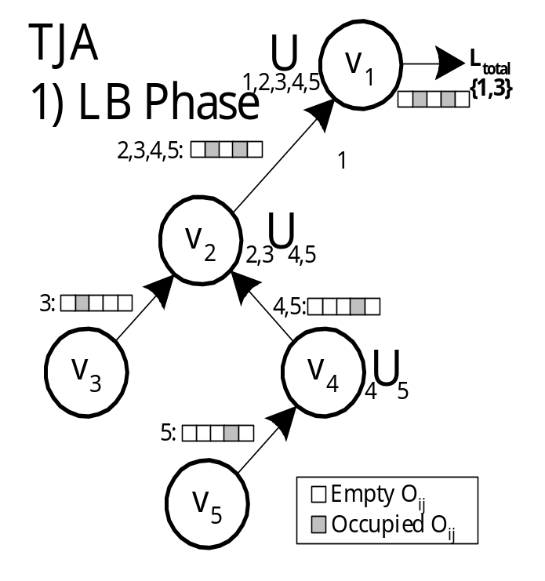
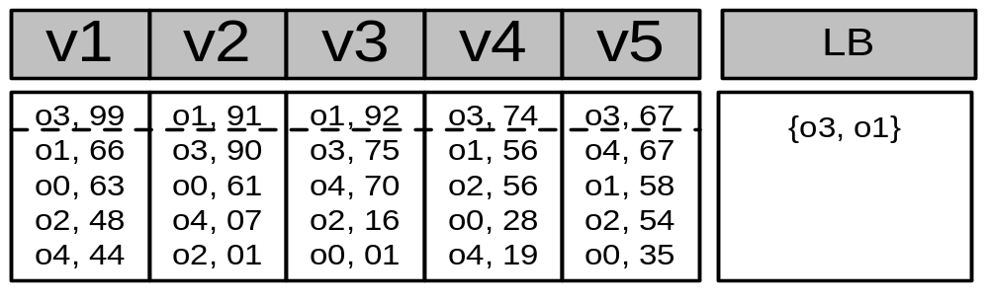
Step 1 - LB (Lower Bound) Phase
Recursively send the K highest objectIDs of each node to the sink.
Each intermediate node performs a union of the received results (defined as τ):
Τ=
Query: TOP-1

Slide 19
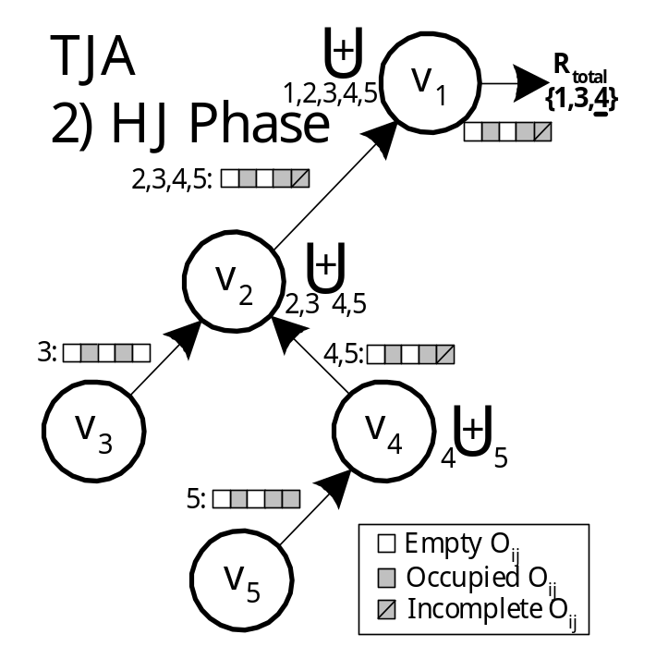
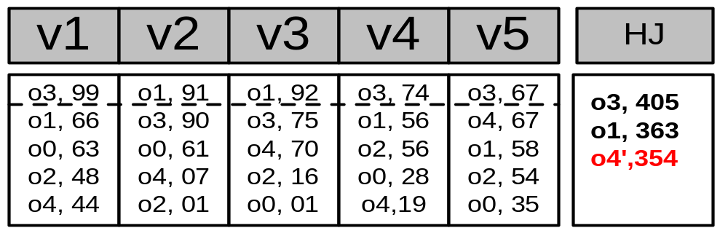
Step 2 – HJ (Hierarchical Join) Phase
Disseminate τ to all nodes
Each node sends back everything with score above all objectIDs in τ.
Before sending the objects, each node tags as incomplete, scores that could not be computed exactly (upper bound)
}
Complete
Incomplete

Slide 20
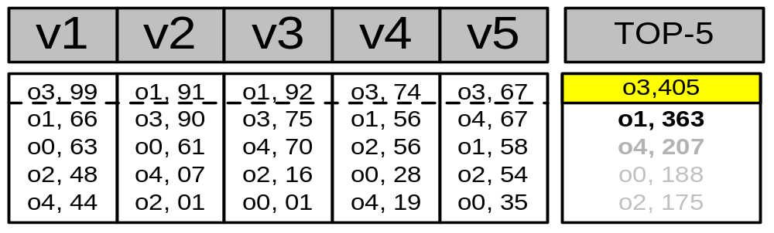
Step 3 – CL (Cleanup) Phase
Have we found K objects with a complete score?
Yes: The answer has been found!
No: Find the complete score for each incomplete object (all in a single batch phase)
CL ensures correctness!
This phase is rarely required in practice.

Slide 21
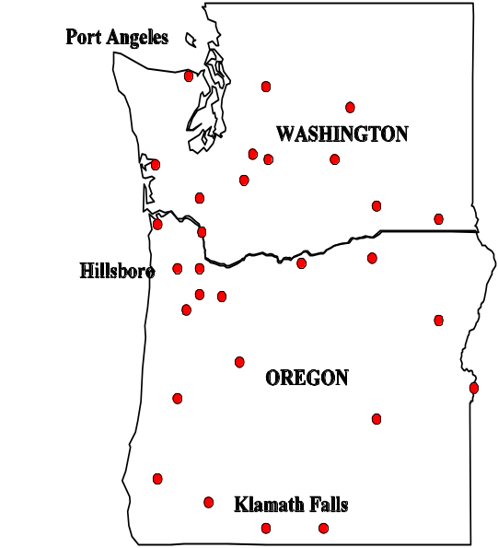
Experimental Evaluation
We implemented a real P2P middleware in JAVA (sockets + binary transfer protocol).
We tested our implementation with a network of 1000 real nodes using 75 Linux workstations.
We use a trace driven experimentation methodology.
For the results presented in this talk:
  Dataset: Environmental Measurements from atmospheric monitoring stations in Washington & Oregon. (2003-2004)
  Query: Find the K timestamps on which the average temperature across all stations was maximum.
  Network: Random Graph (degree=4, diameter 10)
  Evaluation Criteria: i) Bytes, ii) Time, iii) Messages

Slide 22
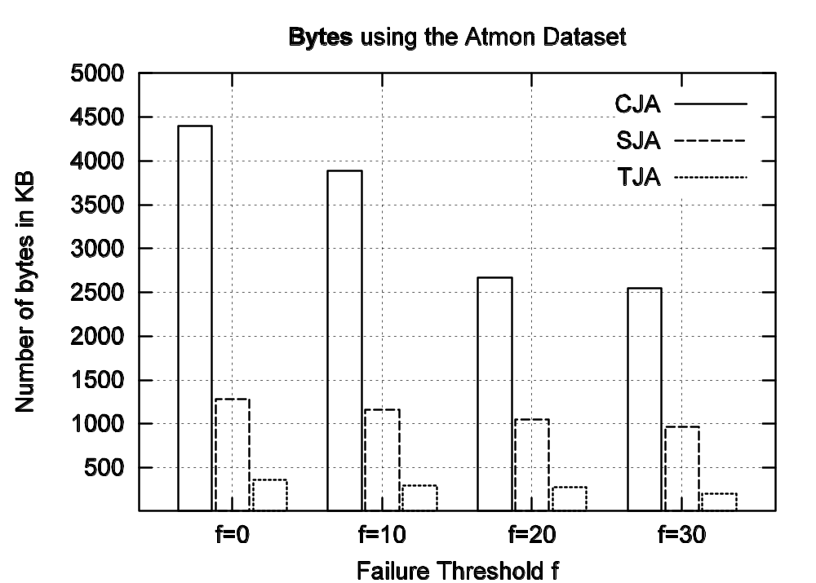
Experimental Results
TJA requires one order of magnitude less
bytes than CJAs!

Slide 23
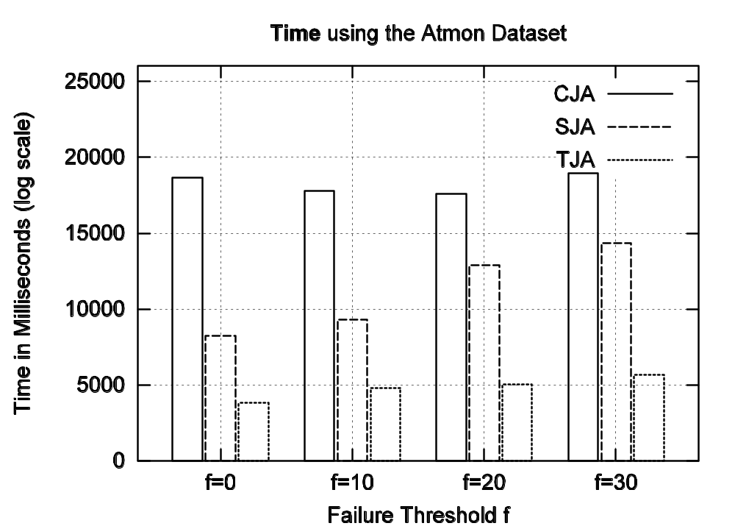
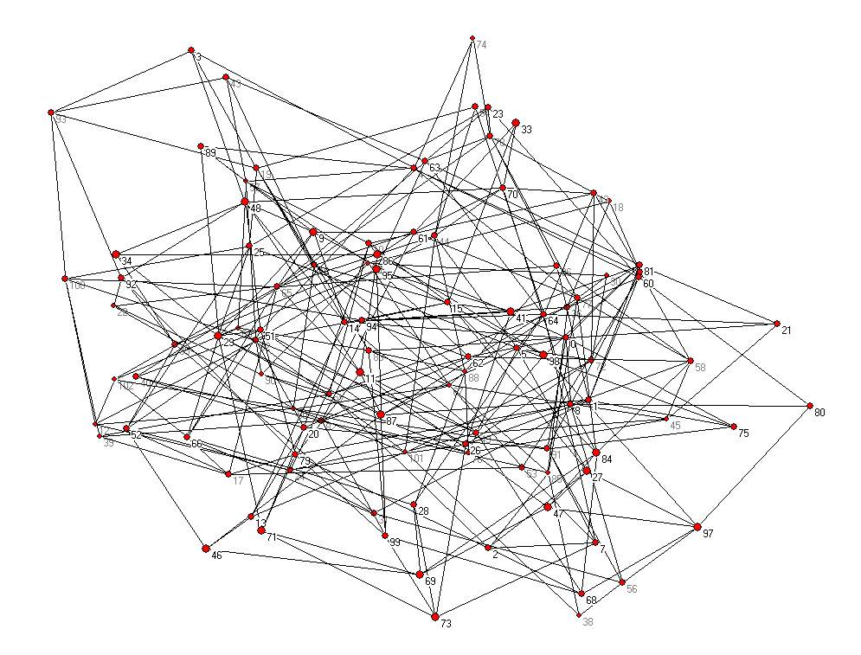
Experimental Results
TJA: 3.7sec [ LB:1.0sec, HJ:2.7sec, CL:0.08sec ] SJA: 8.2sec CJA:18.6sec

Slide 24
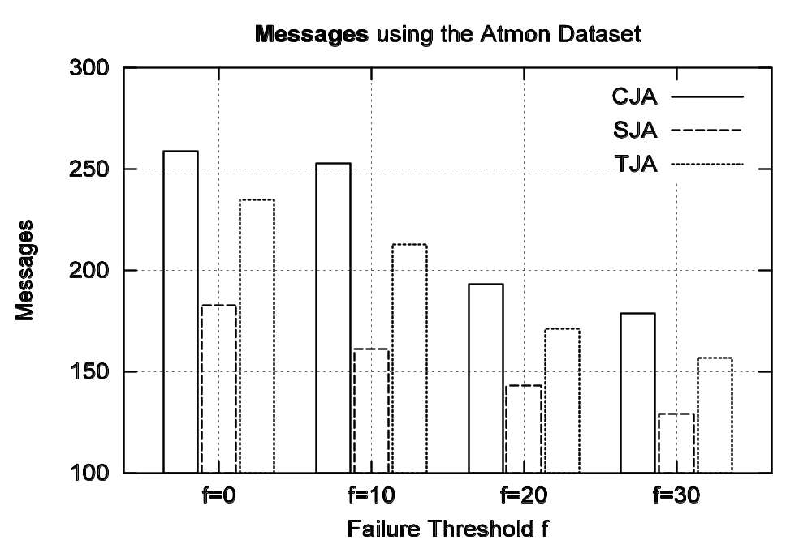
Experimental Results
259
246
183
Although TJA consumes more messages than SJA these are small-size messages

Slide 25

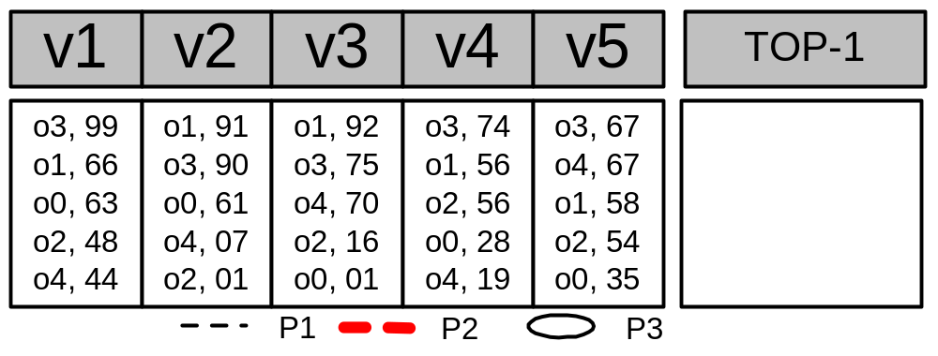
The TPUT Algorithm
o1=183, o3=240
o3=405
o1=363
o2’=158
o4’=137
o0’=124
Q: TOP-1
Phase 1 : o1 = 91+92 = 183, o3 = 99+67+74 = 240
τ = (Kth highest score (partial) / n) => 240 / 5 => τ = 48
Phase 2 : Have we computed K exact scores ?
Computed Exactly: [o3, o1] Incompletely Computed: [o4,o2,o0]
Drawback: The threshold is uniform (too coarse)

Slide 26
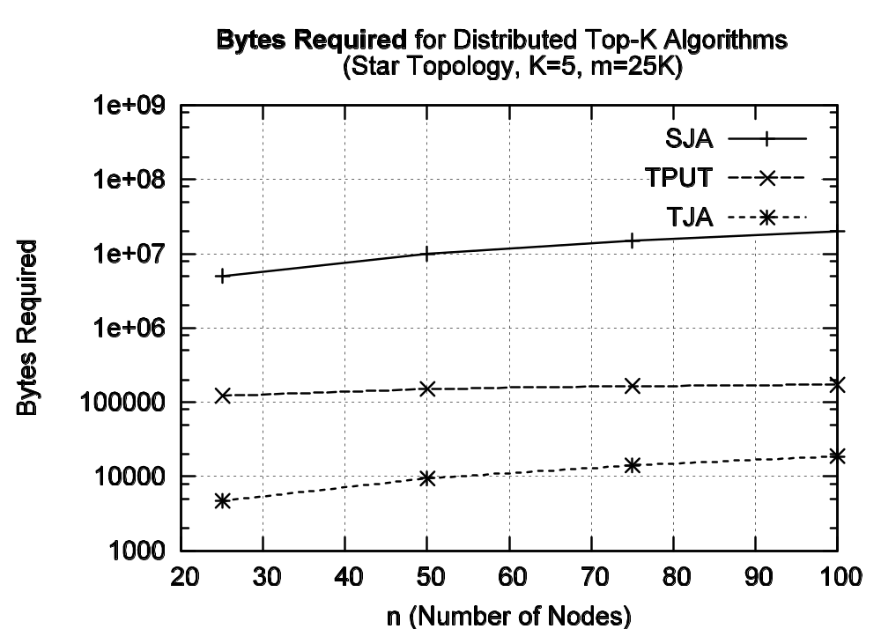
TJA vs. TPUT

Slide 27
Presentation Outline
A. Top-K Algorithms: Definitions
B. Centralized Top-K Query Processing
  The Threshold Algorithm (TA)
C. Distributed Top-K Query Processing
  The Threshold Join Algorithm (TJA)
  Experimentation using 75 workstations
Other Applications of Top-K Queries
  Distributed Spatio-temporal Trajectory Retrieval (UB-K and UBLB-K Algorithms)
  In-Network Top-K Views (MINT Views)

Slide 28
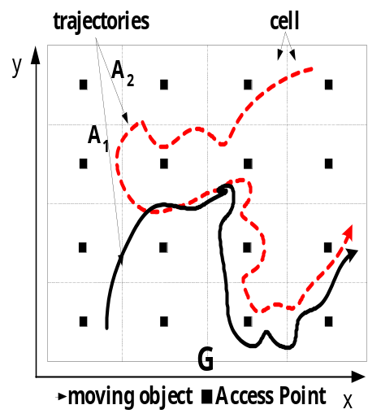
Application 2: Spatiotemporal Query Processing
"Distributed Spatio-Temporal Similarity Search" by
D. Zeinalipour-Yazti, S. Lin, D. Gunopulos, ACM 15th Conference on Information and Knowledge Management, (ACM CIKM 2006), November 6-11, Arlington, VA, USA, pp.14-23, August 2006.
Similarity Search: Given a query Q, find the degree of similarity (Euclidean distance, DTW, LCSS) between Q and a set of m trajectories {A1,A2,…,Am}.
Each Αi (i<=m) is segmented into a number of non-overlapping cells {C1,C2,…,Cn} that maintain the local subsequences.
Challenge: How can we find the K most similar trajectories to Q without pulling together all subsequences
Q

Slide 29
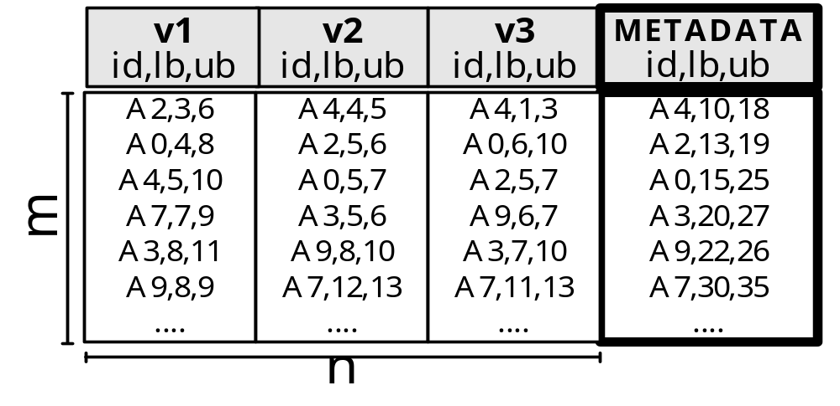
Application 2: Spatiotemporal Query Processing
Solution Outline
Each cell computes a lower bound and an upper bound on the distance of Q to its local subsequences.
The distributed scoring table now contains score bounds (lower,upper) rather than exact scores.
Q
We have proposed two iterative algorithms: UB-K and UBLB-K, which combine these score bounds.
UB-K and UBLB-K find the K most similar trajectories to Q without pulling together the distributed subsequences.

Slide 30
Application 3: ΜΙΝΤ Views
"MINT Views: Materialized In-Network Top-k Views in Sensor Networks"
D. Zeinalipour-Yazti, P. Andreou, P. Chrysanthis and G. Samaras, In IEEE 8th International Conference on Mobile Data Management, Mannheim, Germany, May 7 - 11, accepted, 2007
Views (in databases) are virtual tables that contain the results from an arbitrary query.
… therefore they speedup query execution.
ΜΙΝΤ Views: a novel framework for optimizing the execution of continuous monitoring queries in sensor networks.

Slide 31

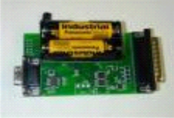
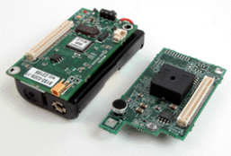



Application 3: ΜΙΝΤ Views
A sensor network at a glance
While parameters are sensed from the physical environment, these are aggregated (with the results of the children) and are then transferred towards the sink for storage and analysis
The Sink
Answer
Programming board
+
+
+
+
+

Slide 32
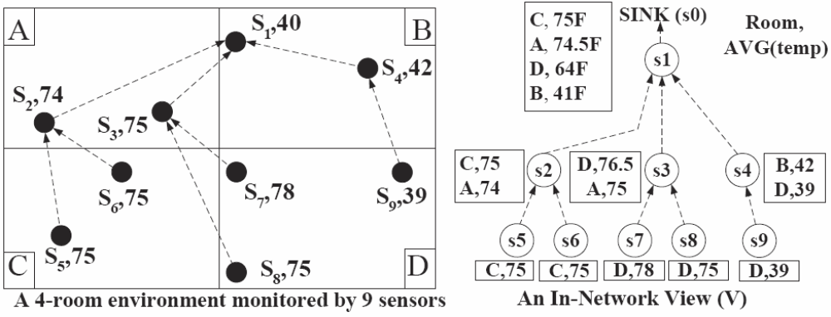
ΜΙΝΤ Views: Example
Example: Four rooms {A,B,C,D}, 9 sensors {s1,…,s9}
Query: Find the room with the highest average temperature (TOP-1 result)
S0

Slide 33
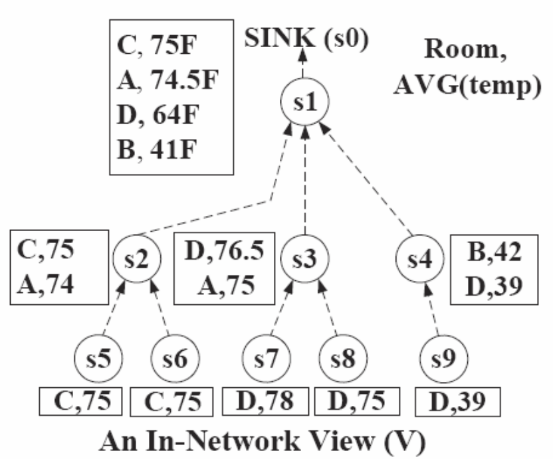
ΜΙΝΤ Views: Example
Assume that we only need the K=1 highest-ranked answers, rather than all of them.
Naïve Solution: Each node eliminates any tuple with a score lower than its top-1 result.
D,76.5
C,75
B,41
Problem:
We received a incorrect answer i.e. (D,76.5) instead of (C,75).
(B,40)

Slide 34
ΜΙΝΤ Views: Top-K Pruning Concept
Objective
Find the correct Top-K answer at the sink.
Problem:
If a node X prunes object O then X’s parent might need O. What should we prune-away?
Solution:
  To determine which objects will be needed at the higher-levels of the hierarchy by bounding them with their maximum possible value.
  Then pruning becomes straightforward!.
  We can guarantee that the pruned objects will not be among the K highest ranked answers at the sink (therefore we always find the correct answer)!

Slide 35
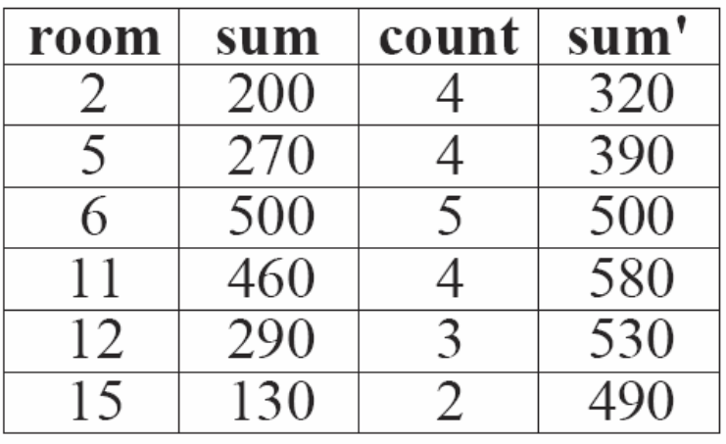
ΜΙΝΤ Views: Example
X is an arbitrary node in the tree hierarchy.
X maintains a list of (room,sum) objects.
X knows some meta-information about the network, e.g.,
  γ1=«max possible temperature»=120, and
  γ2=«sensors in each room»=5.
X now bounds the final value of every object it has locally: sum’=sum+(γ2-count)*γ1
sum’ is an upper bound of sum (maximum possible value for sum at the sink).

Slide 36
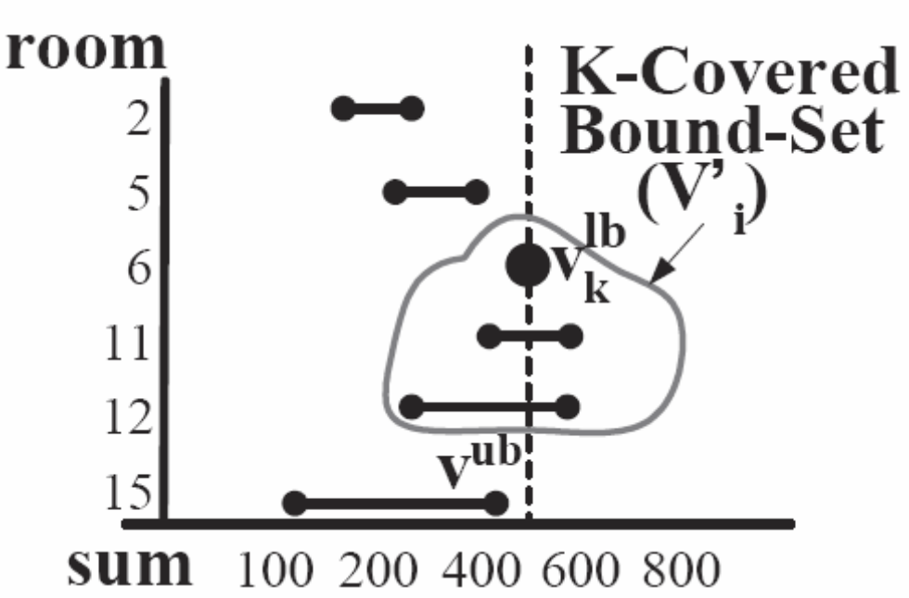
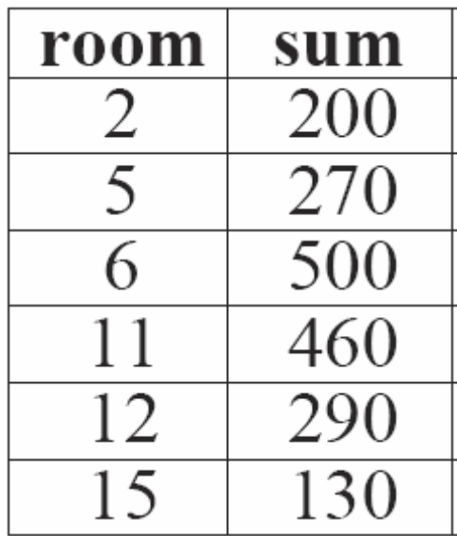
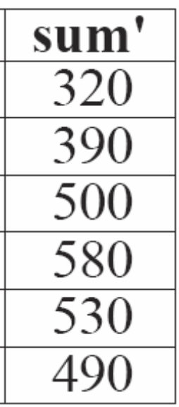
ΜΙΝΤ Views: Example
We can now locally rank these ranges and prune-away any object outside the K-covered-bound set.
K-covered Bound-set : Includes all the objects which have an upper bound (v^{ub}) greater or equal to the kth highest lower bound (v_{k}^{lb} ), i.e., v^{ub}>=v_{k}^{lb}

Slide 37
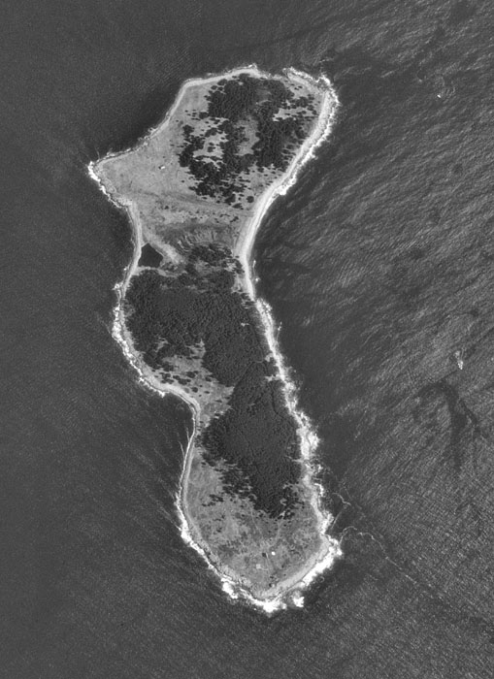
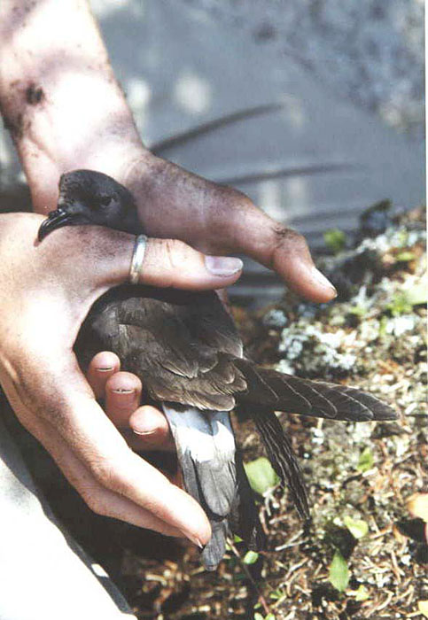
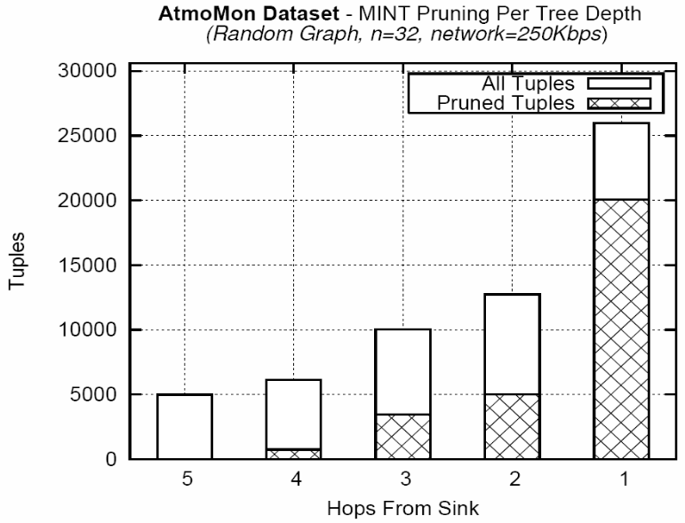
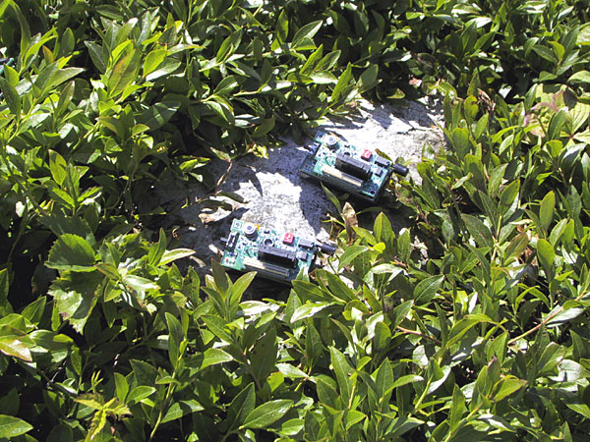
ΜΙΝΤ Views: Experimentation
We obtained a real trace of atmospheric data collected by UC-Berkeley on the Great Duck Island (Maine) in 2002.
We then performed a trace-driven experimentation using XBows TELOSB sensor.
Our query was as follows:
  SELECT TOP-K area, Avg(temp)
  FROM sensors
  GROUP BY area
77%
39%
34%
0%
12%

Slide 38
Conclusions
I have presented the Concepts behind popular Top-k query processing algorithms and an array of Applications utilizing these algorithms.
I have also presented, at a high level, a variety of Algorithms that we have developed in order to support this era of distributed databases.
Top-K Query Processing is a new area with many new challenges and opportunities!
We are working on applying this technology in new application areas, e.g.:
“FailRank: Towards a Unified Grid Failure Monitoring and Ranking System”, Demetrios Zeinalipour-Yazti, Kyriacos Neocleous, Chryssis Georgiou, Marios D. Dikaiakos, submitted for publication, 2007.

Slide 39
Top-K Algorithms:
Concepts and Applications
Department of Computer Science - University of Cyprus
by
Demetris Zeinalipour
Thank you!
This presentation is available at:
http://www2.cs.ucy.ac.cy/~dzeina/talks.html
Related Publications available at:
http://www2.cs.ucy.ac.cy/~dzeina/publications.html

