Slide 1


ETC: Energy-driven Tree Construction in Wireless Sensor Networks
Panayiotis Andreou (Univ. of Cyprus)
Andreas Pamboris (Univ. of California – San Diego)
Demetrios Zeinalipour-Yazti (Univ. of Cyprus)
Panos K. Chrysanthis (Univ. of Pittsburgh, USA)
George Samaras (Univ. of Cyprus)
SenTIE’09 (collocated with MDM 09), Taipei, Taiwan © Andreou, Pamboris, Zeinalipour-Yazti, Chrysanthis, Samaras

Slide 2
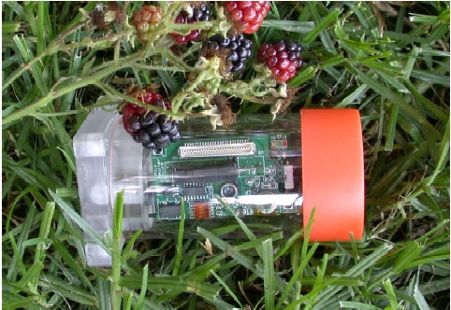

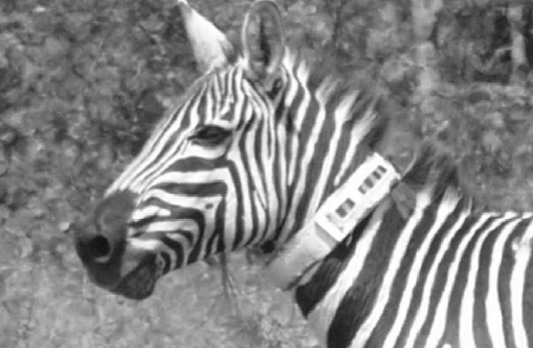
Wireless Sensor Networks
Resource constrained devices utilized for monitoring and understanding the physical world at a high fidelity.
Applications have already emerged in:
  Environmental and habitant monitoring
  Seismic and Structural monitoring
  Understanding Animal Migrations & Interactions between species.
Great Duck Island – Maine (Temperature, Humidity etc).
Golden Gate – SF, Vibration and Displacement of the bridge structure
Zebranet (Kenya) GPS trajectory

Slide 3

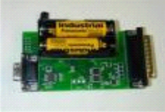
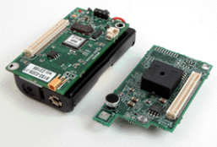



System Model
A continuous query is registered at the sink.
The Query is disseminated using flooding
A Query Routing Tree is constructed to continuously percolate results to the sink.
Q: SELECT MAX(temp)
FROM Sensors
EVERY 31sec
Sink
epoch

Slide 4
Query Routing Tree in TinyDB
Example: The Query Routing Tree in TAG
epoch=31, d (depth)=3
yields a window τ_{i} = ⎣e/d⎦ = ⎣31/3⎦ = 10
Transmit: [20..30)
Listen: [10..20)
A
level 1
Transmit: [10..20)
Listen: [0..10)
level 2
B
C
Transmit: [0..10)
Listen: [0..0)
D
E
level 3

Slide 5
Motivation
Limitations of Existing Frameworks
In predominant data acquisition frameworks (e.g., TAG, Cougar, MINT), Query Routing Trees (T) are constructed in an ad-hoc manner
  No guarantee that the workload of a query will be distributed equally across all nodes.
    Increased Data Transmission Collisions
  Decreased Lifetime and Coverage
    i.e., depleting energy more quickly will lead to decreased network coverage.
Our Solution
We balance the workload in a Wireless Sensor Network by reorganized T in a distributed manner.

Slide 6
Presentation Outline
Motivation
Definitions & Background
The ETC Framework
  Discovery Phase
  Balancing Phase
Experimentation
Conclusions & Future Work

Slide 7
Definitions
s1
s2
s3
s4
Definition: Balanced Tree (T_{balanced})
A tree in which each internal node has β = ⌊^{d}√n⌋ children nodes (branching factor).
  where n: network_size, d: tree depth
  i.e., every leaf node has a height of approximately log_{β}n.
Remarks
T_{balanced} ideal as the query workload is spread across the WSN.
However, T_{balanced} might not be feasible (even under global knowledge) as nodes might not be within communication range.
s5
s6
s7
s8

Slide 8
Definitions
Definition: Near-Balanced Tree (T_{near_balanced})
A tree in which every internal node attempts to obtain less or equal than β children.
Our Objective
Yield a structure similar to T_{balanced} without imposing an impossible network structure
  i.e., nodes are not enforced to nodes that are not within their communication radius.)
Correctness
We shall later define an error metric for measuring the discrepancy between T_{balanced} and T_{near_balanced}

Slide 9
ETC Tree Transformation
s1
s1
s2
s3
s4
s2
s3
s4
+
+
s5
s6
s7
s8
s9
s10
s5
s6
s7
s8
s9
s10
β = ^{d}√n = ⌊ ²√10 ⌋ = ⌊ 3,16 ⌋

Slide 10
Presentation Outline
Motivation
Definitions & Background
The ETC Framework
  Discovery Phase
  Balancing Phase
Experimentation
Conclusions & Future Work

Slide 11
The ETC Framework
ETC stands for Energy-driven Tree Construction.
A framework for balancing arbitrary query routing trees in an in-network and distributed manner.
Objective: Transform T_{input} into a near-balanced tree T_{ETC}
ETC Basic Phases:
  Phase 1: Discover the network topology.
  Phase 2: Reorganize T_{input} into T_{ETC} in an in-network manner.
Visual Intuition behind algorithms will be presented next …

Slide 12
The Discovery Phase
Construct T_{input} using First-Heard-First (i.e., select as parent the one that transmitted the query earlier).
s1
O(n) message cost
APL(s8)={s3}; APL(s9)={s3}
s2
s3
s4
@s3
@s3
s5
s6
s7
s8
s9
s10
Parents maintain an Alternate Parent List (APL) of children(e.g., s2 knows that s8={s3} and that s9={s3})
At the Sink we calculate: n=10, depth=2 ➔ β = ⌊^{d}√n ⌋ = ²√10 = ⌊3,16⌋

Slide 13
The Balancing Phase
Top-down reorganization of the Query Routing Tree in order to make it near-balanced.
β=3
β
children(s1)=3 ≤ β OK
s1
β
β
β
children(s2)=5 > β ➔ FIX
s2
s3
s4
APL(s8)={s3}; APL(s9)={s3}
β
β
β
#s3
#s3
β
s5
s6
s7
s8
s9
s9
#NodeID: s8 and s9 are commanded to switch parents.

Slide 14
Presentation Outline
Motivation
Definitions & Background
The ETC Framework
  Discovery Phase
  Balancing Phase
Experimentation
Conclusions & Future Work

Slide 15
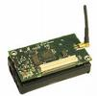
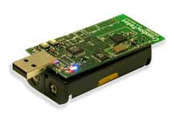
Overview of Experimentation
We perform the following two series of experiments:
Micro-benchmark:
  To empirically assess how severely hub nodes (nodes with large in-degree) contribute to packet losses.
Trace Driven Experimentation:
  To identify the balancing accuracy
  and energy savings of ETC.
MicaZ
TelosB

Slide 16
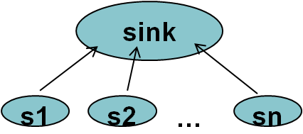
Micro-benchmarks
Setup (Micro-benchmarks)
We use the MicaZ energy model which is based on the CC2420 radio transceiver.
  CC2420: Single-Chip 2.4 GHz IEEE 802.15.4 Compliant and ZigBee™ Ready RF Transceiver.
We construct topologies of 10 up to 100 nodes that report to a dedicated sink S.
Each node sends a 16 byte packet to S for 60s.
We assess the loss rate using the equation:
LossRate(Net_{i}) =1 - PacketsReceived / PacketsSent
  LossRate(N)=1 then no packet was received.

Slide 17
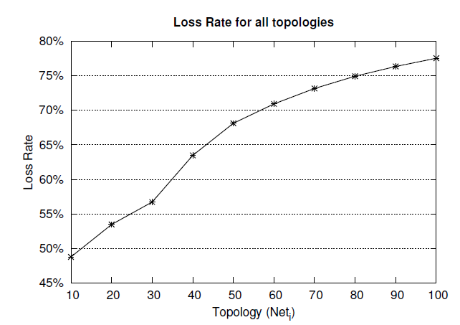
Micro-benchmarks
77% Loss Rate
48% Loss Rate
Linear Increase in Loss Rate (as degree increases)
High in-degrees yield high packet losses 48-77%.

Slide 18
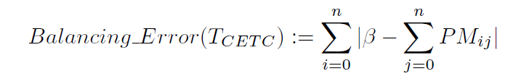
Trace-Driven Experimentation
Algorithms
First-Heard-From: Constructs an adhoc routing tree T_{input} without any specific properties.
CETC: Transforms T_{input} into the best possible near-balanced tree T_{CETC} in a centralized manner (global knowledge)
ETC: Transforms T_{input} into a near-balanced tree T_{ETC} in a distributed manner.
Evaluation Metrics:
  where β = ^{d}√n and PM_{ij}=1 denotes that i is a parent of j and PM_{ij}=0 the opposite.
Energy Consumption of FHF, CETC and ETC respectively.

Slide 19
Trace-Driven Experimentation
Sensing Device
  We utilize the energy model of Crossbow’s TELOSB Sensor (250Kbps, Rx:23mA, Tx:19.5,MCU:7.8mA, sleep:5.1μA)
  Trace-driven experimentation using Energy = Volts x Amperes x Seconds.
Communication Protocol
  based on ZigBee 802.15.4
  Maximum Data Payload:104 bytes (segmentation when required)

Slide 20
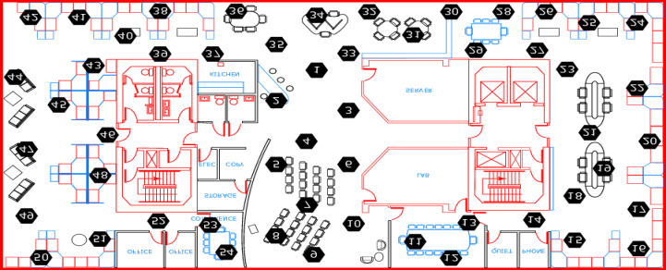
Trace-Driven Experimentation
Datasets:
  A. Intel54 (Small-scale network)
  54 deployed at the Intel Berkeley Research Lab.
  2.3 Million Readings: topology info, humidity, temperature, light and voltage
  B. GDI140 (Medium-scale network)
    140 sensors derived from the Great Duck Island study in Maine, USA.
  C. Intel540 (Large-scale network)
  540 sensors randomly derived from Intel54 dataset

Slide 21
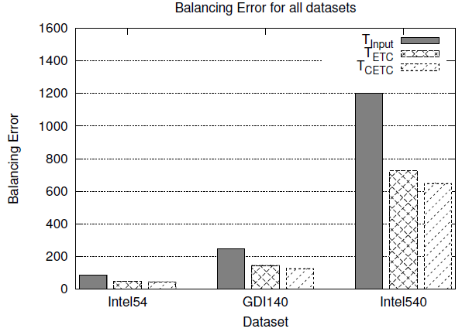
Trace-Driven Experimentation
Balancing_Error(T_{ETC})
T_{input} is Inherently unbalanced
All approaches feature some balancing error.
➔ Fully Balancing a tree is not possible!
T_{ETC} only slightly worse than T_{CETC\} (i.e., by 11%)

Slide 22
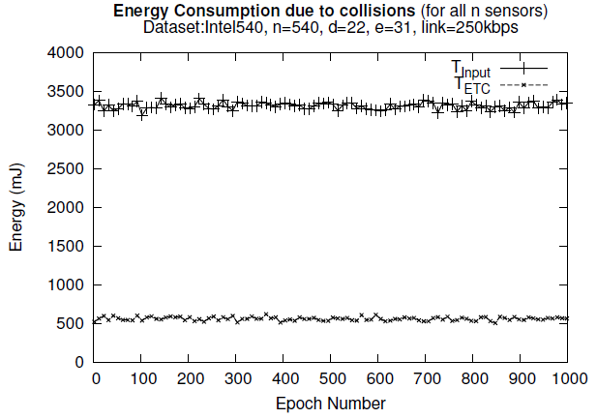
Trace-Driven Experimentation
Energy(T_{Input}) vs. Energy(T_{ETC})
T_{Input}
3,314±50mJ
T_{ETC}
566±22mJ
T_{input} requires more energy than T_{ETC} due to increased retransmissions.
Energy(T_{Input}) = 6 x Energy(T_{ETC})

Slide 23
Presentation Outline
Motivation
Definitions & Background
The ETC Framework
  Discovery Phase
  Balancing Phase
Experimentation
Conclusions & Future Work

Slide 24
Conclusions & Future Work
We have presented ETC, a distributed algorithm for balancing the ad-hoc query routing tree T of a Wireless Sensor Network.
Experimentation with real datasets reveals that ETC generates good approximations of T_{balanced}
  i.e., these are ~11% worse than constructing a T_{balanced} in a centralized manner.
Besides Transmission Deficiencies, we have also studied Reception Deficiencies (i.e., when and for how long a sensor should enable its transceiver (SenTIE’07 and MDM’08)
Currently looking at integrating both into a unified framework.

Slide 25
ETC: Energy-driven Tree Construction in Wireless Sensor Networks
Thank you!
Questions?
This presentation is available at:
http://www.cs.ucy.ac.cy/~dzeina/talks.html
SenTIE’09 (collocated with MDM 09), Taipei, Taiwan © Andreou, Pamboris, Zeinalipour-Yazti, Chrysanthis, Samaras

