Slide 1
FSort: External Sorting on
Flash-based Sensor Devices
Panayiotis Andreou, Orestis Spanos,
Demetrios Zeinalipour-Yazti, George Samaras
University of Cyprus, Cyprus
Panos K. Chrysanthis
University of Pittsburgh, USA
6th Intl. Workshop on Data Management for Sensor Networks (DMSN’09), in conjunction with VLDB’09, Lyon, France, 2009
http://www.cs.ucy.ac.cy/~dzeina/
DMSN’2009, Lyon, France © Andreou, Spanos, Zeinalipour-Yazti, Samaras, Chrysanthis

Slide 2


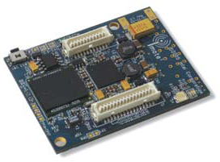
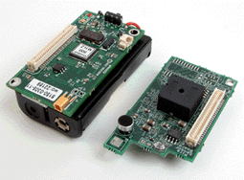
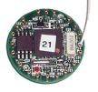
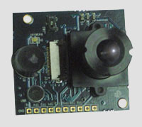

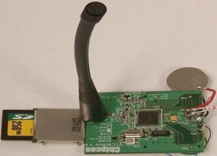
Motivation
Wireless Sensor Devices have evolved from primitive devices into powerful computing devices.
More Computation Power and More Storage!
2002
2005
2009
Applications: Remote Logging / Environmental Monitoring
Applications: Digital Image Processing, etc.
Applications: People-Centric Sensing (sensing data by people for people)
SunSpot: 4MB Flash
IPhone: 32GB Flash
(GPS, camera, mic ambient light, 3-axis accelerometer, digital compass, …)
Imote-2 Multimedia Board
Imote-2: 32MB Flash
Mica2 / Mica2Dot:
RISE: 1GB Flash
HTC Magic
512MB Flash
128KB Flash
512 MB
Notes:
Mica2/Mica2Dot : OS: TinyOS, SOS, MantisOS
IMote2: MS.NET Micro, Linux, TinyOS, Squawk J2ME
HTC Magic: Android
IPhone OS 2.0

Slide 3

Motivation
As data storage mediums continue to grow, Sensor Device Developers tend to store more data in-situ, e.g.,
  To increase the Sensing Fidelity
    Capture data locally, preprocess it, then transmit the useful information over to the sink, e.g., sound detection application
  To overcome the problem of a Distant Sink
    Applicable in Mobile Sensor Networks
Storing large quantities of data locally on each sensor calls for database techniques …
  Indexing (e.g., “MicroHash”, In USENIX FAST’05)
  Architectures (e.g., FlashDB, In IPSN’07)
  External Sorting (e.g., FSort, In DMSN’09)
  ….
MilliBots (CMU)

Slide 4
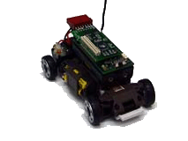
Sorting on Sensors: Why is it Necessary?
a) Acquire Data
b) Store it Locally
C) “Find GPS locations where the temperature is in the range A to B”
Problem: Temperature Data needs be sorted on the given attribute or some index structure might be necessary (e.g., B+tree)
Other Examples: JOIN the readings of two sensors, Sort local Images, Remove duplicates, .
“Find top-k rooms with the lowest noise”
…
#
#
#
#
X,Y,30ºC
X,Y,25ºC
X,Y,23ºC
.....
#
#
#
#

Slide 5

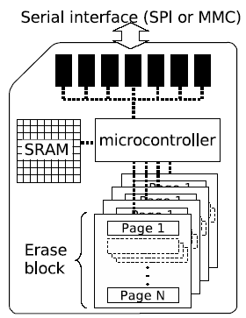
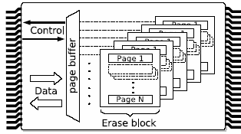
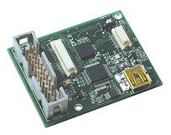



Background: Flash Memory
The most prevalent storage medium used for Sensor Devices is Flash Memory (NAND Flash)
Fastest Growing Memory Market (‘05 $8.7B, ’06 $11B)
Removable Flash
Surface Mount Flash
Notes:
\
Seek Time (rotational latency): It is the amount of time between when the CPU requests a file and when the first byte of the file is sent to CPU. Times between 10 to 20 milliseconds are common.
Magnetic Disks, Spindle RPM Average latency (ms) 4200:7.14ms, 5400:5.55ms, 7200:4.17ms, 10000:3ms, 15000 2ms.

Slide 6
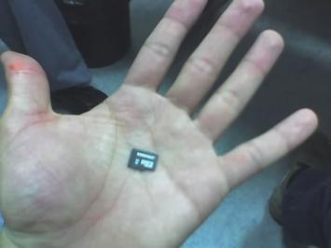
Background: Flash Memory
Simple Cell Architecture
➔ High capacity in a small surface
➔ Economical Reproduction
Fast Random Access (50-80 μs) compared to 10-20ms in Magnetic Disks
Shock Resistant & Power Efficient
➔ Appropriate for Sensor and Mobile Devices

Slide 7
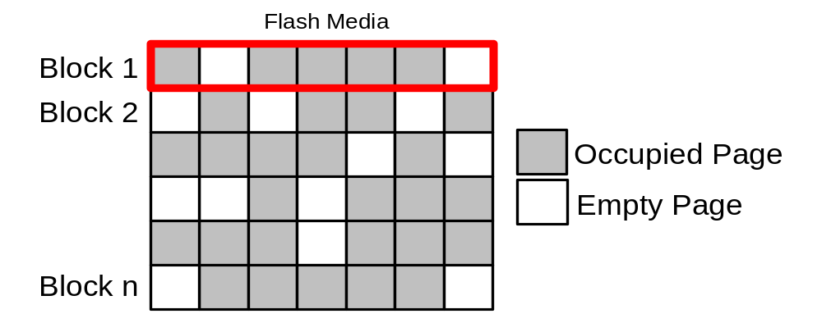
Background: Characteristics of Flash
X
…
Delete-Constraint: Erasure of a page can only be performed at a block granularity (i.e. 8KB~64KB)
Write-Constraint: Data is written to flash on a page granularity (256B~512B) to an empty page (delete page if necessary).
Wear-Constraint: Each page can only be written a limited number of times (typically 10,000-100,000)
Asymmetric Read/Write: Reading Faster (Cheaper) than Writing (23mJ vs. 763mJ on the RISE sensor)
Notes:
!

Slide 8
Presentation Outline
Motivation and Background
Overview of Sorting on Sensor Devices
The FSort External Sorting Algorithm
Experimental Evaluation
Conclusions and Future Work

Slide 9
Sorting on Sensor Devices
Sorting can be performed in two modes:
Online Sorting
  Keep a target sequence sorted at all times.
  i.e., upon reception of a new data record (e.g., after data acquisition), sort sequence using the InsertionSort idea.
Offline Sorting
  Log data records in an Unsorted File until Sorting function is requested.
  Problem: Unsorted File might be too large to fit in main memory, thus In-Memory Sorting (using quicksort, mergesort, etc) is not feasible
  Solution: Use an External Sorting Algorithm

Slide 10

Inefficiency of Online Sorting
Flash memory
Main Memory
Data page
5
New page
Empty page
A
B
C
1
1
2
2
3
4
4
6
…
8
9
Block Erase
1
1
2
2
3
4
4
6
…
8
9
3
4
4
6
5
Block Erase
1
1
2
2
3
4
4
5
…
8
9
8
9
6
1
1
2
2
3
4
4
5
…
6
8
9
6
8
9
Online Sorting is Inefficient! For 1 write it took us:
6 Reads + 7 Writes + 2 Block Erases
Decreased Performance + Decreased Lifetime

Slide 11
Presentation Outline
Motivation and Background
Overview of Sorting on Sensor Devices
FSort External Sorting Algorithm
Experimental Evaluation
Conclusions and Future Work

Slide 12
FSort Algorithm
FSort is an external sorting algorithm appropriate for flash-media on sensor devices
Characteristics
Offline External Sorting Algorithm
  It sorts on-demand, arbitrary large sequences with a fixed-sized (main) memory.
Appropriate for Sensor Devices
  Its performance is boosted by the temporal coherence in sensor readings (i.e., values that don’t change quickly over time).
Designed for Flash
  It deletes blocks sequentially
  It minimizes read/write/block erase operations.

Slide 13
FSort: Outline of Operation
FSort consists of two phases:
Sorting phase:
  Perform a Scan of the Flash media using M block iterators.
  Use the Replacement-Selection concept to produce Sorted Runs (Sequences)
  Append the Sorted Runs to the end of the Flash Media
Merging phase
  Merge the sorted runs recursively until a single sorted output is produced.
Main memory
Buffer
Flash
Flash

Slide 14
FSort: Sorting Phase
a) Initialize B-1 Block Iterators.
b) Write next smallest elem. >= current elem. to run X
If above not possible, output next elem. to run X+1
Flash Media
Flash Media
Main Memory
3
4
5
7
7
8
8
8
9
7
7
7
7
7
8
8
7
4
5
3
7
4
5
3
8
9
8
7
7
7
7
8
8
8
7
7
Run X+1
Run X

Slide 15





FSort: Merging Phase
Example: B Buffer Pages (Input: B-1, Output: 1)
Flash Media
Flash Media
3
4
5
7
7
8
8
8
9
7
7
7
Number of Passes over Data? 2 times

Slide 16
FSort and the Delete Constraint
A block is deleted only whenever all pages within the given block are empty
  This satisfies the Flash Delete Constrain
Additionally, due to temporal coherence (i.e., values within a block are similar) blocks are usually freed up quickly.
3
Block Erase
4
5
7
8
Block Erase
9
8
7
7
Block Erase
7
7
8
8
Block Erase
8
7
7

Slide 17
Presentation Outline
Motivation and Background
Overview of Sorting on Sensor Devices
FSort External Sorting Algorithm
Experimental Evaluation
Conclusions and Future Work

Slide 18
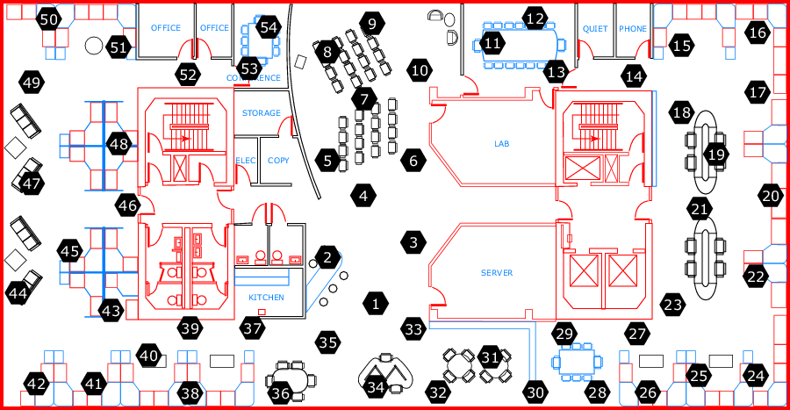
Experimental Evaluation
Testbed: Trace-driven Simulator
  Written in C++ (idea also prototyped in LiteOS/C on IRIS Sensor)
  Emulates Flash (Page=512B, Block=16KB)
  Measures:
    # of read (1.17mA), write (37mA), erases (18mA)
    Energy Consumption Energy = Volts x Amperes x Seconds
Dataset: Intel Research Berkeley
  Temperature, Humidity, Light, Vol, etc.
  2.3 million readings
Compared Algorithms
  Online vs. Offline Sorting
    InsertionSort vs. External Merge Sort
  Comparison of Offline Sorting
    External Merge Sort vs. FSort

Slide 19
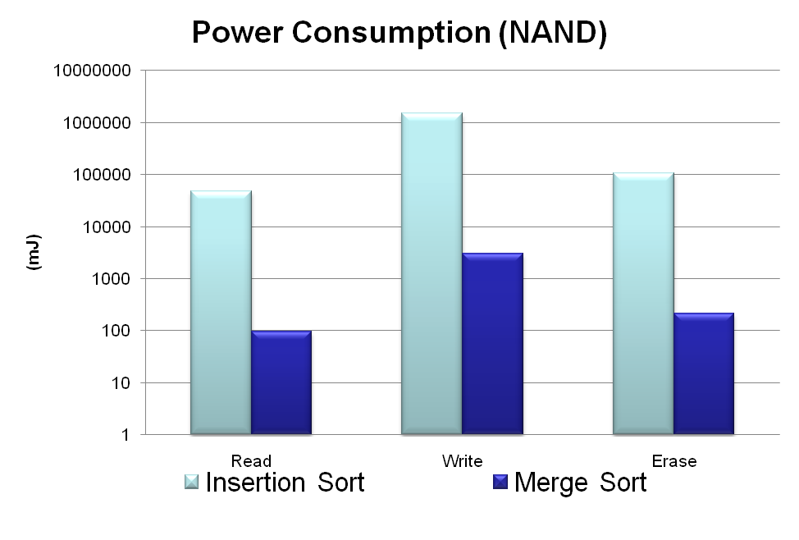
Online vs. Offline Sorting
Sorting 1000 records (1 record / page)
RISE Energy Model
Write: 37mA
Read: 1.17mA
3052mJ
96mJ
Online Sorting is 2 Orders slower (less efficient) than Offline Sorting
Same number of Read/Write operations, yet writing is overall more Expensive

Slide 20
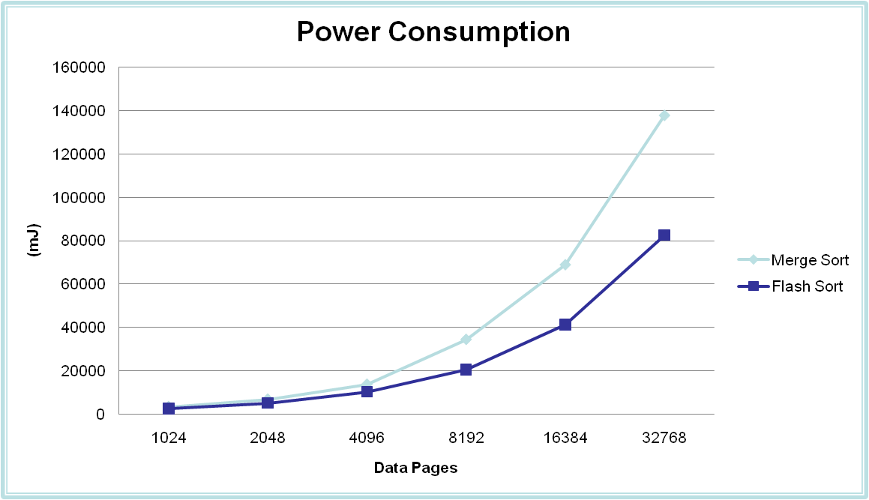
External MergeSort vs. FSort
Task: Sort records (on temperature) after adding 1000 measurement to local flash media.
FSort is 25-40% more efficient than External MergeSort.

Slide 21

External Merge Sort
Example: B Buffer Pages (Input: B-1, Output: 1)
Flash Media
Main Memory
Flash Media
7
4
5
3
7
4
5
3
8
9
8
7
8
9
8
7
7
8
8
9
7
7
7
8
7
7
7
8
7
7
7
8
8
8
7
7
8
8
7
7
7
7
8
8
Drawback of External Merge Sort: Small Runs
Here 4 rather than ~8 (Fsort),
In our experiments we found that they are 2-3 times smaller than FSort

Slide 22
Presentation Outline
Motivation and Background
Overview of Sorting on Sensor Devices
FSort External Sorting Algorithm
FSort Experimental Evaluation
Conclusions and Future Work

Slide 23
Conclusions and Future Work
We have shown that FSort improves response time and energy consumption for sorting by 25 - 40% compared to EMS.
In the future we plan to:
  Formally analyze the performance of the FSort algorithm.
  Empirically assess its performance on real devices and storage mediums (External Flash cards, Smart-phones, SSDs, …)
  Study the utilization of complementary structures for sorting (e.g., indexes)

Slide 24


FSort: External Sorting on
Flash-based Sensor Devices
Thank you!
Questions?
This presentation will be available at:
http://www.cs.ucy.ac.cy/~dzeina/
DMSN’2009, Lyon, France © Andreou, Spanos, Zeinalipour-Yazti, Samaras, Chrysanthis

