Slide 1
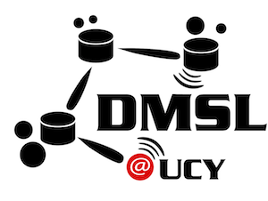


Towards Planet-Scale Localization on Smartphones with a Partial Radiomap
Andreas Konstantinidis
Georgios Chatzimilioudis
Christos Laoudias
Silouanos Nicolaou
Demetrios Zeinalipour-Yazti
[ Contact: dmsl@cs.ucy.ac.cy ]
Presenter: Georgios Larkou
University of Cyprus
University of Cyprus
ACM HotPlanet 2012 – The 4th ACM International Workshop on
Hot Topics in Planet-Scale Measurement – co-located with ACM MobiSys
25th June, 2012 Low Wood Bay, Lake District, UK.
Notes:
Hello everybody, my name is Georgios Larkou and I am a PhD candidate at the University of Cyprus. During this session I will present a collaborative work between the Data Management System Laboratory and KIOS Research Center from the University of Cyprus and the Computer Science Department from the Frederick University. This work is proposing an innovative solution towards planet-scale localization on smartphones with a partial radiomap in order to decrease the amount of time needed for approximating the users’ location while preserving users’ privacy.

Slide 2
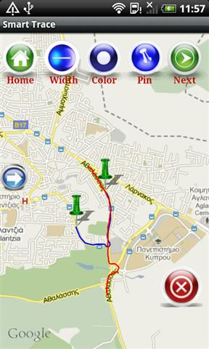
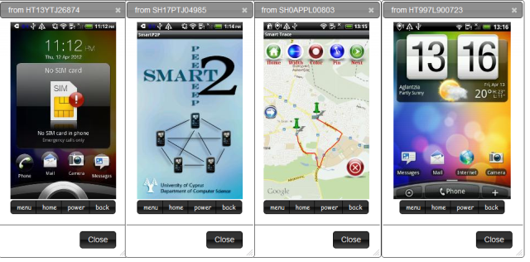
Smartphones (1/2)
Smartphone: A powerful sensing device!
Processing: 1 GHz dual core
RAM & Flash Storage: 1GB & 48GB, respectively
Networking: WiFi, 3G (Mbps) / 4G (100Mbps–1Gbps)
Sensing: Proximity, Ambient Light, Accelerometer, Microphone, Geographic Coordinates based on AGPS (fine)
Interesting Applications
SmartTrace: Crowdsourced
trajectory similarity search
framework.
SmartLab: A programming
cloud of smartphones
Notes:
Before starting the main part of the presentation I would like to introduce you to the world of SmartPhone devices and then introduce ourselves and some of our previous work.
Nowadays, Smartphones became a powerful sensing device. Typically, smartphones consist of powerful hardware, for example dual core and four core processors, some of them up to 1GB or RAM and up to 48GB or flash storage, WiFi and 3G interfaces and a variety of in-built sensors for example , proximity sensors, accelerometer, microphone, GPS and A-GPS.
Thus, smartphones are able to process large amount of data while the combination of those sensors creates opportunities for Geo-located crowd-sourced data acquisition (Opportunistic/ Participatory Sensing) and Location-aware applications and services.
SmartTrace and SmartLab are some applications developed by our group. Firstly, SmartTrace is a crouwdsourced trajectory similarity search framework. SmartLab is the first programming cloud of Android devices. Users are able to lease Android devices and use SmartLab in order to conduct experiments on those devices. Users are able to issue shell commands, transfer files and control multiple devices through their browsers simultaneously. SmartLab will be presented to the Demo Session of MobiSys 2012.
http://en.wikipedia.org/wiki/Wikipedia:Database_download
Wikipedia (Current revisions only, no talk or user pages): 6.07 GB compressed or 27 GB uncompressed
All revisions, all pages: 5 TB!
GPS: 1 meter and of 1.5 meters => up to 30 meters
For instance, the “My Location” service by Google, can only provide accuracies of about 200m while Cell Tower Positioning provides accuracies of several thousand meters.

Slide 3
Smartphones (2/2)
Interesting Applications
AirPlace: Localization on Smartphones using D-RSS RadioMap.
Notes:
Lastly but not least, Airplace is our first prototype for indoor navigation using a decentralize RSS RadioMap. It was one of our first works regarding indoor navigation and it made us realize the importance of a better approach towards planed scale localization. The reason behind this is that while experimenting with Airplace and our experimental database from CS building at UCY we realized how much processing power and energy was needed in order to perform localization and we only had 45000 total RSS Fingerprints. Airplace will also be presented during the Demo Session of MobiSys 2012.

Slide 4
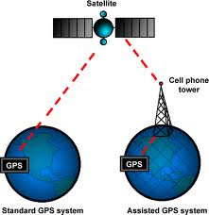
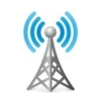



A Word on Localization Systems…
Smartphones already collect positional information. Same applies to Social Networking Applications (e.g., Facebook, Latitude, Gowalla, Twitter, etc.)
A-GPS: assistance of beams transmitted from satellites
C-RSS RadioMap services: collect RSS values from WiFi APs in the vicinity of the user and transfer an RSS vector to a centralized server that derives the user’s location from a RadioMap
AP1
AP3
RSS Vector
D
Location
AP2
Notes:
As mentioned before smartphones already collect positional information such as location of the users utilizing various technologies such as A-GPS and C-RSS RadioMap services.
A-GPS utilizes the geo-spatial information from satelites and with the assistance of the information gathered from the cell phone tower and can provide faster and more accurate results regarding the location of the user.
On the other hand C-RSS RadioMap services collect RSS values from WiFi APs in the vicinity of the user and transfer an RSS vector to a centralized server that derives the user’s location from a RadioMap. For instance, Google's Geolocation API (behind Google's web and mobile positioning features) allows a user to ship the user's RSS vector ("AP1, AP2, .... APl", l<<m) to a server and have the server derive (or approximate) the (x,y) coordinates of the user using its MATRIX structure.

Slide 5
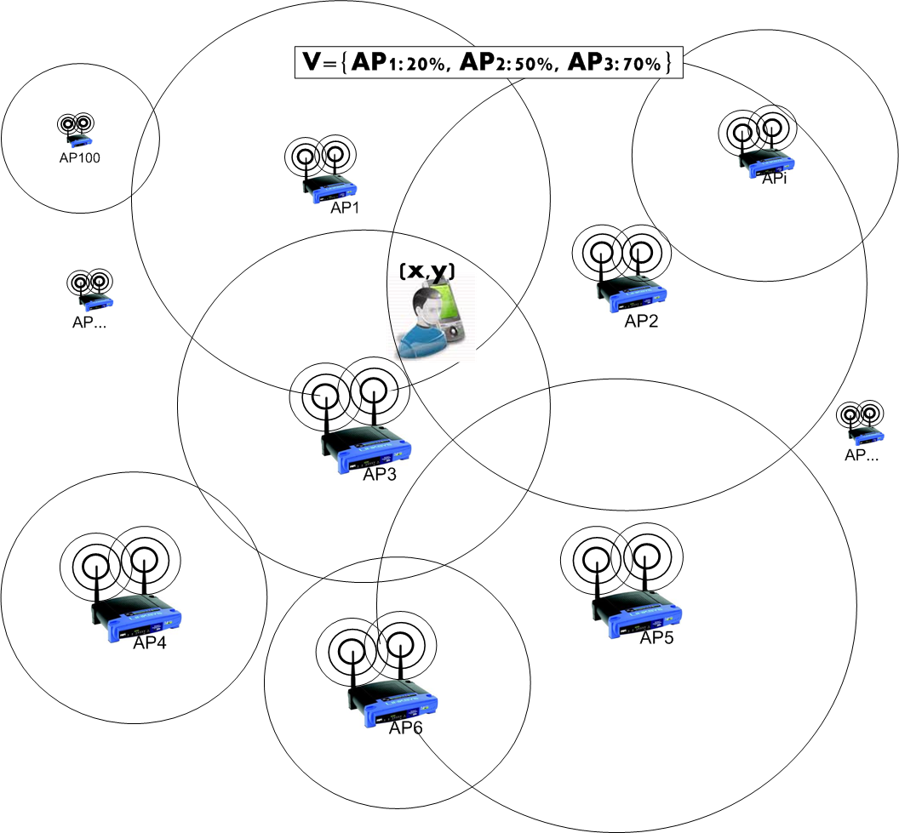
A Word on Localization Systems…
C-RSS RadioMap Services
Google Geolocation API (XML, JSON)
{
"version": "1.1.0",
"host": "maps.google.com",
"access_token": "2:k7j3G6LaL6u_lafw:4iXOeOpTh1glSXe",
"home_mobile_country_code": 310,
"home_mobile_network_code": 410,
"radio_type": "gsm",
"carrier": "Vodafone",
"request_address": true,
"address_language": "en_GB",
"location": {
"latitude": 51.0,
"longitude": -0.1
},
"cell_towers": [{
"cell_id": 42,
"location_area_code": 415,
"mobile_country_code": 310,
"mobile_network_code": 410,
"age": 0,
"signal_strength": -60,
"timing_advance": 5555
}, {
"cell_id": 88,
"location_area_code": 415,
"mobile_country_code": 310,
"mobile_network_code": 580,
"age": 0,
"signal_strength": -70,
"timing_advance": 7777
}],
"wifi_towers": [{
"mac_address": "01-23-45-67-89-ab",
"signal_strength": 8,
"age": 0
}, {
"mac_address": "01-23-45-67-89-ac",
"signal_strength": 4,
"age": 0
}]
}
Notes:
Before proceeding to the rest of the presentation I believe it is advantageous to explain a C-RSS RadioMap service such as Google Geolocation.
From the above request you might notice that a user ships the mac address and RSS value of the cell towers in its vicinity. The given approach, denoted as the Centralized RadioMap Algorithm (CRA) has the following characteristics: + Client-side Energy Consumption: Good! + Client-side Retrieval Time: Good! - Privacy: Bad! Disclosing APs to the Server means disclosing position!

Slide 6
A Word on Localization Systems…
A-GPS localization - Drawbacks:
negatively affected from the environment (e.g., cloudy days, forests)
does not work in indoor spaces
suffers from high-energy drain on mobile devices
C-RSS Radiomap localization - Drawback:
compromises user privacy:
continuously disclosing the RSS vector to a centralized authority means disclosing the user’s location
Notes:
Ofcouse, at this slide we present the aggregated drawbacks of the two previously discussed techniques. in the previous slides those technologies.
As we all know, A-GPS localization is negatively affected from the environment ( eg. Cloudy days, forests, big buildings etc), does not work in indoor spaces and suffers from high-energy drain on mobile devices.
On the other hand, the main concern regarding C-RSS Radiomap localization is the fact that is continuously disclosing the RSS vector to a centralized authority which in simple words means that it is disclosing an approximation of the user’s location and compromising user’s privacy.

Slide 7
Presentation Outline
Introduction
Problem Formulation
The BloomMap Algorithm
Experimental Evaluation
Future Work
Notes:
This concludes our short introduction which provided some insights of the presentation. The rest of the presentation consists of the problem formulation, some preliminaries, a presentation of the proposed BloomMap algorithm, the derived experimental evaluation and some future work plans.

Slide 8
Problem Formulation (1/2)
A user seeks to localize itself using a RSS Radiomap service through a distribution server S that disseminates a RSS Radiomap to the client
S maintains a 2-D MATRIX[N][M] by recording the RSS values of M APs at N geo-locations (x,y)
For example, Radiomap MATRIX format:
AP1, AP2, .... APM => x1,y1
AP1, AP2, .... APM => x2,y2
AP1, AP2, .... APM => x3,y3
....
AP1, AP2, .... APM => xN,yN
Notes:
Let’s start with the problem formulation. Lets imagine, that a user seeks to localize itself using a RSS Radiomap service through a distribution server S that distributes a RSS Radiomap to the user. The server maintains a 2D matrix[n][m] prior user’s request by recording the RSS values of M access points at N locations. The Radiomap looks like the example depicted on this slide where each line contains all the APs RSS signals value which corresponds to the values of the APs signal at the vicinity of the user while the user was at x1, y1 location.
The server maintains a x number of rows each corresponding to a different geo-location with the associated values for the access points RSS signal.

Slide 9
Problem Formulation (2/2)
MATRIX:
typically constructed by centrally overlaying several RSS vectors:
AP1, AP2, .... APl => xi,yi (l<<M),
which are recorded by users using wardriving
extremely large in respect to N, as the M is usually small
can be represented efficiently with adjacency-matrix structures
denoted as a 2-D matrix where most points are null, e.g., NaN (i.e., a sparse matrix)
Notes:
The matrices are constructed by centrally overlaying several RSS vectors which are recorded by users using wardriving. While the matrices are extremely large in respect to N (geo-locations ) the M which represents the number of access points is usually small and can be represented efficiently with adjacency-matrix structures which can be denoted as a 2D matrix where most points are null because not all Aps are on the vicinity of the user while navigating in the environment.

Slide 10
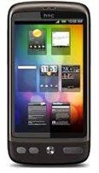
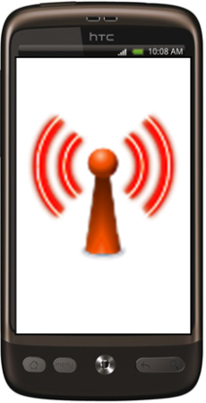

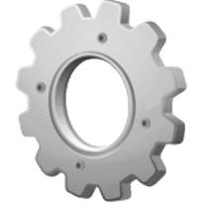
Current Techniques – CRA (1/4)
Current techniques conduct fine-grained positioning using techniques executed on the server
Centralized Radiomap Algorithm (CRA):
user ships RSS vector (“AP1,AP2,…,APl”, l << M) to server
server derives (or approximates) the (x,y) coordinates of the user using its MATRIX structure
REQUEST
<RSS Vector>
RSS Logger
Distribution Server
RESPONSE
<Location>
RSS logs
Notes:
At this point, it is advantageous to refer to some current available techniques. Most of the existing techniques conduct fine-grained positioning using algorithms executed on the server. The user ships the RSS vector collected at his position to the distribution server and the server is able to derive the x,y coordinates of the user using its Matrix structure which were previously collected by volunteers using a RSS logger application. As a result, the distribution server is able to approximate user’s position by comparing the RSS vector received by the user with the previously collected values contained in the RSS Matrix.

Slide 11
Current Techniques – CRA (2/4)
CRA Characteristics:
Energy Consumption (Good): CRA is energy efficient, server performs all calculations and conserves user’s battery energy.
Retrieval Time (Good): faster process, processing power of the server is much higher than the user’s device. Transmitting just the result to the user consumes minor network resources.
Privacy (Bad): Disclosing the RSS vector to the server, as input to the localization process, means disclosing coarsely the user’s position.
Notes:
As we can guess the Centralized Radiomap characteristics are the following.
CRA is energy efficient because the server performs all calculations and minimizes the required energy that needs to be spent for geo-localization.
Secondly, the CRA technique is a fast process as a result of the available processing power of the distribution server in comparison with the limited processing power provided by the users’ device. Additionally, it requires and consumes minor network resources because it only transmits the RSS signals received from the user at a location and the resulted x,y coordinates .
On the other hand, the main disadvantage of this technique is that by disclosing the RSS vector to the server as an input to the localization process means that the server is able to actively determine/track the user’s position and compromise user’s privacy.

Slide 12
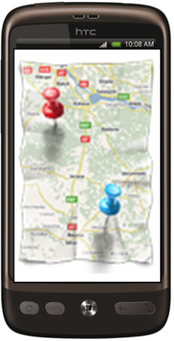
Current Techniques – DRA (3/4)
To tackle the privacy concern of the CRA.
Distributed Radiomap Algorithm (DRA):
Client requests the MATRIX to localize itself.
Sever ships the MATRIX to the client
Client performs the mapping using one known algorithm e.g., KNN.
REQUEST
RSS Logger
Distribution Server
Find Me
RESPONSE
<Radiomap>
RSS logs
Notes:
An alternative technique which aims to tackle the privacy concern of the CRA is the Distributed Radiomap Algorithm. According to this technique the user requests the Matrix (complete RadioMap) to localize itself. The server is responsible to transfer the requested matrix to the user and the user is responsible to use one known algorithm for example KNN (k-nearest neighbors) to locate itself. Again, the Matrix transferred by the distribution server contains all the previously logged matrix vectors collected from RSS Logger.

Slide 13
Current Techniques – DRA (4/4)
DRA Characteristics:
Energy Consumption (Bad): MATRIX is huge for both receiving as well as searching and finding the coordinates. This is not energy efficient for a smartphone user.
Retrieval Time (Bad): Transmission of a huge MATRIX is time consuming and also consumes more network resources.
Privacy (Good): The user’s position is not disclosed since the server knows nothing about the users’ RSS vector.
Notes:
In contrast to CRA characteristics, DRA provides the following characteristics:
Distributed Radio Map algorithm requires a decent amount of battery to be consumed in order to approximate user’s position. The Matrix is huge and requires high processing utilization, resulting in high battery consumption, in order to find the user’s coordinates. For a mobile user where the battery life is limited the use of DRA can be described as not energy efficient.
Additionally retrieval time is bad because in order to be able to perform the localization the transmission of a huge matrix is required. As a result, this is time consuming and consumes more network resources in contrast to the resources needed by CRA.
Finally, DRA preserves the privacy of the user. The server does not require the transmission of any RSS vectors from the user thus it is not able to approximate or track the actual user’s position.

Slide 14
Motivation
Discussion:
DRA improves data-disclosure drawback of CRA
DRA is quite inefficient in terms of energy consumption and retrieval time in planet-scale localization scenarios
Major goal of the proposed approach:
keep the RSS vector in-situ for data-disclosure
offer at the same time high performance
BloomMap Algorithm (BMA) combines:
the advantages of the CRA and DRA
cloaking in location privacy and Bloom filters
Notes:
While the DRA improves data-disclosure drawback of CRA, DRA is quite inefficient in terms of energy consumption and retrieval time in planet-scale localization scenarios.
The major goal of the proposed approach is to keep the RSS vector in-situ for preserving user’s privacy and offer at the same time high performance.
In order to achieve our goals, we introduced BloomMap Algorithm which combines the advantages of the CRA and DRA algorithms while preserving users’ privacy using Bloom filters.

Slide 15
Presentation Outline
Introduction
Problem Formulation
The BloomMap Algorithm
Experimental Evaluation
Future Work
Notes:
We will now proceed to the preliminaries of our work.

Slide 16
Privacy Preserving Techniques
Privacy-preserving techniques for location services are based on one of the following concepts:
dummy locations [1]: user protects their location privacy by reporting a set of fake locations termed dummies
spatial cloaking [2]: users’ locations are transformed into another space, their exact /approximate spatial relationships are maintained
space transformations [3]: blur a user’s exact location into a cloaked area that satisfies the user’s privacy requirements
H. Kido, Y. Yanagisawa, and T. Satoh. An anonymous communication technique using dummies for location-based services. In IEEE ICP, 2005.
C.-Y. Chow and X. L. M.F. Mokbel. Spatial cloaking for anonymous location-based services in mobile peer-to-peer environments. In Geoinformatica, 2011.
G. Ghinita, P. Kalnis, A. Khoshgozaran, C. Shahabi, and K. Tan. Private queries in location based services: Anonymizers are not necessary. In ACM SIGMOD, 2008.
Notes:
A lot of privacy-preserving techniques for location services exist and are based on one of the following concepts.
Firstly, the user reports a set of dummy/fake locations in order to protect their actual location.
Secondly, using spatial cloaking. The users’ locations are transformed into another space while their exact /approximate spatial relationships are maintained.
Thirdly, space transformations technique is proposing to blur a user’s exact location into a cloaked area that satisfies the user’s privacy requirement.
For user anonymity:
k-anonymity guarantees that querying user is indistinguishable from at least k-1others.
k-spatial anonymity is achieved by obfuscating the querying user’s location so that it cannot be identified with a probability > 1/k.
this can be achieved using k dummy locations, assuming that the locations of a user has uniform probability over the space.
Low Distance between two objects
==
High sim
Metric Distance Functions (e.g. Euclidean):
Identity: d(x,x)=0
Non-Negativity: d(x,y)>=0
Symmetry: d(x,y) = d(y,x)
Triangle Inequality: d(x,z) <= d(x,y) + d(y,z)
Non-Metric (e.g., LCSS, DTW): Any of the above properties is not obeyed.

Slide 17

BloomMap Algorithm (BMA)
Minimizes energy consumption + time overhead
Guarantees location privacy
Instead of sending its RSS vector, the user forwards a Bloom filter, constructed from one Access Point (AP) in its vicinity, and its corresponding RSS value to the server
The server uses this Bloom filter to find a small number (r << M) of MATRIX rows [M is the number of APs] that will allow the user to identify its location
REQUEST
<Bloom Filter>
RSS Logger
Distribution Server
Find Me
RESPONSE
<Partial Radiomap>
RSS logs
Notes:
Firstly, the BloomMap algorithm minimizes energy consumption and time overhead and guarantees user’s location privacy.
The reason behind this is that instead of sending its RSS vector, the user forwards a Bloom filter, constructed from one Access Point (AP) in its vicinity and its corresponding RSS value to the server.
Afterwards, the server is responsible to use this Bloom filter and return to the user a small number of Matrix rows that will allow the user to identify its location. In simple words the distribution server returns to the user a partial radiomap which includes the lines from the Matrix representing the actual position of the user and some other lines derived from the bloom filter which represent fake locations based on the dummy APs. As a result, the distribution server is not able to approximate the actual location of the user.

Slide 18
Bloom Filters (1/2)
Bloom filters – basic idea:
allocate a vector of b bits, initially all set to 0
use h independent hash functions to hash an element to h positions in the vector with a uniform random distribution
feed the element to each of the h hash functions to get h vector positions and set them to 1
To test whether an element is a member of a set:
compare the vector of the query to the vector of the set, i.e., the Bloom filter
If all non-zero positions match, then the element might be a member of the set, since Bloom filters do not prevent false positives
1 | 0 | 0 | 1 | 0 | 0 | 1 | 0 | 0 | 0
0 | 0 | 0 | 0 | 0 | 0 | 0 | 0 | 0 | 0
b bits
Notes:
Bloom ﬁlters were proposed by Burton Howard Bloom in 1970, as space-eﬃcient probabilistic data structures that are used to answer set-membership queries eﬃciently. The idea is to allocate a vector of b bits, initially all set to 0, and use h independent hash functions to hash an element to h positions in the vector with a uniform random distribution.
The basic idea behind bloom filters used for preserving users’ privacy and actual/approximate location the following technique is followed:
allocate a vector of b bits, initially all set to 0,
use h independent hash functions to hash an element to h positions in the vector with a uniform random distribution.
feed the element to each of the h hash functions to get h vector positions and set them to 1.
To test whether an element is a member of a set:
compare the vector of the query to the vector of the set, i.e., the Bloom filter.
If all non-zero positions match, then the element might be a member of the set, since Bloom filters do not prevent false positives.
Low Distance between two objects
==
High sim
Metric Distance Functions (e.g. Euclidean):
Identity: d(x,x)=0
Non-Negativity: d(x,y)>=0
Symmetry: d(x,y) = d(y,x)
Triangle Inequality: d(x,z) <= d(x,y) + d(y,z)
Non-Metric (e.g., LCSS, DTW): Any of the above properties is not obeyed.

Slide 19
Bloom Filters (2/2)
The most significant feature of Bloom filters is that there is a clear tradeoff between b and the probability of a false positive
Given h optimal hash functions, b bits for the Bloom filter and the number M of elements we can calculate the amount of false positives produced by the Bloom filter:
False Positive Ratio:
Size of vector:
Notes:
The most significant feature of Bloom filters is that there is a clear tradeoff between b and the probability of a false positive.
Given h optimal hash functions, b bits for the Bloom filter and the number M of elements we can calculate the amount of false positives produced by the Bloom filter:
False positives help us to preserve users’ privacy and this will be explained in more detail during the rest of the presentation.

Slide 20
BloomMap Algorithm Example
M=100, k=3, user at (x,y),
AP1, AP2, AP3 in vicinity,
RSS vector V,
Calculate b=12, fpr = 0.03.
User finds Bloom-Filter for AP₂.
User sends Bloom-Filter to server.
Server tests all APs with 3 hash functions.
Finds matching APids, (AP₁₃, AP₆₅ dummy)
Select rows with non-zero values and send them to the user.
Notes:
A complete example

Slide 21
BloomMap Algorithm (BMA)
BMA Characteristics:
Energy Consumption (Good): Only a very small subset of MATRIX rows are sent to the to user, (r << N).
Retrieval Time (Good): Transmitting a small part of the radiomap ensures fast reception of the results.
Privacy (Good): Simple cloaking and k-spatial anonymity
ensure that the server can only identify a wider area.
Notes:
The BloomMap algorithm characteristics are the following:
In terms of energy consumption BMA is better than DRA because only a very small subset of MATRIX rows are sent to the user and needs to be processed in order to approximate user’s position.
In terms of retrieval time is more efficient as it is only requires the transmition of a partial radiomap and ensures fast reception of the radiomap.
Finally, regarding preserving users’ privacy BloomMap algorithm provides simple cloaking and k-spatial anonymity and ensures that the server can only identify a wider area instead of approximating the actual users’ position.

Slide 22
BloomMap Algorithm (BMA)
Discussion:
User defines the redundancy of the Bloom filter
Only one AP-id from the APs in the user’s vicinity is used to create the Bloom filter
The answer set can be further reduced with a slight trade-off in the amount of cloaking achieved
Notes:
The user is able to define the redundancy of the bloom filter.
Only one AP-id from the APs in the user’s vicinity is used to create the Bloom filter.
The answer set can be further reduced with a slight trade-off in the amount of cloaking achieved.

Slide 23
Presentation Outline
Introduction
Problem Formulation
The BloomMap Algorithm
Experimental Evaluation
Future Work
Notes:
Now, lets proceed to the experimental evaluation of BloomMap algorithm

Slide 24
Airplace Prototype System
consists of the RSS Logger, the Find Me application and the Distribution Server
does not currently integrate BloomMap
RSS Logger Application: uses Android RSS API for scanning and recording data samples in specific locations at predefined intervals.
Find Me Application: Android smartphones connect to the server to download the Radiomap and self-locate using a positioning algorithm.
Distribution Server: responsible for the construction and distribution of the RSS Radiomap as well as the collection of RSS data (wardriving)
Notes:
Before proceeding to our experimental evaluation we will start by presenting a prototype built at the University of Cyprus which implements the DRA technique. Airplace consists of the RSS Logger, the FindMe application and the distribution server.
It does not currently integrate BloomMap but the metrics collected from this application helped us in choosing our evaluation methodology.
The RSS Logger Application uses Android RSS API for scanning and recording data samples in specific locations at predefined intervals. In telecommunications, received signal strength indicator (RSSI) is a measurement of the power present in a received radio signal. RSSI is an indication of the power level being received by the antenna. Therefore, the higher the RSSI number (or less negative in some devices), the stronger the signal.
FindMe application is an Android applications which connects to the server in order to download the Radiomap and self-locate using a positioning algorithm.
Finally the distribution server is responsible for the construction and distribution of the RSS Radiomap as well as the collection of RSS data (wardriving).

Slide 25
Experimental Methodology
Algorithms:
Centralized (CRA): 1) Ship RSS vector to server 2) Conduct centralized computation using Radiomap 3) Download location
Decentralized (DRA): 1) Request Radiomap 2) Download Radiomap 3) Conduct computation to find location
BloomMap (BMA): 1) Ship Bloom filter to server 2) Conduct computation to generate Partial-RadioMap 3) Download Partial-RadioMap 4) Conduct computation to find location
Metrics:
Execution Time (T): The total time to retrieve location
Energy (E) per Device: average energy consumed by a smartphone for retrieving its location (based on Powertutor profile – Univ. of Michigan)
Number of Messages (NoM): Number of messages exchanged between smartphone and server to retrieve location
Notes:
Algorithms:
Centralized (CRA): 1) Ship RSS vector to server; 2) Conduct centralized computation using Radiomap 3) Download location;
Decentralized (DRA): 1) Request Radiomap; 2) Download Radiomap 3) Conduct computation to find location;
BloomMap (BMA): 1) Ship Bloom filter to server; 2) Conduct computation to generate Partial-RadioMap; 3) Download Partial-RadioMap 4) Conduct computation to find location;
Metrics:
Execution Time (T): The total time to retrieve location.
Energy (E) per Device: average energy consumed by a smartphone for retrieving its location (based on Powertutor profile – Univ. of Michigan)
Number of Messages (NoM): Number of messages exchanged between smartphone and server to retrieve location

Slide 26
Experimental Methodology
Datasets used in simulations:
Information | UCY Dataset | KIOS dataset
Location | CS dept., UCY | KIOS, UCY
Devices | 3 (Android) | 3 (Android)
APs | 120 in four floors (+neighb. builgs) | 9 in one floor (+neighb. builgs)
RSS fingerprints per location | 30 | 20
Distinct Locations | 1500 | 105
Total Reference Fingerprints | 45,000 | 2,100
Notes:
For the experiments we used the following two datasets.
A dataset collected from the Computer Science Department at the University of Cyprus. For the collection of the dataset we used 3 Android devices and recorded 120 different APs in four floors plus APs from the neighboring buildings. We recorded 30 RSS fingerprints per location from 1500 distinct values. The resulted dataset consisted of 45 000 reference RSS fingerprints
The second dataset was collected from the KIOS Research Center building. Again, we used 3 Android Smartphones and recorded 9 Aps from one floor and the neighboring buildings. We recorded 20 RSS fingerprints per location from 105 distinct locations. The resulted dataset consisted of 2100 reference RSS fingerprints.

Slide 27
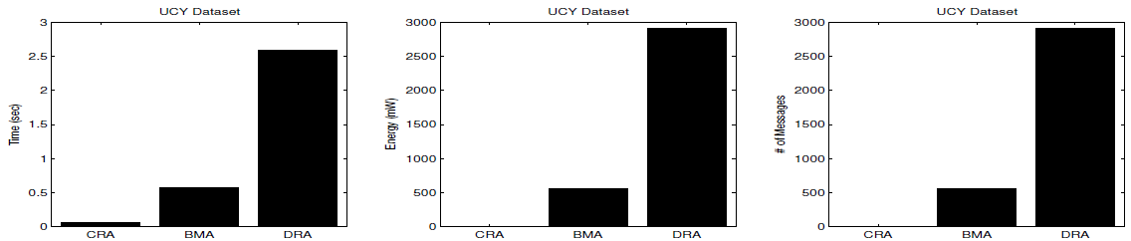
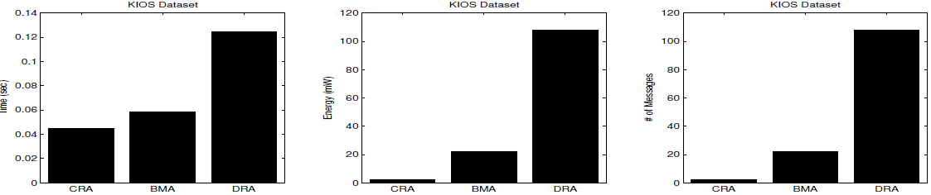
Preliminary Experimental Results
Result: BMA improves the performance of DRA (used in Airplace) by 80% in terms of time, 83% in
terms of energy consumption and utilizes 80% less network resources.
Result: BMA provides 60% less time overhead and 60% less energy consumption and utilizes 80% less
network resources.
Result: CRA outperforms the BloomMap algorithm in both datasets.
CRA violates the user’s privacy, where the BloomMap approach guarantees localization
without revealing the user’s real position.
Notes:
As shown in the results, regarding the Computer Science department dataset, BMA improves the performance of DRA (used in Airplace) by 80% in terms of time, 83% in terms of energy consumption and utilizes 80% less network resources.
Now, according the KIOS dataset, BMA provides 60% less time overhead and 60% less energy consumption and utilizes 80% less network resources.
Result: CRA outperforms the BloomMap algorithm in both datasets. CRA violates the user’s privacy, where the BloomMap approach guarantees localization without revealing the user’s real position.

Slide 28
Presentation Outline
Introduction
Problem Formulation
The BloomMap Algorithm
Experimental Evaluation
Future Work
Notes:
Finally, we will present our plans for future work.

Slide 29
Future Work
Develop extensions that improves privacy and anonymity on multiple-continuous queries while the user is moving.
Collecting larger-scale Radiomaps to test the scalability and robustness of our approach
Evaluate our algorithm in terms of other performance metrics (e.g., scalability) and compare it with other approaches.
Extend the implementation of the Airplace-Bloommap Platform to other mobile operating systems.
Notes:
First of all, we will develop BloomMap algorithm extensions that will improve privacy and anonymity of multiple-continuous queries.
Secondly,wour future plans include the collection of larger-scale radiomaps to test the scalability and robustness of our approach.
We will evaluate our algorithm in terms of other performance metrics (eg. scalability) and compare it with other approaches.
Finally, we would like to extend the implementation of the Airplace – BloomMap Platform to other mobile operating systems.

Slide 30
Towards Planet-Scale Localization on Smartphones with a Partial Radiomap
Thanks! Questions?
Andreas Konstantinidis
Georgios Chatzimilioudis
Christos Laoudias
Silouanos Nicolaou
Demetrios Zeinalipour-Yazti
[ Contact: dmsl@cs.ucy.ac.cy ]
Presenter: Georgios Larkou
University of Cyprus
University of Cyprus
ACM HotPlanet 2012 – The 4th ACM International Workshop on
Hot Topics in Planet-Scale Measurement – co-located with ACM MobiSys
25th June, 2012 Low Wood Bay, Lake District, UK.
Notes:
This brings me to the end of my presentation. Thank you for your attention. I'd be glad to answer any questions you might have.

