Slide 1


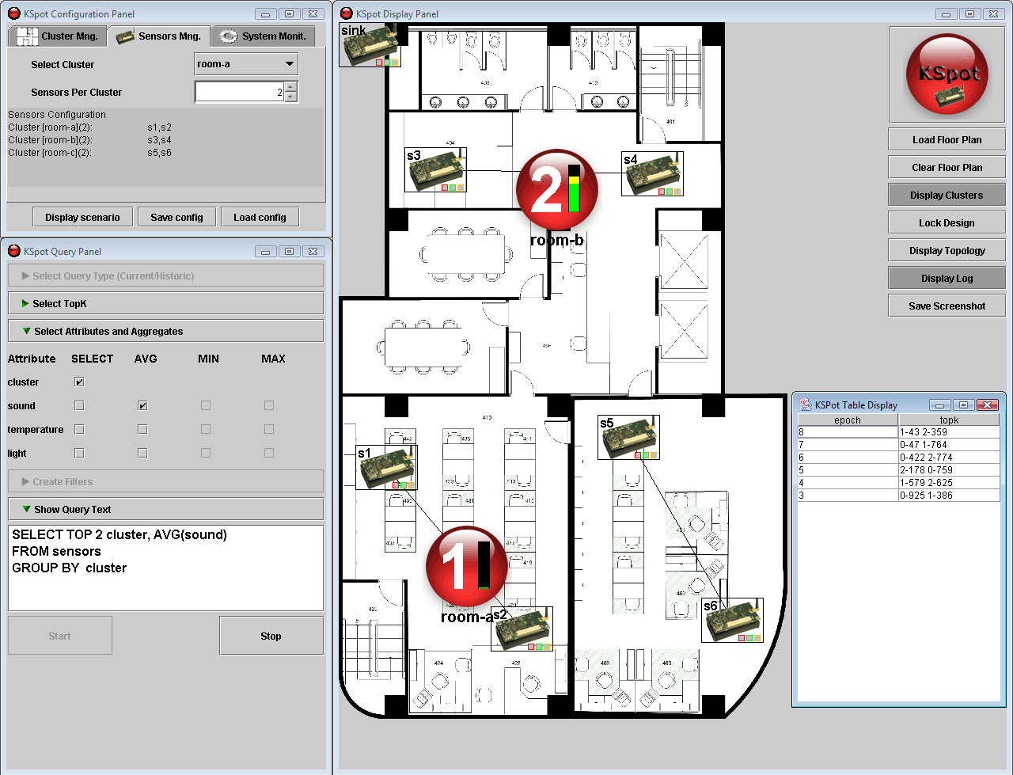
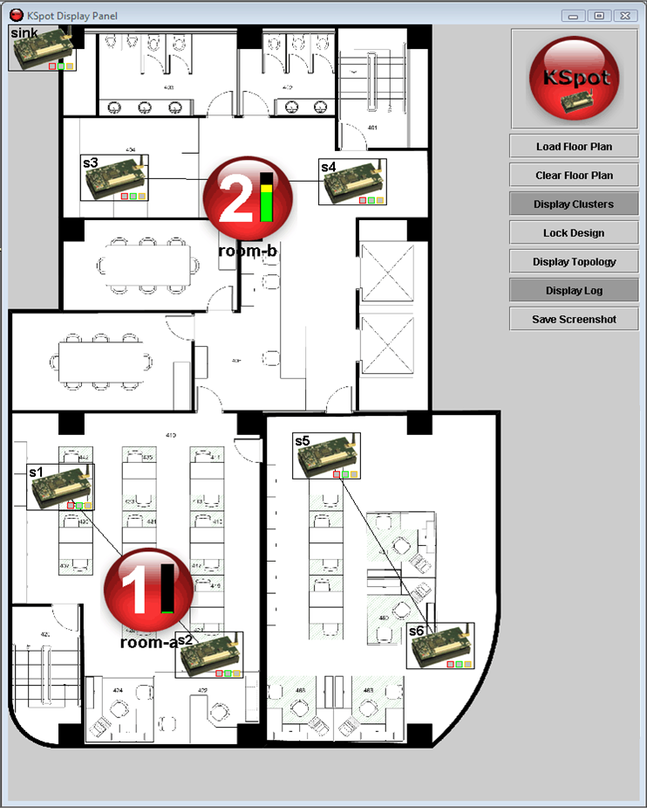

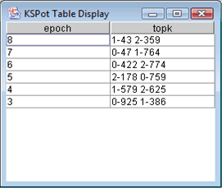
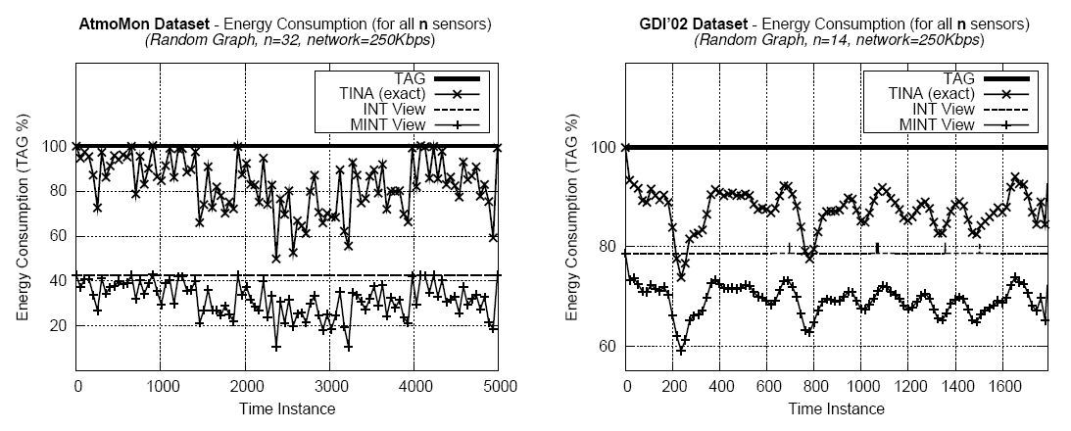
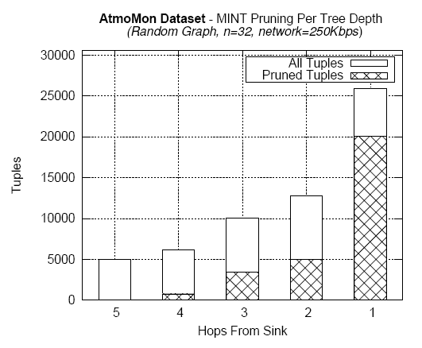



On the Sp t Monitoring
KSpot
Effectively Monitoring the K Most Important Events
in a Wireless Sensor Network
Panayiotis Andreou, Demetrios Zeinalipour-Yazti, Martha Vassiliadou, Panos K. Chrysanthis, George Samaras
Goals and Contributions
Our Goal: Efficiently monitor the K highest ranked answers to a query in a Wireless Sensor Network
What is KSpot?
The first Top-k Query Processing Engine for Wireless Sensor Networks
A general purpose, intuitive and declarative user interface for identifying the most important events quickly (less time) and efficiently (less energy)!
KSpot Architecture and Interface Design
KSpot
Configuration Manager
Manage Clusters
Load/Save Configuration
System Monitoring
Display Window
Load Floor Plan
Display sensors in clusters
Display Spots (rankings)
Gauge support
Save Screenshot
Layered Architecture
TinyDB
TinyOS
Query Manager
Create Snapshot and Historic Queries
Select number of results (k)
Add Filters
Display Query text
Start/Stop Queries
Log Display Support
Displays raw sensor data
Flexible Field Deployment
KSpot Interface
Top-K Query Processing in KSpot
Snapshot Top-k Query Processing
We have developed the MINT algorithm which works in 3 phases:
Creation phase: creates and stores a materialized view locally at the sensor
Pruning phase: prune tuples not in the final top-k results
Update phase: send the view if it has changed from the previous instance
Problem Illustration
Historic Top-k Query Processing
We have developed the TJA algorithm which works in 3 phases:
Lower Bound phase: construct a threshold
Hierarchical Joining phase: each node eliminates objects below the lower bound, and joins qualifying objects from children nodes
Clean-Up phase: actual top-k results are identified
Problem Illustration
room | sum | count | sum’
2 | 200 | 4 | 320
5 | 270 | 4 | 390
6 | 500 | 5 | 500
11 | 460 | 4 | 580
12 | 290 | 3 | 530
15 | 130 | 2 | 490
V₁ | V₂ | V₃ | V₄ | V₅
O₃, 99 | O₁, 91 | O₁, 92 | O₃, 74 | O₃, 67
O₁, 66 | O₃, 90 | O₃, 75 | O₁, 56 | O₄, 67
O₀, 63 | O₀, 61 | O₄, 70 | O₂, 56 | O₁, 58
O₂, 48 | O₄, 07 | O₂, 16 | O₀, 28 | O₂, 54
O₄, 44 | O₂, 01 | O₀, 01 | O₄, 19 | O₀, 35
room
2
V₁ | V₂ | V₃ | V₄ | V₅
O₃, 99 | O₁, 91 | O₁, 92 | O₃, 74 | O₃, 67
O₁, 66 | O₃, 90 | O₃, 75 | O₁, 56 | O₄, 67
O₀, 63 | O₀, 61 | O₄, 70 | O₂, 56 | O₁, 58
O₂, 48 | O₄, 07 | O₂, 16 | O₀, 28 | O₂, 54
O₄, 44 | O₂, 01 | O₀, 01 | O₄, 19 | O₀, 35
5
K-Covered Bound Set
6
11
12
15
100
200
300
400
500
600
O₃, 405
O₁, 363
sum
Evaluation
Energy Consumption of KSpot compared with other known query processing techniques using the AtmoMon and GDI datasets.
10-58% energy reductions using distributed top-k pruning
Additional 10% using historic buffers
Pruning Magnitude: ratio of pruned tuples as we move closer to the sink node.
Exponential Increase when we move closer to the sink
Reaches as high as 77%
In the AtmoMon dataset, we observed a 20000 tuple reduction at level one alone
↓ 70% energy
(KSpot): "KSpot: Effectively Monitoring the K Most Important Events in a Wireless Sensor Network", P. Andreou, D. Zeinalipour-Yazti, M. Vassiliadou, P. K. Chrysanthis and G. Samaras, IEEE ICDE'09, Shanghai, China, April 2009.
(MINT): “MINT Views: Materialized In-Network Top-k Views in Sensor Networks“, D. Zeinalipour-Yazti, P. Andreou, P. K. Chrysanthis and G. Samaras, MDM 2007, pp. 182-189, May 2007.
(TJA): “Finding the K Highest-Ranked Answers in a Distributed Network”, D. Zeinalipour-Yazti et. al., Computer Networks, In Elsevier Press, 2009
Panayiotis Andreou
Ph.D. Candidate
Department of Computer Science
University of Cyprus
P.O. Box 20537, 1678 Nicosia, Cyprus
Email: p.andreou@cs.ucy.ac.cy
University
of Cyprus
Open University
of Cyprus
University
of Pittsburgh
Acknowledgements: This work was supported in part by the Open University of Cyprus under the project SenseView, the US National Science Foundation under the project AQSIOS (#IIS-0534531) and the European Union under the project mPower (#034707)

