Slide 1




ICGrid: Intensive Care Grid
Demetris Zeinalipour
School of Pure and Applied Sciences, Open University of Cyprus, Cyprus
Marios D. Dikaiakos, Harald Gjermundrod, Marios Papa, Nikolas Stylianides
Dept. of Computer Science - University of Cyprus, Cyprus
Theodoros Kyprianou and George Panayi
Intensive Care Unit – Nicosia General Hospital, Cyprus
http://grid.ucy.ac.cy/

Slide 2
Motivation
More than 4,000,000 people are admitted to Intensive Care Units (ICU) in the U.S. – 500,000 of them do not survive. (Leapfrog group,2000)
ICU: An acute care environment deploying multi-disciplinary team skills to treat patients in critical (life-threatening) physiological state.
Intensivists rely heavily on monitoring of patients using sophisticated technology.

Slide 3
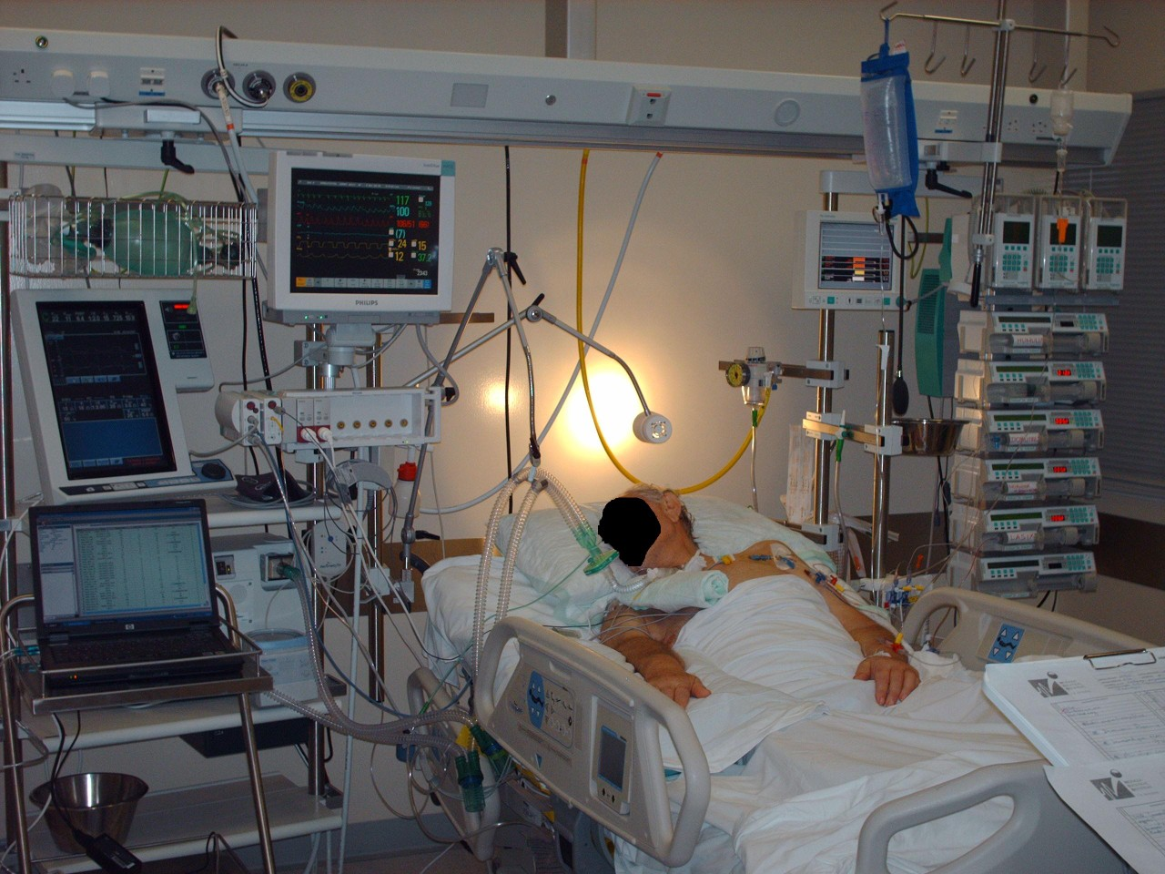
Intensive Care Unit
Drug administration pumps
Sophisticated Monitors
Cables, Catheters, etc
Ventilators
Devices provide a continuous real-time flow of screen-displayed numerical values and waveforms.

Slide 4
Clinically Interesting Episodes
Offline Analysis of acquired signals may help the physicians to identify biopatterns reflecting the prognoses of a patient.
This is particularly true if physicians have at their disposal a large sample of Clinically Interesting Episodes.
  Captured sensor data annotated by the physician.
  e.g., a 15 minute trace during which some abnormal condition occurs to the patient and which might be interesting and useful to other physicians (practice, research, education)
Devices provide a continuous real-time flow of screen-displayed numerical values and waveforms.

Slide 5
ICGrid Objective
Create an infrastructure that will enable the seamless and secure integration, correlation and retrieval of clinically interesting episodes across Intensive Care Units.
Current Feedback is extremely encouraging
  ICGrid recently received the Best Demo Award in the Coregrid Industrial Conference, Sophia Antipolis, France, 2006.
  ICGrid was selected to be presented in Europe's Information Society Technologies Conference, Helsinki, Finland, 2006.
Notes:
May help the physicians to identify bio-patterns reflecting the prognoses of a patient

Slide 6
Implementation Challenges
Limited capabilities and in-house expertise for storing and processing the patient vital parameters at current ICUs.
A plethora of proprietary medical devices are used in ICUs to monitor the patients
Hospitals are neither highly internetworked nor secure environments for sensitive data.
On the other hand the storage of patient data off-site and potential sharing of them raise issues of personal data security
Notes:
Multimodal monitoring: providing multiple modes of monitoring the human

Slide 7
The Grid
“Thousands of computers, Trillions of commands per second, Petabytes of storage and Secure and Controlled Access”
Example:
  EGEE assembles over 250 sites around the world
  More than 30,000 CPUs
  More than 5PB of storage
  Over 100 Virtual Organizations
The Grid is a promising venue for addressing the challenges of IC Medicine!
Notes:
Multimodal monitoring: providing multiple modes of monitoring the human

Slide 8
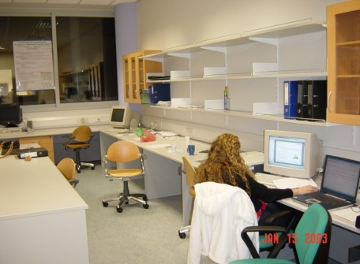
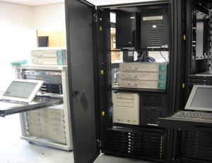
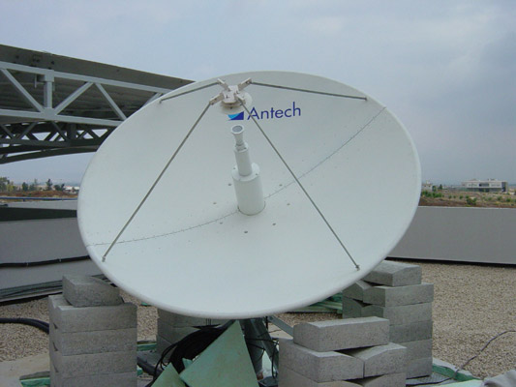
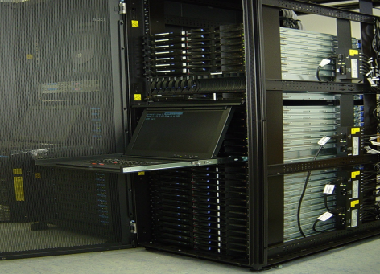
CyGrid - Univ. of Cyprus
TestBed: >100 CPUs, 3.5TB Storage Element SEE Resource Broker, SEE Information Index,
Related Projects: EGEE (2004-current), Healthware (2005-2008), gEclipse (2006-2008), eScience-CY (2004-2008), CoreGrid (2004-2008), Older: Emispher, CrossGrid, APART

Slide 9
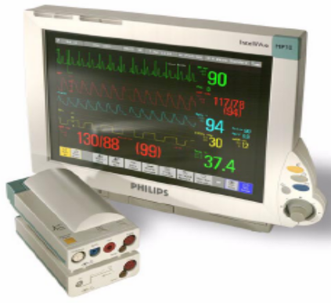
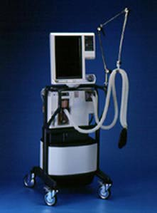

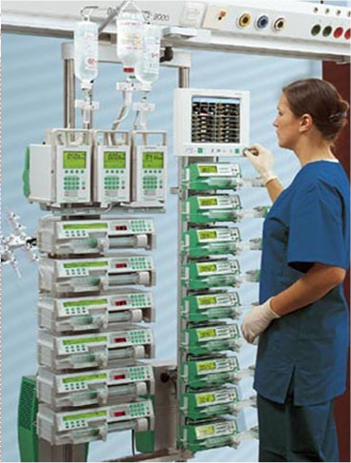
Nicosia General Hospital (NGH)
The largest (500-beds) and most technologically-advanced medical premise on the island.
It covers a wide range of medical specialties.
Intensive-Care-Unit (ICU): 17 beds, each equipped with a Phillips Intellivue Monitor, Mechanical Ventilation, Blood Gas Analyzer, Infusion Pumps and other devices.

Slide 10
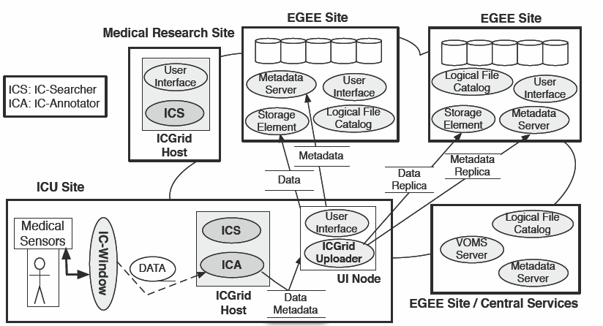
The ICGrid Architecture

Slide 11
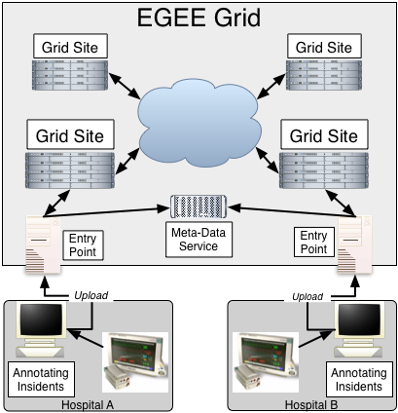
The ICGrid Architecture
"ICGrid: Enabling Intensive Care Medical Research on the EGEE Grid", H. Gjermundrod, M.D. Dikaiakos, D. Zeinalipour-Yazti, G. Panayi, T. Kyprianou, 5th HealthGrid Conference, Geneva, Switzerland, April 24-27, pp. 248-257, IOS Press, 2007.

Slide 12
ICGrid & the EGEE Grid
ICGrid utilizes the gLite Grid Middleware and its readily available services.
Examples:
  VOMS Service: For authenticating users
  Storage Element : For storing the patients data.
  Replica Location Service: Maintaining replicas of the acquired data to improve fault tolerance.
  AMGA Service: Conducting Metadata Storage and Retrieval operations.
  Resource Broker: For scheduling data mining jobs.

Slide 13
ICGrid: Envisioned Features
ICGrid is envisioned to support the following components:
  Grid sites for providing storage and metadata services.
  An ICU Virtual Organization
  ICGrid Software for
    Acquiring Stored Datasets
    Anonymization and Annotation (IC Annotator) of patient data.
    Uploading and Replication of Annotated Datasets to a Storage Element and Metadata Catalog.
    Searching of annotated datasets (IC Searcher).

Slide 14
ICGrid Window (ICWindow)
The Data Acquisition Tool for ICGrid developed at the University of Cyprus.
Runs on Win32 platforms, easy to use and has gone through two major versions v1 and v2.
Implements interfaces to a variety of Ethernet and RS232 devices (e.g., the Phillips Intellivue MP70 bedside patient monitor)
"Intensive Care Window: A multi-modal monitoring tool for Intensive Care Research and Practice" by H. Gjermundrod, M. Papa, D. Zeinalipour-Yazti, M.D. Dikaiakos, G. Panayi, T. Kyprianou 20th IEEE International Symposium on Computer-Based Medical Systems (IEEE CBMS'07), June 20-22, Maribor, Slovenia, pp. 471-476, 2007.

Slide 15
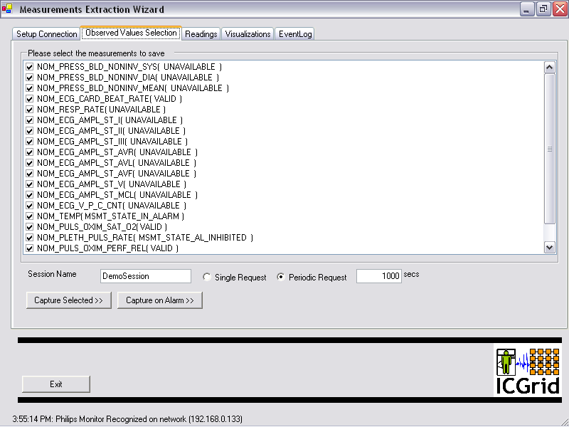
ICGrid Window v1 - Screenshots
Selection of Interesting Parameters

Slide 16
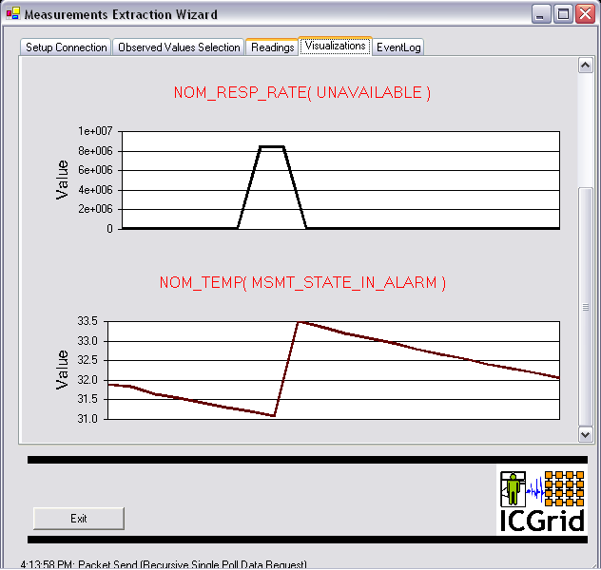
ICGrid Window v1 - Screenshots
Realtime Plots of Numerical Values

Slide 17
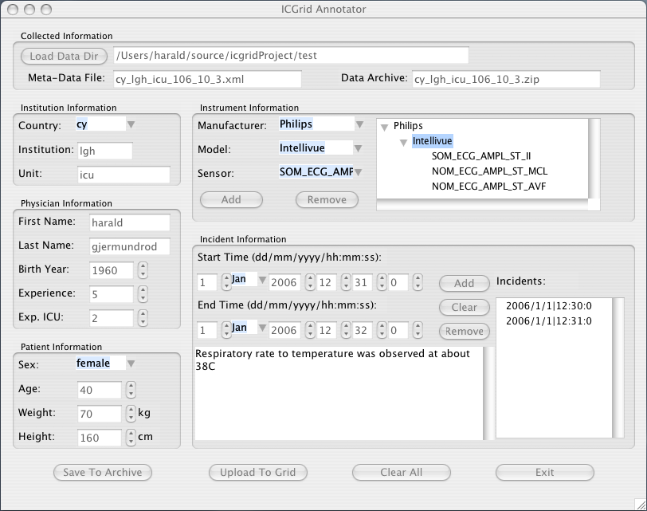
ICGrid Annotator v1 - Screenshots
Annotating Clinically Interesting Episodes

Slide 18
ICGrid Window v2 - Features
Has been utilized for measurements in real life cases at the Nicosia General Hospital

Slide 19
ICGrid Window v2 - Features
Supports Dual Connections (Connection A: Hospital monitoring station, Connection B: ICWindow Software).
More parameters have been added
More graph options – time scale capability
Export capabilities in CSV files
Communication interface with ventilators added

Slide 20
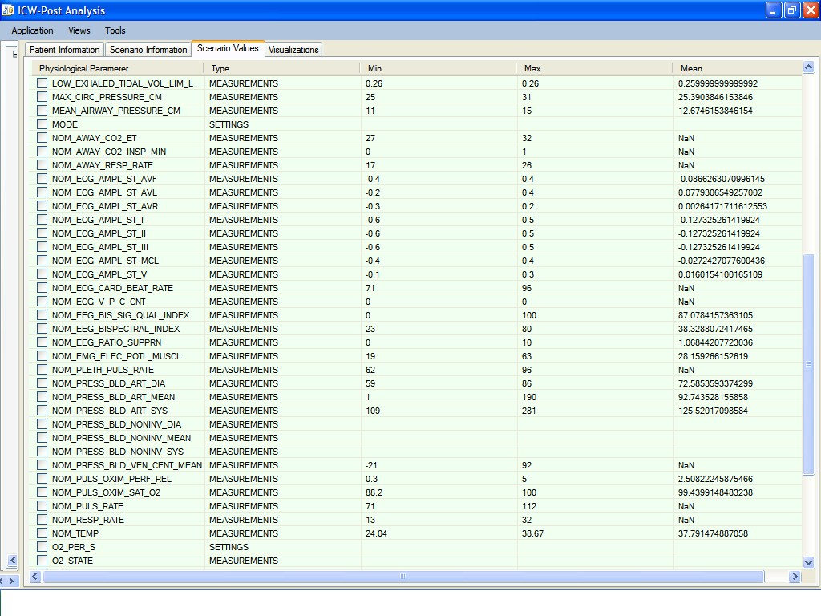
ICGrid Window v2 - Screenshots
More Acquisition Parameters

Slide 21
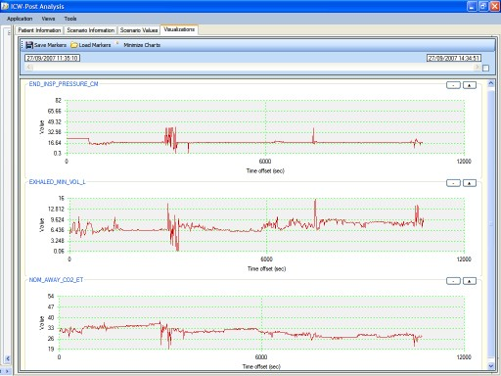
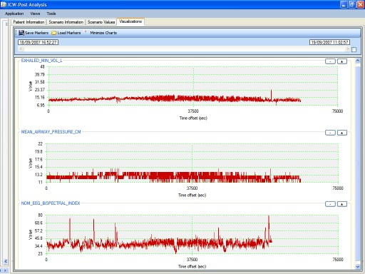
ICGrid Window v2 - Screenshots
Online Monitoring and Offline Replaying

Slide 22
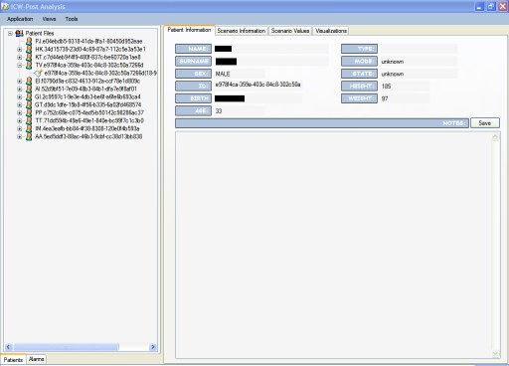
ICGrid Window v2 - Screenshots
Patient Demographic Data Management

Slide 23
Conclusions & Future work
ICGrid is a framework that paves the way for Intensive Care Medical Research on EGEE.
In the future we plan to:
  Develop the communication interfaces for other medical devices used in the ICU
  Streamline and deploy the data uploading component to transfer the data to the EGEE Grid node at UCY
  Develop search tools for finding interesting, previously unknown information through the AMGA index service.

Slide 24
ICGrid: Intensive Care Grid
Demetris Zeinalipour
School of Pure and Applied Sciences, Open University of Cyprus, Cyprus
Marios D. Dikaiakos, Harald Gjermundrod, Marios Papa, Nikolas Stylianides
Dept. of Computer Science - University of Cyprus, Cyprus
Theodoros Kyprianou and George Panayi
Intensive Care Unit – Nicosia General Hospital, Cyprus
Thank you!
Questions?
http://grid.ucy.ac.cy/

