Slide 1
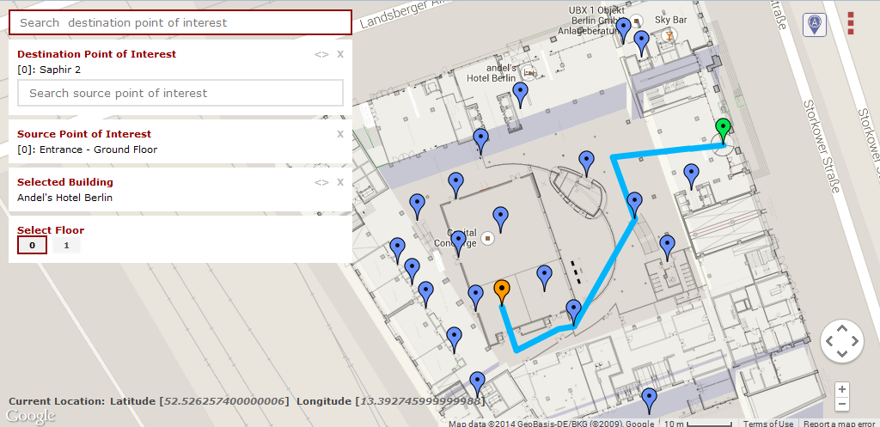


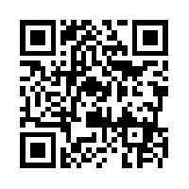

Demo: Crowdsourced Indoor Localization and Navigation with Anyplace
Anyplace
Your (unofficial) IPSN’14 Navigator

