Slide 1
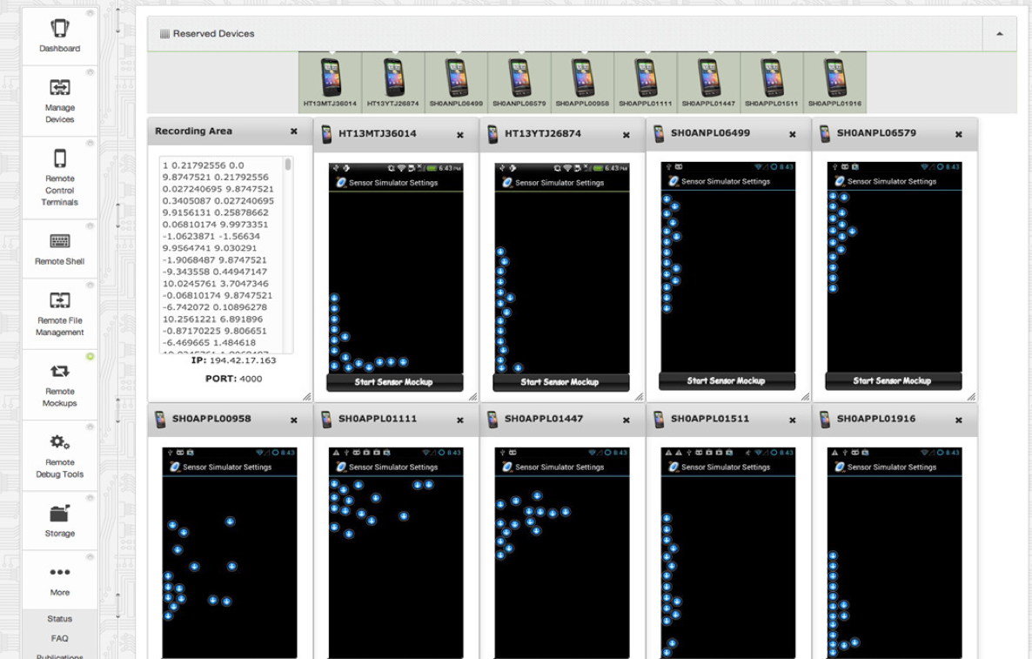
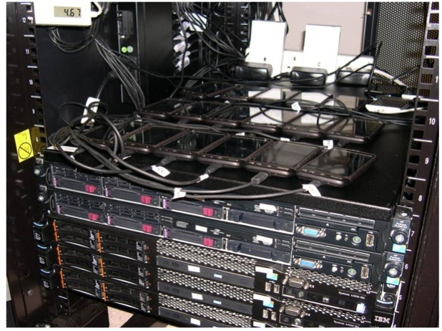


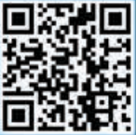

Sensor Mockup Experiments with SmartLab
http://smartlab.cs.ucy.ac.cy/ (USENIX LISA’13 & ACM Mobisys’12)
Rent
Manage
See/Click
Shell
File Sys.
Mockups
Debug
Demetrios Zeinalipour-Yazti, Madness Slide,
IPSN’14, Berlin, Germany_x0018_

