Slide 1



Workload-aware Optimization of Query Routing Trees in Wireless Sensor Networks
Panayiotis Andreou (Univ. of Cyprus)
Demetris Zeinalipour-Yazti (Open Univ. of Cyprus)
Panos K. Chrysanthis (Univ. of Pittsburgh)
George Samaras (Univ. of Cyprus)
(MDM’08) © Andreou, Zeinalipour-Yazti, Chrysanthis, Samaras

Slide 2
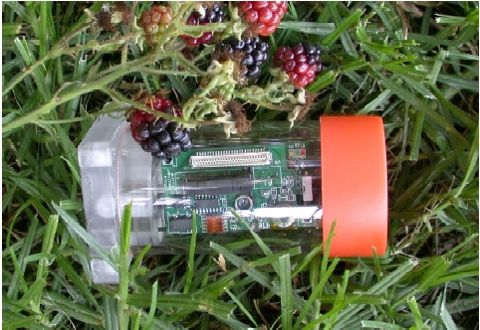

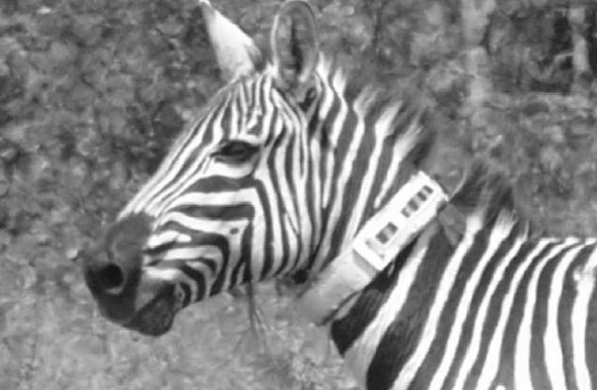
Wireless Sensor Networks
Resource constrained devices utilized for monitoring and understanding the physical world at a high fidelity.
Applications have already emerged in:
  Environmental and habitant monitoring
  Seismic and Structural monitoring
  Understanding Animal Migrations & Interactions between species.
Great Duck Island – Maine (Temperature, Humidity etc).
Golden Gate – SF, Vibration and Displacement of the bridge structure
Zebranet (Kenya) GPS trajectory
Notes:
Wireless sensor networks have been a key research area in the past few years.
Various application have emerged that enable us to monitor and understand our physical world at a high fidelity,
Some popular examples are great duck island in Maine, Golden Gate bridge in San Francisco and Zebranet in Kenya.

Slide 3

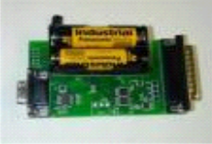
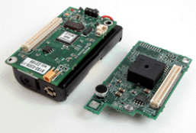



System Model
A continuous query is registered at the sink.
Query is disseminated using flooding
Hierarchical (tree-based) routing to continuously percolate results to the sink.
Q: SELECT MAX(temp)
FROM Sensors
EVERY 1s
Sink
epoch
Notes:
The system model we’ve considered is the following:
Register Query
Disseminate Query
Continuous acquisition of results
SQL Query example
Data acquisition in sensor networks is performed using a query routing tree.
All sensed data are forwarded to a sensor node, usually referred to as the sink, which is connected to a fixed computer with a database.
Most acquisition frameworks support execution of continuous queries that is queries that run continuously for a predefined time period.

Slide 4
Motivation
Limitations
Energy: Extremely limited (e.g. AA batteries)
Communication: Transmitting 1 bit over the radio consumes as much energy as ~1000 CPU instructions.
Solution
Power down the radio transceiver during periods of inactivity.
Studies have shown that a 2% duty cycle can yield lifetimes of 6 months using 2 AA batteries
Notes:
Wireless Sensor Networks have many limitations. One of the most important limitation is their extremely limited energy which comes from the fact that sensors are most commonly powered by 2 AA batteries.
The most energy demanding factor is communication since transmitting 1 bit of data is approximately equivalent to processing 1000 CPU instructions.
One solution in order to cope with the energy challenge is to power down the radio transceiver during periods of inactivity. In particular, it has been shown that sensors operating at a 2% duty cycle can achieve lifetimes of 6 months using 2 AA batteries

Slide 5
Definitions
Definition: Waking Window (τ)
The continuous interval during which sensor A:
Enables its Transceiver.
Collects and Aggregates the results from its children for a given Query Q.
Forwards the results of Q to A’s parent.
Remarks
τ is continuous.
τ can currently not be determined in advance.
Notes:
We now provide some definitions that we will use throughout the presentation.
The Waking Window (t) is the continuous interval during which a sensor:
Enables its Transceiver.
Collects and Aggregates the results from its children for a given Query Q.
Forwards the results of Q to A’s parent.
Note that (t) is continuous because it would be very energy demanding to suspend the transceiver more than once during the interval of an epoch.
In addition, (t) can not be determined in advance since its query specific. For instance, a sensor may not know in advance how many tuples it will receive from its children.

Slide 6
Definitions
Tradeoff
Small τ : Decrease energy consumption + Increase incorrect results
Large τ: Increase energy consumption + Decrease incorrect results
Problem Definition
Automatically tune τ, locally at each sensor without any global knowledge or user intervention.
Notes:
In defining (t) we are challenged with the following trade-off:
Shall S power off the transceiver too early, reduces energy consumption but also increases incorrect results
Shall S keep the transceiver active for too long, increases energy consumption but decreases incorrect results
We define our problem as follows:
Automatically tune (t), locally at each sensor without any global knowledge or user intervention

Slide 7
Presentation Outline
Motivation - Definitions
Background on Waking Windows
The MicroPulse Framework
  Construction Phase
  Dissemination Phase
  Adaptation Phase
Experimentation
Conclusions & Future Work
Notes:
Now I will present some background and related work on waking windows of the most popular sensor network query processors.

Slide 8
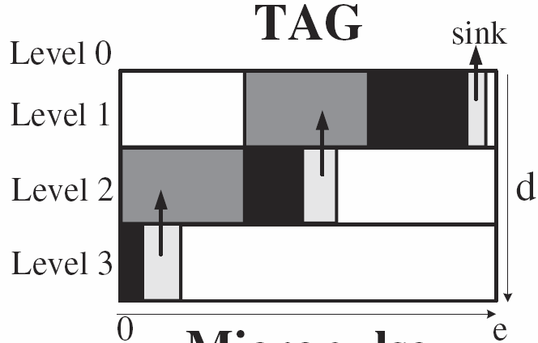
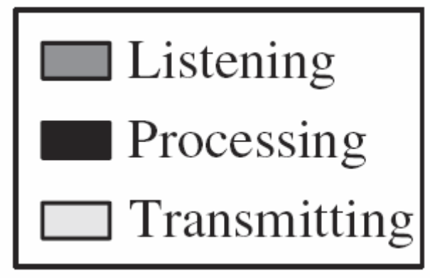
Background on Waking Windows
The Waking Window in TAG*
Divide epoch e into d fixed-length intervals
(d = depth of routing tree)
When nodes at level i+1 transmit then nodes at level i listen.
* Madden et. al., In OSDI 2002.
Notes:
In TAG the epoch (e), is divided into (d) fixed time intervals where d is the depth of the routing tree.
The nodes are synchronized as follows: when nodes at level i+1 transmit the nodes at level i listen. This procedure repeats itself recursively from bottom to top of the query routing tree until the sink receives all answers.

Slide 9
Background on Waking Windows
Example: The Waking Window in TAG
epoch=31, d (depth)=3
yields a window τ_{i} = ⎣e/d⎦ = ⎣31/3⎦ = 10
Transmit: [20..30)
Listen: [10..20)
A
level 1
Transmit: [10..20)
Listen: [0..10)
level 2
B
C
Transmit: [0..10)
Listen: [0..0)
D
E
level 3
Notes:
In order to better describe how TAG works, consider this example. We would like an answer from our query every 31 seconds, i.e epoch equals to 31.
Note that the depth of the query routing tree is 3. Therefore the window is 31 divided by 3 equals 10 seconds.
Starting from bottom to top, nodes D and E will start transmitting from time 0 to 10. Nodes B and C, which are at the previous level will have to turn on their transceivers from 0 to 10 in order to listen for the results of D and E.
As soon as they are done listening they will transmit there results from time 10 to 20, to A.

Slide 10
Background on Waking Windows
Disadvantages of TAG’s τ
τ is an overestimate
  In our experiments we found that it is three orders of magnitudes larger than required.
τ does not capture variable workloads
  e.g., X might need a larger τ in (time+1)
X
X
3 tuples
100 tuples
Y
Z
Y
Z
time
time + 1
Notes:
Tag has some disadvantages.
First of all (t) in TAG is an overestimate. We will show later in our experiments that (t) in TAG is actually three orders of magnitude bigger than required.
In addition (t) does not capture variable workloads i.e a sensor may receive a different amount of tuples during the next epoch.

Slide 11
Background on Waking Windows
The Waking Window in Cougar*
Each node maintains a “waiting list”.
Forwarding of results occurs when all children have answered (or timer h expires)
Listen…
OK
B,C
A
level 1
Listen…
D,E
ø
level 2
OK
B
C
OK
Listen..OK
ø
D
E
ø
level 3
OK
* Yao and Gehrke, In CIDR 2003.
Notes:
Now we present the waking window of Cougar.
Each sensor node in a Cougar network maintains a child list also known as a waiting list. For example B has set its waiting list as D and E. This means that B will wait for results from D and E before it sends its own upwards to its father A.
Cougar also employs a timer h in order to cope with possible node failures from nodes in its waiting list.

Slide 12
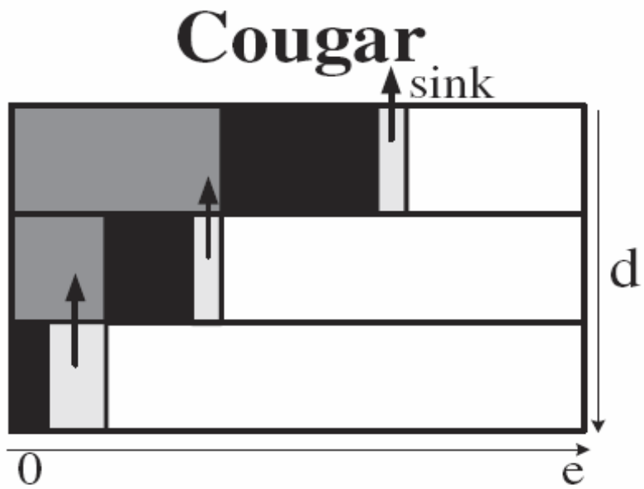
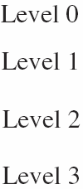
Background on Waking Window
Cougar’s Advantage (w.r.t. τ)
More fine-grained than TAG.
Cougar’s Disadvantage (w.r.t. τ)
Parents keep their transceivers active until all children have answered….this is recursive.
Notes:
Cougar’s advantage is that by utilizing these waiting lists it achieves in reducing the total time each sensor keeps its transceiver on.
However, each sensor has to keep its transceiver active until all its children have answered. This procedure runs recursive to the lower levels.

Slide 13
Presentation Outline
Motivation - Definitions
Background on Waking Windows
The MicroPulse Framework
  Construction Phase
  Dissemination Phase
  Adaptation Phase
Experimentation
Conclusions & Future Work
Notes:
We now present our approach coined MicroPulse. MicroPulse includes three phases, the Construction, Dissemination and Adaptation phase that I will describe in the following slides.

Slide 14
The MicroPulse Framework
A new framework for automatically tuning τ.
MicroPulse :
  Profile recent data acquisition activity
  Schedule τ using an in-network execution of the Critical Path Method (CPM)
CPM is a graph-theoretic algorithm for scheduling project activities.
CPM is widely used in construction, software development, research projects, etc.
Notes:
MicroPulse aims to automatically tune (t) to achieve great energy savings.
Specifically MicroPulse, profiles recent data acquisition activity and schedules (t) by using an in-network execution of the Critical Path Method, CPM.
CPM is a graph-theoretic algorithm for scheduling project activities and is widely used in construction, software development, research projects, etc.

Slide 15
The MicroPulse Framework
MicroPulse Phases
  Construct the critical path cost Ψ.
  Disseminate Ψ in the network and define τ.
  Adapt the τ of each sensor based on Ψ.
s1
Intuition
Ψ allows a sensor to schedule its waking window.
13
15
22
s2
s3
s4
11
7
20
s5
s6
s7
Notes:
MicroPulse start by constructing the critical path cost (psi).
It then disseminates (psi) to the network. Upon receiving (psi) each sensor locally tunes its waking window.
Our intuition is that (psi) allows a sensor to schedule its waking window.
Change schema using figure of next slide.

Slide 16
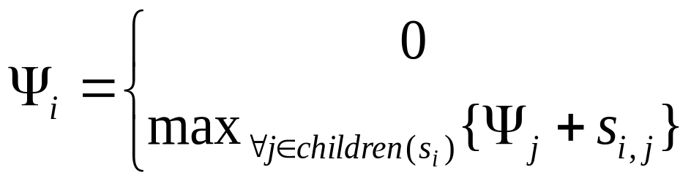
The Construction Phase
Construct Ψ:
Ψ1=max{11+13,15,22+20}
s1
13
22
15
s2
s3
s4
Ψ2=max{11,7}
Ψ4=max{20}
11
7
Ψ3=0
20
Ψ5=0
s5
s6
Ψ6=0
s7
Ψ7=0
Recursive Definition:
, if s_{i} is a leaf node.
, otherwise
Notes:
The construction phase enables the sink node to calculate (psi) using a bottom-up recursive definition which states that:
(psi_i) is equal to 0 if s_i is a leaf node or the maximum (psi) plus the workload received from its children.
Starting from bottom, all leaf nodes receive a (psi) value equal to 0.
As soon as s2 receives the values from its children s5 and s6 it calculates (psi_2) equal to the maximum value between 11 and 7 which is 11.
Similarly s4 sets its (psi) value to 20.
Finally s1 sets its (psi) value to 42 using the same definition. Thus the critical path is formed, that is s7→s4→s1.

Slide 17
The Dissemination Phase
Construct Waking Windows (τ):
“Disseminate Ψ = 42 to all nodes (top-down)”
s1
42
42
13
22
15
42
s4
[29..42)
s2
[20..42)
29
29
s3
11
7
20
20
s5
s6
[27..42)
s7
[0..20)
[18..29)
[22..29)
Notes:
The next step is to disseminate the (psi) value back to the network.
s_1 sends (psi) equals to 42 to its children. Upon receiving (psi) from their parent each sensor locally tunes its waking window.
For example s_4 calculates that in order to transmit its 22 results to s1 it must tune its waking window to transmit from time 20 to 42.
s_2 and s_3 perform similar calculations. In addition each sensor subtracts its workload from the received (psi) value and transmits the new (psi) value to its children.
As a result, s_4 will transmit 20, that is 42 minus 22, to s_7. The same goes for s_2 and s_3.
In the final step, where a leaf node receives (psi) it locally tunes its window and the procedure ends there.

Slide 18
The Dissemination Phase
Construct Local Slack (λ):
“maximum possible workload increase for the children of a node”
s1
22
22
13
22
15
22
s4
λ=9
s2
λ=0
11
11
s3
11
7
20
20
s5
s6
λ=7
s7
λ=0
λ=0
λ=4
Notes:
In addition to the waking windows, each sensor sets its local slack (lambda) value.
The local slack value indicates the how much time a sensor can deviate from its waking window.
Sensors in the critical path can not deviate as any increase in the workload of a sensor that lies in the critical path requires the reconstruction of the (psi) value.
To set the local slack (lambda) s_1 starts by sending the maximum workload value from its children, 22.
s_2, s_3, and s_4 set their local slack by subtracting from their workload value, 22.
As a result they set their slack values to 9, 7 and 0 respectively.
This procedure is recursively repeated until all sensors locally set their (lambda) value

Slide 19
The Adaptation Phase
Intuition
Workload changes are expected, e.g.,
Epoch e
Epoch e+1
Epoch e+2
s1
s1
s1
13
22
11
22
13
28
15
18
15
s2
s3
s4
s2
s3
s4
s2
s3
s4
Question: Should we reconstruct τ?
Answer: Yes/No.
  No in Case e+1, because s2 & s3 know their local slack.
  Yes in Case e+2, because the critical path has been affected.
Notes:
Of course, at some times, we expect some changes in the workload.
The question now, is if we always have to reconstruct (t).
Our adaptation algorithm copes with this question by classifying these changes with respect to the critical path.
If a change affects the critical path, then the critical path must be reconstructed.
On the other hand, if a change does not affect the critical path then nodes locally tune their waking windows and no need for reconstruction is necessary.
The adaptation algorithm is far more complex but will not ....

Slide 20
Presentation Outline
Motivation - Definitions
Background on Waking Windows
The MicroPulse Framework
  Construction Phase
  Dissemination Phase
  Adaptation Phase
Experimentation
Conclusions & Future Work
Notes:
We now continue with our experimental results.

Slide 21
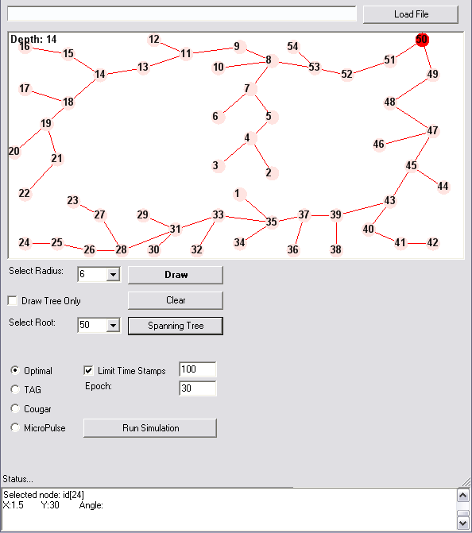
Experimentation
We have implemented a visual simulator that implements the waking window algorithm of TAG, Cougar and MicroPulse.
Notes:
We have implemented a visual simulator that implements the waking window algorithm of TAG, Cougar and MicroPulse.
We employ a failure rate of 20% and set a child wait expiration timer (h) to 200ms.

Slide 22
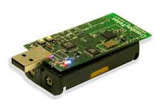
Experimentation
Sensing Device
  We utilize the energy model of Crossbow’s TELOSB Sensor (250Kbps, Rx:23mA, Tx:19.5,MCU:7.8mA, sleep:5.1μA)
  Trace-driven experimentation using Energy = Volts x Amperes x Seconds.
Communication Protocol
  based on ZigBee 802.15.4
  Maximum Data Payload:104 bytes (segmentation when required)
Notes:
Our energy model is base on the TelosB sensing device from Crossbow
We employ various power modes of operation and we calculate energy using the formula: Volts x Amperes x Seconds.
Our communication protocol is based on ZigBee 802.15.4. We assume a maximum data payload of 104 bytes.
If a packet exceeds this value we segment our packets accordingly.

Slide 23
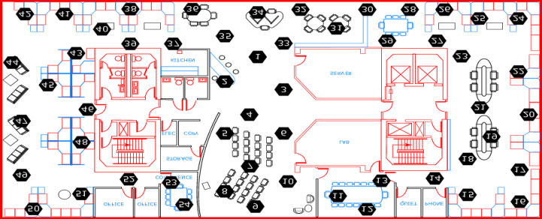
Experimentation
Datasets:
  A. Intel54
  54 deployed at the Intel Berkeley Research Lab (28/2/04 – 5/4/04).
  2.3 Million Readings: topology info, humidity, temperature, light and voltage
  B. Intel540
  540 sensors randomly derived from Intel54 dataset
    Configuration Parameters:
      Epoch = 31 seconds
  Failure Rate = 20%
  Child Wait Expiration Timer h = 200 ms
Available at: http://db.csail.mit.edu/labdata/labdata.html
Notes:
We use two datasets in our experiments.
The Intel54 dataset where we take readings from the 54 sensors that hold the larger amount of readings from the 58 sensors deployed at Intel Berkeley Research Lab from February to April 2004. This dataset contains 2.3 million readings which include humidity, temperature, light and voltage values. This dataset uses an epoch of 31 seconds.
Our second dataset, coined Intel540, contains 540 sensors randomly derived from the Intel54 dataset.

Slide 24
Experimentation
Query Sets:
Single-Tuple Queries (ST)
SELECT moteid, temperature
FROM sensors
WHERE temperature=MAX(temperature)
Multi-Tuple Queries
  Fixed Size (MTF)
SELECT moteid, temperature
FROM sensors
  Arbitrary Size (MTA)
SELECT moteid, temperature
FROM sensors
WHERE temperature>39
This talk presents only these results but the paper contains all of them
Notes:
In order to display the efficiency of our approach under different queries we have considered 3 different query sets.
The first one, Single-Tuple Queries (ST) is a class of queries where a single tuple is produced.
An example of this query set is to return the moteid and the temperature of the sensor with the highest temperature.
The second class are Multi-Tuple Queries. We distinguish this class with two sub classes.
The MTF query class in which sensor return all tuples received from their children and themselves, and...
The MTA query class where sensor apply some filters and return only the tuples that satisfy the filters.

Slide 25
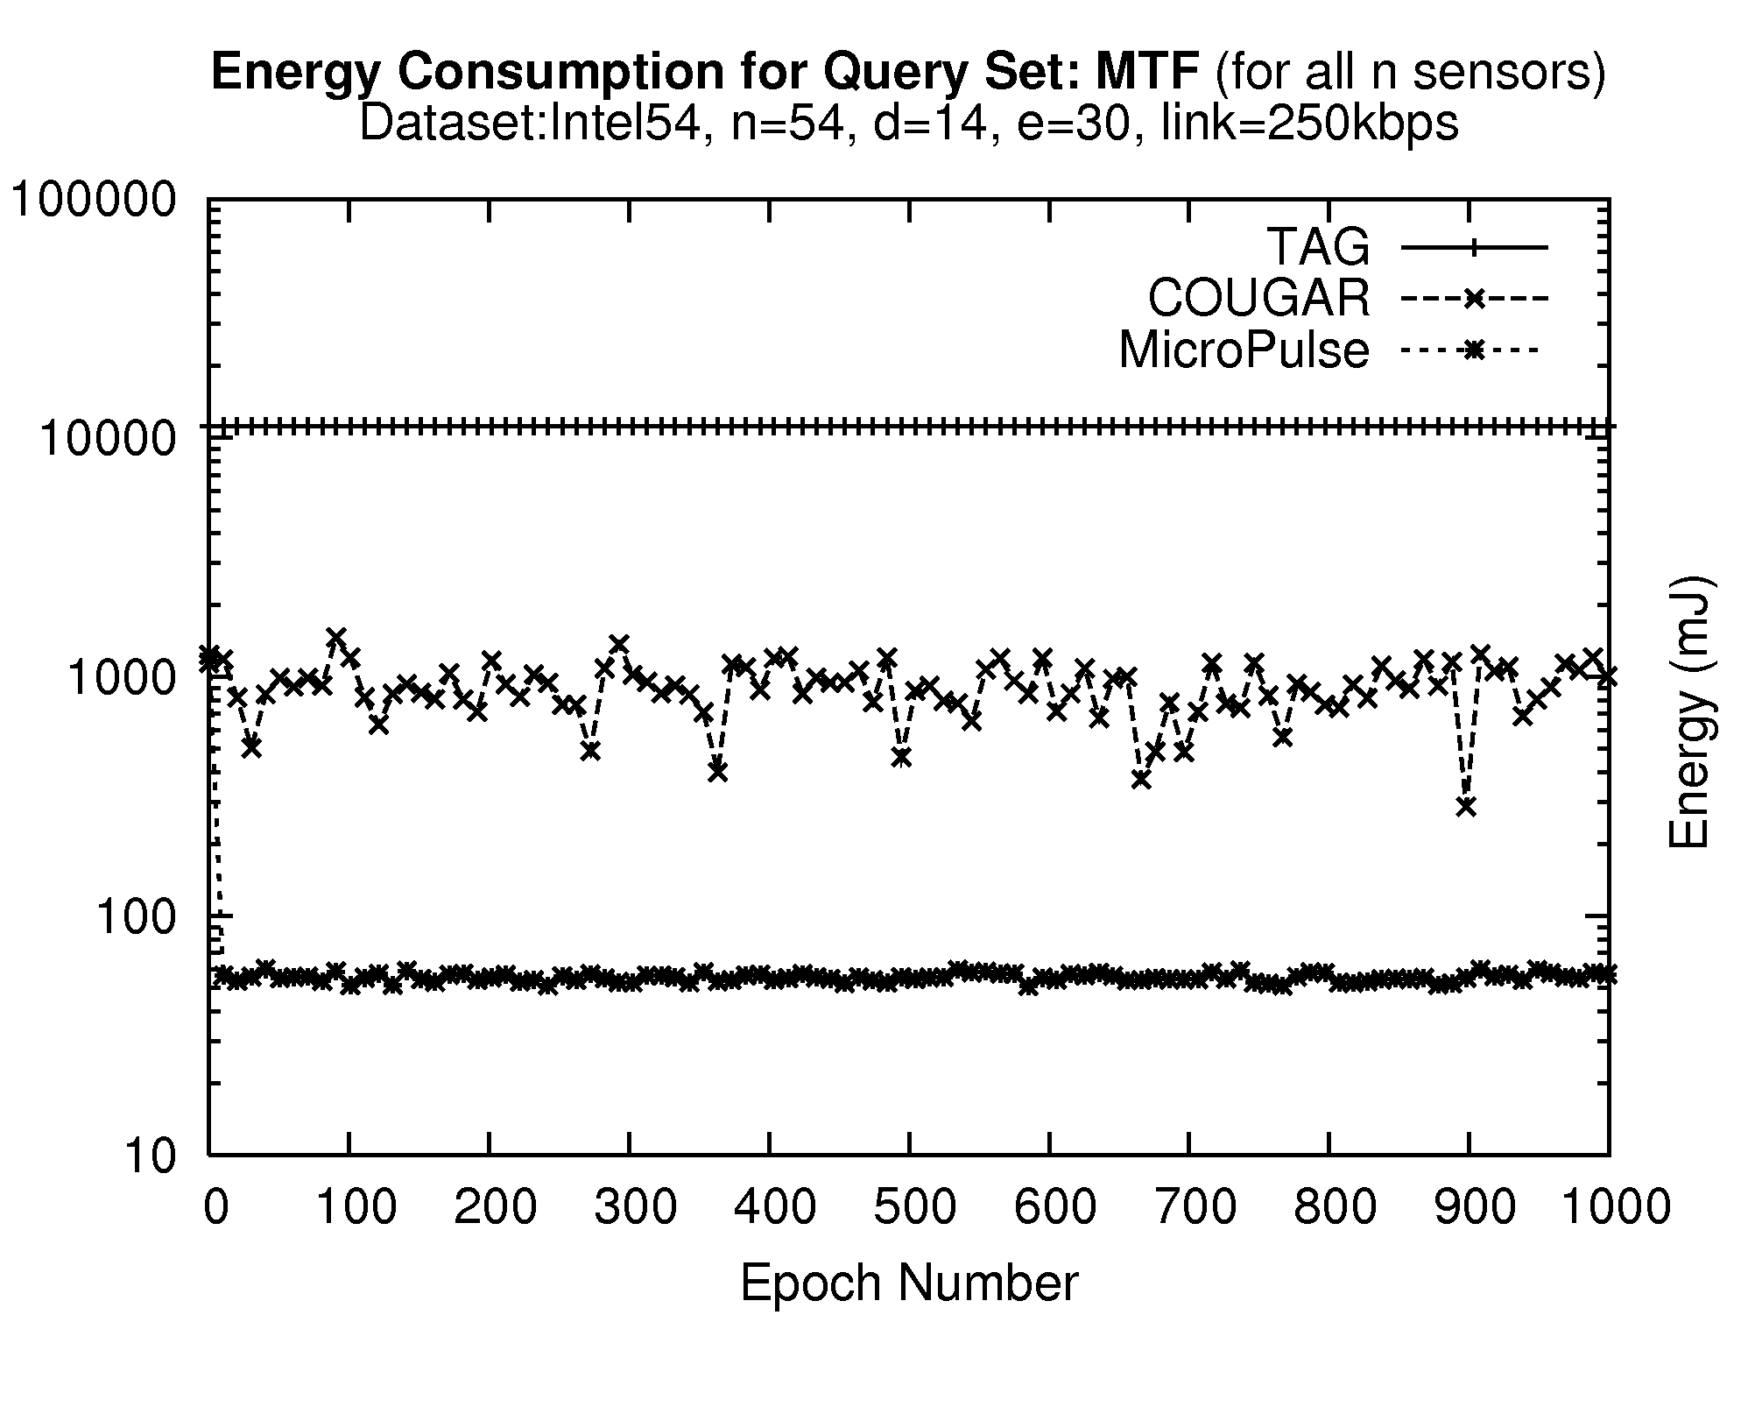
Energy Consumption
Intel54 Dataset – Query Set:MTF
Waking window τ :
τ in TAG is uniform: 2.21sec. (31 /14 depth)
τ in MicroPulse is non-uniform: 146ms on average
Observation
Large standard deviation in Cougar attributed to the following fact: A failure at level K of the hierarchy results in a K*h increase in τ, where h is the expiration timer. (i.e. large standard deviation)
11,228±2mJ
893±239mJ
56±37mJ
COUGAR
Listen
h
h
Timeout
h
Notes:
Our first experimental series we measure the energy consumption using the Intel54 dataset. We only show the results for the MTF query set as similar results apply to the other query sets.
We observe that the waking window in TAG is three orders of magnitude more expensive than in MicroPulse.
This clearly attributed to the fact that in TAG the waking window is uniform, in our experiments where the epoch is 31 and the depth is 14, the waking window is set to 2.21sec.
On the contrary, the waking window in MicroPulse is non-uniform. In this experiment, the waking window is only a 126milliseconds on average.

Slide 26
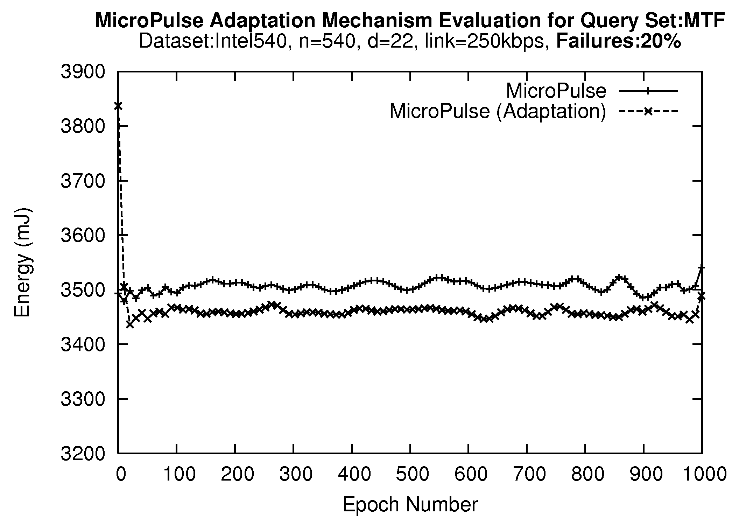
Adaptation Phase Evaluation
Our adaptation algorithm adjusts the critical path cost without reconstructing the CP tree from scratch.
Yields additional energy savings of 60mJ (~416 messages or 1 packet per sensor).
Notes:
In the second experimental series we investigated the efficiency of our adaptation algorithm.
We compare MicroPulse with no adaptation against a version that employs the adaptation rules of our algorithm.
We observe that using the adaptation algorithm can yield additional energy savings of 60mJ.
This translates into approximately 416 messages which is almost one packet per sensor during each epoch.

Slide 27
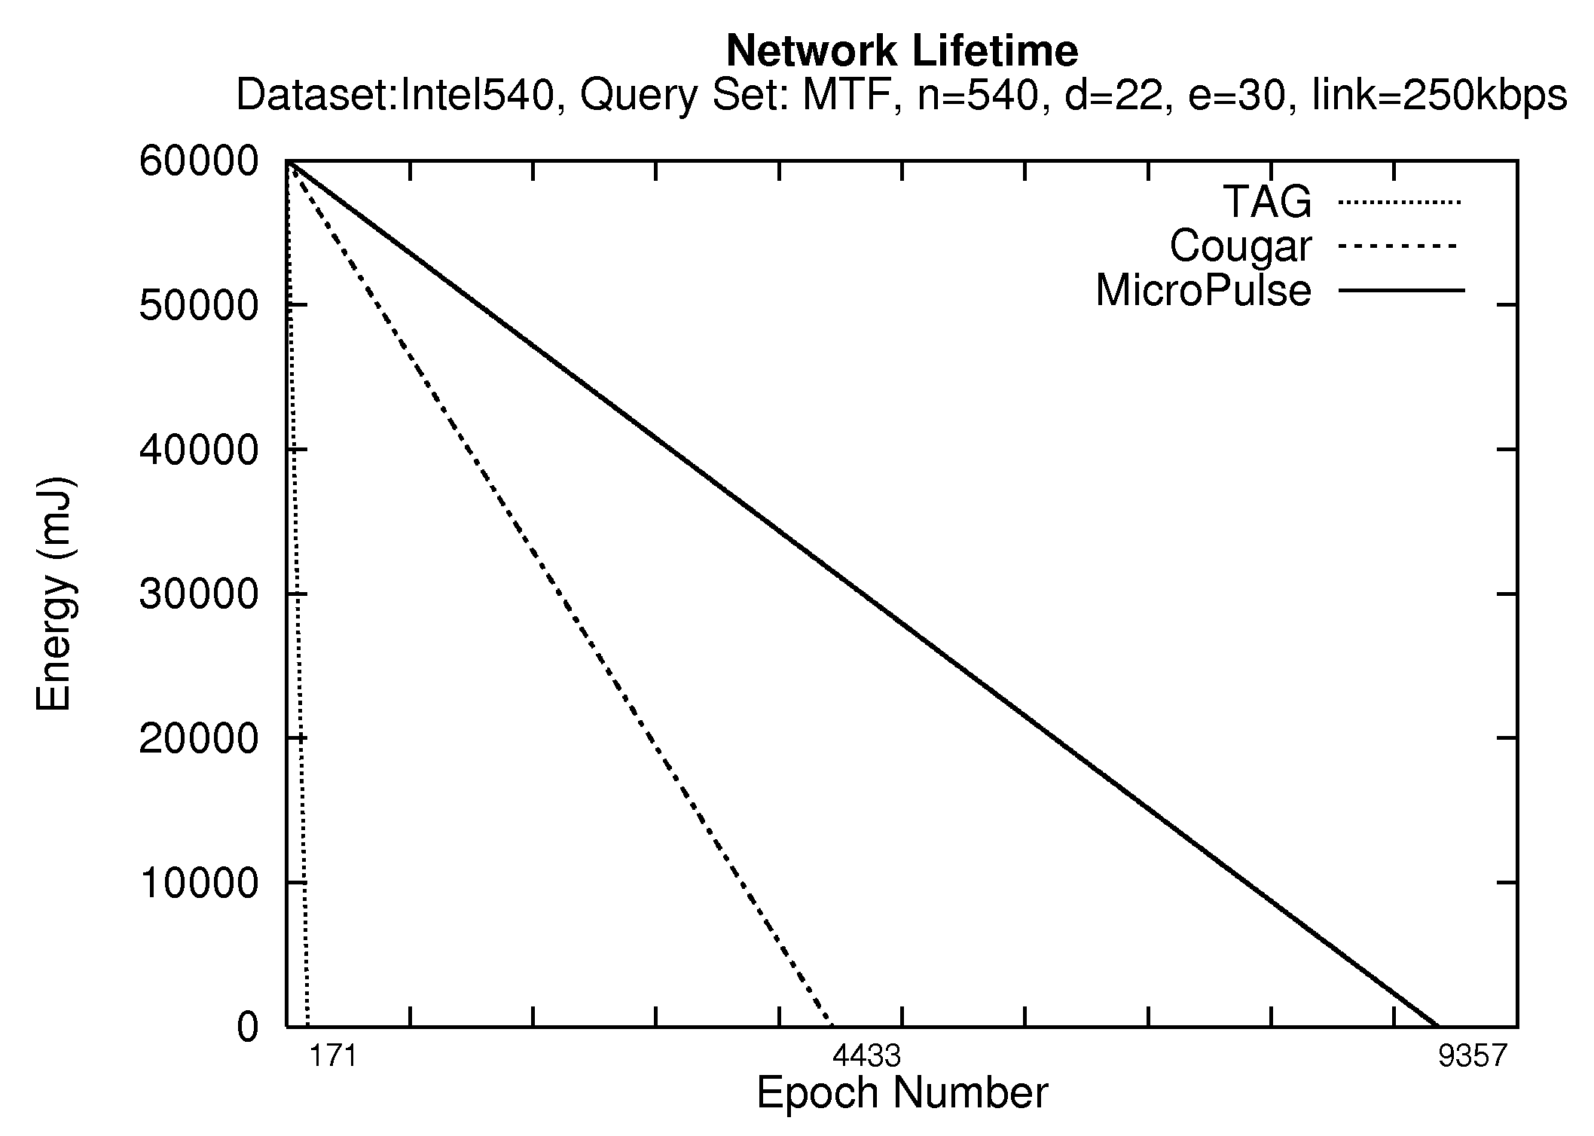
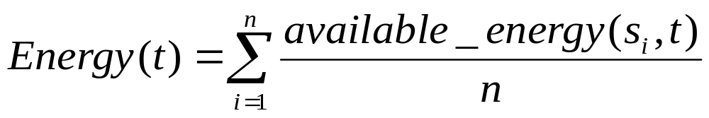
Network Lifetime
TAG, Cougar, MicroPulse
Initial Energy Budget: 60000mJ
Average energy of all sensors at each epoch
Stop when Energy(t’)=0
TAG
85mins
Cougar
36hrs
MicroPulse
77hrs
Notes:
In our final experimental series we demonstrate the efficiency of our approach with regards to network lifetime.
We measure the average energy of all sensors using the illustrated formula.
In order to speed up our experiment we provide each sensor with an initial energy budget of 60000mJ.
We run the experiment using the Intel540 dataset and the MTF query set and stop when all network energy is depleted, i.e. Energy(t’) is equal to 0.
We can observe that under TAG the lifetime is only 171 epochs, i.e. 85 minutes, while in Cougar the lifetime increases to 4433 epochs, i.e. 36 hours.
Finally in MicroPulse, lifetime is increased to 9,537 epochs i.e. 77 hours

Slide 28
Presentation Outline
Motivation - Definitions
Background on Waking Windows
The MicroPulse Framework
  Construction Phase
  Dissemination Phase
  Adaptation Phase
Experimentation
Conclusions & Future Work
Notes:
Finally we present our conclusions and some ideas for future work.

Slide 29
Conclusions
We have presented the design of MicroPulse that adapts the waking window of a sensing device.
Experimentation with real datasets reveals that MicroPulse can reduce the cost of the waking window by three orders of magnitude.
We intend to study collision-aware query routing trees.
Study our approach under mobile sensor networks
Notes:
We have presented the design of MicroPulse that adapts the waking window of a sensing device.
We have experimented with real datasets that reveal that MicroPulse can reduce the cost of the waking window by three orders of magnitude.
In the future we intend to study the effect of collisions in query routing trees and devise efficient methods of avoiding this.

Slide 30
Workload-aware Optimization of Query Routing Trees in Wireless Sensor Networks
Thank you!
Questions?
This presentation is available at:
http://www.cs.ucy.ac.cy/~dzeina/talks.html
(MDM’08) © Andreou, Zeinalipour-Yazti, Chrysanthis, Samaras
(MDM’08) © Andreou, Zeinalipour-Yazti, Chrysanthis, Samaras
Notes:
Thank you for your attention.
Do you have any questions?

Slide 31
Energy Consumption
Intel54 & Intel540 Dataset
Same conclusions hold for the large scale Intel540 dataset
 | Intel54 |  |  | Intel540
 | ST | MTF | MTA | ST | MTF | MTA
TAG | 11,227 | 11,228 | 11,225 | 189,691 | 189,707 | 189,670
Cougar | 882 | 893 | 877 | 7,269 | 7,317 | 7,257
MicroPulse | 53 | 56 | 50 | 3,431 | 3,510 | 3,398
Notes:
We observe that the same conclusions hold for both datasets and for all query sets.

