Slide 1








MDM’10: Program Report
Program Committee Chairs
Vijay Kumar (Univ. of Missouri-Kansas City, USA)
Takahiro Hara (Osaka University, Japan)
Demetris Zeinalipour (University of Cyprus, Cyprus)
Dr. Virender Singhal

Slide 2
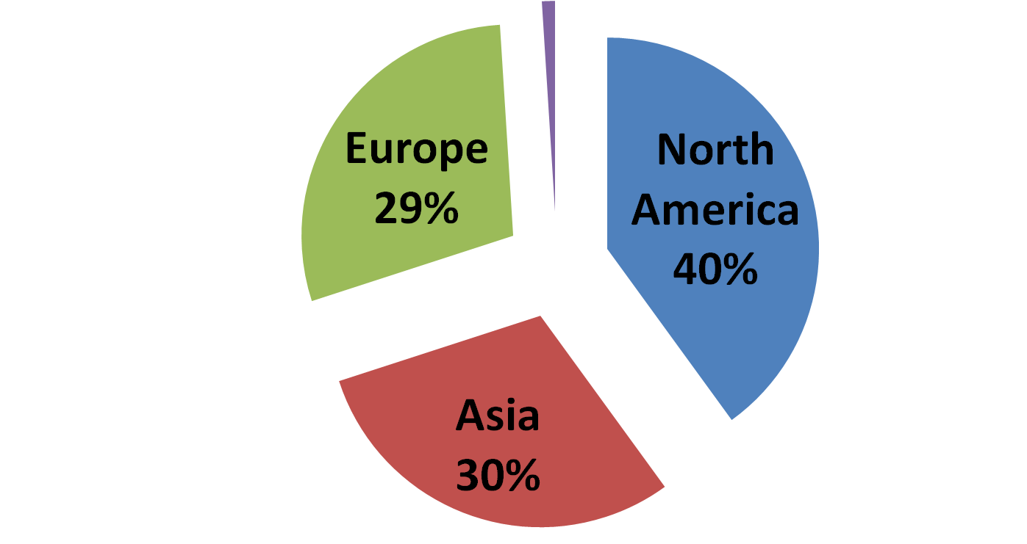
Program Committee Statistics
(PC Members by Continent)
Australia
1%
70 Regular TPC Members
12 Industrial TPC Members
38 External Reviewers
“A technically and geographically diverse, yet concrete, Technical Program Committee (TPC) that enabled us to make high quality decisions.”

Slide 3
Submission Statistics for MDM’10
Regular Papers
  # Regular Submissions: 62
  # Accepted Papers: 16
  Acceptance Rate: 25%

Slide 4

Submission Statistics for MDM’09
Full Papers
  # Submissions: 89
  # Accepted Papers: 23
  Acceptance Rate: 26.1 %

Slide 5
Submission Statistics for MDM’08
Year (City, Country) | Acceptance Rate
MDM’10 (Kansas City, USA) | 25%
MDM’09 (Taipei, Taiwan) | 26.1%
MDM’08 (Beijing, China) | 21.8%
MDM’07 (Mannheim, Germany) | 28.5%
MDM’06 (Nara, Japan) | 23%

Slide 6
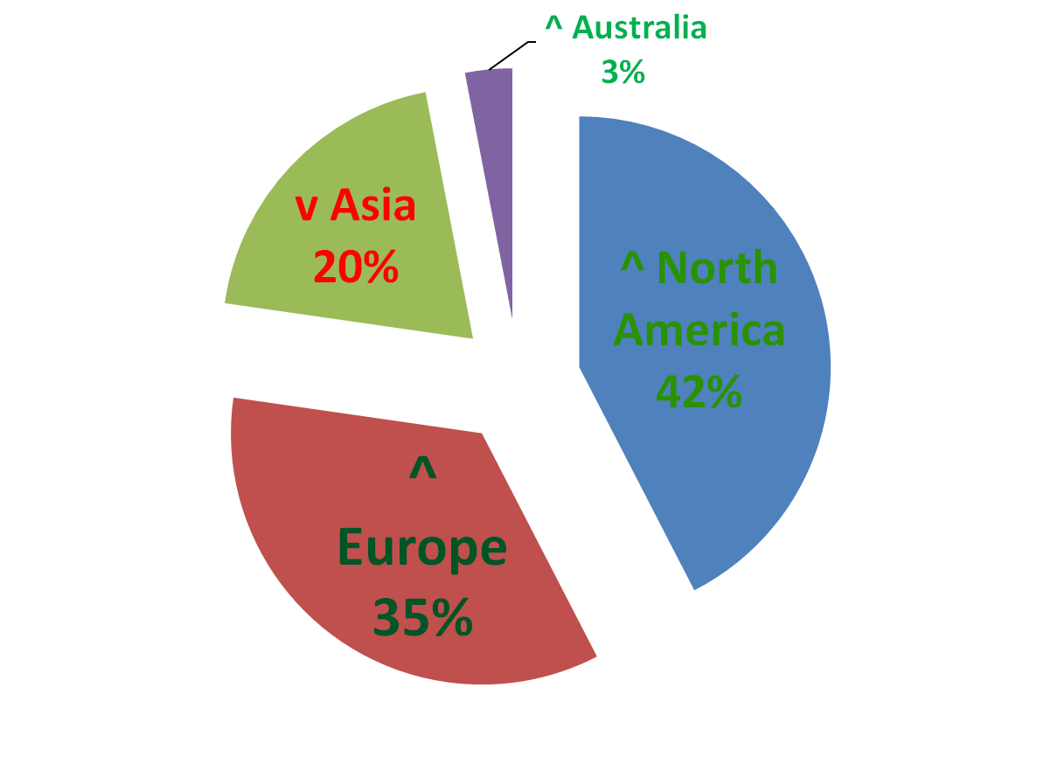
MDM’10 Program Statistics
(Accepted Papers by Continent)
27 USA
8 Germany
7 China
4 Hong Kong
4 Finland
2 France
2 Australia
1 Canada
1 Cyprus
1 Denmark
1 Greece
1 Israel
1 Italy
1 Spain
1 Sweden
1 Taiwan
1 UK

Slide 7
Further Statistics for MDM’10
# Short Papers (max 6 pages): 10
# Poster Papers (max. 3 pages): 8
# Industrial Papers (Long): 3
# Industrial Papers (Short): 2
# PhD Forum Papers: 10

Slide 8


Special Thanks
(beyond those already mentioned)
IEEE Computer Society: Randall Bilof and Bob Werner, who took care of the camera-ready submission and post-production process.
Microsoft Research: for providing us access to the CMT system for administering the paper review process.

Slide 9
MDM’10: Program Report
Program Committee Chairs
Vijay Kumar (Univ. of Missouri-Kansas City, USA)
Takahiro Hara (Osaka University, Japan)
Demetris Zeinalipour (University of Cyprus, Cyprus)
Dr. Virender Singhal

