Slide 1
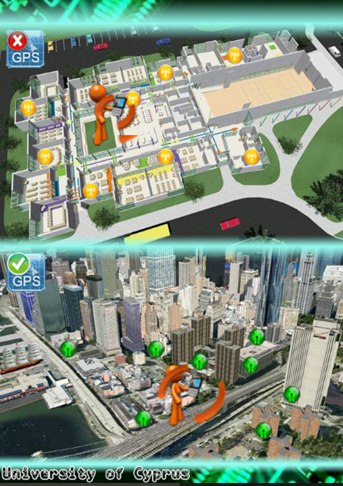

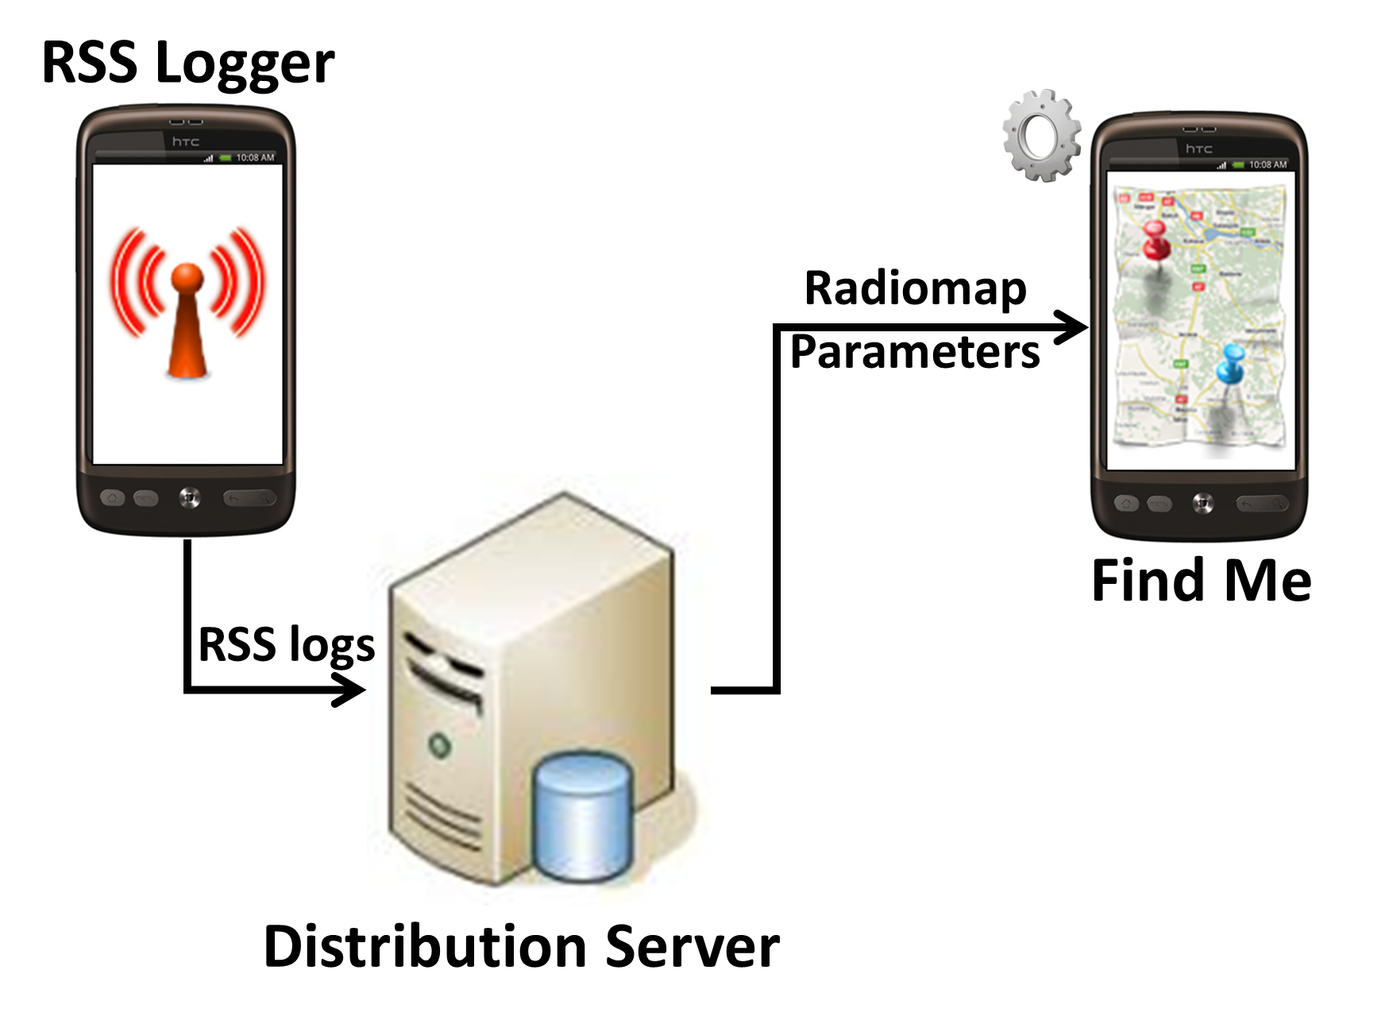
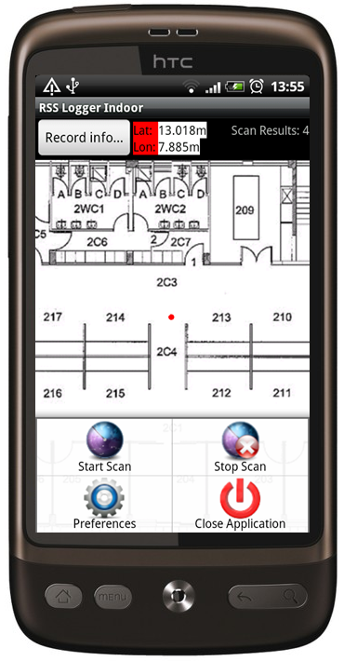
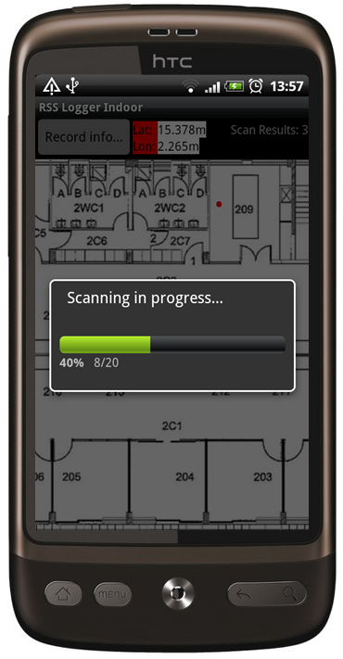
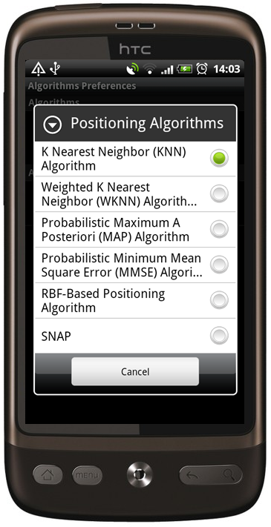
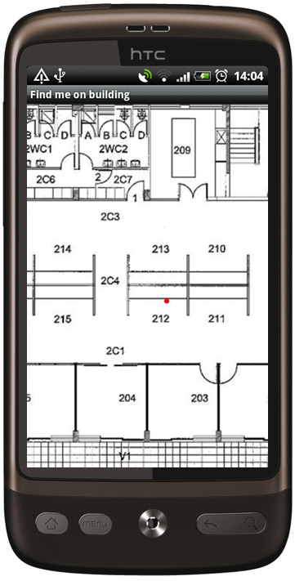
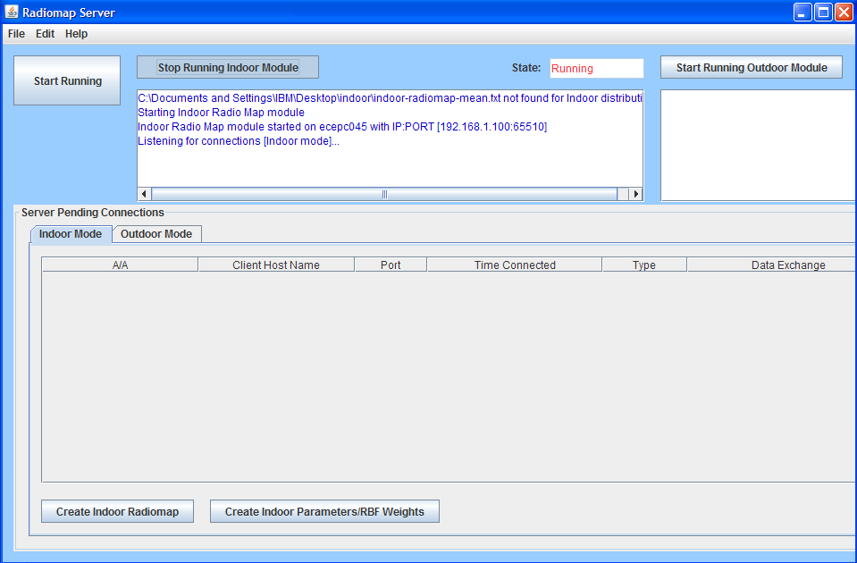
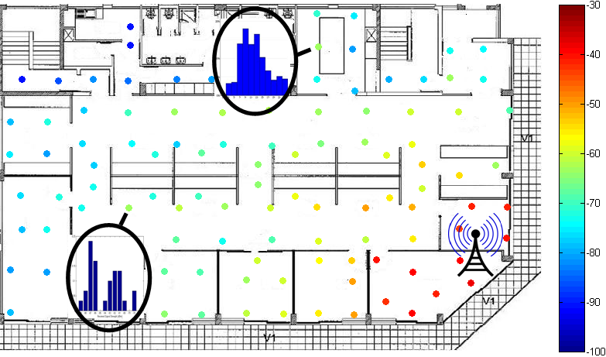
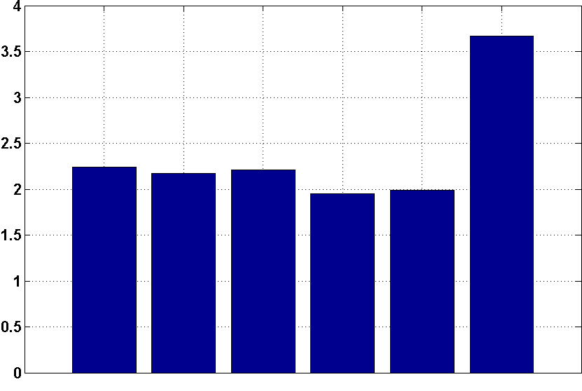
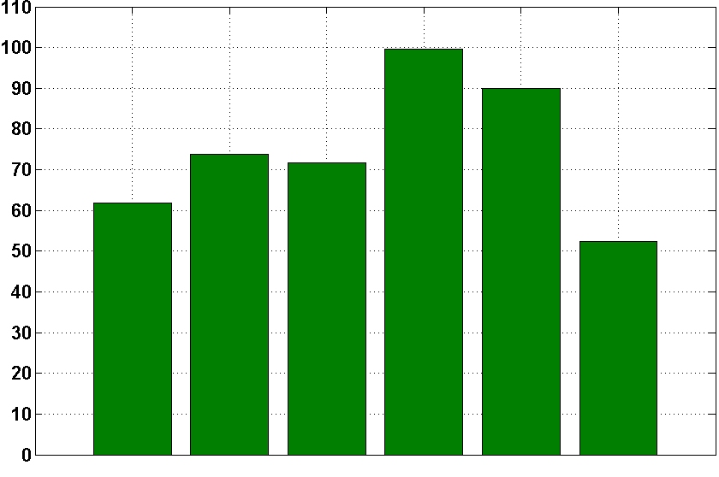
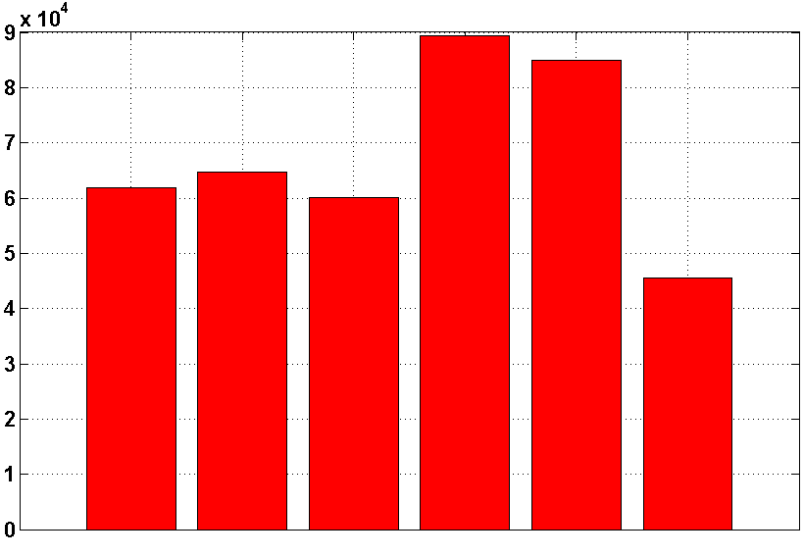
AirPlace
Indoor Positioning Platform for Android Smartphones
C. Laoudias, G.Constantinou, M. Constantinides, S. Nicolaou, D. Zeinalipour-Yazti and C. G. Panayiotou
Department of Computer Science, KIOS Research Center
University of Cyprus
Goals and Contributions
Build an open Android smartphone platform for positioning and tracking inside buildings
Integrate two efficient positioning algorithms, RBF¹ and SNAP², developed in-house
Evaluate the performance of several fingerprint-based positioning algorithms in terms of:
Execution Time: Measure the average time required in practice to perform positioning on smartphones
Positioning Accuracy: Calculate the mean positioning error pertaining to a test dataset
Power Consumption: Investigate the actual battery depletion during positioning with the PowerTutor³ utility
¹ C. Laoudias, P. Kemppi, C. Panayiotou, "Localization using RBF Networks and Signal Strength Fingerprints in WLAN", IEEE GLOBECOM, 2009, pp. 1-6.
² C. Laoudias, M. P. Michaelides, C. G. Panayiotou, "Fault Tolerant Fingerprint-based Positioning", IEEE ICC, 2011, pp. 1-5.
³ PowerTutor: A Power Monitor for Android-based mobile platforms, http://powertutor.org
Positioning System Archtecture
Mobile-based Network-assisted architecture
Low communication overhead: Avoids uploading the observed RSS fingerprint to the positioning server for estimating location.
User privacy & security: location is estimated by the user and not by the positioning server.
Positioning scenario
A User enters an indoor environment, featuring WiFi APs.
His smartphone obtains the RSS radiomap and parameters from the local distribution server in a single communication round.
The client positions itself independently using only local knowledge and without revealing its personal state.
RSS Logger Application
Find Me Application
Features
• Developed around the Android RSS API for scanning and collecting measurements
• User defined number of samples and sampling interval
• RSS data stored locally in a log file with (Lat,Lon) from GPS [outdoors] or (X,Y) by clicking on floorplan map [indoors]
• User can contribute the log files to the system for building and updating the radiomap
Features
• Connects to the server for downloading the radiomap and algorithm parameters
• User selects any of the available algorithms
• Dual operation mode
• Online: Location is plotted on Google Maps [outdoors] or the floorplan map [indoors]
• Offline: Loads an external file with test RSS fingerprints to assess the performance of different algorithms
Radiomap Distribution Server
Experimental Evaluation @ KIOS
Measurement Setup
560m2, 9 WiFi Aps
105 reference locations
Train Data: 105 reference locations,
4200 fingerprints (40 per location)
Test Data: 96 locations, 1920 fingerprints (20 per location)
Features
• Constructs and distributes the radiomap and algorithm parameters to the clients
• Parses all RSS log files and merges them in a single radiomap that contains the mean RSS value fingerprint per location
• Selects and fine-tunes algorithm-specific parameters iteratively by using validation RSS data

