Slide 1


Large-Scale Participatory Urban Sensing: A Fad or Reality?
Demetrios Zeinalipour-Yazti
Data Management Systems Laboratory
Department of Computer Science
University of Cyprus
www.cs.ucy.ac.cy/~dzeina
Panel Positioning Statement at the 14th IEEE International Conference on
Mobile Data Management (MDM'13), Milan, Italy, June 3-6, 2013

Slide 2
Large-Scale Participatory Urban Sensing
Fad or Reality?
2006 (Fad): Few Groups leading Urban Sensing
  "People-Centric Urban Sensing" (WICON'06) Dartmouth Metrosense project.
  "The CarTel Mobile Sensor Computing (Best Demo at Sensys'06), MIT Cartel project.
2013 (Reality):
  Waze.com: 48M users reporting GPS location and events (gas prices, traffic jams, etc.) getting real-time routing updates in response.
  Mobile Data Challenge by Nokia (since 2009)
FAD
REALITY
2006
2007
2008
2009
2010
2011
2012
2013

Slide 3

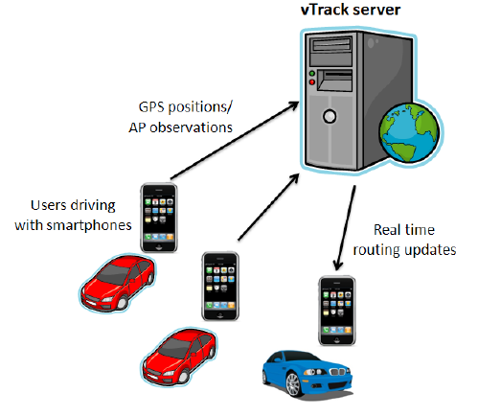
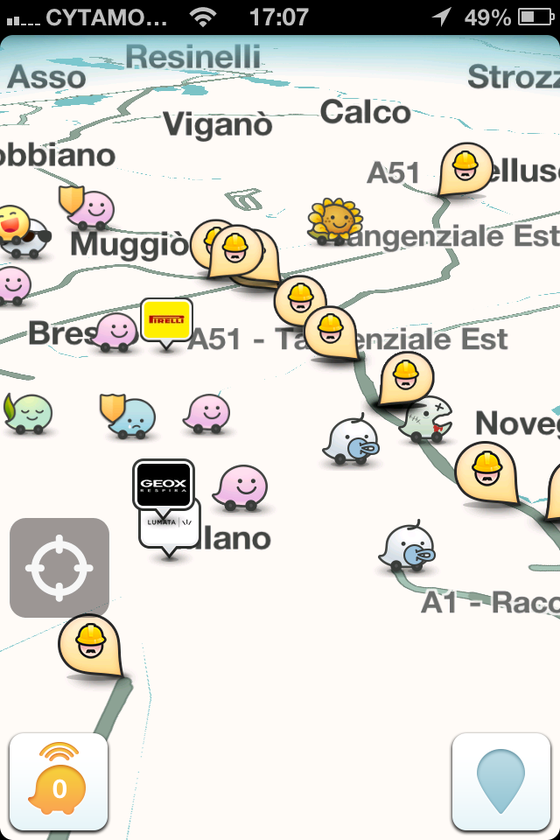
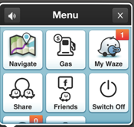
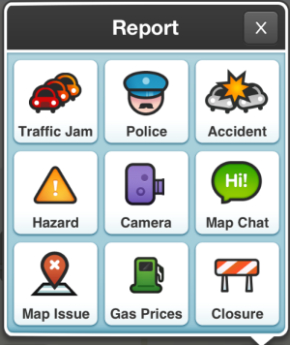
Fad or Reality?
2009
2013
Graphics courtesy of: A .Thiagarajan et. al. “Vtrack: Accurate, Energy-Aware Road Traffic Delay Estimation using Mobile Phones, In Sensys’09, pages 85-98. ACM, (Best Paper) MIT’s CarTel Group

Slide 4
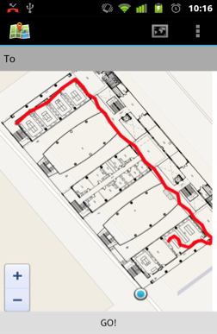
Commercial Impact?
Commercial impact => requires high penetration.
  i.e., a sensor must be widely available!
  New features: NFC, Wifi/3G Direct, Altitude, …
Commercial Impact
  Location / Navigation
    GIS industry expected to $10.6B by 2015!
    Indoor– Collect RSS + Sensor data (e.g., Google Indoor Maps, Wifislam, Anyplace, SmartCampusAAU)
    Rayzit.com collects location data and organizes online
    communities of NN to disseminate questions. (MDM'12)
  Social Networks:
    Collecting all kinds of data (photos, tones, tweets, etc.)
  Personal Sensing & Health Apps
    Fitness and Diet Apps (e.g., Runtastic)
anyplace.cs.ucy.ac.cy

Slide 5
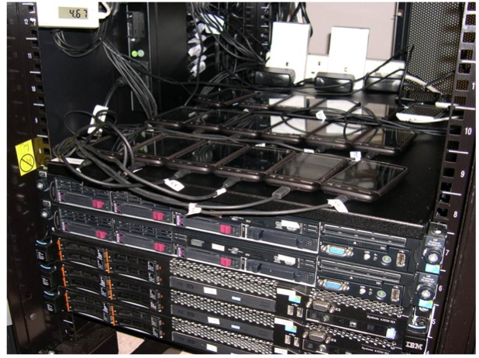
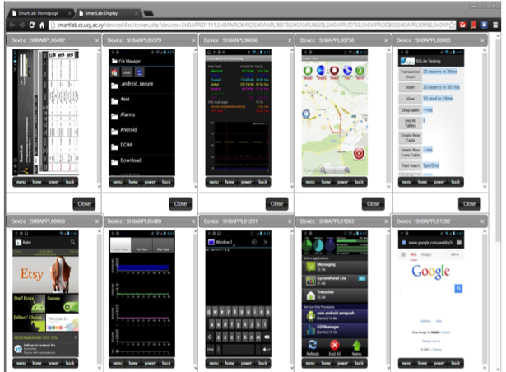
Top Technical Challenges?
Testbeds
  e.g., SmartLab or PhoneLab
Privacy
  e.g., VectorMap
Big-Data Management
  volume + velocity + variety
Data Quality
  e.g., sensor malfunction, magnetic field, multi-device issues
Data interpolation
Power Efficiency
Non-technical: Crowdsourcing Incentives, User Interfaces
smartlab.cs.ucy.ac.cy
Next slide

Slide 6
Big Data Management
Volume: from a few dozen terabytes to many petabytes in a single database.
  Velocity: how fast data is being produced
    Volume calculation for a service with 48M users (urban sensors): 48M users* 0.5KB (typical HTTP) = 24GB / acquisition round.
    24GB * 6 times per minute (i.e., every 10 seconds) * 60 minutes * 24h = 207TB / day (or 75PB / year!)
    Next slide to put the number in a perspective.
  Variety: Numerous technologies, each with its strengths and weaknesses:
    Creating new algorithms will require knowledge about the underlying assumptions

Slide 7
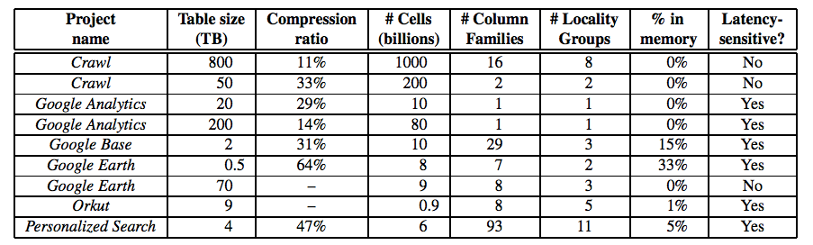
Big Data Management
Google Volume (in 2006)
Volume
Bigtable: A Distributed Storage System for Structured Data,
OSDI'06: Seventh Symposium on Operating System Design and Implementation, Seattle, WA, November, 2006.

Slide 8
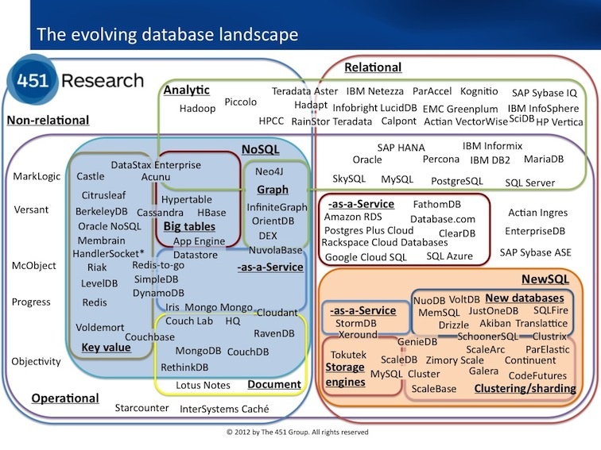
Big Data Management
Variety
451 Research, Matthew Aslett, http://goo.gl/GYcEx

