Slide 1

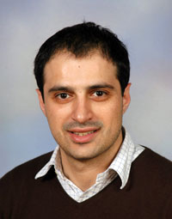

MHS: Minimum-Hot-Spot Query Trees
for Wireless Sensor Networks
Georgios Chatzimilioudis
University of California - Riverside, USA
Demetrios Zeinalipour-Yazti
University of Cyprus, Cyprus
Dimitrios Gunopulos
University of Athens, Greece
MobiDE’10 (collocated with ACM SIGMOD’10), Indianapolis, Indiana, USA © G.Chatzimilioudis, D. Zeinalipour-Yazti, D. Gunopulos
(Online Presentation)

Slide 2
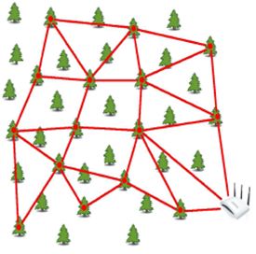
Introduction
Query Routing Trees (QRTs) are structures for percolating query answers to a query processor in a wide range of networks (i.e., as a primitive mechanism)
  e.g., Sensor Networks, Smartphone Networks, Vehicular Networks, etc.
Query Processor
Notes:
Tree: an (undirected) acyclic connected graph

Slide 3
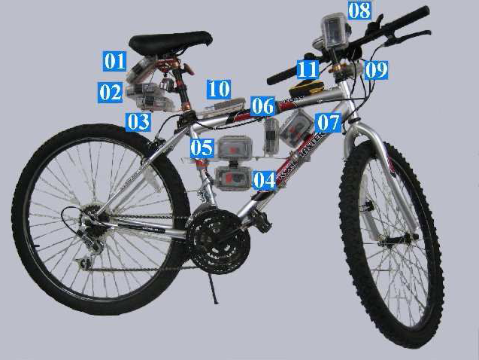
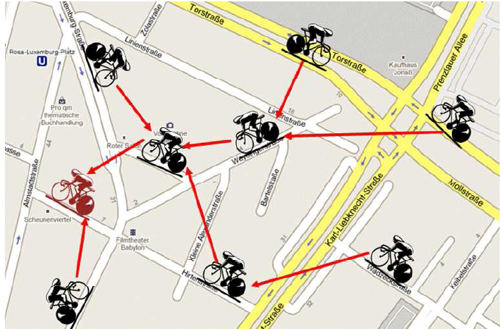
Introduction
Another futuristic application of Query Routing Trees in the Context of a Mobile Sensor Network (BikeNet: Mobile Sensing for Cyclists.)
  E.g., Find routes with low CO2 levels.
Left Graphic courtesy of: S. B. Eisenman et. al., "The BikeNet Mobile Sensing System for Cyclist Experience Mapping", In Sensys'07 (Dartmouth’s MetroSense Group)

Slide 4
Motivation
Predominant data acquisition frameworks designed for sensor networks (e.g., TAG (TinyDB), Cougar, MINT), construct Query Routing Trees in an ad-hoc manner
  i.e., nodes identify their parents in a First-Heard-First manner.
  We found that this yields unbalanced query routing tree structures.
  ➔ Increases data transmission collisions (10 children nodes yield 50% loss rate)
  ➔ Decreases network lifetime and coverage.

Slide 5
High Level Objective
Balance the query routing tree with local decisions (i.e., in a distributed manner) with minimum communication overhead.
s1
s1
s2
s3
s4
s2
s3
s4
+
+
s5
s6
s7
s8
s9
s10
s5
s6
s7
s8
s9
s10

Slide 6
Presentation Outline
Motivation
Definitions & Background
The MHS Framework
  Dissemination Phase
  Parent Selection Phase
Experimentation
Conclusions & Future Work

Slide 7
Definitions
Pitfalls of Balanced Trees in WSNs
A balanced tree T_{balanced}, one where all leaves are at levels h or h-1 with h denoting the height of the tree, might not be feasible (even under global knowledge) as nodes might not be within communication range.
Definition: Near-Balanced Tree
A tree where all nodes have the minimum possible variance in number of children (degree).
Measure of Balancing Goodness
Coefficient of Variation (COV = σ/μ) on Node Degree, where σ = standard deviation, μ = mean: Α normalized measure of node degree dispersion.
  Low COV is good (as it implies that the variation in degree is low, thus balancing is high)

Slide 8
Background: The ETC Algorithm
ETC* (Energy-driven Tree Construction), a framework for balancing arbitrary query routing trees in an in-network and distributed manner.
Basic Idea: Attempt to provide each node with approximately β = ⌊^{d}√n⌋ children nodes.
ETC Basic Phases:
  Phase 1: Discover the network topology.
  Phase 2: Distributed Network Reorganization.
Visual Intuition presented next …
* P. Andreou, A. Pamboris, D. Zeinalipour-Yazti, P. K. Chrysanthis, G. Samaras, "ETC: Energy-driven Tree Construction in Wireless Sensor Networks'', In SeNTIE'09, with MDM'09.
“Optimized Query Routing Trees for Wireless Sensor Networks", P. Andreou, D. Zeinalipour-Yazti, A. Pamboris, P. Chrysanthis, G. Samaras, Information Systems (InfoSys), Elsevier, June 2010.

Slide 9
ETC: Discovery Phase
Construct T_{input} using First-Heard-First (i.e., select as parent the one that transmitted the query earlier).
s1
O(n) message cost
Count Children and Tree depth
APL(s8)={s3}; APL(s9)={s3}
s2
s3
s4
@s3
@s3
s5
s6
s7
s8
s9
s10
Parents maintain an Alternate Parent List (APL) of children(e.g., s2 knows that s8={s3} and that s9={s3})
At the Sink we calculate: n=10, depth=2 ➔ β = ⌊^{d}√n ⌋ = ⌊²√10⌋ = 3

Slide 10
ETC: Balancing Phase
Top-down reorganization of the Query Routing Tree in order to make it near-balanced.
β=3
β
children(s1)=3 ≤ β OK
s1
β
β
β
children(s2)=5 > β ➔ FIX
s2
s3
s4
APL(s8)={s3}; APL(s9)={s3}
β
β
β
#s3
#s3
β
s5
s6
s7
s8
s9
s9
#NodeID: s8 and s9 are commanded to change parent.
#NodeID: If s3 cannot accommodate s8 and s9 then the latter ask s2 for alternative parents.

Slide 11
Background: The ETC Algorithm
Drawbacks of ETC
ETC is based on the global branching factor β of the Tree, which works well in uniform degree distributions (i.e., all nodes approx. same number of children) but not well in random degree distributions.
Although better than a centralized algorithm, ETC might add significant communication overhead in order to balance the Tree (especially in the 2nd step)

Slide 12
Presentation Outline
Motivation
Definitions & Background
The MHS Framework
  Dissemination Phase
  Parent Selection Phase
Experimentation
Conclusions

Slide 13
The MHS Framework
MHS stands for Minimum-Hot-Spot Trees
Basic Idea: Balance the query routing tree level-by-level, by having nodes snoop the choices of neighboring nodes. (i.e., purely distributed)
MHS has 2 phases:
  Phase 1: Disseminate the Query
  Phase 2: Parent Selection by Snooping.
Visual Intuition behind algorithms will be presented next …

Slide 14
MHS Phase 1: Dissemination
s1
Conceptual Order of
Parent Selection
s5, s6 and s10 (AP=1)
s7, s8 (AP=2)
s9 (AP=3)
s2
s3
s4
s5
s6
s7
s8
s9
s10
APL(s9)= {s2,s3,s4}
A) Disseminate Query
B) Count Parents: Children count their candidate parents.
C) Set Timeout: Use ordering to set a timeout for each node that is proportional to the number of candidate parents (i.e., if more parents => choose last!)

Slide 15
MHS Phase 2: Parent Selection
s1
Order of Parent Selection
s5, s6 and s10 (AP=1)
s7, s8 (AP=2)
s9 (AP=3)
s2
s3
s4
ADOPT
ACK
s5
s6
s7
s8
s9
s10
Child sends ADOPT message to Parent (AP=1 only)
Parent sends ACK message to Child (with uniqueid)
Children snoop their parents and count the unique ACK messages they sent ( # Unique-ACKs = # children )
  S7, S8 and S9 snoop the radio. ➔s2 has 2 children while s4 has 1 child.
Next order nodes select parent with the min # of ACKs
  i.e., first s8, then s7 (rand. delta delay, like TDMA, provides ordering)
  finally s9 selects s4 as parent.

Slide 16
MHS Final Tree
s1
s2
s3
s4
s5
s6
s7
s8
s9
s9

Slide 17
Presentation Outline
Motivation
Definitions & Background
The MHS Framework
  Dissemination Phase
  Parent Selection Phase
Experimentation
Conclusions

Slide 18
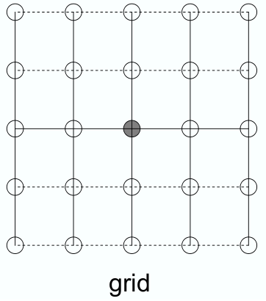
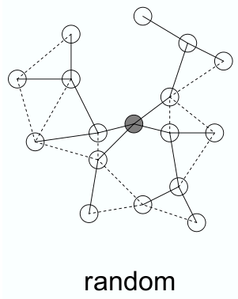
Experimental Setup
Simulation is done with the SensorSim* framework (based on ns-2, “good starting point for understanding sensor models”)
Network Sizes: 81, 324, 729 nodes
Network layouts used:
    Grid (Uniform Distribution of Node Degrees)
    Random (n nodes in 1000x1000 space)
Grid (Unif. # Children)
Random
* SensorSim: http://nesl.ee.ucla.edu/projects/sensorsim/

Slide 19
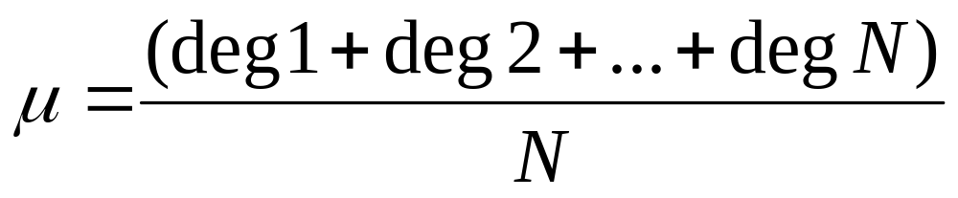
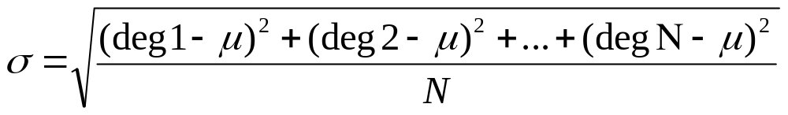
Experiments
Compared Algorithms
COPT: Centralized OPTimal algorithm that constructs an optimally balanced query routing tree.
ETC: Balancing based on the global branching factor β
MHS: Our proposed algorithm, level-wise balancing based on parent selection snooping.
Evaluation Metrics:
Balance Quality: Node Degree Coefficient of Variation COV = σ/μ , where σ = standard deviation of node degree, μ = mean value of node degree
Energy Consumption: measured in Joules

Slide 20
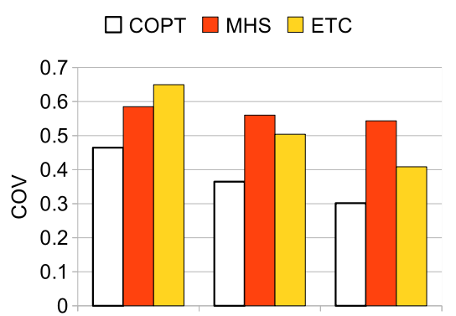
Experiment: Balancing Quality
(Grid Network)
Grid network
MHS and ETC are only slightly worse than COPT (i.e., 0.16 COV on average)
ETC performs better than MHS for larger networks (β performs well in uniform dist.)
81 324 729
# of nodes

Slide 21
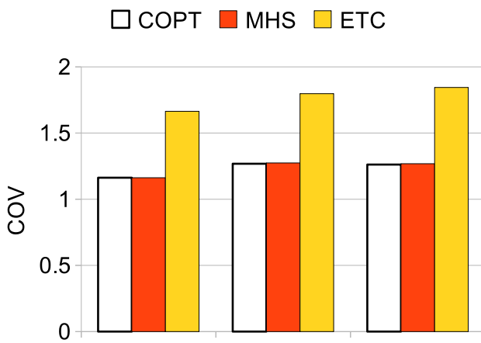
Experiment: Balancing Quality
(Random Network)
Random Network
MHS only marginally worse than COPT (optimal) and better than ETC (i.e., by 0.5 COV)
81 324 729
# of nodes

Slide 22
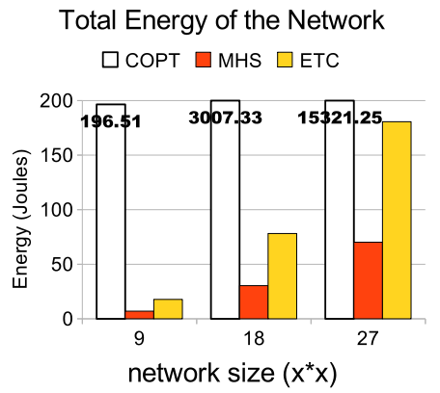
Experiment: Energy Consumption
(Random Network)
MHS and ETC much lower cost than COPT!
81 324 729
# of nodes
Similar results for grid
(only smaller scale)
Collect all info centrally then disseminate solution back

Slide 23
Presentation Outline
Motivation
Definitions & Background
The MHS Framework
  Dissemination Phase
  Parent Selection Phase
Experimentation
Conclusions

Slide 24
Conclusions and Future Work
We have presented MHS, a level-wise balancing algorithm of WSNs based on snooping.
Experimentation with simulations reveals:
  MHS generates better balanced trees
  Consumes significantly less energy
Future Work:
  Combine with waking window optimization
  Prototype in nesC/TinyOS or Contiki.

Slide 25

MHS: Minimum-Hot-Spot
Query Trees
for Wireless Sensor Networks
Thanks!
Questions?

Slide 26
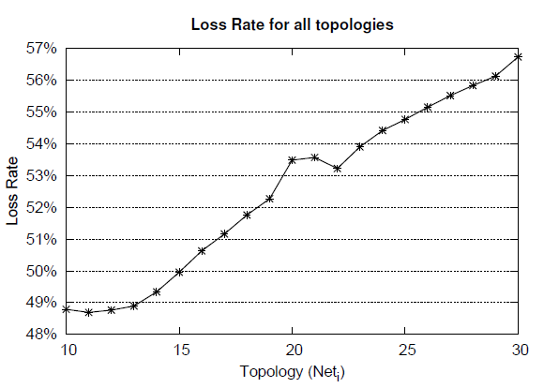
Motivation
Unbalanced Communication Topologies impose a significant network overhead (i.e., increase in Loss Rate)
57%
Right: Microbenchmark in TOSSIM that shows how the loss rate increases by increasing the sink degree [AZP10]
Degree of Sink
[AZP10] “Optimized Query Routing Trees for Wireless Sensor Networks", P. Andreou, D. Zeinalipour-Yazti, A. Pamboris, P. Chrysanthis, G. Samaras, Information Systems (InfoSys), Elsevier Press, June 2010.

Slide 27
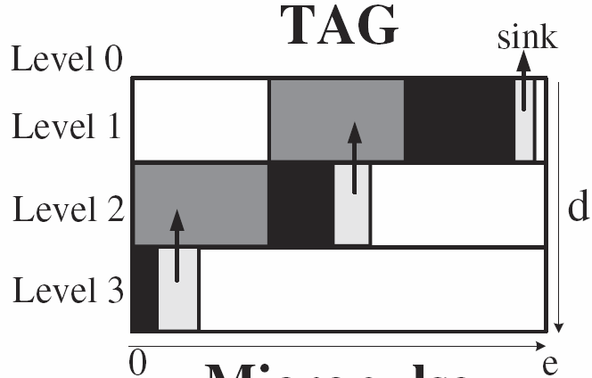
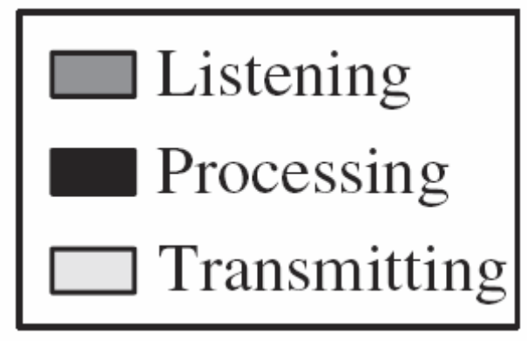
TAG (Waking Window)
The Waking Window in TAG*
Divide epoch e into d fixed-length intervals
(d = depth of routing tree)
When nodes at level i+1 transmit then nodes at level i listen.
* Madden et. al., In OSDI 2002.
Notes:
In TAG the epoch (e), is divided into (d) fixed time intervals where d is the depth of the routing tree.
The nodes are synchronized as follows: when nodes at level i+1 transmit the nodes at level i listen. This procedure repeats itself recursively from bottom to top of the query routing tree until the sink receives all answers.

Slide 28
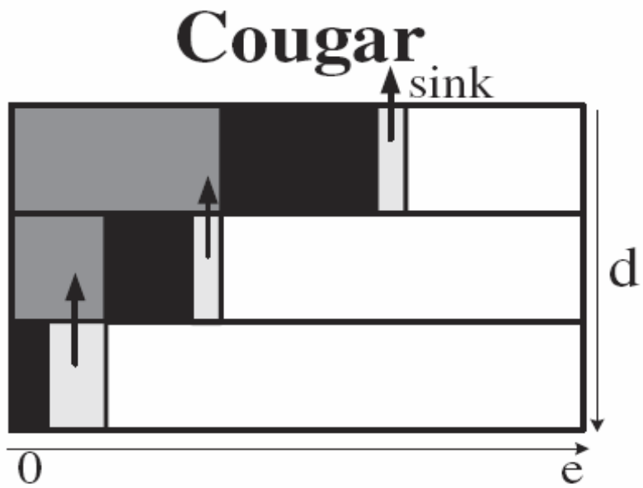
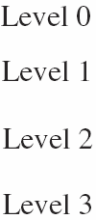
Cougar (Waking Window)
Cougar’s Advantage (w.r.t. τ)
More fine-grained than TAG.
Cougar’s Disadvantage (w.r.t. τ)
Parents keep their transceivers active until all children have answered….this is recursive.
Notes:
Cougar’s advantage is that by utilizing these waiting lists it achieves in reducing the total time each sensor keeps its transceiver on.
However, each sensor has to keep its transceiver active until all its children have answered. This procedure runs recursive to the lower levels.

Slide 29
A Query Routing Tree in TinyDB
Example: The Query Routing Tree in TinyDB
epoch=31, d (depth)=3
yields a window τ_{i} = ⎣e/d⎦ = ⎣31/3⎦ = 10
Transmit: [20..30)
Listen: [10..20)
A
level 1
Transmit: [10..20)
Listen: [0..10)
level 2
B
C
Transmit: [0..10)
Listen: [0..0)
D
E
level 3

Slide 30
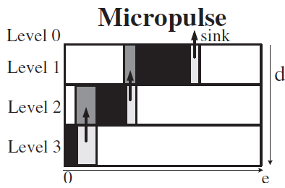
Micropulse (Waking Window)
Micropulse’s Advantage (w.r.t. τ)
Even more fine-grained than Cougar
It uses a distributed critical path computation
Notes:
Cougar’s advantage is that by utilizing these waiting lists it achieves in reducing the total time each sensor keeps its transceiver on.
However, each sensor has to keep its transceiver active until all its children have answered. This procedure runs recursive to the lower levels.

