Slide 1
The MicroPulse Framework for Adaptive Waking
Windows in Sensor Networks
Demetrios Zeinalipour-Yazti (Univ. of Cyprus)
Panayiotis Andreou (Univ. of Cyprus)
Panos Chrysanthis (Univ. of Pittsburgh, USA)
George Samaras (Univ. of Cyprus)
Andreas Pitsillides (Univ. of Cyprus)
http://www.cs.ucy.ac.cy/~dzeina/
DISN 2007 (MDM’07) © Zeinalipour-Yazti, Andreou, Chrysanthis, Samaras, Pitsillides

Slide 2

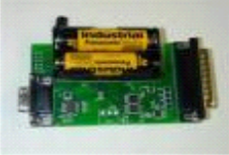
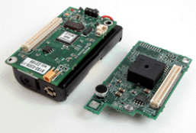



System Model
Distributed Sensing + Centralized Storage
A continuous Data Acquisition Framework
Hierarchical (tree-based) routing
Sink

Slide 3
Motivation
Limitations
Energy: Extremely limited (e.g. AA batteries)
Communication: Transmitting 1 bit over the radio consumes as much energy as ~1000 CPU instructions.
Solution
Power down the radio transceiver during periods of inactivity.
Studies have shown that a 2% duty cycle can yield lifetimes of 6 months using 2 AA batteries

Slide 4
Definitions
Definition: Waking Window (τ)
The continuous interval during which sensor A:
Enables its Transceiver.
Collects and Aggregates the results from its children for a given Query Q.
Forwards the results of Q to A’s parent.
Remarks
τ is continuous.
τ can currently not be determined in advance.

Slide 5
Definitions
Tradeoff
Small τ : Decrease energy consumption + Increase incorrect results
Large τ: Increase energy consumption + Decrease incorrect results
Problem Definition
Automatically tune τ, locally at each sensor without any global knowledge or user intervention.

Slide 6
Presentation Outline
Motivation - Definitions
Background on Waking Windows
The MicroPulse Framework
  Construction Phase
  Dissemination Phase
  Adaptation Phase
Experimentation
Conclusions & Future Work

Slide 7
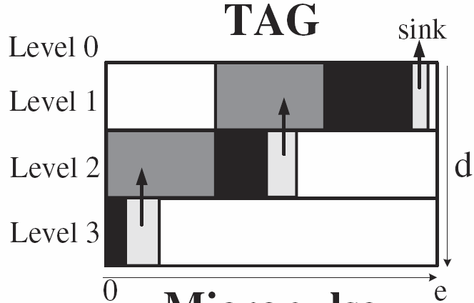
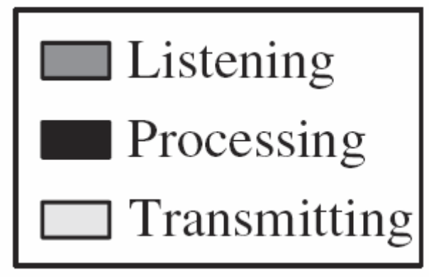
Background on Waking Windows
The Waking Window in TAG*
Divide epoch e into d fixed-length intervals
(d = depth of routing tree)
When nodes at level i+1 transmit then nodes at level i listen.
* Madden et. al., In OSDI 2002.

Slide 8
Background on Waking Windows
Example: The Waking Window in TAG
epoch=31, d (depth)=3
yields a window τ_{i} = ⎣e/d⎦ = ⎣31/3⎦ = 10
Transmit: [20..30)
Listen: [10..20)
A
level 1
Transmit: [10..20)
Listen: [0..10)
level 2
B
C
Transmit: [0..10)
Listen: [0..0)
D
E
level 3

Slide 9
Background on Waking Windows
Disadvantages of TAG’s τ
τ is an overestimate
  In our experiments we found that it is three orders of magnitude bigger than required.
τ does not capture variable workloads
  e.g., X might need a larger τ in (time+1)
X
X
3 tuples
100 tuples
Y
Z
Y
Z
time
time + 1

Slide 10
Background on Waking Windows
The Waking Window in Cougar*
Each node maintains a “waiting list”.
Forwarding of results occurs when all children have answered (or timer h expires)
Listen…
OK
B,C
A
level 1
Listen…
D,E
ø
level 2
OK
B
C
OK
Listen..OK
ø
D
E
ø
level 3
OK
* Yao and Gehrke, In CIDR 2003.

Slide 11
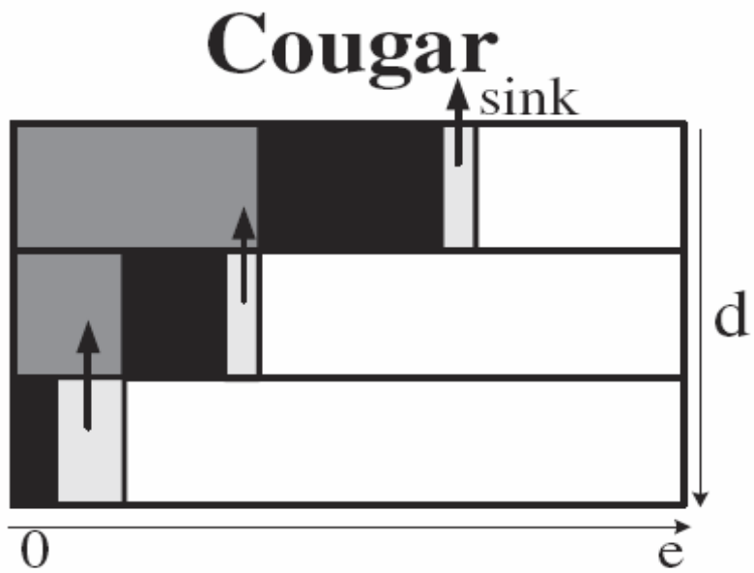
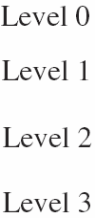
Background on Waking Window
Cougar’s Advantage (w.r.t. τ)
More fine-grained than TAG.
Cougar’s Disadvantage (w.r.t. τ)
Parents keep their transceivers active until all children have answered….this is recursive.

Slide 12
Presentation Outline
Motivation - Definitions
Background on Waking Windows
The MicroPulse Framework
  Construction Phase
  Dissemination Phase
  Adaptation Phase
Experimentation
Conclusions & Future Work

Slide 13
The MicroPulse Framework
A new framework for automatically tuning τ.
MicroPulse :
  Profile recent data acquisition activity
  Schedule τ using an in-network execution of the Critical Path Method (CPM)
CPM is a graph-theoretic algorithm for scheduling project activities.
CPM is widely used in construction, software development, research projects, etc.

Slide 14
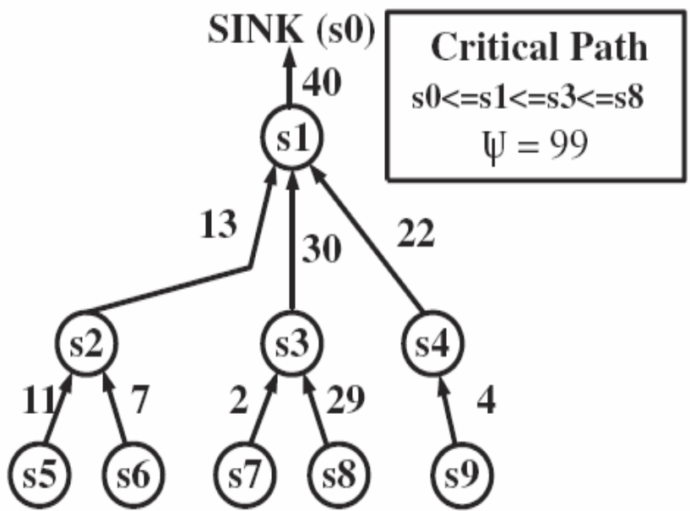
The MicroPulse Framework
MicroPulse Phases
  Construct the critical path cost Ψ.
  Disseminate Ψ in the network and define τ.
  Adapt the τ of each sensor based on Ψ.
Intuition
Ψ allows a sensor to schedule its waking window.

Slide 15
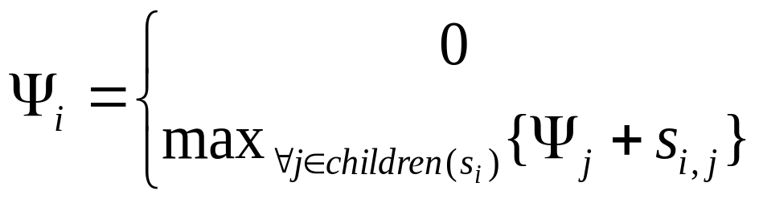
The Construction Phase
Construct Ψ:
Ψ1=max{11+13,15,22+20}
s1
13
22
15
s2
s3
s4
Ψ2=max{11,7}
Ψ4=max{20}
11
7
Ψ3=0
20
Ψ5=0
s5
s6
Ψ6=0
s7
Ψ7=0
Recursive Definition:
, if s_{i} is a leaf node.
, otherwise

Slide 16
The Dissemination Phase
Construct Waking Windows (τ):
“Disseminate Ψ = 42 to all nodes (top-down)”
s1
42
42
13
22
15
42
s4
[29..42)
s2
[20..42)
29
29
s3
11
7
20
20
s5
s6
[27..42)
s7
[0..20)
[18..29)
[22..29)

Slide 17
The Dissemination Phase
Construct Local Slack (λ):
“maximum possible workload increase for the children of a node”
s1
22
22
13
22
15
22
s4
λ=9
s2
λ=0
11
11
s3
11
7
20
20
s5
s6
λ=7
s7
λ=0
λ=0
λ=4

Slide 18
The Adaptation Phase
Intuition
Workload changes are expected, e.g.,
Epoch e
Epoch e+1
Epoch e+2
s1
s1
s1
13
22
11
22
13
28
15
18
15
s2
s3
s4
s2
s3
s4
s2
s3
s4
Question: Should we reconstruct τ?
Answer: Yes/No.
  No in Case e+1, because s2 & s3 know their local slack.
  Yes in Case e+2, because the critical path has been affected.

Slide 19
Presentation Outline
Motivation - Definitions
Background on Waking Windows
The MicroPulse Framework
  Construction Phase
  Dissemination Phase
  Adaptation Phase
Experimentation
Conclusions & Future Work

Slide 20
Experimentation
We have implemented a visual simulator that implements the waking window algorithm of TAG, Cougar and MicroPulse.
Failure Rate = 20%
Child Wait Expiration Timer h = 200 ms

Slide 21
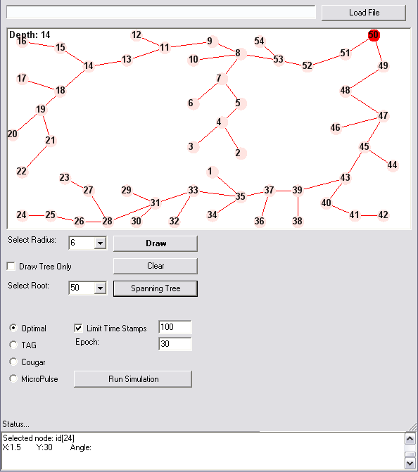
Experimentation

Slide 22
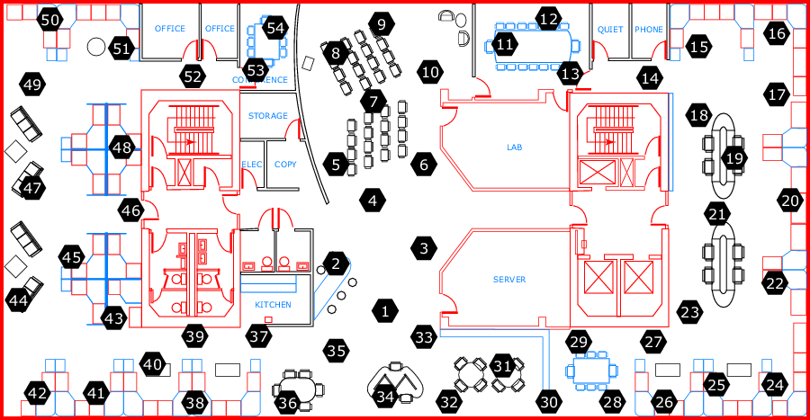
Experimentation
Dataset: Intel Lab Data
  58 sensors deployed in the Intel Berkeley Research Lab (28/2/04 – 5/4/04).
  2.3 Million Readings: topology info, humidity, temperature, light and voltage
  Epoch = 31 seconds
Available at: http://db.csail.mit.edu/labdata/labdata.html

Slide 23
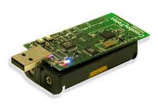
Experimentation
Sensing Device
  We utilize the energy model of Crossbow’s TELOSB Sensor (250Kbps, RF On: 23mA)
  Trace-driven experimentation using Energy = Volts x Amperes x Seconds.
Query:
    SELECT moteid, temperature
    FROM sensors
    EPOCH DURATION 1 min

Slide 24
Energy Consumption
TAG versus MicroPulse
The waking window in TAG is three orders of magnitude more expensive than in MicroPulse.
  TAG: 7,984mJ
  MicroPulse: 13.75±0.58mJ
Difference attributed to the waking window τ :
  τ in TAG is uniform: 2.21sec. (31 /14 depth)
  τ in MicroPulse is non-uniform: 146ms on average.

Slide 25
Energy Consumption
Cougar versus MicroPulse
Same observation holds for Cougar (one order of magnitude more expensive)
  Cougar: 288.97±24.42mJ
  MicroPulse: 13.75±0.58mJ
Observation: A failure at level K of the hierarchy results in a K*h increase in τ, where h is the expiration timer.
COUGAR
h
h
Listen
h
Timeout
TIME

Slide 26
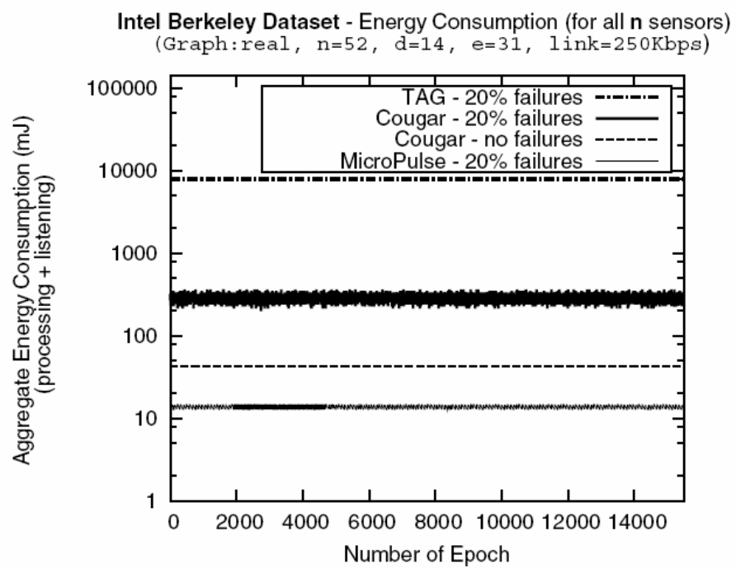
Energy Consumption
Cougar versus MicroPulse
We maintain a competitive advantage over Cougar (no failures)
  Cougar (no failures): 42mJ
  MicroPulse: 13.75±0.58mJ

Slide 27
Presentation Outline
Motivation - Definitions
Background on Waking Windows
The MicroPulse Framework
  Construction Phase
  Dissemination Phase
  Adaptation Phase
Experimentation
Conclusions & Future Work

Slide 28
Conclusions
We have presented the design of MicroPulse that adapts the waking window of a sensing device.
Experimentation with real datasets reveals that MicroPulse can reduce the cost of the waking window by three orders of magnitude.
We intend to study more carefully the adaptation algorithms.

Slide 29
The MicroPulse Framework for Adaptive Waking
Windows in Sensor Networks
Thank you!
Questions?
This presentation is available at:
http://www.cs.ucy.ac.cy/~dzeina/talks.html
Related Publications available at:
http://www.cs.ucy.ac.cy/~dzeina/publications.html
DISN 2007 (MDM’07) © Zeinalipour-Yazti, Andreou, Chrysanthis, Samaras, Pitsillides

