Slide 1

Query Routing Trees in Wireless Sensor Networks
Demetris Zeinalipour, Lecturer
Data Management Systems Laboratory (DMSL)
Department of Computer Science
University of Cyprus
EPL671: Research Methodologies in Computer Science, Graduate Course, Tuesday, Feb 14th, 2011.
http://www.cs.ucy.ac.cy/~dzeina/

Slide 2
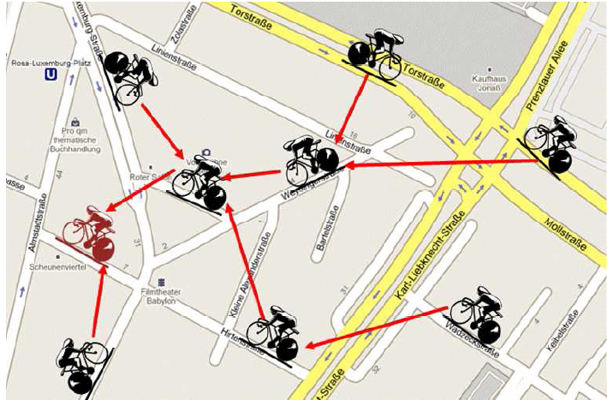
Presentation Goals
To present the (visual) intuition behind the family of Query Routing Tree (QRT) structures we’ve developed for Sensor Network Environments.

Slide 3
References
This presentation is based on the following papers:
  "Optimized Query Routing Trees for Wireless Sensor Networks“ P. Andreou, D. Zeinalipour-Yazti, A. Pamboris, P.K. Chrysanthis, G. Samaras, Information Systems (InfoSys), Elsevier Press, Volume 36, Issue 2, pp. 267-291, April 2011.
    "Workload-aware Optimization of Query Routing Trees in Wireless Sensor Networks", P. Andreou, D. Zeinalipour-Yazti, P. Chrysanthis and G. Samaras 9th Intl. Conference on Mobile Data Management, (MDM'08), April 27-30, 2008, Beijing, China, pp. 189-196, IEEE Computer Society
    "ETC: Energy-driven Tree Construction in Wireless Sensor Networks'', P. Andreou, A. Pamboris, D. Zeinalipour-Yazti, P. K. Chrysanthis, G. Samaras, 2nd International Workshop on Sensor Network Technologies for Information Explosion Era (SeNTIE'09), in conjunction with MDM'09, IEEE Press, Taipei, Taiwan, 2009, pp. 513-518., ISBN: 978-1-4244-4153-2, IEEE Computer Society, 2009.
  ``Minimum-Hot-Spot Query Trees for Wireless Sensor Networks'', G. Chatzimilioudis, D. Zeinalipour-Yazti, D. Gunopulos, Ninth International ACM Workshop on Data Engineering for Wireless and Mobile Access (MobiDE 2010), June 6th, 2010, Indianapolis, Indiana, USA, pp. 33-40, ACM Press, ISBN: 978-1-4503-0151-0, DOI:10.1145/1850822.1850829, 2010.
WART
MicroPulse+
ETC
MHS

Slide 4
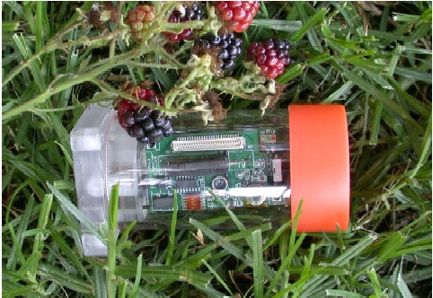

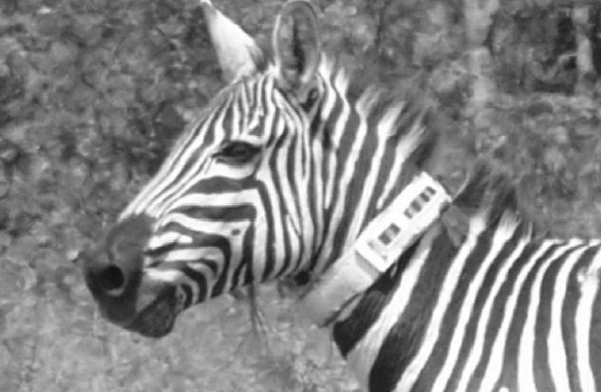
Wireless Sensor Networks
Resource constrained devices utilized for monitoring and understanding the physical world at a high fidelity.
Applications have already emerged in:
  Environmental and habitant monitoring
  Seismic and Structural monitoring
  Understanding Animal Migrations & Interactions between species.
Great Duck Island – Maine (Temperature, Humidity etc).
Golden Gate – SF, Vibration and Displacement of the bridge structure
Zebranet (Kenya) GPS trajectory
Notes:
Wireless sensor networks have been a key research area in the past few years.
Various application have emerged that enable us to monitor and understand our physical world at a high fidelity,
Some popular examples are great duck island in Maine, Golden Gate bridge in San Francisco and Zebranet in Kenya.

Slide 5

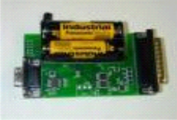
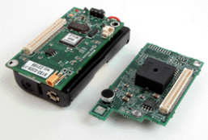



System Model
A continuous query is registered at the sink.
Query is disseminated using flooding
Hierarchical (tree-based) routing to periodically (every e) percolate results to the sink.
Q: SELECT MAX(temp)
FROM Sensors
EVERY 1s
Sink
epoch
Notes:
The system model we’ve considered is the following:
Register Query
Disseminate Query
Continuous acquisition of results
SQL Query example
Data acquisition in sensor networks is performed using a query routing tree.
All sensed data are forwarded to a sensor node, usually referred to as the sink, which is connected to a fixed computer with a database.
Most acquisition frameworks support execution of continuous queries that is queries that run continuously for a predefined time period.

Slide 6
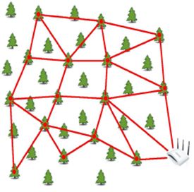
Introduction
Query Routing Trees (QRTs) are structures for percolating query answers to a query processor in a wide range of networks (i.e., as a primitive mechanism)
  e.g., Sensor Networks, Smartphone Networks, Vehicular Networks, etc.
Query Processor
Notes:
Tree: an (undirected) acyclic connected graph

Slide 7
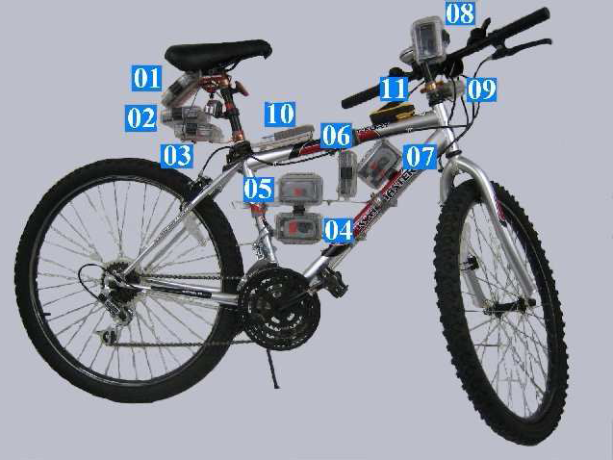
Introduction
QRT in the Context of a Mobile Sensor Network
  BikeNet: Mobile Sensing for Cyclists. (e.g., Find routes with low CO2 levels.)
Left Graphic courtesy of: S. B. Eisenman et. al., "The BikeNet Mobile Sensing System for Cyclist Experience Mapping", In Sensys'07 (Dartmouth’s MetroSense Group)

Slide 8
Motivation
Limitations
Energy: Extremely limited (e.g., AA batteries)
Communication: Very Resource Demanding (e.g., 1 TX/RX =~1000 CPU inst.)
Ad-hoc QRTs: Cause collisions and Retransmissions (draining more Energy!)
Solutions
Power down the radio transceiver during periods of inactivity. (WART)
  Studies have shown that a 2% duty cycle can yield lifetimes of 6 months using 2 AA batteries
Reorganize Ad-hoc QRT (ETC/MHS)
Notes:
Wireless Sensor Networks have many limitations. One of the most important limitation is their extremely limited energy which comes from the fact that sensors are most commonly powered by 2 AA batteries.
The most energy demanding factor is communication since transmitting 1 bit of data is approximately equivalent to processing 1000 CPU instructions.
One solution in order to cope with the energy challenge is to power down the radio transceiver during periods of inactivity. In particular, it has been shown that sensors operating at a 2% duty cycle can achieve lifetimes of 6 months using 2 AA batteries

Slide 9
Presentation Outline
Introduction - Motivation
WART: Tuning the Waking Windows of QRTs
ETC: Balancing the QRT with Global Knowledge
MHS: Balancing the QRTs with Local Knowledge
Conclusions & Future Work
Notes:
Now I will present some background and related work on waking windows of the most popular sensor network query processors.

Slide 10
Definitions
Definition: Waking Window (τ)
The continuous interval during which sensor A:
Enables its Transceiver.
Collects and Aggregates the results from its children for a given Query Q.
Forwards the results of Q to A’s parent.
Remarks
τ is continuous.
τ can currently not be determined in advance.
Notes:
We now provide some definitions that we will use throughout the presentation.
The Waking Window (t) is the continuous interval during which a sensor:
Enables its Transceiver.
Collects and Aggregates the results from its children for a given Query Q.
Forwards the results of Q to A’s parent.
Note that (t) is continuous because it would be very energy demanding to suspend the transceiver more than once during the interval of an epoch.
In addition, (t) can not be determined in advance since its query specific. For instance, a sensor may not know in advance how many tuples it will receive from its children.

Slide 11
Definitions
Tradeoff
Small τ : Decrease energy consumption + Increase incorrect results
Large τ: Increase energy consumption + Decrease incorrect results
Problem Definition
A
level 1
Automatically tune τ, locally at each sensor without any global knowledge or user intervention.
B
C
level 2
[ ..τ ..]
D
E
level 3
Notes:
In defining (t) we are challenged with the following trade-off:
Shall S power off the transceiver too early, reduces energy consumption but also increases incorrect results
Shall S keep the transceiver active for too long, increases energy consumption but decreases incorrect results
We define our problem as follows:
Automatically tune (t), locally at each sensor without any global knowledge or user intervention

Slide 12
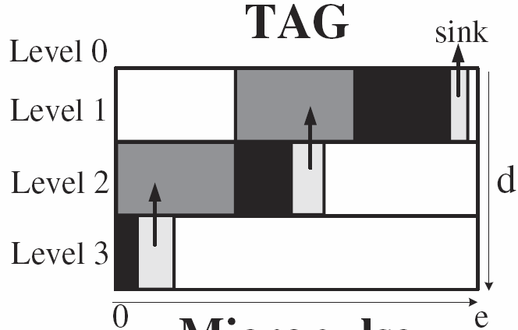
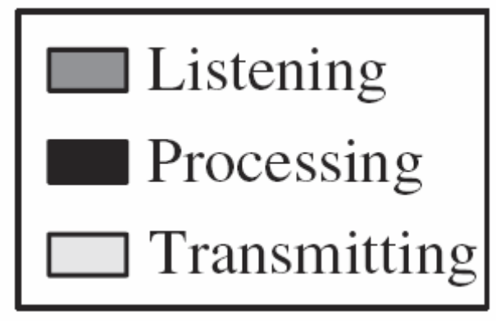
Background on Waking Windows
The Waking Window in TAG*
Divide epoch e into d fixed-length intervals
(d = depth of routing tree)
When nodes at level i+1 transmit then nodes at level i listen.
Notes:
In TAG the epoch (e), is divided into (d) fixed time intervals where d is the depth of the routing tree.
The nodes are synchronized as follows: when nodes at level i+1 transmit the nodes at level i listen. This procedure repeats itself recursively from bottom to top of the query routing tree until the sink receives all answers.

Slide 13
Background on Waking Windows
Example: The Waking Window in TAG
epoch=31, d (depth)=3
yields a window τ_{i} = ⎣e/d⎦ = ⎣31/3⎦ = 10
Transmit: [20..30)
Listen: [10..20)
A
level 1
Transmit: [10..20)
Listen: [0..10)
level 2
B
C
Transmit: [0..10)
Listen: [0..0)
D
E
level 3
Notes:
In order to better describe how TAG works, consider this example. We would like an answer from our query every 31 seconds, i.e epoch equals to 31.
Note that the depth of the query routing tree is 3. Therefore the window is 31 divided by 3 equals 10 seconds.
Starting from bottom to top, nodes D and E will start transmitting from time 0 to 10. Nodes B and C, which are at the previous level will have to turn on their transceivers from 0 to 10 in order to listen for the results of D and E.
As soon as they are done listening they will transmit there results from time 10 to 20, to A.

Slide 14
Background on Waking Windows
Disadvantages of TAG’s τ
τ is an overestimate
  In our experiments we found that it is three orders of magnitudes larger than required.
τ does not capture variable workloads
  e.g., X might need a larger τ in (time+1)
X
X
3 tuples
100 tuples
Y
Z
Y
Z
time
time + 1
Notes:
Tag has some disadvantages.
First of all (t) in TAG is an overestimate. We will show later in our experiments that (t) in TAG is actually three orders of magnitude bigger than required.
In addition (t) does not capture variable workloads i.e a sensor may receive a different amount of tuples during the next epoch.

Slide 15
Background on Waking Windows
The Waking Window in Cougar*
Each node maintains a “waiting list”.
Forwarding of results occurs when all children have answered (or timer h expires)
Listen…
OK
B,C
A
level 1
Listen…
D,E
ø
level 2
OK
B
C
OK
Listen..OK
ø
D
E
ø
level 3
OK
Notes:
Now we present the waking window of Cougar.
Each sensor node in a Cougar network maintains a child list also known as a waiting list. For example B has set its waiting list as D and E. This means that B will wait for results from D and E before it sends its own upwards to its father A.
Cougar also employs a timer h in order to cope with possible node failures from nodes in its waiting list.

Slide 16
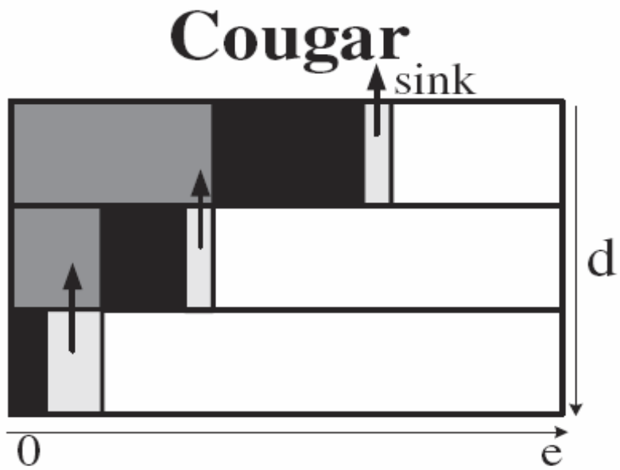
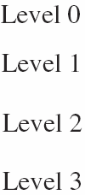
Background on Waking Window
Cougar’s Advantage (w.r.t. τ)
More fine-grained than TAG.
Cougar’s Disadvantage (w.r.t. τ)
Parents keep their transceivers active until all children have answered….this is recursive.
Notes:
Cougar’s advantage is that by utilizing these waiting lists it achieves in reducing the total time each sensor keeps its transceiver on.
However, each sensor has to keep its transceiver active until all its children have answered. This procedure runs recursive to the lower levels.

Slide 17
Our Approach: WART
A new framework for automatically tuning τ.
WART (Workload-Aware Routing Trees):
  Profile recent data acquisition activity
  Schedule τ using an in-network execution of the Critical Path Method (CPM)
CPM is a graph-theoretic algorithm for scheduling project activities.
CPM is widely used in construction, software development, research projects, etc.
Notes:
MicroPulse aims to automatically tune (t) to achieve great energy savings.
Specifically MicroPulse, profiles recent data acquisition activity and schedules (t) by using an in-network execution of the Critical Path Method, CPM.
CPM is a graph-theoretic algorithm for scheduling project activities and is widely used in construction, software development, research projects, etc.

Slide 18
The WART Framework
WART Phases
  Construct the critical path cost Ψ.
  Disseminate Ψ in the network and define τ.
  Adapt the τ of each sensor based on Ψ.
s1
Intuition
Ψ allows a sensor to schedule its waking window.
13
15
22
s2
s3
s4
11
7
20
s5
s6
s7
Notes:
MicroPulse start by constructing the critical path cost (psi).
It then disseminates (psi) to the network. Upon receiving (psi) each sensor locally tunes its waking window.
Our intuition is that (psi) allows a sensor to schedule its waking window.
Change schema using figure of next slide.

Slide 19
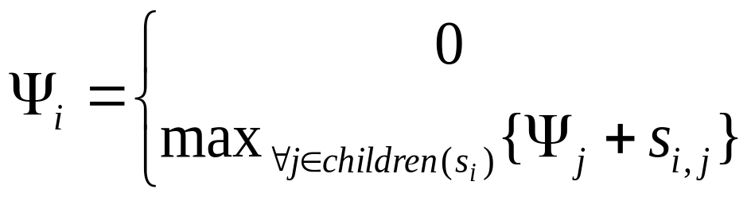
The Construction Phase
Construct Ψ:
Ψ1=max{11+13,15,22+20}
s1
13
22
15
s2
s3
s4
Ψ2=max{11,7}
Ψ4=max{20}
11
7
Ψ3=0
20
Ψ5=0
s5
s6
Ψ6=0
s7
Ψ7=0
Recursive Definition:
, if s_{i} is a leaf node.
, otherwise
Notes:
The construction phase enables the sink node to calculate (psi) using a bottom-up recursive definition which states that:
(psi_i) is equal to 0 if s_i is a leaf node or the maximum (psi) plus the workload received from its children.
Starting from bottom, all leaf nodes receive a (psi) value equal to 0.
As soon as s2 receives the values from its children s5 and s6 it calculates (psi_2) equal to the maximum value between 11 and 7 which is 11.
Similarly s4 sets its (psi) value to 20.
Finally s1 sets its (psi) value to 42 using the same definition. Thus the critical path is formed, that is s7→s4→s1.

Slide 20
The Dissemination Phase
Construct Waking Windows (τ):
“Disseminate Ψ = 42 to all nodes (top-down)”
s1
42
42
13
22
15
42
s4
[29..42)
s2
[20..42)
29
29
s3
11
7
20
20
s5
s6
[27..42)
s7
[0..20)
[18..29)
[22..29)
Notes:
The next step is to disseminate the (psi) value back to the network.
s_1 sends (psi) equals to 42 to its children. Upon receiving (psi) from their parent each sensor locally tunes its waking window.
For example s_4 calculates that in order to transmit its 22 results to s1 it must tune its waking window to transmit from time 20 to 42.
s_2 and s_3 perform similar calculations. In addition each sensor subtracts its workload from the received (psi) value and transmits the new (psi) value to its children.
As a result, s_4 will transmit 20, that is 42 minus 22, to s_7. The same goes for s_2 and s_3.
In the final step, where a leaf node receives (psi) it locally tunes its window and the procedure ends there.

Slide 21
The Dissemination Phase
Construct Local Slack (λ):
“maximum possible workload increase for the children of a node”
s1
22
22
13
22
15
22
s4
λ=9
s2
λ=0
11
11
s3
11
7
20
20
s5
s6
λ=7
s7
λ=0
λ=0
λ=4
Notes:
In addition to the waking windows, each sensor sets its local slack (lambda) value.
The local slack value indicates the how much time a sensor can deviate from its waking window.
Sensors in the critical path can not deviate as any increase in the workload of a sensor that lies in the critical path requires the reconstruction of the (psi) value.
To set the local slack (lambda) s_1 starts by sending the maximum workload value from its children, 22.
s_2, s_3, and s_4 set their local slack by subtracting from their workload value, 22.
As a result they set their slack values to 9, 7 and 0 respectively.
This procedure is recursively repeated until all sensors locally set their (lambda) value

Slide 22
The Adaptation Phase
Intuition
Workload changes are expected, e.g.,
Epoch e
Epoch e+1
Epoch e+2
s1
s1
s1
13
22
11
22
13
28
15
18
15
s2
s3
s4
s2
s3
s4
s2
s3
s4
Question: Should we reconstruct τ?
Answer: Yes/No.
  No in Case e+1, because s2 & s3 know their local slack.
  Yes in Case e+2, because the critical path has been affected.
Notes:
Of course, at some times, we expect some changes in the workload.
The question now, is if we always have to reconstruct (t).
Our adaptation algorithm copes with this question by classifying these changes with respect to the critical path.
If a change affects the critical path, then the critical path must be reconstructed.
On the other hand, if a change does not affect the critical path then nodes locally tune their waking windows and no need for reconstruction is necessary.
The adaptation algorithm is far more complex but will not ....

Slide 23
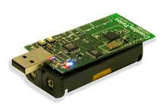
Experimentation
Sensing Device
  We utilize the energy model of Crossbow’s TELOSB Sensor (250Kbps, Rx:23mA, Tx:19.5,MCU:7.8mA, sleep:5.1μA)
  Trace-driven experimentation using Energy = Volts x Amperes x Seconds.
Communication Protocol
  based on ZigBee 802.15.4
  Maximum Data Payload:104 bytes (segmentation when required)
Notes:
Our energy model is base on the TelosB sensing device from Crossbow
We employ various power modes of operation and we calculate energy using the formula: Volts x Amperes x Seconds.
Our communication protocol is based on ZigBee 802.15.4. We assume a maximum data payload of 104 bytes.
If a packet exceeds this value we segment our packets accordingly.

Slide 24
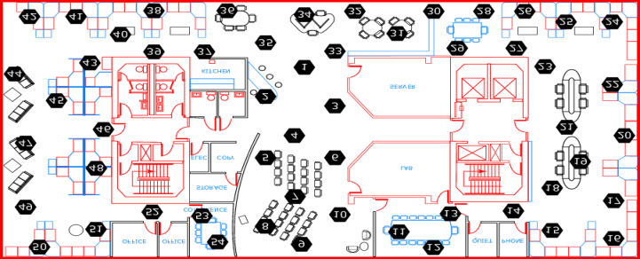
Experimentation
Datasets:
  A. Intel54
  54 deployed at the Intel Berkeley Research Lab (28/2/04 – 5/4/04).
  2.3 Million Readings: topology info, humidity, temperature, light and voltage
  B. Intel540
  540 sensors randomly derived from Intel54 dataset
    Configuration Parameters:
      Epoch = 31 seconds
  Failure Rate = 20%
  Child Wait Expiration Timer h = 200 ms
Available at: http://db.csail.mit.edu/labdata/labdata.html
Notes:
We use two datasets in our experiments.
The Intel54 dataset where we take readings from the 54 sensors that hold the larger amount of readings from the 58 sensors deployed at Intel Berkeley Research Lab from February to April 2004. This dataset contains 2.3 million readings which include humidity, temperature, light and voltage values. This dataset uses an epoch of 31 seconds.
Our second dataset, coined Intel540, contains 540 sensors randomly derived from the Intel54 dataset.

Slide 25
Experimentation
Query Sets:
Single-Tuple Queries (ST)
SELECT moteid, temperature
FROM sensors
WHERE temperature=MAX(temperature)
Multi-Tuple Queries
  Fixed Size (MTF)
SELECT moteid, temperature
FROM sensors
  Arbitrary Size (MTA)
SELECT moteid, temperature
FROM sensors
WHERE temperature>39
This talk presents only these results but the paper contains all of them
Notes:
In order to display the efficiency of our approach under different queries we have considered 3 different query sets.
The first one, Single-Tuple Queries (ST) is a class of queries where a single tuple is produced.
An example of this query set is to return the moteid and the temperature of the sensor with the highest temperature.
The second class are Multi-Tuple Queries. We distinguish this class with two sub classes.
The MTF query class in which sensor return all tuples received from their children and themselves, and...
The MTA query class where sensor apply some filters and return only the tuples that satisfy the filters.

Slide 26
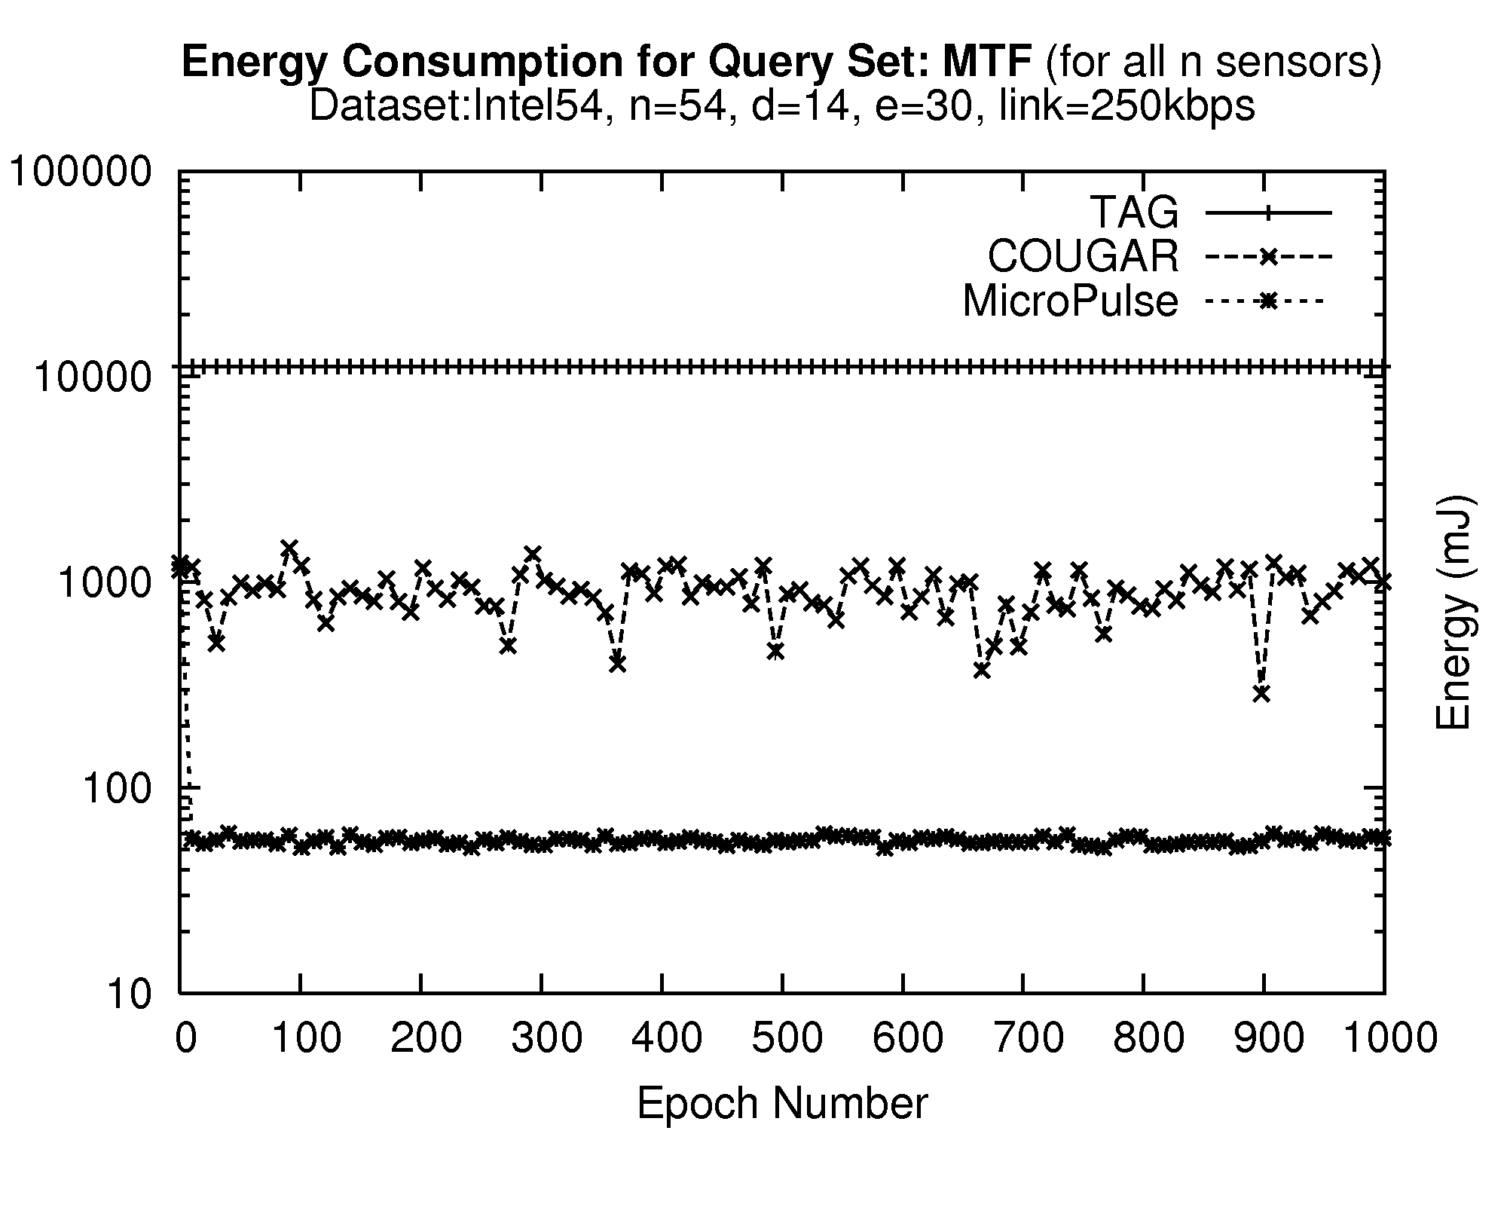
Energy Consumption
Intel54 Dataset – Query Set:MTF
Waking window τ :
τ in TAG is uniform: 2.21sec. (31 /14 depth)
τ in WART is non-uniform: 146ms on average
Observation
Large standard deviation in Cougar attributed to the following fact: A failure at level K of the hierarchy results in a K*h increase in τ, where h is the expiration timer. (i.e. large standard deviation)
11,228±2mJ
WART
893±239mJ
56±37mJ
COUGAR
Listen
h
h
Timeout
h
Notes:
Our first experimental series we measure the energy consumption using the Intel54 dataset. We only show the results for the MTF query set as similar results apply to the other query sets.
We observe that the waking window in TAG is three orders of magnitude more expensive than in MicroPulse.
This clearly attributed to the fact that in TAG the waking window is uniform, in our experiments where the epoch is 31 and the depth is 14, the waking window is set to 2.21sec.
On the contrary, the waking window in MicroPulse is non-uniform. In this experiment, the waking window is only a 126milliseconds on average.

Slide 27
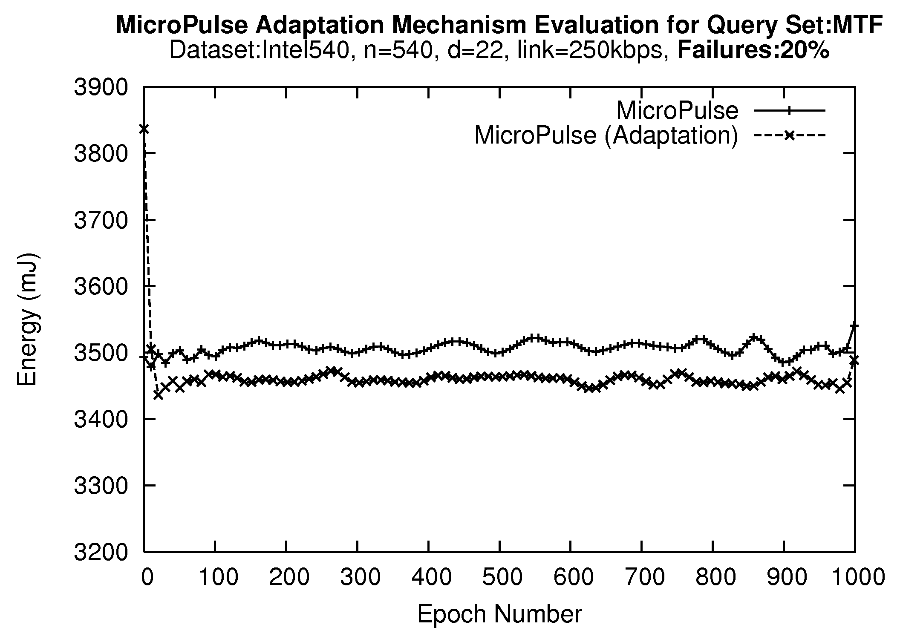
Adaptation Phase Evaluation
Our adaptation algorithm adjusts the critical path cost without reconstructing the CP tree from scratch.
Yields additional energy savings of 60mJ (~416 messages or 1 packet per sensor).
Notes:
In the second experimental series we investigated the efficiency of our adaptation algorithm.
We compare MicroPulse with no adaptation against a version that employs the adaptation rules of our algorithm.
We observe that using the adaptation algorithm can yield additional energy savings of 60mJ.
This translates into approximately 416 messages which is almost one packet per sensor during each epoch.

Slide 28
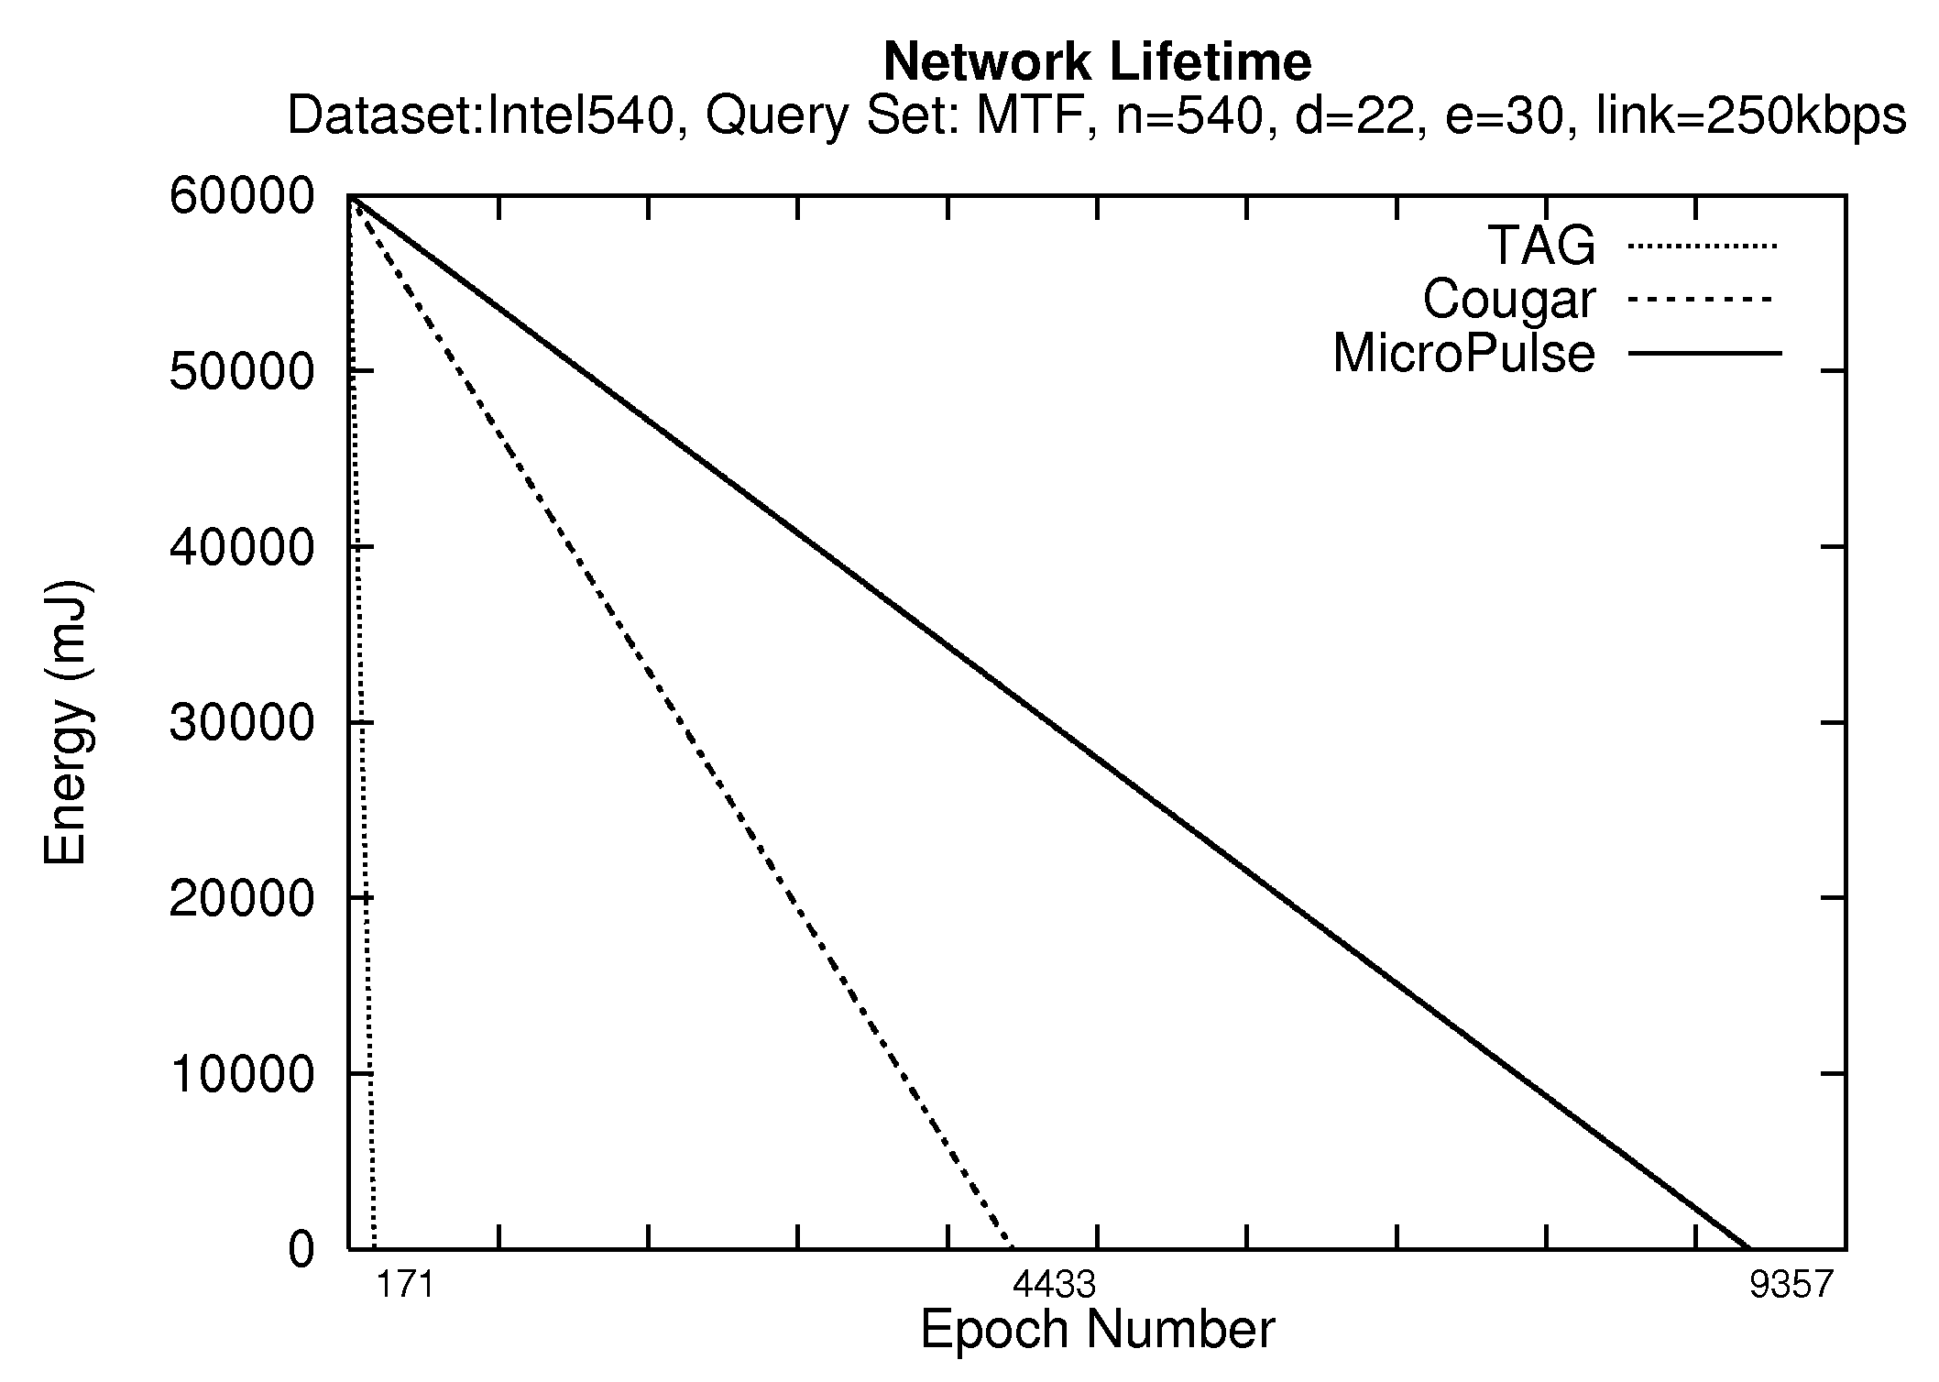
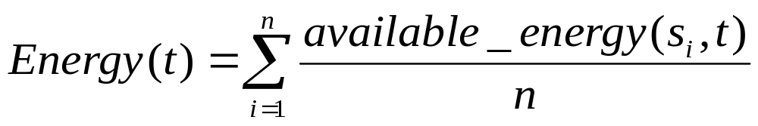
Network Lifetime
TAG, Cougar, MicroPulse
Initial Energy Budget: 60000mJ
Average energy of all sensors at each epoch
Stop when Energy(t’)=0
TAG
85mins
Cougar
36hrs
MicroPulse
77hrs
Notes:
In our final experimental series we demonstrate the efficiency of our approach with regards to network lifetime.
We measure the average energy of all sensors using the illustrated formula.
In order to speed up our experiment we provide each sensor with an initial energy budget of 60000mJ.
We run the experiment using the Intel540 dataset and the MTF query set and stop when all network energy is depleted, i.e. Energy(t’) is equal to 0.
We can observe that under TAG the lifetime is only 171 epochs, i.e. 85 minutes, while in Cougar the lifetime increases to 4433 epochs, i.e. 36 hours.
Finally in MicroPulse, lifetime is increased to 9,537 epochs i.e. 77 hours

Slide 29
Presentation Outline
Introduction - Motivation
WART: Tuning the Waking Windows of QRTs
ETC: Balancing the QRT with Global Knowledge
MHS: Balancing the QRTs with Local Knowledge
Conclusions & Future Work
Notes:
Now I will present some background and related work on waking windows of the most popular sensor network query processors.

Slide 30
High Level Objective
Predominant data acquisition frameworks designed for sensor networks construct QRTs in ad-hoc manners.
Specifically, QRTs are structured with First-Heard-First approaches.
  Sensor Networks: π.χ., TinyDB, Cougar, MINT,…
  P2P Networks: π.χ., Gnutella, ..
  Vehicular Networks: π.χ., VITP, κτλ.
This yields non-balanced tree topologies (drawbacks follow…)

Slide 31
High-Level Objective
Drawbacks of non-balanced trees:
Increase Collisions: A sensor with 10 children => 50% loss rate.
Decrease network lifetime and coverage.
s1
Distributed Tree
Re-organization
s1
s2
s3
s4
s2
s3
s4
+
+
s5
s6
s7
s8
s9
s10
s5
s6
s7
s8
s9
s10

Slide 32
Definitions
Pitfalls of Balanced Trees in WSNs
A balanced tree T_{balanced}, one where all leaves are at levels h or h-1 with h denoting the height of the tree, might not be feasible (even under global knowledge) as nodes might not be within communication range.
Definition: Near-Balanced Tree
A tree where all nodes have the minimum possible variance in number of children (degree).
Measure of Balancing Goodness
Coefficient of Variation (COV = σ/μ) on Node Degree, where σ = standard deviation, μ = mean: Α normalized measure of node degree dispersion.
  Low COV is good (as it implies that the variation in degree is low, thus balancing is high)

Slide 33
Background: The ETC Algorithm
ETC* (Energy-driven Tree Construction), a framework for balancing arbitrary query routing trees in an in-network and distributed manner.
Basic Idea: Attempt to provide each node with approximately β = floor(^{d}√n) children nodes. (i.e., log_{β}n = d ➔ β^{d}=n)
ETC Basic Phases:
  Phase 1: Discover the network topology.
  Phase 2: Distributed Network Reorganization.
Visual Intuition presented next …

Slide 34
ETC: Discovery Phase
Construct T_{input} using First-Heard-First (i.e., select as parent the one that transmitted the query earlier).
s1
O(n) message cost
Count Children and Tree depth
APL(s8)={s3}; APL(s9)={s3}
s2
s3
s4
@s3
@s3
s5
s6
s7
s8
s9
s10
Parents maintain an Alternate Parent List (APL) of children(e.g., s2 knows that s8={s3} and that s9={s3})
At the Sink we calculate: n=10, depth=2 ➔ β = ⌊^{d}√n ⌋ = ⌊²√10⌋ = 3

Slide 35
ETC: Balancing Phase
Top-down reorganization of the Query Routing Tree in order to make it near-balanced.
β=3
β
children(s1)=3 ≤ β OK
s1
β
β
β
children(s2)=5 > β ➔ FIX
s2
s3
s4
APL(s8)={s3}; APL(s9)={s3}
β
β
β
#s3
#s3
β
s5
s6
s7
s8
s9
s9
#NodeID: s8 and s9 are commanded to change parent.
#NodeID: If s3 cannot accommodate s8 and s9 then the latter ask s2 for alternative parents.

Slide 36
Presentation Outline
Introduction - Motivation
WART: Tuning the Waking Windows of QRTs
ETC: Balancing the QRT with Global Knowledge
MHS: Balancing the QRTs with Local Knowledge
Conclusions & Future Work
Notes:
Now I will present some background and related work on waking windows of the most popular sensor network query processors.

Slide 37
Background: The ETC Algorithm
Drawbacks of ETC
ETC is based on the global branching factor β of the Tree, which works well in uniform degree distributions (i.e., all nodes approx. same number of children) but not well in skewed degree distributions.
Although better than a centralized algorithm, ETC might add significant communication overhead in order to balance the Tree (especially in the 2nd step)
Notes:
Skewed Distribution = Ασσύμετρη Κατανομή
Uniform Distribution = Ομοιόμορφη Κατανομή
Normal Distribution = Κανονική Κατανομή

Slide 38
The MHS Framework
MHS stands for Minimum-Hot-Spot Trees
Basic Idea: Balance the query routing tree level-by-level, by having nodes snoop the choices of neighboring nodes. (i.e., purely distributed)
MHS has 2 phases:
  Phase 1: Disseminate the Query
  Phase 2: Parent Selection by Snooping.
Visual Intuition behind algorithms will be presented next …

Slide 39
A Note on Broadcast vs. Unicast
R2
Broadcast
Snooping Radio Channel
R4
Sender
R5
R1
R6
Unicast
R3

Slide 40
MHS Phase 1: Dissemination
s1
Conceptual Order of
Parent Selection
s5, s6 and s10 (AP=1)
s7, s8 (AP=2)
s9 (AP=3)
s2
s3
s4
s5
s6
s7
s8
s9
s10
APL(s9)= {s2,s3,s4}
A) Disseminate Query
B) Count Parents: Children count their candidate parents.
C) Set Timeout: Use ordering to set a timeout for each node that is proportional to the number of candidate parents (i.e., if more parents => choose last!)

Slide 41
MHS Phase 2: Parent Selection
s1
Order of Parent Selection
s5, s6 and s10 (AP=1)
s7, s8 (AP=2)
s9 (AP=3)
s2
s3
s4
ADOPT
ACK
s5
s6
s7
s8
s9
s10
Child sends ADOPT message to Parent (AP=1 only)
Parent sends ACK message to Child (with uniqueid)
Children snoop their parents and count the unique ACK messages they sent ( # Unique-ACKs = # children )
  S7, S8 and S9 snoop the radio. ➔s2 has 2 children while s4 has 1 child.
Next order nodes select parent with the min # of ACKs
  i.e., first s8, then s7 (rand. delta delay, like TDMA, provides ordering)
  finally s9 selects s4 as parent.

Slide 42
Presentation Outline
Introduction - Motivation
WART: Tuning the Waking Windows of QRTs
ETC: Balancing the QRT with Global Knowledge
MHS: Balancing the QRTs with Local Knowledge
Conclusions & Future Work
Notes:
Now I will present some background and related work on waking windows of the most popular sensor network query processors.

Slide 43
Conclusions
Experimentation reveals that MicroPulse+ (WART+ETC) improves 3 times over WART (see Infosys’11 paper)
In the future we plan to incorporate the stripped-down editions of our QRT implementations in the KSpot Architecture. (see next slide)
We are also studying social applications in the context of Smartphone Sensor Networks
Notes:
Now I will present some background and related work on waking windows of the most popular sensor network query processors.

Slide 44
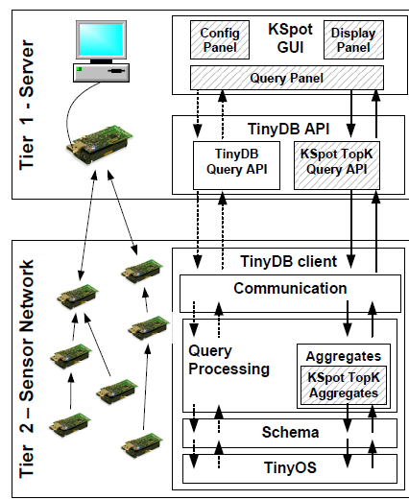
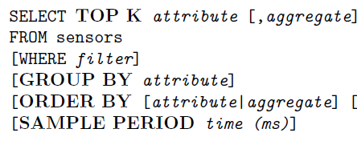
KSpot System Architecture
``MINT Views: Materialized In-Network Top-k Views in Sensor Networks‘’ D. Zeinalipour-Yazti, P. Andreou, P. Chrysanthis and G. Samaras, The IEEE 8th International Conference on Mobile Data Management (MDM'07), , Mannheim, Germany, May 7 - 11, ISBN 14244-1240-4, pp. 182-189, IEEE Press, 2007.
``KSpot: Effectively Monitoring the K Most Important Events in a Wireless Sensor Network", P. Andreou, D. Zeinalipour-Yazti, M. Vassiliadou, P.K. Chrysanthis, G. Samaras, 25th International Conference on Data Engineering March (ICDE'09), Shanghai, China, May 29 - April 4, 2009.
"Power Efficiency through Tuple Ranking in Wireless Sensor Network Monitoring“, P. Andreou, D. Zeinalipour-Yazti, P. Chrysanthis, G. Samaras,, Distributed and Parallel Databases (DAPD), Special Issue on Query Processing in Sensor Networks, Springer Press, Volume 29, Numbers 1-2, pp. 113-150, DOI: 10.1007/s10619-010-7072-5, January 2011.

Slide 45
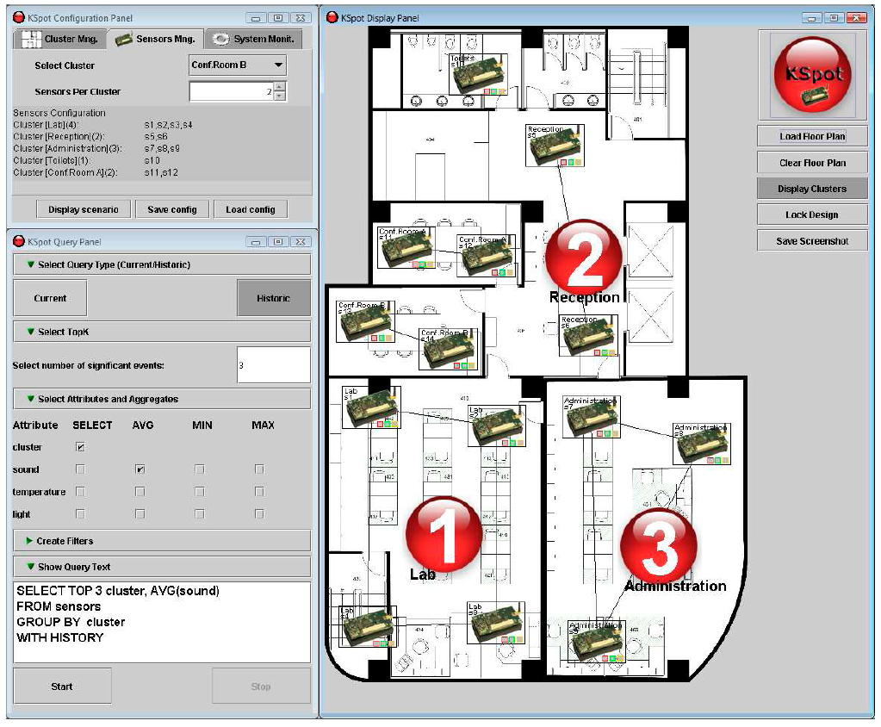
KSpot System GUI
Configuration Panel
Online Ranking
Query Box
Download: http://dmsl.cs.ucy.ac.cy/kspot
Notes:
ICDE: highest noise level, indicator for crowded areas of the conference

Slide 46

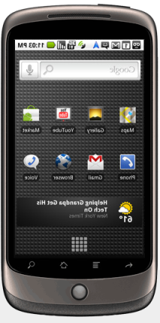
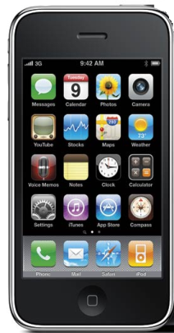


Smartphone Networks
Smartphone Network: A set of smartphones that communicate over a shared network, in an unobtrusive manner and without the explicit interactions by the user in order to realize a collaborative task (Sensing activity, Social activity, ...)
Smartphone: offers more advanced computing and connectivity than a basic 'feature phone'.
  OS: Google’s Android, Nokia’s Maemo, Apple iOS
  CPU: >1 GHz ARM-based processors
  Memory: 512MB Flash, 512MB RAM, 4GB Card;
  Sensing: Proximity, Ambient Light, Accelerometer, Camera, Microphone, Geo-location based on GPS, WIFI, Cellular Towers,…

Slide 47
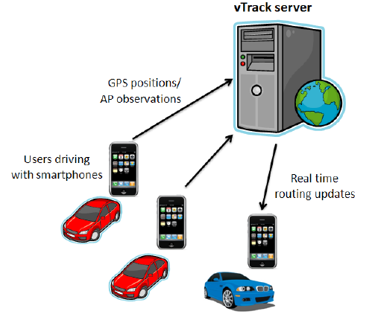
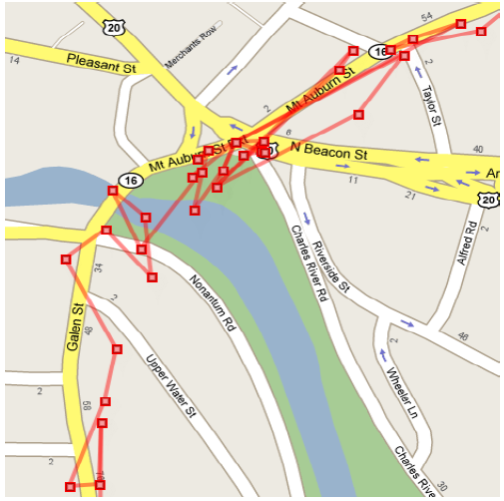
Smartphone Network: Applications
Intelligent Transportation Systems with VTrack
Graphics courtesy of: A .Thiagarajan et. al. “Vtrack: Accurate, Energy-Aware Road Traffic Delay Estimation using Mobile Phones, In Sensys’09, pages 85-98. ACM, (Best Paper) MIT’s CarTel Group
Notes:
Smartphones participate in a collaborative sensing activity to enable a new service: i.e., high-fidelity traffic estimation.

Slide 48
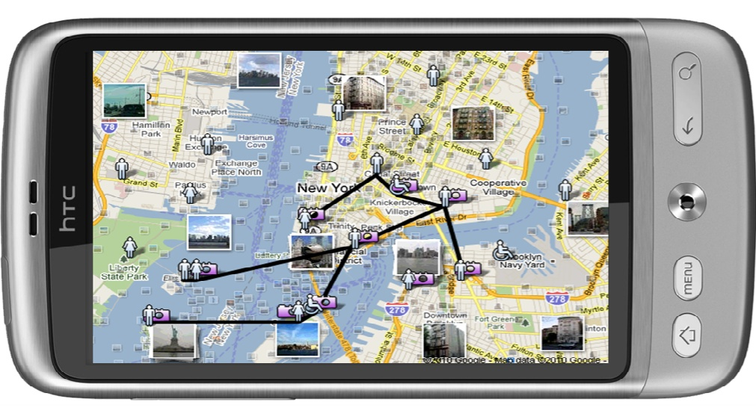
SmartOpt (under review)
Application: Smartphone Social Networks
  Data Disclosure Constraints (keep content local)
  Energy Constraints (WiFi / Bluetooth / 3G)
  Latency Constraints (get query answers quickly!)
We devise QRT structures based on a Multi-Objective Optimization algorithm.
Notes:
We have presented the design of MicroPulse that adapts the waking window of a sensing device.
We have experimented with real datasets that reveal that MicroPulse can reduce the cost of the waking window by three orders of magnitude.
In the future we intend to study the effect of collisions in query routing trees and devise efficient methods of avoiding this.

Slide 49
Query Routing Trees in Wireless Sensor Networks
Demetris Zeinalipour, Lecturer
Data Management Systems Laboratory (DMSL)
Department of Computer Science
University of Cyprus
Thanks!
EPL671: Research Methodologies in Computer Science,
Graduate Course, Tuesday, Feb 14th, 2011.
http://www.cs.ucy.ac.cy/~dzeina/

