Slide 1
MINT Views:
Materialized In-Network Top-k Views in Sensor Networks
Demetrios Zeinalipour-Yazti (Uni. of Cyprus)
Panayiotis Andreou (Uni. of Cyprus)
Panos Chrysanthis (Uni. of Pittsburgh, USA)
George Samaras (Uni. of Cyprus)
http://www.cs.ucy.ac.cy/~dzeina/
MDM 2007 © Zeinalipour-Yazti, Andreou, Chrysanthis, Samaras

Slide 2
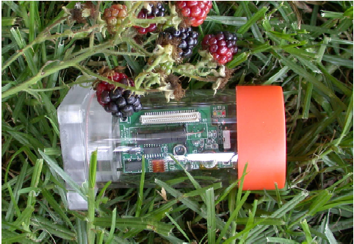

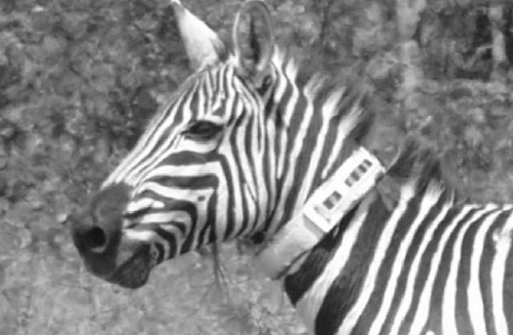
Wireless Sensor Networks
Resource constrained devices utilized for monitoring and understanding the physical world at a high fidelity.
Applications have already emerged in:
  Environmental and habitant monitoring
  Seismic and Structural monitoring
  Understanding Animal Migrations & Interactions between species.
Great Duck Island – Maine (Temperature, Humidity etc).
Golden Gate – SF, Vibration and Displacement of the bridge structure
Zebranet (Kenya) GPS trajectory

Slide 3

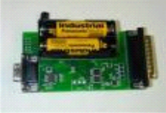
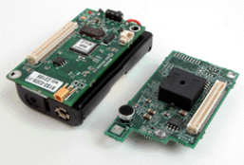



Wireless Sensor Networks
Distributed Sensing of the environment.
Hierarchical Transfer of readings to the sink.
Sink

Slide 4
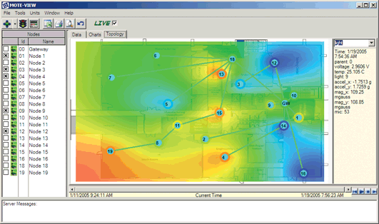
Coarse Data Acquisition
Out-of-Network computation (at the sink)
  No in-network Aggregation
  No in-Network Filtering
Example: Crossbow’s Moteview software
Drawback
Retrieving every single reading
➔ too coarse and too energy demanding
Available at: http://www.xbow.com/

Slide 5
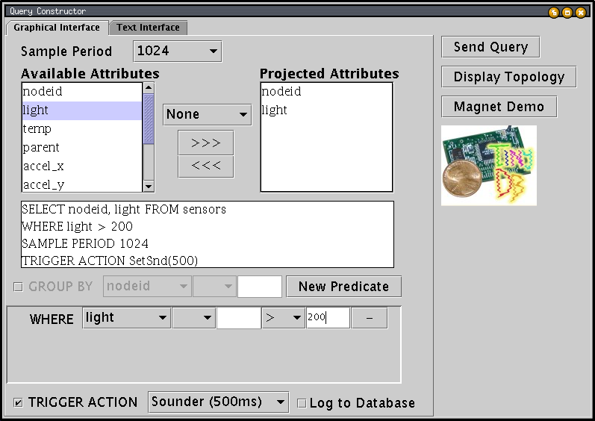
In-Network Computation
In-Network Aggregation
In-Network Filtering (i.e., WHERE clause)
Example: TinyDB: A Declarative Interface for Data Acquisition in Sensor Networks.
Drawback
The Answer set might be very large (e.g. temp>70)
Available at: http://telegraph.cs.berkeley.edu/tinydb/

Slide 6
Top-K Queries
Example:
    SELECT room, Avg(temp)
    FROM sensors
    GROUP BY room
    EPOCH DURATION 1 min
Goal: Trade the number of answers with the execution cost, i.e.,
  Return less results (K<<n tuples)
  Minimize retrieval cost (i.e., disk I/Os, network I/Os, CPU etc).
TOP-K

Slide 7
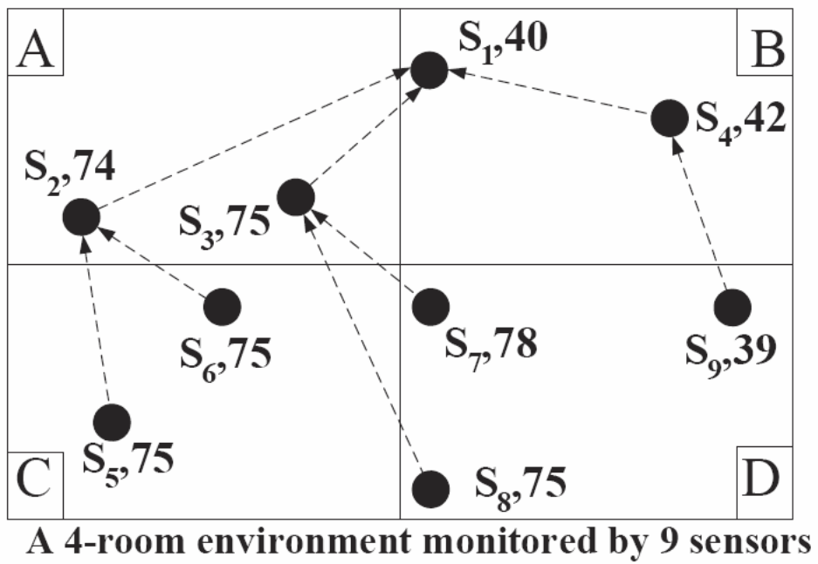
Centralized Top-K Pruning
Example: Four rooms {A,B,C,D}, 9 sensors {s1,…,s9}
Query (Q): Find the room with the highest average temperature (TOP-1)
Answer
C, 75F
A, 74,5F
D, 64F
B, 41F
Avg:74.5
S0
Avg:41
Avg:64
Avg:75
Drawback: No energy savings!

Slide 8
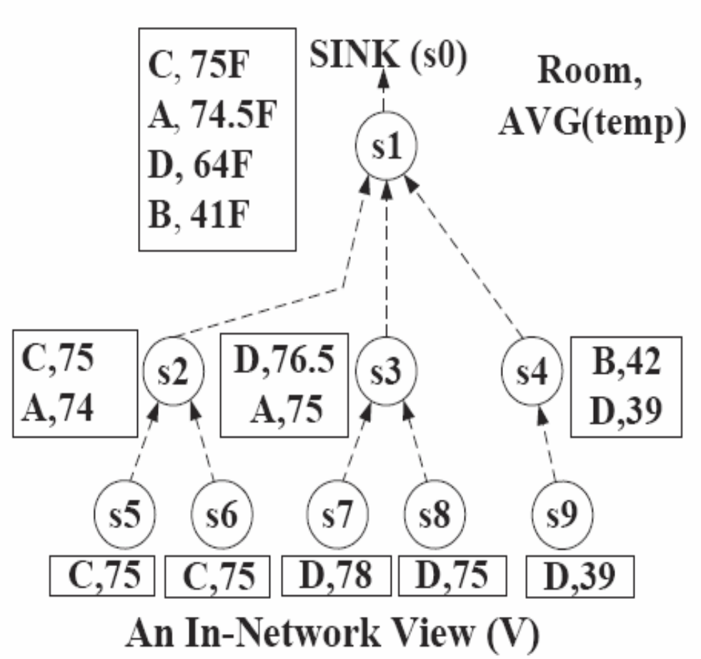
Naïve In-Network Top-K Pruning
Each node eliminates any tuple with a score lower than its top-1 result.
D,76.5
C,75
B,41
Drawback:
We received a incorrect answer i.e. (D,76.5) instead of (C,75).
This happens because we eliminated (D,39) that would have changed the result.
(B,40)

Slide 9
Our Approach
Design and Implement framework that enables:
  In-Network Aggregation
  In-Network Filtering (i.e., WHERE clause)
  In-Network Top-K Pruning
Problem - Challenges
  Determine Correct Top-K Results
  Continuous Top-K Execution
  Energy Constraints

Slide 10
Presentation Outline
Introduction and Motivation
Materialized In-Network Top-K Views
  Construction Phase
  Pruning Phase
  Maintenance Phase
Experimentation
Conclusions & Future Work

Slide 11
MINT Framework
The MINT Framework works in three phases:
  Creation Phase: Executed during the first acquisition of readings which results in n distributed views , V_{i} (i<=n)
  Pruning Phase: Each sensor s_{i} locally prunes V_{i} and generates V_{i}‘ (⊆ V_{i}).
  C) Update Phase: Executed once per epoch, during which s_{i} updates its parent with V_{i}‘.

Slide 12
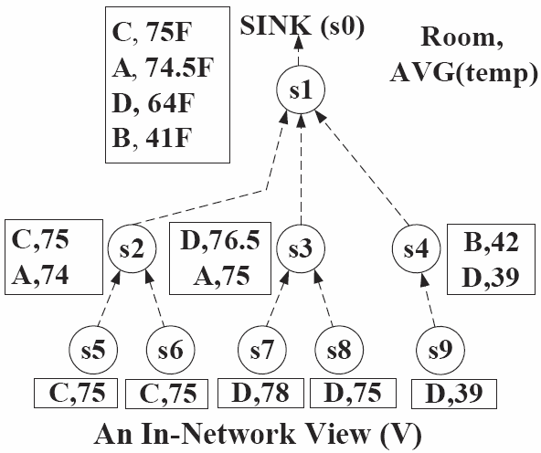
MINT: Creation Phase
Execute Q locally
Aggregate the result with the Query Answers from children.
This generates a local View V_{i} .
V₁
V₂
V₄
V₅
V₉

Slide 13
MINT: Pruning Phase
Each sensor node s_{i} now locally prunes V_{i} and generates V_{i}‘ (⊆ V_{i}).
Problem: Each s_{i} needs to know which tuples will be required by its parent.
  Recall the elimination of (D,39) that lead to wrong answer at the sink.

Slide 14
MINT: Pruning Phase
Pruning Algorithm Outline
  Bounding Step: Locally Bound (above) each tuple in V_{i} with its maximum possible value.
  Elimination Step: Prune away any tuple in V_{i} that can not be among the K highest-ranked answers.

Slide 15
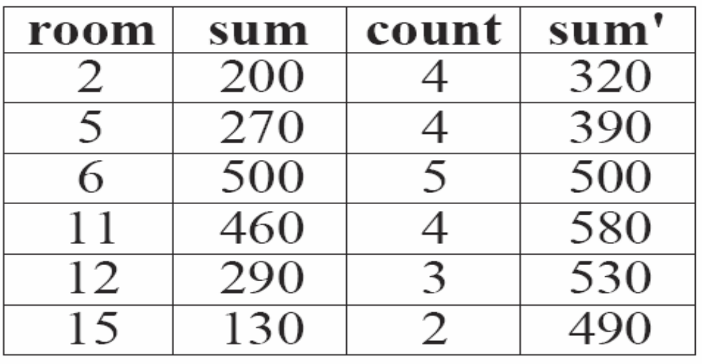
MINT: Pruning Phase
Bounding Step
s_{i} maintains a list of (room,sum) tuples.
s_{i} knows some meta-information about the network, e.g.,
  γ1 = «max possible temperature» = 120, and
  γ2 = «sensors in each room» = 5.
sum’ is an upper bound for sum
V_{i}
sum’=sum+(γ2-count)*γ1

Slide 16
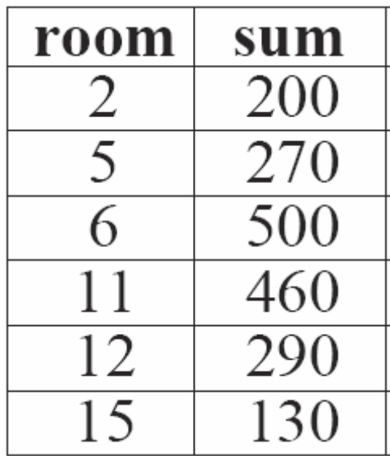
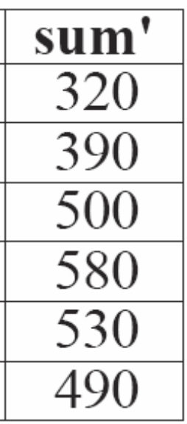
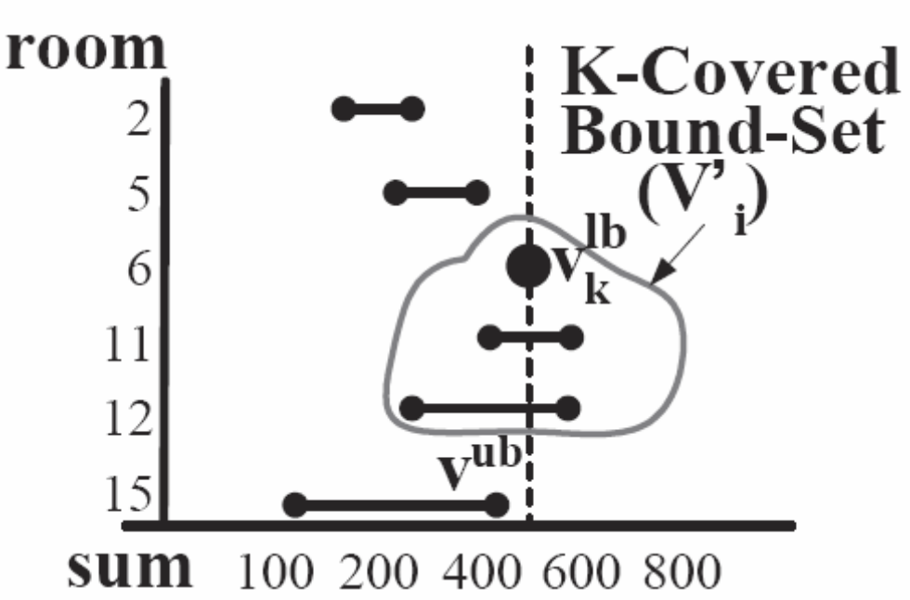
MINT: Pruning Phase
Elimination Step
Prune-away any tuple outside the K-covered-bound set.
K-covered Bound-set (V_{i}’): Includes all the tuples which have an upper bound (v^{ub}) greater or equal to the kth highest lower bound (v_{k}^{lb} ), i.e., v^{ub}>=v_{k}^{lb}
The running time of the pruning algorithm is O(|Vi|)

Slide 17
MINT: Update Phase
We assumed so far that each s_{i} is state-less (it does not remember the V_{i} of the previous time chronon).
This defines an INT View that is appropriate for devices with limited SRAM or FLASH storage.
Now assume that we have adequate space to store the V_{i} of the previous chronon, as PV_{i}.

Slide 18
MINT: Update Phase
Core idea of the update phase:
“Utilize PV_{i} in order to update the parent’s View”
Update cases:
a)
ignore
b)
Tuple update
c)
v_{k}^{lb}
Vi’ update

Slide 19
Presentation Outline
Introduction and Motivation
Materialized In-Network Top-K Views
  Construction Phase
  Pruning Phase
  Maintenance Phase
Experimentation
Conclusions & Future Work

Slide 20
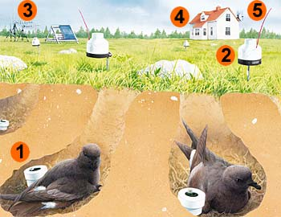
ΜΙΝΤ Views: Experimentation
Datasets:
  Great Duck Island (GDI):
    14 sensors deployed on the Great Duck Island (Maine) in 2002.
    Sensors: Temperature, Light, Humidity, Voltage...
  Washington State Climate (Atmomon):
    32 sensors deployed in Washington and Oregon for 208 days in (2003-2004).
    Sensors: Temperature and Wind speed.
Notes:
Focuses on monitoring microclimate in and around the nests of endangered species which are sensitive to disturbance.
Large-Scale deployment by Intel Research, Berkeley in 2002-2003 (Maine USA).
They deployed more than 166 motes installed in remote locations (such as 1000 feets in the forest)

Slide 21
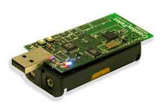
ΜΙΝΤ Views: Experimentation
Sensing Device
  We utilize the energy model of Crossbow’s TELOSB Sensor (250Kbps, RF On: 23mA)
  Trace-driven experimentation using Energy = Volts x Amperes x Seconds.
Query:
    SELECT TOP-K area, Avg(temp)
    FROM sensors GROUP BY area
    EPOCH DURATION 1 min

Slide 22
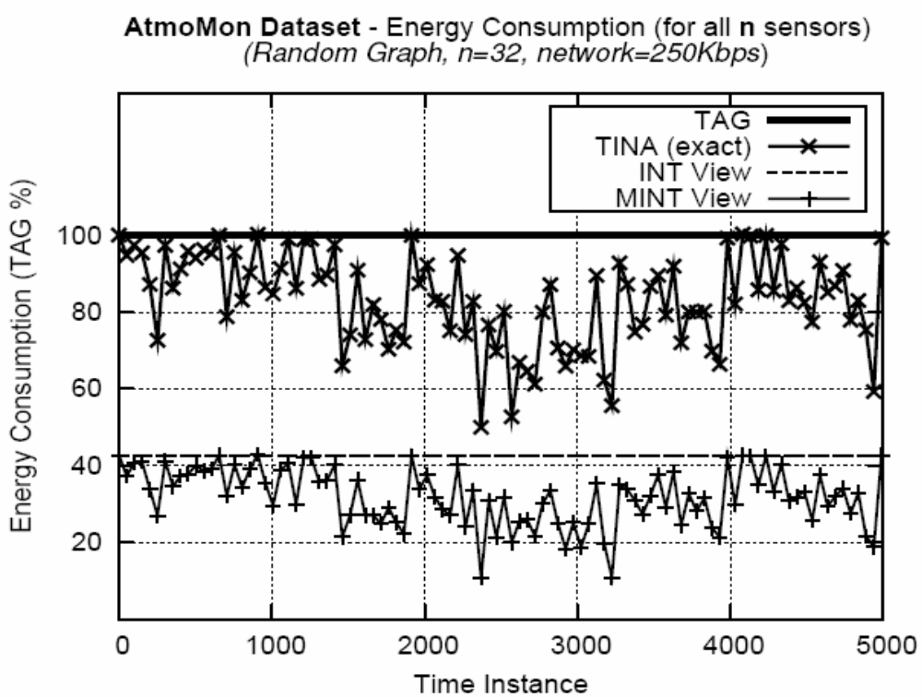
Energy Consumption
Atmomon Dataset
100%
83%
42%
32%
Notes:
Due to the exploitation of temporal coherence in the TINA and MINTS Views, the energy between consecutive time instances can greatly vary. In order to facilitate our presentation, we apply a spline interpolation smoothing between consecutive data points which accurately approximates the TINA and MINT curves.

Slide 23
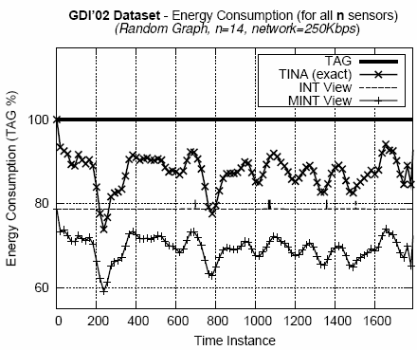
Energy Consumption
Great Duck Island Dataset
100%
87%
Surges
78%
70%
Top-k Pruning is less efficient for shallow query acquisition trees
(depth=3 with 14 nodes).

Slide 24
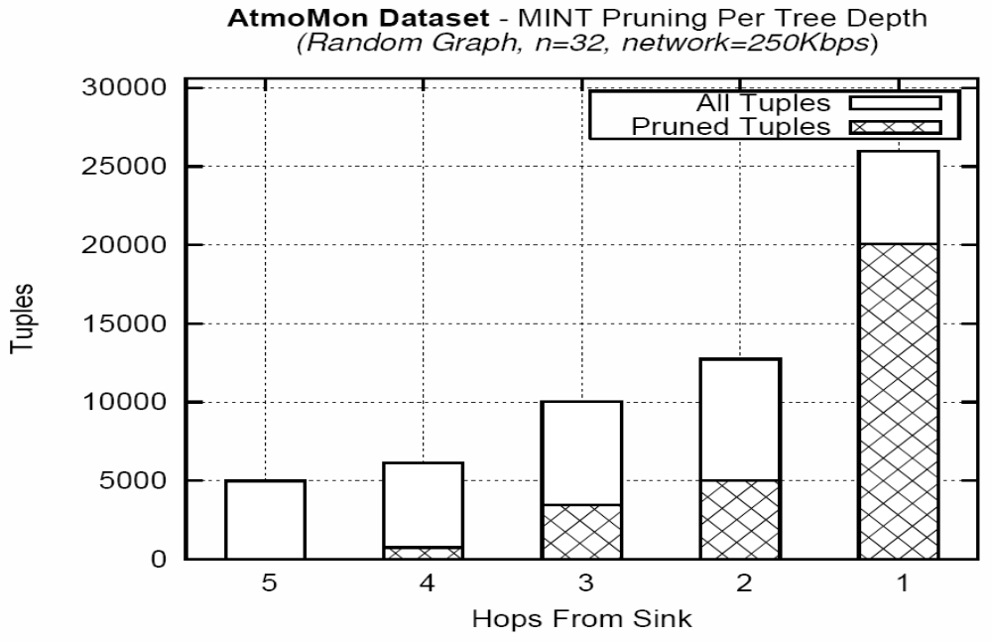
Pruning Magnitude (at each level)
Atmomon Dataset
77%
39%
34%
0%
12%
MINT eliminates 48% of the tuples.(29K / 60K).
Nodes closer to sink eliminate more tuples.

Slide 25
Presentation Outline
Introduction and Motivation
Materialized In-Network Top-K Views
  Construction Phase
  Pruning Phase
  Maintenance Phase
Experimentation
Conclusions & Future Work

Slide 26
Conclusions
We have presented MINT, a new framework for the execution of continuous queries in WSN.
We devised efficient Construction, Pruning and Maintenance for such In-Network Views.
Experimentation reveals that MINT can be the premise for energy efficiency in WSN.

Slide 27
Future Work
We are currently implementing a nesC prototype of the MINT View Framework.
Deferred View Maintenance: instead of updating the view on each change, propagate changes periodically (after a certain number of changes or randomly).

Slide 28
MINT Views:
Materialized In-Network Top-k Views in Sensor Networks
Thank you!
Questions?
This presentation is available at:
http://www.cs.ucy.ac.cy/~dzeina/talks.html
Related Publications available at:
http://www.cs.ucy.ac.cy/~dzeina/publications.html
MDM 2007 © Zeinalipour-Yazti, Andreou, Chrysanthis, Samaras

