Slide 1

Identifying Failures in Grids through Monitoring and Ranking
Demetris Zeinalipour
Open University of Cyprus
Kyriacos Neocleous, Chryssis Georgiou, Marios D. Dikaiakos University of Cyprus
Adaptive Grid Computing workshop,
IEEE NCA 2008
July 12

Slide 2
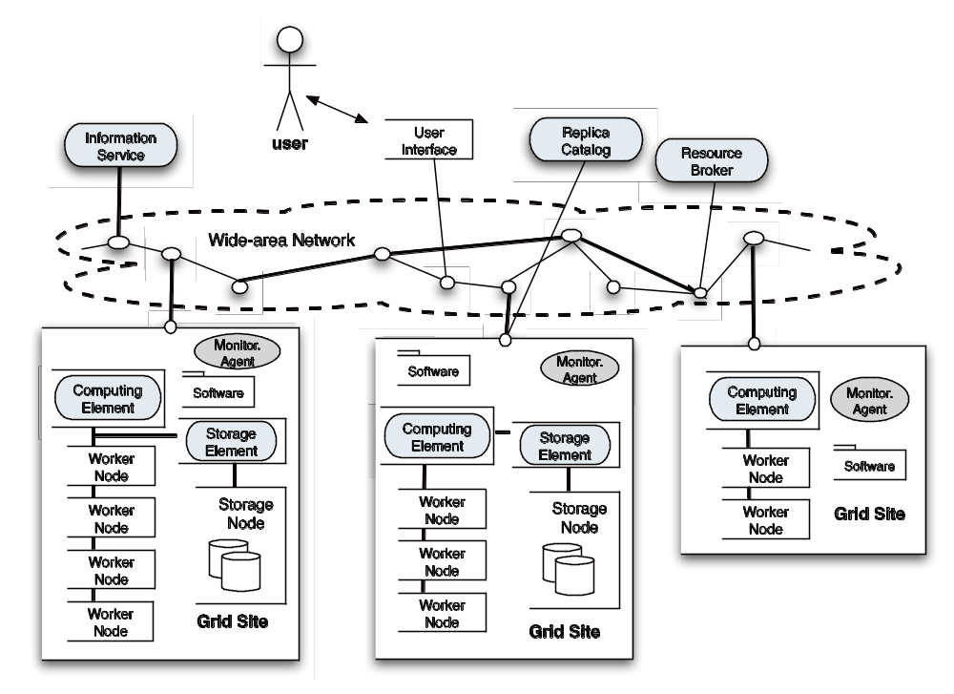
Anatomy of the Grid
(WMS)

Slide 3
Motivation
“Things tend to fail”
Examples
  The FlexX and Autodock challenges of the WISDOM¹ project (Aug’05) show that only 32% and 57% of the jobs exited with an “OK” status.
  Our group conducted a 9-month study² of the SEE-VO EGEE (Feb’06-Nov’06) and found that only 48% of the jobs completed successfully.
Our goal: A Dependable Grid
  Extremely complex task that currently relies on over-provisioning of resources, ad-hoc monitoring and user intervention.
  ¹ http://wisdom.eu-egee.fr/
  ² DaCosta, Dikaiakos, Orlando. Nine months in the life of EGEE: a look from the South, IEEE MASCOTS 2007
Notes:
WISDOM initiative aims to demonstrate the relevance and the impact of the grid approach to address drug discovery for neglected and emergent diseases.

Slide 4
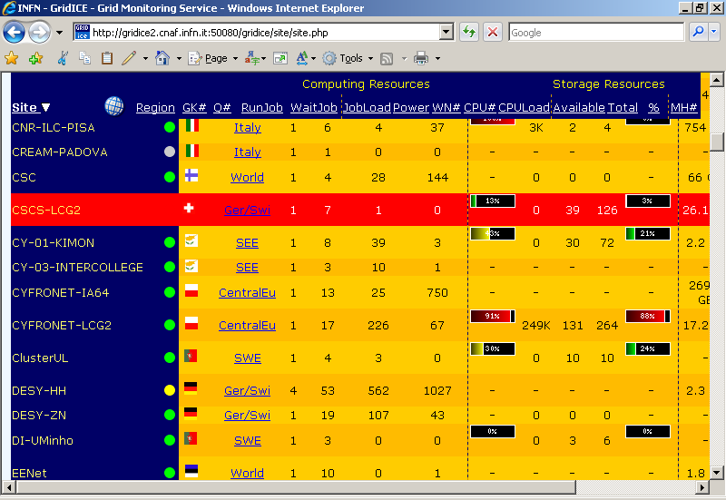
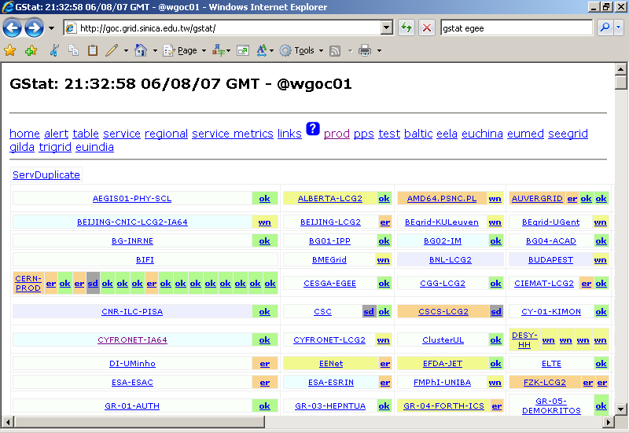
Solutions?
To make the Grid dependable we have to efficiently manage failures.
Grid monitoring for failures is currently conducted through several monitoring sites
GridICE: http://gridice2.cnaf.infn.it:50080/gridice/site/site.php
GStat: http://goc.grid.sinica.edu.tw/gstat/

Slide 5
Limitations
Limitations of Current Monitoring Systems
Require Human Monitoring and Intervention:
  This introduces Errors and Omissions
  Human Resources are very expensive
Reactive vs. Proactive Failure Prevention:
  Reactive: Administrators (might) reactively respond to important failure conditions.
  On the contrary, proactive prevention mechanisms could be utilized to identify failures and divert job submissions away from sites that will fail.
OUR OBJECTIVE!!!

Slide 6
Our Approach: FailRank
A new framework for automated failure management in very large and complex environments such as Grids.
FailRank Outline:
  Integrate & Rank, the failure-related information from monitoring systems (e.g. GStat, GridICE, etc.)
  2. Identify Candidates, that have the highest potential to fail (based on the acquired info).
  3. (Temporarily) Exclude Candidates: from the pool of resources available to the Resource Broker (Workload Management System).

Slide 7
Presentation Outline
Motivation and Introduction
The FailRank Architecture
The FailBase Repository
Experimental Evaluation
Conclusions & Future Work

Slide 8
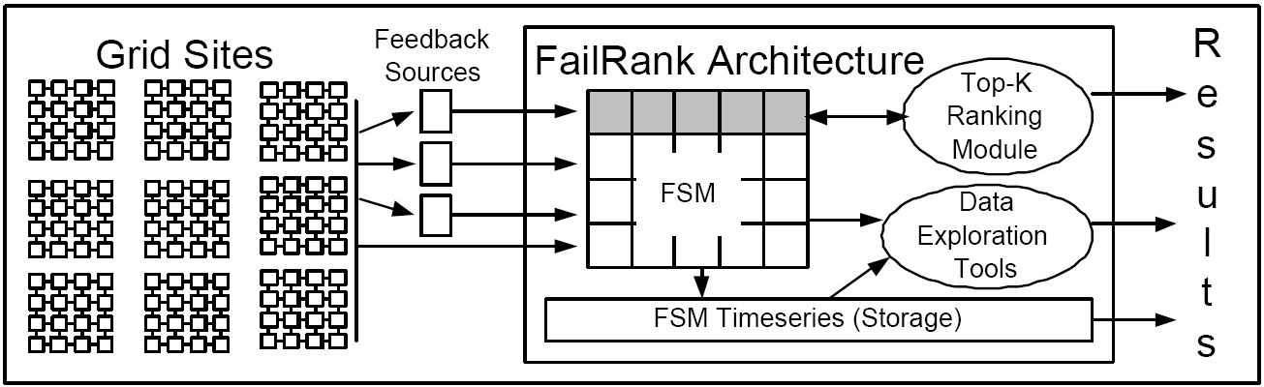
FailRank Architecture
Grid Sites:
i) report statistics to the Feedback sources;
ii) allow the execution of micro-benchmarks that reveal the performance characteristics of a site.

Slide 9
FailRank Architecture
Feedback Sources (Monitoring Systems) Examples:
Information Index LDAP Queries: grid status at a fine granularity.
Service Availability Monitoring (SAM): periodic test jobs.
Grid Statistics: by sites such as GStat and GridICE
Network Tomography Data: obtained through pinging and tracerouting.
Active Benchmarking: Low level probes using tools such as GridBench, DiPerf, etc
etc.
Notes:
Global Grid User Support (GGUS): ticketing system used to report component failures and site-related updates.
CIC broadcasts: site managers report down time events through the CIC site.

Slide 10
FailRank Architecture
FailShot Matrix (FSM): A Snapshot of all failure-related parameters at a given timestamp.
Top-K Ranking Module: Efficiently finds the K sites with the highest potential to feature a failure by utilizing FSM.
Data Exploration Tools: Offline tools used for exploratory data analysis, learning and prediction by utilizing FSM.

Slide 11
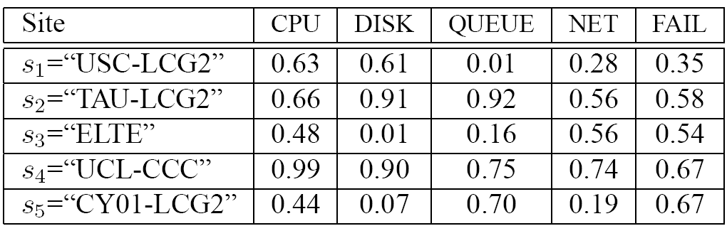
The Failshot Matrix
The FailShot Matrix (FSM) integrates the failure information, available in a variety of formats and sources, into a representative array of numeric vectors.
The Failbase Repository we developed contains 75 attributes (from 5 feedback sources) and 2,500 sites.

Slide 12
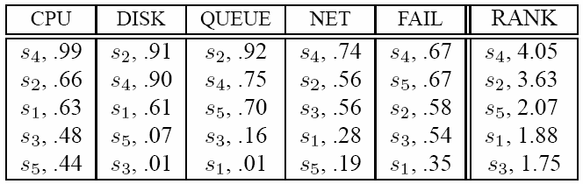
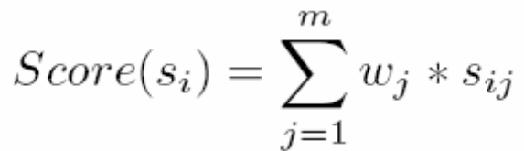
The Top-K Ranking Module
Objective: To continuously rank the FSM Matrix and identify the K highest-ranked sites that will feature an error.
TOP-K
Scoring Function: combines the individual attributes to generate a score per site
e.g., w_{CPU}=0.1, w_{DISK}=0.2, w_{QUEUE}=0.1, w_{NET}=0.2 , w_{FAIL}=0.4

Slide 13
Presentation Outline
Introduction and Motivation
The FailRank Architecture
The FailBase Repository
Experimental Evaluation
Conclusions & Future Work

Slide 14
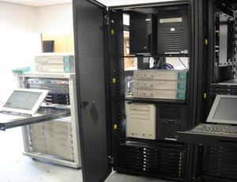
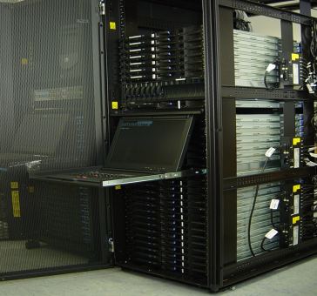

The FailBase Repository
A 38GB corpus of feedback information that characterizes EGEE for one month in 2007.
Paves the way to systematically study and uncover new, previously unknown, knowledge from the EGEE operation.
Trace Interval: March 16th – April 17th, 2007
Size: 2,565 sites.
Testbed: Dual Xeon 2.4GHz, 1GB RAM connected to GEANT at 155Mbps.

Slide 15
Presentation Outline
Introduction and Motivation
The FailRank Architecture
The FailBase Repository
Experimental Evaluation
Conclusions & Future Work

Slide 16

Experimental Methodology
We utilize a trace-driven simulator that utilizes 197 sites of the FailBase repository for 32 days.
At each chronon (time step) we identify:
  Top-K sites that might fail (denoted as I_{set})
  Top-K sites that have failed (denoted as R_{set}), derived through the SAM tests.
We then measure the Penalty:
i.e., the number of sites that were not identified as failing sites but failed.
R_{set}
I_{set}

Slide 17
Experiment 1: Evaluating FailRank
Task: “At each chronon identify the K=20 (~8%) of the sites that might fail”
Evaluation Strategies
  FailRank Selection: Utilize the FSM matrix in order to determine which sites have to be eliminated.
  Random Selection: Choose the sites that have to be eliminated at random.

Slide 18
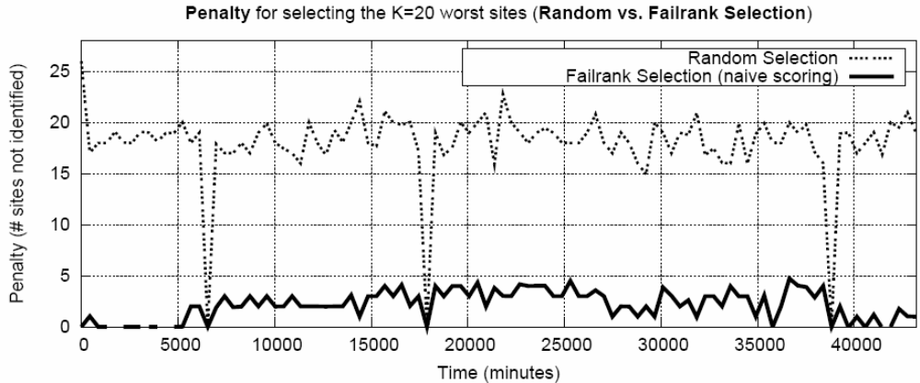
Experiment 1: Evaluating FailRank
~18.19
~2.14
Naïve scoring: ∀j, w_{j}=1/m, m: # of attributes
FailRank misses failing sites in 9% of the cases while Random in 91% of the cases (20 is 100%)

Slide 19
Experiment 2: the Scoring Function
Question: “Can we decrease the penalty even further by adjusting the scoring weights?”.
Instead of using Naïve Scoring, use different weights for individual attributes.
  e.g.,w_{CPU}=0.1, w_{DISK}=0.2, w_{QUEUE}= 0.1, w_{NET}=0.2, w_{FAIL}=0.4
Methodology: We requested from our administrators to provide us with indicative weights for each attribute: Expert Scoring

Slide 20
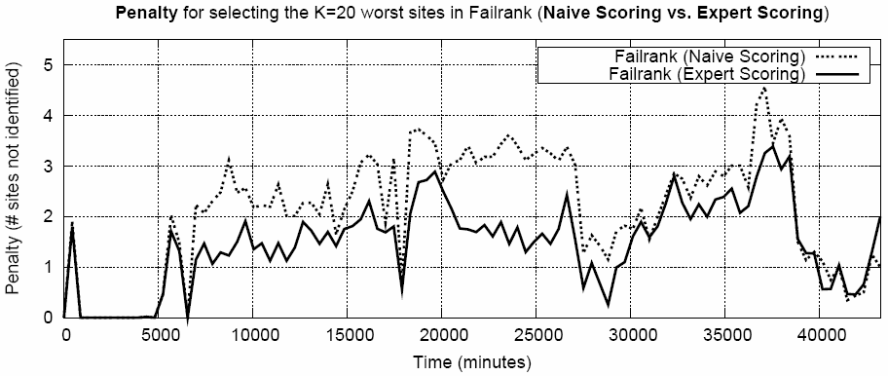
Experiment 2: Scoring Function
~2.14
~1.48
Expert scoring misses failing sites in only 7.4% of the cases while Naïve scoring in 9% of the cases

Slide 21
Ongoing/Future Work
Minimize the number of attributes required to compute the K highest ranked sites.
  − Vertical and horizontal pruning
Study the trade-offs of different K and different scoring functions.
Develop and deploy a real prototype of the FailRank system.
  Objective: Validate that the FailRank concept can be beneficial in a real environment.

Slide 22


Slide 23
Appendix

Slide 24
Problem Definition
Can we coalesce information from monitoring systems to create some useful knowledge that can be exploited for:
  Online Applications: e.g.
    Predicting Failures.
    Subsequently improve job scheduling.
  Offline Applications : e.g.
    Finding Interesting Rules (e.g. whenever the Disk Pool Manager then cy-01-kimon and cy-03-intercollege fail as well).
    Timeseries Similarity Search (e.g. which attribute (disk util., waitingjobs, etc) is similar to the CPU util. for a given site).

Slide 25
Experiment 2: the Scoring Function
Expert Scoring Advantages
  Fine-grained (compared to Random strategy).
  Significantly reduces the Penalty.
Expert Scoring Disadvantages
  Requires Manual Tuning.
  Doesn’t provide the optimal assignment of weights.
  Shifting conditions might deteriorate the importance of the initially identified weights.
Future Work: Automatically tune the weights

Slide 26
Conclusions
We have presented FailRank, a new framework for integrating and ranking information sources that characterize failures in a Grid framework.
We have also presented the structure of the Failbase Repository.
Experimenting with FailRank has shown that it can accurately identify the sites that will fail in 91% of the cases

Slide 27
Presentation Outline
Introduction and Motivation
The FailRank Architecture
The FailBase Repository
Experimental Evaluation
Conclusions & Future Work

