Slide 1

Semantic Challenges in (Mobile) Sensor Networks
Demetris Zeinalipour
Department of Computer Science
University of Cyprus, Cyprus
Dagstuhl Seminar 10042: Semantic Challenges in Sensor
Networks, Dagstuhl, Germany, 24 Jan. – 29 Jan. 2010.
http://www.cs.ucy.ac.cy/~dzeina/

Slide 2
Talk Objective
Provide an overview and definitions of Mobile-Sensor-Network (MSN) related platforms and applications.
Outline some Semantic and Other Challenges that arise in this context.
Expose some of my research activities at a high level.

Slide 3
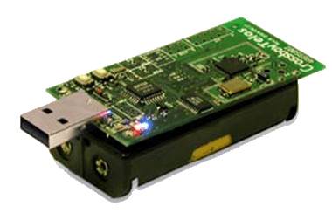


Wireless Sensor Networks (WSNs)
Resource constrained devices utilized for monitoring and studying the physical world at a high fidelity.

Slide 4
What is a Mobile Sensor Network (MSN)?
MSN Definition*: A collection of sensing devices that moves in space over time.
  Generates spatio-temporal records
  (x [,y] [,z] ,time [,other])
  Word of Caution: The broadness of the definition captures the different domains that will be founded on MSNs.
So let us overview some instances of MSNs before proceeding to challenges.
* "Mobile Sensor Network Data Management“, D. Zeinalipour-Yazti, P.K. Chrysanthis, Encyclopedia of Database Systems (EDBS), Editors: Ozsu, M. Tamer; Liu, Ling (Eds.), ISBN: 978-0-387-49616-0, 2009.

Slide 5
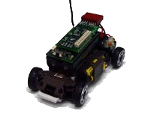
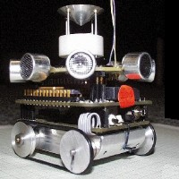
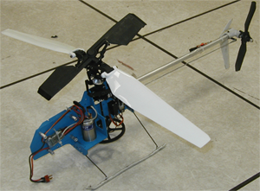
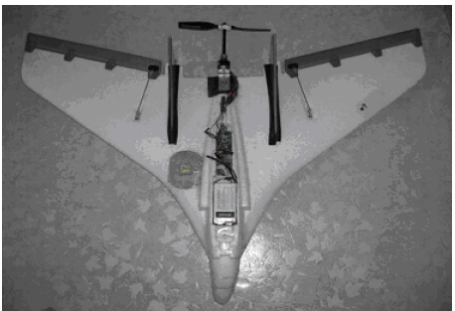
MSNs Type 1: Robots with Sensors
Type 1: Successors of Stationary WSNs.
Artifacts created by the distributed robotics and low power embedded systems areas.
Characteristics
Small-sized, wireless-capable, energy-sensitive, as their stationary counterparts.
Feature explicit (e.g., motor) or implicit (sea/air current) mechanisms that enable movement.
LittleHelis (USC)
SensorFlock (U of Colorado Boulder)
MilliBots (CMU)
CotsBots (UC-Berkeley)

Slide 6
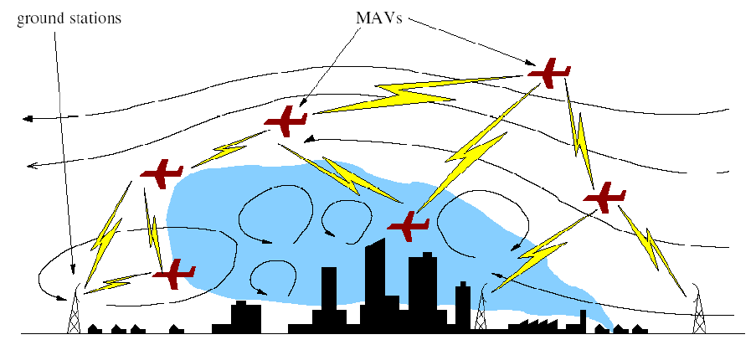
MSN Type 1: Examples
Example: Chemical Dispersion Sampling
Identify the existence of toxic plumes.
Micro Air Vehicles (UAV – Unmanned Aerial Vehicles)
Ground Station
Graphic courtesy of: J. Allred et al. "SensorFlock: An Airborne Wireless Sensor Network of Micro-Air Vehicles", In ACM SenSys 2007.

Slide 7

MSN Type 1: Examples
SenseSwarm: A new framework where data acquisition is scheduled at perimeter sensors and storage at core nodes.
  PA Algorithm for finding the perimeter
  DRA/HDRA Data Replication Algorithms
s6
s4
s5
s7
s2
s3
s8
s1
In our recent work: "Perimeter-Based Data Replication and Aggregation in Mobile Sensor Networks'', Andreou et. al., In MDM’09.

Slide 8
MSN Type 1: Advantages
Advantages of MSNs
Controlled Mobility
  Can recover network connectivity.
  Can eliminate expensive overlay links.
Focused Sampling
  Change sampling rate based on spatial location (i.e., move closer to the physical phenomenon).

Slide 9

MSN Type 2: Smartphones
Type 2: Smartphones, the successors of our dummy cell phones …
  Mobile:
    The owner of the smart-phone is moving!
  Sensor:
    Proximity Sensor (turn off display when getting close to ear)
    Ambient Light Detector (Brighten display when in sunlight)
    Accelerometer (identify rotation and digital compass)
    Camera, Microphone, Geo-location based on GPS, WIFI, Cellular Towers,…
  Network:
    Bluetooth: Peer-to-Peer applications / services
    WLAN, WCDMA/UMTS(3G) / HSPA(3.5G): broadband access.

Slide 10


MSN Type 2: Smartphones
Type 2: Smartphones, the successors of our dummy cell phones …
  Actuators: Notification Light, Speaker.
  Programming Capabilities on top of Linux OSes: OHA’s Android (Google), Nokia’s Maemo OS, Apple’s OSX, …

Slide 11
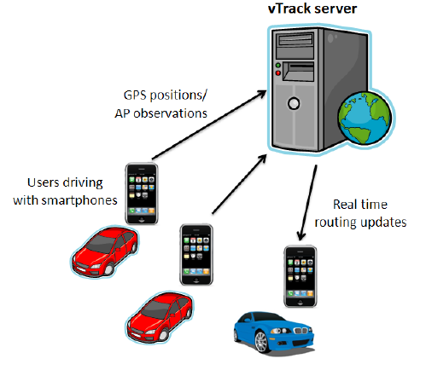
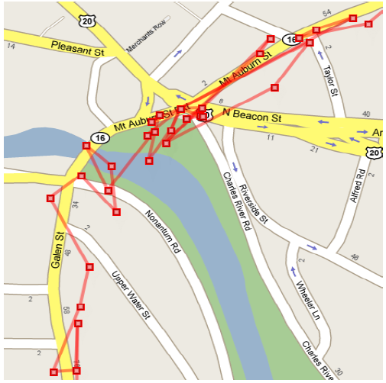
MSN Type 2: Examples
Intelligent Transportation Systems with VTrack
Better manage traffic by estimating roads taken by users using WiFi beams (instead of GPS) .
Graphics courtesy of: A .Thiagarajan et. al. “Vtrack: Accurate, Energy-Aware Road Traffic Delay Estimation using Mobile Phones, In Sensys’09, pages 85-98. ACM, (Best Paper) MIT’s CarTel Group

Slide 12
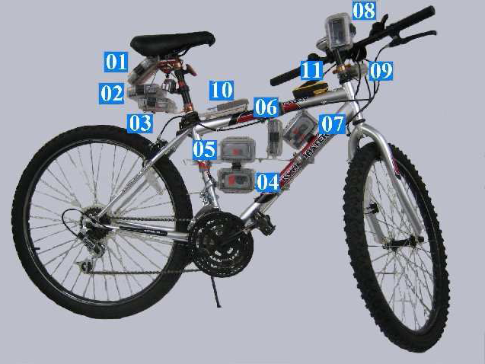
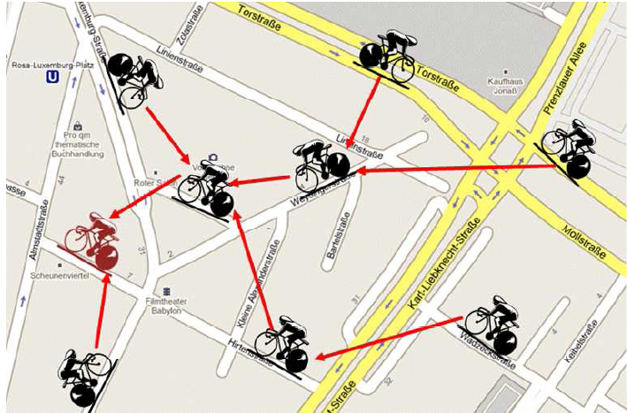
MSN Type 2: Examples
BikeNet: Mobile Sensing for Cyclists.
Real-time Social Networking of the cycling community (e.g., find routes with low CO2 levels)
Left Graphic courtesy of: S. B. Eisenman et. al., "The BikeNet Mobile Sensing System for Cyclist Experience Mapping", In Sensys'07 (Dartmouth’s MetroSense Group)

Slide 13
MSN Type 2: Examples
Mobile Sensor Network Platforms
SensorPlanet*: Nokia’s mobile device-centric large-scale Wireless Sensor Networks initiative.
Underlying Idea:
  Participating universities (MIT’s CarTel, Dartmouth’s MetroSense,etc) develop their applications and share the collected data for research on data analysis and mining, visualization, machine learning, etc.
  Manhattan Story Mashup**: An game where 150 players on the Web interacted with 183 urban players in Manhattan in an image shooting/annotation game
    First large-scale experiment on mobile sensing.
http://www.sensorplanet.org/
V. Tuulos, J. Scheible and H. Nyholm, Combining Web, Mobile Phones and Public Displays in Large-Scale: Manhattan Story Mashup. Proc. of the 5th Intl. Conf. on Pervasive Computing, Toronto, Canada, May 2007

Slide 14


MSN Type 2: Examples
Other Types of MSNs?
Body Sensor Networks (e.g., Nike+): Sensor in shoes communicates with I-phone/I-pod to transmit the distance travelled, pace, or calories burned by the individual wearing the shoes.
Vehicular (Sensor) Networks (VANETs): Vehicles communicate via Inter-Vehicle and Vehicle-to-Roadside enabling Intelligent Transportation systems (traffic, etc.)

Slide 15



Semantic Challenges in (M)SNs
So, we can clearly observe an explosion in possible mobile sensing applications that will emerge in the future.
I will now present my viewpoint of what the Semantic Challenges in Mobile Sensor Networks are.
  Observation: Many of these challenges do also hold for Stationary Sensor Networks so I will use the term (M)SN rather than MSN.

Slide 16
Semantic Challenges: Vastness
A) Data Vastness and Uncertainty
  Web: ~48 billion pages that change “slowly”
  MSN: >1 billion handheld smart devices (including mobile phones and PDAs) by 2010 according to the Focal Point Group* while ITU estimated 4.1 billion mobile cellular subscriptions by the start of 2009.
  Think about these generating spatio-temporal data at regular intervals …
  This will become problematic even if individual domains have their own semantic worlds (ontologies, platforms, etc)
    * According to the same group, in 2010, sensors could number 1 trillion, complemented by 500 billion microprocessors, 2 billion smart devices (including appliances, machines and vehicles).

Slide 17
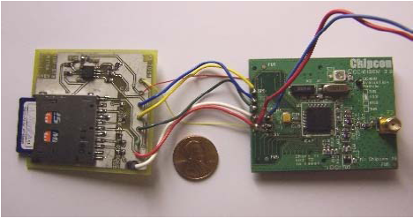
Semantic Challenges: Uncertainty
A) Data Vastness and Uncertainty
  A major reason for uncertainty in “real-time” applications is that sensors on the move are often disconnected from each other and or the base station.
  Thus, the global view of collected data is outdated…
  Additionally, that requires local storage techniques (on flash)
  "MicroHash: An Efficient Index Structure for Flash-Based Sensor Devices", D. Zeinalipour-Yazti et. al., In Usenix FAST’05.
  " Efficient Indexing Data Structures for Flash-Based Sensor Devices", S. Lin, et. al., ACM TOS, 2006

Slide 18
Semantic Challenges: Uncertainty
A) Data Vastness and Uncertainty
  Uncertainty is also inherent in MSNs due to the following more general problems of Sensor Networks:
  Integrating data from different Mobile Sensors might yield ambiguous situations (vagueness).
    e.g., Triangulated AP vs. GPS
  Faulty electronics on sensing devices might generate outliers and errors (inconsistency).
  Hacked sensor software might intentionally generate misleading information (deceit).
  ……

Slide 19
Semantic Challenges: Integration
B) Integration: Share domain-specific MSN data through some common information infrastructure for discovery, analysis, visualization, alerting, etc.
In Stationary WSNs we already have some prototypes (shown next) but no common agreement (representation, ontologies, query languages, etc.):
  James Reserve Observation System, UCLA
  Senseweb / Sensormap by Microsoft
  Semantic Sensor Web, Wright State

Slide 20
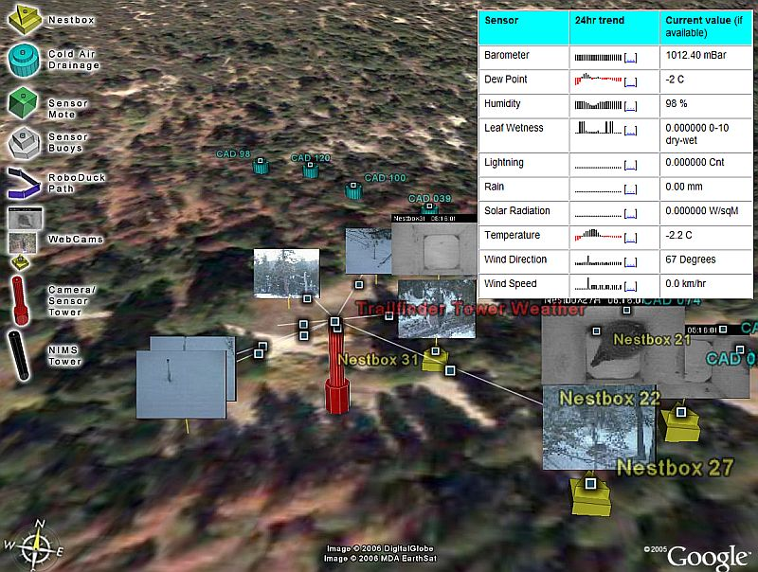
Semantic Challenges: Integration
The James Reserve Project, UCLA
Available at: http://dms.jamesreserve.edu/ (2005)

Slide 21
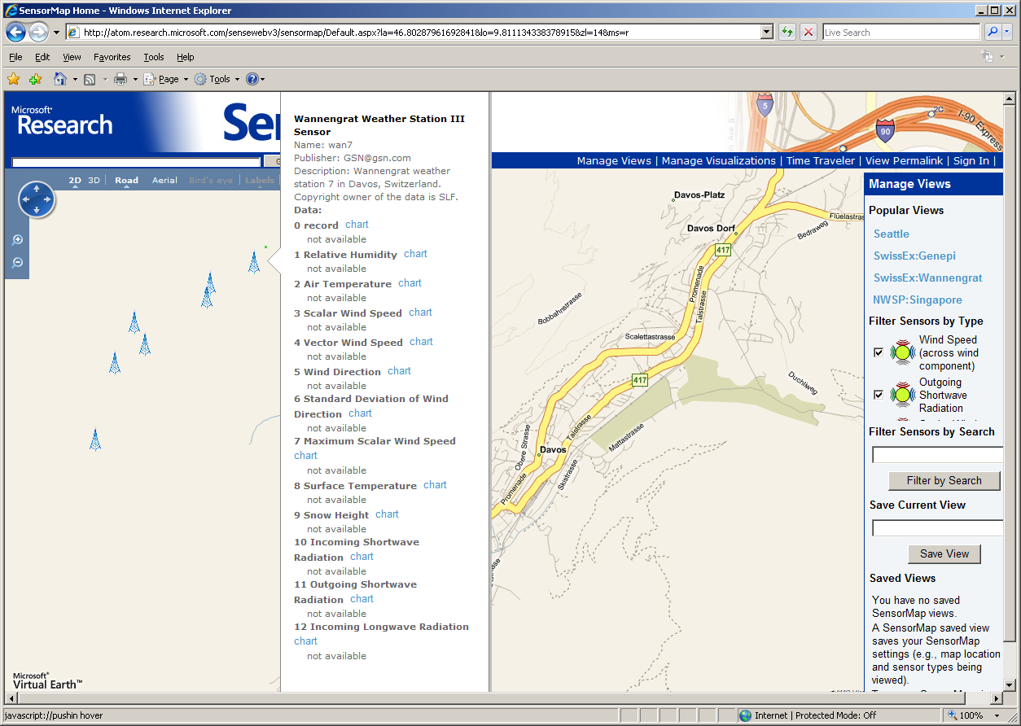
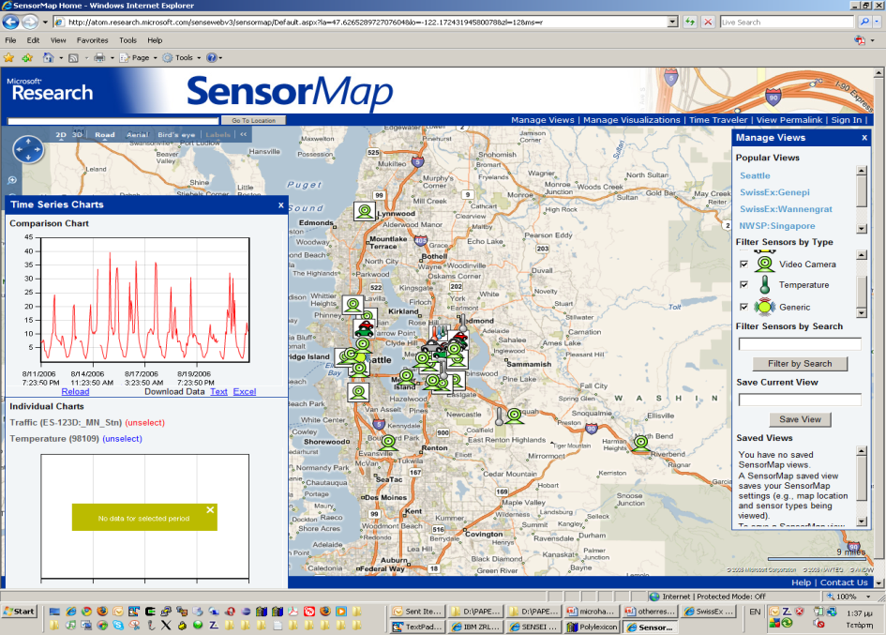
Semantic Challenges: Integration
Microsoft’s SenseWeb/SensorMap Technology
SenseWeb: A peer-produced sensor network that consists of sensors deployed by contributors across the globe
SensorMap: A mashup of SenseWeb’s data on a map interface
Swiss Experiment (SwissEx)
(6 sites on the Swiss Alps)
Chicago (Traffic, CCTV Cameras, Temperature, etc.)
Available at: http://research.microsoft.com/en-us/projects/senseweb/

Slide 22


Semantic Challenges: Integration
Sensor integration standards might play an important role towards the seamless integration of sensor data in the future.
  Candidate Specifications: OGC’s (Open Geospatial Consortium) Sensor Web Enablement WG.
  Open Source Implementations: 52 North’s Sensor Observation Service implementation.

Slide 23
Semantic Challenges: Query Processing
C) Query Processing: Effectively querying spatio-temporal data, calls for specialized query processing operators.
Spatio-Temporal Similarity Search: How can we find the K most similar trajectories to Q without pulling together all subsequences
``Distributed Spatio-Temporal Similarity Search’’, D. Zeinalipour-Yazti, et. al, In ACM CIKM’06.
"Finding the K Highest-Ranked Answers in a Distributed Network", D. Zeinalipour-Yazti et. al., Computer Networks, Elsevier, 2009.

Slide 24
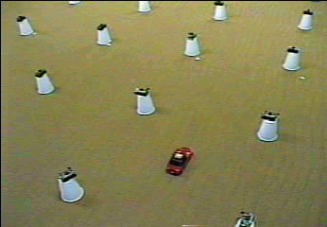
Semantic Challenges: Query Processing

Slide 25
Semantic Challenges: Query Processing
ST Similarity Search Challenges
  Flexible matching in time
  Flexible matching in space (ignores outliers)
  We used ideas based on LCSS
ignore majority of noise
match
match

Slide 26
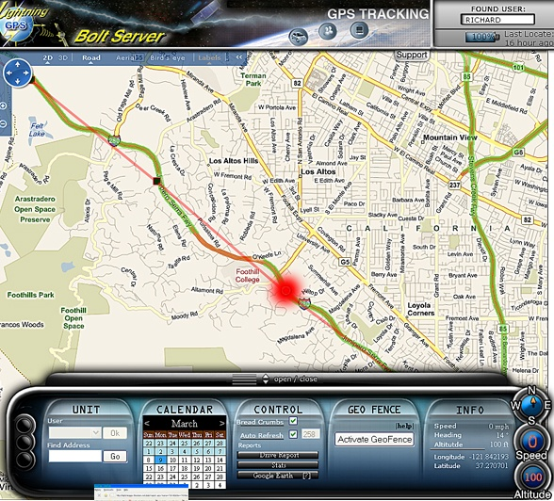
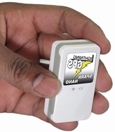
Semantic Challenges: Privacy
D) Privacy in (M)SNs:
…a huge topic that I will only touch with an example.
For Type-2 MSNs that creates a Big Brother society!
This battery-size GPS tracker allows you to track your children (i.e., off-the-shelf!) for their safety.
How if your institution/boss asks you to wear one for your safety?
Brickhousesecurity.com

Slide 27
Semantic Challenges: Testbeds
E) Evaluation Testbeds of MSN:
Currently, there are no testbeds for emulating and prototyping MSN applications and protocols at a large scale.
  MobNet project (at UCY 2010-2011), will develop an innovative hardware testbed of mobile sensor devices using Android
  Similar in scope to Harvard’s MoteLab, and EU’s WISEBED but with a greater focus on mobile sensors devices as the building block
    Application-driven spatial emulation.
    Develop MSN apps as a whole not individually.

Slide 28
Semantic Challenges: Others
E) Other Challenges for Semantic (M)SNs:
How/Where will users add meaning (meta-information) to the collected spatio-temporal data and in what form.
How/Where will Automated Reasoning and Inference take place and using what technologies.

Slide 29
Semantic Challenges: Architecture
E) Reference Architecture for Semantic MSN:
That might greatly assist the uptake of Semantic (M)SNs as it will improve collaboration and minimize duplication of effort.
  Provide the glue (API) between different layers (representation, annotation, ontologies, etc).
  Centralized, Cloud, In-Situ, combination ?
Reference Architecture
?

Slide 30
Semantic Challenges in (Mobile) Sensor Networks
Demetris Zeinalipour
Department of Computer Science
University of Cyprus, Cyprus
Thank you
Questions?
Dagstuhl Seminar 10042: Semantic Challenges in Sensor
Networks, Dagstuhl, Germany, 24 Jan. – 29 Jan. 2010.
http://www.cs.ucy.ac.cy/~dzeina/

