Slide 1
SenseSwarm: A Perimeter-based Data Acquisition Framework for Mobile Sensor Networks
Demetrios Zeinalipour-Yazti (Open Univ. of Cyprus)
Panayiotis Andreou (Univ. of Cyprus)
Panos K.Chrysanthis (Univ. of Pittsburgh, USA)
George Samaras (Univ. of Cyprus)
http://cs.ouc.ac.cy/~zeinalipour
DMSN 2007 (VLDB’07) © Zeinalipour-Yazti, Andreou, Chrysanthis, Samaras

Slide 2
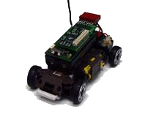
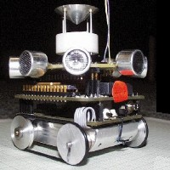
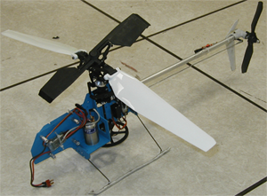
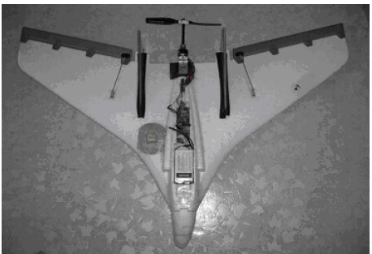
Mobile Sensors
Mobile Sensors
Artifacts created by the distributed robotics and low power embedded systems areas.
Characteristics
Large-scale, highly distributed and energy-sensitive, as their stationary counterparts.
Feature explicit (e.g., motor) or implicit (sea/air current) mechanisms which enable movement.
LittleHelis (USC)
SensorFlock (U of Colorado Boulder)
MilliBots (CMU)
CotsBots (UC-Berkeley)

Slide 3
Mobile Sensor Networks (MSNs)
What is a Mobile Sensor Network?
A new class of networks where small sensing devices move in space over time.
  Generate spatio-temporal records (x,y,t,other)
Advantages
Controlled Mobility
  Can recover network connectivity.
  Can eliminate expensive overlay links.
Focused Sampling
  Change sampling rate based on spatial location (i.e., move closer to the physical phenomenon).
Notes:
gliders

Slide 4
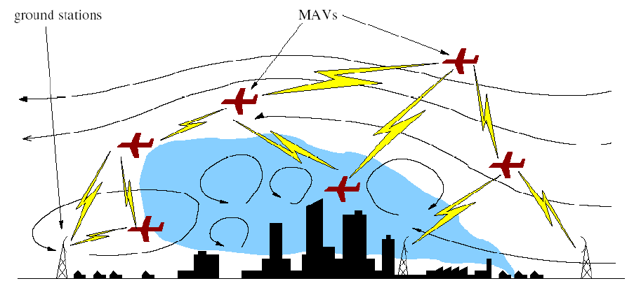
Applications of MSNs
Chemical Dispersion Sampling
Identify the existence of toxic plumes.
Ground Station
Micro Air Vehicles
Graphic courtesy of: J. Allred et al. "SensorFlock: An Airborne Wireless Sensor Network of Micro-Air Vehicles", In ACM SenSys 2007.
Notes:
The given paper actually enumerates some further interesting applications that become available in the 3rd dimension.

Slide 5
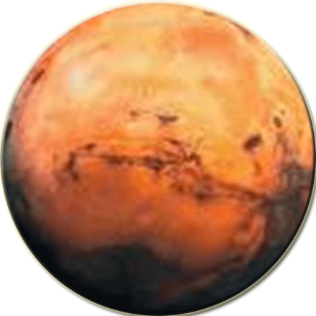


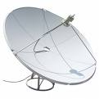

A Futuristic Application of MSNs
Mars Exploration: Find water on the red planet.
Solution: Mobile Sensor Networks
Potentially Cheaper
More Fault Tolerant
SINK
WATER
Failures
X
X
Queries Query 1: Has the MSN identified any water? Query 2: Where exactly?
MARS

Slide 6



Our Data/Querying Model
Queries are historic (the sink is usually OFF)
  Thus, results have to be stored in-network.
Sensor failures might happen frequently.
  Thus, replication techniques are adopted
New events are more likely on the perimeter
  e.g., the toxic plume example, identify oil-spills in oceans, etc., …
  Thus, schedule acquisition on the perimeter
MARS
SINK

Slide 7

Our Solution Outline
SenseSwarm: A new framework where data acquisition is scheduled at perimeter sensors and storage at core nodes.
s6
s4
s5
s7
s3
s2
s8
s1
Swarm (or Flock): a group of objects that exhibit a polarized, non-colliding and aggregate motion.

Slide 8
Presentation Outline
Motivation – Definitions
The SenseSwarm Framework
  Task 1: Perimeter Construction
  Task 2: Data Acquisition
  Task 3: Data Replication
  Task 4: Query Execution
Experimentation
Conclusions & Future Work

Slide 9
Task 1: Perimeter Construction
Problem:
How do we construct the perimeter for N sensors?
Centralized Perimeter Algorithm (CPA)
  Collect all sensor coordinates
Calculate Perimeter
Disseminate Perimeter
Disadvantage: Collecting all coordinates requires the transfer of O(N²) (x,y)-pairs – too expensive!

Slide 10
Task 1: Perimeter Construction
Our approach:
Construct the perimeter in a distributed manner.
Our Algorithm: Perimeter Algorithm (PA)
Find the sensor with the minimum y coordinate using TAG (denoted as s_{min}).
Inform s_{min} about this choice.
s_{min} initiates the recursive perimeter construction step using counterclockwise turns.
Left
s1
Right
s3
smin
Notes:
Difference from Convex Hull algorithms:
-These are centralized.
Convex hull considers only convex angles (up to π). Τwo popular algorithms are Jarvis March (or Gift wrapping): rotate a rope around a number of pegs (O(n^2)), Graham’s Scan O(nlogn): sort edges using quicksort.

Slide 11
Task 1: Perimeter Construction
=s1
Phase 1: Find s_{min} from a random sink
Phase 2: Disseminate s_{min}
Phase 3: Build the perimeter from s_{min}
s6
s4
s5
sink
s7
s3
s8
s2
s1
S_{min}

Slide 12
Task 1: Perimeter Construction
PA Message Complexity:
N: Number of nodes in the network
p: Number of nodes on the perimeter
Phase 1: Identify s_{min} ➔ O(N) messages.
Phase 2: Disseminate s_{min} ➔ O(N) messages
Phase 3: Construct Perimeter ➔ O(p) messages
Overall Message Complexity = O(N+p)
Notes:
Sink point is selected using the Round-Robin approach

Slide 13
Task 2: Data Acquisition
A) Data Acquisition takes place at the perimeter
Perimeter Nodes sample at high frequencies
Core Nodes are idle ➔ Energy Conservation
B) Events are buffered in-situ on the perimeter
s6
s4
s5
s7
s3
s2
s8
s1

Slide 14
Task 3: Data Replication
Why Replication?
Ensures that node failures will not subvert any detected events.
Outline: Perimeter Nodes perform k-hop flooding of aggregated Events to neighbors.
D=(4,5)
E=(10,10)
C=(3,4)
F
G
B=(3,3)
[(2,2), (4,5)]
[(2,2), (10,10)]
A=(2,2)
Minimum Bounding Rectangle (MBR)

Slide 15

Task 3: Data Replication
MBRs (Minimum Bounding Rectangles) aggregate the spatial coordinates.
i.e., quadruple [X1,Y1,X2,Y2]
However, sensor data is temporal!
MBCs (Minimum Bounding Cuboids) aggregate both in space and in time.
i.e., sextuple [X1,Y1,time1,X2,Y2,time2]
Y
X
TIME
Notes:
Mention that the sextuple might be supplemented with additional dimensions that will record various aggregates sum, count, min, max, etc.

Slide 16
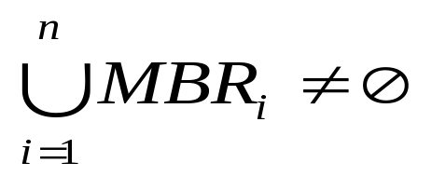
Task 4: Querying
Post-process the MBRs or MBCs to answer historic queries, e.g.,
Query 1: Has the MSN identified any water?
Solution: Yes if,
Query 2: Where exactly?
Solution: Combine the MBRs and the actual events (i.e., points) to derive the possible region.

Slide 17
Presentation Outline
Motivation – Definitions
The SenseSwarm Framework
  Task 1: Perimeter Construction
  Task 2: Data Acquisition
  Task 3: Data Replication
  Task 4: Query Execution
Experimentation
Conclusions & Future Work

Slide 18
Experimentation
Dataset: synthetically derived from 54 sensors deployed at Intel Research Berkeley in 2004.
Query: Conjunctive, historic Boolean queries of the type a&b&c&d➔Interesting Event
Swarm Motion: We derive synthetic temporal coordinates using the Craig Reynolds algorithm (model of coordinated flock motion).
Testbed: A custom simulator along with visualization modules.
Energy Model: Crossbow’s TELOSB Sensor (250Kbps, RF On: 23mA) E=Vol x Amp x Sec
Failure Rate: 20% of the nodes fail at random

Slide 19
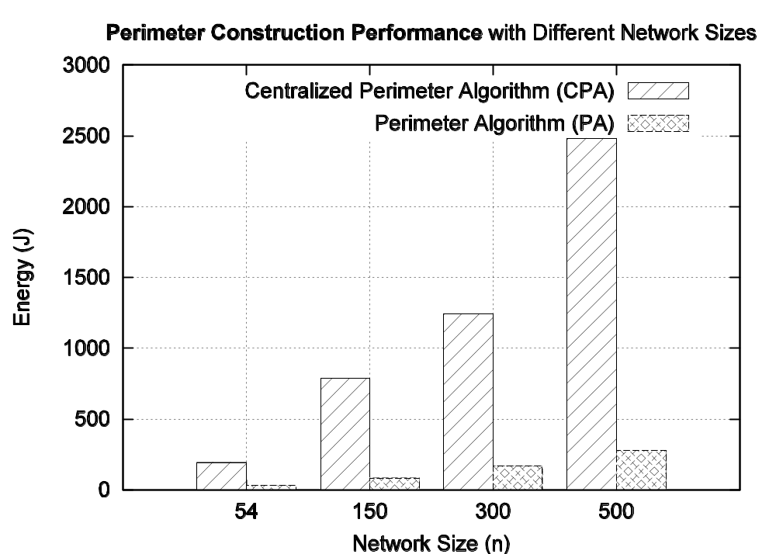
Perimeter Construction Evaluation
Perimeter Algorithm (PA) Vs. Centralized-PA (CPA)
PA requires 85~89% less energy than CPA

Slide 20
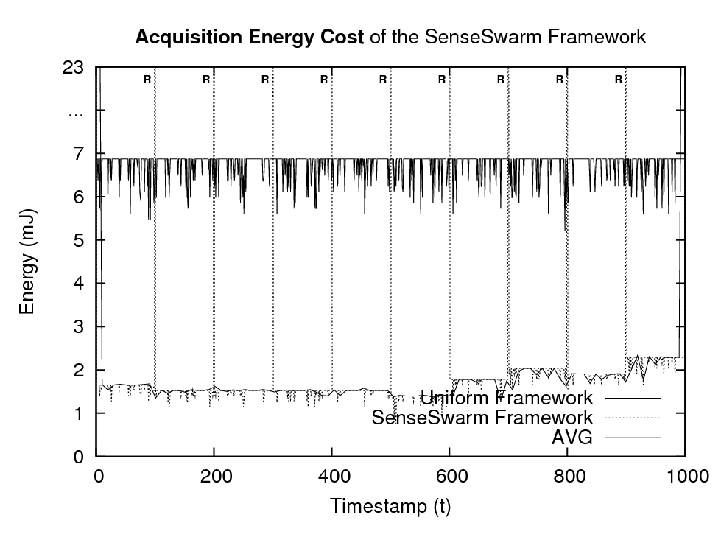
Acquisition Cost Evaluation
Uniform Scenario: All sensors participate
SenseSwarm Scenario: Perimeter sensors participate, core nodes are idle.
PA periodic Execution
SenseSwarm: 75% less energy than Uniform

Slide 21
Presentation Outline
Motivation – Definitions
The SenseSwarm Framework
  Task 1: Perimeter Construction
  Task 2: Data Acquisition
  Task 3: Data Replication
  Task 4: Query Execution
Experimentation
Conclusions & Future Work

Slide 22
Conclusions
We introduced SenseSwarm, a perimeter-based data acquisition framework for MSNs.
We proposed:
  A new distributed perimeter algorithm; and
  A new in-network aggregation scheme.
Future Work:
  Sink selection strategies
  Incremental perimeter update mechanisms
  Full Evaluation of Query Processing
Notes:
Sink selection: e.g. leader election from distributed computing, or finding the sink that is approximately in the center of the network.

Slide 23



SenseSwarm: A Perimeter-based Data Acquisition Framework for Mobile Sensor Networks
Thank you!
Questions?
This presentation is available at:
http://cs.ouc.ac.cy/~zeinalipour
DMSN 2007 (VLDB’07) © Zeinalipour-Yazti, Andreou, Chrysanthis, Samaras, Pitsillides

