Slide 1
Perimeter-based Data Acquisition and Replication in Mobile Sensor Networks
Panayiotis Andreou (Univ. of Cyprus)
Demetrios Zeinalipour-Yazti (Univ. of Cyprus)
Maria Andreou (Open Univ. of Cyprus)
Panos K. Chrysanthis (Univ. of Pittsburgh, USA)
George Samaras (Univ. of Cyprus)
http://www.cs.ucy.ac.cy/~dzeina/
MDM 2009, Taipei, Taiwan © Andreou, Zeinalipour-Yazti, Andreou, Chrysanthis, Samaras

Slide 2
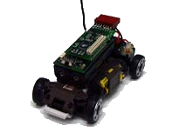
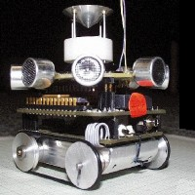
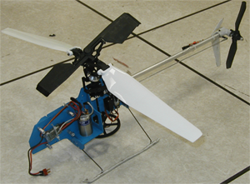
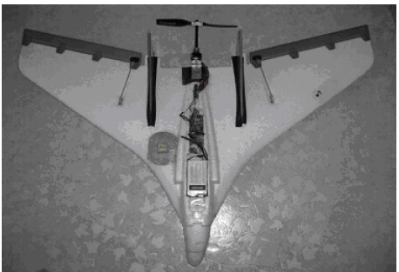
Mobile Sensors
Mobile Sensors
Artifacts created by the distributed robotics and low power embedded systems areas.
Characteristics
Small-sized, wireless-capable, energy-sensitive, as their stationary counterparts.
Feature explicit (e.g., motor) or implicit (sea/air current) mechanisms that enable movement.
LittleHelis (USC)
SensorFlock (U of Colorado Boulder)
MilliBots (CMU)
CotsBots (UC-Berkeley)

Slide 3
Mobile Sensor Networks (MSNs)
What is a Mobile Sensor Network?
A new class of networks where small sensing devices move in space over time.
  Generate spatio-temporal records (x,y,t,other)
Advantages
Controlled Mobility
  Can recover network connectivity.
  Can eliminate expensive overlay links.
Focused Sampling
  Change sampling rate based on spatial location (i.e., move closer to the physical phenomenon).

Slide 4
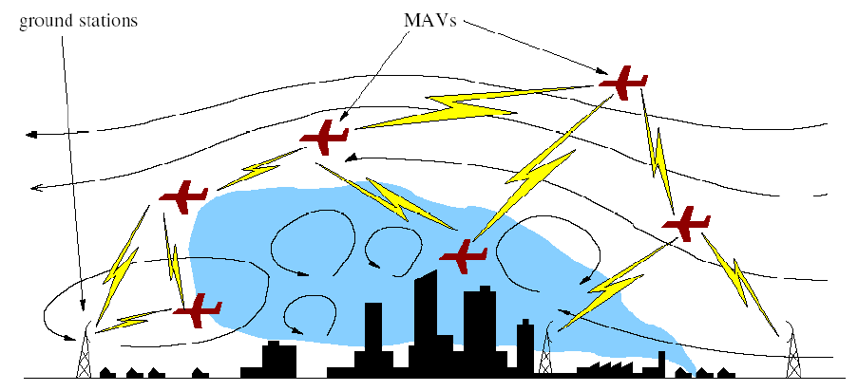
Applications of MSNs
Chemical Dispersion Sampling
Identify the existence of toxic plumes.
Micro Air Vehicles (UAV – Unmanned Aerial Vehicles)
Ground Station
Graphic courtesy of: J. Allred et al. "SensorFlock: An Airborne Wireless Sensor Network of Micro-Air Vehicles", In ACM SenSys 2007.

Slide 5
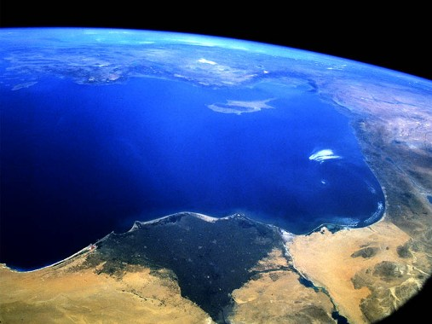

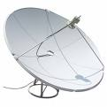

Futuristic Application of MSNs
Oil Spill Exploration: Find an oil spill in a lake or sea
Solution: Mobile Sensor Networks
Potentially Cheaper
More Fault Tolerant
SINK
OIL Spill
Failures
X
X
Periodic Queries Query 1: Has the MSN identified an oil spill and where exactly?
MARS

Slide 6

Our Data/Querying Model
Queries are historic (the sink is usually OFF)
  Thus, results have to be stored in-network.
Sensor failures might happen frequently.
  Thus, replication techniques are adopted
New events are more likely on the perimeter
  e.g., the toxic plume example, identify oil-spills in oceans, etc., …
  Thus, schedule acquisition on the perimeter
MARS
SINK

Slide 7

Our Solution Outline
SenseSwarm: A new framework where data acquisition is scheduled at perimeter sensors and storage at core nodes.
s6
s4
s5
s7
s3
s2
s8
s1
Swarm (or Flock): a group of objects that exhibit a polarized, non-colliding and aggregate motion.

Slide 8
Presentation Outline
Motivation – Definitions
The SenseSwarm Framework
  Task 1: Perimeter Construction
  Task 2: Data Acquisition
  Task 3: Data Replication
Experimentation
Conclusions & Future Work

Slide 9
Task 1: Perimeter Construction
Problem:
How do we construct the perimeter for N sensors?
Centralized Perimeter Algorithm (CPA)
  Collect all sensor coordinates
Calculate Perimeter
Disseminate Perimeter
Disadvantage: Collecting all coordinates requires the transfer of O(N²) (x,y)-pairs – too expensive!

Slide 10
Task 1: Perimeter Construction
Our approach:
Construct the perimeter in a distributed manner.
Our Algorithm: Perimeter Algorithm (PA)
Find the sensor with the minimum y coordinate using TAG (denoted as s_{min}).
Inform s_{min} about this choice.
s_{min} initiates the recursive perimeter construction step using counterclockwise turns.
Left
s1
Right
s3
smin

Slide 11
Task 1: Perimeter Construction
=s1
Phase 1: Find s_{min} from a random sink
Phase 2: Disseminate s_{min}
Phase 3: Build the perimeter from s_{min}
s6
s4
s5
sink
s7
s3
s8
s2
s1
S_{min}

Slide 12
Task 1: Perimeter Construction
PA Message Complexity:
N: Number of nodes in the network
p: Number of nodes on the perimeter
Phase 1: Identify s_{min} ➔ O(N) messages.
Phase 2: Disseminate s_{min} ➔ O(N) messages
Phase 3: Construct Perimeter ➔ O(p) messages
Overall Message Complexity = O(N+p) = O(N)

Slide 13
Task 2: Data Acquisition
A) Data Acquisition takes place at the perimeter
Perimeter Nodes sample at high frequencies
Core Nodes are idle ➔ Energy Conservation
B) Events are buffered in-situ on the perimeter
s6
s4
s5
s7
s3
s2
s8
s1

Slide 14
Task 3: Data Replication
Why Replication?
Ensures that node failures will not subvert any detected events.
Setting: Perimeter nodes replicate their local datums (i.e., buffered measurements) to neighboring nodes according to our Data Replication Algorithm (DRA)
datum
Objective: Create an energy-efficient data replication plan
x,y,70º
Perimeter node

Slide 15
Task 3: Data Replication
Data Replication Algorithm (DRA)
Construct the Neighbor List of node si (i.e., NH(s_{i})) such than |NH(s_{i})|>v_{min} (v_{min} is user-defined threshold)
  Analyze NH(s_{i}) using hop count info to identify the top-w nodes (w ≤ |NH(s_{i})|) with the least replication cost
  During the recovery of a datum d_{i} we must perform at least v-w+1 reads to recover d_{i}.
    Replicate to One: w=1 and v=4 ➔ 4-1+1 = 4 reads necessary
    Replicate to ALL: w=4 and v=4 ➔ 4-4+1 = 1 read necessary
s_{i}
s_{i}
Cost: 4 broadcasts
Cost: 1 broadcast

Slide 16
Presentation Outline
Motivation – Definitions
The SenseSwarm Framework
  Task 1: Perimeter Construction
  Task 2: Data Acquisition
  Task 3: Data Replication
Experimentation
Conclusions & Future Work

Slide 17
Experimentation
Datasets: derived from 54 sensors deployed at Intel Research Berkeley in 2004.
Swarm Motion: We derive synthetic temporal coordinates using the Craig Reynolds algorithm (model of coordinated flock motion).
Query: At each timestamp ask the network to identify 10 historic datums (chosen at random).
Testbed: A custom simulator along with visualization modules.
Energy Model: Crossbow’s TELOSB Sensor (250Kbps, RF On: 23mA) E=Vol x Amp x Sec
Failure Rate: 20-70% of the nodes fail at random

Slide 18
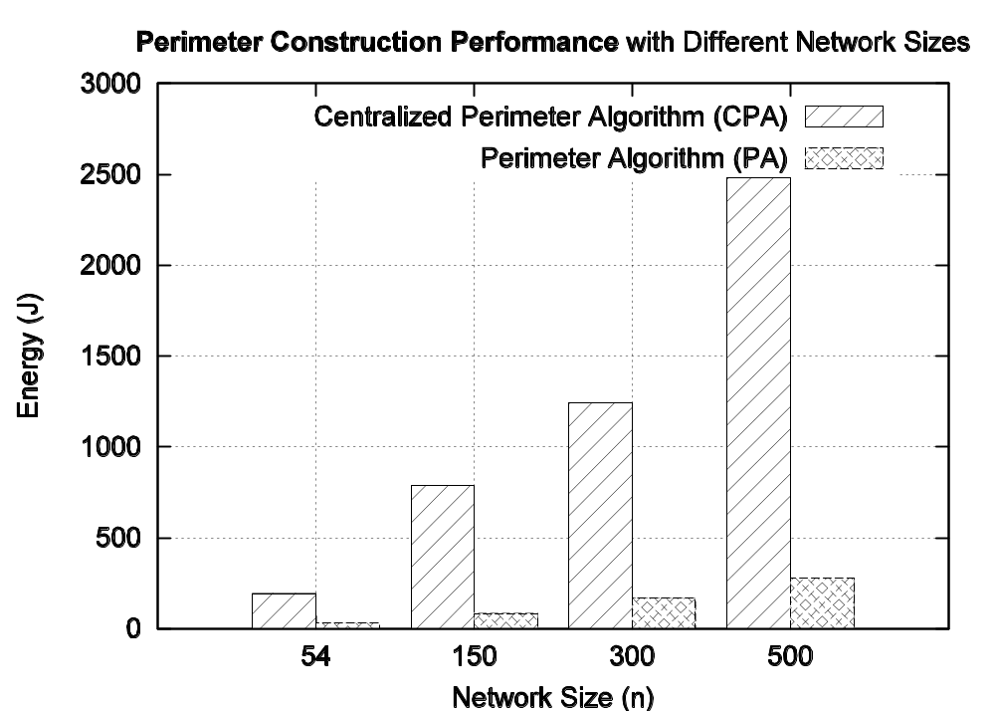
Perimeter Construction Evaluation
Perimeter Algorithm (PA) Vs. Centralized-PA (CPA)
PA requires 85~89% less energy than CPA

Slide 19
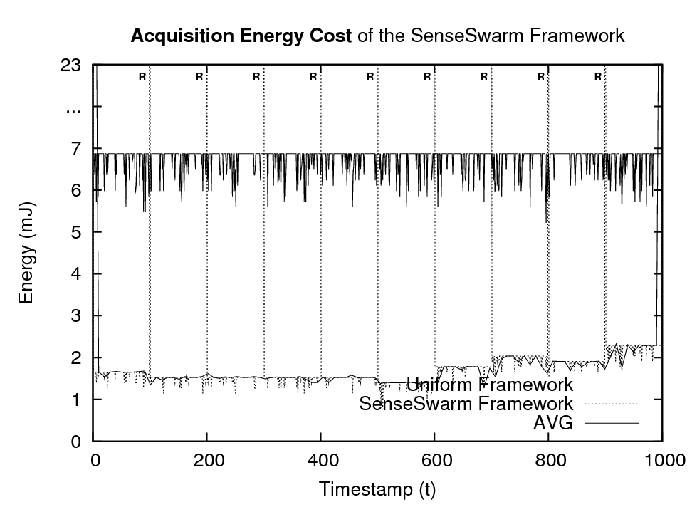
Acquisition Cost Evaluation
Uniform Scenario: All sensors participate
SenseSwarm Scenario: Perimeter sensors participate, core nodes are idle.
PA periodic Execution
SenseSwarm: 75% less energy than Uniform

Slide 20
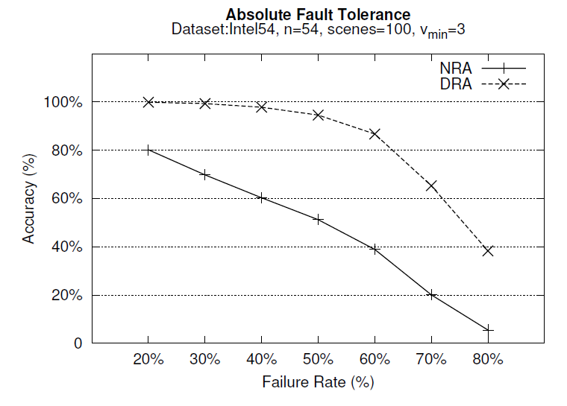
Evaluating Data Replication Accuracy
Accuracy = Recovered Datums / Replicated Datums
Algorithms: i) DRA (Data Replication Algorithm)
ii) NRA (No Replication Algorithm)
DRA is 19%-48% more accurate than NRA
With >60% failures it is difficult to guarantee survivability

Slide 21
Presentation Outline
Motivation – Definitions
The SenseSwarm Framework
  Task 1: Perimeter Construction
  Task 2: Data Acquisition
  Task 3: Data Replication
Experimentation
Conclusions & Future Work

Slide 22
Conclusions
We introduced SenseSwarm, a perimeter-based data acquisition framework for MSNs.
We proposed:
  A new distributed perimeter algorithm; and
  A data replication algorithm based on votes.
Future Work:
  Sink selection strategies
  Incremental perimeter update mechanisms
  Detailed Evaluation of Query Processing

Slide 23


Perimeter-based Data Acquisition and Replication in Mobile Sensor Networks
Thank you!
Questions?
This presentation is available at:
http://www.cs.ucy.ac.cy/~dzeina/
MDM 2009, Taipei, Taiwan © Andreou, Zeinalipour-Yazti, Andreou, Chrysanthis, Samaras

