Slide 1

Energy Efficient Data Management in Smartphone Networks
Demetris Zeinalipour
Department of Computer Science
University of Cyprus
NSF Workshop on Sustainable Energy Efficient Data Management
(SEEDM), Arlington, Virginia, May 2nd – 3rd, 2011.
http://www.cs.ucy.ac.cy/~dzeina/

Slide 2
Smartphones
Smartphone Devices have emerged into powerful computational platforms equipped with multitude of sensors.
  Processing: 1 GHz dual core
  RAM & Flash Storage: 1GB & 48GB, resp.
  Networking: WiFi, 3G (Mbps) / 4G (100Mbps)
  Sensing: Proximity, Ambient Light,
  Accelerometer, Microphone, Geographic Coordinates based
  on AGPS (fine), WiFi or Cellular Towers (coarse).
Research studies using the sensing capability of these devices have already emerged:
  MetroSense (Dartmouth)
  Cartel (MIT)
  SmartTrace (UCY)
Notes:
http://en.wikipedia.org/wiki/Wikipedia:Database_download
Wikipedia (Current revisions only, no talk or user pages): 6.07 GB compressed or 27 GB uncompressed
All revisions, all pages: 5 TB!
GPS: 1 meter and of 1.5 meters => up to 30 meters
For instance, the “My Location” service by Google, can only provide accuracies of about 200m while Cell Tower Positioning provides accuracies of several thousand meters.

Slide 3
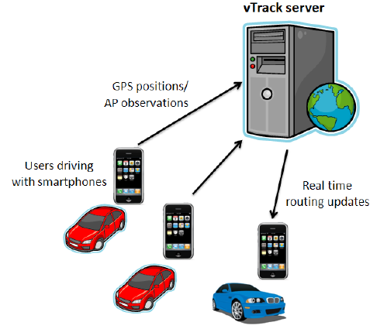
Smartphone Network Applications
Mapping the Road traffic by collecting WiFi signals.
Received Signal Strength (RSS): power present in WiFi radio signal
Graphics courtesy of: A .Thiagarajan et. al. “Vtrack: Accurate, Energy-Aware Road Traffic Delay Estimation using Mobile Phones, In Sensys’09, pages 85-98. ACM, (Best Paper) MIT’s CarTel Group

Slide 4
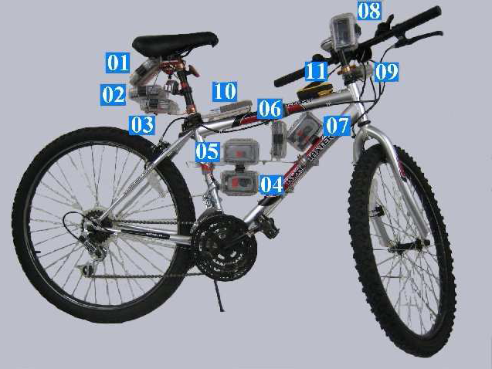
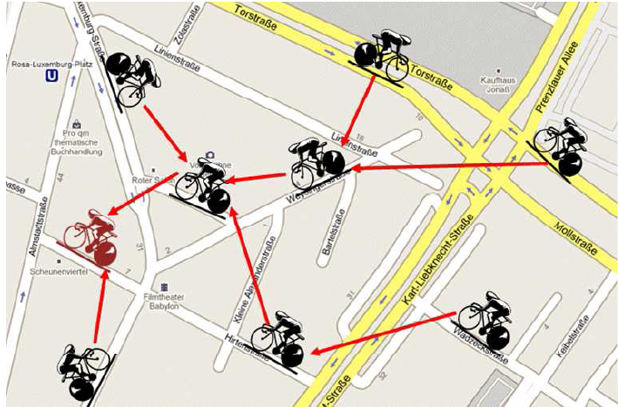
Smartphone Network Applications
BikeNet: Mobile Sensing for Cyclists.
Real-time Social Networking of the cycling community (e.g., find routes with low CO2 levels)
Left Graphic courtesy of: S. B. Eisenman et. al., "The BikeNet Mobile Sensing System for Cyclist Experience Mapping", In Sensys'07 (Dartmouth’s MetroSense Group)

Slide 5
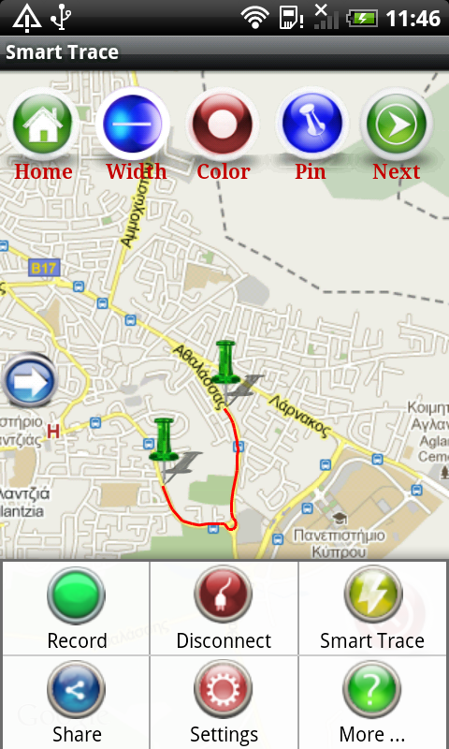
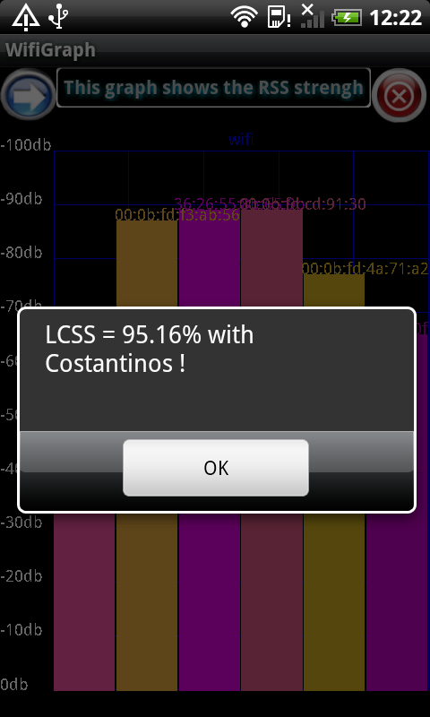
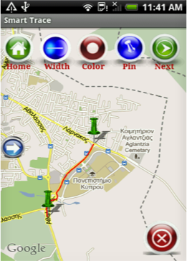
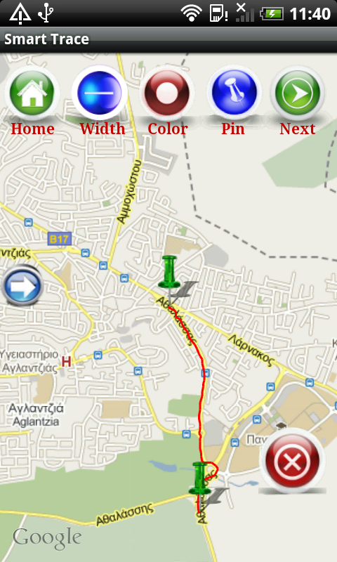
Smartphone Network Applications
Perform Trajectory queries over other users without seeing their (GPS or WiFi) traces.
* “SmartTrace: Finding Similar Trajectories in Smartphone Networks without Disclosing the Traces”, C. Costa, C. Laoudias, D. Zeinalipour-Yazti, D. Gunopulos Demo at the 27th IEEE Intl. Conf. on Data Engineering (ICDE’11), Hannover, Germany, 2011.

Slide 6
Power Profile of a Smartphone
Power Profile of a Typical Android Smartphone
"Disclosure-free GPS Trace Search in Smartphone Networks", D. Zeinalipour-Yazti, C. Laoudias, M. I. Andreou, D. Gunopulos, 12th International Conference on Mobile Data Management (MDM'11), IEEE Computer Society, Lulea, Sweden, June 6-9, 201
Basic Operation | Power (mW = mJ/s)
CPU Idle (OS running) | 176mW
CPU Busy (Processing) | 369mW
WiFi Idle (Connected) | 38mW
WiFi Busy (Uplink 123kbps, -58dBm) | 600mW
OLED Display Brightness (Low, Med, High) | 300-500-700mW
GPS | 280 mW
Audio | 100mW

Slide 7
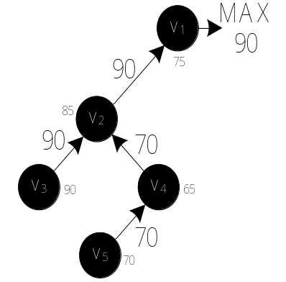
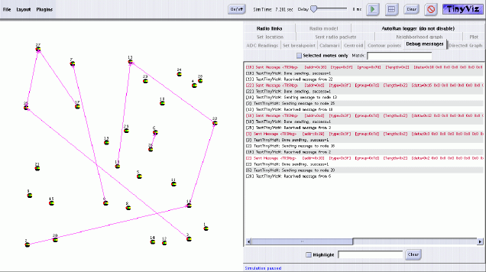
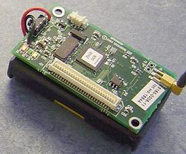
Research Directions
A. What lessons have we learnt from Sensor Network Data Management?
  Energy-aware algorithms for aggregation (TAG @ UCB), declarative languages (Tinydb, Cougar, etc.)
  Query Routing Trees (MicroPulse)
  Flash Storage and Indexing (MicroHash, SensorDB)
  Testbeds? Languages? Environments?
Notes:
http://en.wikipedia.org/wiki/Wikipedia:Database_download
Wikipedia (Current revisions only, no talk or user pages): 6.07 GB compressed or 27 GB uncompressed
All revisions, all pages: 5 TB!
GPS: 1 meter and of 1.5 meters => up to 30 meters
For instance, the “My Location” service by Google, can only provide accuracies of about 200m while Cell Tower Positioning provides accuracies of several thousand meters.

Slide 8
Research Directions
Where is the (Query) Processing and Storage going to take place in the future: Cloud or In-Situ?
  Handle Data on the Cloud: offload energy-demanding functionality to powerful servers
    Google Voice Search (processing)
    Dropbox (storage)
    Gmail (networking)
  Handle Data on the Device
    Storing and Processing in-situ (where sensed parameters are recorded) has the following characteristics:
      Reduces network activity
      Increases local processing
      Increases privacy

Slide 9
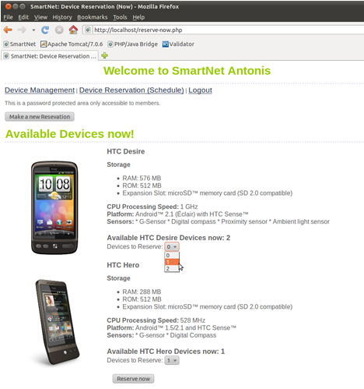
Research Directions
C. Testbeds?
No testbeds for emulating Smartphone Network applications.
No power measuring tools for large-scale power measuring (e.g., PowerTOSSIM)
MobNet project (at UCY 2010-2012) is developing a programming cloud for smartphone devices

Slide 10
Energy Efficient Data Management in Smartphone Networks
Demetris Zeinalipour
Department of Computer Science
University of Cyprus_x0018_
Thanks!
Questions?
NSF Workshop on Sustainable Energy Efficient Data Management
(SEEDM), Arlington, Virginia, May 2nd – 3rd, 2011.
http://www.cs.ucy.ac.cy/~dzeina/

