Slide 1

Spatio-Temporal Query Processing in Smartphone Networks
Demetris Zeinalipour
Department of Computer Science
University of Cyprus, Cyprus
Workshop on Research Directions in
Situational-aware Self-managed Proactive Computing in
Wireless Ad-hoc Networks,
with MDM’10, Kansas City, Missouri, May 23rd, 2010
http://www.cs.ucy.ac.cy/~dzeina/

Slide 2

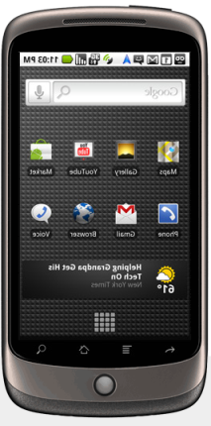
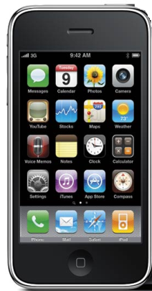


What is a Smartphone Network?
Smartphone Network: A collection of smartphones that communicate over a network to realize a collaborative task (Sensing activity, Social activity, ...)
    Bluetooth: Infrastructure-less P2P applications
    WiFi 802.11, WCDMA/UMTS(3G) / HSPA(3.5G): Infrastructure-Oriented.
Smartphone: offers more advanced computing and connectivity than a basic 'feature phone'.
  OS: Android, Nokia’s Maemo, Apple X
  CPU: >1 GHz ARM-based processors
  Memory: 512MB Flash, 512MB RAM, 4GB Card;
  Sensing: Proximity, Ambient Light, Accelerometer, Camera, Microphone, Geo-location based on GPS, WIFI, Cellular Towers,…

Slide 3
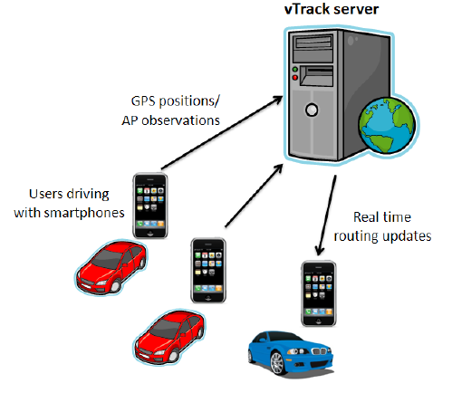
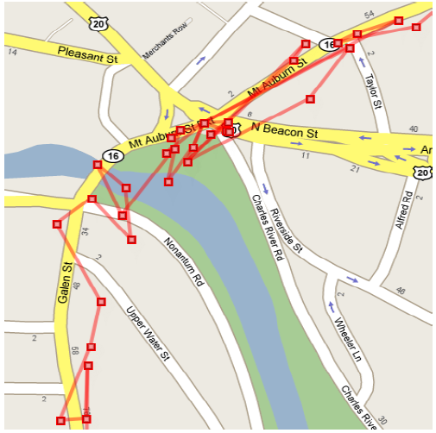
Smartphone Network: Applications
Intelligent Transportation Systems with VTrack
Better manage traffic by estimating roads taken by users using WiFi beams (instead of GPS) .
Graphics courtesy of: A .Thiagarajan et. al. “Vtrack: Accurate, Energy-Aware Road Traffic Delay Estimation using Mobile Phones, In Sensys’09, pages 85-98. ACM, (Best Paper) MIT’s CarTel Group
Notes:
Smartphones participate in a collaborative sensing activity to enable a new service: i.e., high-fidelity traffic estimation.

Slide 4
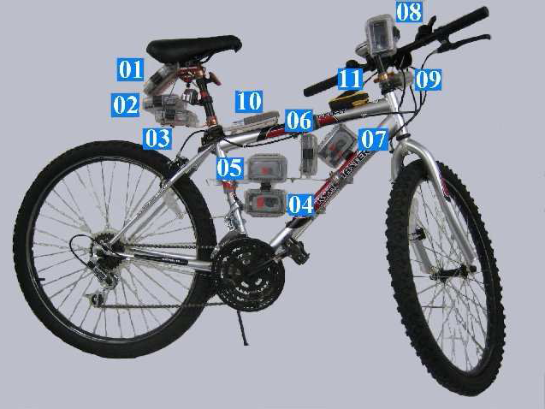
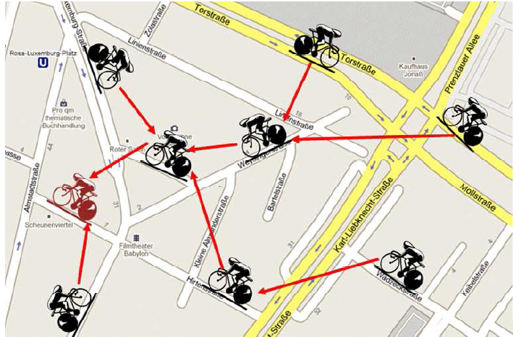
Smartphone Network: Applications
BikeNet: Mobile Sensing for Cyclists.
Real-time Social Networking of the cycling community (e.g., find routes with low CO2 levels)
Left Graphic courtesy of: S. B. Eisenman et. al., "The BikeNet Mobile Sensing System for Cyclist Experience Mapping", In Sensys'07 (Dartmouth’s MetroSense Group)

Slide 5
Spatio-Temporal Query Processing
Query Processing: Effectively querying spatio-temporal data, calls for specialized query processing operators.
Spatio-Temporal Similarity Search: How can we find the K most similar trajectories to Q without pulling together all subsequences
``Distributed Spatio-Temporal Similarity Search’’, D. Zeinalipour-Yazti, et. al, In ACM CIKM’06.
"Finding the K Highest-Ranked Answers in a Distributed Network", D. Zeinalipour-Yazti et. al., Computer Networks, Elsevier, 2009.

Slide 6
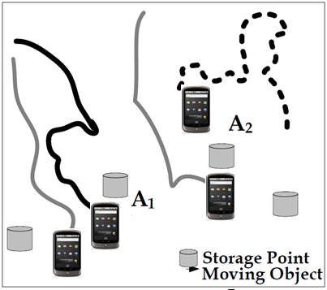
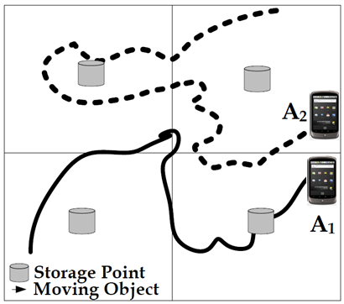
Spatio-Temporal Query Processing
Horizontal Fragmentation
(of trajectories)
Vertical Fragmentation
(of trajectories)
HUB-K Algorithm
UB-K & UBLB-K
Algorithms

Slide 7
The Longest Common Subsequence
ST Similarity Search Challenges?
  Flexible matching in time
  Flexible matching in space (ignores outliers)
LCSS is proven to be good at both, but is computationally expensive.
ignore majority of noise
match
match

Slide 8
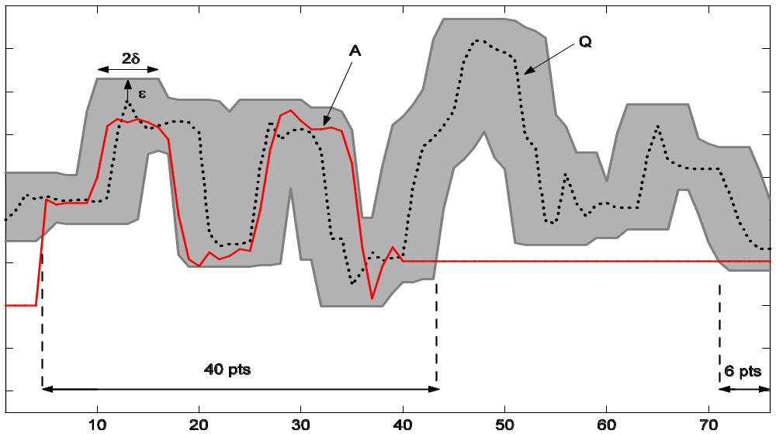
The Longest Common Subsequence
Bounding Above the LCSS Metric
ΜΒΕ: Minimum Bounding Envelope
2δ
Q
A
ε
40 pts
6 pts
* Indexing multi-dimensional time-series with support for multiple distance measures,
M. Vlachos, M. Hadjieleftheriou, D. Gunopulos, E. Keogh, In KDD 2003.

Slide 9
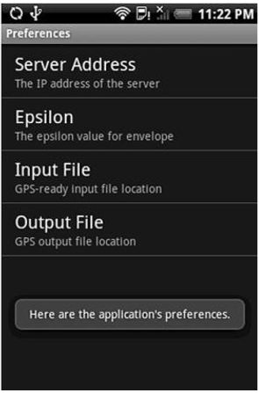
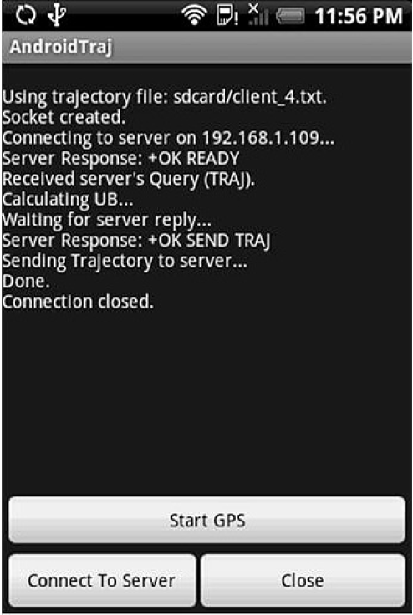
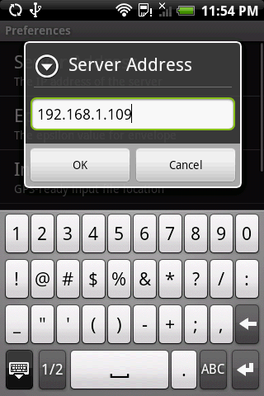
Evaluation Testbeds
Query Processor
Running HUB-K
Querying large traces within seconds rather than minutes

Slide 10
Challenges A: Data Vastness
A) Data Vastness
  Web: ~48 billion pages that change “slowly”
  MSN: >1 billion handheld smart devices (including mobile phones and PDAs) by 2010 according to the Focal Point Group* while ITU estimated 4.1 billion mobile cellular subscriptions by the start of 2009.
  Think about these generating spatio-temporal data at regular intervals …
    * According to the same group, in 2010, sensors could number 1 trillion, complemented by 500 billion microprocessors, 2 billion smart devices (including appliances, machines and vehicles).

Slide 11
Challenges B: Uncertainty
B) Uncertainty
  Smartphones on the move might be disconnected from the query processor, thus a (out-of-sync global view).
  Integrating data from different devices might yield ambiguous situations (vagueness).
    e.g., Triangulated AP vs. GPS
  Faulty electronics on sensing devices might generate outliers and errors (inconsistency).
  Compromised software might intentionally generate misleading information (deceit).

Slide 12
Challenges C: Privacy
C) Privacy
  A Smartphone can nowadays unveil private information at a high fidelity
  Spatial Privacy (Where?)
  Temporal Privacy (When?)
  Contextual Privacy (What?)
  A huge topic that asks for practical solutions in Smartphone Networks.
  There are some interesting recent works on this subject:
Chi-Yin Chow, Mohamed F. Mokbel, and Walid G. Aref. "Casper*: Query Processing for Location Services without Compromising Privacy". ACM Transactions on Database Systems, TODS 2009, accepted.

Slide 13
Challenges D: Testbeds
D) Testbeds
Currently, there are no testbeds for emulating and prototyping Smartphone Network applications and protocols at a large scale.
  MobNet project (at UCY 2010-2011), will develop an innovative hardware testbed of mobile sensor devices using Android
    Application-driven spatial emulation.
    Develop MSN apps as a whole not individually.

Slide 14
Spatio-Temporal Query Processing in Smartphone Networks
Demetris Zeinalipour
Department of Computer Science
University of Cyprus, Cyprus
Thank you
Questions?
Workshop on Research Directions in
Situational-aware Self-managed Proactive Computing in
Wireless Ad-hoc Networks,
with MDM’10, Kansas City, Missouri, May 23rd, 2010
http://www.cs.ucy.ac.cy/~dzeina/

