Slide 1


Multi-Objective Query Optimization in Smartphone Social Networks
Andreas Konstantinidis, Demetrios Zeinalipour-Yazti, Panayiotis Andreou, George Samaras
12th IEEE International Conference on Mobile Data Management
(MDM’11), June 7th, 2011, Luleå, Sweden
http://www.cs.ucy.ac.cy/~dzeina/
MDM 2011 © Konstantinidis, Zeinalipour-Yazti, Andreou, Samaras

Slide 2
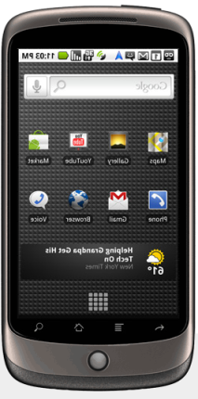
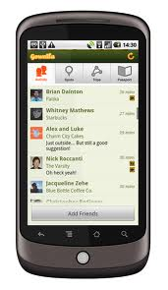

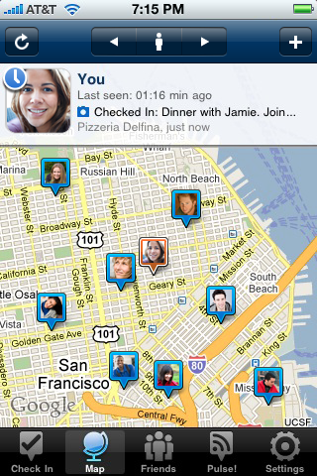
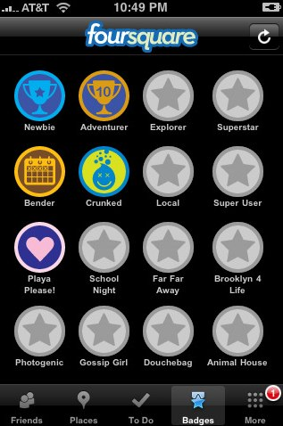
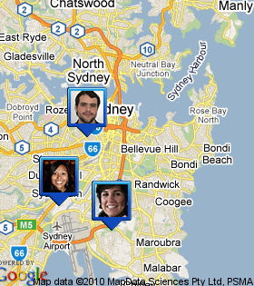

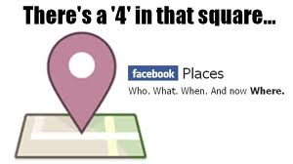



Smartphone Social Network
A social structure made up of individuals carrying smartphones used for Sharing and Collaboration (Content, Interest, Comments, Places, etc.)
Latitude

Slide 3
Smartphone Social Network
Main Functionality of these Services
  Who - What - When – Where
  Upload Photos / Tag (Comment) on Photos
    Facebook 50+ Billion Photos in 07/2010
  “Check-in” (Places, Gowalla, Foursquare):
    let user's friends know where they are at the moment.
    receive location-based deals (e-loyalty card)
  Location History (Latitude)

Slide 4
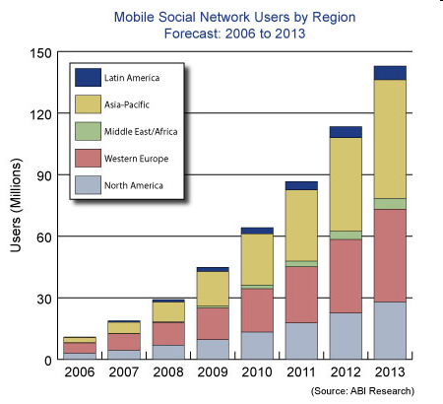
Smartphone Social Network
Mobile Social Network applications are projected to grow in the future.

Slide 5
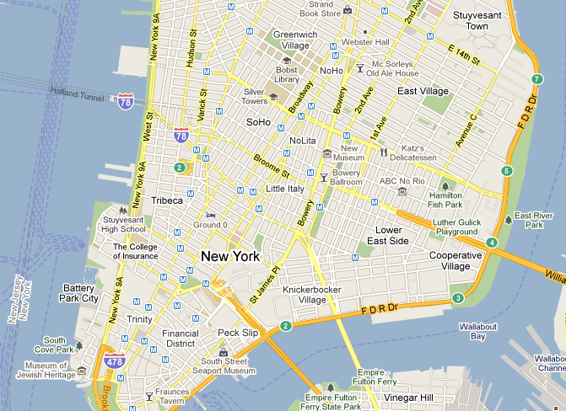




Motivating Example
Scenario: Five (5) User moving in Lower Manhattan collecting data (video, photos, sound, rss, …)
U5
U2
U3
U4
U1

Slide 6
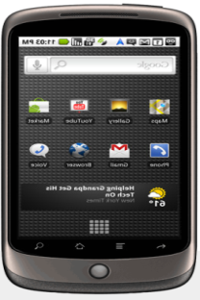
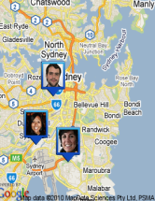

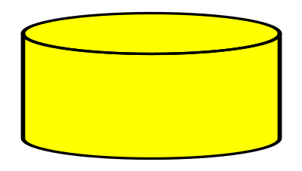
The Search Problem
Query Processor (QP)
Fact: Content is Distributed and there is no Global Index!
Problem: How to find the answer more “efficiently”.
Find Video of street artists performing right now?
U1
U2
U3
U4
U5
{(X,Y,T,obj) | X,Y: spatial, T: temporal, Obj: object}

Slide 7
Presentation Outline
Introduction
Background and Existing Solutions
The SmartOpt Framework
Preliminary Evaluation
Ongoing and Future Work

Slide 8
Background and Characteristics
Data Privacy
  Social sites are already undergoing significant privacy restructuring (e.g., google buzz, facebook)
Network Traffic and Local Processing
  Objects are large (e.g., High Resolution photo)
  3G/4G and WiFi traffic: i) depletes smartphone battery and ii) degrades network health*
    In 2009 AT&T’s customers affected by iPhone release.
Short-range (Bluetooth, NFC) vs. Long Range (WiFi | 3G) Wireless Links
  0.40W – No connections
  0.52W – Bluetooth Connection Established
  1.73W – Download 120KBps via 3G

Slide 9
Motivating Example
Centralized Search (CS):
  Build a big repository with all objects and tags
    currently utilized by all social networking sites
  Scores bad in all three characteristics: Privacy, Network Traffic, Only Long-Link
Query Processor (QP)
U1

Slide 10
Motivating Example
Distributed Random Search (DRS):
  Keep object/tags in-situ and conduct a distributed brute-force (p2p) search
  Improves privacy but still not adequate:
  Privacy, Network Traffic, Only-Long
Query Processor (QP)
U1
U2
U3
U4
U5

Slide 11
Presentation Outline
Introduction
Background and Existing Solutions
The SmartOpt Framework
Preliminary Evaluation
Ongoing and Future Work

Slide 12

SmartOpt: Solution Outline
Interest Matrix (Profile)
Social Site
Arts
Food
Cinema
…
QP
U1
X
Social Graph (G)
U2
X
X
U3
X
U4
X
X
Query Routing Tree (T)
Disseminate Query using T
(WiFi| 3G)
Bluetooth (cheaper)
Bluetooth
(cheaper)
U1
U2
U3
U4
U5

Slide 13


Definition of Objectives
Problem: Construct a QRT (X) over active users U’ that optimizes three (3) conflicting objectives, concurrently, in conducting query Q:
  Α) Minimize Total Energy Consumption:
  B) Minimize Response Time :
  C) Maximize (Query Result) Recall :

Slide 14
SmartOpt Optimizer
Founded on a Multi-Objective Evolutionary Algorithm using Decomposition (MOEAD).
  Mimics the process of natural evolution by decomposing the problem into M subproblems.
Optimizer Main Steps:
  Initialization: Uniformly and Randomly generate a set of M Query Routing Trees.
  For i:=1 to M apply:
    i) a genetic operator (select, crossover, mutation);
    ii) repair operator (disconnection, repetition, loops) and
    iii) population update operator
  Repeat the above until a maximum number of generations has been produced.

Slide 15
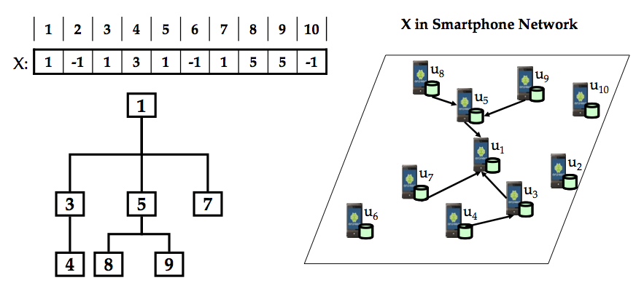
SmartOpt Optimizer
Representation and Initialization: Record the parent of each node in a vector (-1 for nodes with no parent)

Slide 16
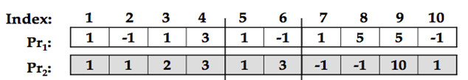
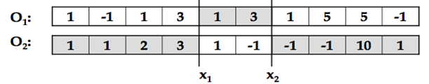
SmartOpt Optimizer
Crossover: Randomly select 2 parents Pr1,Pr2 and create offsprings O1,O2 by crossing the range between two random points X1,X2
New solution shares many of the parent characteristics found in parents.

Slide 17
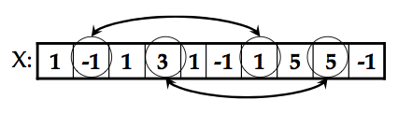

SmartOpt Optimizer
Mutation: Randomly select 2 indexes in each offspring and swap their parents.
This step is expected to improve exploration and consequently the diversity of the initial solution
However, this might create disconnections as this is shown next. ☹
1 2 3 4 5 6 7 8 9 10
1 2 3 4 5 6 7 8 9 10

Slide 18
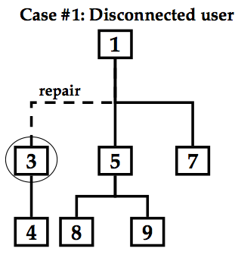
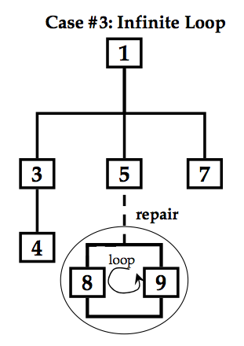
SmartOpt Optimizer
Repair: Correct problems that might show up in the offspring solutions (e.g., disconnected subtrees, infinite loops, etc.)

Slide 19
Presentation Outline
Introduction
Background and Existing Solutions
The SmartOpt Framework
Preliminary Evaluation
Ongoing and Future Work

Slide 20
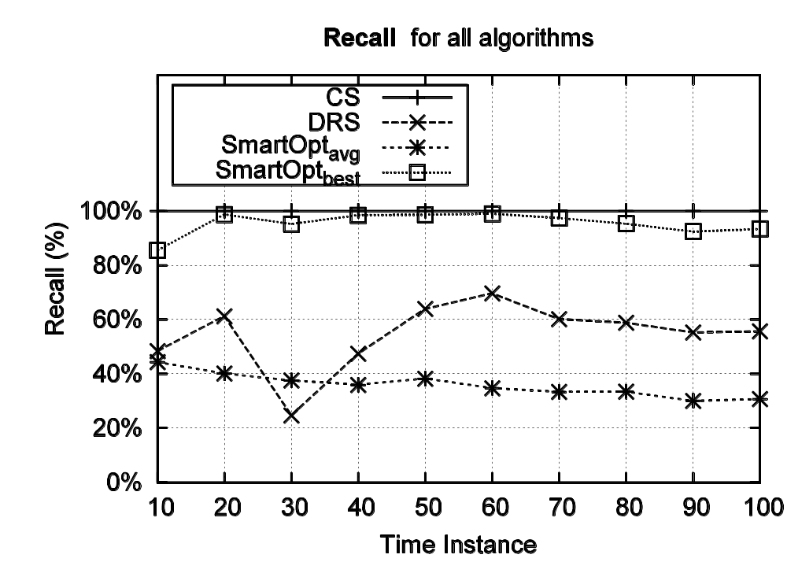
Experimental Results
A. RECALL:
Average Performance of the Pareto Set.
Best Solution close to the answer set >95%

Slide 21
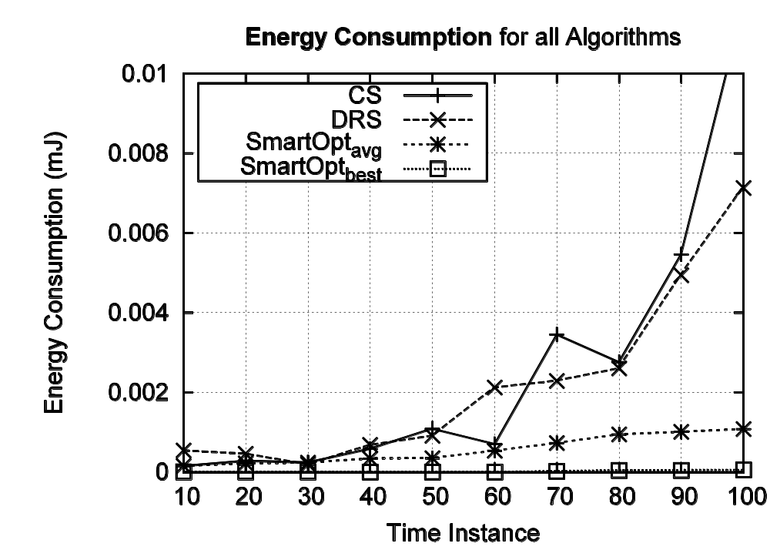
Experimental Results
B. ENERGY:
Almost 6 times more energy-efficient than CS
6x
Similar findings for Time

Slide 22
Presentation Outline
Introduction
Background and Existing Solutions
The SmartOpt Framework
Preliminary Evaluation
Ongoing and Future Work

Slide 23
Ongoing and Future Work
Look at other Multi-Objective Optimization alternatives such as the large body of skyline operators for disk-resident data.
Fine-tune the search algorithm and compare it against the large literature of P2P search.
Evaluate the SmartOpt prototype system over the SmartNet testbed of 50+ smartphones we are developing.

Slide 24
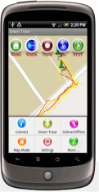

Ongoing and Future Work
SmartNet
Install APK,
Upload File,
Reboot, …
Programming cloud for the development of smartphone network applications & protocols as well as experimentation with real smartphone devices.

Slide 25
Multi-Objective Query Optimization in Smartphone Social Networks
Andreas Konstantinidis, Demetrios Zeinalipour-Yazti, Panayiotis Andreou, George Samaras
Thanks!
Questions?
12th IEEE International Conference on Mobile Data Management
(MDM’11), June 7th, 2011, Luleå, Sweden
http://www.cs.ucy.ac.cy/~dzeina/
MDM 2011 © Konstantinidis, Zeinalipour-Yazti, Andreou, Samaras

