Slide 1





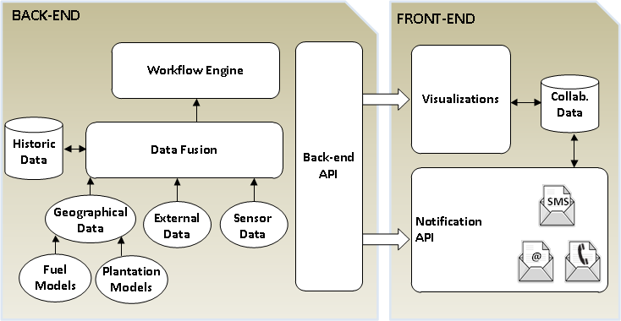

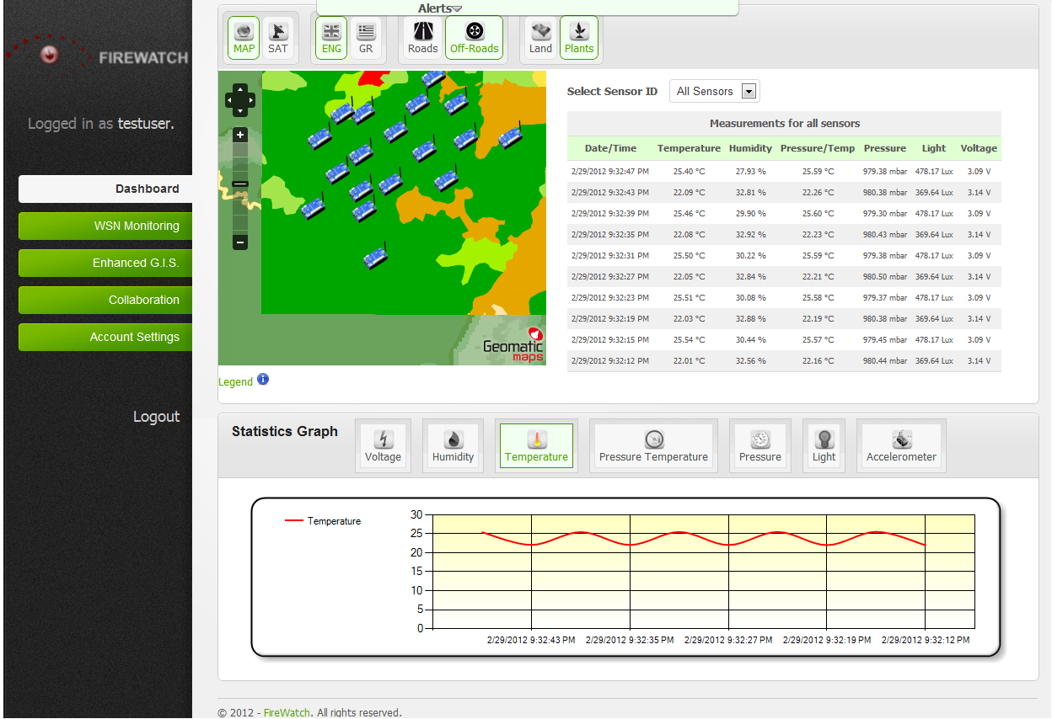
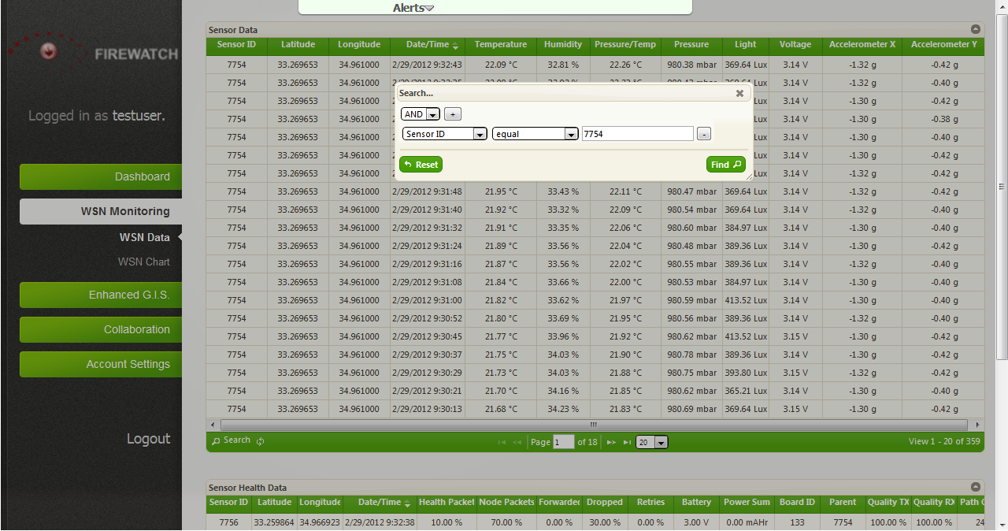
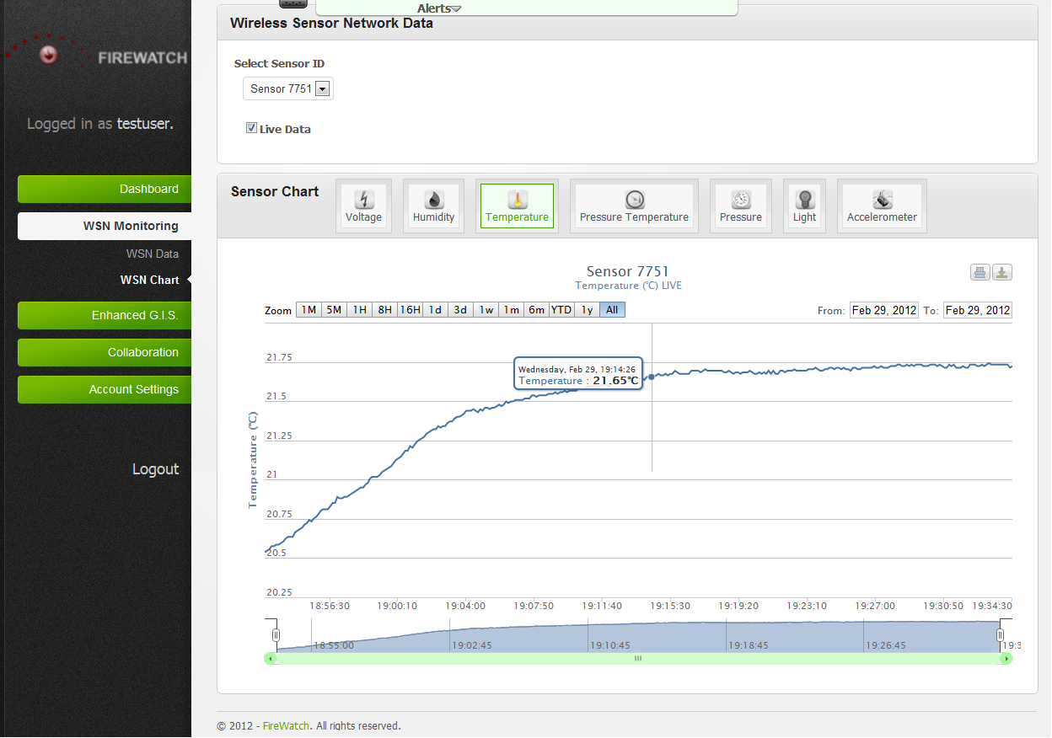






FireWatch: G.I.S.-assisted Wireless
Sensor Networks for Forest Fires
http://firewatch.cs.ucy.ac.cy/
Panayiotis G. Andreou, George Constantinou, Demetrios Zeinalipour-Yazti, George Samaras
Department of Computer Science, University of Cyprus
Goals and Contributions
Our Goal: Development of an automated fire detection and prediction system by utilizing state of the art technologies (Wireless Sensor Networks, Computer-supported Cooperative Work and Geographic Information Systems and Terrain Analysis & Digital Terrain Modeling).
What is FireWatch?
A system able to detect forest fires more accurately and forecast forest fire danger more promptly.
FireWatch features an innovative web-based interface that enables fire officers to overview the status of the wireless sensor network as well as query/retrieve specific information.
It can speed up collaboration between authorities by identifying the workflows in case of hazard.
FireWatch Architecture
BACK-END
Sensor Data: stores real-time sensor data
Geographical Data: stores geographical information, road and off-road data, fuel and plantation models .
External Data: Stores the data provided by external data sources (e.g., from the meteorological service). Supplementary data readings include daily rainfall at ground level, wind speed during the day, barometric and atmospheric temperatures at different heights.
Data Fusion: correlates sensor, external and geographical data to produce a comprehensive view of the network status.
Workflow Engine: incorporates information models that analyze the real-time and historic data so as to detect/predict forest fire events.
FRONT-END
Visualizations: displays all data in a visual manner (i.e., map view, tabular form, graphs) and provides different interfaces for querying the data of each component.
Notification API: supports various notification mechanisms for providing alerts to users (e.g., visual alerts, audio alerts) and involved authorities (e.g., voice messages, SMS, Email).
3
2
1
VIRTUAL MACHINES
1
Wireless Sensor Network
Controlled Node Deployment
2
G.I.S. Server
3
Workflows Server
Interface Design
WSN Monitoring Chart
Visual representation of measurements
Access to specific time periods
Export graphs
WSN Monitoring Data
Execute queries on real-time and historic sensor data.
Filter results.
View WSN health and predicted lifetime.
Collaboration
Search and retrieve appropriate government authorities that can aid in forest fire management
Utilizes a number of different communication techniques such as alerts, SMS, emails.
Dashboard
Overview of the overall system
Displays latest sensor data (tabular form and charts)
Map of the high risk forest area and the sensor locations
Enhanced G.I.S.
Plots sensor locations on the map.
Supports three modes (normal view/satellite view/plantation/fuel models view)
Provides alternative off-road routes to the location of the hazard
“FireWatch: G.I.S.-assisted Wireless Sensor Networks for Forest Fires”, Panayiotis G. Andreou, George Constantinou, Demetrios Zeinalipour-Yazti and George Samaras, 24th International Conference on Scientific and Statistical Database Management, Chania, Crete, Greece, 25-27 June, (2012).
“Towards a Network-aware Middleware for Wireless Sensor Networks”, Andreou, P., Zeinalipour-Yiazti, D., Chrysanthis, P.K., Samaras, G. 8th International Workshop on Data Management for Sensor Networks (DMSN’11), The Westin Hotel, Seattle, WA, USA, August 29, (2011).
"Power Efficiency through Tuple Ranking in Wireless Sensor Network Monitoring", P. Andreou, D. Zeinalipour-Yazti, P.K. Chrysanthis, G. Samaras, Distributed and Parallel Databases Journal, Vol.29, No.1-2, pp.113-150, 2011.
"Optimized Query Routing Trees for Wireless Sensor Networks", P. Andreou, D. Zeinalipour-Yazti,A. Pamboris, P.K. Chrysanthis, G. Samaras, Information Systems Journal, Volume 36, Issue 2, pp.267-291, April 2011.
Panayiotis G. Andreou
Post-doctoral Research Fellow
Department of Computer Science, University of Cyprus
1 University Avenue, 2109 Aglantzia, Nicosia, Cyprus.
Email: panic@cs.ucy.ac.cy
Acknowledgements: This work is partly supported by the project FireWatch (#0609-BIE/09) sponsored by the Cyprus Research Promotion Foundation, the European Union under the project CONET (#224053) and the third author’s startup grant sponsored by the University of Cyprus.

