Slide 1

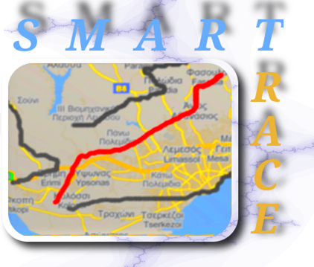

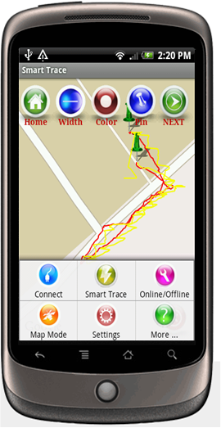
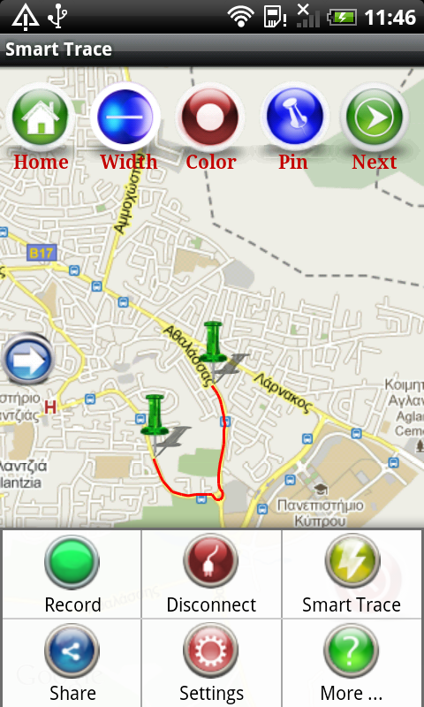
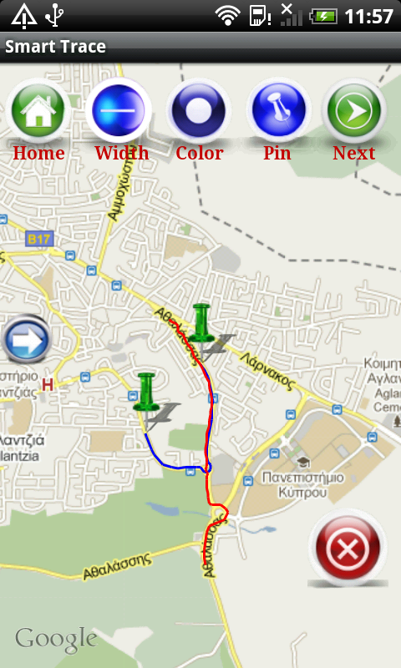

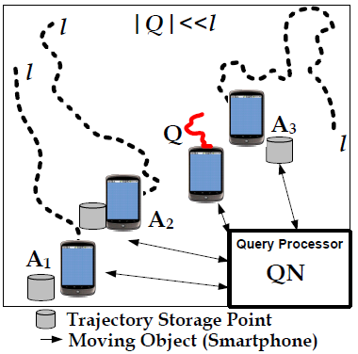
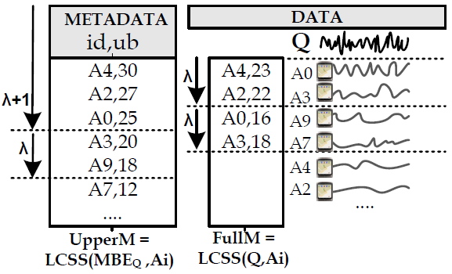
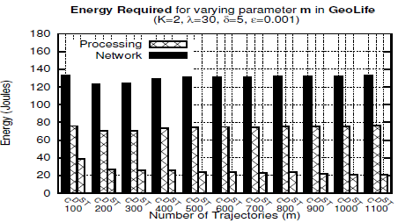
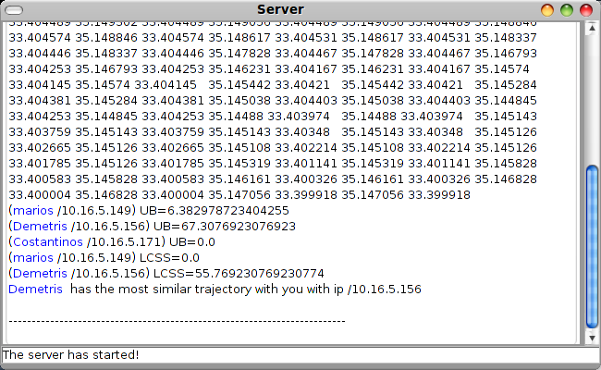
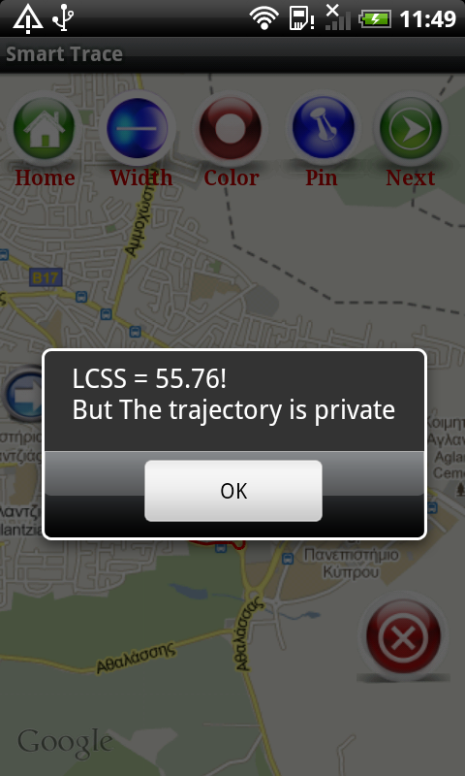
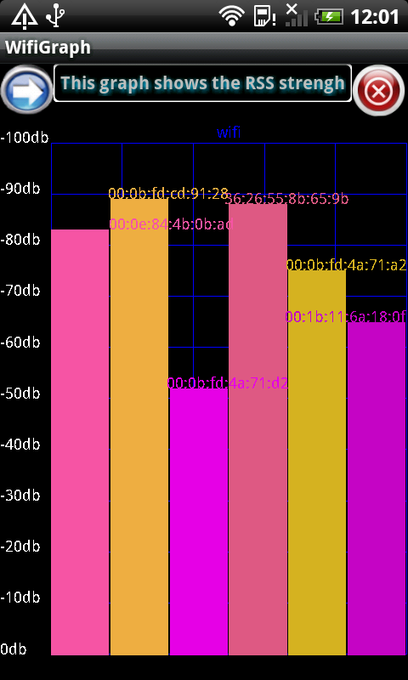
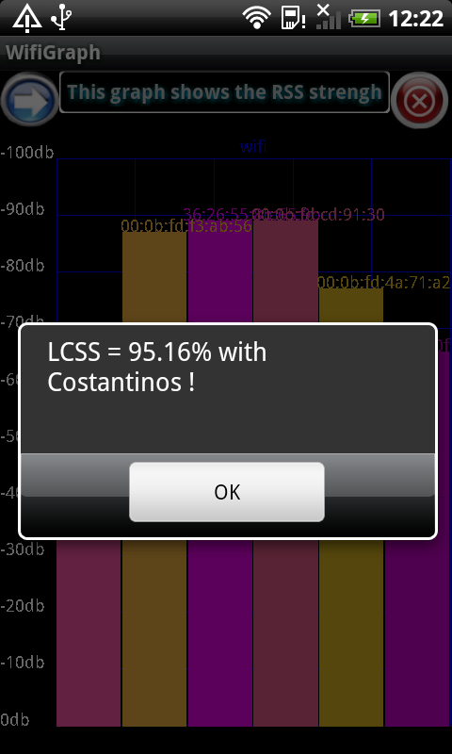
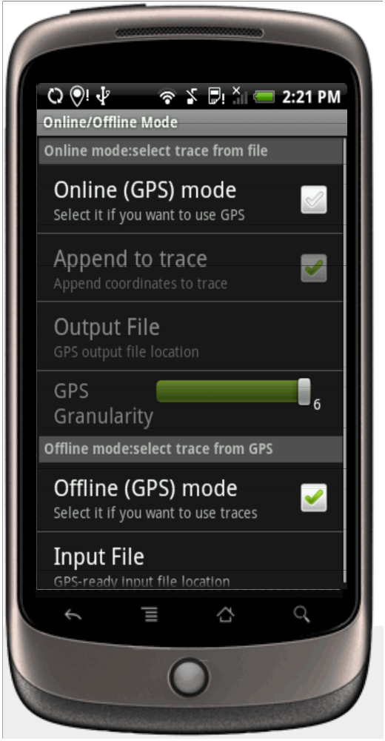
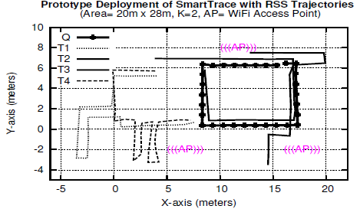
SmartTrace
Crowdsourced Trace Similarity with Smartphones
Costantinos Costa, Christos Laoudias, Demetrios Zeinalipour-Yazti and Dimitrios Gunopulos
University of Cyprus & University of Athens
Goals and Contributions
Similarity Comparison
Problem: Find the K users moving more similarly to a query trajectory Q, in a Smartphone Network.
ignore majority of noise
Privacy: User trajectories and User identities are not disclosed to the Query Processor.
Performance: a) In-situ data storage of trajectories (on smartphone flash) and b) Query Processing using a Top-K Query Processing Algorithm that uses Bound Scores*
match
match
Ubiquity: Our system works both outdoors (using GPS) and indoors (using WLAN Signal Strength)
  Flexible matching in time (ignore temporal noise)
  Flexible matching in space (ignore spatial noise)
The SmartTrace Framework
System Model
Performance Evaluation
Smartphone Energy: ↓ 81%
Android-based Smartphone Implementation
Server Console
Server
• Ubuntu Linux
• JDK 6, ~1500 LOC
“No Sharing” Policy
SmartTrace Indoors (WLAN RSS)
Client
• HTC Desire smartphones
• Android 2.1 (Eclair)
• Google Map API
• ~2500 LOC, ~250 lines XML
• 510KB installation package APK
• Runs on Dalvik VM (future: native C with Android NDK)
SmartTrace Outdoors (GPS)
SmartTrace Client GUI
• Query devices by example
• Plot and iterate through the responses using a variety of presentation styles
• Configure parameters (e.g. K)
• Control privacy settings
• Online/Offline modes for recorded scenario playback
• GPS/WiFi modes
Indoor scenario at KIOS Research Center
• 560m² area, 3 APs, 1 Query (Q) RSS trajectory
• 4 other (T1-T4) RSS trajectories, top-2 search
• T2 and T3 correctly identified as top-2 answers

