Slide 1
Hekaton: SQL Server’s Memory-Optimized OLTP Engine
By Cristian Diaconu, Craig Freedman, Erik Ismert, Per-Åke Larson, Pravin Mittal, Ryan Stonecipher, Nitin Verma, Mike Zwilling
ANDREAS IOANNOU & GIORGOS MOLESKIS
aioann01@cs.ucy.ac.cy & gmoles1@cs.ucy.ac.cy

Slide 2
OVERVIEW
Introduction
Principles behind the design of the engine.
High-level overview of the architecture.
How data is stored, indexed, and updated.
How stored procedures and table definitions are compiled into native code.
Transaction management and concurrency control
How transaction durability is ensured.
Garbage collection
Some experimental results.

Slide 3
What is Hekaton ?
Is a new database engine optimized for memory resident data and OLTP workloads.
Fully integrated into SQL Server.
How to use?
Simply declare a table memory optimized.

Slide 4
INTRODUCTION
The most database management systems were designed assuming that main memory is expensive and data resides on disk.
This assumption is no longer valid.
Memory prices have dropped by a factor of 10 every 5 years.
The majority of OLTP databases fit entirely in 1TB
The largest OLTP databases can keep the active working set in memory.

Slide 5
Advantage of being Integrated into SQL
Avoid the hassle and expense of another DBMS.
Only the most performance-critical tables need to be in main memory, other tables can be left unchanged.
Stored procedures accessing only Hekaton tables can be compiled into native machine code for further performance gains.
Conversion can be done gradually, one table and one stored procedure at a time.

Slide 6
Memory optimized tables
Managed by Hekaton and stored entirely in main memory
Are fully durable and transactional, though non-durable tables are also supported.
Can be queried and updated using T-SQL in the same way as regular SQL Server tables.
A query can reference both Hekaton tables and regular tables and a single transaction can update both types of tables.
T-SQL stored procedure that references only Hekaton tables can be compiled into native machine code(fastest way to query and modify data)

Slide 7
Concurrency
Does not rely on partitioning to achieve this
Any thread can access any row in a table without acquiring latches or locks.
The engine uses:
Latch-free (lock-free) data structures to avoid physical interference among threads
Optimistic Multiversion concurrency control technique to avoid interference among transactions

Slide 8
DESIGN CONSIDERATIONS
Throughput can be increased in three ways:
Improving scalability
Improving CPI (cycles per instruction)
Reducing the number of instructions executed per request
Even under highly optimistic assumptions, improving scalability and CPI can produce only a 3-4X improvement.
Reduce the number of instructions executed
To go 10X faster, the engine must execute 90% fewer instructions and yet still get the work done.
To go 100X faster, it must execute 99% fewer instructions.
This level of improvement is not feasible by optimizing existing storage and execution mechanisms.
Reaching the 10- 100X goal requires a much more efficient way to store and process data

Slide 9
Architectural Principles Optimize indexes for main memory
Current mainstream database systems use disk-oriented storage structures
Records are stored on disk pages that are brought into memory
Complex buffer pool
A page must be protected by latching before it can be accessed
A simple key lookup in a B-tree index may require thousands of instructions even when all pages are in memory.
Hekaton indexes are designed and optimized for memory-resident data
Durability is ensured with
Logging
Checkpoints
During recovery Hekaton tables and their indexes are rebuilt entirely from the latest checkpoint and logs.

Slide 10
Architectural Principles Eliminate latches and locks
Scalability suffers when the systems has shared memory locations that are updated at high rate
Latches, spinlocks
Highly contended resources(lock manager, the tail of the transaction log,B-tree index)
All Hekaton’s internal data structures are entirely latch-free (lock-free).
Indexes
Transaction map
Hekaton uses a new optimistic multiversion concurrency control to provide transaction isolation semantics(no locks and no lock table)
System where threads execute without stalling or waiting.

Slide 11
Architectural Principles Compile requests to native code
SQL Server uses interpreter based execution mechanisms in the same ways as most traditional DBMSs
Great flexibility but at a high cost
Even a simple transaction performing a few lookups may require several hundred thousand instructions.
Hekaton converts statements and stored procedures from T-SQL to machine code
The generated code contains exactly what is needed to execute the request
At compile time makes decisions to reduce runtime overhead

Slide 12
Architectural Principles No Partitioning
Recent systems designed for OLTP workloads and memory resident data
Partition the database by core
One exclusive core for each partition
Partitioning can be expensive if a transaction needs access to several partitions
Hekaton does not partition the database
Any thread can access any part of the database

Slide 13
HIGH-LEVEL ARCHITECTURE
Storage engine manages
User data and Indexes
Transactional operations on tables of records, hash and range indexes
Base mechanisms for storage, checkpointing, recovery and high-availability
Hekaton compiler
Compiles the procedure into native code designed to execute against tables and indexes managed by the Hekaton storage engine.
Hekaton runtime system provides integration with SQL Server resources and serves as a common library of additional functionality

Slide 14
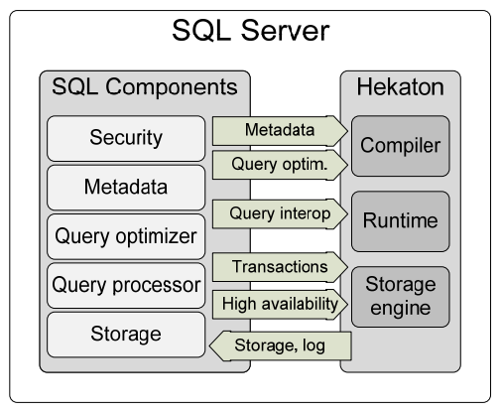
Metadata
Metadata about Hekaton tables, indexes are stored in the SQL Server catalog
Query optimization
Queries embedded in compiled stored procedures are optimized using the regular SQL Server optimizer
Query interop
Operators for accessing data in Hekaton tables
Transactions
can access and update data both in regular tables and Hekaton tables
High availability: AlwaysOn, SQL Server’s high availability feature
Storage, log: Hekaton logs its updates to the regular SQL Server transaction log

Slide 15
STORAGE AND INDEXING
A table created with the new option memory_optimized is managed by Hekaton and stored entirely in memory.
Hekaton can have several indexes and supports two types of indexes:
hash indexes
implemented using lock-free hash tables
range indexes
implemented using Bw-trees, a novel lock-free version of B-trees
Hekaton uses multiversioning
an update always creates a new version.

Slide 16
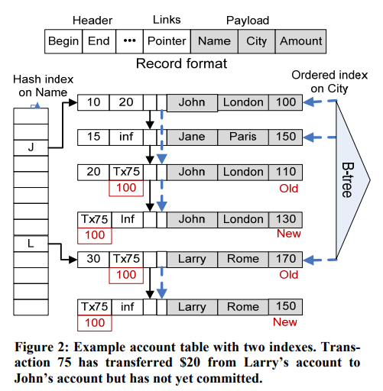
STORAGE AND INDEXING
Record Format
Hash Index on name
Ordered index on city
Reads
At most one version of a record is visible to a read
Records returns with valid times (Ex. 10 –20)
Non-overlapping valid times
Updates
When updating change Header End to current time
Current time shows the next record that could be valid
Header end = inf is always the latest record valid
We can't update obsolete versions
A version can be discarded when it is no longer visible to any active transaction.

Slide 17
PROGRAMMABILITY AND QUERY PROCESSING
Hekaton maximizes run time performance by converting SQL statements and stored procedures into highly customized native code.
Compile once-and-execute-many-times
Reuse much of the SQL Server T-SQL compilation stack including the metadata, parser, name resolution, type derivation, and query optimizer.
The output of the Hekaton compiler is C code and with Microsoft’s Visual C/C++ compiler to convert the C code into machine code.

Slide 18
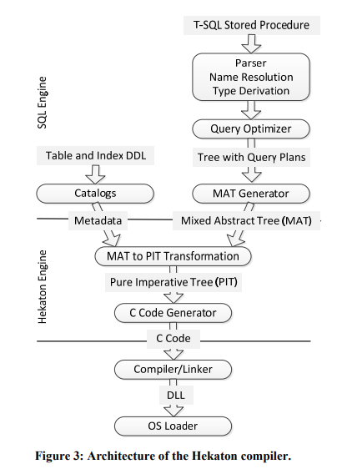
PROGRAMMABILITY AND QUERY PROCESSING
Architecture of the Hekaton compiler
There are two main points where we invoke the compiler:
Creation of a memory optimized table
Creation of a compiled stored procedure.
MAT ( mixed abstract tree )
Tree capable of representing metadata, imperative logic, expressions, and query plans.
PIT(pure imperative tree)
Data structure which is a much “simpler” data structure that can be easily converted to C code

Slide 19
PROGRAMMABILITY AND QUERY PROCESSING
Schema Compilation
Table creation requires code generation
Hekaton storage engine treats records as opaque objects.
No knowledge of
Internal content or format of records
Cannot directly access or process the data in records
The Hekaton compiler provides the engine with customized callback functions for each table:
Computes hash function on a key or record
Comparing two records
Serializing a record into a log buffer
These functions are compiled into native code
Inserts and searches are extremely efficient

Slide 20
PROGRAMMABILITY AND QUERY PROCESSING
Compiled Stored Procedures
Challenges
Transformation of query plans into C code
T-SQL and C type systems and expression semantics are very different
T-SQL includes many data types such as date/time types and fixed precision numeric types that have no corresponding C data types.
In addition, T-SQL supports NULLs while C does not.
Finally, T-SQL raises errors for arithmetic expression evaluation failures such as overflow and division by zero while C either silently returns a wrong result or throws an OS exception that must be translated into an appropriate T-SQL error.
Solution
Intermediate step
Converting the MAT into the PIT
Convert PIT to C code.

Slide 21
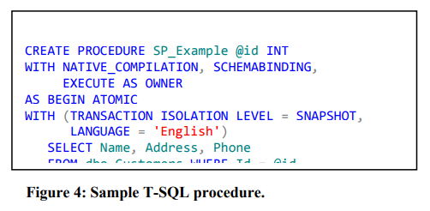

Slide 22
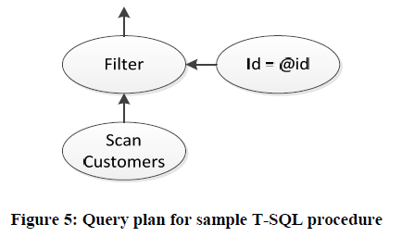
Possible Plan

Slide 23
PROGRAMMABILITY AND QUERY PROCESSING
Compiled Stored Procedures
Interface consists of
“get first,” “get next,” “return row,” and “return done.”
Without functions.
Result in wasted instructions where one operator merely calls another without performing any useful work.
Collapse an entire query plan into a single function
Use labels and gotos to implement and connect these interfaces.

Slide 24
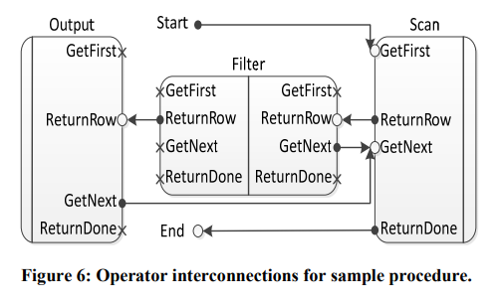

Slide 25
PROGRAMMABILITY AND QUERY PROCESSING
Compiled Stored Procedures
Single function design
Fewest number of instructions executed
Smallest overall binary
Using gotos
The code always grows linearly with the number of operators
There are cases where it does not make sense to generate custom code
Sort operator
generic sort implementation with a callback function to compare records
Complex or expensive functions
include them in a library and call them from the generated code

Slide 26
PROGRAMMABILITY AND QUERY PROCESSING
Restrictions
Hekaton Support SELECT, INSERT, UPDATE, and DELETE
Queries currently can include inner joins, sort and top sort, and basic scalar and group by aggregation.
Limitations of compiled stored procedures
Support a limited set of options
Controlled at compile time only
Eliminates unnecessary run time checks.
Execute in a predefined security context so that we can run all permission checks once at creation time.
Schema bound
Tables referenced by that procedure cannot be dropped without first dropping the procedure
This avoids costly schema stability locks before execution
Fourth, compiled stored procedures must execute in the context of a single transaction.
This requirement ensures that a procedure does not block midway through to wait for commit.

Slide 27
Query Interop
Mechanism that enables the conventional query execution engine to access memory optimized tables
Import and export of data to and from memory optimized tables
Using the existing tools and processes that already work for regular tables.
Execute virtually any legal SQL query against memory optimized tables
Use features such as views and cursors that are not supported in compiled stored procedures.
Support for transactions that access both memory optimized and regular tables.
Ease of app migration.
Existing tables can be converted to memory optimized tables without extensive work
Convert existing stored procedures into compiled stored procedures.

Slide 28
TRANSACTION MANAGEMENT
Hekaton utilizes optimistic multiversion concurrency control (MVCC) to provide snapshot, repeatable read and serializable transaction isolation without locking
To ensure that a transaction T is serializable we must ensure that the following two properties hold.
Read stability.
T reads some version V1
Must ensure that V1 is still the version visible to T as of the end of the transaction.
Implemented by validating that V1 has not been updated before T commits.
Phantom avoidance.
Must ensure that the transaction’s scans would not return additional new versions.
Implemented by rescanning to check for new versions before commit.

Slide 29
TRANSACTION MANAGEMENT Timestamps and Version Visibility
Timestamps produced by a monotonically increasing counter are used to specify the following.
Logical Read Time
the read time of a transaction can be any value between the transaction’s begin time and the current time.
Commit/End Time for a transaction:
every transaction that modifies data commits at a distinct point in time called the commit or end timestamp of the transaction
Valid Time for a version of a record:
The begin timestamp denotes the commit time of the transaction that created the version and the end timestamp denotes the commit timestamp of the transaction that deleted the version
A transaction executing with logical read time RT must only see versions whose begin timestamp is less than RT and whose end timestamp is greater than RT.
A transaction must see its own updates.

Slide 30
TRANSACTION MANAGEMENT Transaction Commit Processing
Validation and Dependencies
At the time of commit, a serializable transaction must verify that:
The versions it read have not been updated
No phantoms have appeared.
The validation phase begins with the transaction obtaining an end timestamp.
This end timestamp determines the position of the transaction within the transaction serialization history.
To validate its reads
Transaction checks that the versions it read are visible as of the transaction’s end time.
To check for phantoms
It repeats all its index scans looking for versions that have become visible since the transaction began
To enable validation each transaction maintains a read set, a list of pointers to the versions it has read, and a scan set containing information needed to repeat scans.

Slide 31
TRANSACTION MANAGEMENT Transaction Commit Processing
If the validation succeeds
The transaction is likely to commit
Its effects must be respected by all other transactions in the system as if they occurred atomically as of the end timestamp.
If validation fails
Nothing done by the transaction must be visible to any other transaction.
How Hekaton preserve the non-blocking nature
Commit dependency
T1 take a commit dependency on T2.
This means that T1 is allowed to commit only if T2 commits.
If T2 aborts, T1 must also abort so cascading aborts are possible.

Slide 32
TRANSACTION MANAGEMENT Transaction Commit Processing
Commit dependencies introduce two problems:
A transaction cannot commit until every transaction upon which it is dependent has committed
Commit dependencies imply working with uncommitted data and such data should not be exposed to users.
Solution: Read barriers.
This simply means that a transaction’s result set is held back and not delivered to the client while the transaction has outstanding commit dependencies.
The results are sent as soon as the dependencies have cleared.

Slide 33
Transaction Commit Processing
Commit Logging and Post-processing
Committed as soon as its changes to the database have been hardened to the transaction log.
Irreversibly committed
Post-processing phase
Update begin and end timestamps in all versions affected by the transaction to contain the end timestamp of the transaction.
Transactions maintain a write-set, a set of pointers to all inserted and deleted versions that is used to perform the timestamp updates and generate the log content.

Slide 34
Transaction Commit Processing
Transaction Rollback
Transactions can be rolled back at
User request
Due to failures in commit processing
Rollback is achieved by invalidating all versions created by the transaction and clearing the end-timestamp field of all versions deleted by the transaction.

Slide 35
TRANSACTION DURABILITY
Transaction logs to durable storage
Checkpoints to durable storage.
Log streams contain the effects of committed transactions logged as insertion and deletion of row versions.
Checkpoint streams come in two forms:
Data streams which contain all inserted versions during a timestamp interval
Delta streams, each of which is associated with a particular data stream and contains a dense list of integers identifying deleted versions for its corresponding data stream.

Slide 36
Transaction Logging
Each transaction is logged in a single, potentially large, log record.
The log record contains information about all versions inserted and deleted by the transaction, sufficient to redo them.
Dirty data is never written to durable storage.
Hekaton tries to group multiple log records into one large I/O
Multiple log streams can be used because serialization order is determined solely by transaction end timestamps and not by ordering in the transaction log

Slide 37
Checkpoints
The checkpointing scheme is designed to satisfy two important requirements.
Continuous checkpointing.
Checkpoint related I/O occurs incrementally and continuously as transactional activity accumulates.
Streaming I/O.
Checkpointing relies on streaming I/O rather than random I/O for most of its operations. Even on SSD devices random I/O is slower than sequential and can incur more CPU overhead due to smaller individual I/O requests.

Slide 38
Checkpoint Files
Checkpoint data is stored in two types of checkpoint files:
Data files
Contains only inserted versions (generated by inserts and updates) covering a specific timestamp range
Are append-only while opened and once closed, they are strictly read-only
Delta files.
Stores information about which versions contained in a data file have been subsequently deleted
Are append-only for the lifetime of the data file they correspond to.
At recovery time, is used as a filter to avoid reloading deleted versions into memory.
A complete checkpoint consists of multiple data and delta files and a checkpoint file inventory that lists the files comprising the checkpoint.
There is a 1:1 correspondence between a delta file and a data file.
A checkpoint file inventory tracks references to all the data and delta files that make up a complete checkpoint. The inventory is stored in a system table.

Slide 39
Checkpoint Process
Checkpoint Process
A checkpoint task takes a section of the transaction log not covered by a previous checkpoint and converts the log contents into one or more data files and updates to delta files.
New versions are appended to either the most recent data file or into a new data file and the IDs of deleted versions are appended to the delta files corresponding to where the original inserted versions are stored.
Once the checkpoint task finishes processing the log, the checkpoint is completed with the following steps.
Flush all buffered writes to the data and delta files and wait for them to complete.
Construct a checkpoint inventory that includes all files from the previous checkpoint plus any files added by this checkpoint. Harden the inventory to durable storage.
Store the location of the inventory in a durable location available at recovery time. We record it both in the SQL Server log and the root page of the database.

Slide 40
Checkpoints
Since crash recovery will read the contents of all data and delta files in the checkpoint, performance of crash recovery degrades as the utility of each data file drops.
The solution to this problem is to merge temporally adjacent data files when their active content (the percentage of undeleted versions in a data file) drops below a threshold. Merging two data files DF1 and DF2 results in a new data file DF3 covering the combined range of DF1 and DF2.
All deleted versions, that is, versions identified in the DF1 and DF2’s delta files, are dropped during the merge. The delta file for DF3 is empty immediately after the merge.

Slide 41
Checkpoints Recovery
Hekaton recovery starts after the location of the most recent checkpoint inventory has been recovered during a scan of the tail of the log
Hekaton recovery itself is parallelized
Each delta file represents in effect a filter for rows that need not be loaded from the corresponding data file
This data/delta file pair arrangement means that checkpoint load can proceed in parallel across multiple IO streams at file pair granularity.
Creates one thread per core to handle parallel insertion of the data produced by the I/O streams
The choice of one thread per core means that the load process is performed as efficiently as possible.

Slide 42
GARBAGE COLLECTION
Garbage collection
Poor performance
Lengthy pause times
Blocking
Other scaling problems often seen in the virtual machines for managed languages
Hekaton avoids these problems.
In Hekaton, garbage is defined by a version's "visibility"
A version of a record is garbage if it is no longer visible to any active transaction.

Slide 43
GARBAGE COLLECTION
The design of the Hekaton garbage collection (GC) subsystem has the following desirable properties.
Hekaton GC is non-blocking.
Garbage collection runs concurrently with the regular transaction workload
The GC subsystem is cooperative.
Worker threads running the transaction workload can remove garbage when they encounter it
Processing is incremental.
Garbage collection may easily be throttled and can be started and stopped to avoid consuming excessive CPU resources.
Garbage collection is parallelizable and scalable.
Multiple threads can work in parallel on various phases of garbage collection

Slide 44
Garbage Collection Details
GC Correctness
A version becomes garbage
It was deleted (via explicit DELETE or through an UPDATE operation)
Εnd timestamp < oldest active transaction
More precisely, the versions deleted or updated by T can be garbage collected because they are invisible to all current and future transactions.
Less common way for versions to become garbage is if they were created by a transaction that subsequently rolls back.

Slide 45
Garbage Removal
Garbage Removal
First be unlinked from all indexes in which it participates.
Regular index scanners encounter garbage versions as they scan indexes
Unlink garbage versions when they encounter them.
Parallelizes garbage collection in the system
No extra work to locate garbage versions
Sold versions will not slow down future scanners
However, this process is insufficient to ensure that either
'Cold' areas of an index which are not traversed by scanners are free of garbage
A garbage version is removed from other indexes that it might participate in
These versions do not need to be collected for performance reasons
They needlessly consume memory and, as such, should be removed as promptly as possible.
Offloaded to a background GC process (not critical)

Slide 46
GARBAGE COLLECTION
If GC finds a version that is still linked in one or more indexes, it cannot immediately unlink the version since it has no information about the row's predecessor.
In order to remove such versions:
GC first scans the appropriate part of each index
Unlinks the version, after which it can be removed.
While scanning, it of course unlinks any other garbage versions encountered.

Slide 47
GARBAGE COLLECTION - Scalability
Early versions of the Hekaton GC used a fixed set of threads for collection
It was difficult to ensure that a single GC thread could maintain the necessary rate of collection for a high number of incoming transactions, especially for those workloads that were more update/delete heavy.
In order to address this problem, the garbage collection has been parallelized across all worker threads in the system.
Periodically recalculating the oldest transaction watermark and partitioning completed transactions accordingly. However, once this work has been done, transactions that are ready for collection are then distributed to a set of work queues.
This serves two scalability benefits.
First, it naturally parallelizes the work across CPU cores, without the additional overhead and complexity of maintaining dedicated worker threads, and second, it allows the system to self-throttle.
By ensuring that each thread in the system that is responsible for user work is also responsible for GC work, and by preventing a user thread from accepting more transactional work until a bit of garbage has been collected, this scheme introduces a small delay in the processing of transactions in the system, making sure that the system does not generate more garbage versions than the GC subsystem can retire.

Slide 48
EXPERIMENTAL RESULTS - CPU Efficiency
Experiments on workstation with:
2.67GHz Intel Xeon W3520 processor
6 GB of memory
An 8 MB L2 cache.
Experiment Schema:
(c1 int, c2 int, c3 varchar(32)), each containing 1M rows. Column c1 is the primary key
Two identical tables, T1 and T2
T1 was a Hekaton table with a hash index on c1
T2 was a regular table with a B-tree index on c1.
Both tables resided entirely in memory.

Slide 49
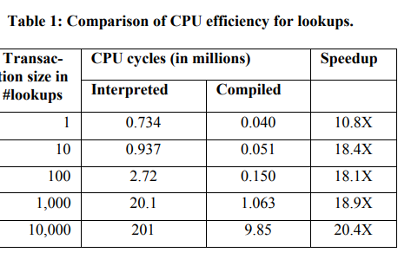
EXPERIMENTAL RESULTS Lookup Efficiency
T-SQL procedure RandomLookups that does N random lookups (RAND()) on the primary key (column c1) and computes the average, min, and max of column c2.
The driver calls RandomLookups
(procedure) in a loop and computes the average CPU cycles consumed per call.
The speedup is 20X when doing 10 or more lookups per call. Expressed differently, the Hekaton engine completed the same work using 5% of the CPU cycles used by the regular SQL Server engine.

Slide 50
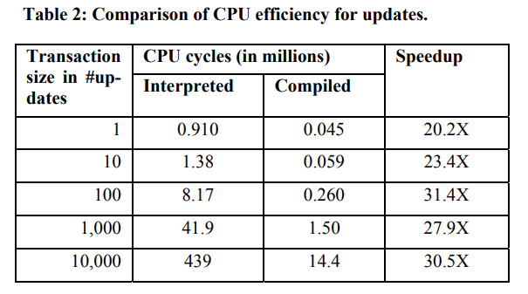
EXPERIMENTAL RESULTS Update Efficiency
TSQL procedure RandomUpdates that updates the c2 column of N randomly selected rows.
To measure CPU efficiency and not transaction latency,
Enabled write caching on the disk used for the transaction log.
The speedup is even higher than for lookups, reaching around 30X for transactions updating 100 or more records. Even for transactions consisting of a single updated, the speedup was around 20X.
Hekaton got the work done using between 3% and 5% of the cycles used by the regular engine.

Slide 51
EXPERIMENTAL RESULTS Scaling Under Contention
Scalability of database systems is often limited by contention on locks and latches
The system is simply not able to take advantage of additional processor cores
Throughput levels off or even decreases.
Hekaton is designed to eliminate lock and latch contention, allowing it to continue to scale with the number of processor cores.

Slide 52
EXPERIMENTAL RESULTS Scaling Under Contention
This experiment simulates an order entry system for, say, a large online retailer.
The load on the system is highly variable and during peak periods throughput is limited by latch contention.
SalesOrderDetails table that stores data about each item ordered.
The table has a unique index on the primary key
Clustered B-tree index if the table is a regular SQL Server table
Hash index if it is Hekaton table
The workload in the experiment consists of 60 input streams
Each a mix of 50% update transactions and 50% read-only transactions.
This experiment was run on a machine with
2 sockets,
12 cores (Xeon X5650, 2.67GHz),
144GB of memory
Gigabit Ethernet network cards.
External storage consisted of four 64GB Intel SSDs for data and three 80GB Fusion-IO SSDs for logs.

Slide 53
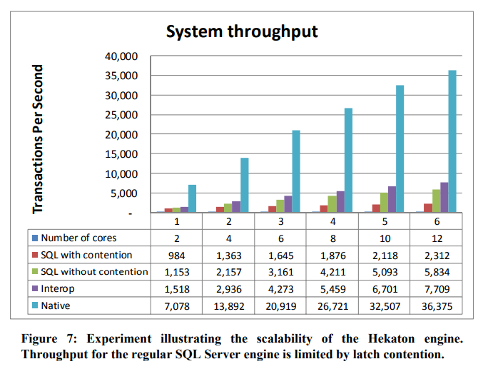
EXPERIMENTAL RESULTS Scaling Under Contention
Throughput as the number of cores used varies
The regular SQL Server engine shows limited scalability as we increase the number of cores used.
Latch contention limits the CPU utilization to just 40% for more than 6 cores
Converting the table to a Hekaton table and accessing it through interop
Improves throughput to 7,709 transactions per second for 12 cores, a 3.3X increase over plain SQL Server
Accessing the table through compiled stored procedures
improves throughput further to 36,375 transactions per second at 12 cores, a total increase of 15.7X.

Slide 54
EXPERIMENTAL RESULTS Scaling Under Contention
The Hekaton engine shows excellent scaling.
Going from 2 to 12 cores
Throughput improves by 5.1X for the interop case (1,518 to 7,709 transactions per second).
If the stored procedures are compiled
throughput also improves by 5.1X (7,078 to 36,375 transactions per second).
Partitioned the database and rewrote the stored procedure
Different transactions did not interfere with each other
Removing contention
Increased maximum throughput to 5,834 transaction/sec
Still lower than the throughput achieved through interop.
Improved scaling significantly from 2.3X to 5.1X going from 2 cores to 12 cores.

Slide 55
Concluding Remarks
Hekaton Is a new database engine which is optimized for large main memories and many-core processors.
It is fully integrated into SQL Server, which allows customers to gradually convert their most performance-critical tables and applications to take advantage of the very substantial performance improvements offered by Hekaton.
Hekaton achieves its high performance and scalability by using very efficient latch-free data structures, multiversioning, a new optimistic concurrency control scheme, and by compiling T-SQL stored procedure into efficient machine code.
Transaction durability is ensured by logging and checkpointing to durable storage.
High availability and transparent failover is provided by integration with SQL Server’s AlwaysOn feature.
As evidenced by our experiments, the Hekaton engine delivers more than an order of magnitude improvement in efficiency and scalability with minimal and incremental changes to user applications or tools.

Slide 56
THANK YOU FOR YOUR TIME!!

