Slide 1

THERMAL-JOIN: A Scalable Spatial Join for Dynamic Workloads
EPL646: Advanced Topics in Databases
THERMAL-JOIN: A Scalable Spatial Join for Dynamic Workloads. Farhan Tauheed, Thomas Heinis, and Anastasia Ailamaki. 2015. In Proceedings of the 2015 ACM SIGMOD International Conference on Management of Data (SIGMOD '15). ACM, New York, NY, USA, 939-950. DOI: https://doi.org/10.1145/2723372.2749434
By: Elena Prodromou (eprodr02@cs.ucy.ac.cy),
Giorgos Komodromos (gkomod01@cs.ucy.ac.cy)

Slide 2
Abstract
Simulations have become ubiquitous in many domains of science
Scientists study phenomena by building spatial models and running simulations on them
Challenge during the simulation is the repeated computation of self-joins of the model at each time step
Improving the precision of the simulation by increasing the number and size of the objects increases the join selectivity therefore challenges the performance and scalability of state-of art approach
This paper presents THERMAL-JOIN a spatial self-join algorithm for dynamic memory-resident workloads
Several experiments show that the THERMAL-JOIN approach provides 8X-12x speedup compared to the state of the art and scales as scientists improve the precision of the simulation

Slide 3
Introduction
Computing the interaction between spatial objects that make the model is crucial for many simulations
Simulation has to identify at runtime all pairs of objects whose 3D extents overlap
Overlapping pairs of objects are “a spatial self-join” that is performed repeatedly at each time step of the simulation
During the simulation, the location of all spatial objects is changed at each time step to mimic the behavior of the phenomena
2 Aspects of the problem:
All objects move incremental join (re-using old results becomes unfeasible)
Objects don’t move in predictable trajectories for short distances

Slide 4
Introduction
Known approaches do not scale in case scientists increase the precision of the simulation
We present THERMAL-JOIN, an in-memory spatial self-join algorithm for moving objects. To address:
The spatial aspect (high join selectivity)
The temporal aspect of the problem (massive and unpredictable updates)
Leverages the dataset density to minimize the cost of joining
Introduces the hotspots, regions with high spatial density, where all objects are guaranteed to overlap with each other
Is scalable approach where the benefits increase as the join selectivity and dataset increase
Use a novel linked-hash table to build, join and maintain a nested uniform grid
Uses uniform grid to index hot spots
Adapts and self-tunes the indexing structures used to account for the dynamic nature of the workload

Slide 5
Related Work
Iterative Static Spatial Join
Known static spatial join techniques update or re-build their data structures from scratch at each time step before the join
Takes time and is costly
Hierarchical decomposition
Can be used to avoid replication
The Octree is based on a uniform grid and splits a cell uniformly if the number of objects in it exceeds a defined threshold
An expansion of the Octree is the loose Octree [2]
Data-oriented partitioning techniques
Avoid replication by dividing the space based on the distribution of objects
The indexed nested-loop join builds an R-Tree on one dataset and executes a range query on it for each object in the other dataset to find intersecting objects
Indexes that based on the R-Tree and optimized for memory are the CR-Tree and the TOUCH[3]

Slide 6
Related Work
Joining Moving Objects
Spatio-temporal join methods, that are optimized for moving objects, can also be used
These methods join incrementally (reuse previously used data structures)
Other approaches such as TPR*-tree[4]: exploit the predictability in movement of the objects by approximating them with trajectories to reduce the overhead of frequent maintenance

Slide 7
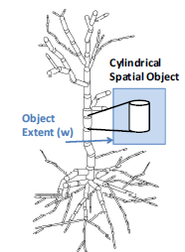
Motivation
Development of THERMAL-JOIN is driven by the needs of scientists who are facing performance bottleneck in simulating changes in massive spatial datasets
Use Cases:
Development of THERMAL-JOIN originates from a collaboration with the neuroscientists in the Human Brain Project [5]
Performance bottlenecks and scalability of neural simulations were studied

Slide 8
Motivation
Iterative Spatial Self-Join
Consider a spatial dataset D with N 3D spatial objects
The minimum bounding rectangle (MBR) is the spatial extent for each spatial object
The problem of a spatial self-join is to find all pairs of spatial objects to satisfy the predicate of spatial overlap
During the simulation, the location of each spatial object is changed to mimic the behavior of the phenomena studied
Makes the problem of a spatial (self-) join more challenging
Data Management Challenge
Even with few GBs of data in main memory, an iterative spatial self-join can take hours to complete and it therefore creates a substantial bottleneck in simulation applications

Slide 9

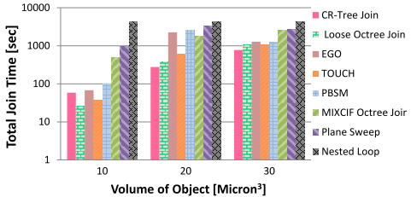

Slide 10
The THERMAL-JOIN approach
Addresses the problem of high join selectivity by organizing the dataset into hot spots
Processes a self-join within each hot spot as efficiently as possible while minimizing the overhead of joining objects of a hot spot with objects in its surrounding spatial region
Finding hot spots in spatial datasets in simulations can become expensive as the dataset changes unpredictably at every time step of the simulation
Uses a two-level nested spatial grid to do so efficiently
The choice of using a spatial grid further favors efficient rebuilding and maintenance as the dataset changes during the simulation

Slide 11
The THERMAL-JOIN approach
Three phases:
Index Building
Joining Phase
Index Maintenance

Slide 12
The THERMAL-JOIN approach
Index Building
The datasets were partitioned using a uniform spatial grid
The spatial objects of the model dataset are mapped to the grid based on their centre and therefore are not replicated
Real simulation datasets have a skewed data distribution that cause the majority of the grid cells to remain empty
Use of hash table that only keeps cells that have at least one object assigned to it
Avoids overhead of managing empty cells
Reduces the memory consumption signiﬁcantly
The cost of accessing (spatially) neighbouring cells during the join phase increases as hash lookups are required which cause a signiﬁcant overhead due to collisions

Slide 13
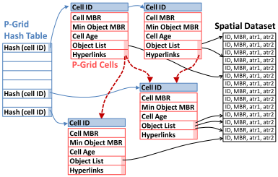
THERMAL-JOIN uses a two-level nested grid
The primary grid (P-Grid), built and maintained to reﬂect the most recent location of each object for the last time step
Built by calculating the cell each object belongs to (centre of object is in the cell)
Hash Lookup is performed on the cells identifier to determine if the object is added to the cell’s list or if a new cell is required
P-Grid cells can further divide the space using a temporary throw away grid (T-Grid) to enhance join performance

Slide 14
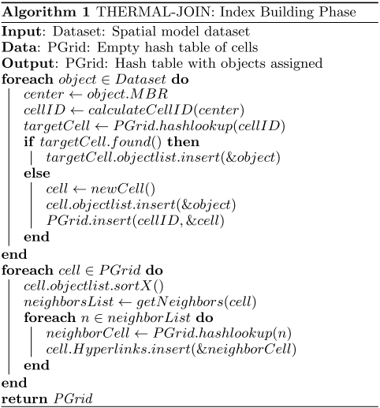

Slide 15
The THERMAL-JOIN approach
Joining
Starts after P-Grid is constructed
Two Part Process:
External: joining objects in each cell with the adjacent P-Grid cell
Internal: joining all objects within each P-Grid cell
External Join
Half of the adjacent cells of each cell is considered for external join to avoid joining pairs of cells more than once
Number of adjacent cells taken into account for the external join depends on the width of P-Grid cell and the width of largest object in the dataset

Slide 16
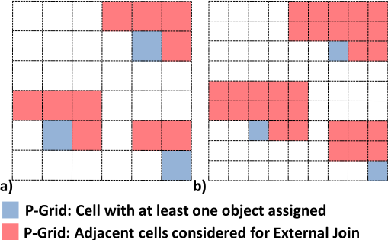
Once the index is built and the hyperlinks are created:
Every object a of Cell A in the P-Grid is joined with all objects of Adj. Cells of A via an optimized plane-sweep approach
if the MBR of any object a encloses the entire MBR of cell B then all objects of Adj. Cell B overlap with Object a

Slide 17
The THERMAL-JOIN approach
Internal Join
Hot spot as a grid cell, whose width is equal to or less than the width of the smallest object assigned to that cell
Choosing the width of the cell less than or equal to the width of the smallest object:
All cells are hot spots
Ensures regardless where the centres of the objects are located inside the cell, all objects will overlap (avoid expensive pair-wise overlap tests)
If dataset contains only a few very small objects this strategy forces the grid to have a very ﬁne resolution
The internal join will speed up but the overhead for the external join will also be increased because smaller cells mean that more adjacent cells need to be considered

Slide 18
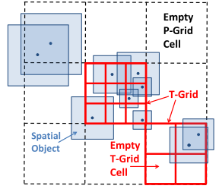
If P-Grid cell is a hot spot then:
The join results can be directly reported by generating all possible pair-wise combinations for objects assigned to that grid cell
The objects assigned to the same P-Grid cell are densely packed together with a considerable chance of overlapping with each other
Each P-Grid cell that is not a hot spot can therefore have a diﬀerent resolution for the sub grid

Slide 19
The THERMAL-JOIN approach
Objects assigned to the T-Grid in two phases (similar P-Grid):
First: Joining objects between two diﬀerent T-Grid cells by using an optimized variant of the plane-sweep approach, followed by a quick internal T-Grid cell join by simply reporting all pair-wise combinations
Second: an array is used to manage the grid (T-Grid in practice has only a few cells) and therefore the space overhead of representing empty cells is insigniﬁcant

Slide 20
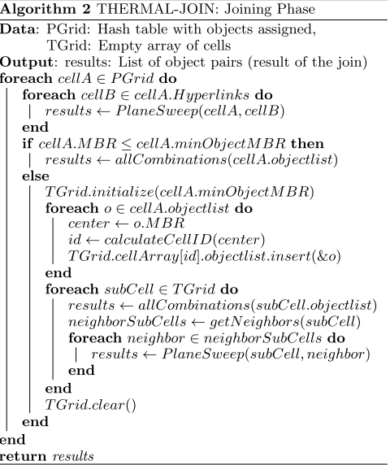

Slide 21
The THERMAL-JOIN approach
Index Maintenance
Incremental maintenance was implemented by re-using parts of the P-Grid index
At each time step object’s location was checked and if needed, it was assigned a new P-Grid cell
Data Structures for every object assigned to same P-Grid cell or to a non-empty neighbouring cell were re-used (no new cells, or hyperlinks)
Incremental maintenance approach requires adjustment of Algorithm 1 so that
For each time step only the object list of a cell is recreated
Empty P-Grid cells exist in memory
Could be used in a following timestep where object moves to their cell
Garbage Collection is performed if the number of vacant cells exceeds a deﬁned threshold (e.g. 35%)

Slide 22
The THERMAL-JOIN approach
Iterative Index Tuning
Tuning takes place iteratively during the simulation
The resolution of the P-Grid can vary
The performance of THERMAL-JOIN depends on conﬁguring this grid properly
Use of a normalized metric is applied to configure the resolution
Grid resolution is fixed to the largest object in dataset r=1
Set P-Grid resolution so that r>1 P-Grid cell is no longer hotspot then the cost of internal join increases
Set P-Grid resolution so that r<1 P-Grid cells are hotspots → Cost of internal join decreases number of P-Grid cells for external Join increases

Slide 23
Experimental Evaluation
Setup and Methodology
Experiments run on a Linux Ubuntu 2.6 machine equipped with:
2x Intel Xeon Processors each with 6 cores and 48GB RAM
Software Setup
Each competiting algorithm implemented uses a single CPU core for fair comparison
The implementations are all written in C++
A real neural simulation workload simulation datasets (previously mentioned) are loaded in memory and organized as a list of spatial objects

Slide 24
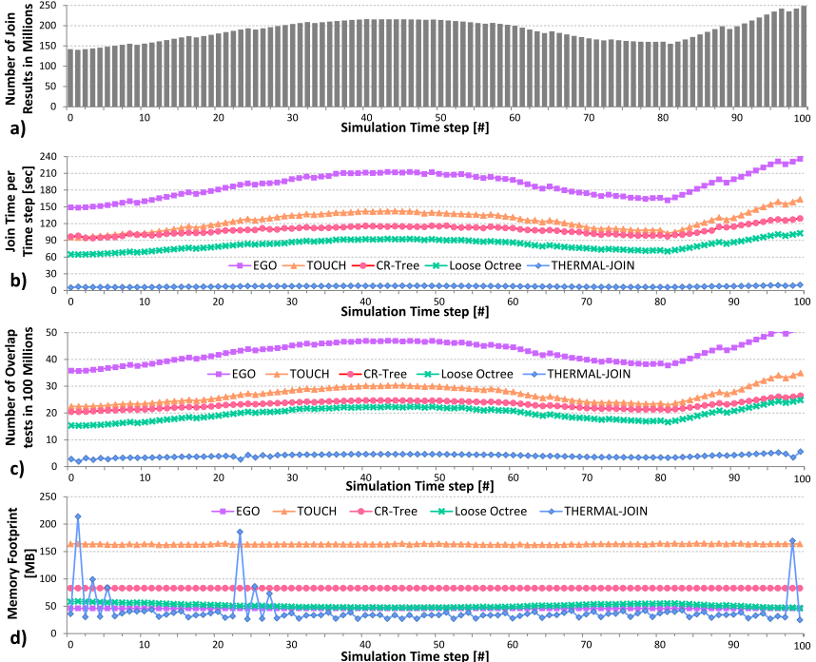
If the spatial density of a region increases, the number of join results for a time step increases as well

Slide 25
Experimental Evaluation
Synthetic Benchmark
Experimenting with real workloads
Two Benchmarks used:
A uniform random distributed benchmark with 10 million 3D spatial objects
A benchmark representing a skewed workload with 10 million objects and 15 units of object width
Created using a normal distribution with the centre of the cluster chosen randomly and a spread deﬁned by the standard deviation sd = 1

Slide 26
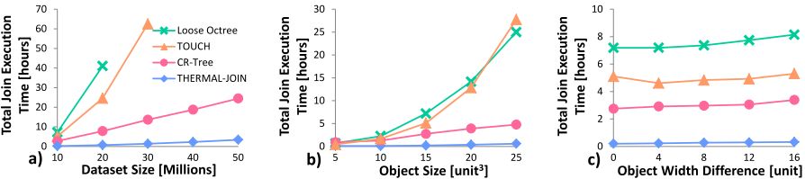
Dataset size increased
THERMAL-JOIN outperforms competing approaches and by 7.1× to the 2nd best CR-Tree
Object Size Increased
THERMAL-JOIN provides a speedup of 7.2× compared to the 2nd best CR-Tree
Variation in Object Size
When all objects have the same size, THERMAL-JOIN achieves a speedup of 13.7×
For the worst case THERMAL-JOIN still achieves a speedup of 10.4× over related work

Slide 27
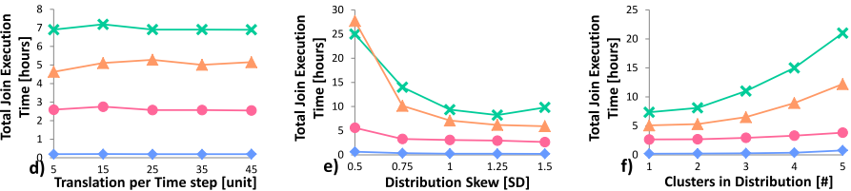
Temporal Resolution
TOUCH, CR-Tree, loose Octree are rebuilt from scratch at every time step
THERMAL-JOIN uses incremental building and garbage collection to keep the overhead of building the index low
Distribution Skew
THERMAL-JOIN outperforms competing approaches and achieves a speedup of 8.8×
Clustering (Objects divided among many clusters)
THERMAL-JOIN outperforms competing approaches by 5×

Slide 28
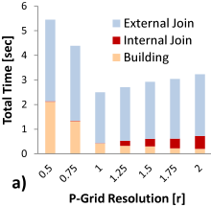
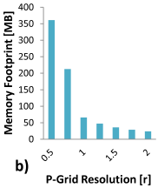
THERMAL-JOIN Analysis
Join phases and the memory footprint are chanced when the P-Grid resolution changes:
Grid resolution r varied from 0.5 to 2
Dataset: Real neural workload with 1M objects
Observations:
As the resolution increases (r > 1), the cost of internal join starts to become substantial
As the resolution decreases (r < 1), the cost of the building and external join time substantially increases
The memory required depends on the number of grid cells instantiated
As the resolution increases (r > 1), fewer cells are needed and thus the footprint becomes insigniﬁcant

Slide 29
THERMAL-JOIN Analysis
Applicability
THERMAL-JOIN is applicable to many diﬀerent problems that require iterative spatial self-join. e.g. video games
The assumption that the number and the shape of objects should remain constant during the simulation does not limit applicability
Limitations
THERMAL-JOIN is designed to address the challenges of joining highly selective datasets that change unpredictably during the simulation
If no extreme access pattern are observed, simpler solutions can be used
The design choices for THERMAL-JOIN prioritize runtime performance and scalability. In terms of memory footprint, however, spikes are observed due to the iterative tuning

Slide 30
Conclusion
THERMAL-JOIN
Is a high performance and scalable solution for executing spatial self-joins iteratively in main memory
The algorithm is practical to use, i.e., it does not require tuning elaborate conﬁguration parameters and it is resilient to diﬀerent workload characteristics
The approach uses the novel concept of spatial hot spots that improve the performance for workloads with high join selectivity
Approach achieves speedup of 8 to 12× when compared to the state-of-the-art
Remains competitive in terms of memory footprint

Slide 31
References
All figures were taken by the paper presented [1]
[1] THERMAL-JOIN: A Scalable Spatial Join for Dynamic Workloads. Farhan Tauheed, Thomas Heinis, and Anastasia Ailamaki. 2015. In Proceedings of the 2015 ACM SIGMOD International Conference on Management of Data (SIGMOD '15). ACM, New York, NY, USA, 939-950
[2] H. Samet, J. Sankara, and M. Auerbach. Indexing Methods for Moving Object Databases: Games and Other Applications. In SIGMOD ’13
[3] S. Nobari, F. Tauheed, T. Heinis, P. Karras, S. Bressan, and A. Ailamaki. TOUCH: In-Memory Spatial Join by Hierarchical Data-Oriented Partitioning. In SIGMOD ’13
[4] Y. Tao, D. Papadias, and J. Sun. The TPR*-tree: an Optimized Spatio-temporal Access Method for Predictive Queries. In VLDB ’03
[5] H. Markram et al. Introducing the Human Brain Project. In European Future Technologies ’11

