Slide 1

AQWA
Adaptive Query-Workload-Aware Partitioning of Big Spatial Data
Dimosthenis Stefanidis
Stelios Nikolaou

Slide 2
Introduction
Spatial Data
The data or information that identifies the geographic location (coordinates) of features and boundaries on Earth.
Due to the big amount of location-aware devices large amount of spatial information are created every day.

Slide 3
Introduction
2. What is AQWA?
AQWA(adaptive query-workload-aware) is a data partitioning mechanism that minimizes the query processing time of spatial queries.
AQWA updates the partitioning according to:
the data changes(SpatialHadoop require recreating the partitions)
the query workload

Slide 4
Introduction
Keeps a lower bound on the size of each partition ( traditional spatial index structures has unbounded decomposition)
Allowing too many small partitions can be harmful to the overall health of a computing cluster.

Slide 5
Introduction
AQWA supports spatial range and kNN queries.
AQWA presents a more efficient approach that guarantees the correctness of evaluation of kNN queries through a single round of computation while minimizing the amount of data to be scanned during processing the query(Existing approaches for kNN require two rounds of processing).
AQWA can react to different types of query workloads (i.e. multiple hotspots).

Slide 6

Main Goal
Partitioning the data in a way that minimizes that cost
L = set of partitions
Oq(p) = the number of queries that overlap Partition p
N(p) = the count of points in p

Slide 7
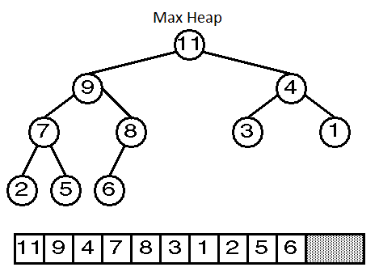
Split Queue(Priority Queue)
We maintain a priority queue of candidate partitions. Partitions in the split-queue are decreasingly ordered in a max-heap according to the cost reduction that would result after the split operations.

Slide 8
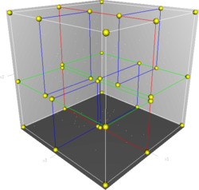
K-d tree
Space-partitioning data structure for organizing points in a k-dimensional space

Slide 9
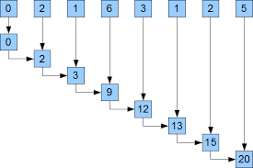
Prefix Sum

Slide 10
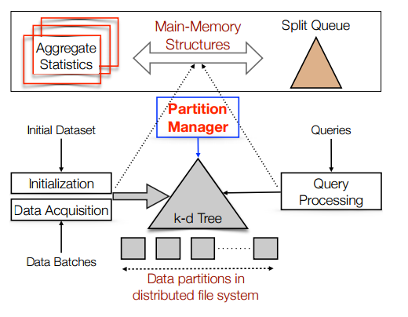
Initialization

Slide 11
Initialization
Divide the space into a grid(G[i,j]) which contains the total number of points whose coordinates are inside the boundaries.
A K-d tree decomposition (recursively) to identify the best partition layout. Partition the data in a way that balances the number of points across the partitions.
A MapReduce job reads the entire data and assigns each data point to its corresponding partition (creates the partition).

Slide 12
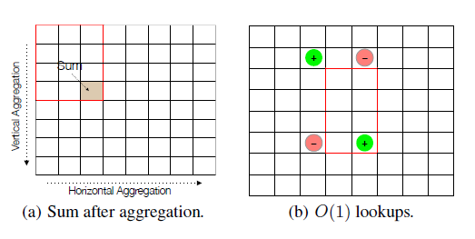
Efficient Search via Aggregation
perform horizontal aggregation
perform vertical aggregation

Slide 13
Query Execution

Slide 14
Query Execution
Select the partitions that are relevant to the invoked query.
Selected partitions are passed as input to a MapReduce job to
determine the actual data points that belong to the answer of
the query.
We may take a decision to repartition the data. If so update their
corresponding values in the priority queue.

Slide 15
Data repartition after a Query
Three factors affect this decision:
The cost gain that would result after splitting a partition.
The overhead of reading and writing the contents of these partitions.
The sizes of the resulting partitions.

Slide 16
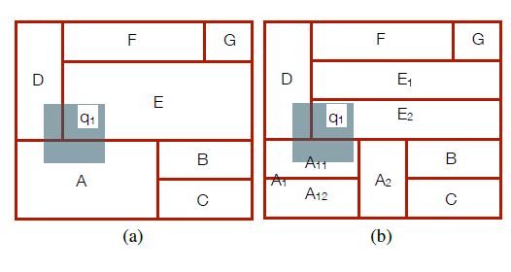
Splitting Partitions
A→20 points
E→30 points
D→15points
Cost is 20 × 1 + 30 × 1 + 15 × 1 = 65
E → split to E1 and E2
E1, E2 have 15 points each →
New cost = 50

Slide 17
Should we decide to split a partition?
Decreased Cost = C(E) − C(E1)*q − C(E2)*q
Cost for read/write:
Crw(E) = 2 × N(E)
N(E) is the number of points in E
Sizes of resulting partitions:
N(E1) > minCount
N(E2) > minCount
Where minCount=block size/(number of bytes of a data point)
Decreased cost > Crw

Slide 18
Time-Fading Weights
AQWA keeps the history of all queries that have been pro-cessed and it maintains counts in grid G, for the old queries (C old, received in the last T time units) and the current queries(C new, received before T time units)
(T parameter = time-fading cycle).
Every T time units, C old gets divided by c(c > 1) and C new is added to C old(then C new is set to zero).
Number of queries in a region: C new + C old

Slide 19
Time-Fading Weights
It process the partitions in a round-robin cycle and it process only Np/T partitions every T(Np = number of partitions). For each of the Np/T partitions, we recalculate the cost and reinsert these partitions into the split-queue.

Slide 20
Data Acquisition

Slide 21
Data Acquisition
Issue a MapReduce job that appends each new data point to its corresponding partition according to the current layout of the partitions.
The counts of points in the grid are incremented according to the corresponding counts in the given batch of data.

Slide 22
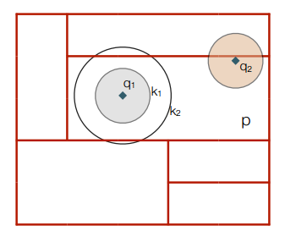
Support for kNN Queries
The boundaries that contain the answer of the query are unknown until the query is executed.
The spatial region that contains the answer of a kNN query depends on:
the value of k
the location of the query focal point
the distribution of the data

Slide 23
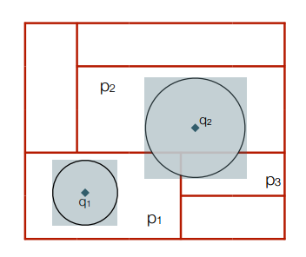
Support for kNN Queries
Scan the grid cells from the query focal point, and count the number of points in the encountered cells.
Once the accumulative count reaches the value k, we mark the largest distance between the query focal point and any encountered cell.
A kNN query is treated as a range query once the rectangular bounds enclosing the answer are determined.

Slide 24
Concurrency Control
Problem:
It is possible that while a partition is being split, a new query is received that may also trigger another split to the very same partitions being altered.
Solution: Simple locking mechanism
Whenever a query(q) triggers a split q tries to acquire a lock on each of the partitions to be altered. If q succeeds to acquire all the locks then q is allowed to alter the partitions. Locks are released after the partitions are completely altered. If q cannot acquire the locks then the decision to alter the partitions is cancelled.

Slide 25
Experiments
7-node cluster: running Hadoop 2.2 over Red Hat Enterprise Linux 6. Node in cluster: Dell r720xd server 16 Intel E5-2650v2 cores
Memory: 64 GB
Local Storage: 48 B
Ethernet interconnect: 40 Gigabit
Data size: Small scale(250 GB) & Large scale (2.5 TB)
We choose the k-d and grid-based partitioning as our baselines because this allows us to contrast AQWA against two different extreme partitioning schemes: 1) pure spatial decomposition(uniform grid) and 2) data decomposition (k-d tree)

Slide 26
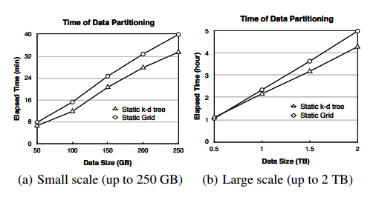
Initialization
AQWA is the same with k-d tree

Slide 27
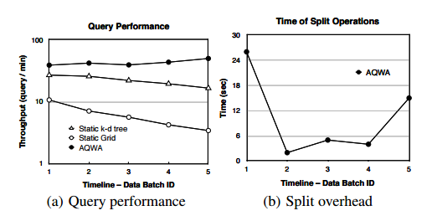
Range Query Performance
The system throughput indicates the number of queries that can be answered per unit time.
The split overhead indicates the time required to perform the split operations.

Slide 28
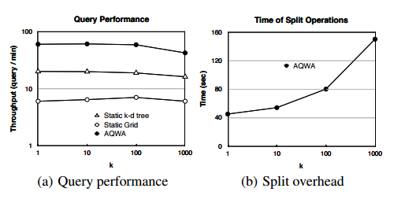
kNN Query Performance
The performance of kNN queries for different values of k.

Slide 29
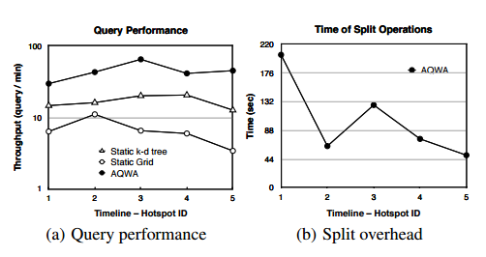
Handling Multiple Query-Workloads
In this set of experiments, we study the effect of having two or more query-workloads. In this mode, we simulate the migration of the workload from one hotspot to another.

Slide 30
Conclusion
In AQWA we addressed several performance and system challenges:
The limitations of Hadoop
The overhead of rebuilding the partitions in HDFS
The dynamic nature of the data where new batches are created every day
The issue of workload-awareness where the query workload can change

