Slide 1

Γιώργος Παναγιώτου
Κούλα Χατζηκώστα
Λευτέρης Ελευθεριάδης

Slide 2
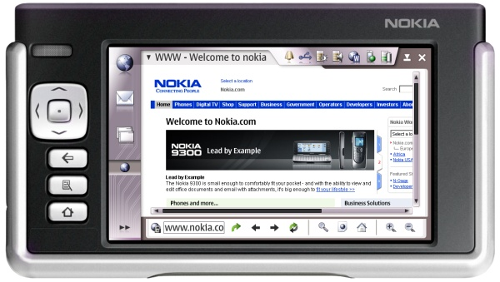
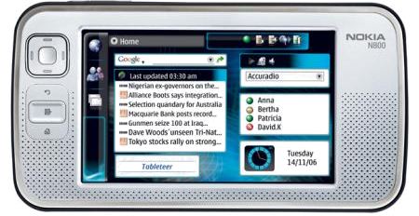
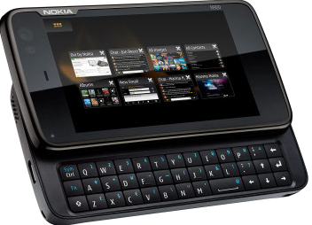
Ιστορική Αναδρομή
Νοέμβριος 2005
  Nokia Ν700 Internet tablet
Ιανουάριος 2007
  Nokia N800 Skype, camera
Νοέμβριος 2007
  N810 Keyboard, Google talk
  Mozilla browser, GPS, touch screen
Νοέμβριος 2009
  N900 Cell phone, finger touch,
  multitasking, OpenGL
Βασική εναλλακτική επιλογή η πλατφόρμα
Android
Notes:
N900 Arm Cortex processor 600Mhz

Slide 3
Πλεονεκτήματα
Ευνοεί την ανάπτυξη cross-platform παιχνιδιών(OpenGL ES) και εφαρμογών(Qt).
Μπορεί να τρέξει εφαρμογές Linux.
Υποστηρίζει Adobe Flash.
Καλή επίδοση και προσαρμοστικότητα.
Notes:
B2: me elaxistes allages, kai ena aplo recompile (περιοριζόμαστε σε 256ΜΒ ram)
B3: se anti8esi me to iphone
Β4: se sugkrisi me to android, to linux pou trexei einai plires enw to android trexei kommatia linux

Slide 4
Μειονεκτήματα
Ανάγκη για recompilation των εφαρμογών με κάθε νέα έκδοση.
Ακριβή συσκευή (N900 @ €385)
Υποστηρίζεται μόνο από την NOKIA
Δεν υποστηρίζει επίσημα την Java
Notes:
Β2: android (€300)
B3: 20 kataskeuastes uposthrizoun to android
B4: To third party πακέτο Jalimo παρέχει την δυνατότητα

Slide 5

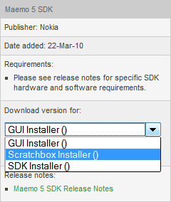
Εγκατάσταση Maemo
Development on any Debian 32bit derivative (our case Ubuntu 9.10)
Installation scripts: http://www.forum.nokia.com/Tools_Docs_and_Code/Tools/Platforms/Maemo/
add 'vm.vdso_enabled = 0’ to /etc/sysctl.conf
$ sudo sysctl -p
$ sudo bash maemo-scratchbox-install_5.sh (440MB)
$ sudo bash maemo-scratchbox-install_5.sh –u username
Relog on linux
$/scratchbox/login
[sbox-: ~] > logout
$sudo python maemo-sdk-install-wizard_5.0.py (14 + ~230 MB)

Slide 6
Εγκατάσταση ESbox
Eclipse IDE for maemo
http://esbox.garage.maemo.org/2nd_edition/installation_product.html
  Final Common Components (92 MB)
  Final Linux/GTK Support (2 MB)
$sudo apt-get install sun-java6-jre
$ bash esbox.sh
Σε περίπτωση προβλήματος (κενό messagebox)
  $ sudo apt-get install xulrunner
Extract in the same dir

Slide 7
Ανάπτυξη Εφαρμογών
Scratchbox cross-compilation toolkit
Μέσω:
  Maemo 5 SDK
    Eclipse scratchbox IDE (ESbox)
    C, C++, Python
  QT toolkit
    QT creator
    $Xephyr :2 -host-cursor -screen 800x480x16 -dpi 96 -ac -kb &
    $cp –a /projectfolder /scratchbox/users/$USER/$HOME
    $/scratchbox/login
    [sbox-FREMANTLE_X86: ~]> export DISPLAY=:2
    [sbox-FREMANTLE_X86: ~]> af-sb-init.sh start
    [sbox-FREMANTLE_X86: ~]> cd /projectfolder
    [sbox-FREMANTLE_X86: ~]> qmake
    [sbox-FREMANTLE_X86: ~]> make
    [sbox-FREMANTLE_X86: ~]> run-standalone.sh ./targetexe

Slide 8
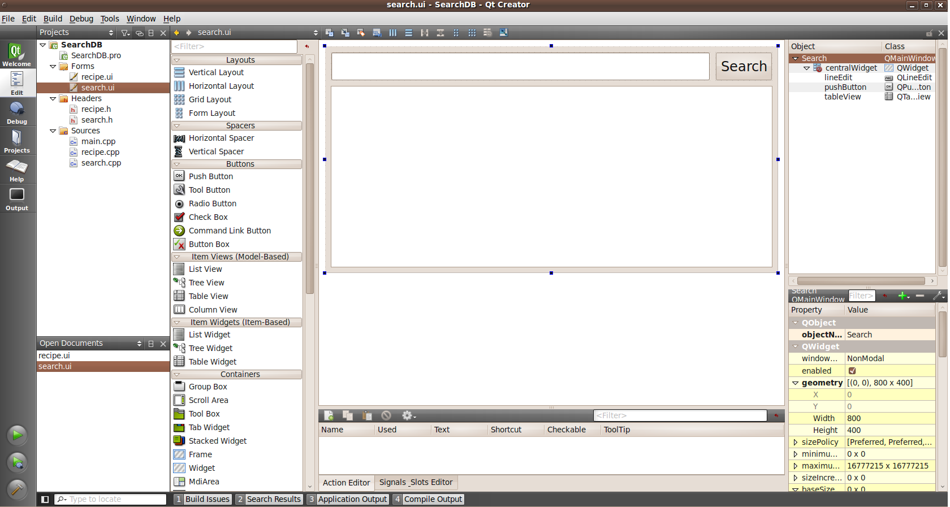
Qt creator IDE

Slide 9
Hello World
#include <gtk/gtkmain.h>
#include <gtk/gtklabel.h>
int main(int argc, char *argv[])
{
/* Create needed variables */
HildonProgram *program;
HildonWindow *window;
/* Initialize the GTK. */
gtk_init(&argc, &argv);
/* Create the Hildon program and setup the title */
program = HILDON_PROGRAM(hildon_program_get_instance());
g_set_application_name("HelloWorld");
/* Create HildonWindow and set it to HildonProgram */
window = HILDON_WINDOW(hildon_window_new());
hildon_program_add_window(program, window);
/* Add example label to window */
gtk_container_add(GTK_CONTAINER(window),
GTK_WIDGET(gtk_label_new("Hello World")));
/* Begin the main application */
gtk_widget_show_all(GTK_WIDGET(window));
/* Connect signal to X in the upper corner */
g_signal_connect(G_OBJECT(window), "delete_event",
G_CALLBACK(gtk_main_quit), NULL);
gtk_main();
return 0;
}

Slide 10
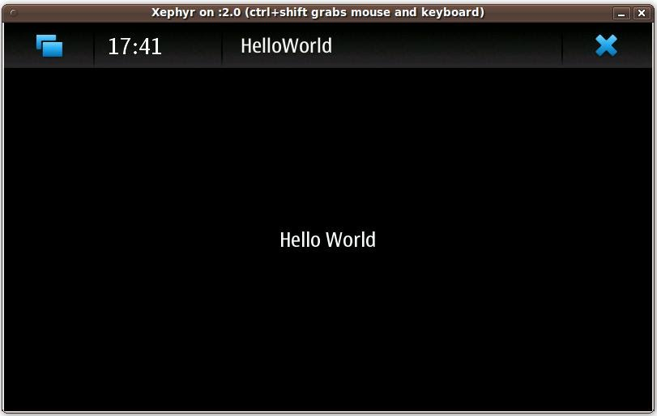
Compiling Hello world…
    $Xephyr :2 -host-cursor -screen 800x480x16 -dpi 96 -ac -kb &
    $/scratchbox/login
    [sbox-FREMANTLE_X86: ~]> export DISPLAY=:2
    [sbox-FREMANTLE_X86: ~]> af-sb-init.sh start
    [sbox-FREMANTLE_X86: ~]> gcc helloworld.c –o helloworld
    [sbox-FREMANTLE_X86: ~]> runstandalone.sh ./helloworld

Slide 11
Δυνατότητες
Έχει τις δυνατότητες ενός Linux
Multimedia (video, audio, flash)
User Interface (Hildon)
Connectivity (Bluetooth, wifi, sockets, GPS)
OpenGL ES (with hardware acceleration)
File System, SQLite database
Inter-process communication (DBUS)

Slide 12
SDK Libraries
Toolkit APIs
Gio
Glib
Gobject
GTK+
ATK
GDK
GDK-pixbuf
dbus
dbus-glib
dbus-glib_2
gconf
pango
cairo
clutter
Multimedia APIs
gstreamer
gstreamer-libs
gstreamer-plugins-0.10
pulseaudio
gupnp
gupnp-av
libcanberra
libmafw
libspeex
mafw-shared
libsoup
Connectivity APIs
libconic
libgwobex
bluez
osso-wlan
icd2
fmtx-middleware
Hildon APIs
libhildon
libhildondesktop
libhildonfm
libosso
libnotify
libtracker-common
libtracker-module

Slide 13
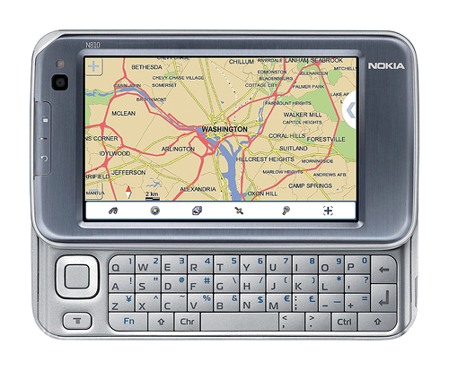
GPS
#include <location/location-gps-device.h>
#include <location/location-gpsd-control.h>
static void on_changed(LocationGPSDevice *device, gpointer data){
if (!device) return;
if (device->fix && device->fix->fields & LOCATION_GPS_DEVICE_LATLONG_SET) {
g_debug("lat = %f, long = %f", device->fix->latitude, device->fix->longitude);
location_gpsd_control_stop((LocationGPSDControl *) data);
}
}
static gboolean start_location(gpointer data){
location_gpsd_control_start((LocationGPSDControl *) data);
return FALSE;
}
int main(int argc, char *argv[]){
LocationGPSDControl *control;
LocationGPSDevice *device;
GMainLoop *loop;
g_type_init();
loop = g_main_loop_new(NULL, FALSE);
control = location_gpsd_control_get_default();
device = g_object_new(LOCATION_TYPE_GPS_DEVICE, NULL);
g_object_set(G_OBJECT(control), "preferred-method", LOCATION_METHOD_USER_SELECTED,
"preferred-interval", LOCATION_INTERVAL_DEFAULT, NULL);
g_signal_connect(device, "changed", G_CALLBACK(on_changed), control);
g_idle_add(start_location, control);
g_main_loop_run(loop);
g_object_unref(device);
g_object_unref(control);
return 0;
}

Slide 14
GUI-Color Chooser
#include <hildon/hildon-color-chooser-dialog.h>
#include <hildon/hildon-color-button.h>
static GdkColor color = {0, 0, 0, 0};
GtkWidget *selector;
gint result;
selector = hildon_color_chooser_dialog_new();
/* Set the current selected color to selector */
hildon_color_chooser_dialog_set_color(HILDON_COLOR_CHOOSER_DIALOG(selector), &color);
/* Show dialog */
result = gtk_dialog_run(GTK_DIALOG(selector));
/* Wait for user to select OK or Cancel */
switch (result) {
case GTK_RESPONSE_OK:
/* Get the current selected color from selector */
hildon_color_chooser_dialog_get_color
(HILDON_COLOR_CHOOSER_DIALOG(selector), &color);
/* Now the new color is in 'color' variable */
gtk_widget_destroy(selector);
break;
default:
/* If dialog didn't return OK then it was canceled */
gtk_widget_destroy(selector);
break;
}

Slide 15
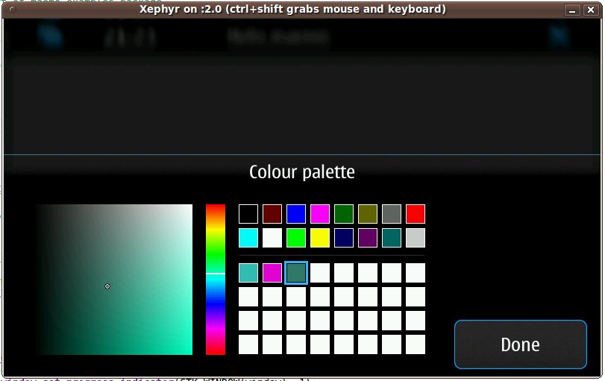
GUI-Color Chooser

Slide 16
Camera
#define VIDEO_SRC "v4l2camsrc"
#define VIDEO_SINK "xvimagesink“
/* Camera video stream comes from a Video4Linux driver */
camera_src = gst_element_factory_make(VIDEO_SRC, "camera_src");
/* Colorspace filter is needed to make sure that sinks understands
* the stream coming from the camera */
csp_filter = gst_element_factory_make("ffmpegcolorspace", "csp_filter");
/* Tee that copies the stream to multiple outputs */
tee = gst_element_factory_make("tee", "tee");
/* Queue creates new thread for the stream */
screen_queue = gst_element_factory_make("queue", "screen_queue");
/* Sink that shows the image on screen. Xephyr doesn't support XVideo
* extension, so it needs to use ximagesink, but the device uses xvimagesink */
screen_sink = gst_element_factory_make(VIDEO_SINK, "screen_sink");
/* Creates separate thread for the stream from which the image is captured */
image_queue = gst_element_factory_make("queue", "image_queue");
/* Filter to convert stream to use format that the gdkpixbuf library can use */
image_filter = gst_element_factory_make("ffmpegcolorspace", "image_filter");
/* A dummy sink for the image stream. Goes to bitheaven */
image_sink = gst_element_factory_make("fakesink", "image_sink");

Slide 17
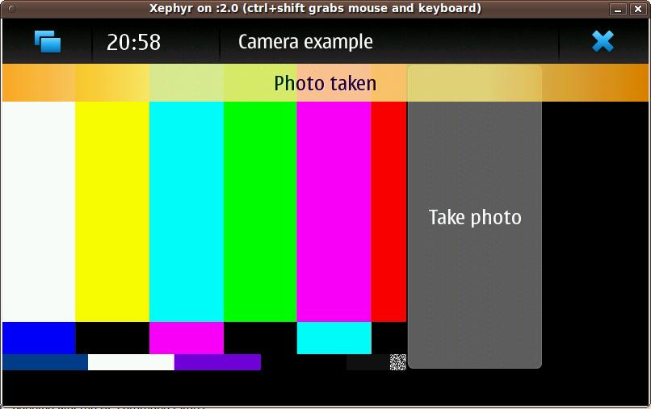
Camera

Slide 18
Bluetooth
#include <dbus/dbus-glib.h>
#define CONBTDIALOGS_DBUS_SERVICE "com.nokia.bt_ui"
#define CONBTDIALOGS_DBUS_INTERFACE "com.nokia.bt_ui"
#define CONBTDIALOGS_DBUS_PATH "/com/nokia/bt_ui"
files[0] = "\data\pic001.jpg"; files[1] = NULL;
appdata.dbus = dbus_g_bus_get(DBUS_BUS_SYSTEM, NULL);
/* Create a proxy object for bt_ui service */
bt_ui = dbus_g_proxy_new_for_name(
appdata->dbus, CONBTDIALOGS_DBUS_SERVICE,
CONBTDIALOGS_DBUS_PATH, CONBTDIALOGS_DBUS_INTERFACE);
/* Call show_send_file_dlg which shows a device selection
* dialog to user and handles the sendling also */
call_result = dbus_g_proxy_call(bt_ui,"show_send_file_dlg“,&error,
G_TYPE_STRV, files,G_TYPE_INVALID, G_TYPE_INVALID);
g_object_unref(bt_ui);

Slide 19
Touch screen/Drawing example
GdkPixmap *pixmap;
int main(int argc, char** argv){
GtkWidget *drawing_area;
//Create the drawing area widget
drawing_area = gtk_drawing_area_new();
pixmap = gdk_pixmap_new(widget->window,800,480,-1);
//Connect the events
gtk_signal_connect (GTK_OBJECT (drawing_area), "button_press_event",
(GtkSignalFunc) button_press_event, appdata);
//Set event mask for drawing_area
gtk_widget_set_events (drawing_area, GDK_BUTTON_PRESS_MASK);
}
gboolean button_press_event( GtkWidget *widget, GdkEventButton *event, AppData *appdata){
if (event->button == 1 && pixmap != NULL){
char text[64]="";
//Draw rectangle on screen
gdk_draw_rectangle(pixmap, widget->style->black_gc, 1, x-10, y-10,20,20);
//Change the caption of the label to indicate touch co-ordinates
sprintf(text, "You pressed point(%d,%d)", (int)event->x, (int)event->y);
g_object_set(appdata->xyLabel, "label", text, NULL);
}
return TRUE;
}

Slide 20
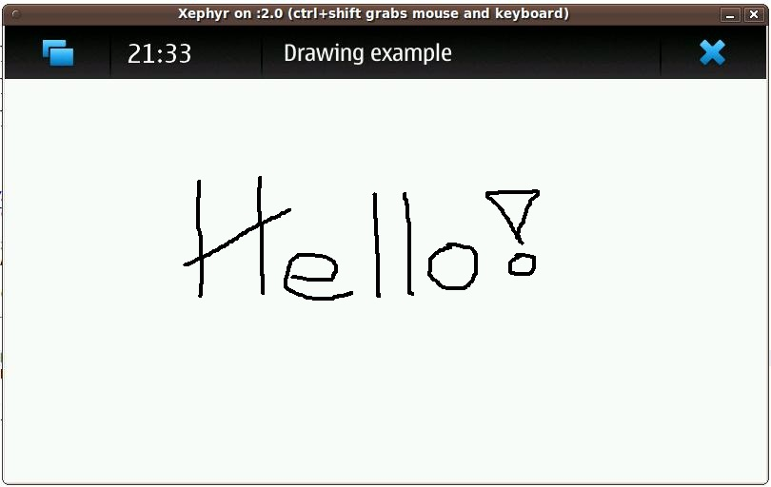
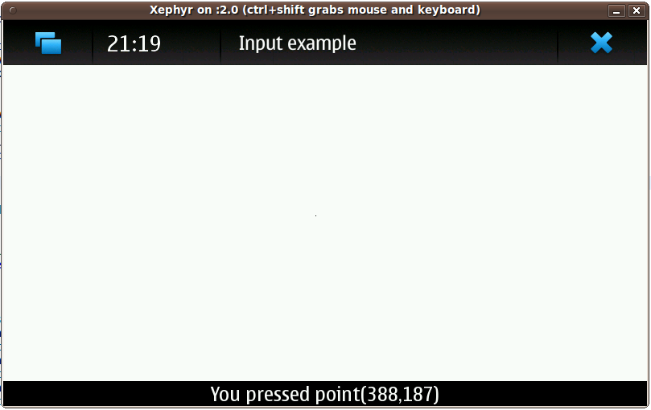
Touch screen/Drawing example

Slide 21
Αναζήτηση σε Βάση Συνταγών
Μας ζητήθηκε να αναπτύξουμε μια εφαρμογή για αναζήτηση κειμένου σε μια βάση δεδομένων μέσω γραφικής διαπροσωπίας.
Στατιστικά:
  Χρόνος Ανάπτυξης: 2 ώρες
  Γραμμές κώδικα: 250

Slide 22
Αναζήτηση σε Βάση Συνταγών
//initialize forms
s = new Search();
re = new Recipe();
//connect to database
db = QSqlDatabase::addDatabase("QSQLITE");
db.setDatabaseName("recipe.sqlite");
if (!db.open())
{
//on error, display message box
QMessageBox msgBox;
msgBox.setText("ERROR");
msgBox.setInformativeText("Something went wrong with the database connection.");
msgBox.setStandardButtons(QMessageBox::Ok);
msgBox.setIcon(QMessageBox::Critical);
msgBox.exec();
}
//show search form
s->show();

Slide 23
Αναζήτηση σε Βάση Συνταγών
void Search::on_pushButton_clicked()
{
//when search button is clicked set a query according to the user’s input
model->setQuery("SELECT ID, RecipeName, Description FROM recipe WHERE RecipeName
LIKE \"%" + ui->lineEdit->text() + "%\"");
//display query results
ui->tableView->setModel(model);
ui->tableView->show();
ui->tableView->setColumnHidden(0,true);
ui->tableView->setColumnWidth(1,290);
ui->tableView->setColumnWidth(2,430);
}
void Search::on_tableView_doubleClicked(QModelIndex index)
{
//when double click on table, display recipe form
re->displayRecipe(model->record(index.row()).field(0).value().toString());
this->hide();
}

Slide 24
Αναζήτηση σε Βάση Συνταγών
void Recipe::displayRecipe(QString index)
{
QSqlRecord r;
ui->textEdit->clear();
//set a query according to the index given as input,to get the information of the
//recipe
querymodel->setQuery("Select * from Recipe where ID=\"" + index + "\";");
r = querymodel->record(0);
//display recipe information
ui->textEdit->append("<div align=\"center\"><u>" +
r.field(1).value().toString() +
((r.field(64).value().toString().isEmpty())?"":" (" +
r.field(64).value().toString()+")") +
"</u></div><BR><b>Equipment:</b>");
…………
}

Slide 25
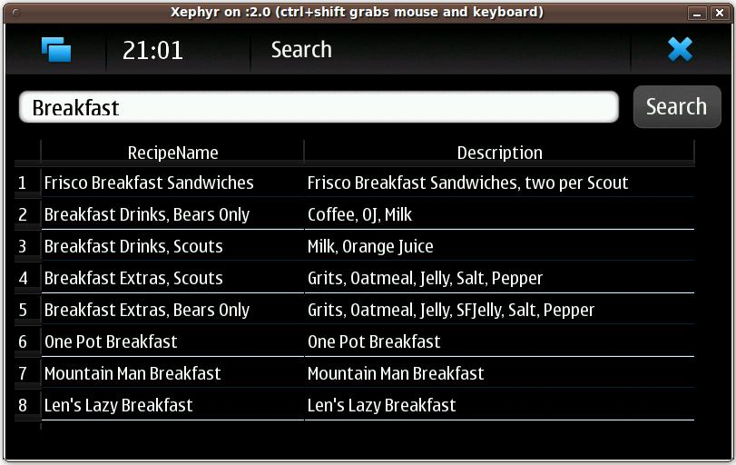
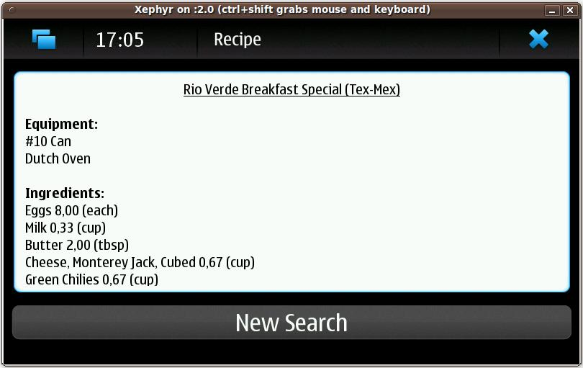
Αναζήτηση σε Βάση Συνταγών

Slide 26
Συμπεράσματα
Απαραίτητη η συσκευή για πολλές εφαρμογές
Εύκολη και γρήγορη ανάπτυξη εφαρμογών μέσω Qt
Έλλειψη βιβλιοθηκών (πχ database connectors)
Καλό community support
Καλό documentation από πλευράς Qt, μέτριο από πλευράς Maemo SDK
Notes:
B3) sql lite

Slide 27
Βιβλιογραφία
http://gdgt.com/discuss/maemo-vs-android-what-makes-3nu/
http://www.infosyncworld.com/news/n/10506.html
http://farm3.static.flickr.com/2301/1599334793_fcb8a41497.jpg
http://talk.maemo.org/showthread.php?t=49909
www.scratchbox.com
http://wiki.maemo.org/Documentation/Maemo_5_Developer_Guide/Development_Environment/Maemo_SDK
http://www.freedesktop.org/wiki/Software/Xephyr
http://wiki.forum.nokia.com/index.php/Maemo_multimedia_applications_-_Part_II
http://talk.maemo.org/showthread.php?t=49909
http://www.mail-archive.com/maemo-developers@maemo.org/msg21613.html

Slide 28


