Slide 1
Android Game Development Libraries
Charis Marangos

Slide 2
Games versus Most Applications
Technical implementation is hard
Real-time and responsive (at least 25 frames per second)
Hungry for Battery and other Resources
Dynamic experience (many objects to draw and update)
Logic implementation
Must be separate from technical implementation
Quality of content
Story
Graphics
Sound
Fun to play!

Slide 3
Supported Graphics for Android
Canvas and Drawables
Easier to work with
Other SDK features may be used easily (Text, AlertDialogues, etc)
Only for 2D
OpenGL (ES 1.x, ES 2.0)
Supports 3d graphics
Much faster
Hardware acceleration

Slide 4
Game Libraries
Less time spent in technical details
Less native calls exposed
Handling of devices
Loading and handling resources
More time available for:
Game-specific logic programming
Developing content
Helps with portability
Hardware abstraction
Platform abstraction

Slide 5
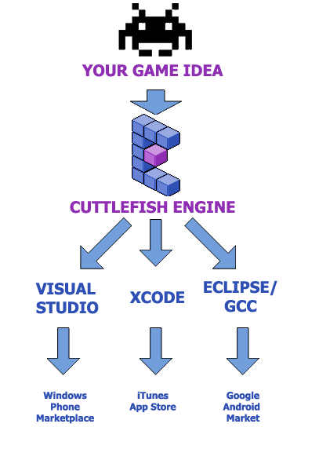
Cuttlefish Engine
Cross-platform 2D Engine
Windows, Mac
iOS, Android
The Engine is open-source
Designer
Not free! ($100 per year)
Tile-based Level Editor with Layer support
Particle Effects
Language: Cuttlescript
Similar to C#
Compiles to native code
box2D physics
Support for native code
Still doesn’t support many devices
Only 20% of Android devices

Slide 6
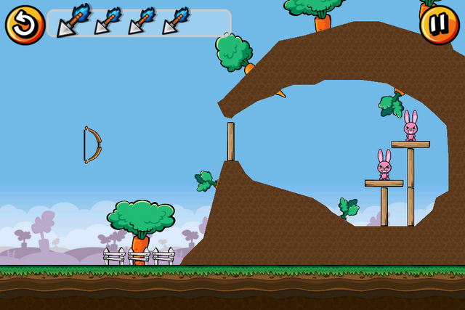
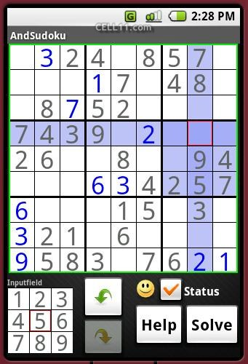
AndEngine
2D abstraction layer for OpenGL
Android only
Built on top of the Android SDK
Fully open-source
Fast
Box2D Physics
Games:
Bunny Shooter

Slide 7
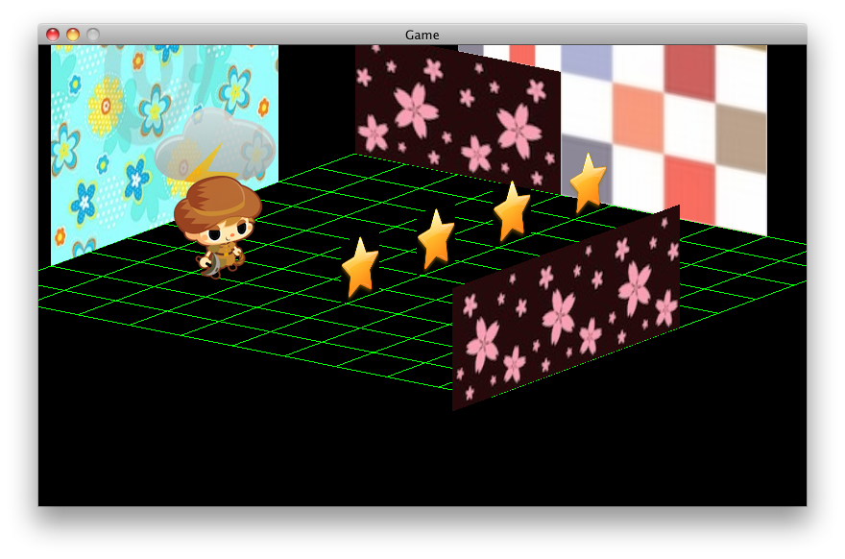
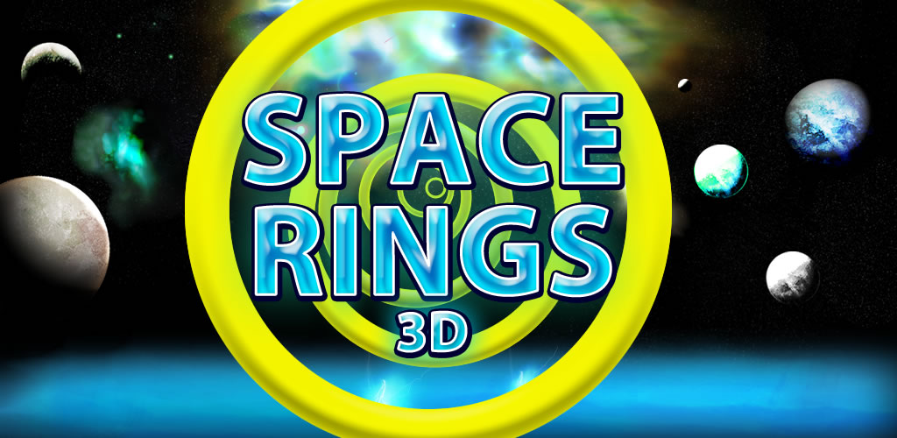
LibGDX
Cross-platform
Windows, Linux, Mac
Android, iOS
Free and fully open-source!
A Complete framework, but not a game engine
Low-level 3D with OpenGL
High-level 3D
High-level 2D
Physics with box2D
Math classes for 3D
Utilities, Tools & Extensions
Language: Java
Games
Newton
Space Rings 3D

Slide 8
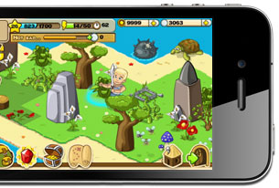
Corona
For Android and iOS
2D games only
Free to use, but requires subscription ($350 per year) to publish games
Similar to Flash, geared for Flash developers
Includes Tools which help with the reuse of Flash assets
Games
The Lost City
Shovel heroes

Slide 9

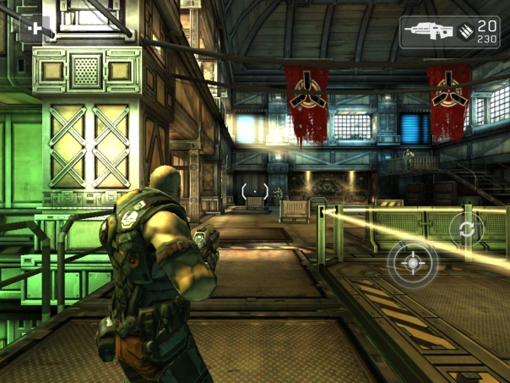
Unity 3D
Cross-platform
Windows, Mac and (soon, but not yet) Linux
Web (requires plugin), Flash
Android, iOS
Xbox360, PS3 and Wii
Many versions
Standard version is free for Windows and Mac
Pro license: $1,500
Android: $400
iOS: $400
Languages: C#, UnityScript (similar to JavaScript), Boo (similar to Python)
It is possible to use all 3 languages in the same project
Compiles to Mono
Slight overhead
Extremely easy to use
Very powerful, with a plethora of features
Not recommended for 2D games
Games
Shadowgun
Angry Viking

Slide 10

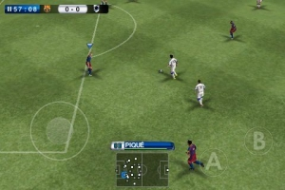
Marmalade
Cross-platform
Android, iOS
Symbian
Windows, MacOS
Application and Game SDK
Mature product, good support
Powerful 3D pipeline
Optimal performance geared for specific devices
Full access to OpenGL ES 2.0
Language: C++
Visual Studio
Xcode
Compiles natively (uses NDK for Android)
Supports ASM instructions
Games
Need for Speed Shift
Pro Evolution Soccer 2011

Slide 11
Standard Android OpenGL vs LibGDX!
Drawing text in standard Android SDK:
// Create an empty, mutable bitmap
Bitmap bitmap = Bitmap.createBitmap(256, 256, Bitmap.Config.ARGB_4444);
// get a canvas to paint over the bitmap
Canvas canvas = new Canvas(bitmap);
bitmap.eraseColor(0);
// get a background image from resources
// note the image format must match the bitmap format
Drawable background = context.getResources().getDrawable(R.drawable.background);
background.setBounds(0, 0, 256, 256);
background.draw(canvas); // draw the background to our bitmap
// Draw the text
Paint textPaint = new Paint();
textPaint.setTextSize(32);
textPaint.setAntiAlias(true);
textPaint.setARGB(0xff, 0x00, 0x00, 0x00);
// draw the text centered
canvas.drawText("Hello World", 16,112, textPaint);
//Generate one texture pointer...
gl.glGenTextures(1, textures, 0);
//...and bind it to our array
gl.glBindTexture(GL10.GL_TEXTURE_2D, textures[0]);
//Create Nearest Filtered Texture
gl.glTexParameterf(GL10.GL_TEXTURE_2D, GL10.GL_TEXTURE_MIN_FILTER, GL10.GL_NEAREST);
gl.glTexParameterf(GL10.GL_TEXTURE_2D, GL10.GL_TEXTURE_MAG_FILTER, GL10.GL_LINEAR);
//Different possible texture parameters, e.g. GL10.GL_CLAMP_TO_EDGE
gl.glTexParameterf(GL10.GL_TEXTURE_2D, GL10.GL_TEXTURE_WRAP_S, GL10.GL_REPEAT);
gl.glTexParameterf(GL10.GL_TEXTURE_2D, GL10.GL_TEXTURE_WRAP_T, GL10.GL_REPEAT);
//Use the Android GLUtils to specify a two-dimensional texture image from our bitmap
GLUtils.texImage2D(GL10.GL_TEXTURE_2D, 0, bitmap, 0);
//Clean up
bitmap.recycle();

Slide 12
Standard Android OpenGL vs LibGDX!
Drawing text in LibGDX:
BitmapFont font;
SpriteBatch batch;
public void create() {
font = new BitmapFont();
batch = new SpriteBatch();
}
public void render() {
Gdx.graphics.getGL10().glClear(GL10.GL_COLOR_BUFFER_BIT);
batch.begin();
font.draw(batch, "Hello World!", 10, 10);
//..rest of drawing code for other elements
batch.end();
}

Slide 13
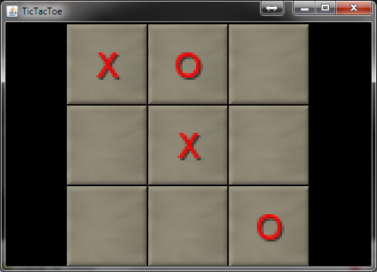
Tic Tac Toe
My implementation of the tic tac toe game, using LibGDX

Slide 14
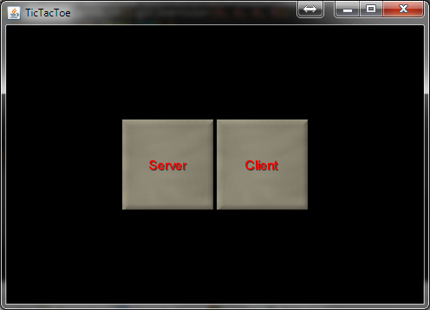
Tic Tac Toe

Slide 15
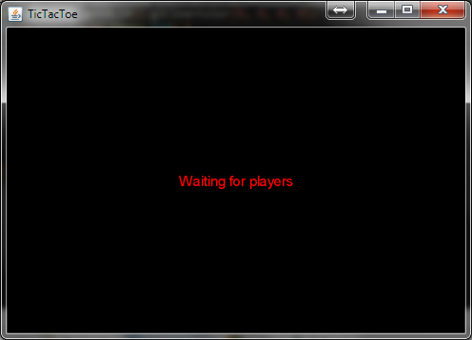
Tic Tac Toe

Slide 16
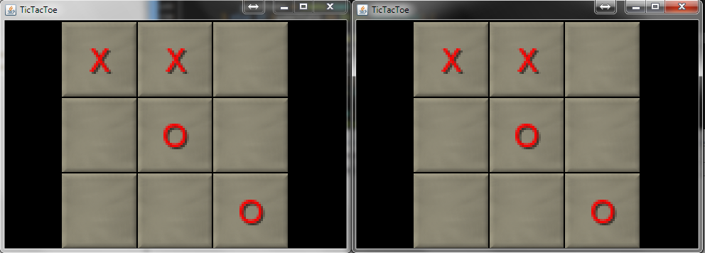
Tic Tac Toe

Slide 17
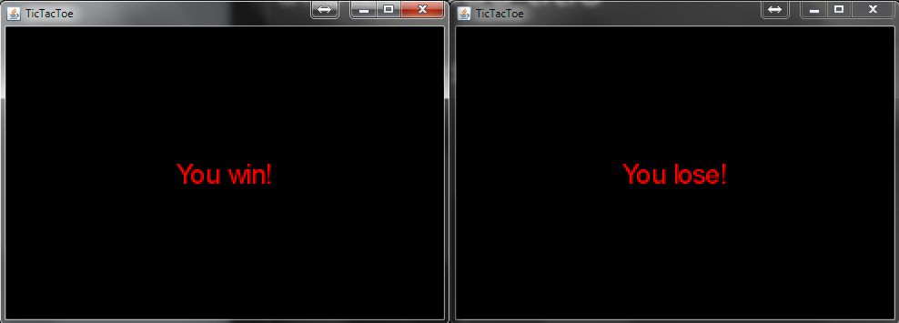
Tic Tac Toe

Slide 18
Thank you!

