Slide 1

Android Tools & Wireless ADB
Αντρέας Λύμπουρας
Θεόφιλος Φωκάς
Ζαχαρίας Χ’’Λάμπρου

Slide 2
Android Development Tools plugin (ADT)
What is ADT?
Plugin for Eclipse IDE designed to give you a powerful, integrated environment in order to build Android applications.
What it Does?
extends the capabilities of Eclipse to let you quickly set up new Android projects
create an application UI
add packages based on the Android Framework API
debug your applications using the Android SDK tools
export signed (or unsigned) .apk files in order to distribute your application
A good way to start programming android devices is to use eclipse adt
Very Easy to install
Notes:
Enas kalos tropos na kseikinisete na programatizete gia android siskeues einai na xrisimopoihseis to android developmetn tools plugin gia to eclipse…………………….. Sti sinexeia tha anaferthume se kapia ergaleia pou erxonte
Mazi me to adt plugin
extends the capabilities of Eclipse to let you quickly set up new Android projects
create an application UI
add packages based on the Android Framework API
debug your applications using the Android SDK tools
export signed (or unsigned) .apk files in order to distribute your application.
New android project – δημιουργείται αυτόματα η δομή του project, xml files, main activity e.t.c -> ADT
Start Eclipse, then select Help > Install New Software....
Click Add, in the top-right corner.
In the Add Repository dialog that appears, enter "ADT Plugin" for the Name
and the following URL for the Location: https://dl-ssl.google.com/android/eclipse/
Click OK

Slide 3
DDMS
Debugging tool called the Dalvik Debug Monitor Server (DDMS)
Run From Eclipse: Click Window > Open Perspective > Other... > DDMS

Slide 4
DDMS features
Screen capture
Thread and heap information
Tracking memory allocation of objects
Logcat
System info
Call and location data spoofing
Notes:
Screenshot tis othonis tis siskeuis mas
Plirofories gia ta thread kai heap mias diergasias
Logcat minimata tou sistimatos
Plirofories tou sistimatos
Call spoofing prospihsi eiserxomenu tilefwnimatos h sms gia na sigureutume oti antidra h efarmogi mas swsta se exwterikes eidopoihseis

Slide 5
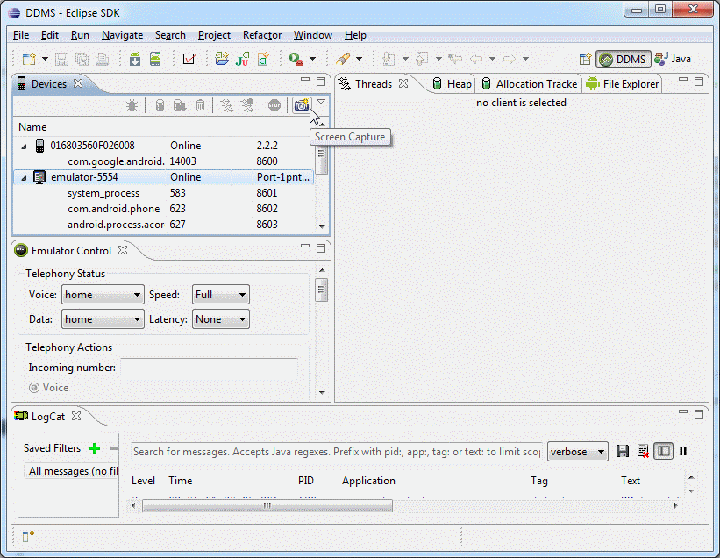
DDMS features

Slide 6
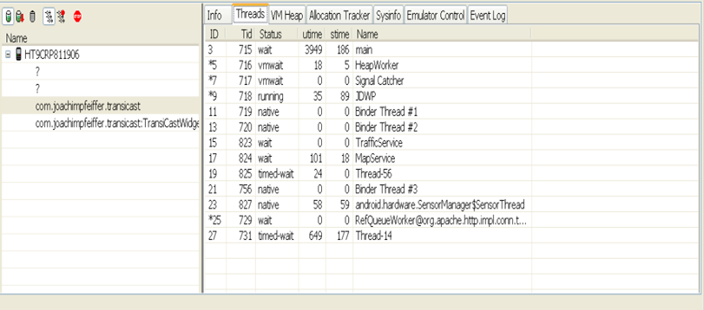
DDMS features
Thread information

Slide 7
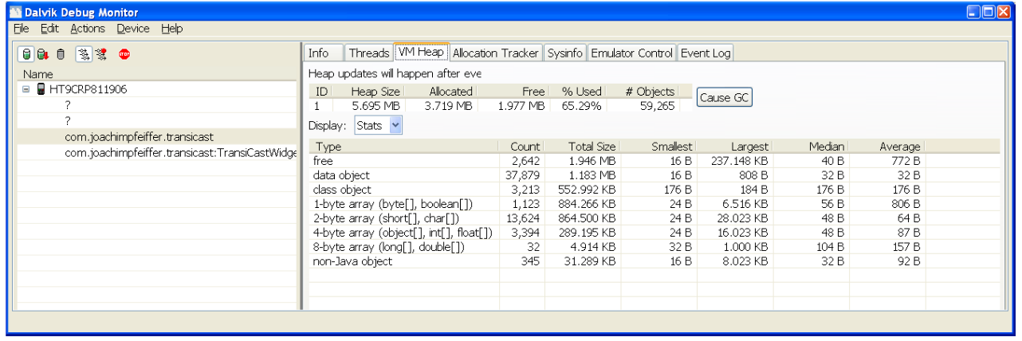
DDMS features
Click Cause GC to start garbage collection and update the information
Heap information
Notes:
Heap information about the process

Slide 8
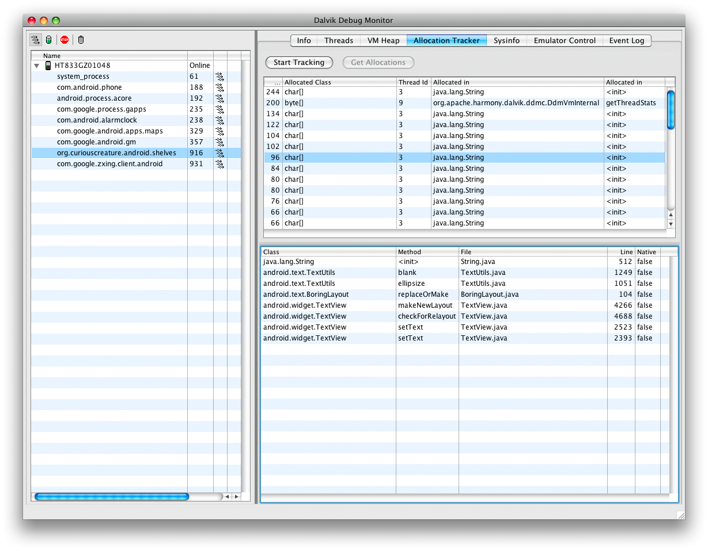
DDMS features
Tracking memory allocation of objects
Notes:
To ddms mas prosferei tin dinatotita na dume ta antikeimena mias diergasias pou ginontai allocate apo poia klasi kai apo pio thread

Slide 9
DDMS features
Logcat
Mechanism for collecting and viewing system debug output
Logcat dumps a log of system messages, stack traces when error occurs and user messages written with the Log class
You can filter the log
for viewing only messages from a particular process, error messages, debug messages
warning messages etc
Notes:
Einai enas mixanismos gia na vlepeis minimata tou sistimatos, oi minimata pou grafei o user mesw tis klasis log.. Sto logacat grafun polles diergasies kai mporei na einai diskolo na vgaleis simperasma
so to ddms sou dinei tin dinatotita na filtrareis to Log file… etsi wste na vlepeis mono minimata mias sigkekrimenis ergasias, na vlepeis mono ta error messages ktl

Slide 10
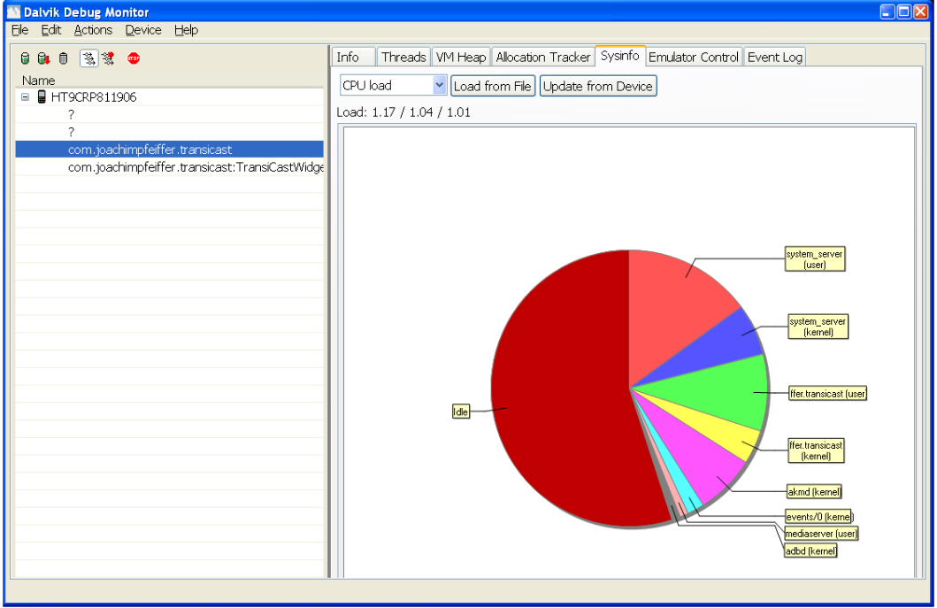
DDMS features
System info
Notes:
Vlepume pws katanemete o fortos ergasias tou epexergasti

Slide 11
Android monkey runners
The Monkey is a program that runs on your emulator or device and generates random events such as clicks, touches, or gestures, as well as a number of system-level events.
You can use it for testing your application
You can set a number of options like number of event to attempt, event types and frequencies, delay between the events
How to run monkey?
adb shell monkey -v -p your.package.name 300
Notes:
adb shell monkey -v -p your.package.name 300
launches application and send 300 pseudo-random events to it

Slide 12
Android Debug Bridge (ADB)
What is ADB?
command line tool that lets you communicate with an emulator instance or connected Android-powered device
Contains three major components
Client – on development machine
Server – background process on development machine
Daemon – on emulator or device
Notes:
Ergaleio pou se afinei na epikoinwseis me ena emulator h sindedemeni siskeui kai na ektelesis diafores entoles panw stin siskeui.
The ADB utility lets you connect to the phone itself and issue rudimentary shell commands, such as copying files to and from the device.
A client, which runs on your development machine. You can invoke a client from a shell by issuing an adb command. Other Android tools such as the ADT plugin and DDMS also create adb clients.
A server, which runs as a background process on your development machine. The server manages communication between the client and the adb daemon running on an emulator or device.
A daemon, which runs as a background process on each emulator or device instance.

Slide 13
Android Debug Bridge (ADB)
What it does?
Issue shell commands
Push files to the device
Pull files from device
Install files remotely

Slide 14
Android Debug Bridge (ADB)
How to execute a command?
adb -s <serialNumber> <command>
Major ADB Commands
adb devices - List of devices attached
adb install <path_to_apk>
Push command

Slide 15
Android Debug Bridge (ADB)
..Major ADB Commands
adb pull /sdcard/foo.txt foo.txt
adb shell
adb shell [<shellCommand>]

Slide 16

Android Remote ADB Bridge
ADB commands over Wi-Fi..
Purpose:
Execute commands
Transfer files
Control your phone
Notes:
Το project μας αφορούσε την υλοποίηση των εντολών adb over wifi. Δηλαδή..

Slide 17
ADB
Client (Android phone)
setprop service.adb.tcp.port <port>
Stop adb
Start adb
Remote Device
adb tcpip <port>
adb connect <IP Of your phone>:<port>
Notes:
Πρώτη προσέγγιση
Built in commands του adb για wireless connectivity
Πολύ εύκολο
Υποστήριξη όλων των εντολών adb
Eclipse run and debug wireless

Slide 18

Limitations
Two major limitations
Wired part of the procedure (unrooted devices)
Doesn’t work for all unrooted phones

Slide 19
Our Approach
Remote Device
Php web server
MySQL database
Client (Android device)
Android application
Post IP to server
Background service for accepting requests
Notes:
DEMO

Slide 20
Advantages
Everything done wireless
Easy switching between devices
Simple interface for entering commands

Slide 21
References..
http://developer.android.com/guide/index.html
http://developer.android.com/guide/topics/manifest/uses-library-element.html
http://developer.android.com/guide/developing/tools/adb.html
http://developer.android.com/guide/developing/debugging/ddms.html
http://developer.android.com/sdk/eclipse-adt.html

