Slide 1



AirPlace
Kyriakos Georgiou
Athina Paphitou
Maria Christodoulou

Slide 2

AirPlace
Indoor positioning system
Using Wi-Fi fingerprinting
For Android smartphones
Flexible Wi-Fi API
(Received Signal Strength)
Sensor rich
(Accelerometer, Gyroscope, etc)

Slide 3
Indoor Localization
GPS does not work.
Some indoor positioning methods:
Camera to spot unique visual landmarks (Inside App)
Magnetic field and accelerometer sensors (Smartsense)
Multi-antenna systems that measure distance (EasyPoint)

Slide 4
Indoor Localization
Wi-Fi signals utilization.
Android API provides classes and methods to track Wi-Fi signals.
An initial mapping/logging of the building required.
RSS fingerprint-based algorithms.

Slide 5
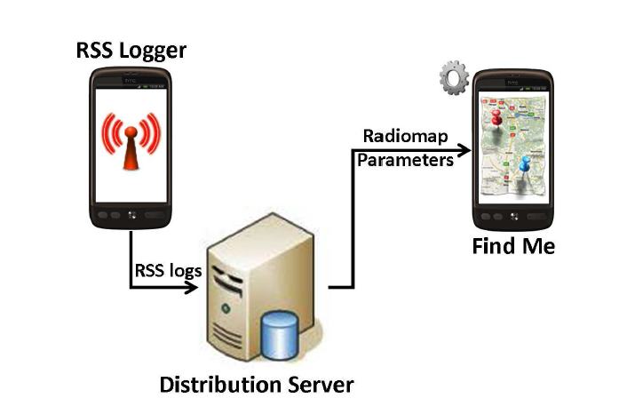


System Architecture

Slide 6
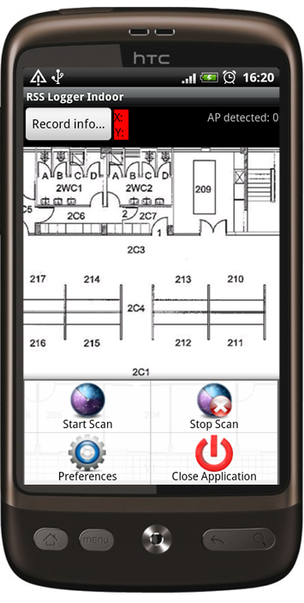
RSS Logger
A floor plan of the building is required.
User moves to the desired location and selects their position on the map.

Slide 7
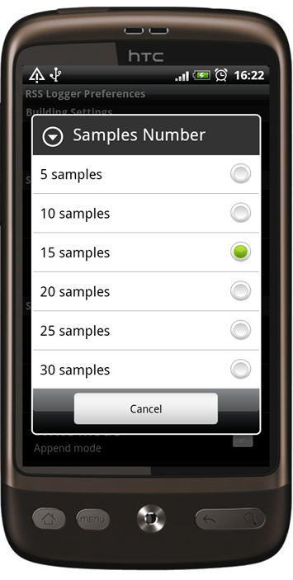
RSS Logger
User selects number of samples to be collected and time interval between them.

Slide 8
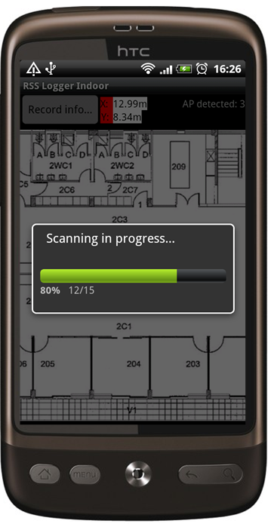
RSS Logger
By pressing ‘Record Info’, the logger starts collecting samples from surrounding access points.
Samples are stored on the device, can be uploaded on server.

Slide 9
Distribution Server
Constructs and circulates the radiomaps.
Stores various positioning algorithm-specific parameters.
Users either upload collected RSS data, or download radiomaps and algorithm parameters.

Slide 10
Distribution Server
All samples collected on a specific location are averaged and merged in a single file.
Reduced noise (e.g. varying RSS)
Exaggerated measurements (e.g. malfunctioning hardware)
Minimum download file size (for the tracking app).

Slide 11
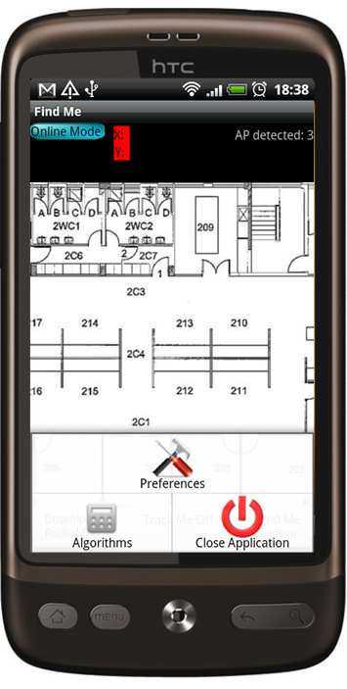
Tracker – Find Me
Positioning client.
Downloads radiomap for a specific building and positioning algorithm parameters from distribution server

Slide 12
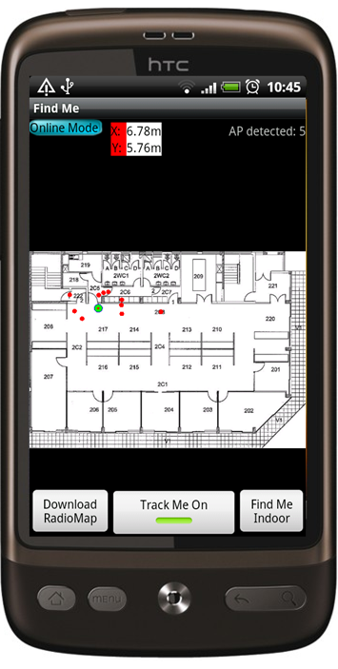
Tracker – Find Me
User can select their preferred positioning algorithm.
‘Find Me Indoor’ button positions user on the map.
‘Track Me On’ button allows real-time indoor navigation.

Slide 13

Crowdsourcing and AirPlace
Logger app allows users to contribute collected RSS values.
Pros
Cons
Multiple RSS mappings for various buildings
Collaborative effort
User involvement
Malicious users
Incentives

Slide 14
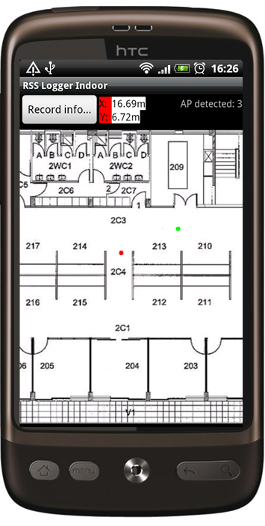
What we had to implement
Until now…
Logger application
The user touches on a point on the floor plan and presses the record button.
The application receives N signal samples.
The samples are associated with the specific spot on the floor plan and log files are created.

Slide 15
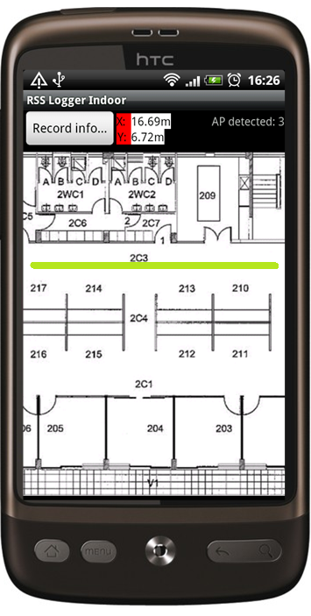
What we had to implement
Our implementation
Logger application
The user touches on a spot and immediately starts walking in a straight line.
Wi-Fi samples are gathered continuously.
Standing/walking detector.
When the user stops walking they touch the spot representing their final location.

Slide 16
What we had to implement
The RSS samples are then distributed evenly along the points on the line the user has walked.
The distance between the two spots is already known.
Standing/walking detector is used
When the user is standing, all samples received at that location are associated with it.
That location is marked as one point on the straight line.

Slide 17
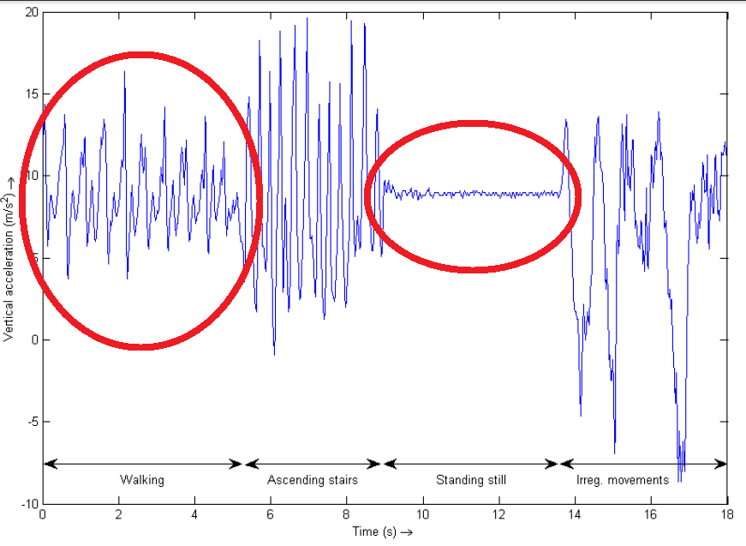

Movement detection
$$α=\sqrt{x^{2}+y^{2}+z^{2}} −g$$

Slide 18
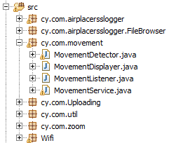
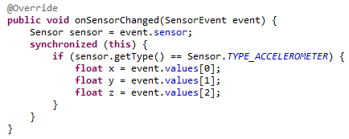
Movement detection

Slide 19
Execution example
User movement
#RSS samples = 20
9 of them when the user was standing
Total distance = 10m
Starting point (2,0)
Ending point (2,10)
So now we have
(2,0) – 1 sample – S1
(2,1) – 1 sample – S2
(2,2) – 1 sample – S3
(2,3) – 1 sample – S4
(2,4) – 1 sample – S5
(2,5) – 9 samples – S6-S14
(2,6) – 1 sample – S15
(2,7) – 1 sample – S16
(2,8) – 1 sample – S17
(2,9) – 1 sample – S18
(2,10) – 1 sample – S19
Walk 5m.
Samples collected:5
Stand.
Samples collected: 9
Walk 5m.
Samples collected: 6

Slide 20
What we accomplished
A more intuitive way of RSS logging.
Less user interaction.

Slide 21
AirPlace – To sum up
Indoor localization
– Wi-Fi fingerprinting
Infrastructure independent
Low network usage
– position is calculated locally on the device
Privacy

Slide 22
Recent Award
2nd place at
Microsoft Research Indoor Localization Contest (IPSN'14) in Berlin, Germany.

Slide 23
Thank you for your attention

Slide 24
References
[C42] "The Airplace Indoor Positioning Platform for Android Smartphones", C. Laoudias, G. Constantinou, M. Constantinides, S. Nicolaou, D. Zeinalipour-Yazti, C. G. Panayiotou "Proceedings of the 13th IEEE International Conference on Mobile Data Management" (MDM '12), IEEE Computer Society, Pages: 312--315, Bangalore, India, ISBN: 978-0-7695-4713-8, 2012.
[C39] "Demo: the airplace indoor positioning platform", C. Laoudias, G. Constantinou, M. Constantinides, S. Nicolaou, D. Zeinalipour-Yazti and C. G. Panayiotou "Proceedings of the 10th International Conference on Mobile Systems, Applications and Services" (Mobisys '12), Pages: 467-468, Low Wood Bay, Lake District UK, June 25 - 29, ISBN: 978-1-4503-1301-8, 2012.
http://anyplace.cs.ucy.ac.cy/
http://research.microsoft.com/en-us/events/ipsn2014indoorlocalizatinocompetition/
https://github.com/bagilevi/android-pedometer
http://www.gizmag.com/led-rf-product-location-system/21247/
http://www.gizmag.com/inside-app-indoor-navigation/30702/
http://archive.wired.com/wired/archive/14.06/crowds.html

