Slide 1
STORM
Chrystalla Tsoutsouki
Chrysovalantis Anastasiou
Notes:
ctsout01

Slide 2
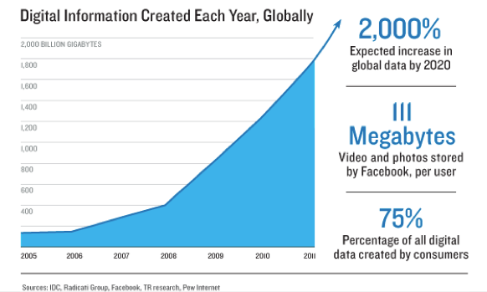
PROBLEM
Notes:
ctsout01

Slide 3


SOLUTIONS
Notes:
ctsout01

Slide 4
Distributed
Fault-tolerant
Any programming language
Works on HDFS
Batch Processing
Distributed
Fault-tolerant
Any programming language
Integrates with all technologies
Real-time Computation
Notes:
ctsout01

Slide 5
STORM
Introduction to Storm Concept
Notes:
Canast02
Prin proxwrisoume va8ia sto sistima storm kai ston tropo p leitourgei prepei na kanume mia mikri isagwgi se merikous
Orous pou einai aparaititi.
To concept tou storm opws exoume idi pei einai I epe3ergasia terastion posotiton dedomenon se pragmatiko xrono.

Slide 6
Tuples
Ordered set of elements
[“the”, 14], [“boy”, 2]
Notes:
Canast02
Oros tuple (I pleiada opws onomazete sta ellinika) afora ena diatetagmeno sinolo mias I perissoteron timwn
Pou 8a ipostoun I exoun ipostei kapoia epe3ergasia
Gia paradeigma oi pleiades p vlepoume sti diafaneia proeki4an apo mia word count efarmogi I opoia exei mexri stigmis katametrisi 14 fores tin le3i “the” kai 2 fores tin le3i “boy”

Slide 7
Streams
Sequence of tuples
Tuple
Tuple
Tuple
Tuple
Tuple
Notes:
Canast02
Otan miloume gia stream ennooume mia sinexeis roi apo pleides
Simfwna me to paradeigma mas t tou word count (to opoio 8a doume k pio praktika se metepeita diafaneies) ena stream 8a itan gia paradeigma mia sinexomeni roi apo le3eis oi opoies prepei na katametri8oun

Slide 8
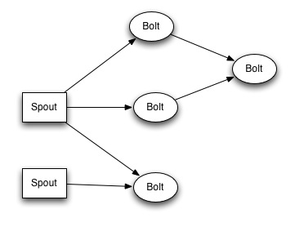
Storm Topology
Spout:
Source of streams
Bolt:
Computation unit
Notes:
Canast02
Gia na tre3oume kapoio ipologismo se pragmatiko xrono sto storm prepei na dimiourgisoume mia topologia.. Mia topologia mporei na apeikonistei san enas grafos tou opoiou ta nodes einai eitai spouts eite bolts kai oi akmes tou streams..
Pio sigkekrimena to spout einai mia pigi apo ateliwta streams kai mporoume na t fantastoume san mia vrisi pou stazei sinexos..ta spout mporei na antloun dedomena kai na dimiourgoun tis pleiades eite apo kapoio API opws g paradeigma to twitter API, i apo kapoia vasi dedomenon..
Otan kapoio spout etoimasei ena tuple, tote to topo8etei se ola ta streams p exei…me liga logia ka8e tuple p paragetai apo kapoio spout, paei se ola ta bolts pou einai subscribed sto sigkekrimeno spout (dixnw sta slide perki katalavoun)
Ta bolt einai monades epe3ergasias oi opoies katanalwnoun tuples, kai mporoun an xriazete na ta stiloun metepeita se kapoio allo bolt I na ta apo8ikeusoun se mia vasi dedomenon I na ta steiloun kapou meso mias tcp sindesis. Parallilia mporei na ipar3ei k mesa se kapoio bolt afu ena bolt mporei na trexei parallila polla tasks.

Slide 9
Stream Grouping
Shuffle Grouping
Fields Grouping
All Grouping
Global Grouping
None Grouping
Direct Grouping
Local Grouping
Notes:
Canast02
ta tuples enos stream mporoun na katanemi8oun me diaforous tropous sta task enos bolt.
Pio sini8ismenos einai to shuffle grouping. Me to shuffle grouping oi pleiades katanemonte me tetoio tropo sta task tou bolt etsi wste na pernoun ola iso forto ergasias (load balancing)
Enas allos xrisimos tropos einai to fields grouping. Me to fields grouping oi pleiades katanemontai me vasi kapoio pedio ts. Diladi an eixame pliades pou eixan kapoio pedio id, tote me t fields grouping oi pliades pou exoun idio id 8a ginontai panta map st idio task
Me to all grouping oi pliades pane se ola ta task enos bolt
Me to global grouping ola ta tuple pane sto task me to mikrotero id
To none grouping den einai ilopoiimeno akoma k giafto leitourgei san t shuffle grouping alla st mellon ta bolts p einai none grouping 8a trexoun sto idio thread me afton p apostelei tis pleiades
Me to direct grouping o apostoleas mporei na epile3ei to task st opoio 8elei na stilei to tuple
To local grouping einai ena diaforetiko onoma gia to shuffle grouping

Slide 10
Parallelism
Level 1:
Different Bolts can make different computations
Bolt
Spout
Bolt
Notes:
ctsout01

Slide 11
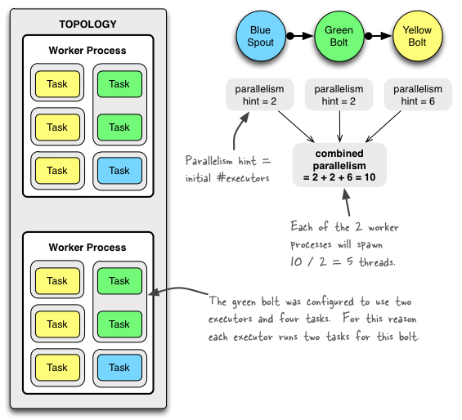
Parallelism
Level 2:
Worker Processes
Executors (Threads)
Task
Notes:
ctsout01

Slide 12
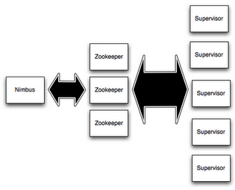
Storm Cluster
Notes:
ctsout01

Slide 13
Storm UI
Notes:
Canast
Edw vlepoume to web interface tou storm. Mesa apo to interface mporoume na doume ts mixanes p anikoun sto clustes ka8os kai ta topologies p iparxoun tora st sistima. Mporoume episis na skotosoume topologies I na doume statistika gi aftes

Slide 14
Wordcount Topology
Random Sentence Spout
Sentence Split Bolt
Word Count Bolt
Notes:
Canast
Gia na e3igisoume pio praxtika tn tropo p doulevei to storm 8a paroume san paradeigma to provlima t wordcount. Stin topologia afti exoume ena spout p paragei sinexws apeires tixaiees protaseis (tuples) kai tis vazei se ena stream. Afto to stream katanalwnete apo to prwto bolt to opoio spazei tin protasi se le3eis (tuples) kai tis proo8ei sto epomeno stream. To telefteo bolt lamvanei ts le3eis kai apo8ikeuei to pli8os tis ka8e le3is..

Slide 15
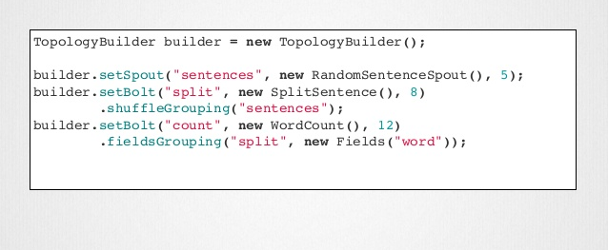
Example
Notes:
Canast
Explain how the code is
Fields grouping is important for mapping a word always to the same task

Slide 16
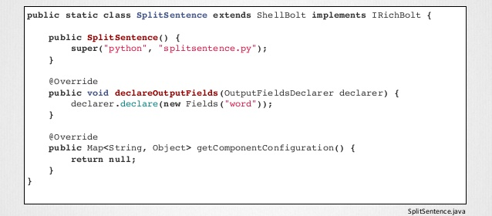
Example
Notes:
Canast

Slide 17
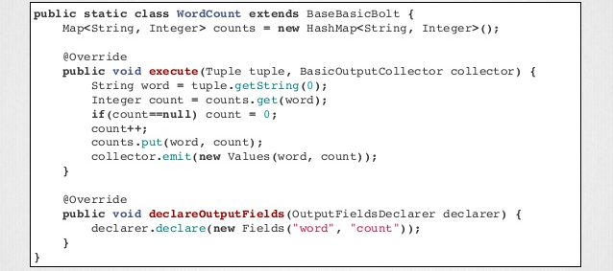
Example
Notes:
Canast

Slide 18
Spitfire
Distributed AkNN computation
Notes:
ctsout

Slide 19
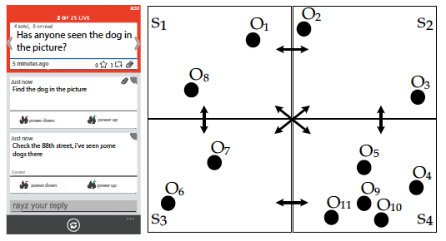
Notes:
ctsout

Slide 20
Step 1 - Partitioning
90.0
-90.0
-180.0
180.0
Notes:
ctsout

Slide 21
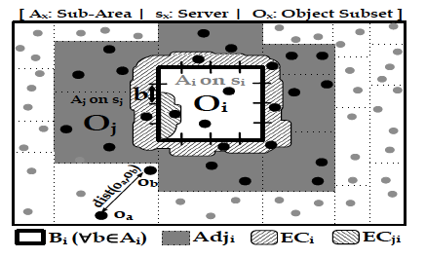
Step 2 - Replication
Notes:
Canast
Afou exoume ta diafora partitions prepei na frontisoume oi users pou einai konta sta border na mporoun na ipologisoun swsta tous plisiesteroun geitones tous afou mporei kapoios kontinos geitonas ts na anikei se diplano partition..
Gia na lisoume afto to provlima, to ka8e partition ipologizei xrisimopoiontas kapoio algori8mo ts users p vriskontai se mia sigkekrimeni apostasi apo to border p einai analogi tou K kai ts stelnei sto geitona p isws na ts xriastei..
Na analisoume ligo to sxima g na katalavoume kltr ti ginete se afto to vima..

Slide 22
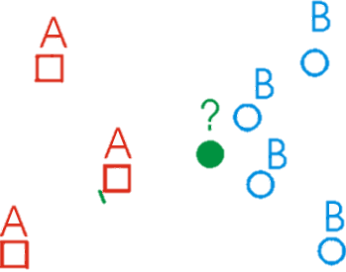
Step 3 - Refinement
Each node performs a
local kNN using internal
geographic grouping
and bulk processing
Notes:
Canast
Afou staloun oi EC stous gitones tote mporei ka8e partition na tre3ei to diko s kNN algori8mo topika stous dikous ts users

Slide 23
Our approach – Step 1
UsersSpout
Sort
CellBounds
SyncBolt
Notes:
canast

Slide 24
Our approach – Step 2
Neighbors
ECands
DistributeECs
Notes:
canast

Slide 25
Our approach – Step 3
Local kNN
Notes:
canast

Slide 26

Notes:
canast

